Slide 1
Viva: Deepfake Detection Using Cross-Model Transformer Fusion
Jasmi Preethi Alasapuri
2571395
Supervisor: Lucian Duta
BSc (Hons) Data Science and Artificial Intelligence
CN6000 Dissertation 2026

Slide 2
The Problem — Why Deepfake Detection Matters
AI-generated synthetic media is eroding trust in digital evidence across law, politics, finance, and journalism
Real-world incidents:
• £20M corporate fraud via deepfake video call (Arup, 2024)
• Political deepfakes used for disinformation (Zelenskyy, 2022)
• AI kidnapping & impersonation scams (FBI, 2025)
Multimodal deepfakes — manipulating both audio and video — are the hardest to detect. Current systems are vision-centric and fail to capture fine-grained temporal relationships between speech and lip motion.
Computing challenge: Process 1.4 TB video data, train a 50M-parameter neural network, build real-time inference.

Slide 3
Project Aims & Objectives
Aim: A multimodal deepfake detection system to distinguish real from manipulated audio- visual media.
Six Objectives:
1. Literature review on deepfake generation & detection techniques
2. Analyse real-world impacts across sectors; identify gaps in current solutions
3. Quantitative secondary analysis of AV-Deepfake1M++ (speaker-disjoint split)
4. Design & implement Cross-Modal Transformer Fusion architecture
5. Resumable training pipeline; evaluation on held-out test set
6. Standalone inference system; demo web interface for non-technical use

Slide 4
Literature Review — Key Findings
Evolution of Deepfakes:
Phase | Era | Characteristics
Visual Fidelity | 2017–2019 | Face-swaps via Autoencoders / GANs
In-the-Wild | 2019–2021 | Multi-subject, uncontrolled environments
Multimodal | 2023–2025 | Neural generation affecting audio + video
Three Gaps Identified:
1. Identity Leakage — Random splits allow face recognition, not manipulation detection
2. Vision-Centric Bias — Audio is ignored or handled via simple concatenation
3. Limited Generalisation — Detectors overfit to training generators

Slide 5
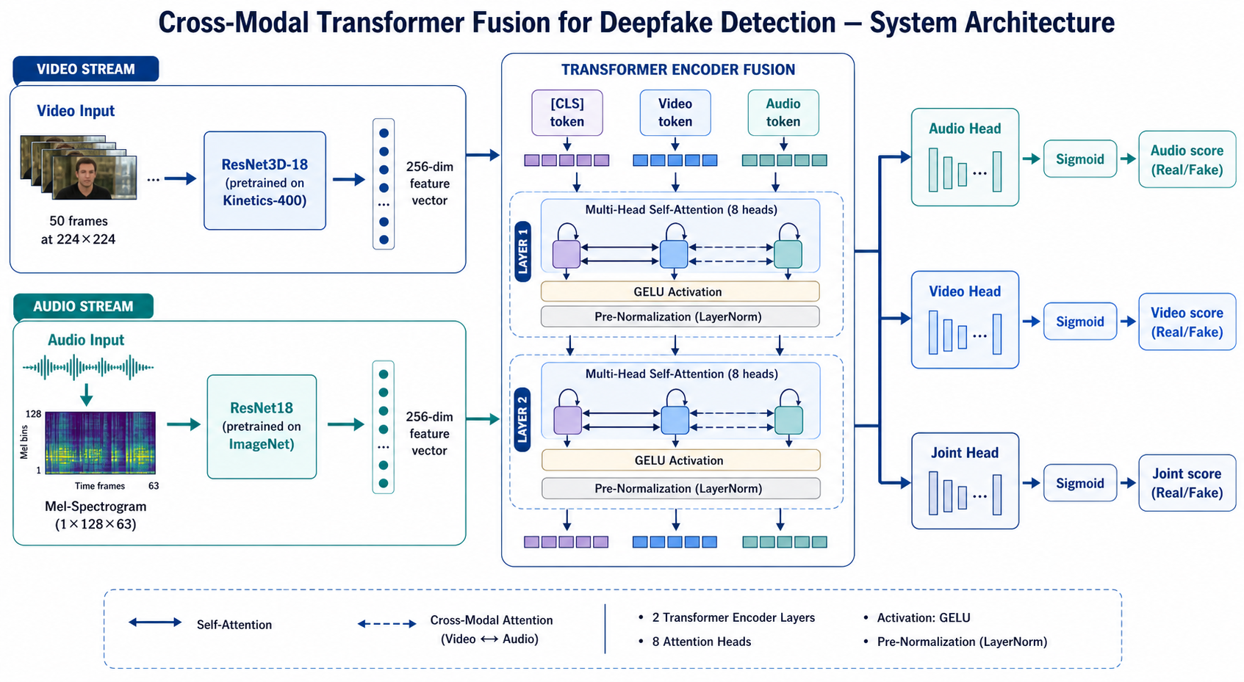
Cross-Modal Transformer Fusion — Architecture

Slide 6
Key Design Decisions
Component | Initial Plan | Final Choice | Reason
Audio Encoder | Wav2Vec 2.0 | ResNet18 + Mel-spec | torchaudio/FFmpeg handles corrupted MP4s
Video Encoder | MobileNetV3 | ResNet3D-18 | 3D convolutions for temporal lip-motion artefacts
Fusion Module | DiMoDif | Transformer + [CLS] | Cross-modal self-attention captures inconsistencies
Loss Function | BCE | Focal Loss (γ=2.0) | Down-weights easy examples; focuses on hard boundary cases
Learnable [CLS] token + positional embeddings → 2-layer Transformer Encoder (8 heads, 512-dim, GELU) → Audio / Video / Joint heads

Slide 7
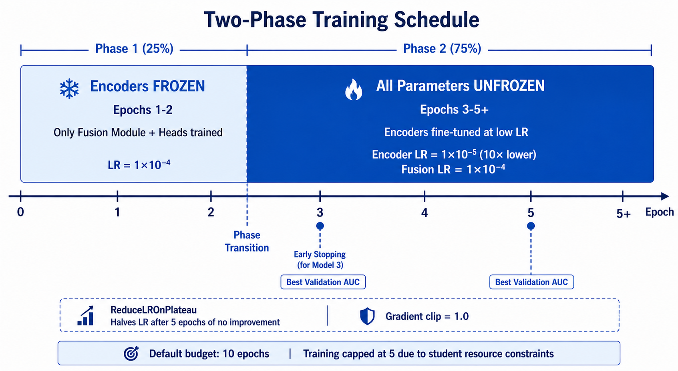
Implementation — Training Pipeline
Setting | Value
Dataset | 68,851 clips (val split); 4 types; 8,475 dropped
Phase 1 | Frozen encoders (~2 epochs)
Phase 2 | Full fine-tune at 10× lower LR
Optimiser | AdamW (fusion: 1e-4, encoders: 1e-5)
Batch Size | 8 per GPU (×2 with DataParallel)
Infrastructure | Vast.ai (2× RTX 3080); W&B tracking
Augmentation | SpecAugment + flip/brightness/contrast jitter
Workers | 28 CPU parallel extraction, crash-resumable

Slide 8
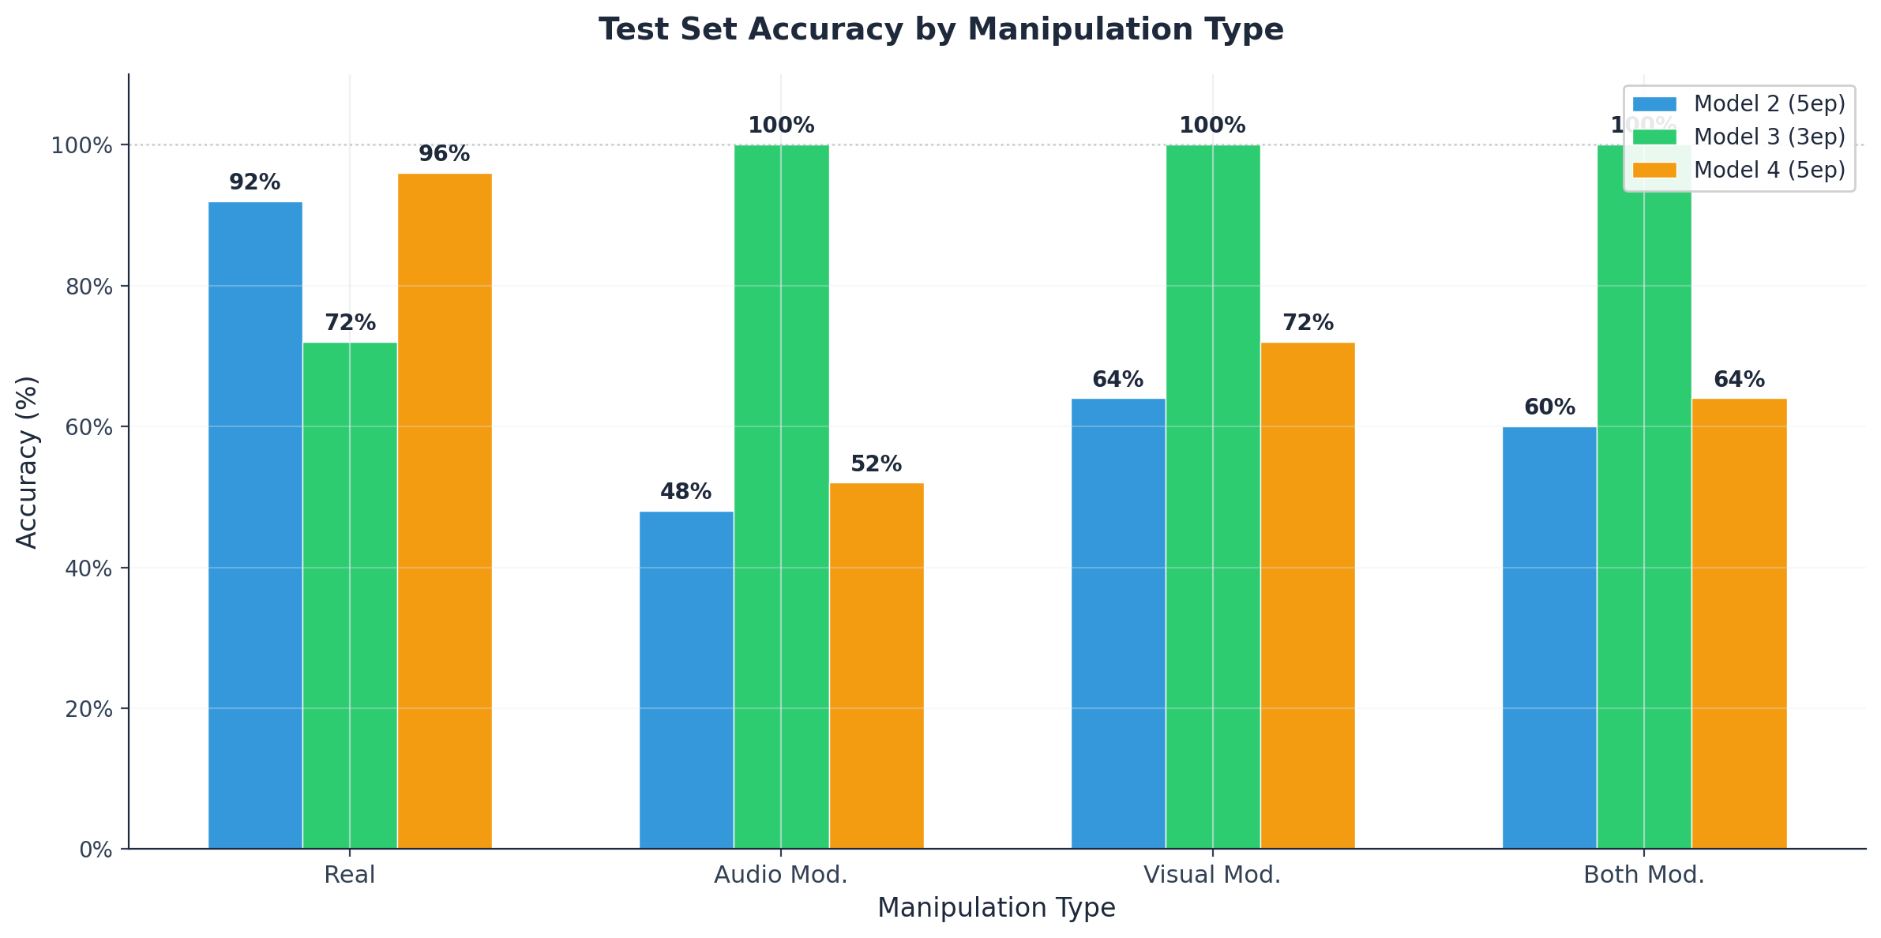
Results — Training History & Per-Type Accuracy
Model | Ep | Val AUC | Test AUC | Test Acc | Notes
M1 | 1 | 0.663 | — | — | Underfit; corrupted download
M2 | 5 | 0.994 | 0.919 | 66% | Highest val AUC
M3 ★ | 3 | 0.985 | 0.937 | 93% | Best: Precision 1.000, 0 FP
M4 | 5 | 0.993 | 0.915 | 71% | Same run as M3, epoch 5

Slide 9
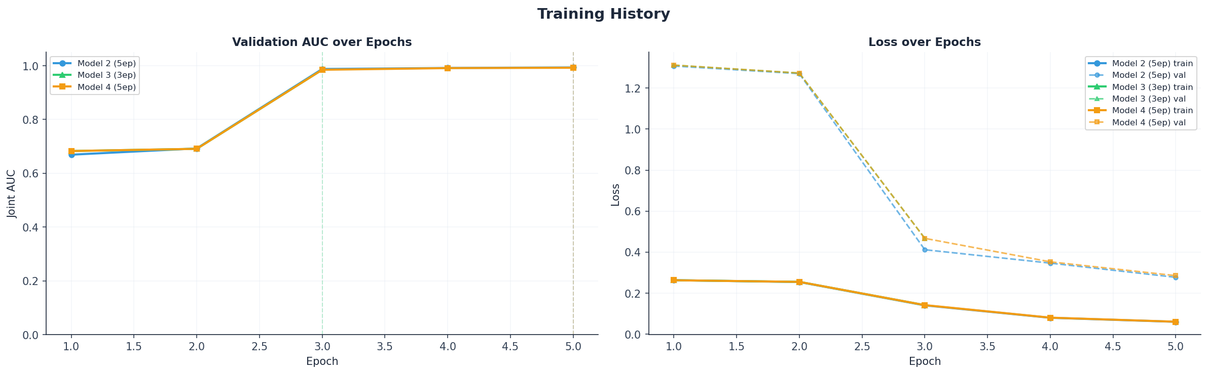
Results — Training History & Per-Type Accuracy

Slide 10
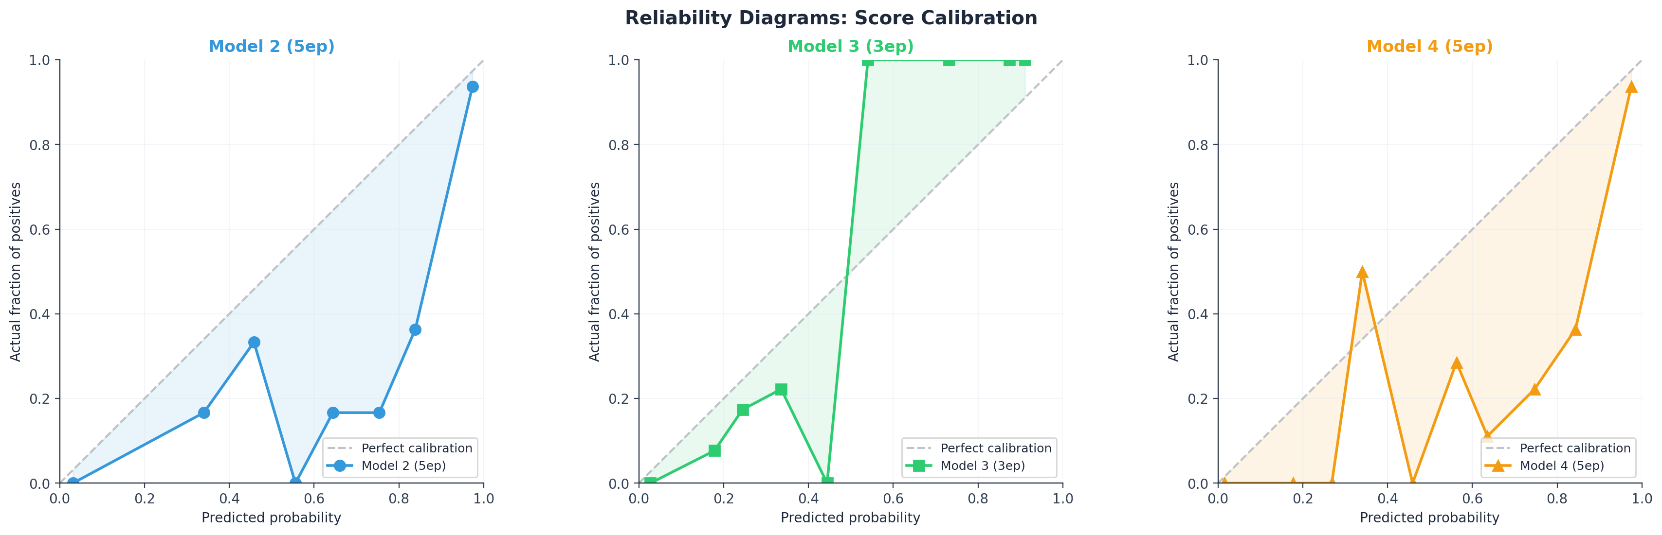
Model Comparison & Score Calibration
Key Finding:
Higher validation AUC does NOT equal better deployment performance.
• Model 2 (AUC 0.994) → 66% accuracy at τ=0.5 (poorly calibrated scores near boundary)
• Model 3 (AUC 0.985) → 93% accuracy at τ=0.5 (well-separated scores, zero false positives)
Calibration curves show Model 3 has near-perfect score alignment — predicted probabilities match observed outcomes.
Audio-modified is hardest type (88%) — genuine video counteracts audio head's fake signal.

Slide 11
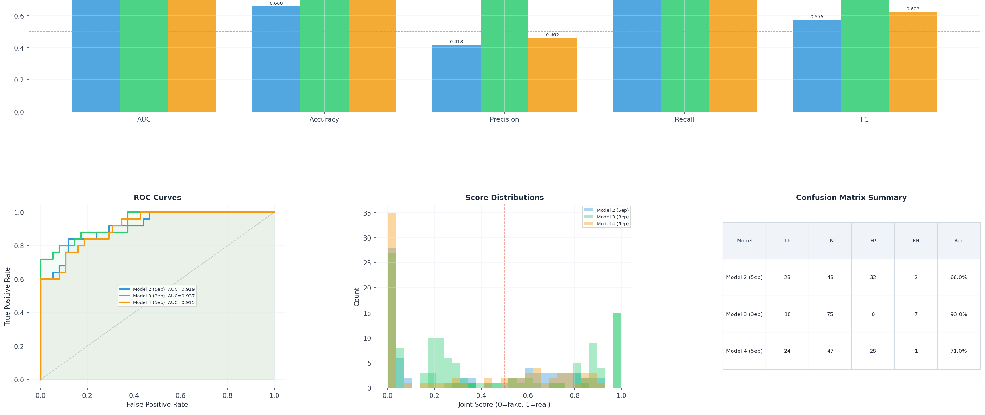
Model Comparison & Score Calibration

Slide 12
Key Findings
1. Phase 2 fine-tuning is essential: Phase 1 only (Model 1): AUC 0.663. All Phase-2 models: ≥ 0.915 test AUC. Cross-modal representations require encoder adaptation.
2. Validation AUC ≠ deployment performance: Model 2 (AUC 0.994) → 66% accuracy. Model 3 (AUC 0.985) → 93% accuracy. Score calibration determines real-world readiness.
3. Three-head architecture provides genuine modality specialisation: Audio/video scores dissociate by manipulation type as predicted. Per-modality interpretability for forensic analysis.
4. Speaker-disjoint evaluation is critical: GroupShuffleSplit ensures zero speaker overlap → results reflect manipulation detection, not identity recognition.

Slide 13
Limitations
Limitation | Impact
100-video test set | 1 misclassification = 1% accuracy shift; wide confidence intervals
Validation split only | 68,851 clips vs 1M+ in full training set; limited diversity exposure
No ablation study | Cannot attribute performance to specific components (Focal Loss, Transformer, etc.)
Fixed 2-second window | May miss manipulation in short, late, or distributed segments
Single dataset | No cross-dataset evaluation (FakeAVCeleb, DFDC, FaceForensics++)
5-epoch training cap | Cloud GPU budget prevented full convergence and hyperparameter sweeps

Slide 14
Thank You

