Slide 1

PLUS RENTAL
Jasmine Chen

Slide 2
Problem Statement
A car rental system
Customers may have trips and make payments
Each trip is sales by employee
We would have multiple cars, and each car has their own model, brand and year
For each trip, I would want to know how is it be charged
For drivers under 25, a young driver fee will be applied

Slide 3
If I’m business owner (or just employee, I also want to know
Best car
Best customer
Best employee

Slide 4
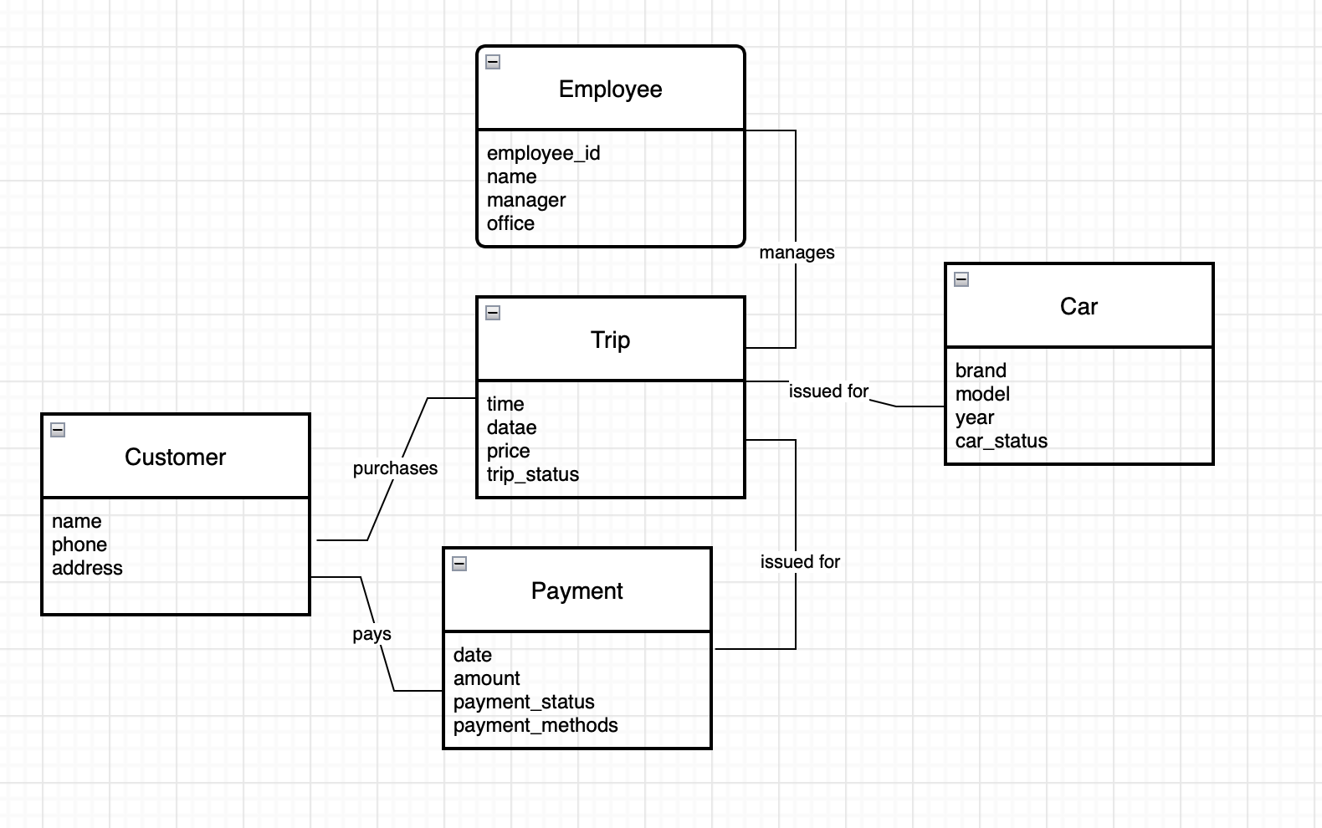
ER diagram

Slide 5
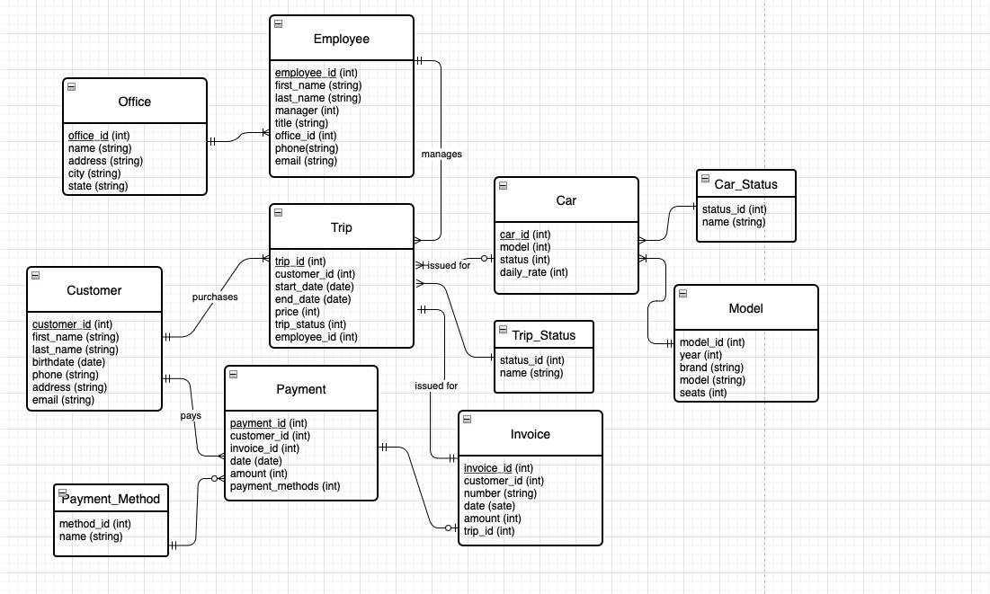
EER diagram

