Slide 1
Beyond the Clutter: Investigating The Impact of “Note Bloat” in NLP
MIDS 266
Jasmol S Dhesi

Slide 2

Agenda
1
Background
2
Methodology
3
Results and Discussion
4
Final Thoughts

Slide 3
Background

Slide 4
Motivation
The shift from paper charts to Electronic Health Records (EHRs) has streamlined data collection for medical professionals, vastly modernizing clinical workflows.
However, this time-saving process has led to an unanticipated issue: clinicians increasingly rely on shortcuts like copying and pasting, which can proliferate redundant and uninformative text.
This overuse of copy-paste practices, known as “note bloat,” diminishes the quality of documentation, lengthens clinical notes unnecessarily, and poses risks for errors in patient records.
With the rise of Natural Language Processing (NLP) in healthcare, deep learning models are being developed to aid clinical decision-making. It remains an open question whether note bloat degrades model performance by introducing excess, non-informative text.

Slide 5
Agenda
1
Background
2
Methodology
3
Results and Discussion
4
Final Thoughts

Slide 6
Methodology

Slide 7
Dataset
Data Source: Utilized the publicly available MIMIC‑III dataset containing de‑identified health data for approximately 60,000 ICU admissions.
Dataset Composition: Includes vital signs, laboratory measurements, procedures, medications, and free‑text clinical notes (focus of this study).
Preprocessing Steps: Cleaned and structured notes for NLP by removing duplicates, anonymizing protected health information, and tokenizing text.
Stratified Sampling: Ensured proportional representation across critical categories to enhance robustness and minimize bias.
Data Splitting: Partitioned into 70% training, 15% validation, and 15% test sets to facilitate rigorous evaluation and validation.

Slide 8
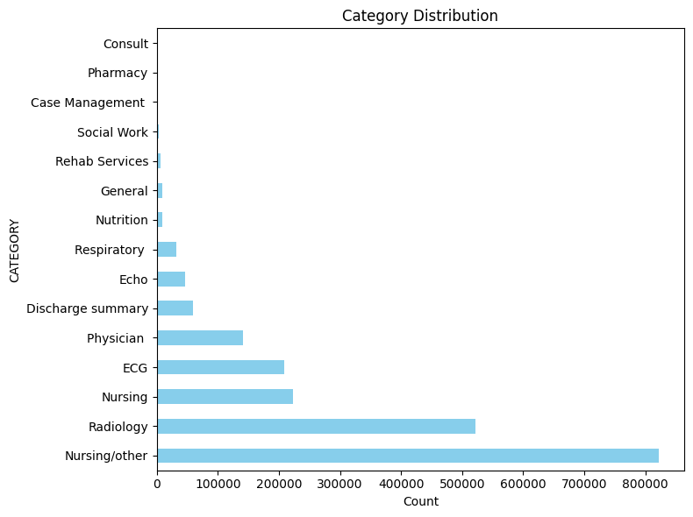
Dataset (cont.)
Full Dataset: 2,083,180 x 14 entries
After stratified sampling:
Training Dataset: 1029 x 14 entries
Validation Dataset: 220 x 14 entries
Test Dataset: 221 x 14 entries
Figure 1. Medical Department Distribution in MIMIC-III

Slide 9
Note-Bloat Analysis Techniques
Redundancy Analysis
Template Review and Policy
Deduplication using Clinical Embeddings
Outcome Measurement

Slide 10
Redundancy Analysis
Redundancy is evaluated both within individual notes (within-note similarity) and across notes grouped by clinical department (between-note similarity).
Term Frequency-Inverse Document Frequency(TF-IDF) vectorization and cosine-similarity were used to quantify redundancy.
By comparing intra-department and inter-department similarity scores, one can reveal both consistent standardized language within specific specialties and the variability across different clinical areas.

Slide 11
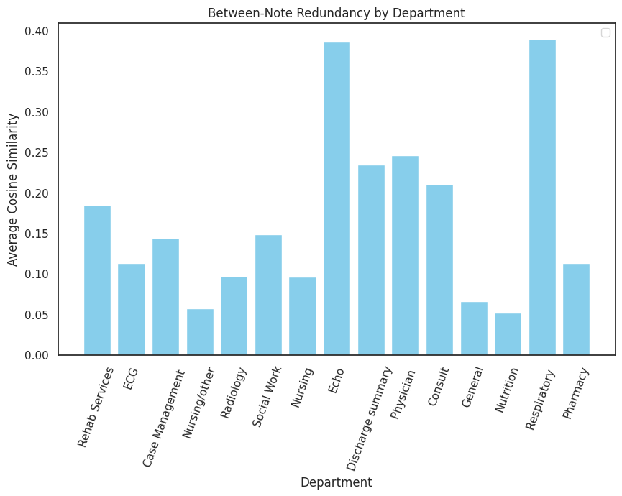
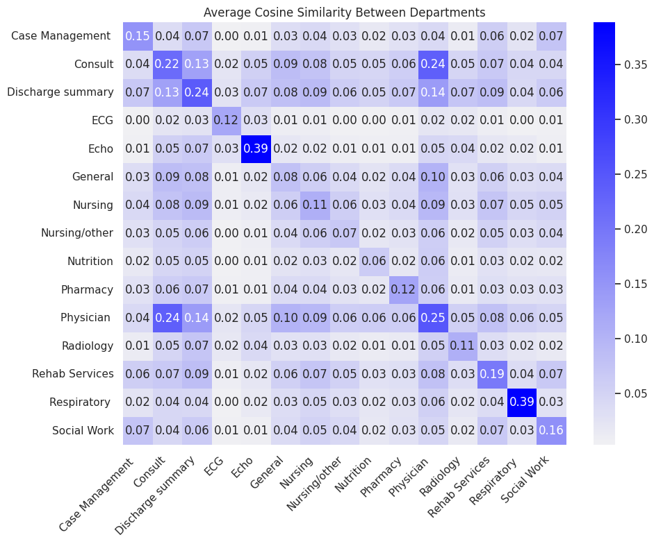
Redundancy Analysis (cont.)
Figure 2. Between-Note Redundancy (Training Dataset)
Figure 3. Heatmap of Between-Note Cosine Similarity (Training Dataset)

Slide 12
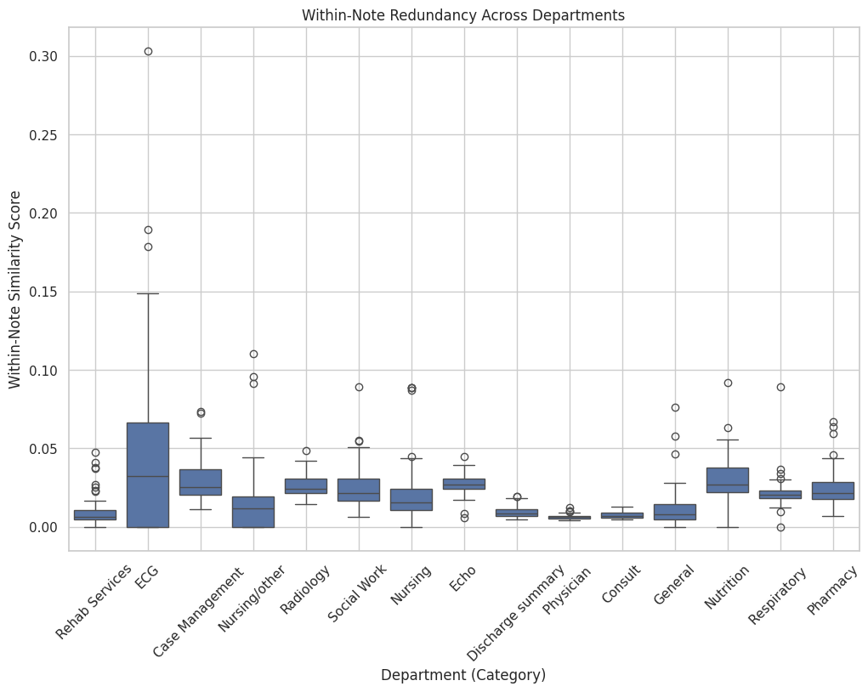
Redundancy Analysis (cont.)
Figure 4. Within-Note Cosine-Similarity (Training Dataset)

Slide 13
Note-Bloat Analysis Techniques
Redundancy Analysis
Template Review and Policy
Deduplication using Clinical Embeddings
Outcome Measurement

Slide 14
Template Review and Policy
Segment all clinical notes and compute the frequency of each segment, flagging those appearing at least five times as potential templates.
Manually review flagged segments to assess clinical value and identify redundant or unnecessary content.
Differentiate between reusable standardized templates and excessive repetition to preserve essential information and clarity.
Apply policy recommendations to optimize template usage, reduce note bloat, and enhance EHR quality. Subject to review by medical professionals.

Slide 15
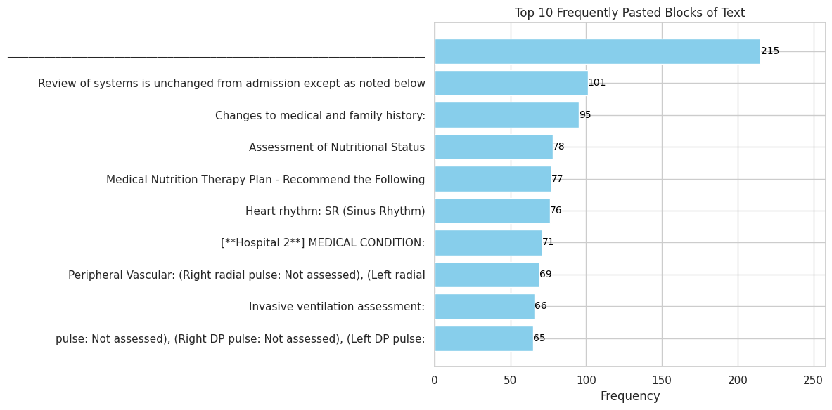
Template Review and Policy (cont.)
Figure 5. Top 10 Most Frequent “Templates” (Training Dataset)

Slide 16
Note-Bloat Analysis Techniques
Redundancy Analysis
Template Review and Policy
Deduplication using Clinical Embeddings
Outcome Measurement

Slide 17
Deduplication Using Clinical Embeddings
Utilized the pre‑trained “emilyalsentzer/Bio_ClinicalBERT” model to generate high‑dimensional semantic embeddings for each text segment.
Implement a greedy deduplication algorithm: compare each new segment’s embedding to retained ones and remove it if similarity exceeds a set threshold (0.9).
Reconstruct the note by concatenating only the retained, unique segments to preserve essential clinical content.

Slide 18
Deduplication Example
Original Note (1489 Characters):
PT. REMAINS LIGHTLY SEDATED ON BOTH FENTANYL AND VERSED GTT'S. PT. AWAKE EASILY AND NODS HEAD TO QUESTIONS ASKED BYT THE TEAM. PT. REMAINS AFEBRILE THROUGHOUT THIS SHIFT WITH WBC'S WNL'S. PT. HAS REMAINED NSR 70-90'S WITH NO NOTED ECTOPY. B/P COTINUES TO BE SUPPORTED BY DOPAMINE PRESENTLY AT 2.2MCG/KG/MIN. PT. IS OM ROUTINE SINEMET TO AID IN TRANSITION TO WEAN OFF DOPAMINE. PT. REMAINS INTUBATED, WITH NO VENT CHANGES MADE DURING THIS SHIFT. PT. HAS BEEN SUCTIONED FOR MINIMAL AMT'S OF CLEAR/WHITE SECRETIONS. PT'S LUNG SOUND WERE COARSE AND DIMINISHED INTHE BASES, THIS HAS IMPROVED THIS AM. NOW RIGHT SIDE HAS CLEARED SIGNIFICANTLY, STILL DIMINISHED BIBASILAR. O2 SATS >98% AND RESP RATE CONTROLLED. PT. CONTINUES TO TUBE FEEDS AT GOAL RATE OF 55CC/HR ON RESPALOR. RESIDUALS ARE MINIMAL. BLOOD SUGARS HAVE BEEN [**Name (NI) 9503**] WITH PT. RECEIVING HIS AM INSULIN DOSE. BOWEL SOUNDS ARE EASILY AUDIBLE WITH NO STOOL THIS SHIFT. PT. REMAINS ON CVVHD WITH GOAL OF RUNNING EVEN. THERE WAS A TWO HR PERIOD BETWEEN MACHINE CLOTTING OFF AND NEW MACHINE SETUP. AM LABS DRAW AND BOTH POTASSIUM AND CALCIUM GTT'S TITRATED PER DOCTERS ORDERS. HEPARIN DOSING STARTED PER CVVHD AS WELL. ALL PT'S LINES ARE INTACT ANS SECURED, AND FUNCTIONING WELL.
\nPT. REMAINS A FULL CODE AT THIS TIME. [**Name (NI) **] WIFE WAS UPDATED LAST EVENING ON PT'S STATUS. PT. HAS BEEN STATED ON SINEMET WITH HOPES TO WEAN OFF DOPAMINE GTT. PT. IS FOR POSSIBLE TRACH EVAL FROM SURGERY. OTHERWISE PT. REMAINS STABLE.
Deduplicated Note (951 Characters):
REMAINS LIGHTLY SEDATED ON BOTH FENTANYL AND VERSED GTT'S. AWAKE EASILY AND NODS HEAD TO QUESTIONS ASKED BYT THE TEAM. REMAINS AFEBRILE THROUGHOUT THIS SHIFT WITH WBC'S WNL'S.HAS REMAINED NSR 70-90'S WITH NO NOTED ECTOPY. B/P COTINUES TO BE SUPPORTED BY DOPAMINE PRESENTLY AT 2.2MCG/KG/MIN. REMAINS INTUBATED, WITH NO VENT CHANGES MADE DURING THIS SHIFT. HAS BEEN SUCTIONED FOR MINIMAL AMT'S OF CLEAR/WHITE SECRETIONS.NOW RIGHT SIDE HAS CLEARED SIGNIFICANTLY, STILL DIMINISHED BIBASILAR. O2 SATS >98% AND RESP RATE CONTROLLED. RESIDUALS ARE MINIMAL. BLOOD SUGARS HAVE BEEN [**Name (NI) 9503**] WITH PT. RECEIVING HIS AM INSULIN DOSE. BOWEL SOUNDS ARE EASILY AUDIBLE WITH NO STOOL THIS SHIFT. REMAINS ON CVVHD WITH GOAL OF RUNNING EVEN. THERE WAS A TWO HR PERIOD BETWEEN MACHINE CLOTTING OFF AND NEW MACHINE SETUP. ALL PT'S LINES ARE INTACT ANS SECURED, AND FUNCTIONING WELL.
REMAINS A FULL CODE AT THIS TIME. IS FOR POSSIBLE TRACH EVAL FROM SURGERY.

Slide 19
Deduplication Discussion
Deduplication yields a reduction in note length (36% for the example provided) while retaining essential clinical information.
Shorter, more concise notes improve readability and efficiency for healthcare providers and patients who may wish to review their medical information at later dates.
Thorough validation by medical professionals is crucial to ensure no vital details are inadvertently removed.

Slide 20
Note-Bloat Analysis Techniques
Redundancy Analysis
Template Review and Policy
Deduplication using Clinical Embeddings
Outcome Measurement

Slide 21
Outcome Measurement
Recompute within‑note similarity on deduplicated notes and compare against original scores to quantify redundancy reduction.
Perform a quantitative comparison of similarity metrics before and after deduplication for each note.
Assess readability using the Flesch Reading Ease metric on both original and deduplicated notes.
Compare readability score changes to evaluate clarity improvements resulting from deduplication.

Slide 22
Flesch Reading Ease metric
Description: The Flesch Reading Ease score is a classic readability formula that assigns a score from 0 to 100 to a text, where higher scores indicate easier reading. Negative scores imply highly difficult text. It combines two key factors:
Average sentence length (words per sentence)
Average word complexity (syllables per word)
Quantifies improvement: Comparing pre‑ and post‑deduplication scores shows how much text conciseness enhances readability.
Supports validation: A measurable gain in reading ease suggests the removal of redundant, confusing passages without sacrificing essential content.
Guides iteration: If scores plateau or decline, one can adjust deduplication thresholds or reintroduce critical details.

Slide 23
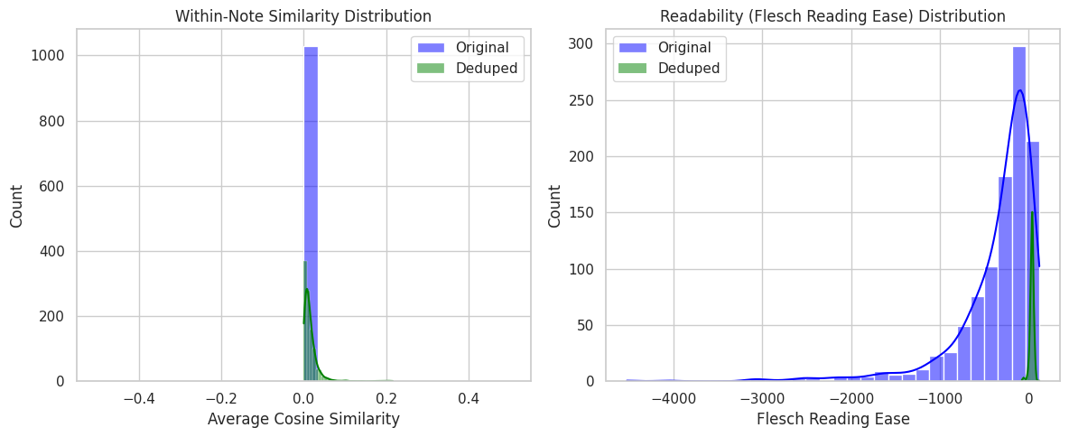
Outcome Measurement Training Data Results
Figure 6. Deduplication Notes Similarity and Readability (Training Dataset)

Slide 24
Agenda
1
Background
2
Methodology
3
Results and Discussion
4
Final Thoughts

Slide 25
Results and Conclusion

Slide 26
Note De-Duplication Results
 | Within-Note Similarity (Lower is Better) |  | Readability Score (Higher is Better)
Dataset | Base | Deduplicated | Base | Deduplicated
Train | 0.000 | 0.016 | -347.1 | 36
Test | 0.000 | 0.017 | -296.49 | 33.53
Table 1. Deduplication Results (Test Dataset)

Slide 27
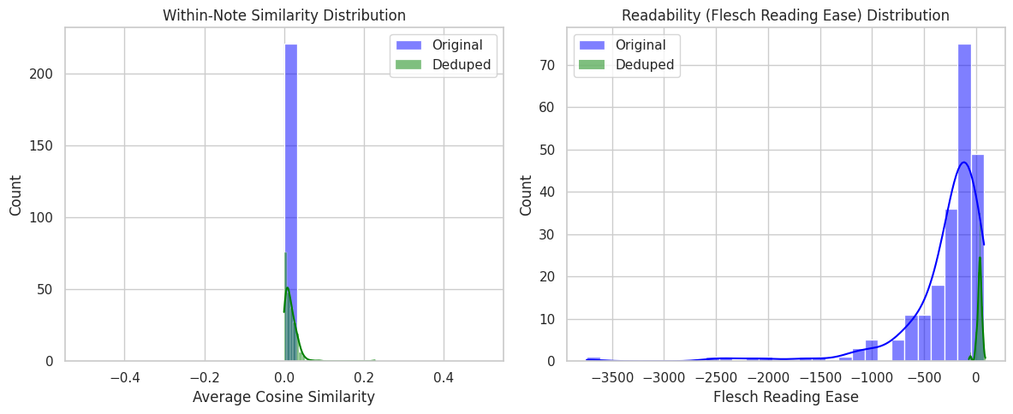
Test Data Results
Figure 7. Deduplication Notes Similarity and Readability (Test Dataset)

Slide 28
Discussion
ClinicalBERT embeddings combined with traditional similarity measures yielded substantial gains in readability scores and modest increases in within‑note similarity.
This hybrid approach effectively eliminates redundant content and improves textual clarity.
Enhanced clarity supports more reliable clinical decision‑making and boosts the performance of downstream NLP models.
Future work should involve fine‑tuning similarity thresholds and integrating richer clinical context to maximize these benefits.

Slide 29
Agenda
1
Background
2
Methodology
3
Results and Discussion
4
Final Thoughts

Slide 30
Final Thoughts

Slide 31
Limitations
Computational resources were insufficient to process the full dataset of over two million clinical notes, potentially reducing the precision of outcomes.
Stratified sampling was constrained by the smallest category (1,470 entries), and subsequent splitting into training, validation, and test sets further diminished sample size and analytical robustness.
Clinical terminology and numeric values inflate Flesch Reading Ease scores pre-deduplication, exaggerating perceived readability gains. Future work should adopt specialized readability measures or adjust existing metrics for medical terminology.

Slide 32
Future Evaluation
Test methodology on the most recent MIMIC-IV dataset for more robust results.
Primary evaluation demonstrated clear gains in redundancy reduction and improved readability.
Future work should assess deduplication’s impact on downstream NLP tasks.
Key applications include clinical concept extraction, disease prediction, and decision‑support.
Compare NLP model performance when trained on original versus deduplicated notes.

Slide 33
Thank You!

Slide 34
Questions?

