Slide 1
Cloud Foundations
GURURAJ, JASON, LUIS

Slide 2
Presentation Link
https://broadcast.amazon.com/videos/1163159

Slide 3
Scenario
As you know, Washington is looking for solutions to maintain the road infrastructure as more people switch to electric vehicles. The gas tax, which traditionally funded road maintenance, is declining. The proposed road charge system aims to address this by charging drivers per mile driven.
To implement the road charge system effectively, we need a clear picture of the electric vehicle landscape in Washington. We need to know where EVs are concentrated, how fast they're growing in different regions, and how this might change in the future. That's exactly where this project comes in. We’ve created visualizations that show the current distribution of electric vehicles across Washington, and if this idea wants to be expanded, it also includes California, Virginia, Maryland, and Texas.

Slide 4




Services
S3
Glue
Athena
Quicksight

Slide 5
Demo Video
https://broadcast.amazon.com/videos/1163141

Slide 6
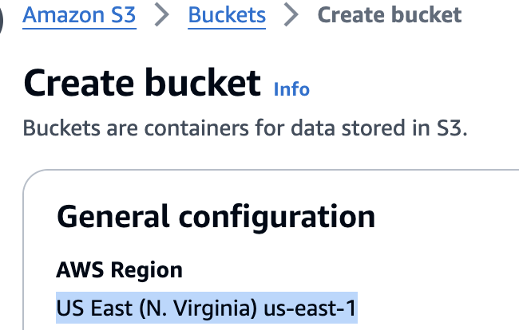
S3
Object storage service
Metadata
Key is composed of prefix + object name
S3://my-bucket/my_folder/my_file.txt
Region level
Notes:
An object is a file and any metadata that describes the file.
A key feature of S3 is its region-level functionality, which lets users choose specific geographic regions to store data, optimizing for latency, compliance, and cost efficiency.

Slide 7
S3
Security and data protection
User-Based
Resource-based
Lowest price and highest performance
Multiple storage classes
Durability and availability
99.99% availability
Scalability
Auto growing and shrinking as adding and removing data
99.999999999%
Notes:
This regional approach ensures data durability and availability by storing it across multiple, isolated locations within the chosen region.
Scalability: S3 is fully elastic, automatically growing and shrinking as you add and remove data. There’s no need to provision storage, and you pay only for what you use.
security and data protection:
User-based: IAM policy - which API calls should be allowed for a specific user from IAM
Resource-Based
Bucket Policies – is a set of rules written in JSON format that define the permissions to allow or deny access to the objects in an Amazon S3 bucket
Object Access Control List (ACL) – finer grain (can be disabled) Bucket Access Control List (ACL) – less common (can be disabled)
lowest price and highest performance
S3 has multiple storage classes with the best price performance for any workload and automated data lifecycle management, so you can store massive amounts of frequently, infrequently, or rarely accessed data in a cost-efficient way.

Slide 8
Quicksight
Serverless Architecture
Integrated with
RDS, Aurora, Redshift, S3, Athena
Pay-per-Session pricing
Use case
Business analytics
Building visualizations
Get business insights using data
74%
Notes:
QuickSight is a serverless machine learning-powered business intelligence service that can integrated with RDS, Aurora, Redshift, S3, Athena
it automatically scales to handle our data analysis load, from a few hundred to tens of thousands of users, without any infrastructure management
This unique pricing model makes it cost-effective, as you only pay when users access dashboards or reports, making it ideal for both small and business and large enterprise
74% lower cost of BI solution over three years.

Slide 9
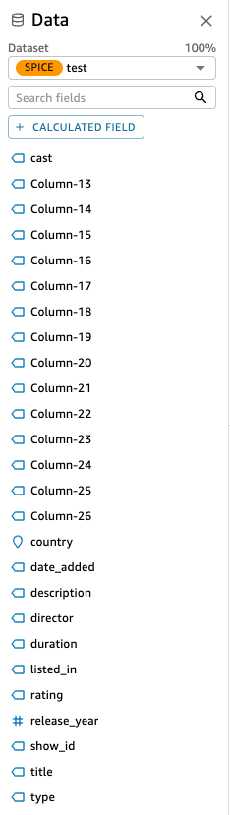
Cons
+
S3
Quicksight

Slide 10
Glue
Fully Managed ETL Service
No servers to provision or manage
Automatic provisioning and scaling of resources
Data Catalog
Persistent metadata store
Stores table definitions, schemas, and partition information Integrates with Athena, Redshift Spectrum, and EMR
Data Integration
Supports various data sources (S3, RDS, DynamoDB, etc.)
Built-in data transformations (filter, join, dedup, etc.)
Serverless and Pay-per-use
No upfront costs or long-term commitments
Pay only for the resources used during job runs
Integration with Other AWS Services
Works seamlessly with S3, Athena, Redshift, EMR, and more
Enables building end-to-end data pipelines

Slide 11
Athena
Scalability:
Athena automatically adjusts resources based on your query needs, so you don't have to worry about capacity planning.
Flexibility:
Athena can adapt to changing data formats and structures without needing to define schemas upfront.
Durability and Availability:
Your data stored in S3 is highly durable and available, thanks to Amazon's robust infrastructure.
Security:
Athena allows you to control access to your data through user-based and resource-based permissions.
Cost-Effective:
You only pay for the queries you run, eliminating the need to maintain expensive infrastructure.
High Performance:
Athena efficiently executes queries in parallel, providing fast results even on large datasets.
Storage Options:
Athena can query data stored in different S3 storage classes, giving you cost-effective options for various data types.

Slide 12
Quicksight Dashboard

Slide 13
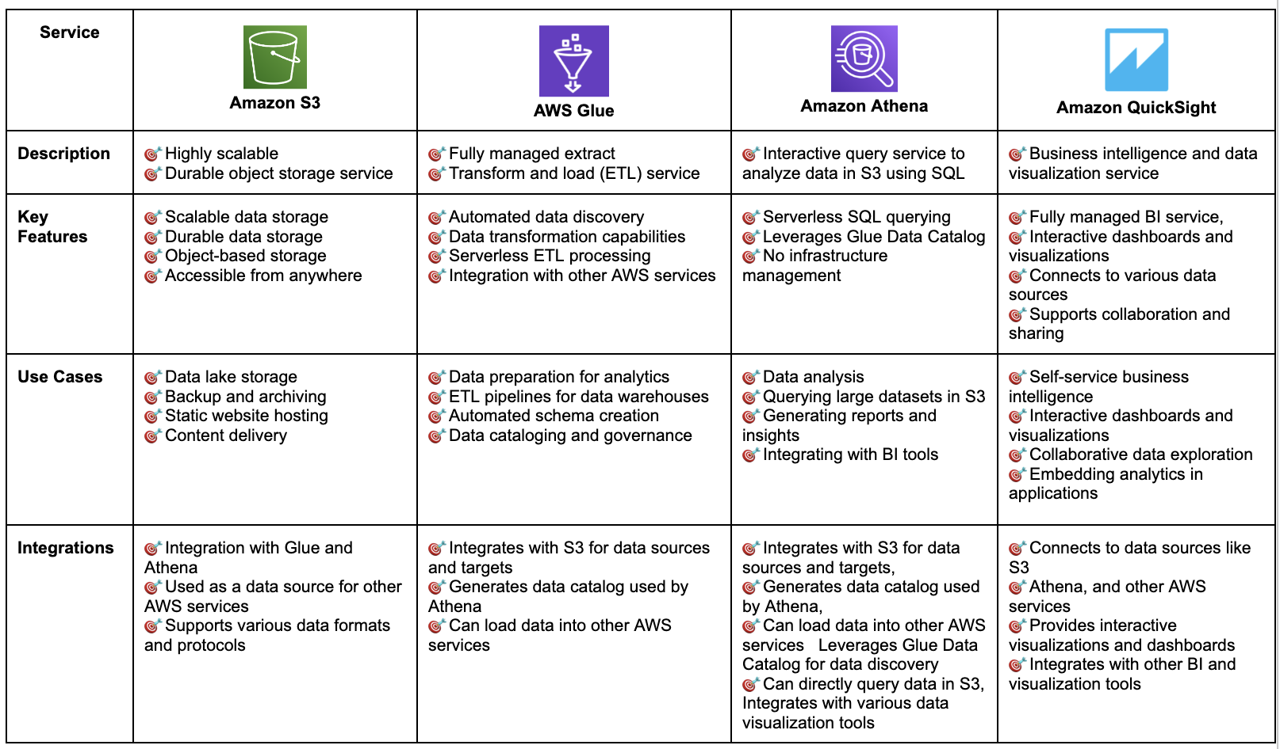
Summary

Slide 14



Disaster
https://distributedalgorithm.wordpress.com/2016/02/25/disaster-recovery-for-solr-a-story-from-the-field/

Slide 15
Demo Video - Replication Rule
https://broadcast.amazon.com/videos/1163156

Slide 16
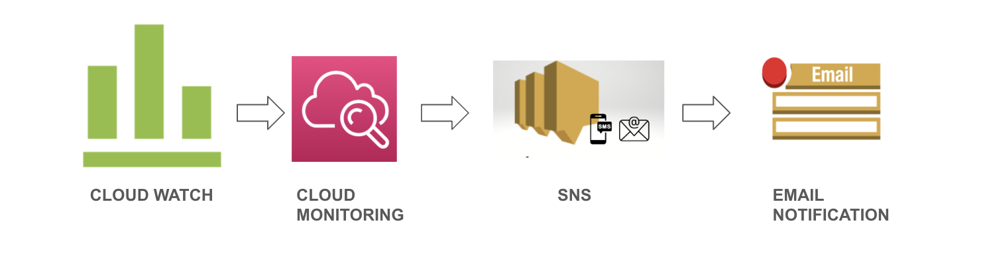
Notification

Slide 17
Problems we got
Problem 1: Encounters issues importing data from Athena to Quicksight; tables do not appear in Quicksight
Solution 1: To ensure Athena and Quicksight are in the same region.
Problem 2: Unable to connect Quicksight to S3 bucket
Solution 2: Need to select the specific s3 bucket to share permission. (Manage Quicksight -> Security & permissions -> Manage(Access granted to services) -> select the specific s3 bucket)
Problem 3: Glue crawler fails to discover data in S3 bucket.
Solution 1: Double-check the IAM role assigned to the Glue crawler. The role should have the necessary permissions to access the S3 bucket and read the data files. Additionally, ensure that the data files are stored in a supported format (e.g., CSV, JSON, Parquet) and that the crawler is configured to include the correct file extensions or prefixes.

Slide 18
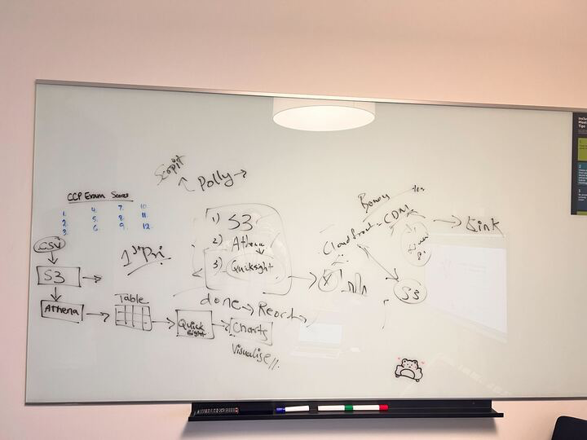

Q&A

