Slide 1
Project 2
Networking
project
Jason Zhang

Slide 2
Demo Video: https://broadcast.amazon.com/videos/1176703

Slide 3



VPC –Set up
VPC
10.0.0.0/16
Route Table:
Destination | Target
0.0.0.0/0 | Igw-<igwID>
<VPC IPv4 CIDR> | local
Public Subnet
10.0.0.0/26
IGW
Default NACL:
Allow ALL traffic to flow in and out of the subnets with which it is associated
NACL

Slide 4
VPC
VPC
x.x.x.x/16 ~ /28
Max 5 CIDR / VPC
Min CIDR / 28 (16)
Max CIDR /16 (65536)
Do not overlap with other VPC while peering
Private IP only allow
10.0.0.0 – 10.255.255.255
172.16.0.0 – 172.31.255.255
192.168.0.0 – 192.168.255.255
5 reserves IPs (F4L1)
10.0.0.0
10.0.0.1
10.0.0.2
10.0.0.3
10.0.0.255
Example: if need 29 IP address, /27 = 32 IPs, 32 - 5 = 27 < 29, thus subnet mask
should be /26
Notes:
Private IP only allow *
10.0.0.0 – 10.255.255.255 (10.0.0.0/8)çin big networks *
172.16.0.0 – 172.31.255.255 (172.16.0.0/12) AWS defaultVPC in that range *
192.168.0.0 – 192.168.255.255 (192.168.0.0/16) ç e.g., home networks
Do not overlap with other VPC
5 reserves IP address (F4L1) *
10.0.0.0 – Network Address *
10.0.0.1 – reserved by AWS for the VPC router
10.0.0.2 – reserved by AWS for mapping to Amazon-provided DNS
10.0.0.3 – reserved by AWS for future use
10.0.0.255 – Network Broadcast Address.
AWS does not support broadcast in a VPC, therefore the address is reserved
example: if need 29 IP address, /27 = 32 IPs, 32 - 5 = 27 < 29, thus subnet mask should /26

Slide 5


Web
Server – Set up
VPC
10.0.0.0/16
Public Subnet
10.0.0.0/26
Security Group:
NACL
IGW
Inbound
EC2
Type | Port | Source
SSH | 22 | 0.0.0.0/0
HTTP | 80 | 0.0.0.0/0
Public IP: 54.172.17.28
Private IP: 10.0.0.29
✓
✓
X
SSH
HTTP
SG
outbound
Type | Port | Source
All traffic | All | 0.0.0.0/0
Notes:
support both the IPv4 and IPv6 addressing protocols.
By default, Amazon VPC uses the IPv4 addressing protocol
you can't disable this behavior.
if EC2 can’t be launched, maybe IPv4 issue, fix this but creating a new IPv4 CIDR in subnet.
Time out – SG issue
(failed)net::ERR_CONNECTION_REFUSED – disable httpd.service

Slide 6
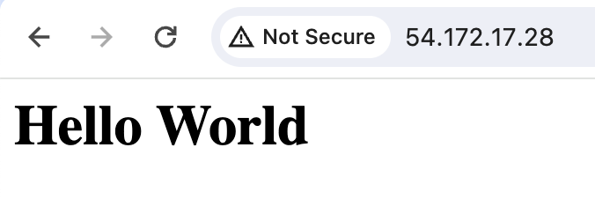
Web
Server - Connect
VPC
10.0.0.0/16
Public Subnet
10.0.0.0/26
http://54.172.17.28/
NACL
IGW
EC2
Public IP: 54.172.17.28
Private IP: 10.0.0.29
✓
✓
X
SSH
HTTP
SG
Notes:
support both the IPv4 and IPv6 addressing protocols.
By default, Amazon VPC uses the IPv4 addressing protocol
you can't disable this behavior.
if EC2 can’t be launched, maybe IPv4 issue, fix this but creating a new IPv4 CIDR in subnet.
Time out – SG issue
(failed)net::ERR_CONNECTION_REFUSED – disable httpd.service

Slide 7
Q&A
Q: how does the EC2 instance know its way out to the internet?
From the VPC section, we need to set up an Internet gateway for the public subnet. Since the EC2 instance is in the public subnet, it can access the Internet. However, the EC2 instance still needs to determine which protocols can be accessed. Therefore, we need to set up inbound rules in the security group to allow SSH or HTTP access.
http://54.172.17.28/
✓
✓
X
SSH
HTTP
Server
IGW
NACL
SG
Public IP: 54.172.17.28
Private IP: 10.0.0.29
Hello World

Slide 8
Client
Side – Set up
VPC
10.0.0.0/16
Public Subnet
10.0.0.0/26
Security Group:
NACL
IGW
Inbound
EC2
Type | Port | Source
SSH | 22 | 0.0.0.0/0
Public IP: 54.161.213.242
Private IP: 10.0.0.45
✓
✓
X
SSH
SG
outbound
Type | Port | Source
All traffic | All | 0.0.0.0/0

Slide 9
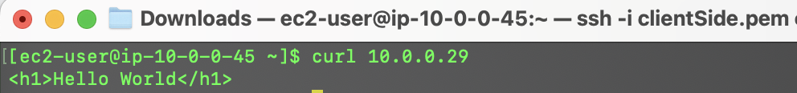
In Client
Side
VPC
10.0.0.0/16
Public Subnet
10.0.0.0/26
> Curl 10.0.0.29
NACL
IGW
curl <private-IP of web-server>
Server
Client
Public IP: 54.172.17.28
Private IP: 10.0.0.29
Public IP: 54.161.213.242
Private IP: 10.0.0.45
SSH
HTTP
✓
✓
X
✓
✓
X
SSH
SG
SG

Slide 10
Q&A
Q: Does connectivity work? If so, what do you see? Did we traverse the internet while making this request?
The connectivity works. The terminal returns “Hello, World.” The traffic does not traverse the internet; instead, it stays within the AWS internal network.
VPC
10.0.0.0/16
Public Subnet
10.0.0.0/26
Public IP: 54.161.213.242
Private IP: 10.0.0.45
> Curl 10.0.0.29
Public IP: 54.172.17.28
Private IP: 10.0.0.29
all
HTTP/SSH
outbound
Inbound
Client
✓
✓
X
✓
✓
X
Server
Hello World
Notes:
SG is stateful!

Slide 11
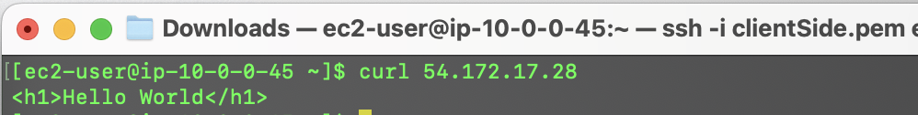
In Client
Side
VPC
10.0.0.0/16
Public Subnet
10.0.0.0/26
> Curl 54.172.17.28
NACL
IGW
curl <public-IP of web-server>
Server
Client
Public IP: 54.172.17.28
Private IP: 10.0.0.29
Public IP: 54.161.213.242
Private IP: 10.0.0.45
SSH
HTTP
✓
✓
X
✓
✓
X
SSH
SG
SG

Slide 12
Q&A
Q: Is there any difference in response? Did we traverse the internet while making this request?
Same response, but the traffic does traverse the internet while making this request. Despite both instances being in the same subnet, using the public IP forces the traffic to go outside the internal AWS network, making a round trip over the internet before returning to the second instance. This route involves extra latency and potential security risks compared to using private IPs.
> Curl 54.172.17.28
Public IP: 54.172.17.28
Private IP: 10.0.0.29
Public IP: 54.161.213.242
Private IP: 10.0.0.45
Allow all
Allow all
HTTP/SSH
outbound
outbound
inbound
Inbound
Client
✓
✓
X
✓
✓
X
Server
all
NACL
IGW
NACL
Hello World
inbound
outbound
Notes:
NACL is stateless

Slide 13
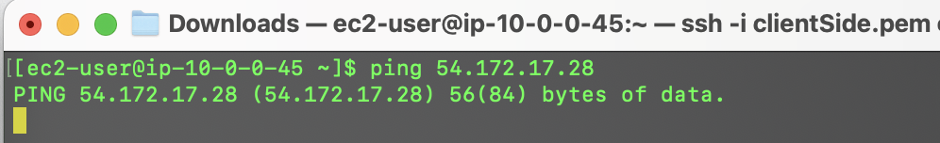
In Client
Side
VPC
10.0.0.0/16
Public Subnet
10.0.0.0/26
> ping 54.172.17.28
NACL
IGW
ping <public-IP of web-server>
Server
Client
Public IP: 54.172.17.28
Private IP: 10.0.0.29
Public IP: 54.161.213.242
Private IP: 10.0.0.45
SSH
HTTP
✓
✓
X
✓
✓
X
SSH
SG
SG

Slide 14
Q&A
Q: Did pinging the web-server work? Why? Hint: What protocol does PING use?
Pinging the web server does not work because ping requires the ICMP protocol. In the security group of the web server, only SSH & HTTP traffic are allowed.
> ping 54.172.17.28
Public IP: 54.161.213.242
Private IP: 10.0.0.45
Public IP: 54.172.17.28
Private IP: 10.0.0.29
Allow all
Allow all
Without ICMP rule
outbound
outbound
inbound
Inbound
Client
✓
✓
X
✓
✓
X
Server
all
NACL
IGW
NACL
SSH, HTTP
Hello World
Notes:
NACL is stateless

Slide 15
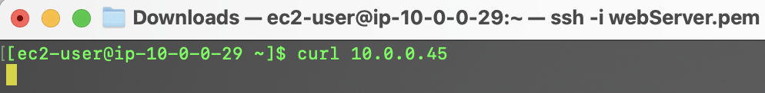
In Web
Server
VPC
10.0.0.0/16
Public Subnet
10.0.0.0/26
> curl 10.0.0.45
NACL
IGW
curl <private-IP of client instance>
Server
Client
Public IP: 54.172.17.28
Private IP: 10.0.0.29
Public IP: 54.161.213.242
Private IP: 10.0.0.45
SSH
HTTP
✓
✓
X
✓
✓
X
SSH
SG
SG

Slide 16
Q&A
Q: What was the response? If connectivity failed, explain the possible cause.
There is no response because, in the security group of the client instance, only SSH traffic is allowed, but the curl command requires the HTTP protocol.
Public Subnet
10.0.0.0/26
> curl 10.0.0.45
Public IP: 54.172.17.28
Private IP: 10.0.0.29
Public IP: 54.161.213.242
Private IP: 10.0.0.45
all
SSH
outbound
Inbound
Server
✓
✓
X
✓
✓
X
Client

Slide 17
Bonus points

Slide 18
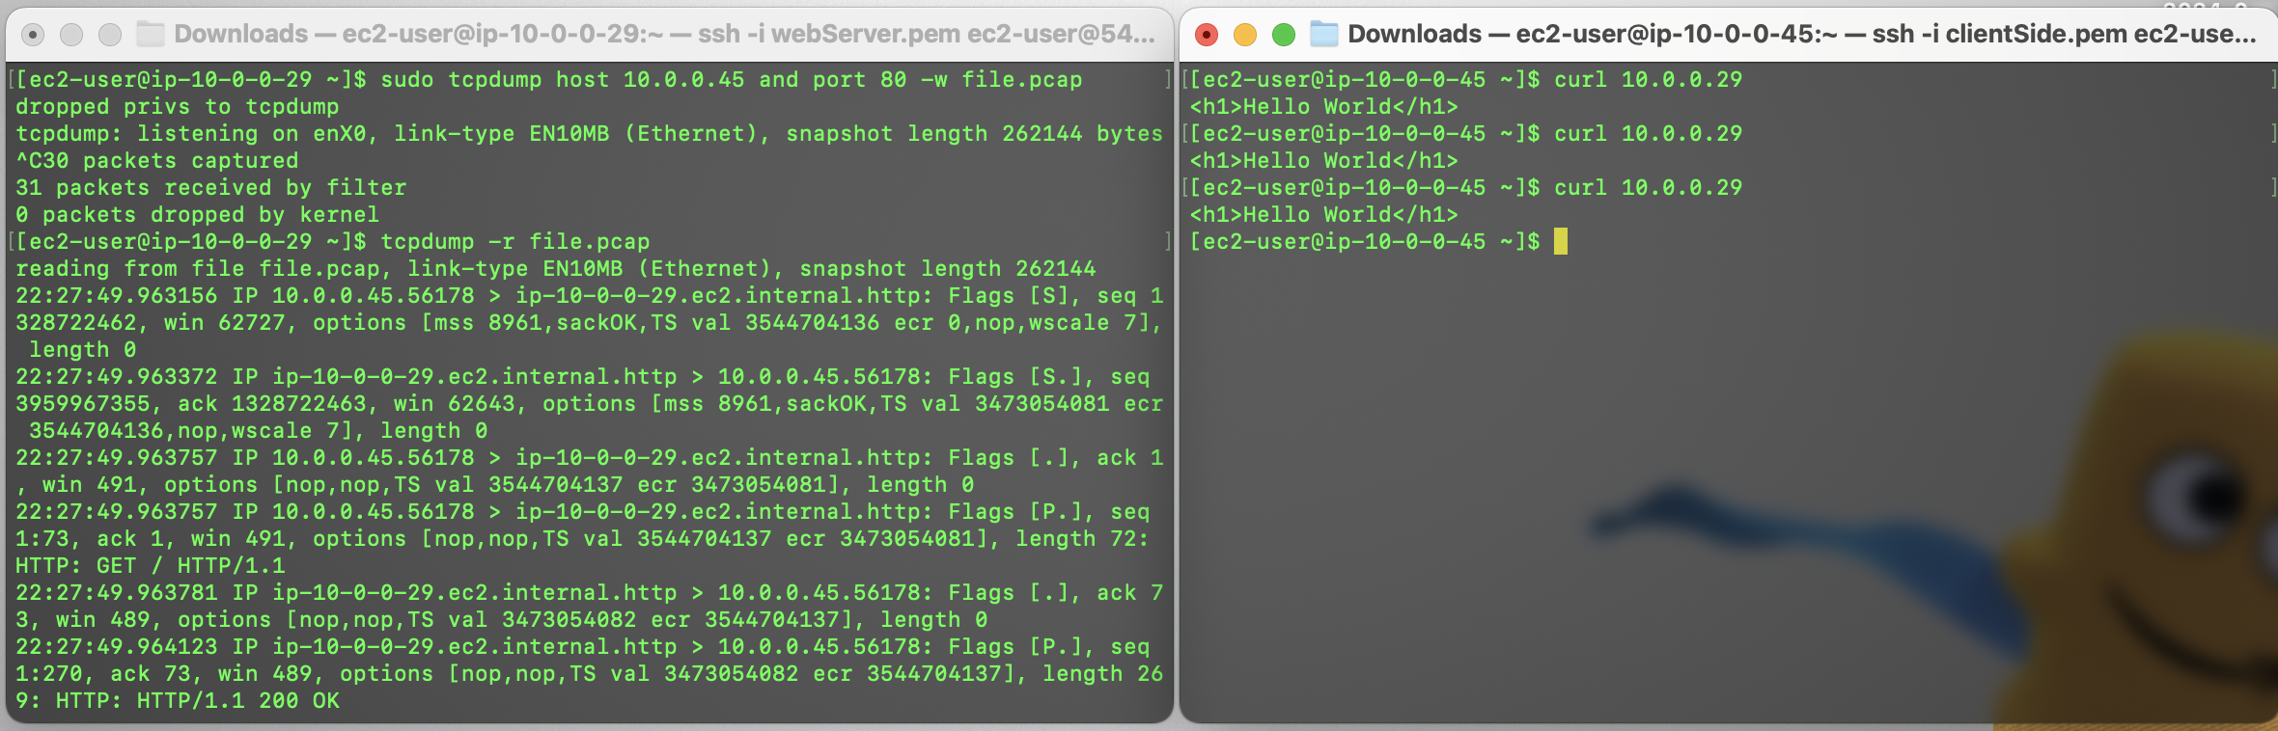
> sudo yum install tcpdump
> sudo tcpdump host 10.0.0.29 and port 80 –w file.pcap
> Curl 10.0.0.29
> Curl 10.0.0.29
> tcpdump –r file.pcap
> Curl 10.0.0.29

Slide 19
Q&A
Q: Who initiates the TCP three-way handshake?
Client instance initiates the three-way handshake by sending the first SYN packet. This is typical for HTTP requests, where the client starts the process to establish a TCP connection.
SYN
Public IP: 54.161.213.242
Private IP: 10.0.0.45
Public IP: 54.172.17.28
Private IP: 10.0.0.29
SYN-ACK
Client
Server
ACK
Notes:
NACL is stateless

Slide 20
Q&A
Q: What is the HTTP request method?
“In its simplest form, HTTP is a client/server, one-request/one-response protocol.”
- 2017 Nemeth Evi etal - UNIX and Linux System Administration Handbook[5thED]_Rell, P675
Verb | Purpose
GET | Retrieves the specified resource
HEAD | Like GET, but requests no payload; retrieves metadata only
DELETE | Deletes the specified resource
POST | Applies request data to the given resource
PUT | Similar to POST, but implies replacement of existing contents
OPTIONS | Shows what methods the server supports for the specified path
Notes:
NACL is stateless

Slide 21
Q&A
Q: How is the connection closed between the two peers? (What TCP flags do you see?)
[ec2-user@ip-10-0-0-29 ~]$ tcpdump -r file.pcap
reading from file file.pcap, link-type EN10MB (Ethernet), snapshot length 262144
22:27:49.963156 IP 10.0.0.45.56178 > ip-10-0-0-29.ec2.internal.http: Flags [S], seq 1328722462, win 62727, options [mss 8961,sackOK,TS val 3544704136 ecr 0,nop,wscale 7], length 0
22:27:49.963372 IP ip-10-0-0-29.ec2.internal.http > 10.0.0.45.56178: Flags [S.], seq 3959967355, ack 1328722463, win 62643, options [mss 8961,sackOK,TS val 3473054081 ecr 3544704136,nop,wscale 7], length 0
22:27:49.963757 IP 10.0.0.45.56178 > ip-10-0-0-29.ec2.internal.http: Flags [.], ack 1, win 491, options [nop,nop,TS val 3544704137 ecr 3473054081], length 0
22:27:49.963757 IP 10.0.0.45.56178 > ip-10-0-0-29.ec2.internal.http: Flags [P.], seq 1:73, ack 1, win 491, options [nop,nop,TS val 3544704137 ecr 3473054081], length 72: HTTP: GET / HTTP/1.1
22:27:49.963781 IP ip-10-0-0-29.ec2.internal.http > 10.0.0.45.56178: Flags [.], ack 73, win 489, options [nop,nop,TS val 3473054082 ecr 3544704137], length 0
22:27:49.964123 IP ip-10-0-0-29.ec2.internal.http > 10.0.0.45.56178: Flags [P.], seq 1:270, ack 73, win 489, options [nop,nop,TS val 3473054082 ecr 3544704137], length 269: HTTP: HTTP/1.1 200 OK
22:27:49.964541 IP 10.0.0.45.56178 > ip-10-0-0-29.ec2.internal.http: Flags [.], ack 270, win 489, options [nop,nop,TS val 3544704138 ecr 3473054082], length 0
22:27:49.964707 IP 10.0.0.45.56178 > ip-10-0-0-29.ec2.internal.http: Flags [F.], seq 73, ack 270, win 489, options [nop,nop,TS val 3544704138 ecr 3473054082], length 0
[S] SYN
[S.] SYN-ACK
Public IP: 54.161.213.242
Private IP: 10.0.0.45
[.] ACK
Public IP: 54.172.17.28
Private IP: 10.0.0.29
[P.] Push data
[.] ACK
Client
[P.] Push data
Server
[.] ACK
[F.] Finish Connection
Notes:
NACL is stateless

Slide 22
Thank You!
Networking Project
Jason Zhang

