Slide 1
Weekly Report
指導教授：吳誠文
報告：周昱佑 、 程亞淇
2021/03/12
Laboratory of Reliable Computing
Department of Electrical Engineering
National Cheng Kung University

Slide 2
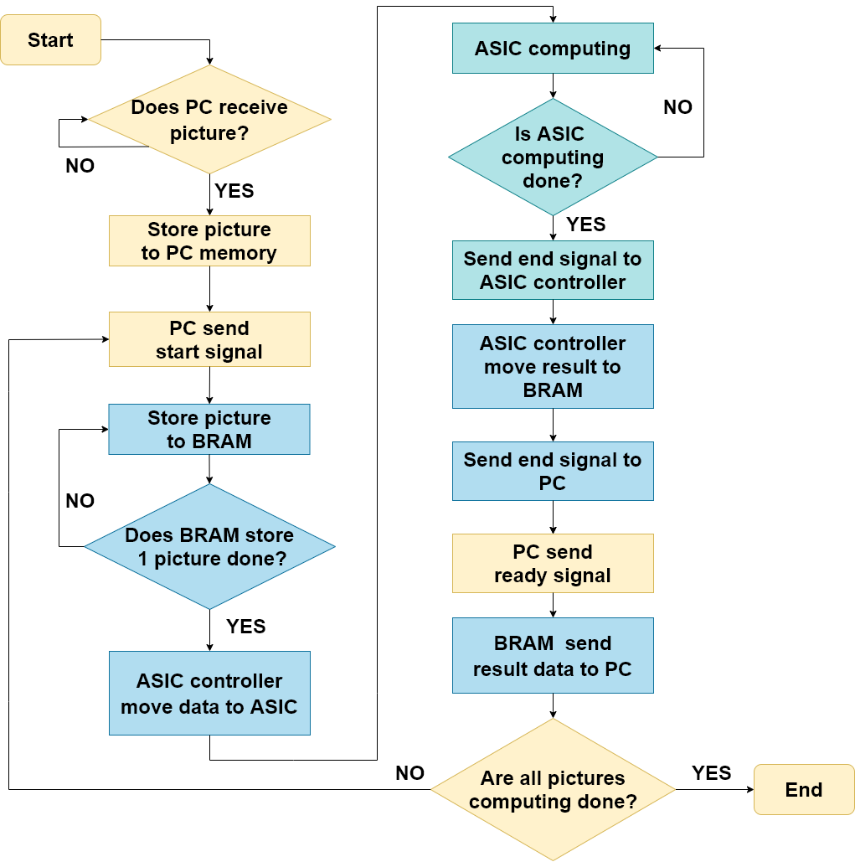
System Flow Chart

Slide 3
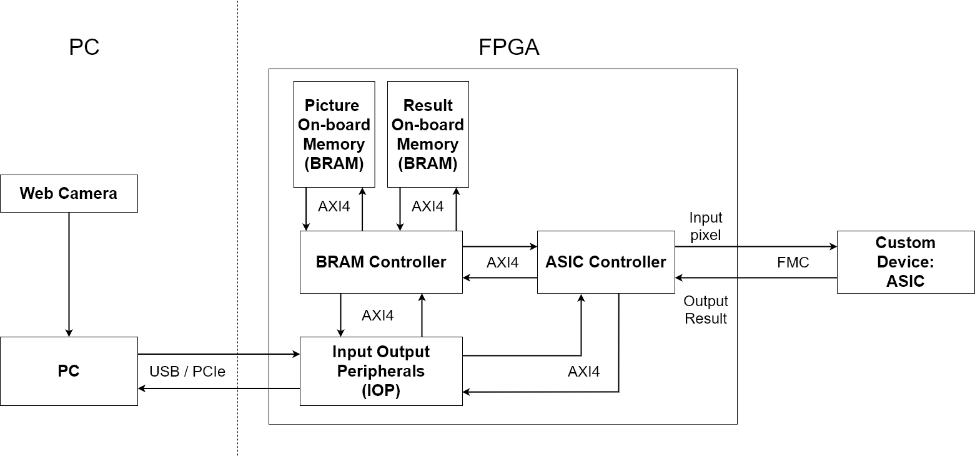
System Architecture Block Diagram

Slide 4
Clock Domain Crossing Problem
Specification:
ASIC operating clock rate:100MHz
AXI4 operating clock rate:200MHz
Problem:
May cause metastable state.
May receive incorrect data.
Solution:
Asynchronous FIFO circuit
Vivado has AXI interface FIFOS IP.

Slide 5
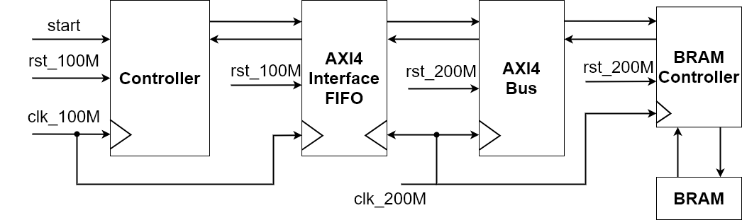
Controller Architecture
Controller generate 0~127 digits
Write into BRAM
Read from BRAM and display on LED[6:0]

Slide 6
Future Work
Design ASIC Controller.
Connect to ASIC .

Slide 7

Architecture
FPGA
USB port transfer DATA
OS : Windows
Programming language : C

Slide 8
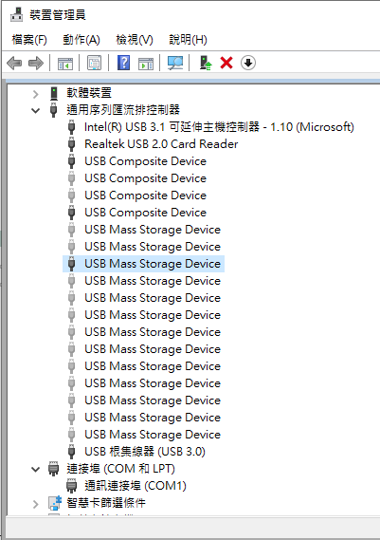
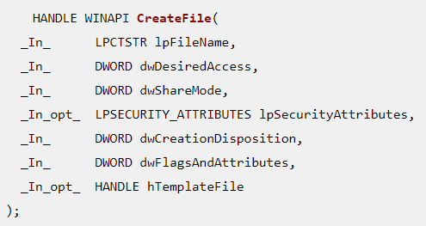

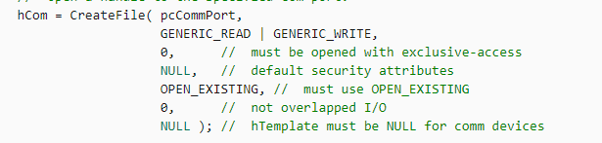
Schedule

Slide 9
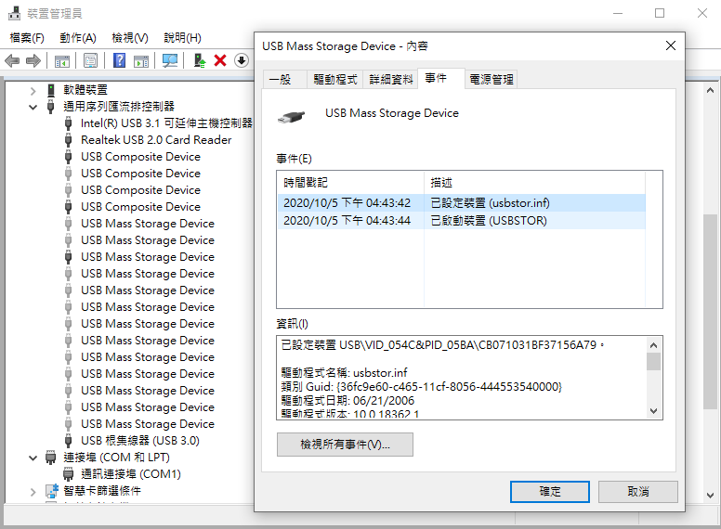
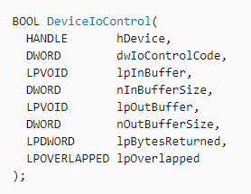
Schedule
call HCD
call HUB
find HUB connect info.
get sub-HUB info.

Slide 10
Future work
Open USB port for data transmission
Read PCIe user guide

