Slide 1
Weekly Report
指導教授：吳誠文
報告：周昱佑 、 程亞淇、杜冠勳
2021/05/06
Laboratory of Reliable Computing
Department of Electrical Engineering
National Cheng Kung University

Slide 2
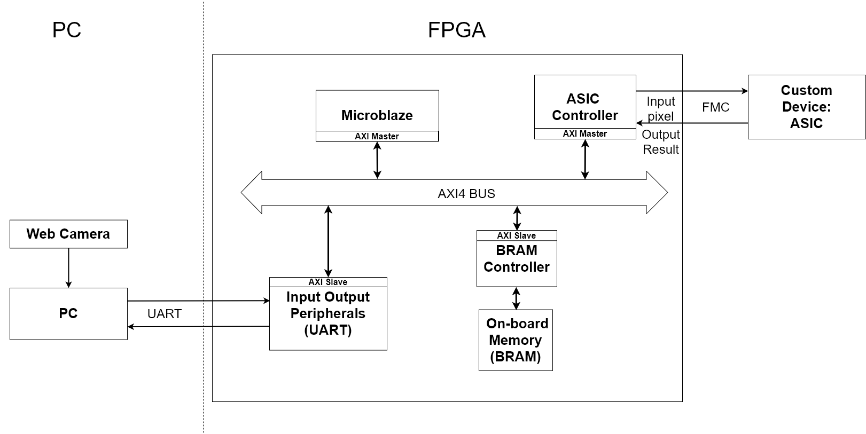
Review

Slide 3
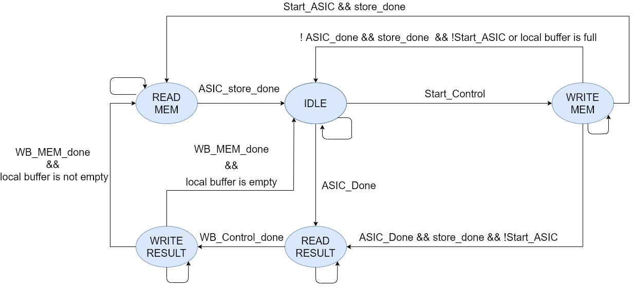
Controller FSM
WRITE MEM: Transfer data from BRAM to local buffer
READ MEM: Transfer data from local buffer to ASIC
READ RESULT: Transfer result from ASIC to local buffer
WRITE RESULT: Transfer result from local buffer to BRAM

Slide 4
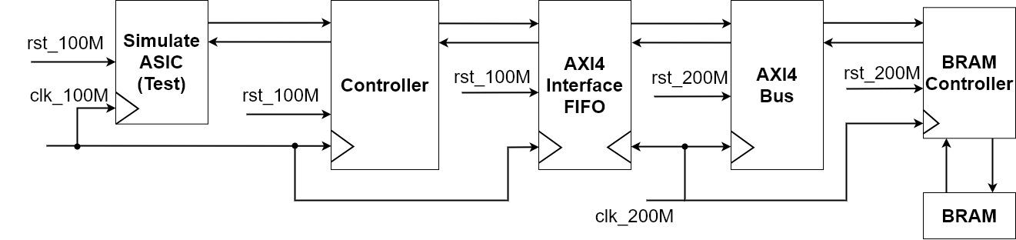
Controller Architecture

Slide 5
Problem
In 200MHz /100 MHz
Simulation pass
Synthesis pass
Implementation timing failed.
Setup time failed
In 125MHz/100MHz pass
Probable reason: BRAM path too long

Slide 6
Future Work
Solve timing problem.
Connect to 冠勳’s design.
Learn how to display on LCD.

Slide 7

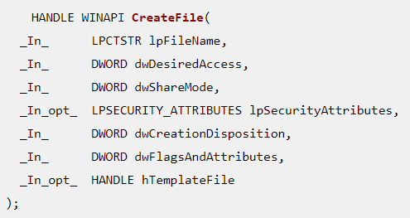

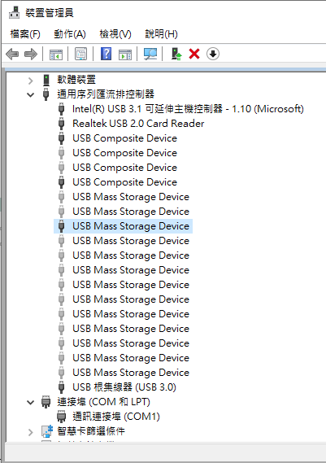
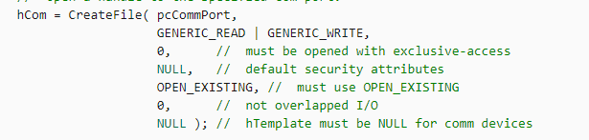
Review
FPGA
USB port transfer DATA
OS : Windows
Programming language : C

Slide 8
Flow Process
※main process
※thread process
START
read/write flag==1
No
read source data to buffer
START
open thread
Yes
count 1 sec
read answer from FPGA
write buffer data to FPGA
create UART port
read/write flag set to 1
read/write flag set to 0
open source data file
free buffer
read/write flag set to 1
No
read answer time !=30
read answer time++
No
Read answer time==30
Yes
End
Yes
End

Slide 9
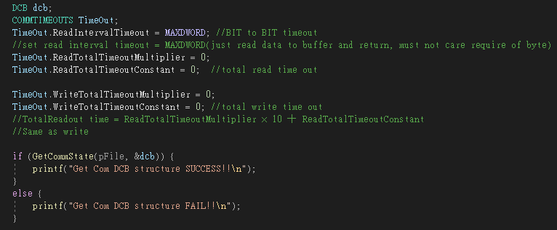
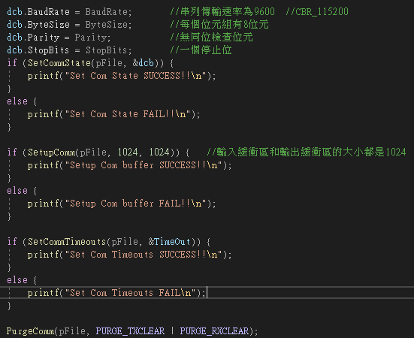
Problem
Windows10 does not support “pci-tree”
UART has some problem on setting (sloved)

Slide 10
Future work
Make API (UART_port C code)
To know WinDriver or PCIScope user guide
暑假實習 -- 逆變器、SiC 功率元件/模組

Slide 11
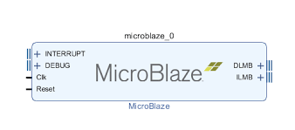
UART communication with FPGA
IP List
MicroBlaze(soft-core processor)
Architechture can be configurable
Enable interrupt mode
Interrupt module cannot have empty connection
Uart_16550
Axi_uartlite cannot be used
Connect the interrupt line to the microblaze
CP2102 has a max baud rate of 1 Mbps.
Notes:
architechture cache size, pipeline depth (3-stage, 5-stage, or 8-stage), embedded peripherals, memory management unit, and bus-interfaces
MicroBlaze's overall throughput is substantially less than a comparable hard CPU core (such as the ARM Cortex-A9 in the Zynq).
32-bit/64-bit

Slide 12
SDK C code design
Prog Image_filter
Step1 PC send a photo (bmp format )to FPGA and store data in local cache.
Step2 microblaze processor do some calculation with pixel value(255-pixel value)
Step3 FPGA send back the calculated data to PC port and store the data as bmp format.

Slide 13
SDK C code design
使用 teraterm 傳送資料時 必須選用二進制
使用 日記生成圖片時 必須選用二進制
若程式中迴圈失效 可能是FPGA 設計的memory 不足夠使用導致 迴圈設計失效 FPGA design 的memory 大小可於 Linker Script 文件中查看
Uart 傳輸中若遇到資料遺失 可用兩種方法解決#include “sleep.h” 加入wait 的設計 若上述方法仍無法解決則可依 缺失的資料數補足 dummy data 0x00
#include “xuartns550_i.h”#include “xuartns550.h“ uart driver C code 函式庫
#include <stdlib.h> 記憶體宣告函式庫

Slide 14

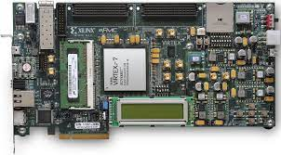

System design flow
1. Image 512*512 bmp format
3. Send back data to PC
2. Filter process
(255-pixel value)
Teraterm is used monitoring COM PORT

Slide 15
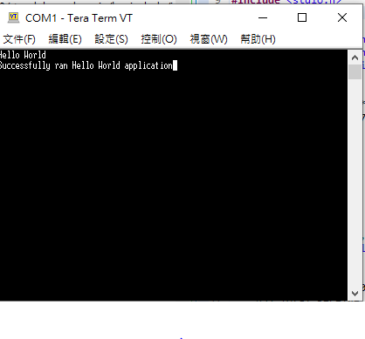
Prog1 Result

Slide 16
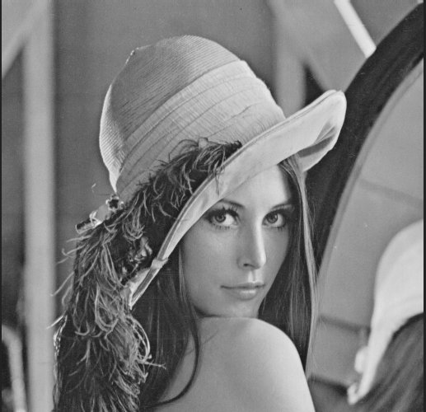
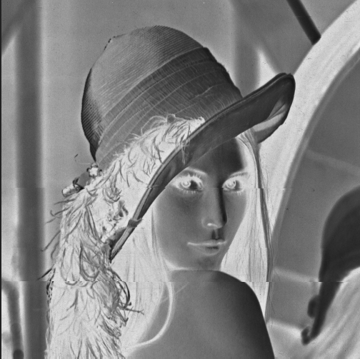
Prog2 Result
Image filter

Slide 17
Future Work
與昱佑 PC 端 程式互接 傳送圖片或 影像
與亞淇 的control module 互接

