Slide 2
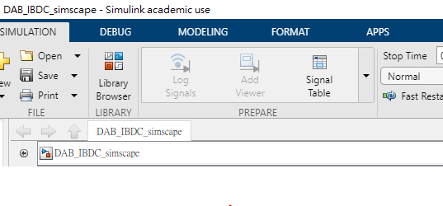
Configure parameter =>Configure logging
Solver => model setting
Simscape logging => model setting

