Slide 1
Weekly Report
Presenter: Kuan-Hsun-Duh
Advisor: Cheng-Wen Wu
2021/02/26

Slide 2
Memory type
Xilinx® 7 series
Type | B(blocked)RAM | D(distributed)RAM | off-chip RAM
Memory | SRAM | SRAM | SDRAM
Consume additional LUT | X | V | X
Capacity | 36 Kbits | small storage (a 4-byte buffer for a UART) | 1GB (storing data like images)

Slide 3
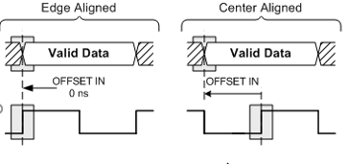
Off-chip RAM
DDR3
Operate in byte lane(8 or 9 bits) 1 bits for data strobe(DQS)
Datapath width: 64 bits
DQS provides the reference timing for capturing data by the receiver
Read Data
Write Data

Slide 4
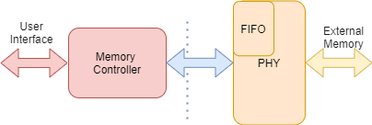
Off-chip RAM
Memory Interface Generator(MIG)
The PHY generates the signal timing and sequencing required to interface to the memory device
Lower power consumption

Slide 5
Memory Interface Generator(MIG) Flow
Continue…….

Slide 6
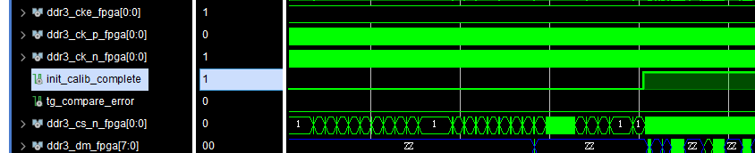
Memory Interface Generator(MIG)
init_calib_complete pin :initialization
tg_compare_error: check if any fault happened
Behavior level and Synthesizable

Slide 7
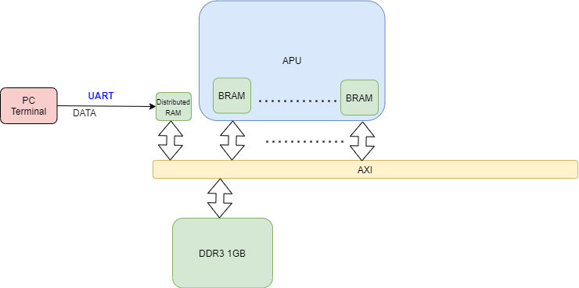
Architecture
Bottleneck : USB to UART(CP2103) Baud rates: 300 bps to 1 Mbps while DDR3 is Up to 1,600 MT/s
UART is fairly low bandwidth(serial data bus)
DDR3 is fairly high bandwidth

