Slide 1
A Consideration of Bidirectional Superposed Dual Active Bridge DC-DC Converter
Nagasaki University/Nishimu Electronics Industries
Toshiro Hirose / Hirofumi Matsuo
12 August 2010 Accepted by IEEE
Presenter: Kuan-Hsun-Duh
Advisor: Cheng-Wen Wu
2021/07/01

Slide 2
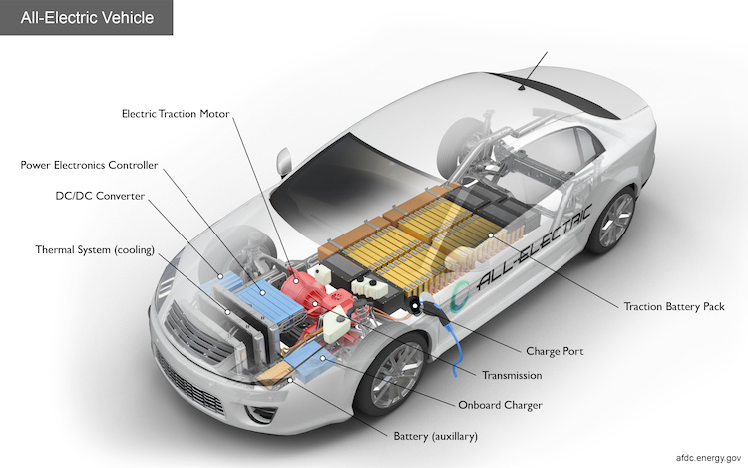
Introduction
Converter application :
Hybrid car/Energy storing system
Natural energy conversion
Problem :
Huge energy conversion →current ↑ → converter size ↑ → switching loss ↑ → efficiency ↓
Notes:
儲電裝置 無法供給出大電壓 故需要聲押器的幫忙來轉換電力

Slide 3
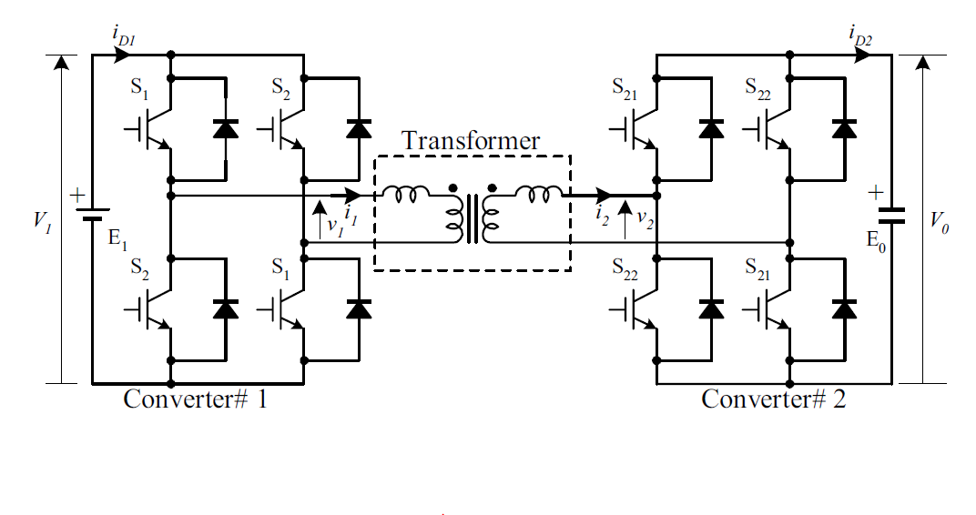
Traditional Converter
Transform flow:DC → AC → AC → DC
Buck/Boost mode
S1 ON S2 OFF
S22 ON S21 OFF
positive phase

Slide 4
Traditional Converter
S1 OFF S2 ON
S22 OFF S21 ON
negative phase

Slide 5
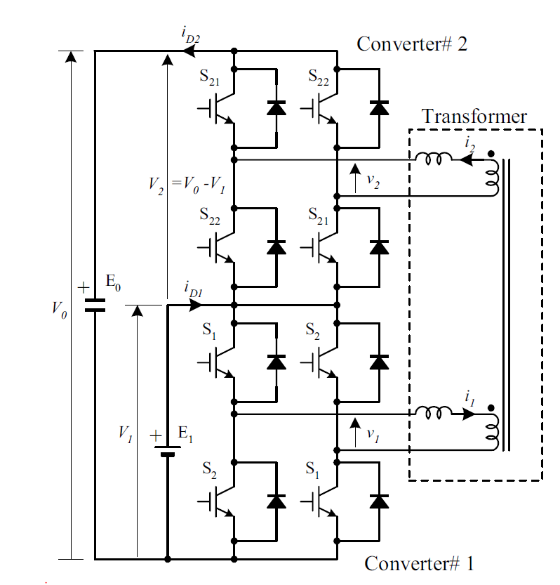
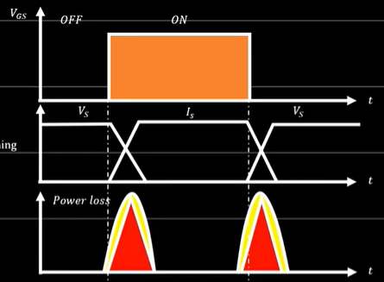
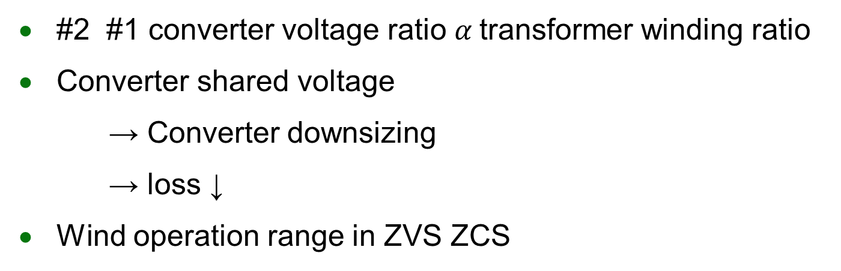
Proposed Converter
#2 #1 converter voltage ratio $α$transformer winding ratio
Converter shared voltage
→ Converter downsizing
→ loss ↓
Wind operation range in ZVS ZCS
REF.Ahmad Elkhateb 2021/01/28
Queen's University Belfast Soft Switching Hard Switching vs Resonance
https://www.youtube.com/watch?v=SXfsH-oxSAk&t=0s

Slide 6
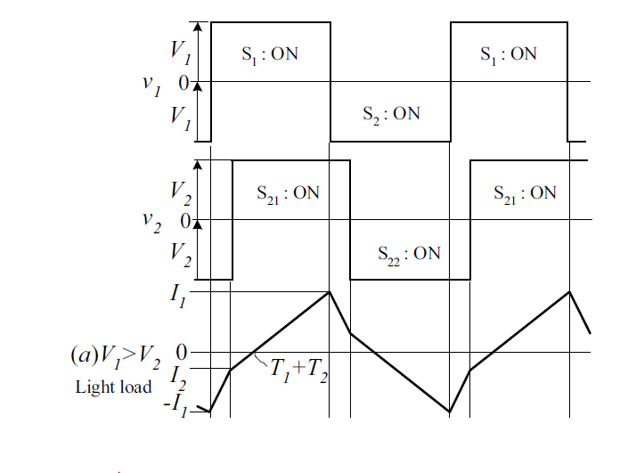
Operation mode
Pattern A (hard turn on) light load/ V1>V2
Pattern B (hard turn on) light load/V2>V1
Pattern C (ZVS ZCS state) high load/

Slide 7
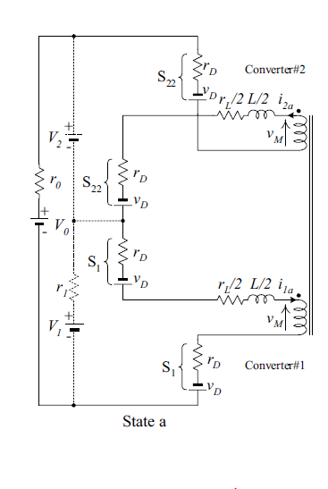
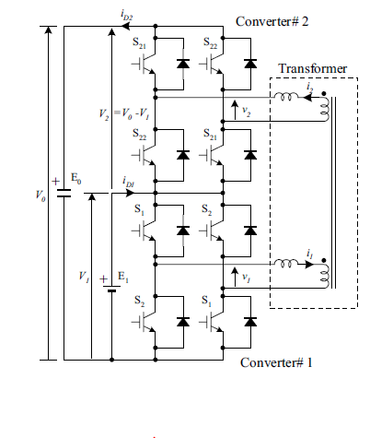
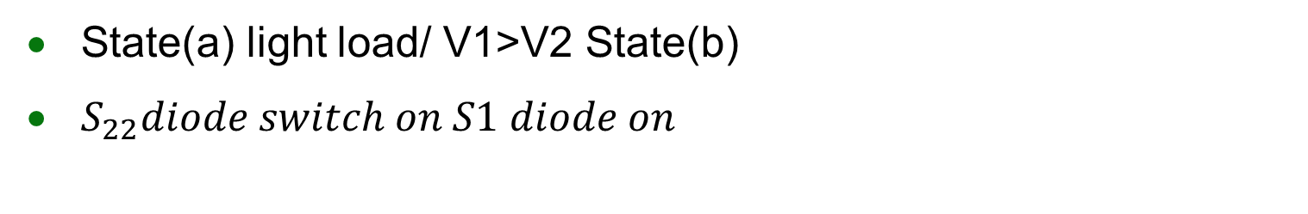
Pattern A Operation Analysis
State(a) light load/ V1>V2 State(b)
$S_{22}diode switch on S1 diode on$

Slide 8
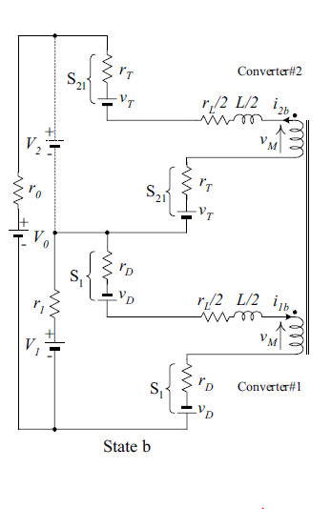

Pattern A Operation Analysis
State(b) ${ S}_{21 }IGBT switch on S1 diode on$
Purpose : create ZCS for ${ S}_{21 }$

Slide 9
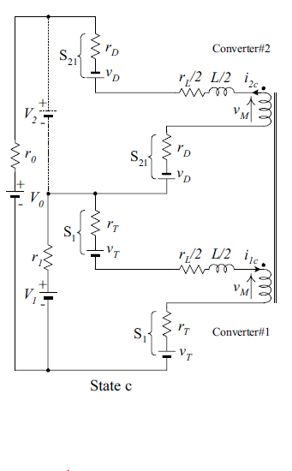
Pattern A Operation Analysis
State(c) ${ S}_{21 }diode switch on S1 IGBT switch on$

Slide 10
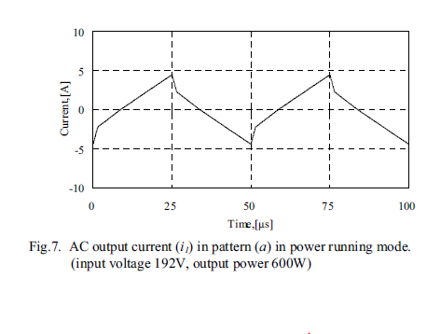
AC output current waveforms
Software modeling
KVL / KCL → Laplace transform →Inverse Laplace transform

Slide 11
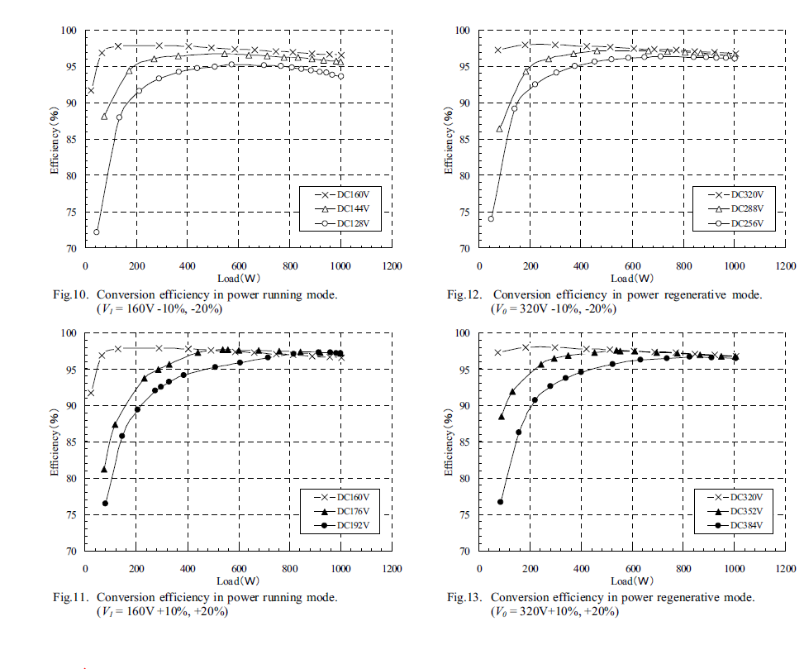
Experiment Result Conversion Efficiency
Rated output capacity Po = 1kW,
Low-voltage side V1 =160V/ High-voltage side V0 = 320V
96.6%
97.6%
Notes:
Running mode efficiency 96.6% half load : 97.6%
Regenerative mode efficiency 96.8% % half load : 97.7%

Slide 12
Experiment Result Conversion Efficiency
Notes:
At the rated load, the smaller the input voltage is,the lower the conversion efficiency becomes.
During light load, when the voltage difference between V1 and V2 becomes larger, the conversion efficiency drop becomes larger

Slide 13
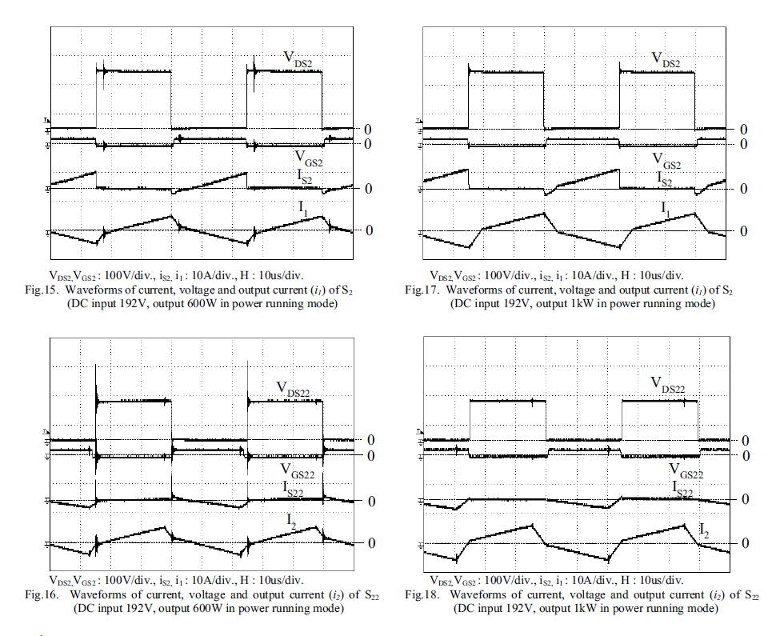
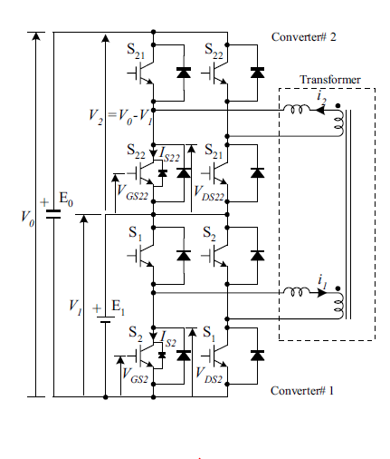




Experiment Result Conversion Efficiency
Input voltage 192V
output voltage 320V
600KW/$S_{2}/$low voltage side
1000KW/$S_{2}$/low voltage side
600KW/$S_{22}$ $/high$ voltage side
1000KW/ $S_{22}$ $/high$ voltage side
Notes:
Fig.16 indicates that the
hard-turn-on phenomenon emerged more during lighter
load as compared to that shown in Fig.18,
current (IS2) flowing to S2 was negative
When S2 was turned on (at the time of rise of VGS22) whether
load was large or small. It was found that current flowed
to anti-parallel diodes of S2, and VDS2 was clamped by the
forward voltage of diodes. Thus, the turn-on of S2
occurred under the condition of ZVS and ZCS.

Slide 14
Conclusion
Cons:
No isolate the input and output power circuits
Hard-turn-on phenomenon problem
Pros:
downsizing of converter
reduction in power losses of switching

Slide 15
Backup

Slide 16
PFC
功率因數修正電路（power factor correction）簡稱PFC，是可以改善交流電源端功率因數的電路。是開關模式電源中常見的電路之

Slide 17
OBC
車載式電池充電器的英文全稱是On-Board Battery Charger (OBC)，是指固定安裝在電動設備上的充電器，充電器依據內部的電池管理系統（Battery Management System, BMS）所提供的資料，能動態調節設備充電時的電流或電壓參數，執行相應的動作，完成充電過程。
將市電的交流電轉換為直流電進行充電[1]，其輸出電壓則依電動車電池規格而不同。有車載充電器的電動車可以用交流的方式進行充電
車載充電機是開關模式電源，一般會包括功因修正電路（PFC）以及直流-直流轉換器，因為裝在車內，空間較小，一般會配合水冷系統，功率也比較小 因此配合車載充電機的交流充電站只能進行慢速充電，不能進行類似直流充電站的快速充電。

Slide 18
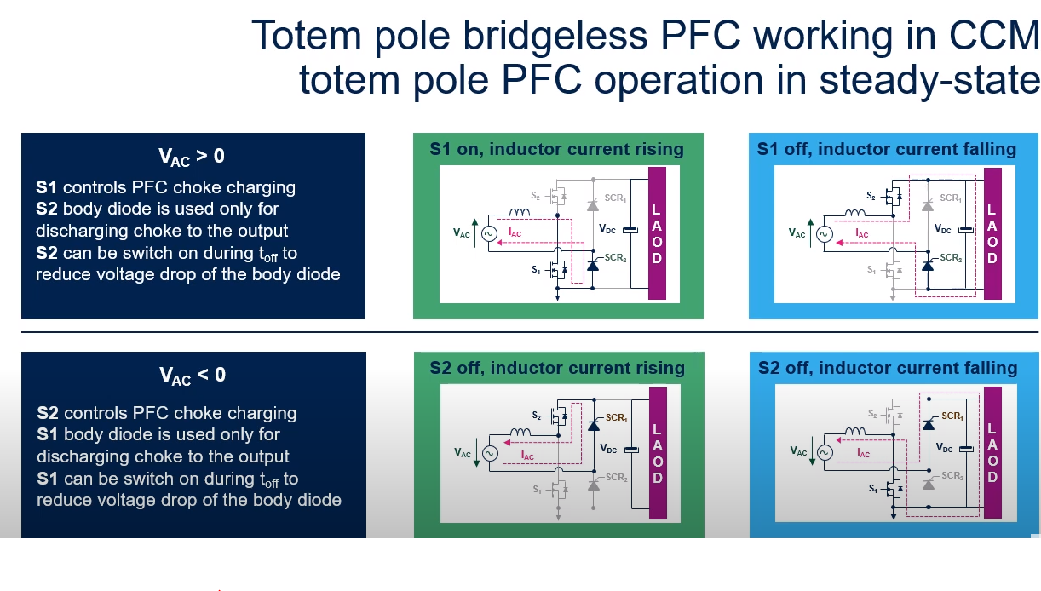

Slide 19
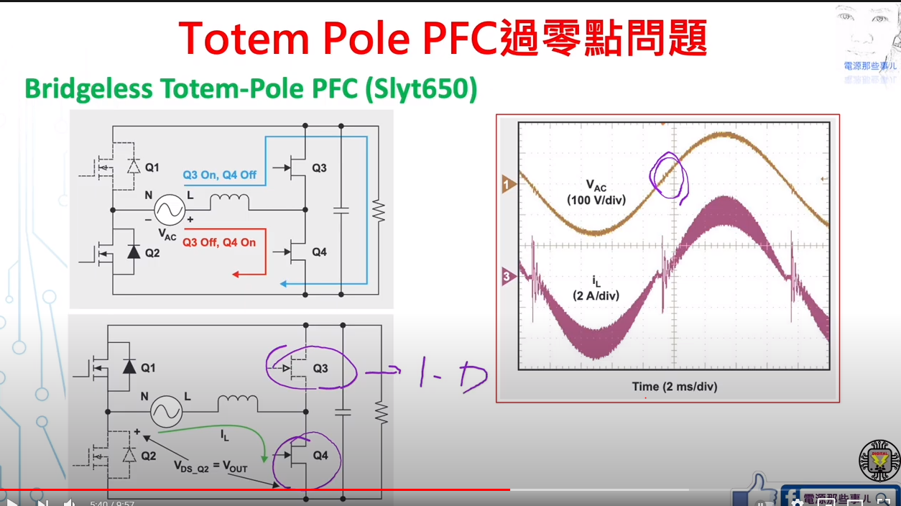

Slide 20
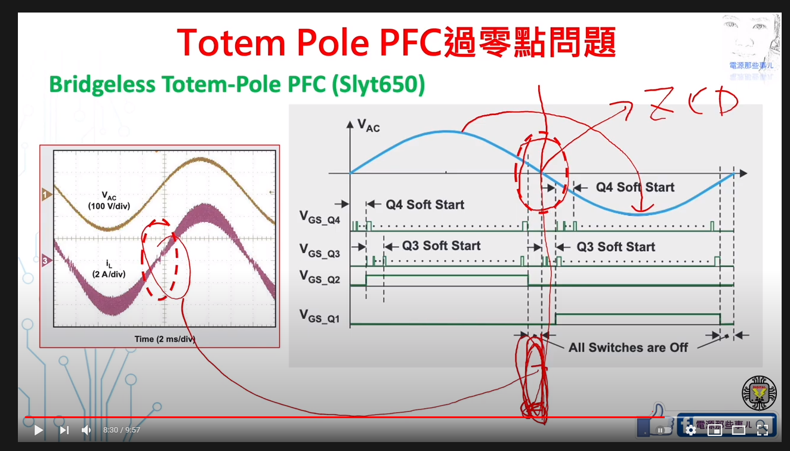
將ZVS 前後都全部switch off

Slide 21
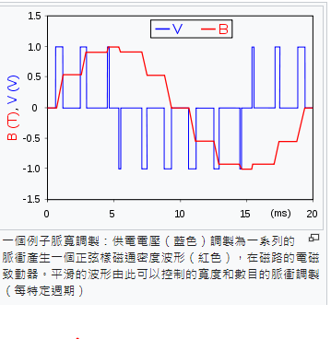
脈波

