Slide 1
Weekly Report
Presenter: Kuan-Hsun-Duh
Advisor: Cheng-Wen Wu
2021/07/16

Slide 2
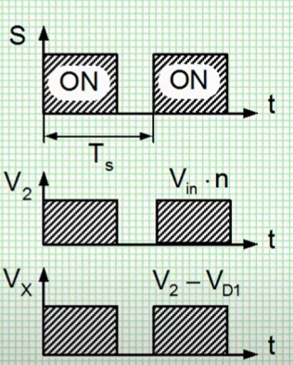
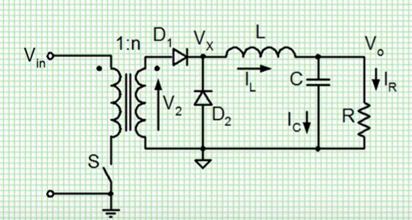








Forward Converter(Traditional)
Circuit operation:
$$V_{L}$$
$$V_{x}−Vo$$
$$t$$
$$S_{+}=\left(nVin−Vo\right)∗ton$$
$$\frac{Vo}{Vin}=n∗Don$$
$$S_{−}=\left(−Vo\right)∗toff$$
$$−Vo$$
$$\frac{ton}{T}=Don$$
Israel Ben Gurion University of the Negev Shmuel Ben-Yaakov
open source cource 2016/11/20

Slide 3
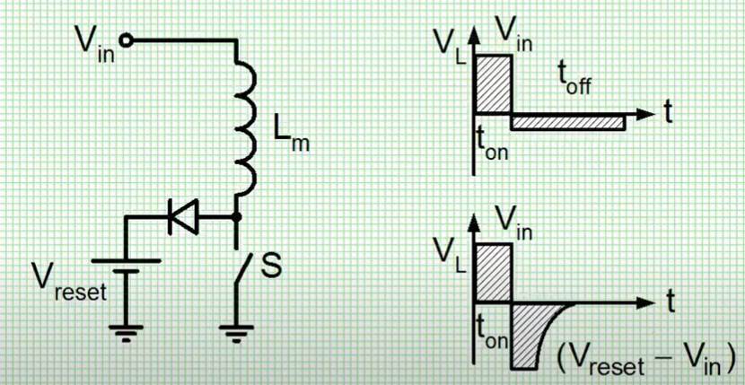
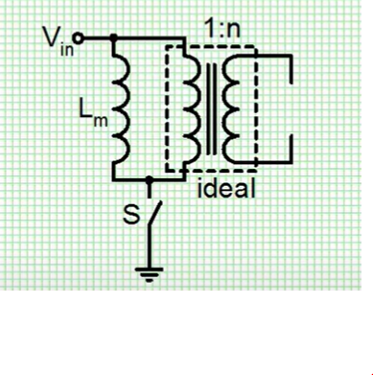

Reset mechanism
The Lm inductance will keep charging
V=L$\frac{di}{dt}$
ZCS for next state
soft switching
Israel Ben Gurion University of the Negev Shmuel Ben-Yaakov
open source cource 2016/11/20

Slide 4
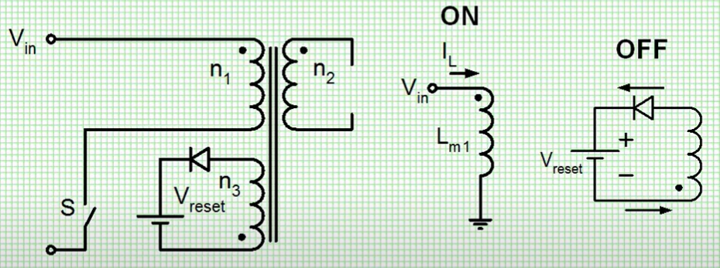

Reset winding
Reset requirement $Doff\frac{Vreset}{n3}=\frac{Vin}{n1}Don$
Cons: require 2 source voltage
Israel Ben Gurion University of the Negev Shmuel Ben-Yaakov
open source cource 2016/11/20

Slide 5
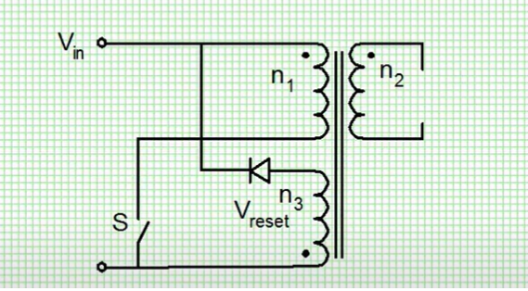

Reset winding (same source)
Reset requirement $D_{off}\frac{Vin}{n3}>D_{on}\frac{Vin}{n1}$ → $\frac{n3}{n1}<\frac{Don}{Doff}$
Israel Ben Gurion University of the Negev Shmuel Ben-Yaakov
open source cource 2016/11/20

Slide 6
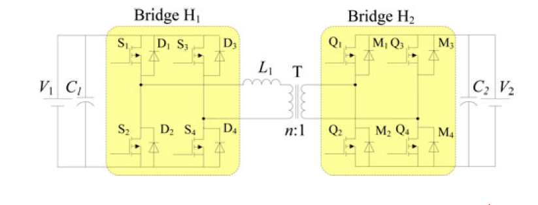
Forward Converter VS DAB-IBDC
DAB-IBDC has smaller filter size
New material (Sic GaN) make DAB-IBDC feasible for eliminating LF transformers from PCS

Slide 7
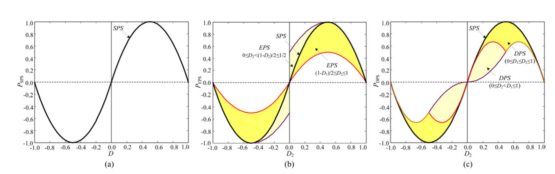
Transmission Power Characterization
SPS(single phase shift control)
EPS(Extended phase shift control)
DPS(Dual phase shift control)
Overview of Dual-Active-Bridge Isolated Bidirectional DC–DC Converter for
High-Frequency-Link Power-Conversion System 2014/8 accepted by IEEE
B. Zhao, Q. Song, W. Liu and Y. Sun

Slide 8
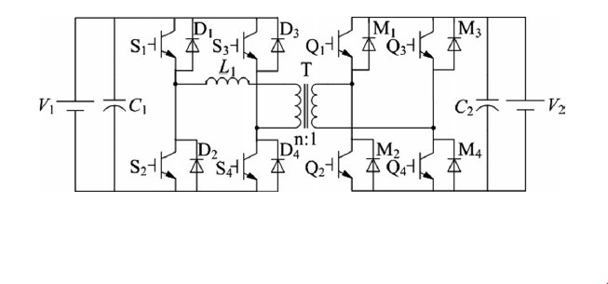
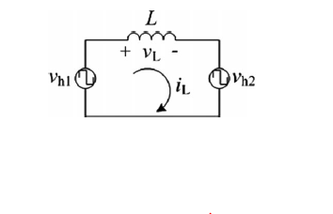

Single phase shift control(traditional)
0 ≤ D ≤ 1( D represent the ratio of $t_{on}$in T period)
V1 ≥ nV2 (voltage bucking)
Extended-Phase-Shift Control of Isolated Bidirectional DC–DC Converter for Power
Distribution in Microgrid
Biao Zhao, Student Member, IEEE, Qingguang Yu, Member, IEEE, and Weixin Sun
2011/11 accepted by IEEE

Slide 9
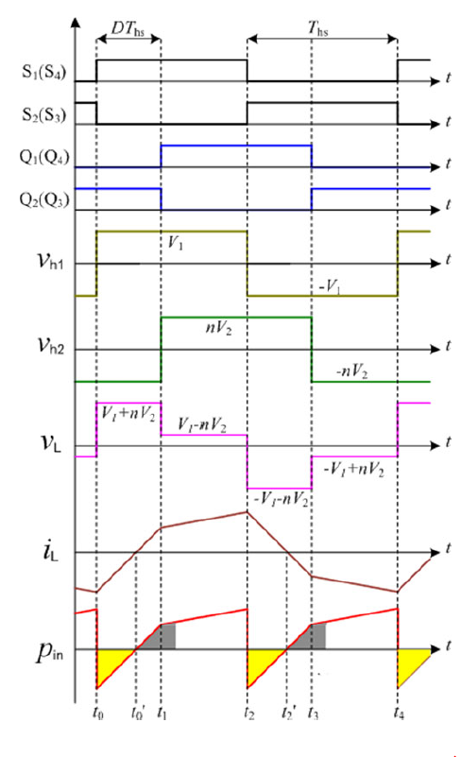
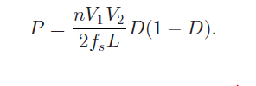
Single phase shift control(traditional)
Constraint
k>=1(transformer wind ratio)
0<=D<=1
Transmission power
(power during Ths)
Extended-Phase-Shift Control of Isolated Bidirectional DC–DC Converter for Power
Distribution in Microgrid
Biao Zhao, Student Member, IEEE, Qingguang Yu, Member, IEEE, and Weixin Sun
2011/11 accepted by IEEE

Slide 10
Extended phase shift control
{D1 D4 } pair switch at different time
shift phase:D1
Primary and secondary switch at different time
shift phase:D2
Constraint:
k>=1 Buck converter
0<=D1,D2<=1
0<=D1+D2<=1

Slide 11
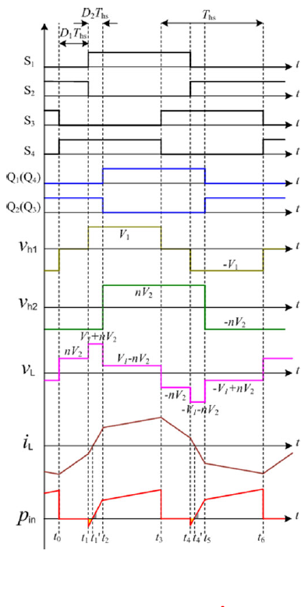
Extended phase shift control
Extended-Phase-Shift Control of Isolated Bidirectional DC–DC Converter for Power
Distribution in Microgrid
Biao Zhao, Student Member, IEEE, Qingguang Yu, Member, IEEE, and Weixin Sun
2011/11 accepted by IEEE

Slide 12
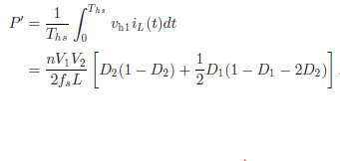
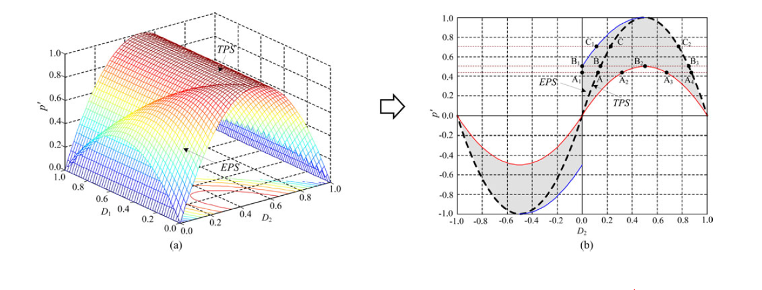
2 different way control model
Tranmission power equation
D1=0

