Slide 1
Monthly Report
Presenter: Kuan-Hsun-Duh
Advisor: Cheng-Wen Wu
2021/08/26

Slide 2
Outline
Proposal:Predicting temperature model
Power analyze
4 type current cause losses
DCM CCM control
Proposal:Analyze power loss tool
DC DC converter architechture
Different component analyze

Slide 3
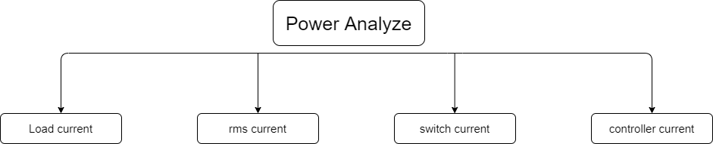
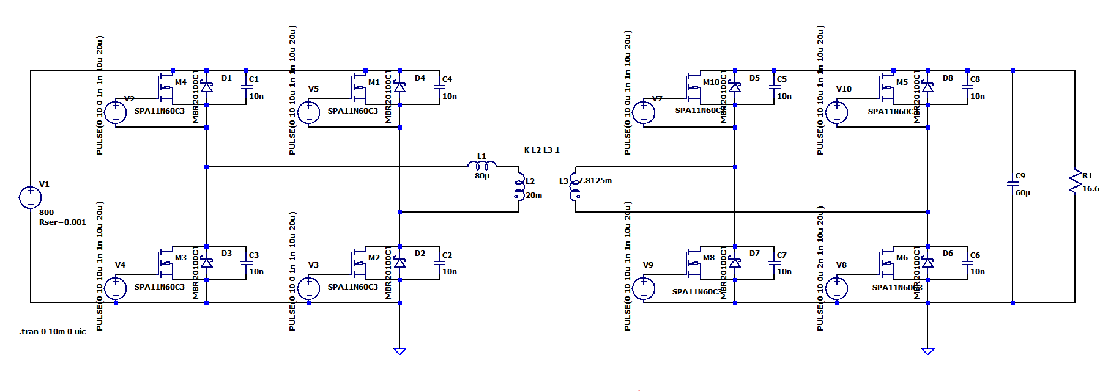
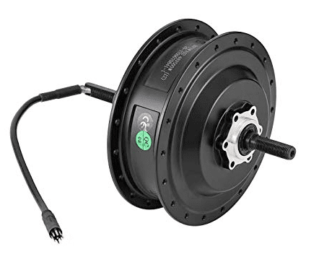
Power analyze
Switch current
Load current
rms current
Controller current
Gate drive current power loss

Slide 4
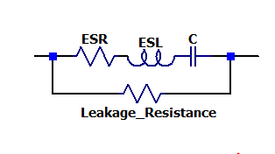
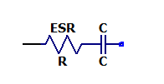
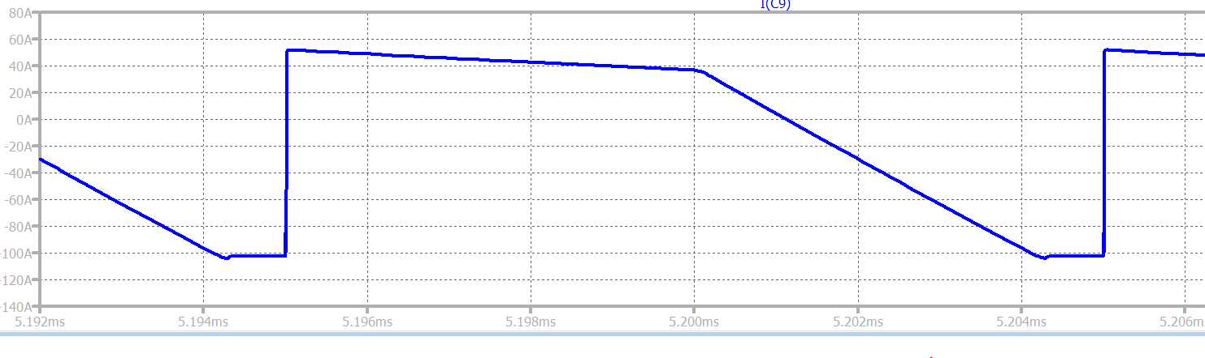
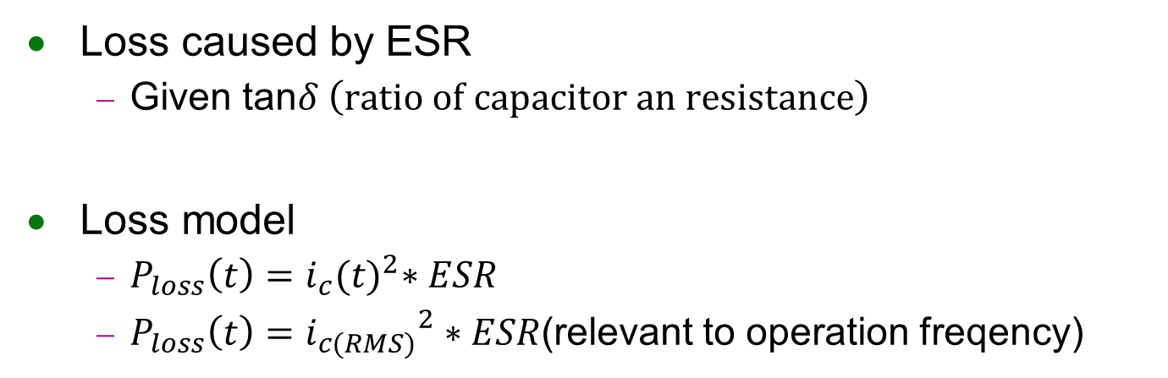

Power analyze (Capacitor Loss)
Loss caused by ESR
Given tan$δ \left(ratio of capacitor an resistance\right)$
Loss model
$P_{loss}\left(t\right)=i_{c}{(t)}^{2}∗ESR$
$P_{loss}\left(t\right)={i_{c(RMS)}}^{2}∗ESR$(relevant to operation freqency)
$I_{C}$(A)
0A
Period
Time(ms)

Slide 5
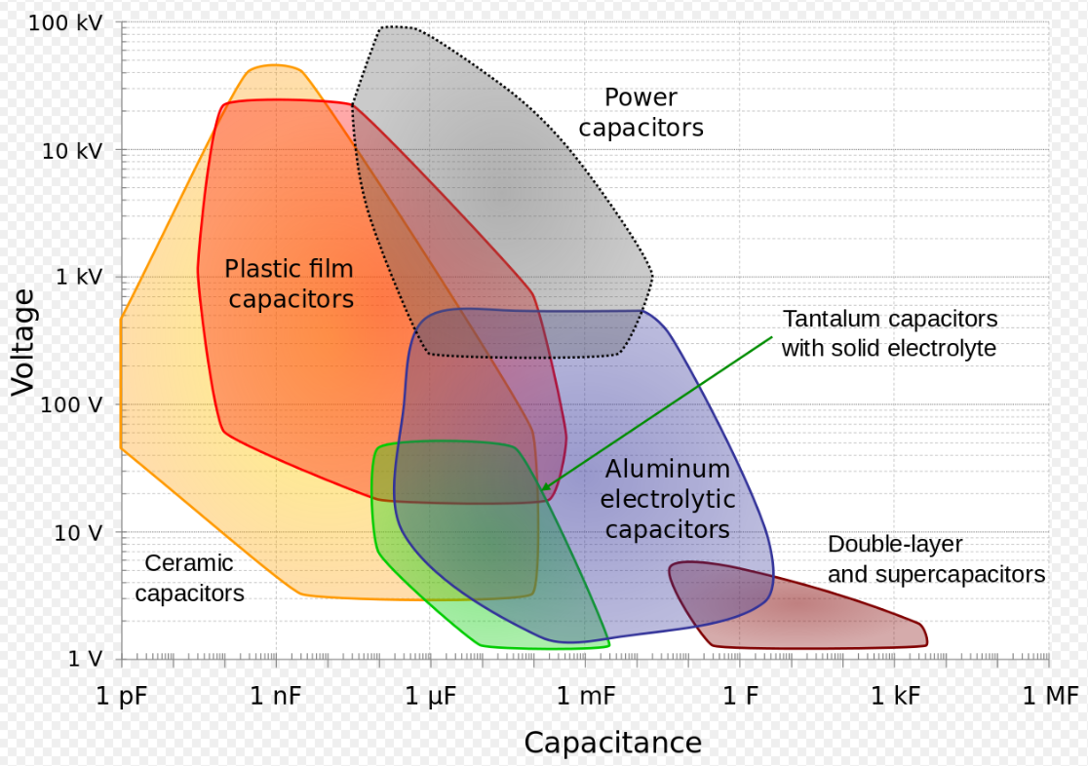

Power analyze (Capacitor Loss)
Component Failure
Electrical Breakdown
Thermal Breakdown
$T_{initial}+P_{loss}∗R_{∅}>T_{max}$
Spice thermal model :$R_{∅}$(unit:degree/watt)

Slide 6
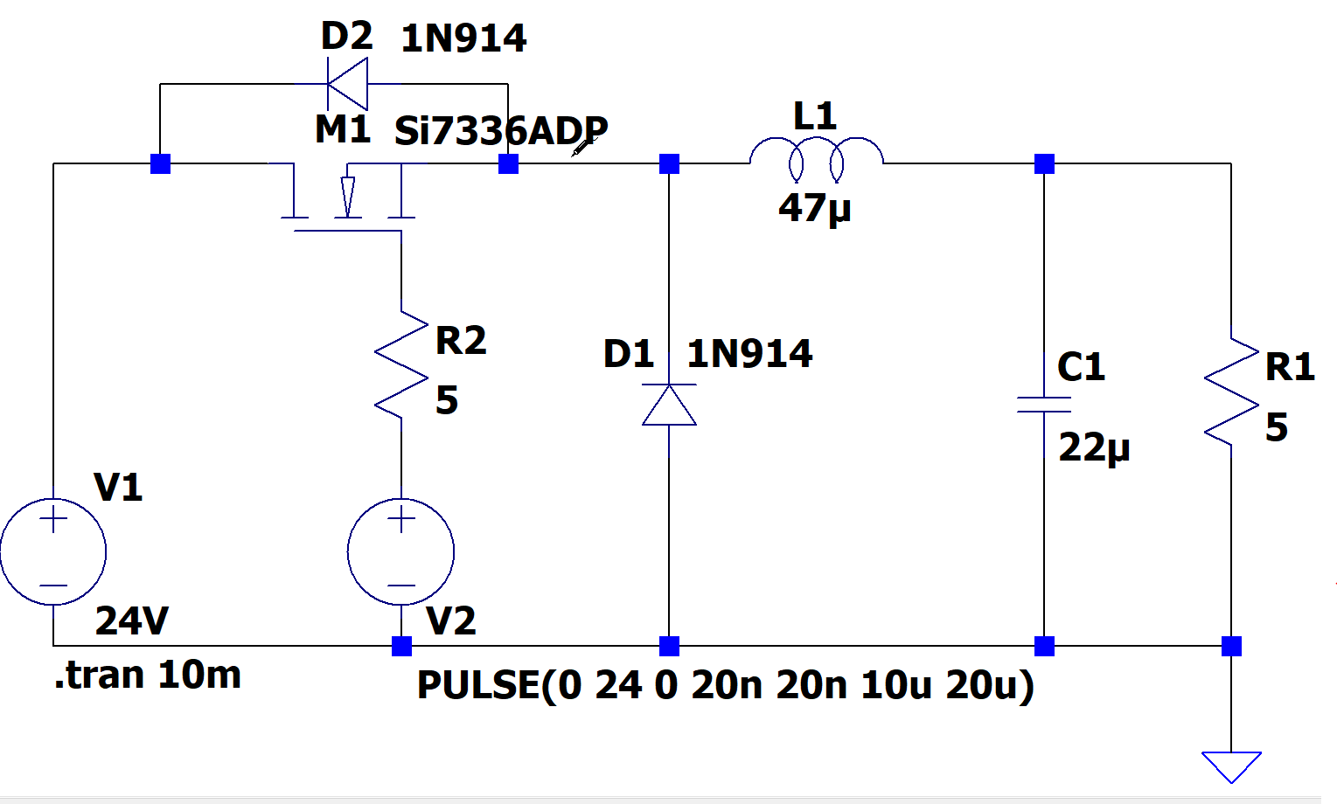
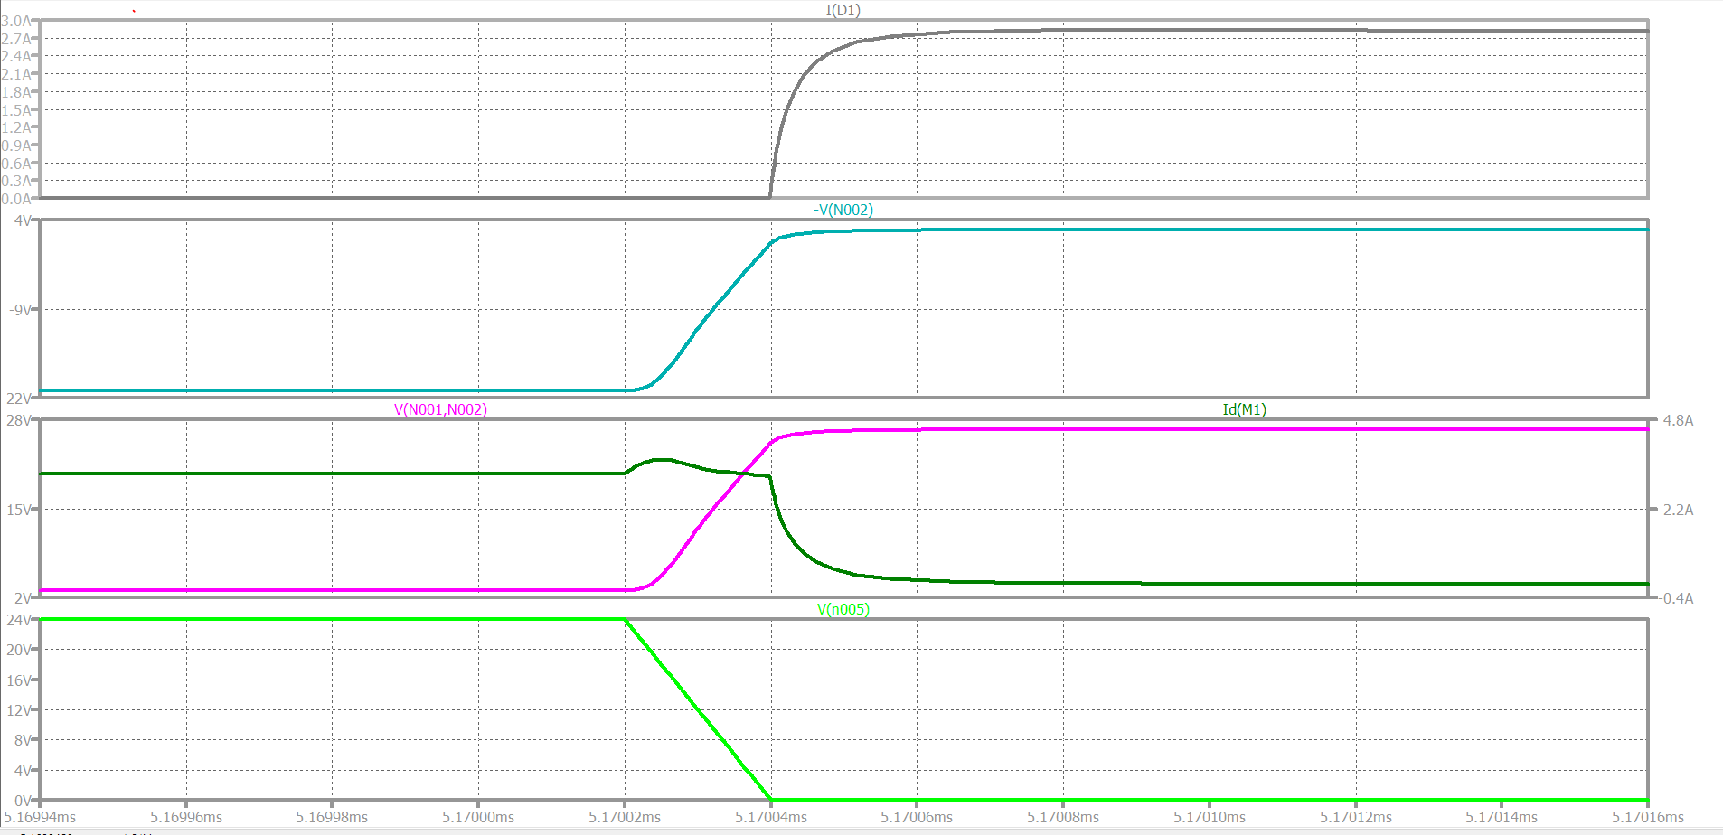

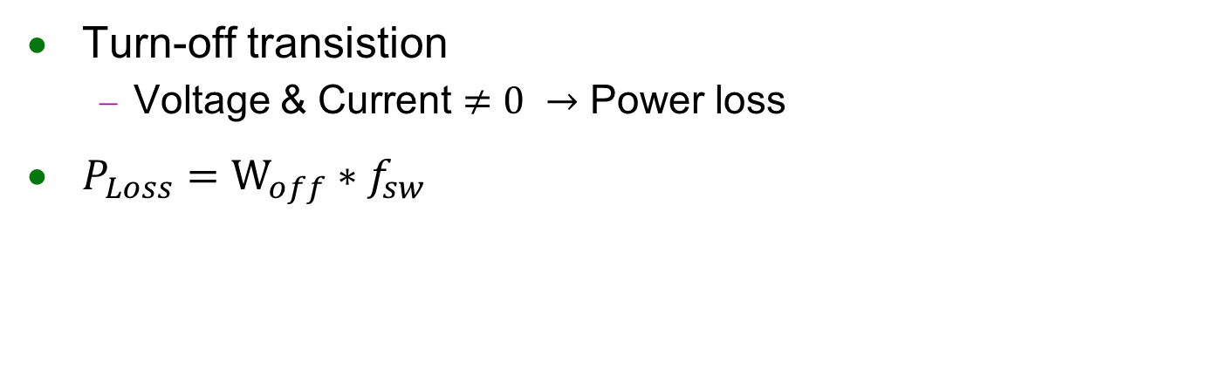






Power analyze (Switching Loss)
Turn-off transistion
Voltage & Current $≠0 →$ Power loss
$P_{Loss}=W_{off}∗f_{sw}$
$$t_{ON(delay)}$$
$$t_{off (I_{mosfet}=0)}$$
$$I_{Doide}$$
$$V_{Doide}$$
$$I_{mosfet}$$
$$V_{DS}$$
$$V_{GS}$$

Slide 7
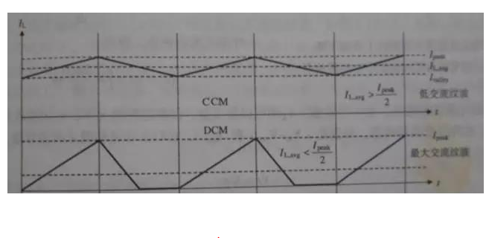

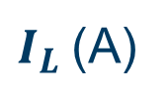
Power analyze
Load current
Depending on the motor power spec
rms current
Reduce passive component using
←trade off→ ZVS VCS region become smaller
Switching current
Replace diode as mosfet switching →conduction loss$↓$
Freq↑ → loss↑
Changing duty cycle of switching (operation at ZVS ZCS)
Thermal issue (Temperature↑ → mosfet resistance↑)
Spice thermal resistance (unit:degree/watt)
Controller current(light loading condition)
DCM CCM controlling method (Mode hopping)
Using in big power supply
$I_{L}$(A)
Time

Slide 8
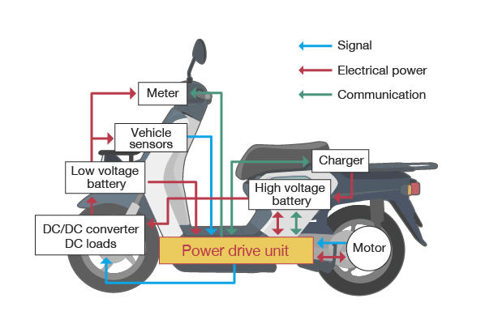
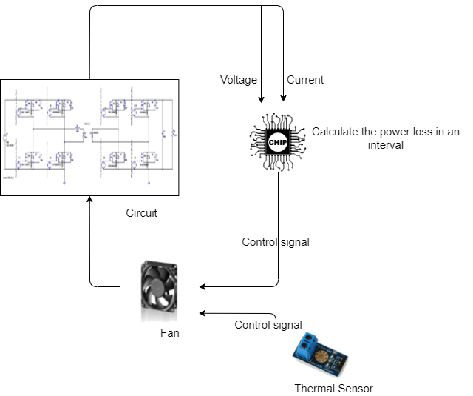
Proposal
Controller
Input: Componant’s voltage & current
Output : fan-on fan-off signal
Predicting the temperature

Slide 9
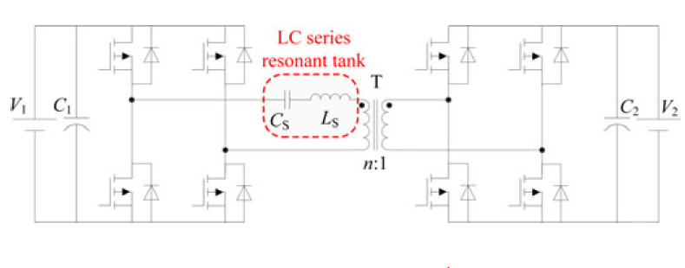
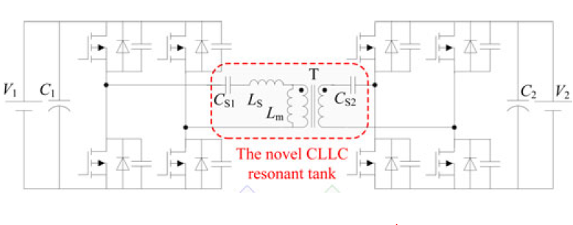
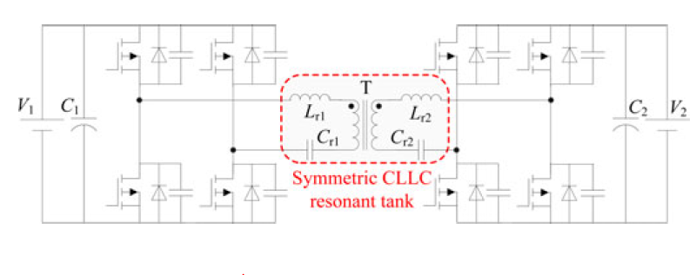
DC_DC converter architechture
DAB_IBDC
LC type
CLLC type symmetric
CLLC type asymmetric
Different ZCS ZVS
Switiching range
Power loss
RMS current dissipates power through
passive components
Capacitor with bullky size

Slide 10
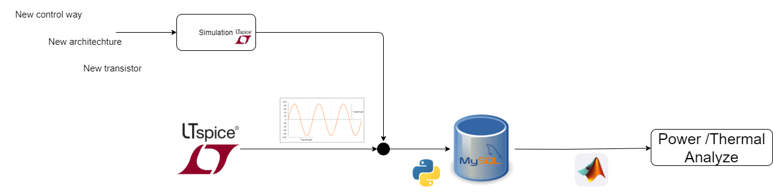
Proposal
User interface produce result waveform
Different architechture
Different transistor
Different control way
Storage system: mysql
Analyze power/thermal
4 different power loss
Power loss and thermal relationship(researching……)

Slide 11
Schedule(short term)
Make a copy design of Pro. F. S. Pai (DC to DC Charger)
Ltspice…………………………………………………(processing)
Q3D
Build up the database of Ltspice waveform
Mysql ………………………………………………… (processing)
Build up the power model of different type
Python code (by waveform information)
Other analyzing tool (ADET)
Build up the thermal model of different type
Spice thermal model

Slide 12
Schedule(Long term)
Under typical condition( Pro. F. S. Pai)
Analyzing different issue on DAB_IBDC_DC converter
different kinds of architechture
different controlling way/new component
Power
Thermal

Slide 13
END

Slide 14
Power analyze (Inductor Loss)
steinmetz equation
Coilcraft tool

Slide 15
Power analyze (Conduction Loss)

Slide 16
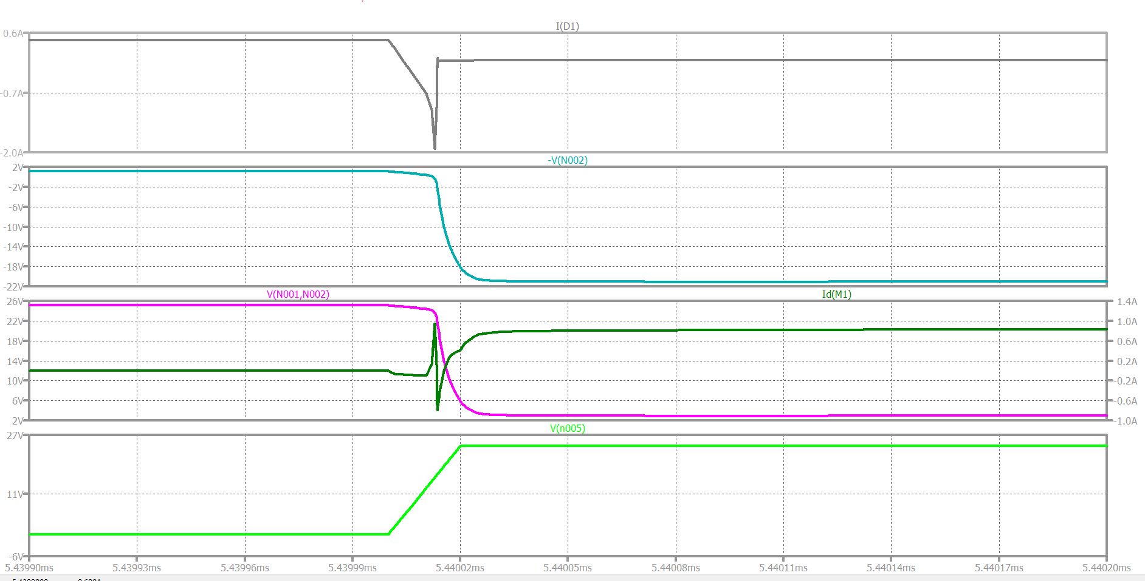




Power analyze (Switching Loss)
$$I_{Doide}$$
$$V_{Doide}$$
$$V_{DS}$$
$$I_{mosfet}$$
$$V_{GS}$$

Slide 17
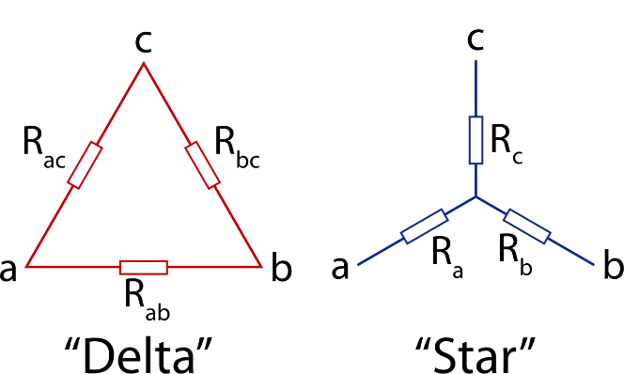
DC_DC converter architechture
Transformer
Single phase
Three phase
Harmomic current effect(HVDCT)
Delta connections control 3rd harmonic current
Bulky transformer size(magnetic size is 3 times than single phase)

Slide 18
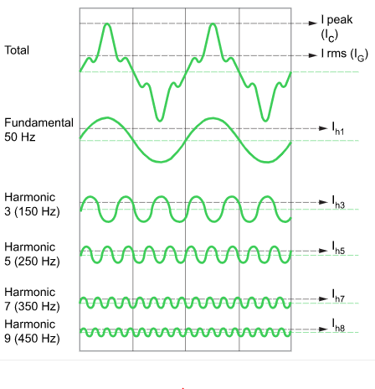
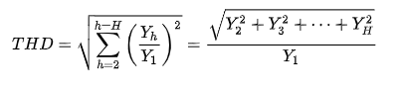
Harmonic current effect
Origin: nonlinear load(diode,transistor……..)
Total Harmonic Distortion (THD)
Reduce method:
Delta connections control
3rd harmonic current

Slide 19
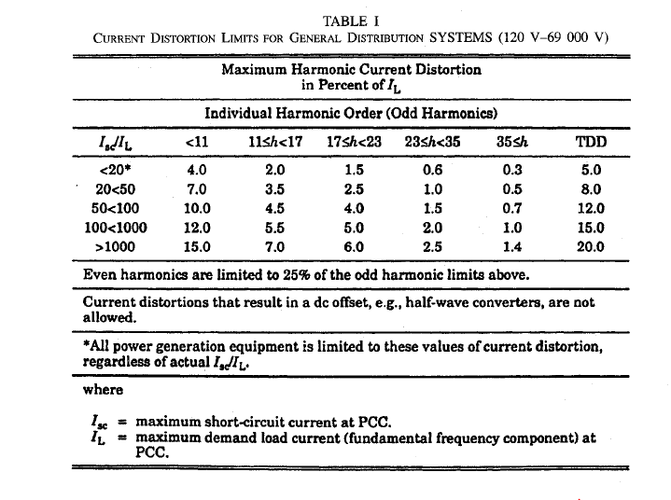
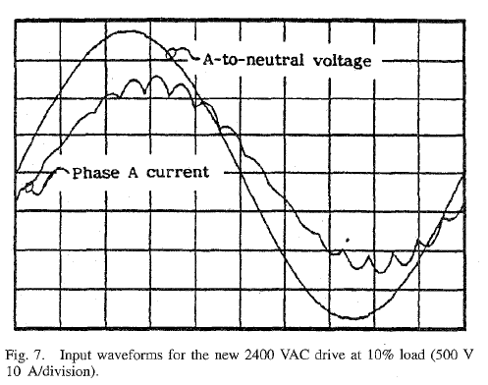
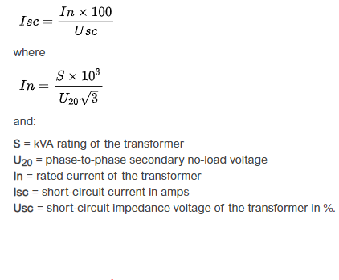
Harmonic current effect
IEEE Standard 519-1922
point of common coupling (PCC)
REF.A new approach to enhance power quality for medium voltage AC drives
P. W. Hammond Jan.-Feb. 1997 IEEE ASIRobicon USA
Notes:
If load 1 is only used 50% of the time and load 2 is only used the remaining 50% of the time, 10 Amps (Load 1) + 10 Amps (Load 2) = 20 Amps (Total Connected Load), then
20 Amps (Total Connected Load) x 0.5 (Diversity Factor @ 50%) = 10 Amps (Maximum Demand).

Slide 20
PIC

Slide 21
DAB_IBDC design
20KW LOAD
800V <DC DC converter>570V

Slide 22
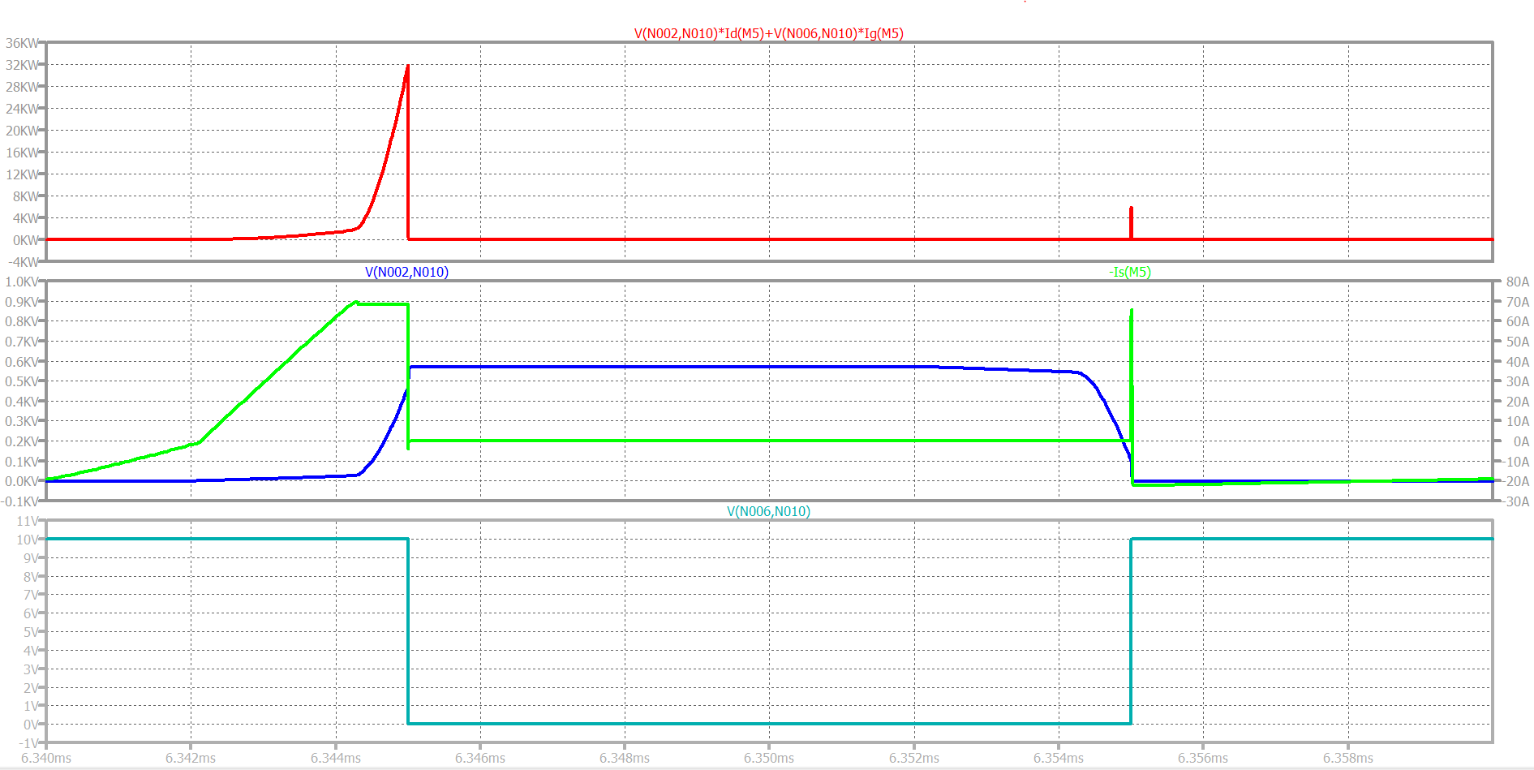
0.2

Slide 23
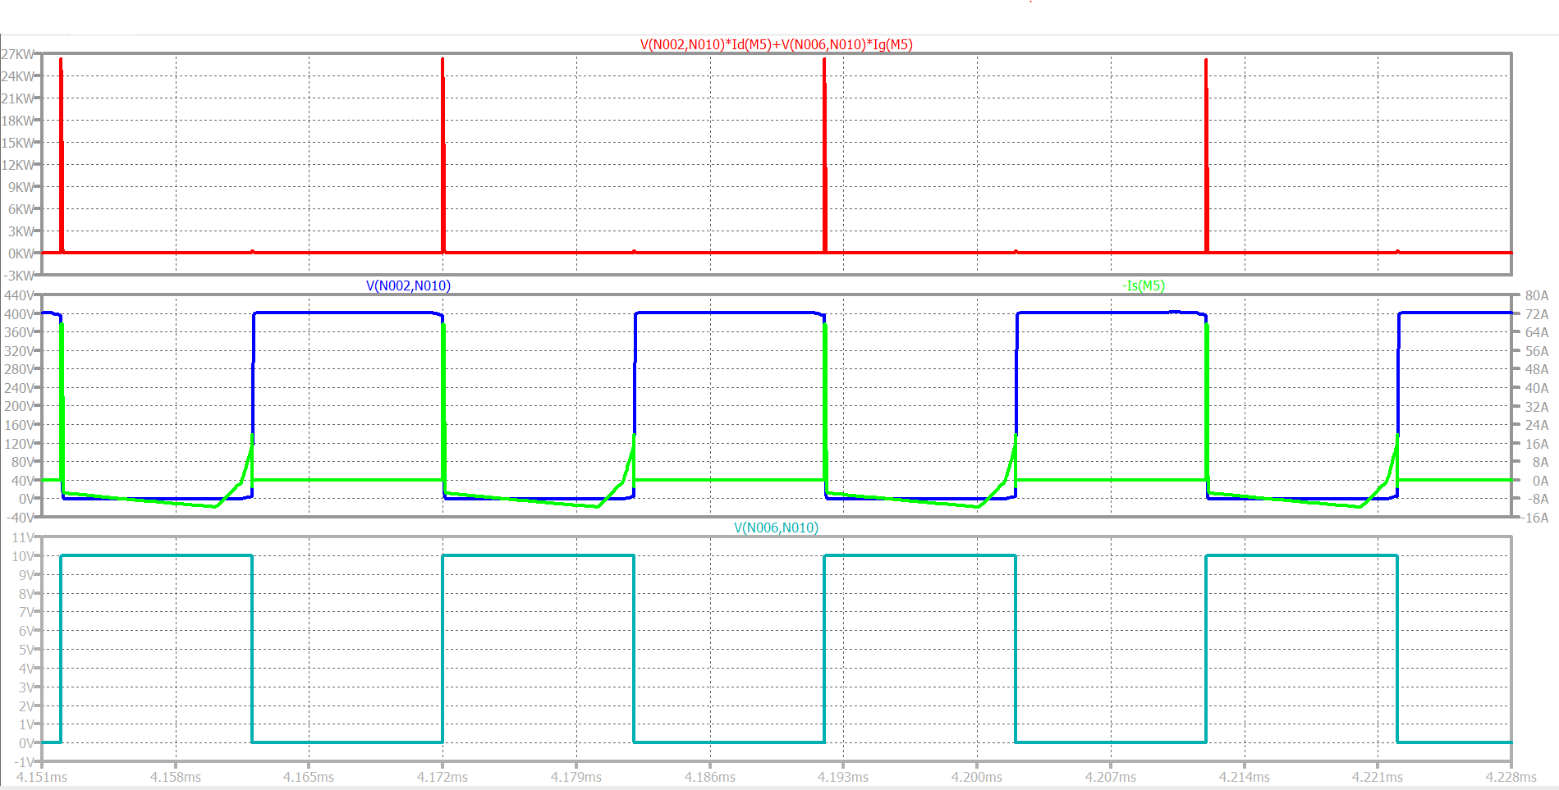
0.5

Slide 24
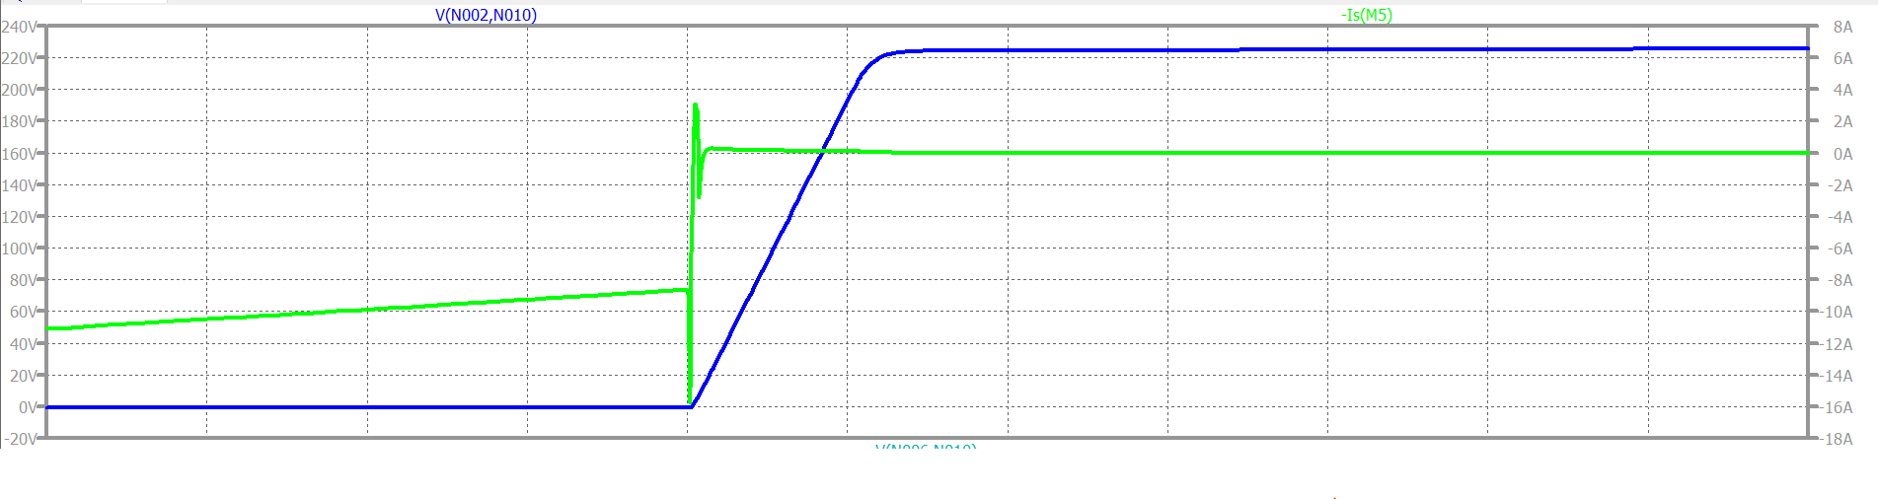
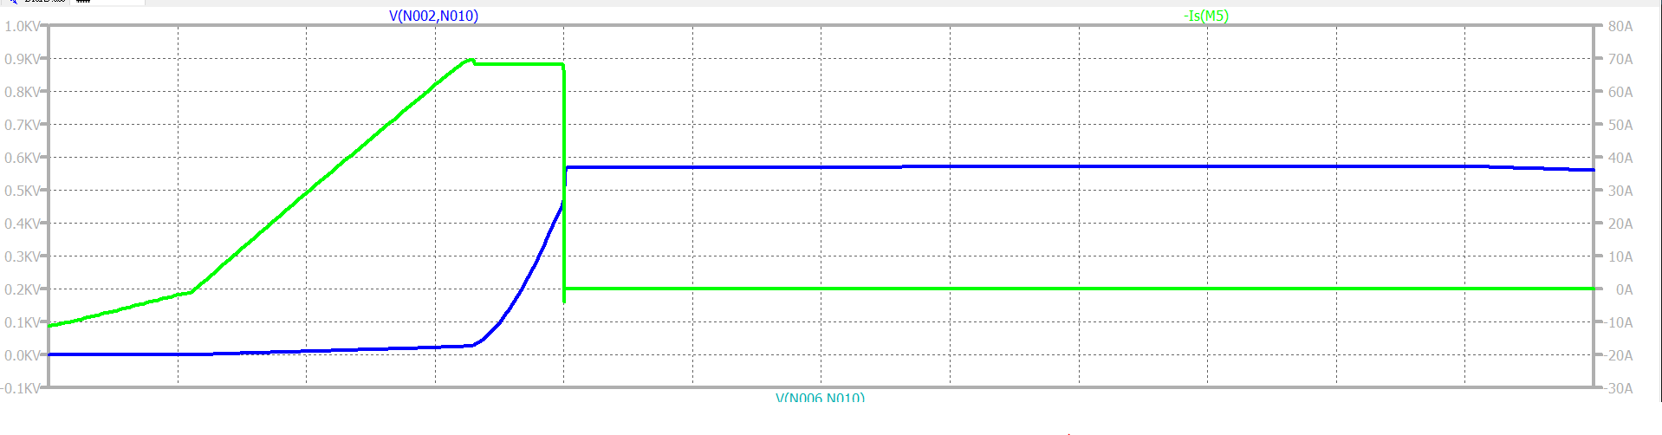

Slide 25
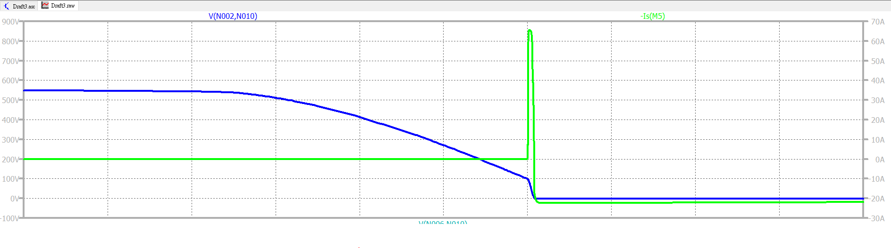
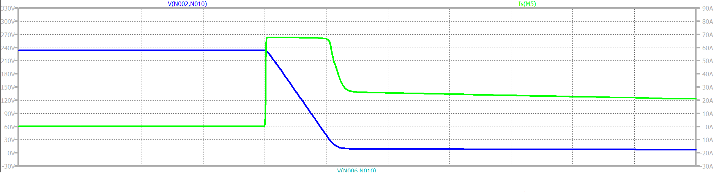

Slide 26
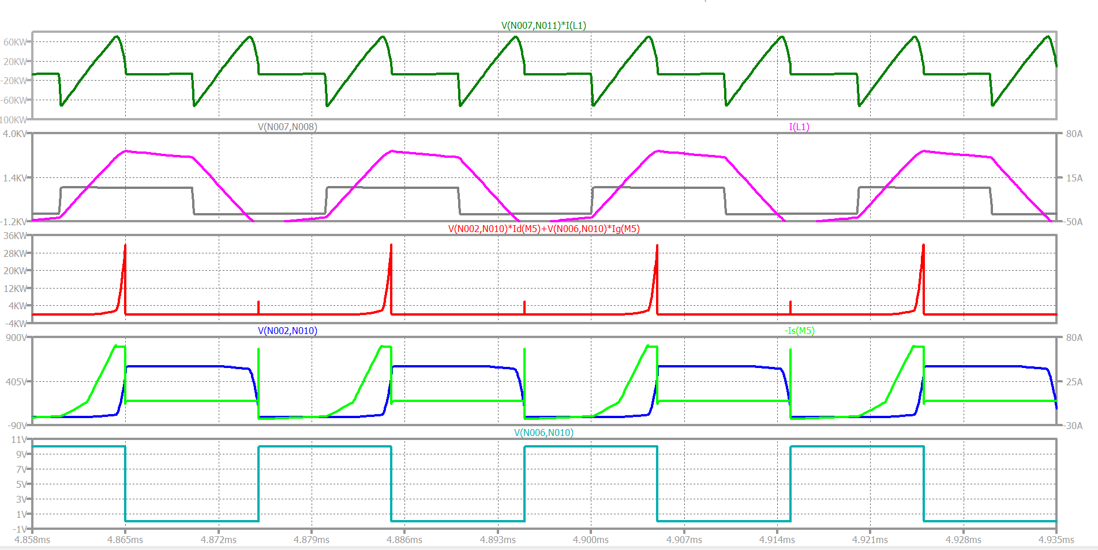
0.5

Slide 27
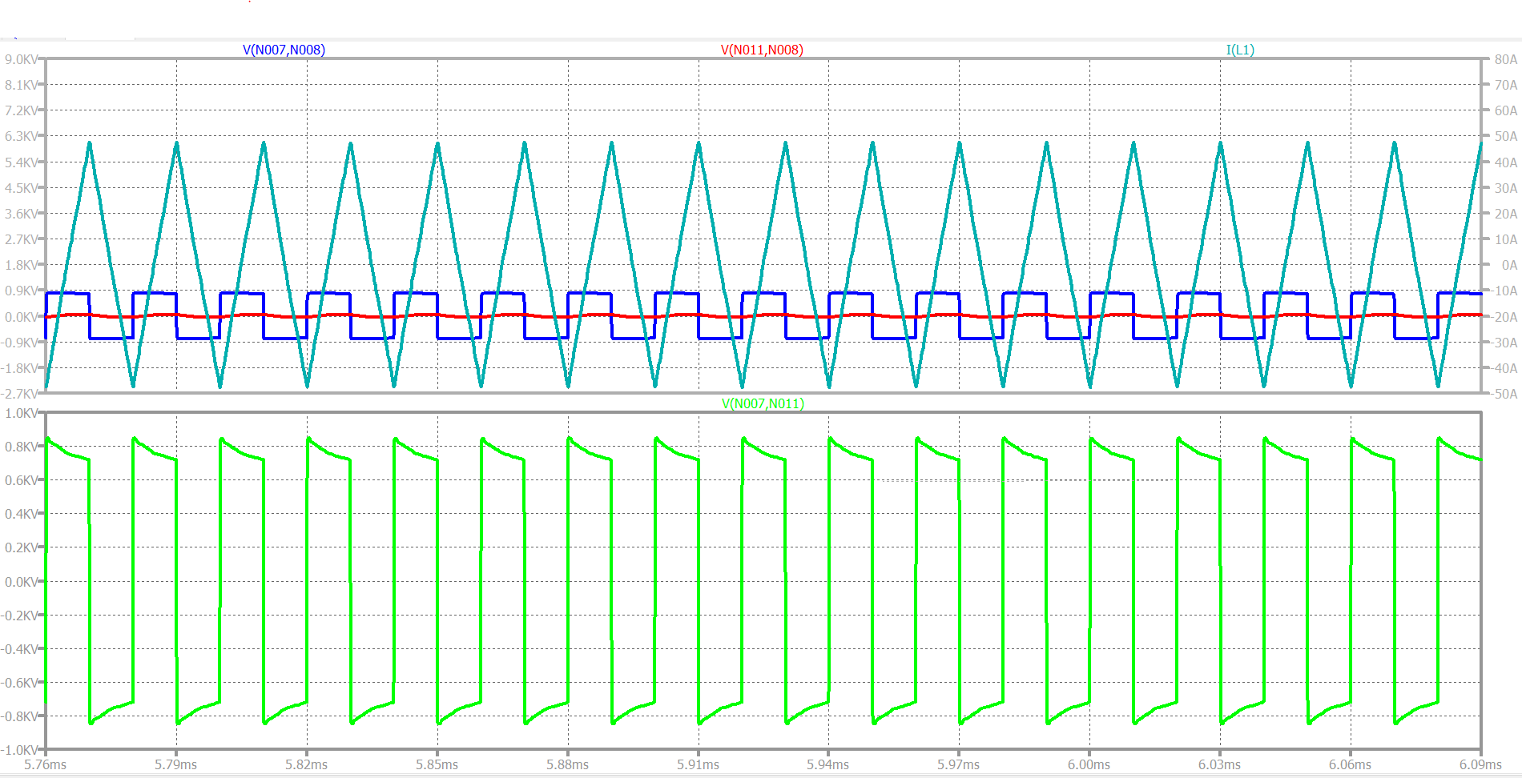
Waveform(D=0)
Blue line --- primary side voltage
Red line --- secondary side voltage
Dark green line --- primary side inductor current
bright green line --- inductor voltage

Slide 28
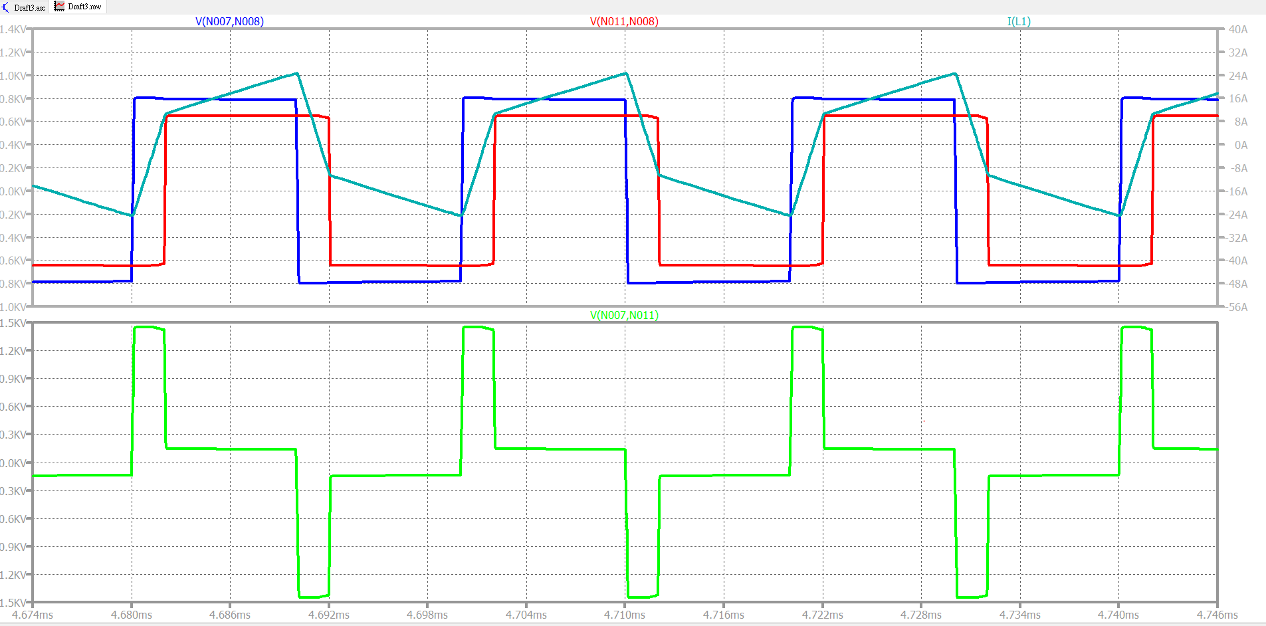
Waveform(D=0.2)

Slide 29
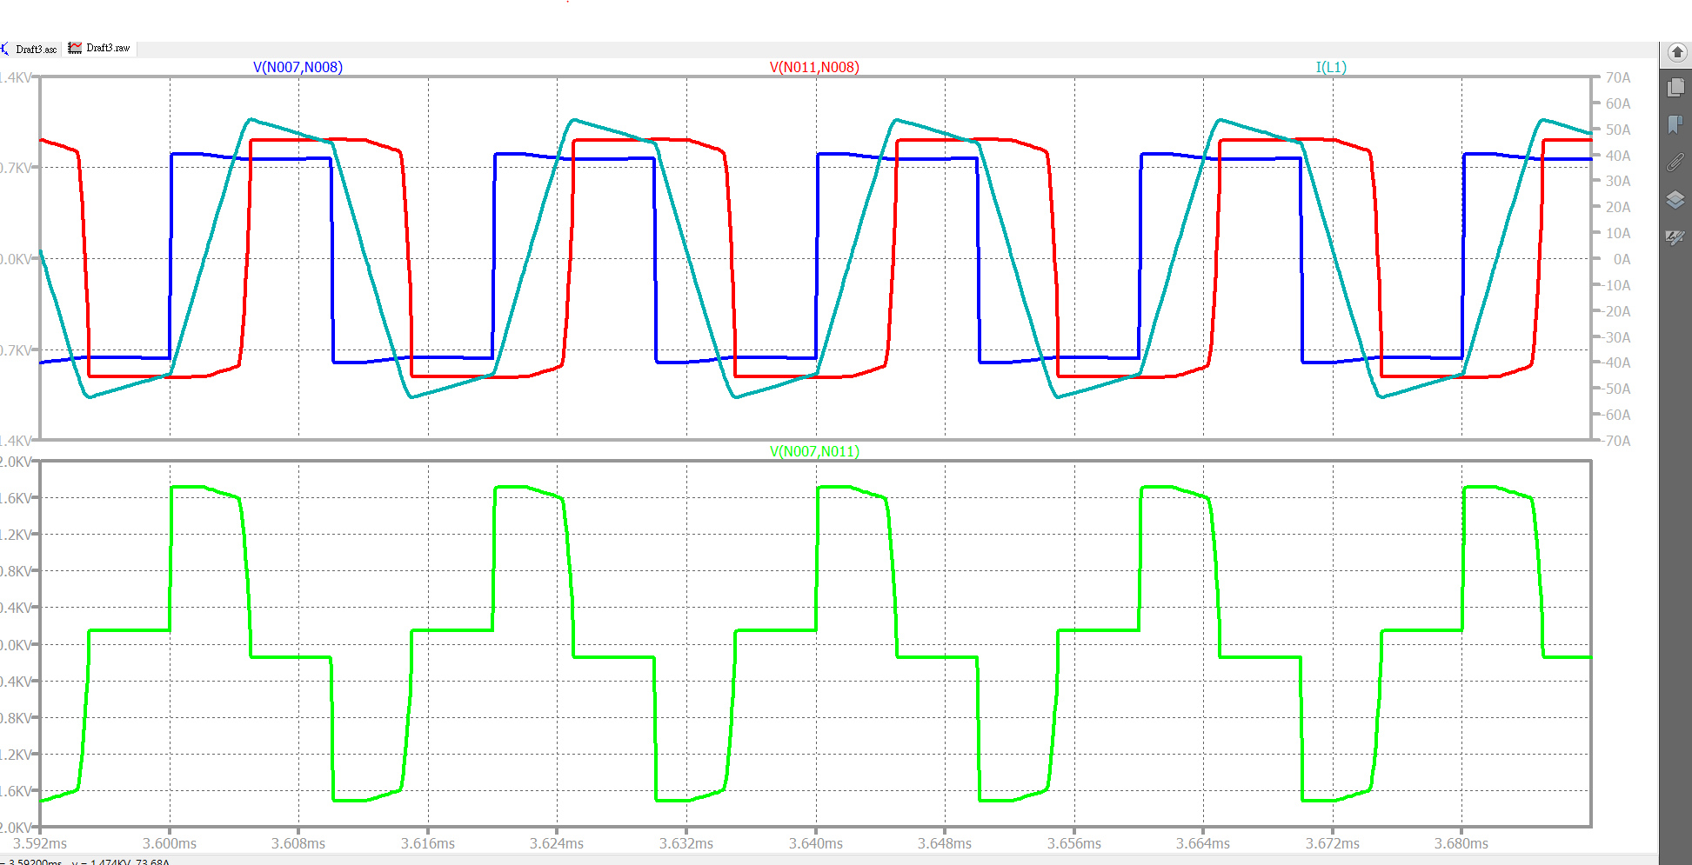
Waveform(D=0.5)

Slide 30
END
ITRI comment
在相同的規格下 類比電路架構是可是前先預估的
元件材料上的選擇 相對來說是較少的
須明確定義出 cost function

Slide 31
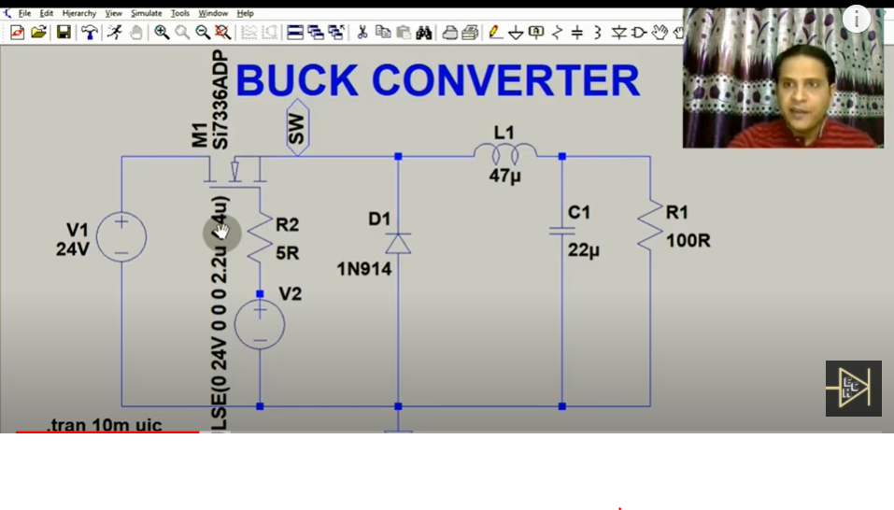
Buck Converter
Use Initial Conditions (UIC)

Slide 32
HF noise is induced mainly by the high dV/dt of the switch coupling through inductor parasitic capacitance (CL) and equivalent series inductance (ESL).

Slide 33
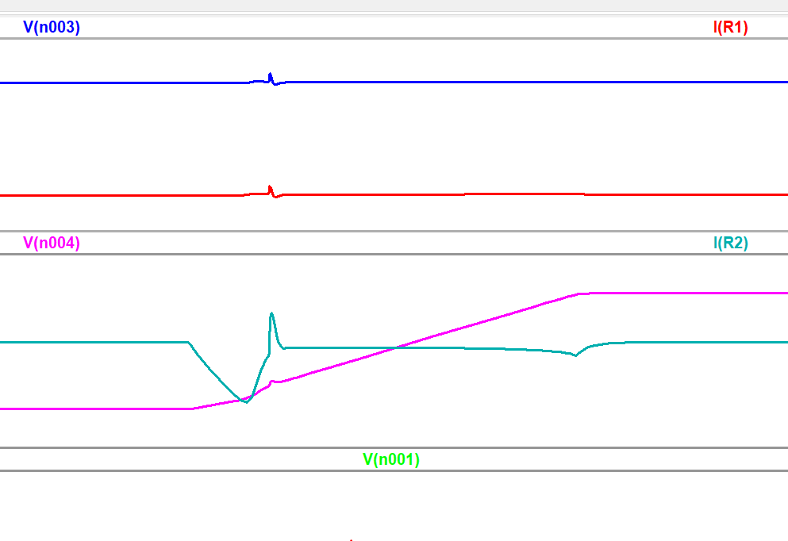
LF

Slide 34
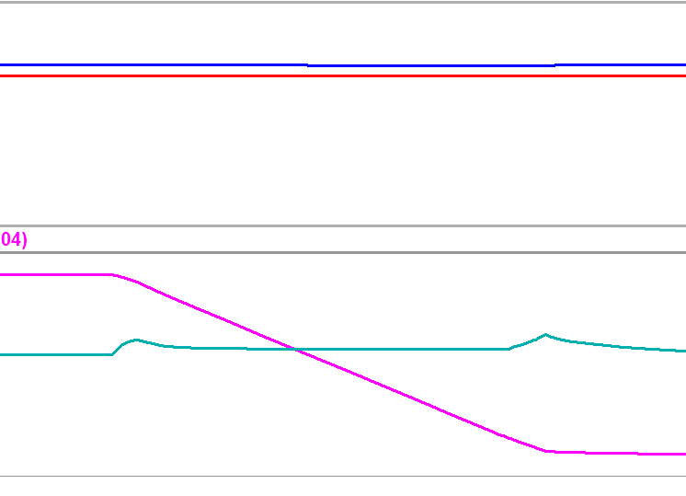
HF

Slide 35
Output ripple
Casuse by parasitic capacitance coupling ?

Slide 36
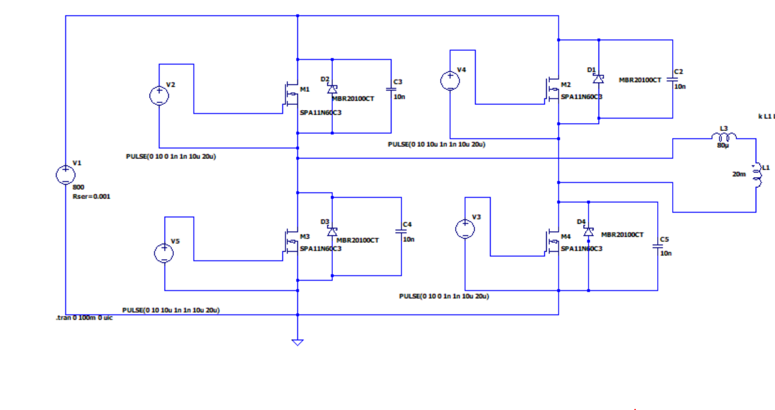
DAB IBDC_DC Converter(HV)

Slide 37
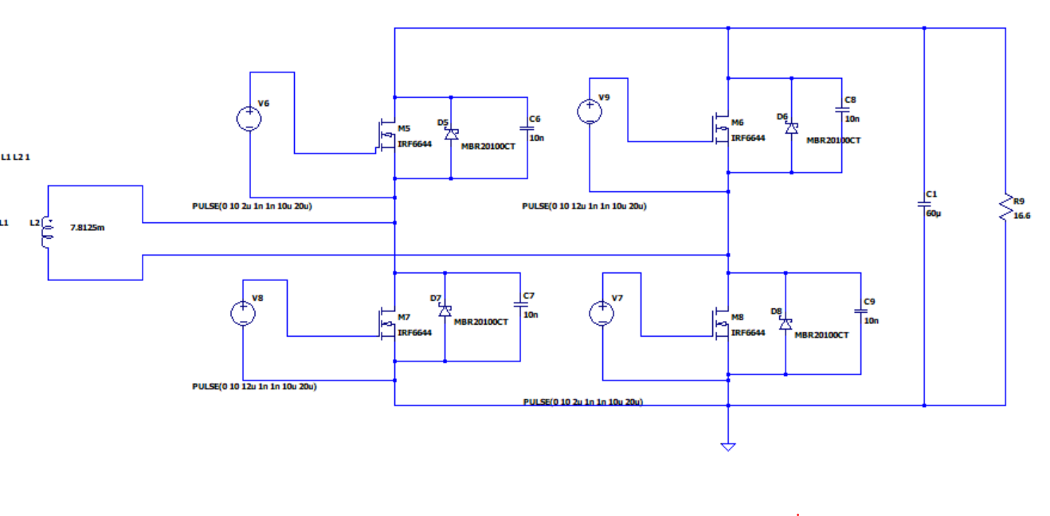
DAB IBDC_DC Converter(LV)

Slide 38
DAB IBDC_DC Converter
Why needed RSER??

Slide 39
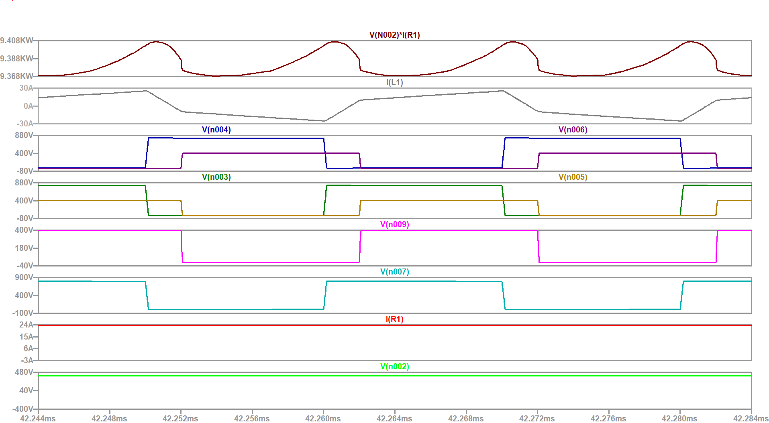
Mosfet - power mosfet

Slide 40
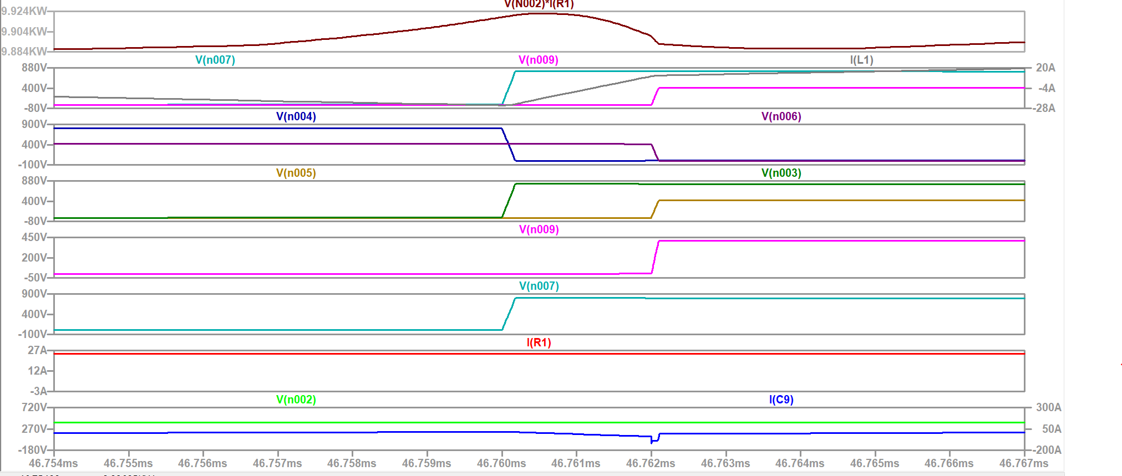
Mosfet-mosfet(2ns delays)

Slide 41
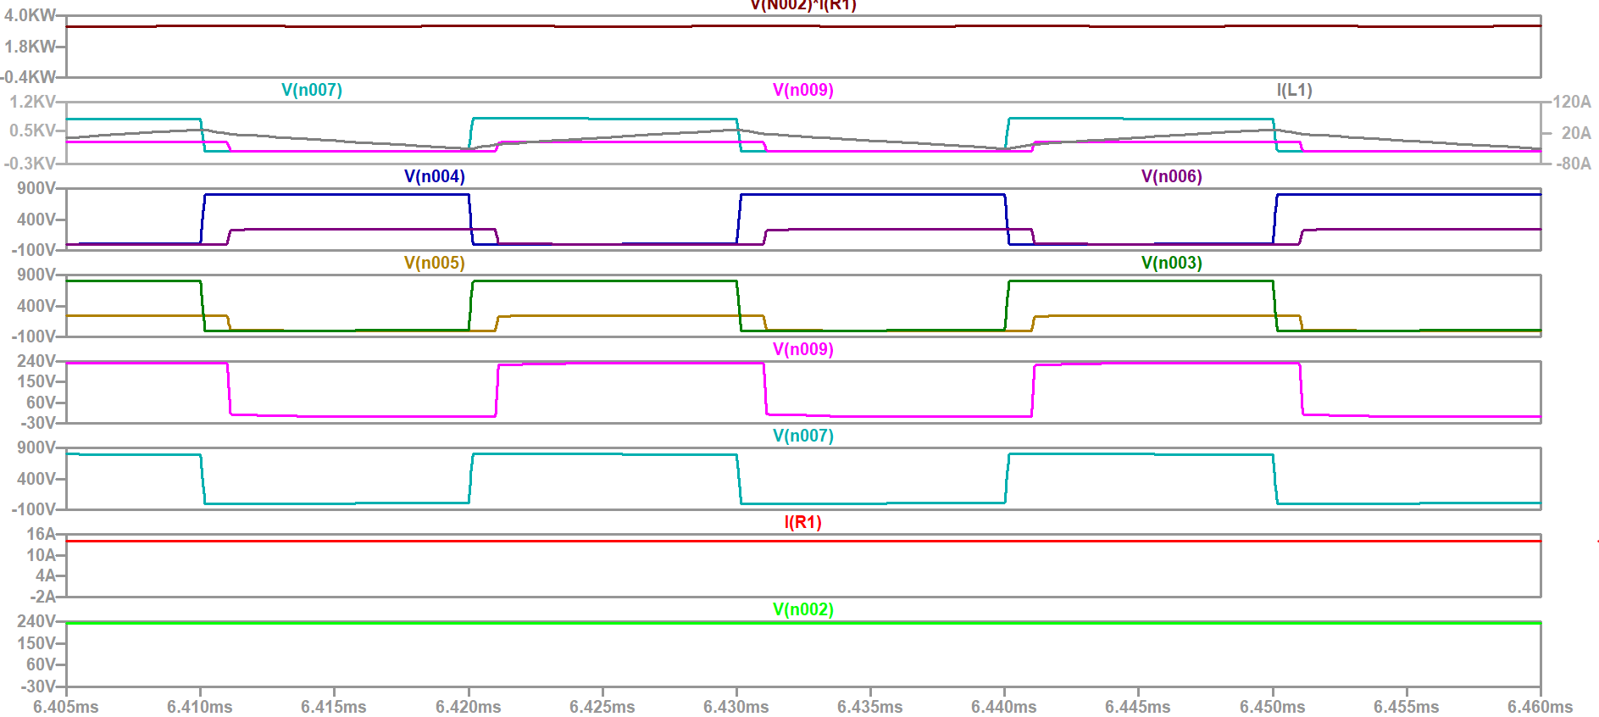
Mosfet-mosfet( 1ns delays)

Slide 42
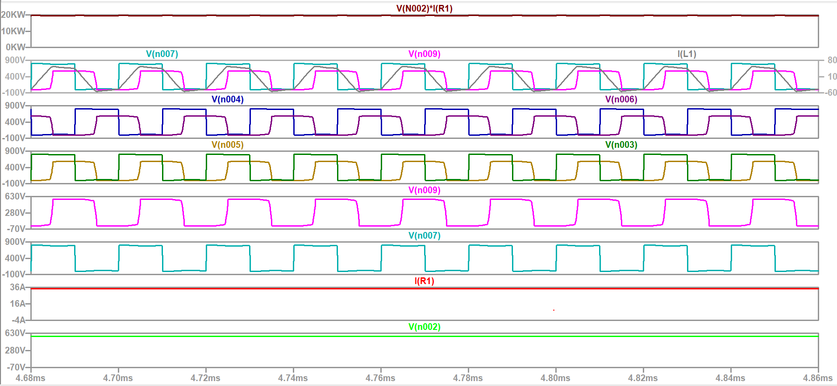
Mosfet-mosfet( 5ns delays)

Slide 43
IRF6644 power mosfet
SPA11N60C3 mosfet
315712 point in 10 ms
3157.12
取 5-6ms
12628.48~~~15785.6
12628-15786

Slide 44
Proposal
目的:以電動腳踏車為主軸 在不同的經濟預算下 尋找出 能讓efficiency 最高的架構以及元件
變因1:不同的chopper 比較下 為何選擇 Dual active bridge
變因2:引入不同的model (Si SiC IGBT IGCT)為何選擇 SiC mosfet 作為switching
變因3 在同為SiC元件下不同廠商的比較
比較要素:
Power efficiency
ZVS ZCS
Zero current sequence(High voltage)
Harmonic current effect(High voltage)
Pulse width control
Price

Slide 45
研究方法
不同的chopper 架構
參考1---DC-DC-Conver_2015_Power-Electronics-Applied-to-Industrial-Systems-and-Tr
利用 LTSPICE 搭建出來
不同的SiC IGBT SI mosfet 元件model 和price
利用網路爬蟲方式大量從ROHM infineon ……等公司建立後端資料庫(good cloud mysql) 供LTSPICE 模擬
Power efficieny
monte carlo simulation(By python or LTspice)
Pulse width control(LTspice)

Slide 46
Schedule
Aug
SUN | MON | TUE | WED | THU | FRI | SAT
22 | 23 | 24 | 25 | 26 | 27 | 28
Sep
SUN | MON | TUE | WED | THU | FRI | SAT
29 | 30 | 31 | 1 | 2 | 3 | 4

Slide 47
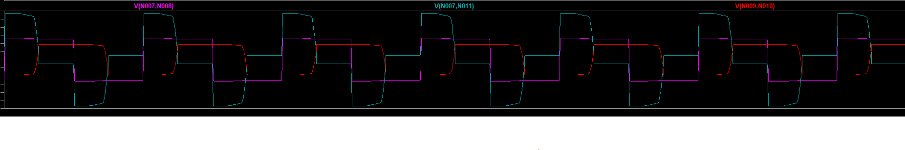
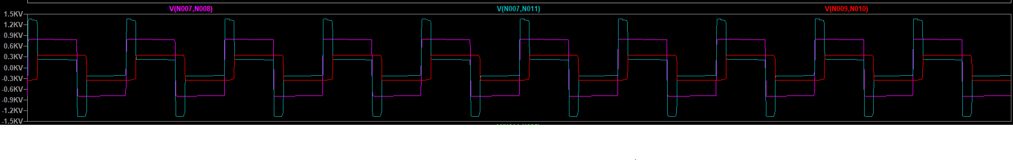

Slide 48
突波電壓造成元件損壞風險
Power loss 計算(計算VI圖對應面積)
漏電感效應

Slide 49
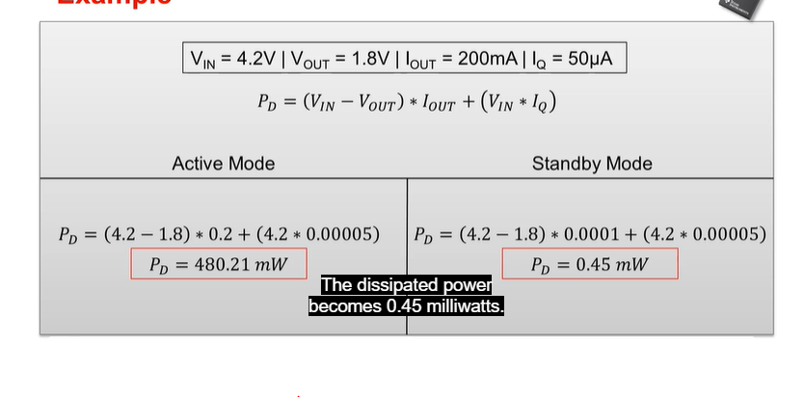
Quansient current

Slide 50
DCM CCM mode hopping

Slide 51
SPS_DC_DC 有講述到 圖波???

Slide 52

Blue line --- secondary side voltage
Red line --- primary side voltage
Pink line --- primary side inductor power
0 V

Slide 53


Slide 54


