Slide 1
Weekly Report
Presenter: Kuan-Hsun-Duh
Advisor: Cheng-Wen Wu
2021/09/16

Slide 2
Outline
Power analyzing
Reactive power loss
TPS Control
Backflow Power
Minimum Backflow Power Conrtrol(MBPC)
Backflow Simulation Result
GMPBPC v.s GMSBPC in rms current result
Non-Active Power Transmissions
Minimum Non-Active Power Transmission Time Control
Backflow Simulation Result
Effective Power Transmission Time Ratio Result
MNPC v.s GMBPC in rms current result
Conclusion
Proposal
REF. A Study on Modulation Strategies of Dual Active Bridge DC–DC Converter for Battery Energy Storage Systems
Ritsumeikan University March 2019
Author :Muhammad Hazarul Azmeer bin Ab Malek
REF. Backflow Power Optimization Control for Dual Active Bridge DC-DC Converters
Beijing Jiaotong University Author : Fei Xiong accepted by MDPI in 10 August 2017
Notes:
MDPI 5th largest publisher overall in terms of journal paper output.

Slide 3
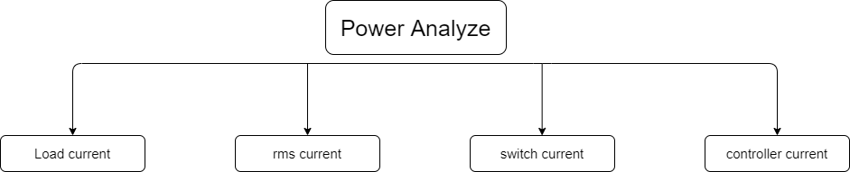
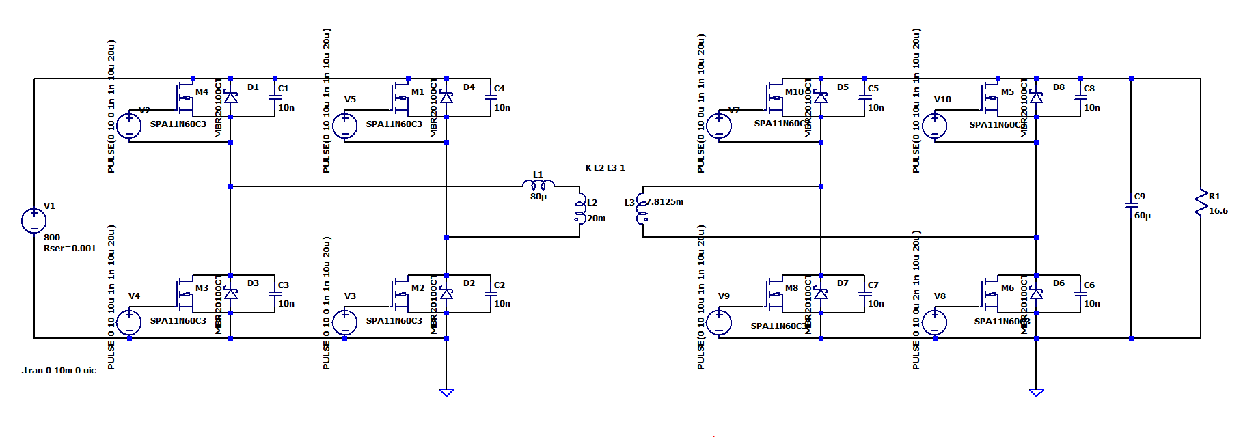
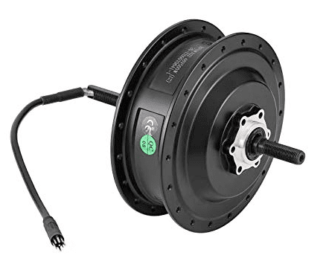
Power analyzing
Switch current
Load current
rms current
Switch current(Backflow power)
Rms current (reactive component)

Slide 4
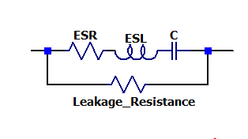
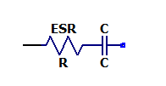
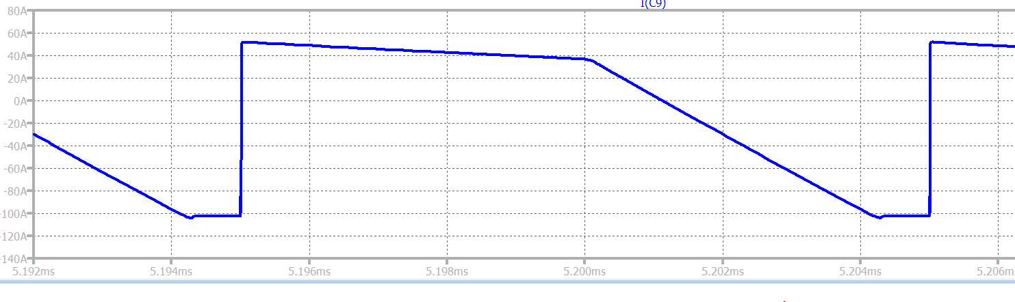
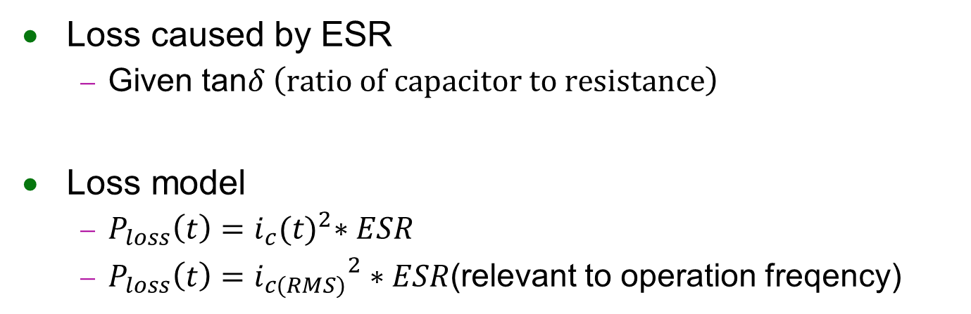

Power analyzing (Capacitor Loss)
Loss caused by ESR
Given tan$δ \left(ratio of capacitor to resistance\right)$
Loss model
$P_{loss}\left(t\right)=i_{c}{(t)}^{2}∗ESR$
$P_{loss}\left(t\right)={i_{c(RMS)}}^{2}∗ESR$(relevant to operation freqency)
$I_{C}$(A)
0A
Period
Time(ms)

Slide 5
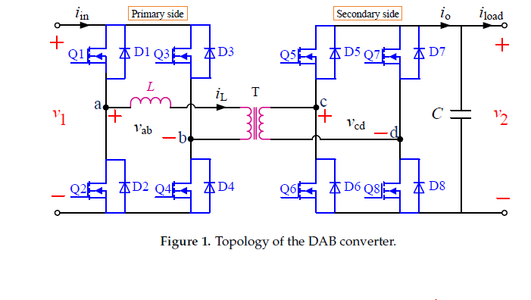
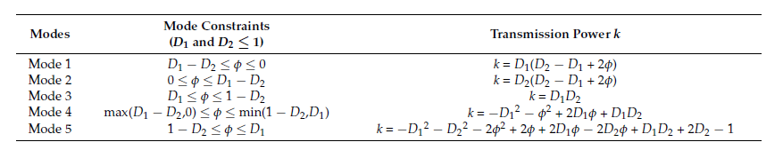
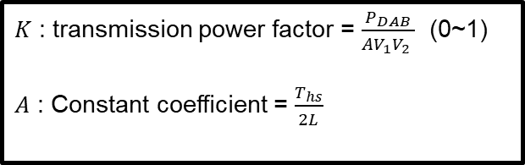
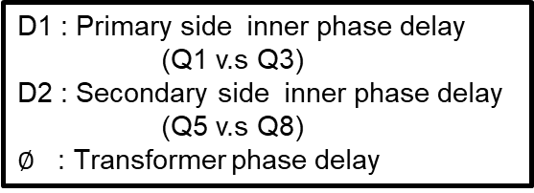
TPS Control
5 operation mode
Low power operation
mode1~mode4
High power operation
mode5
D1 : Primary side inner phase delay
(Q1 v.s Q3)
D2 : Secondary side inner phase delay
(Q5 v.s Q8)
$∅$ : Transformer phase delay
$K$ : transmission power factor = $\frac{P_{DAB}}{AV_{1}V_{2} } \text{(0\sim 1)}$
$A$ : Constant coefficient = $\frac{T_{hs}}{2L}$
REF. Backflow Power Optimization Control for Dual Active Bridge DC-DC Converters
Beijing Jiaotong University Fei Xiong accepted by MDPI in 10 August 2017

Slide 6
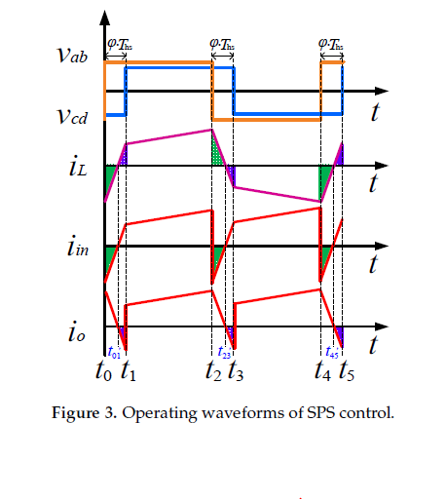
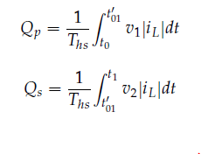

Backflow Power
Primary side
$i_{in} v.s v_{ab}$
Secondary side
$i_{o}v.s v_{cd}$
Transmission power flowback
REF. Backflow Power Optimization Control for Dual Active Bridge DC-DC Converters
Beijing Jiaotong University Fei Xiong accepted by MDPI in 10 August 2017

Slide 7
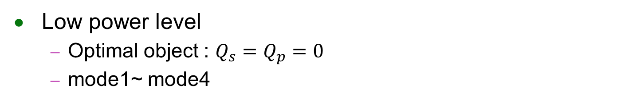
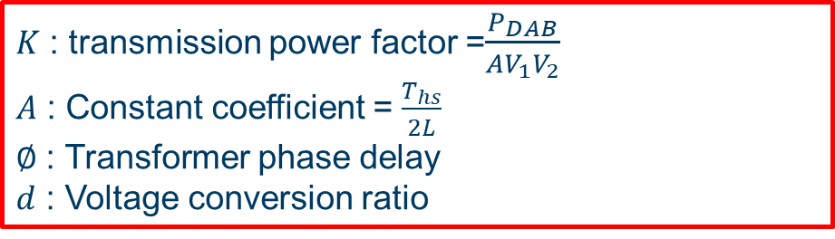
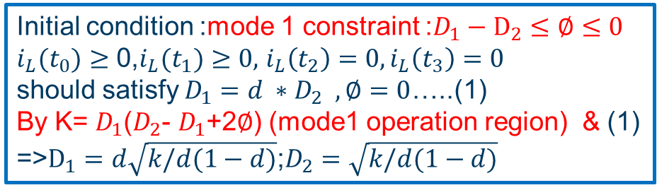
Minimum Backflow Power Conrtrol
Low power level
Optimal object : $Q_{s}=Q_{p}=0$
mode1~ mode4
$K$ : transmission power factor =$\frac{P_{DAB}}{AV_{1}V_{2}}$
$A$ : Constant coefficient = $\frac{T_{hs}}{2L}$
$∅$ : Transformer phase delay
$d$ : Voltage conversion ratio
Initial condition :mode 1 constraint :$D_{1}−D_{2}≤∅≤0$
$i_{L}(t_{0})≥$ 0,$i_{L}(t_{1})≥0,$ $i_{L}\left(t_{2}\right)=0,i_{L}\left(t_{3}\right)=0$
should satisfy $D_{1}={d ∗D}_{2} ,∅=0$…..(1)
By K= $D_{1}$($D_{2}$- $D_{1}$+2$∅$) (mode1 operation region) & (1)
=>$D_{1}=d\sqrt{k/d(1−d)}$;$D_{2}=\sqrt{k/d(1−d)}$
REF. Backflow Power Optimization Control for Dual Active Bridge DC-DC Converters
Beijing Jiaotong University Fei Xiong accepted by MDPI in 10 August 2017

Slide 8
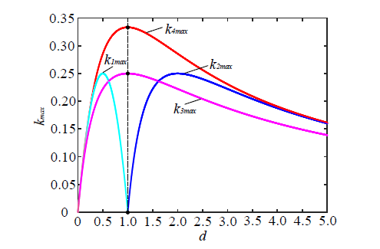
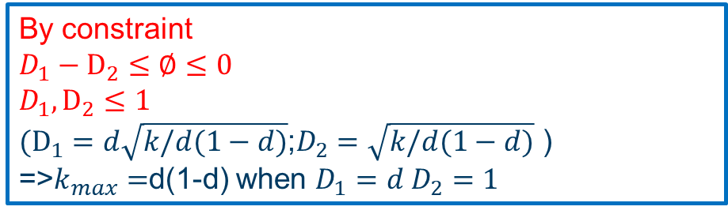
Minimum Backflow Power Conrtrol
By constraint
$D_{1}−D_{2}≤∅≤0$
$D_{1},D_{2}≤1$
$(D_{1}=d\sqrt{k/d(1−d)}$;$D_{2}=\sqrt{k/d(1−d)}$ )
=>$k_{max}=$d(1-d) when $D_{1}=d D_{2}=1$
Mode 4 has maximum k value for widest power range for zero backflow power
REF. Backflow Power Optimization Control for Dual Active Bridge DC-DC Converters
Beijing Jiaotong University Fei Xiong accepted by MDPI in 10 August 2017
Notes:
Low power control
不同phase 下的 power efficiency

Slide 9
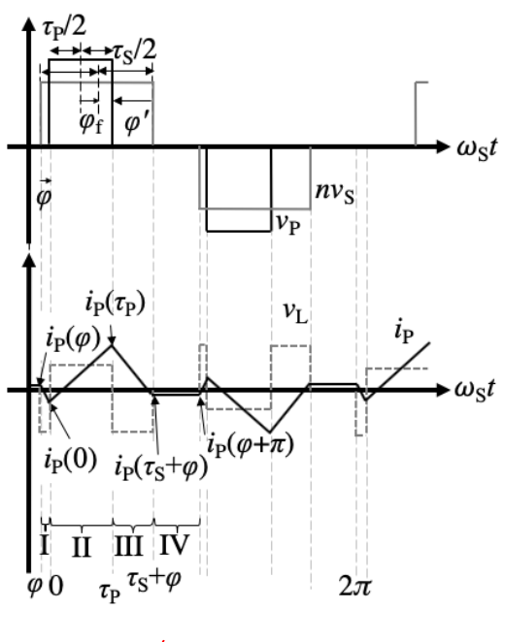
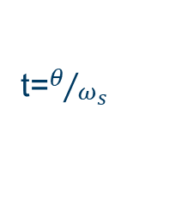

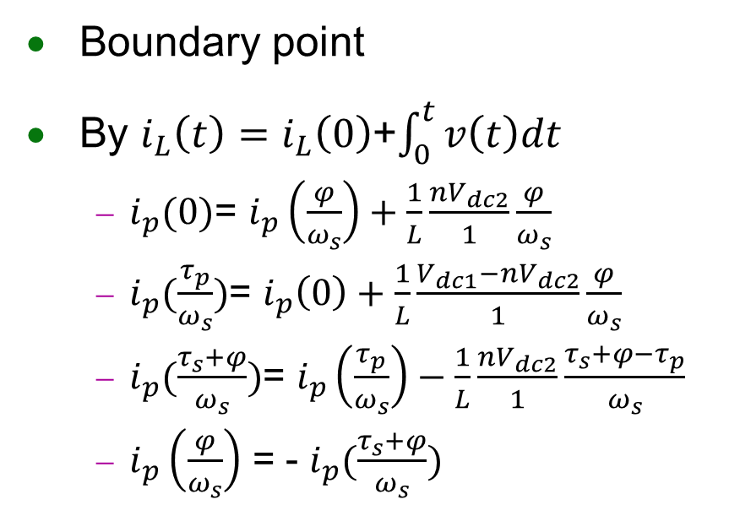
Minimum Backflow Power Conrtrol
$$D_{1}={d ∗D}_{2} , ∅=0$$
Boundary point
By $i_{L}\left(t\right)=$ $i_{L}\left(0\right)$+$\int_{0}^{t}{v\left(t\right)dt}$
$i_{p}(0)$= $i_{p}\left(\frac{φ}{ω_{s}}\right)+\frac{1}{L}\frac{nV_{dc2}}{1}\frac{φ}{ω_{s}}$
$i_{p}(\frac{τ_{p}}{ω_{s}})$= $i_{p}\left(0\right)+\frac{1}{L}\frac{V_{dc1}−nV_{dc2}}{1}\frac{φ}{ω_{s}}$
$i_{p}(\frac{τ_{s}+φ}{ω_{s}})$= $i_{p}\left(\frac{τ_{p}}{ω_{s}}\right)−\frac{1}{L}\frac{nV_{dc2}}{1}\frac{τ_{s}+φ−τ_{p}}{ω_{s}}$
$i_{p}\left(\frac{φ}{ω_{s}}\right)$ = - $i_{p}(\frac{τ_{s}+φ}{ω_{s}})$
t=$θ/{ω_{s}}$
REF. A Study on Modulation Strategies of Dual Active Bridge DC–DC Converter for Battery Energy Storage Systems Ritsumeikan University March 2019
Author :Muhammad Hazarul Azmeer bin Ab Malek
Notes:
ResearchGate針對科學專家學者提供一個研究分享平台。研究人員可以以註冊該網站而免費的分享全球各個領域尖端科學專家學者最新科研成果和學術著作，而且能夠按照他們的意願迅速擴大整個研究領域對自己的研究成果的關注。

Slide 10
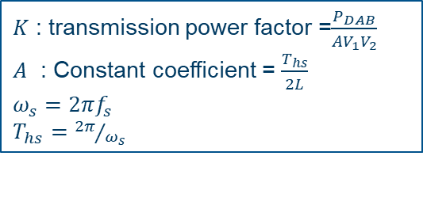
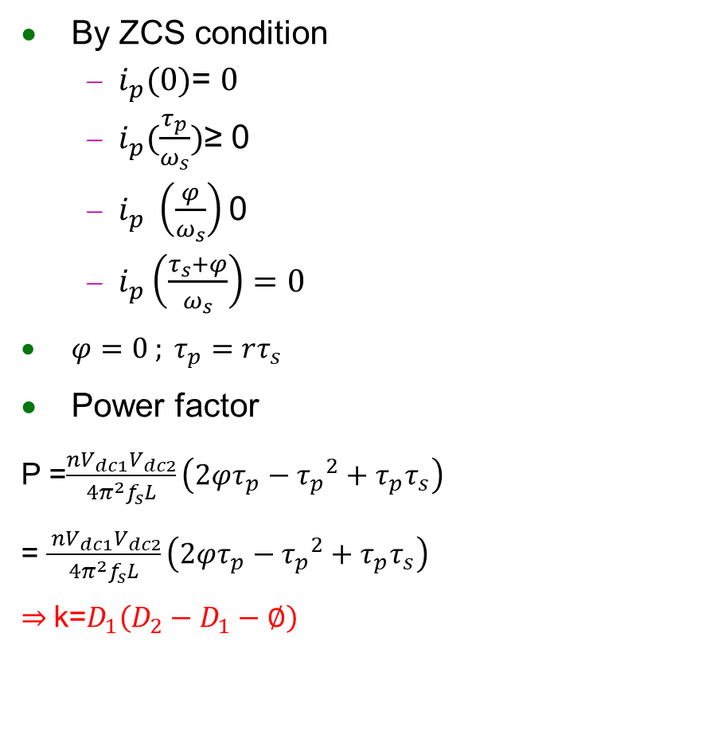
Minimum Backflow Power Conrtrol
By ZCS condition
$i_{p}(0)$= $0$
$i_{p}(\frac{τ_{p}}{ω_{s}})$≥ 0
$i_{p} \left(\frac{φ}{ω_{s}}\right)$0
$i_{p}\left(\frac{τ_{s}+φ}{ω_{s}}\right)=0$
$φ=0 ; τ_{p}=rτ_{s}$
Power factor
P =$\frac{nV_{dc1}V_{dc2}}{4π^{2}f_{s}L}\left(2φτ_{p}−{τ_{p}}^{2}+τ_{p}τ_{s}\right)$
= $\frac{ nV_{dc1}V_{dc2}}{4π^{2}f_{s}L}\left(2φτ_{p}−{τ_{p}}^{2}+τ_{p}τ_{s}\right)$
$⇒$k=$D_{1}\left(D_{2}−D_{1}−∅\right)$
$K$ : transmission power factor =$\frac{P_{DAB}}{AV_{1}V_{2}}$
$A$ : Constant coefficient = $\frac{T_{hs}}{2L}$
$ω_{s}=2πf_{s}$
$T_{hs}=$ ${2π}/{ω_{s}}$
REF. A Study on Modulation Strategies of Dual Active Bridge DC–DC Converter for Battery Energy Storage Systems Ritsumeikan University March 2019
Author :Muhammad Hazarul Azmeer bin Ab Malek
Notes:
ResearchGate針對科學專家學者提供一個研究分享平台。研究人員可以以註冊該網站而免費的分享全球各個領域尖端科學專家學者最新科研成果和學術著作，而且能夠按照他們的意願迅速擴大整個研究領域對自己的研究成果的關注。

Slide 11

Minimum Backflow Power Conrtrol
High Power Level
Operation in mode 5
GMPBPC
$Q_{p}=0$ $\min{ }Q_{s}$
GMSBPC
$Q_{s}=0$ ${\min{ }Q}_{p}$
High Power Level
GMBPC
${min Q}_{sum}=Q_{s}+$ $Q_{p}$
REF. Backflow Power Optimization Control for Dual Active Bridge DC-DC Converters
Beijing Jiaotong University Fei Xiong accepted by MDPI in 10 August 2017

Slide 12
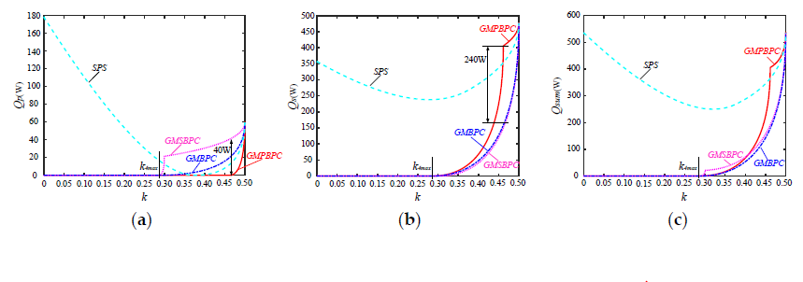
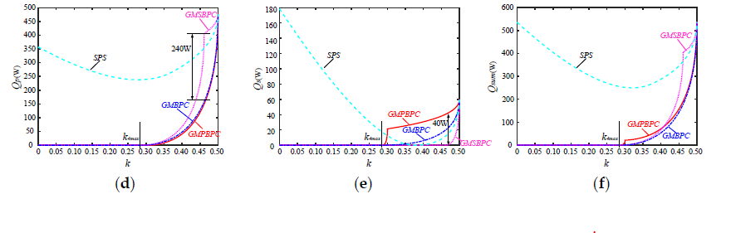



Backflow Simulation Result
At lower power level reduce backflow power effectively
GMPBPC has worse optimized results than GMSBPC when d >1
$Q_{p}$(w)
$Q_{s}$(w)
$Q_{sum}$(w)
d>1(boost)
d<1(buck)

Slide 13
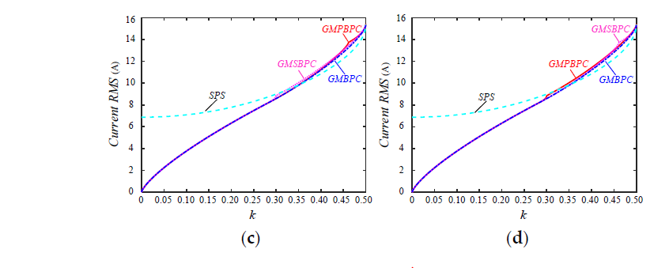
GMPBPC v.s GMPSPC in rms current result
GMPBPC has worse optimized results than GMSBPC when d >1 in high voltage transmission
Larger conduction losses arise
boost
buck
Notes:
傳遞越高的能量 儘管有optimization 不可避免會產生較多餘的消耗

Slide 14
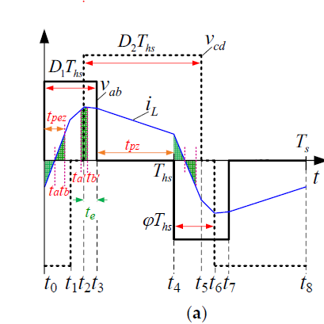
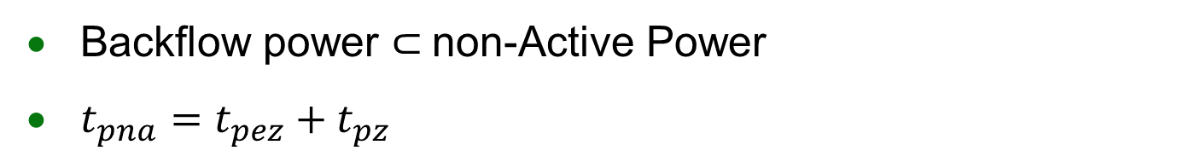
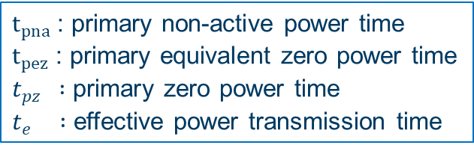
Non-Active Power Transmission
Backflow power $⊂$non-Active Power
$t_{pna}=t_{pez}+t_{pz}$
$t_{pna}$: primary non-active power time
$t_{pez}$: primary equivalent zero power time
$t_{pz } :$ primary zero power time
$t_{e } :$ effective power transmission time
Primary side
Zero power
backflow power
Positive power(maximum power transmission effciency)

Slide 15
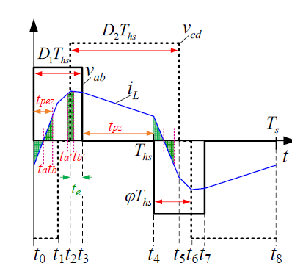
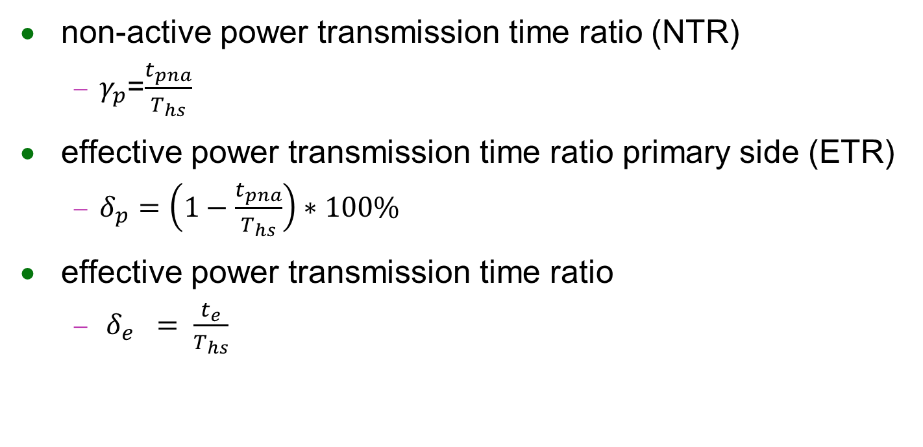
Non-Active Power Transmission
non-active power transmission time ratio (NTR)
$γ_{p}$=$\frac{t_{pna}}{T_{hs}}$
effective power transmission time ratio primary side (ETR)
$δ_{p}=\left(1−\frac{t_{pna}}{T_{hs}}\right)∗100\%$
effective power transmission time ratio
$δ_{e} = \frac{t_{e}}{T_{hs}}$
REF. Backflow Power Optimization Control for Dual Active Bridge DC-DC Converters
Beijing Jiaotong University Fei Xiong accepted by MDPI in 10 August 2017

Slide 16
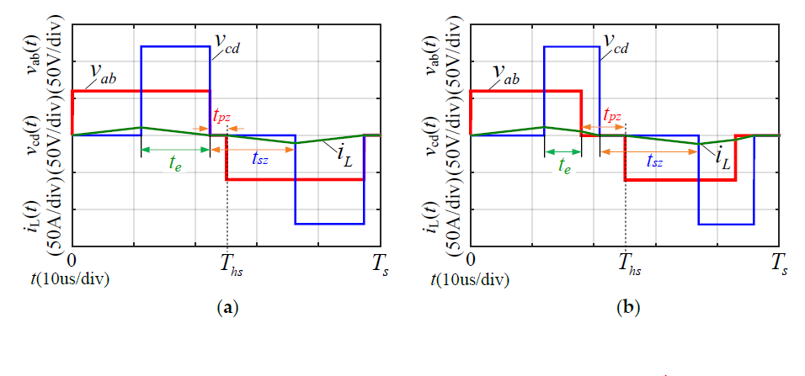

Minimum Non-Active Power Transmission Time Control(MNPC)
Object : Maximize $δ_{e}$ or Minimize $δ_{p}$
MNPC
GMBPC
REF. Backflow Power Optimization Control for Dual Active Bridge DC-DC Converters
Beijing Jiaotong University Fei Xiong accepted by MDPI in 10 August 2017

Slide 17
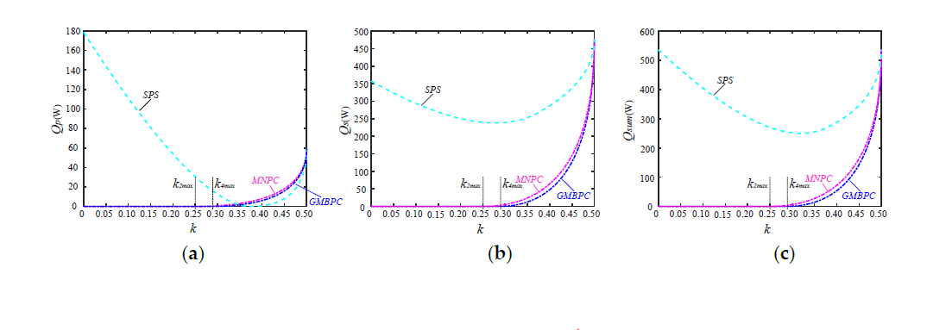
Backflow power comparison
MNPC and GMBPC is much smaller than the backflow power of SPS control especially at lower power level.
REF. Backflow Power Optimization Control for Dual Active Bridge DC-DC Converters
Beijing Jiaotong University Fei Xiong accepted by MDPI in 10 August 2017

Slide 18
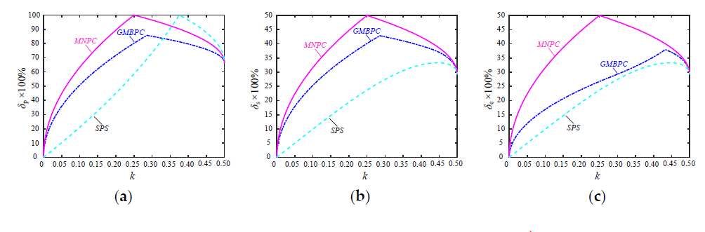
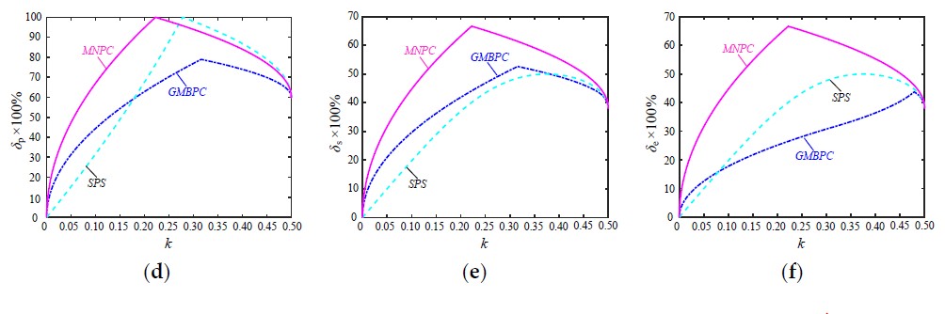

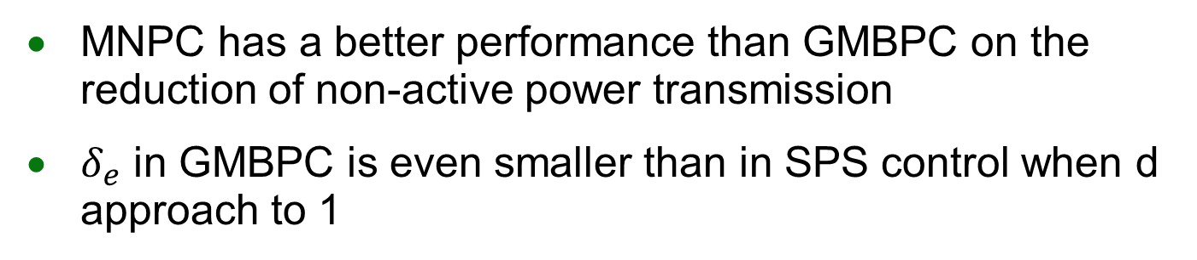


Effective Power Transmission Time Ratio Result
MNPC has a better performance than GMBPC on the reduction of non-active power transmission
$δ_{e}$ in GMBPC is even smaller than in SPS control when d approach to 1
$$δ_{p}$$
$$δ_{s}$$
$$δ_{e}$$
60V → 120V
80V → 120V
REF. Backflow Power Optimization Control for Dual Active Bridge DC-DC Converters
Beijing Jiaotong University Fei Xiong accepted by MDPI in 10 August 2017

Slide 19
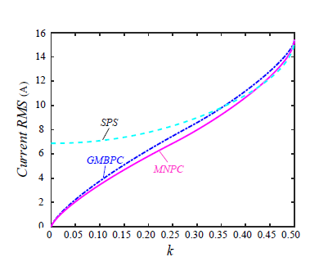
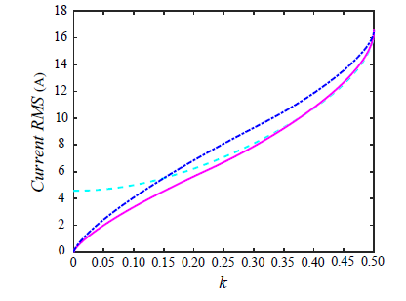
MNPC v.s GMBPC in rms Current
The current rms of GMBPC are even larger than that of SPS control whn d approach to 1
60V → 120V
80V → 120V
REF. Backflow Power Optimization Control for Dual Active Bridge DC-DC Converters
Beijing Jiaotong University Fei Xiong accepted by MDPI in 10 August 2017

Slide 20
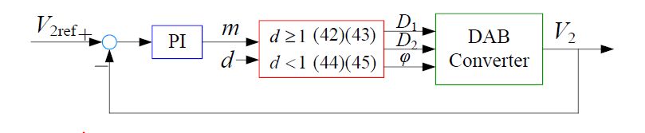
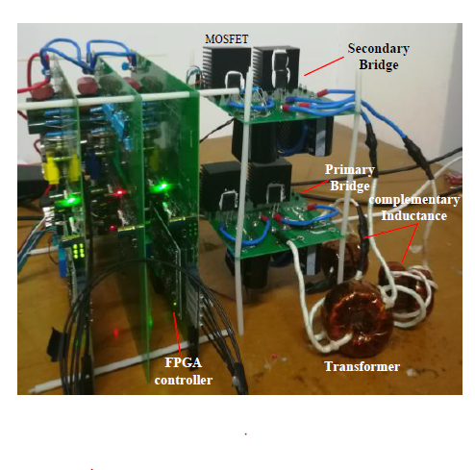
Implementation
Experiment flow

Slide 21
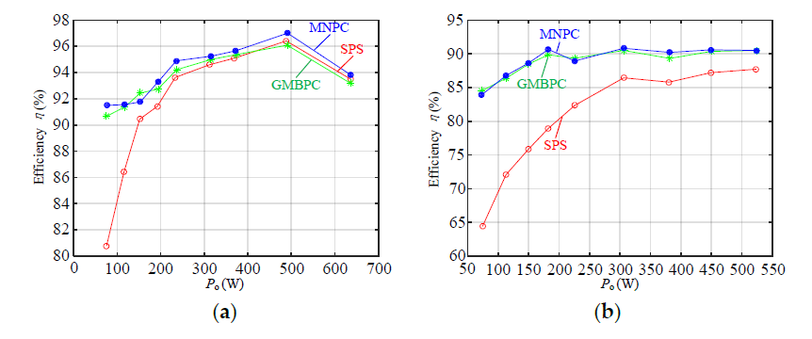
Implementation result
d<1(buck)
d>1(boost)
REF. Backflow Power Optimization Control for Dual Active Bridge DC-DC Converters
Beijing Jiaotong University Fei Xiong accepted by MDPI in 10 August 2017

Slide 22
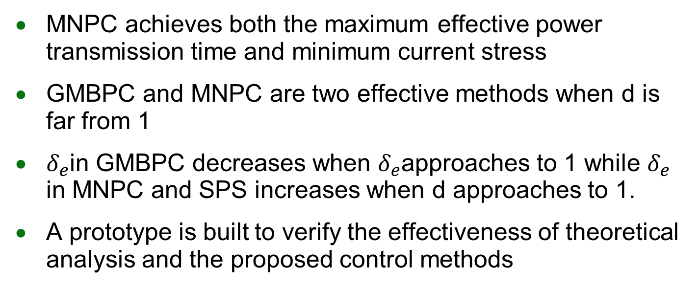
Conclusions
MNPC achieves both the maximum effective power transmission time and minimum current stress
GMBPC and MNPC are two effective methods when d is far from 1
$δ_{e}$in GMBPC decreases when $δ_{e}$approaches to 1 while $δ_{e}$ in MNPC and SPS increases when d approaches to 1.
A prototype is built to verify the effectiveness of theoretical analysis and the proposed control methods

Slide 23
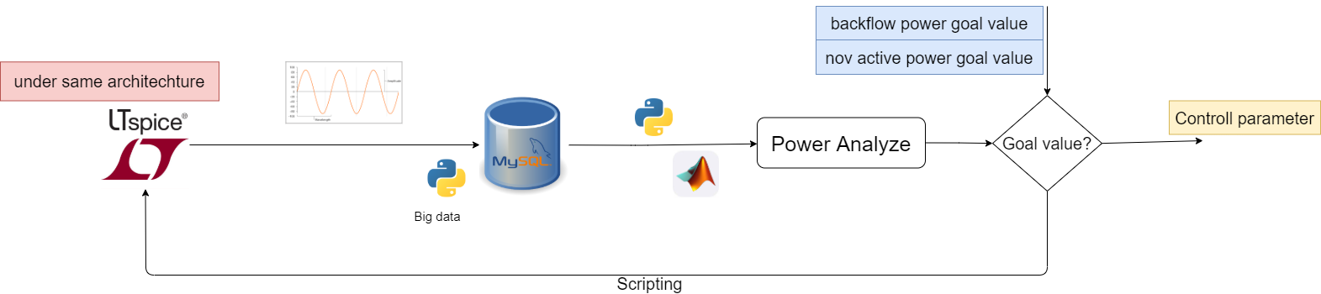
Proposal
Build a simulation tool
Find the best optimization method under specific constraint
Future work
Algorithm
Power calculation model
Scripting ltspice
Sql database control

Slide 24
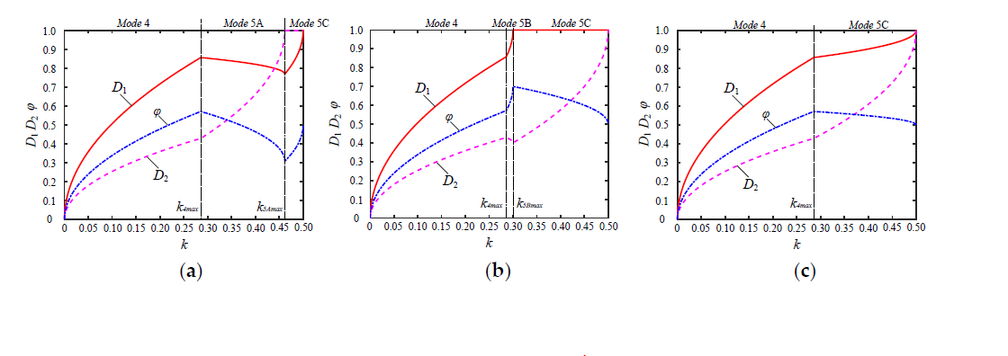
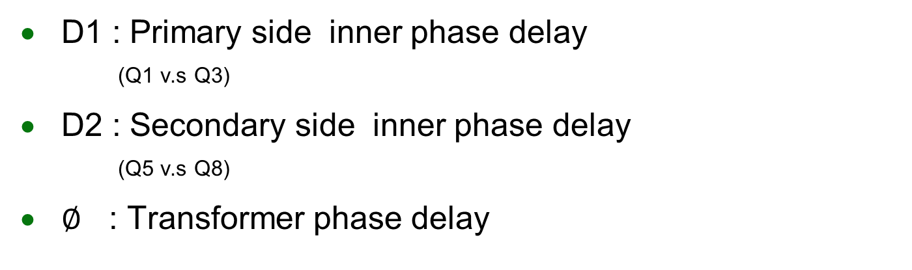
Backflow Control Parameter
D1 : Primary side inner phase delay
(Q1 v.s Q3)
D2 : Secondary side inner phase delay
(Q5 v.s Q8)
$∅$ : Transformer phase delay
GMPBPC
GMSBPC
GMBPC

