Slide 1
Weekly Report
Presenter: Kuan-Hsun-Duh
Advisor: Cheng-Wen Wu
2021/10/05

Slide 2
Outline
Recap
Backflow power
Proposal
IBDC_DAB with PI control
SPS control without Algorithom(matlab)
Proposed method
Expectation effect and problem
Future work

Slide 3

Control method
Voltage mode control
Peak current control method
電流控制模式
斜率補償技術(比較器之所以會有鋸齒波的存在)
因為duty超過50% 容易產生震盪($∆I$)

Slide 4
回授穩定度分析
前述的兩種控制 又可細分DCM CCM design
DCM 通常會加入CT module 來調控電流
電壓控制模式
降壓模式中 以 CCM 為最常見設計
Phase margin 代表電路穩定度 反應變化的能力
系統若有一極點在右半平面則會不穩定

Slide 5
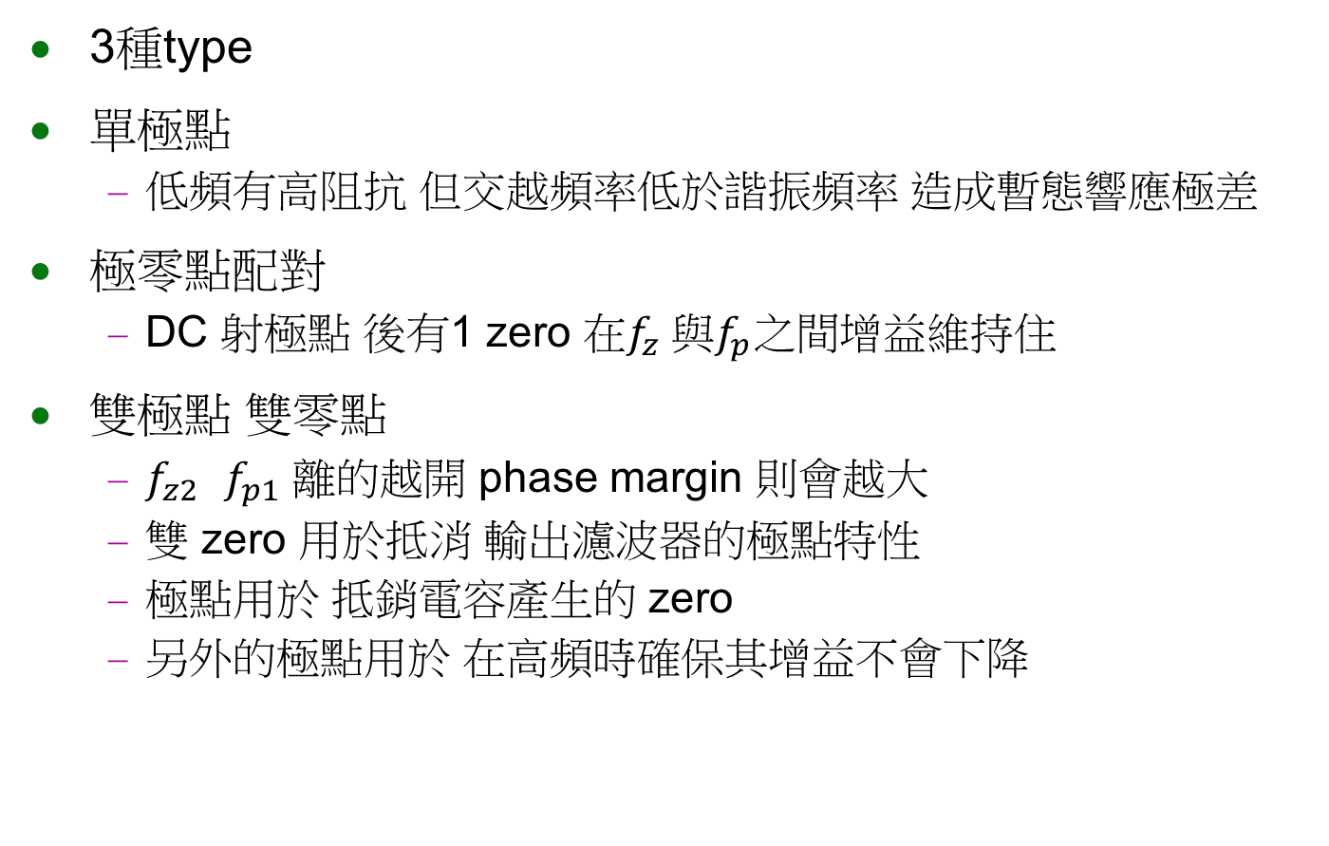
回授補償電路
3種type
單極點
低頻有高阻抗 但交越頻率低於諧振頻率 造成暫態響應極差
極零點配對
DC 射極點 後有1 zero 在$f_{z} 與f_{p}之間$增益維持住
雙極點 雙零點
$f_{z2}$ $f_{p1}$ 離的越開 phase margin 則會越大
雙 zero 用於抵消 輸出濾波器的極點特性
極點用於 抵銷電容產生的 zero
另外的極點用於 在高頻時確保其增益不會下降

Slide 6
控制器比較
數位控制器
優勢: 可調節 便宜 抗雜訊能力好
弱勢:

Slide 7
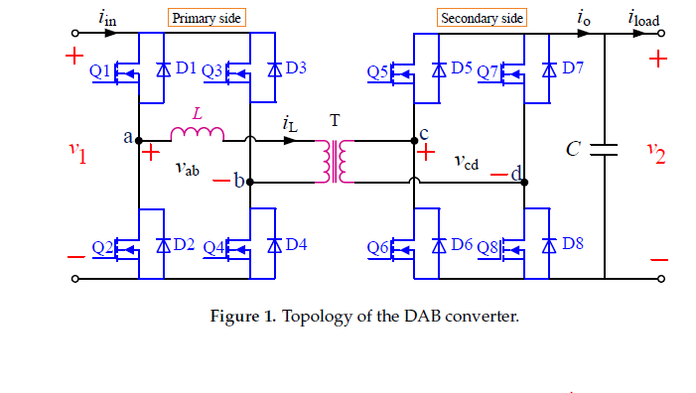
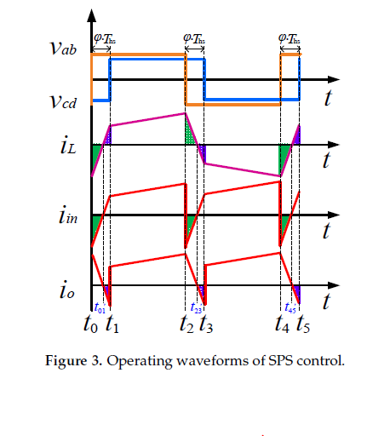
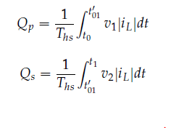

Backflow Power(Recap)
Primary side
$i_{in} v.s v_{ab}$
Secondary side
$i_{o}v.s v_{cd}$
Transmission power flowback
REF. Backflow Power Optimization Control for Dual Active Bridge DC-DC Converters
Beijing Jiaotong University Fei Xiong accepted by MDPI in 10 August 2017

Slide 8
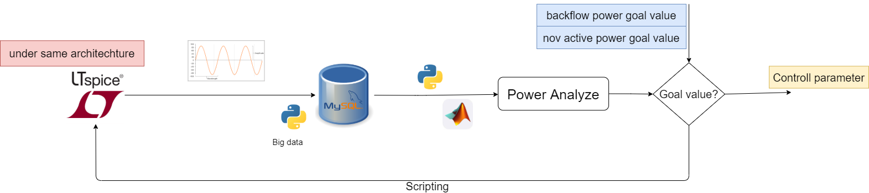
Proposal(Recap)
Build a simulation tool
Find the best optimization method under specific constraint
Future work
Algorithm
Power calculation model
Scripting ltspice
Sql database control

Slide 9
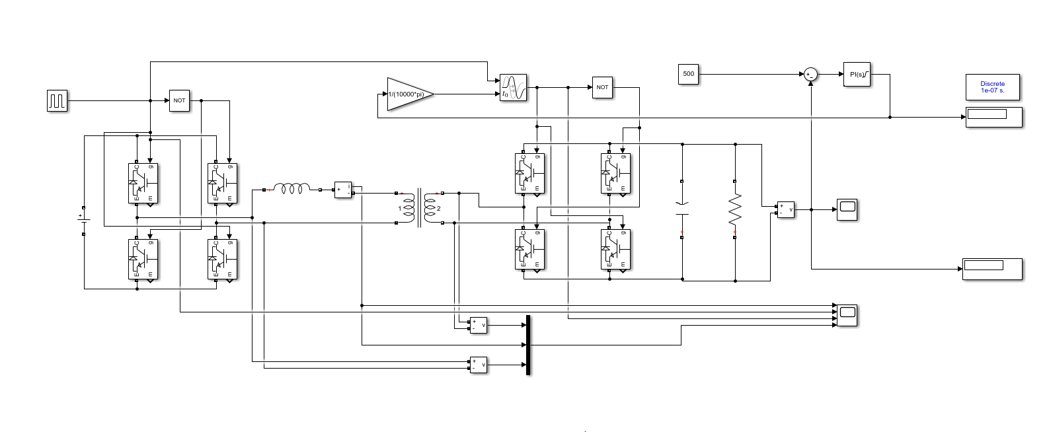
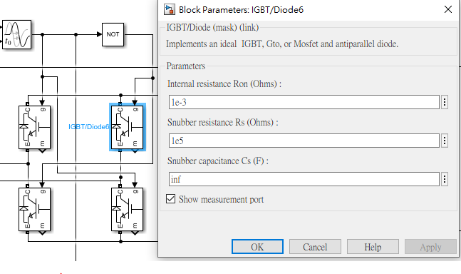
IBDC_DAB with PI control
IBDC_DAB by PI control in SPS way
Switching tunable
Silmiler to ltspice simulation result

Slide 10
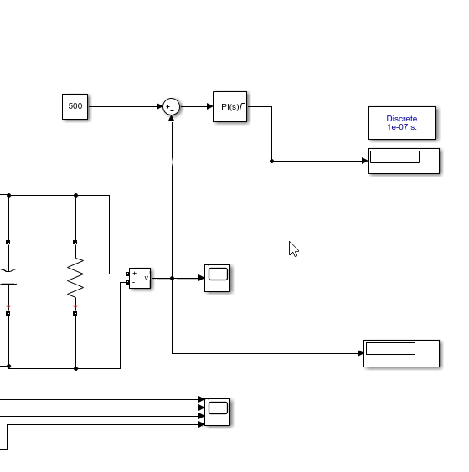
SPS control without Algorithom
Goal value
Error
Delay parameter
System output voltage

Slide 11
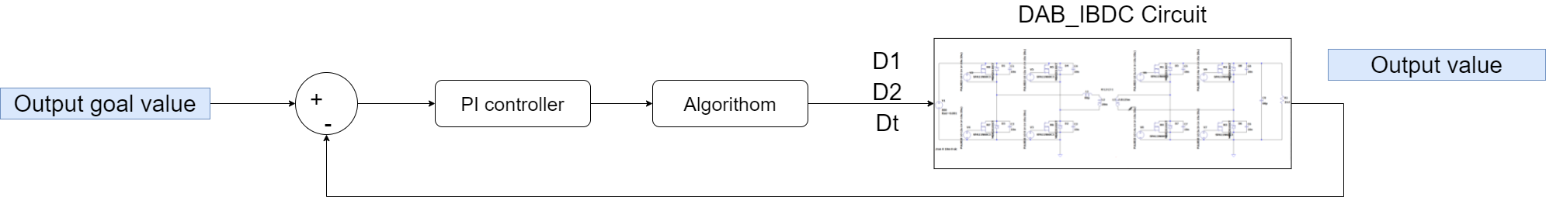
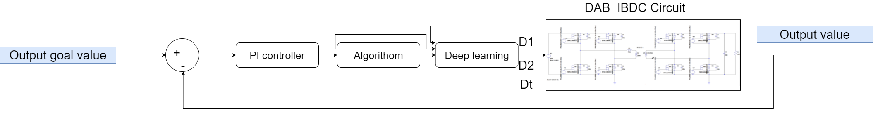
Problem analysis
Goal:
Help system to tune the duty-cycle to achieve the goal value(backflow value) more quickly
Method:
Add machine learning block after PI control block
Fig1. Traditional architecture
Fig2. Proposed architecture

Slide 12
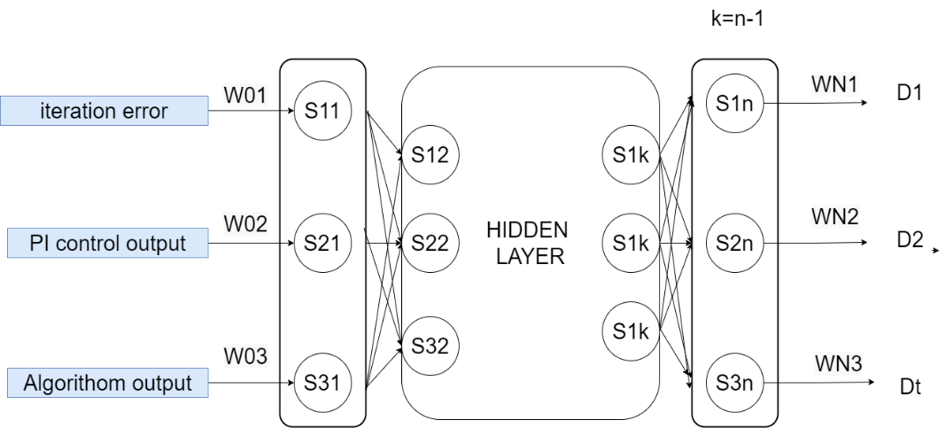
Proposed method
Initial condition: first set point by algorithom
Yellow path weight iniatilize to 1
Other weight iniatilize to 0

Slide 13
Expectation effect and problem
Problem1:
Condition:
optimized duty cycle(after ML training) don’t have the big difference compare with initial duty cycle(mathmetical model )
The optimized duty cycle is 30%(after ML training)
Switching Initial start from 25% (mathmetical model )
Problem2:
Condition :
optimized duty cycle(after ML training) don’t have the big difference compare with initial duty cycle(mathmetical model )
optimized duty cycle is 24% Initial start from 25%

Slide 14
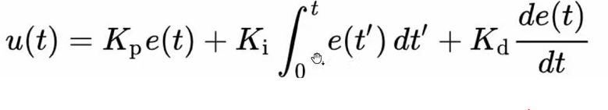
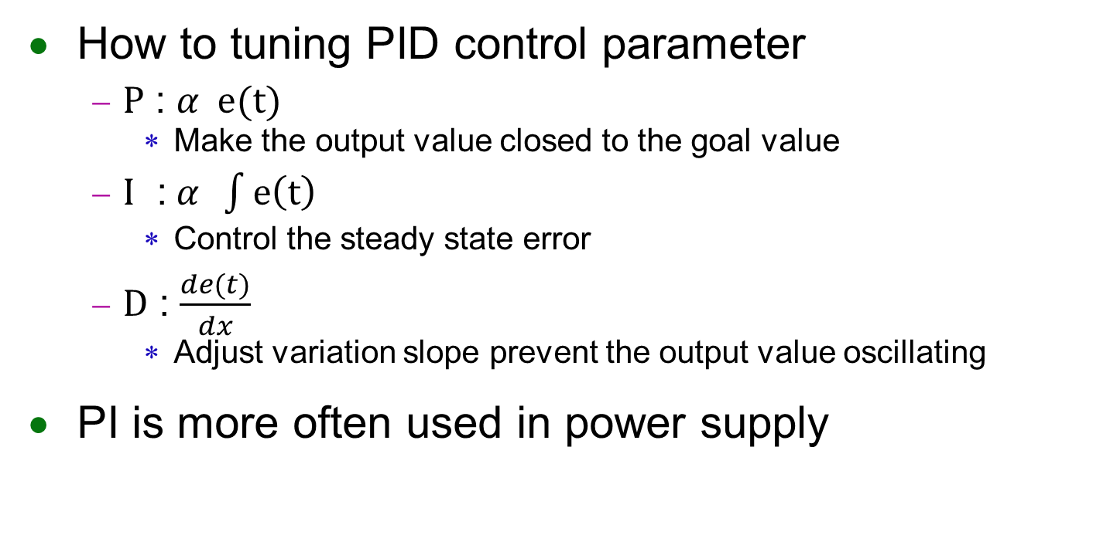
Future work
How to tuning PID control parameter
$P$ : $α e(t)$
Make the output value closed to the goal value
$I$ :$α \int{e\left(t\right)}$
Control the steady state error
$D$ : $\frac{de(t)}{dx}$
Adjust variation slope prevent the output value oscillating
PI is more often used in power supply

Slide 15
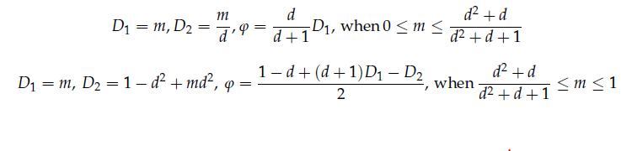
Future work
PID controller + Algorithom & design (TPS control)
Algorithom implement by the reference paper
REF. Backflow Power Optimization Control for Dual Active Bridge DC-DC Converters
Beijing Jiaotong University Fei Xiong accepted by MDPI in 10 August 2017

Slide 16
Future work
Proposal problem should be redefined
Keep study on electric vehicle issue
SNN training software implementation
STBP
STDP
TSSL-BP

