Slide 1
Weekly Report
Presenter: Kuan-Hsun-Duh
Advisor: Cheng-Wen Wu
2021/10/12

Slide 2
Outline
Recap
Backflow power
Original control flow
Proposal
Problem analysis
Proposed control flow
Expectation effect and problem
Replacing PID with machine learning method

Slide 3
Outline
Controller design
PID parameter
Control method
Feedback Stability
Compensation circuit
Experiment build up
SPS control without Algorithom(matlab)
Future work

Slide 4
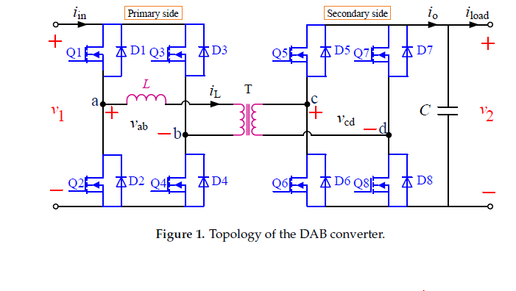
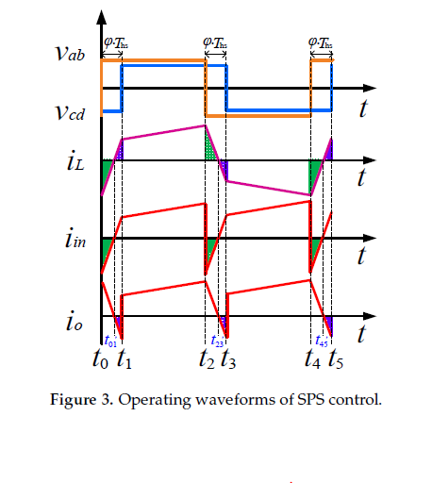
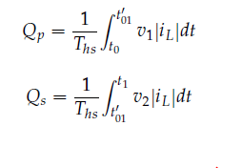

Backflow Power(Recap)
Primary side
$i_{in} v.s v_{ab}$
Secondary side
$i_{o}v.s v_{cd}$
Transmission power flowback
REF. Backflow Power Optimization Control for Dual Active Bridge DC-DC Converters
Beijing Jiaotong University Fei Xiong accepted by MDPI in 10 August 2017

Slide 5
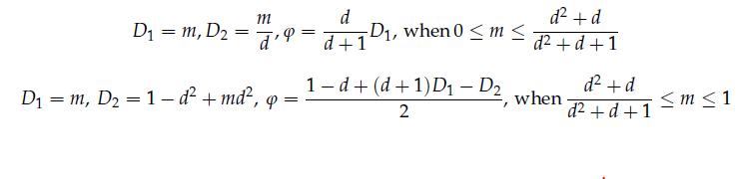
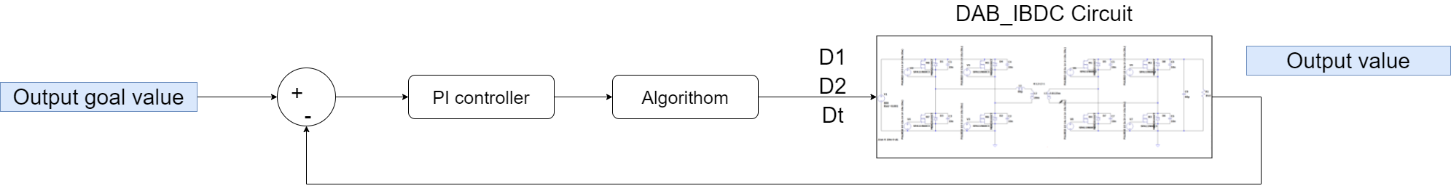
Original control flow
PI controller + Algorithom & design (TPS control)
Algorithom implement by the reference paper
REF. Backflow Power Optimization Control for Dual Active Bridge DC-DC Converters
Beijing Jiaotong University Fei Xiong accepted by MDPI in 10 August 2017

Slide 6
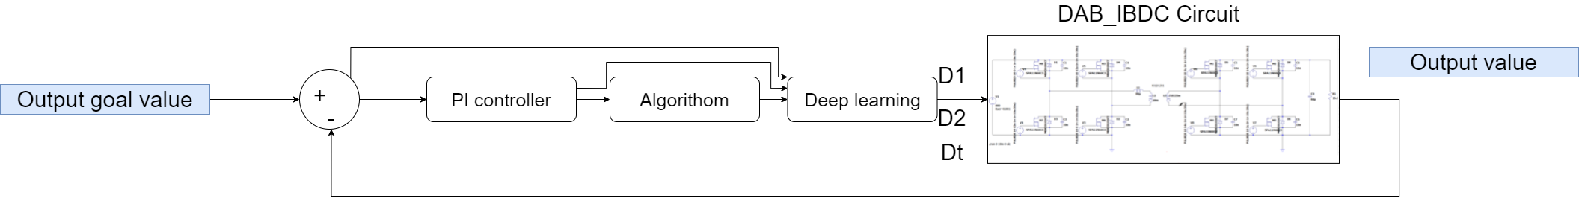
Problem analysis
Goal:
Help system to tune the duty-cycle to achieve the goal value(backflow value) more quickly with time
Method:
Add machine learning block after PI control block
Fig1. Traditional architecture
Fig2. Proposed architecture

Slide 7
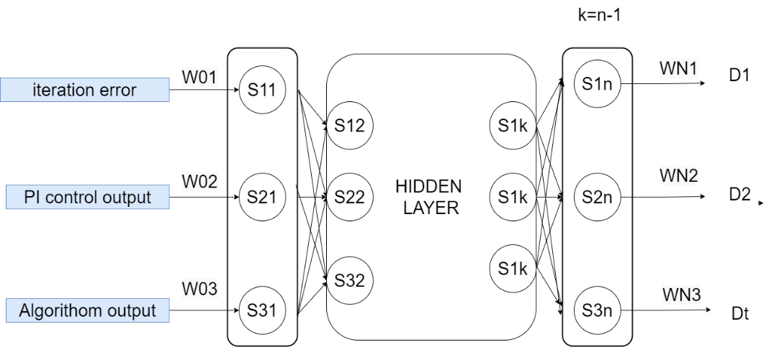
Proposed control flow
Initial condition: first set point by algorithom
Yellow path weight iniatilize to 1
Other weight iniatilize to 0

Slide 8
Expectation effect and problem
Expectation effect
transition (low load to high load) reaction time will be improved with time.
Problem
Control is not an NP problem
Controller can be tunable by human

Slide 9
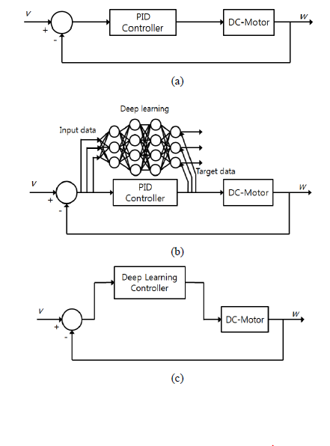
Deep learning replacing PID
REF. On Replacing PID Controller with Deep Learning Controller for DC Motor System
Kangbeom Cheon, Kyungpook National University,Korea, December, 2015.

Slide 10
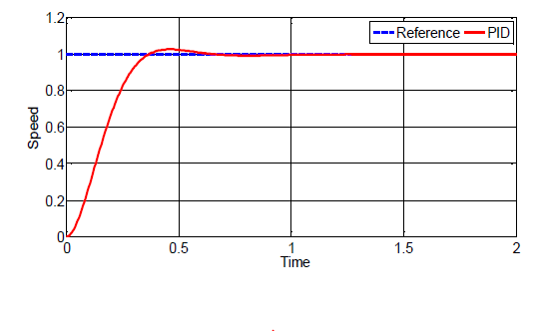
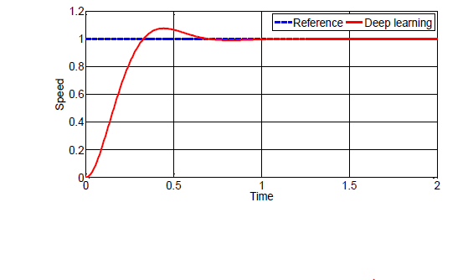
Step response Result
Rise time : deep learning < PID control
Overshoot : deep learning > PID control

Slide 11
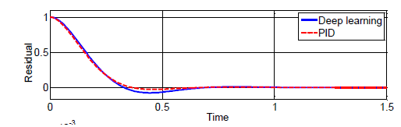
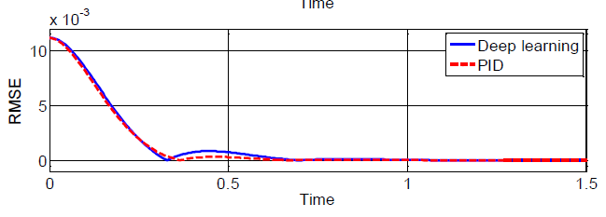
Result
Residuals : the variance of error
RMSE:root-mean-square deviation

Slide 12
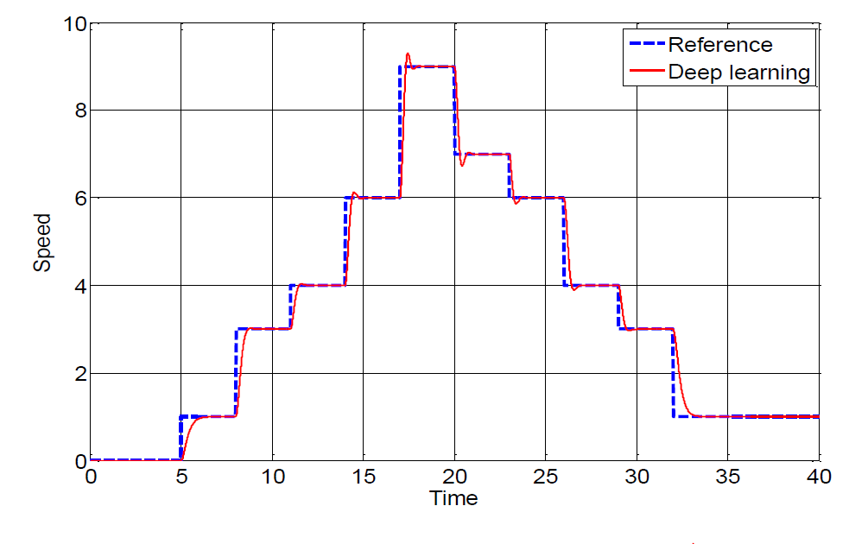
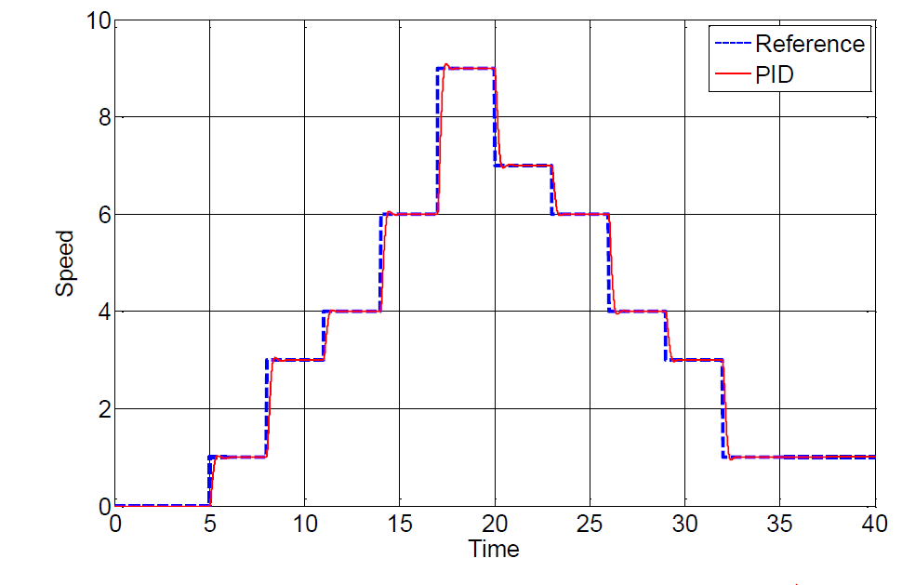
Result

Slide 13
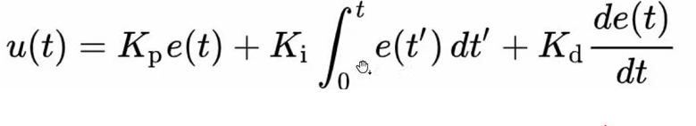
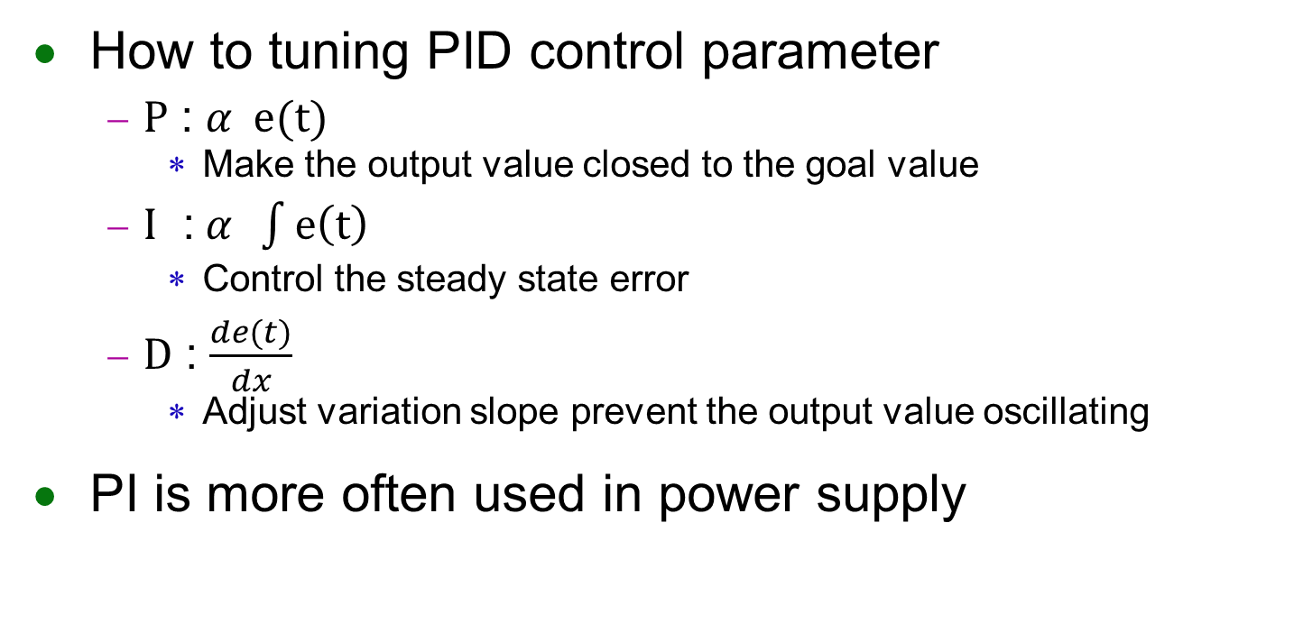
PID parameter
How to tuning PID control parameter
$P$ : $α e(t)$
Make the output value closed to the goal value
$I$ :$α \int{e\left(t\right)}$
Control the steady state error
$D$ : $\frac{de(t)}{dx}$
Adjust variation slope prevent the output value oscillating
PI is more often used in power supply

Slide 14
Control method
Voltage mode control
Peak current control
Other control method
Vally current control method
Emulated current mode control
Hysteretic current mode control
Average current mode control

Slide 15
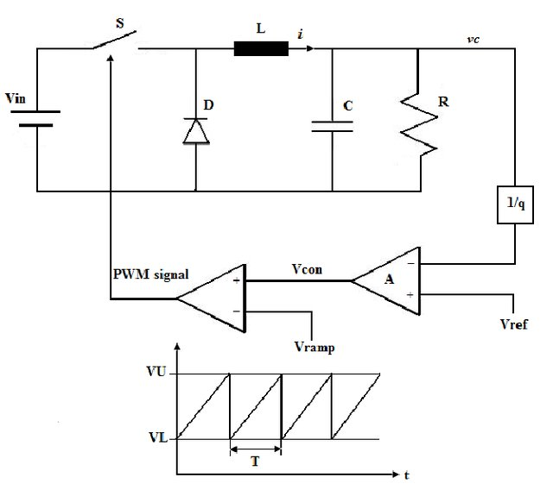
Voltage mode control
REF.切換式電源轉換器-吳義利

Slide 16
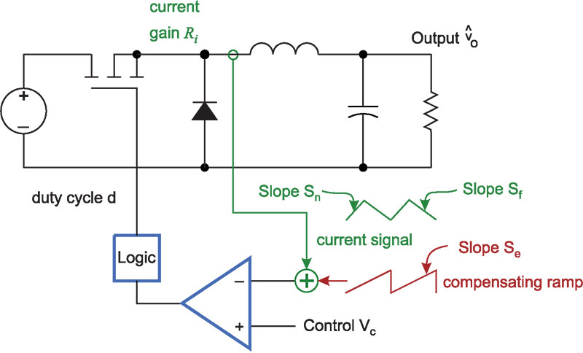
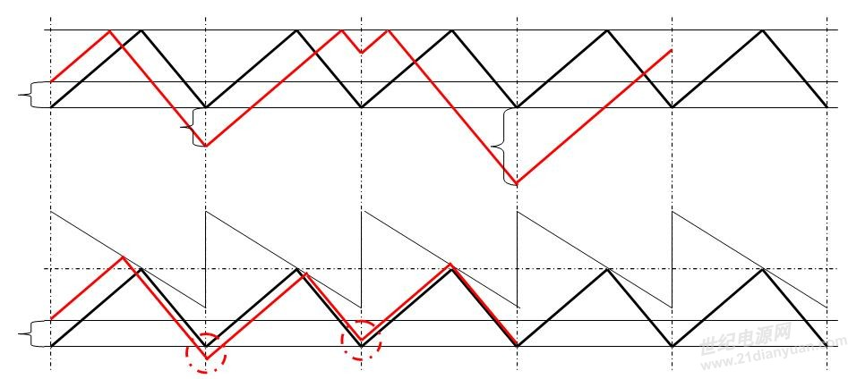
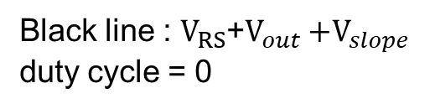


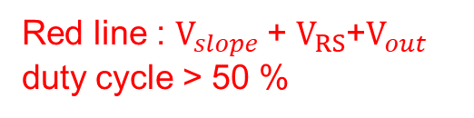
Peak current control method
Pros : Obtain inactive current from switching
Cons : Switching duty cycle >50 % will cause current osicallating
Black line : $V_{RS}$+$V_{out}$
duty cycle = 0
Red line : $V_{RS}$+$V_{out}$
duty cycle > 50 %
Black line : $V_{RS}$+$V_{out}{+V}_{slope}$
duty cycle = 0
Red line : $V_{slope}$+ $V_{RS}$+$V_{out}$
duty cycle > 50 %
REF.切換式電源轉換器-吳義利
Notes:
限流保護電路作用
較快的反應速度

Slide 17
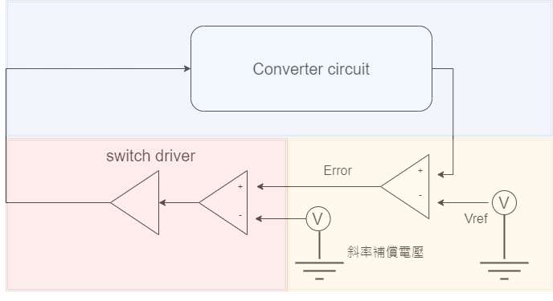

Feedback Stability
Small signal analyze
Step1 : calculate the transfer function on block1 : $G_{p}(s)$ & block2 ${: G}_{pwm}(s)$
$G_{pL}(s)$= $G_{p}(s)$ * $G_{pwm}(s)$
Step2 : design the error amplifier
1
3
2

Slide 18
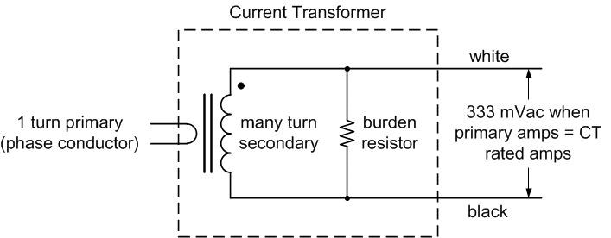
Feedback Stability (Peak current control method)
Reducing inactive current by current transformer module
REF.切換式電源轉換器-吳義利

Slide 19
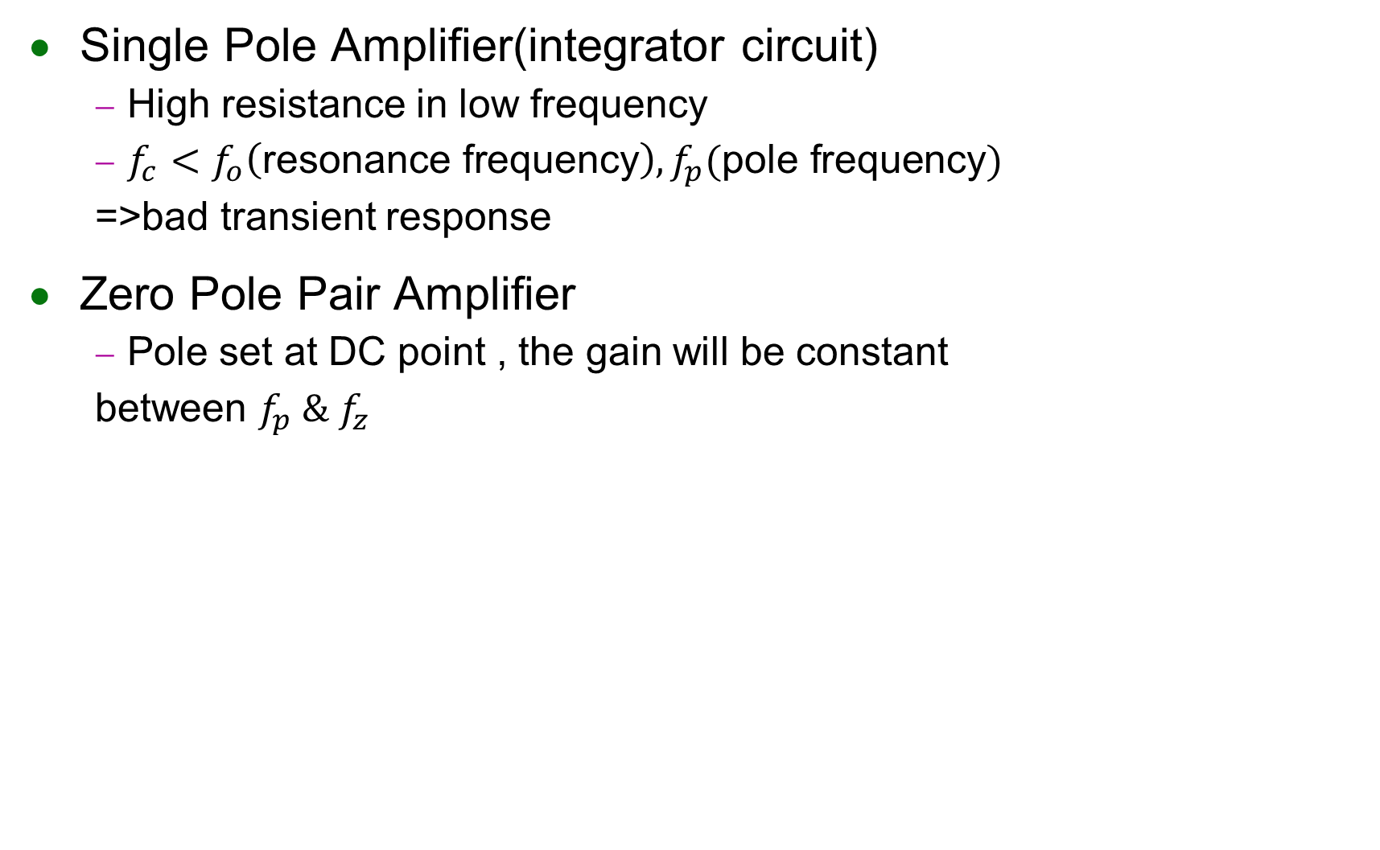
Compensation circuit
Single Pole Amplifier(integrator circuit)
High resistance in low frequency
$f_{c}<f_{o}\left(\text{resonance} \text{frequency}\right), f_{p}(\text{pole} \text{frequency})$
=>bad transient response
Zero Pole Pair Amplifier
Pole set at DC point , the gain will be constant
between $f_{p} \& f_{z}$
REF.切換式電源轉換器-吳義利
Notes:
高阻抗 輸出電壓大

Slide 20

Compensation circuit
Two Pole two zero Amplifier (Circuit with L-C filter)
Distance brtween $f_{p} \& f_{z} ↑$ phase margin$↑$
$f_{z1} {\& f}_{z2}$ is used to eliminate the pole of the output filter
$f_{p1}$ is used to eliminate the zero produced
by the ESR of the capacitor
$f_{p2}$ is used to maintain the gain at high frequency
REF.切換式電源轉換器-吳義利

Slide 21
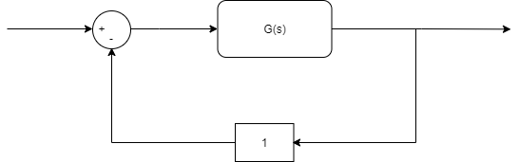
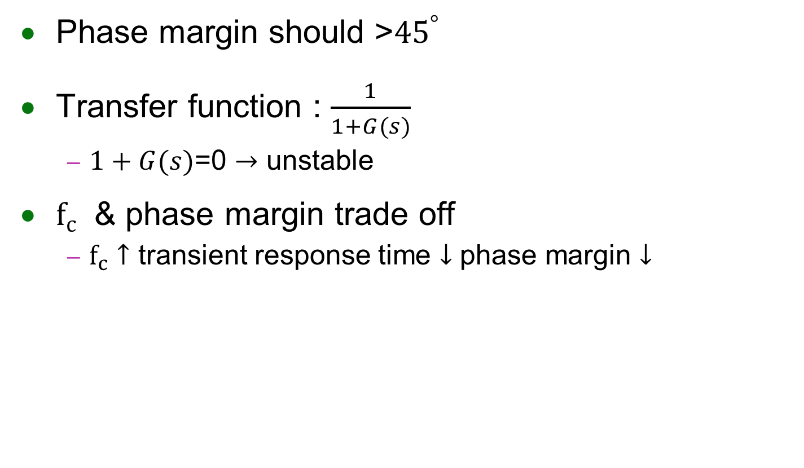
Controller design (phase margin)
Phase margin should >${45}^{°}$
Transfer function : $\frac{1}{1+G(s)}$
$1+G(s)$=0 $→$ unstable
$f_{c}$ & phase margin trade off
$f_{c}↑$ transient response time $↓$ phase margin $↓$

Slide 22
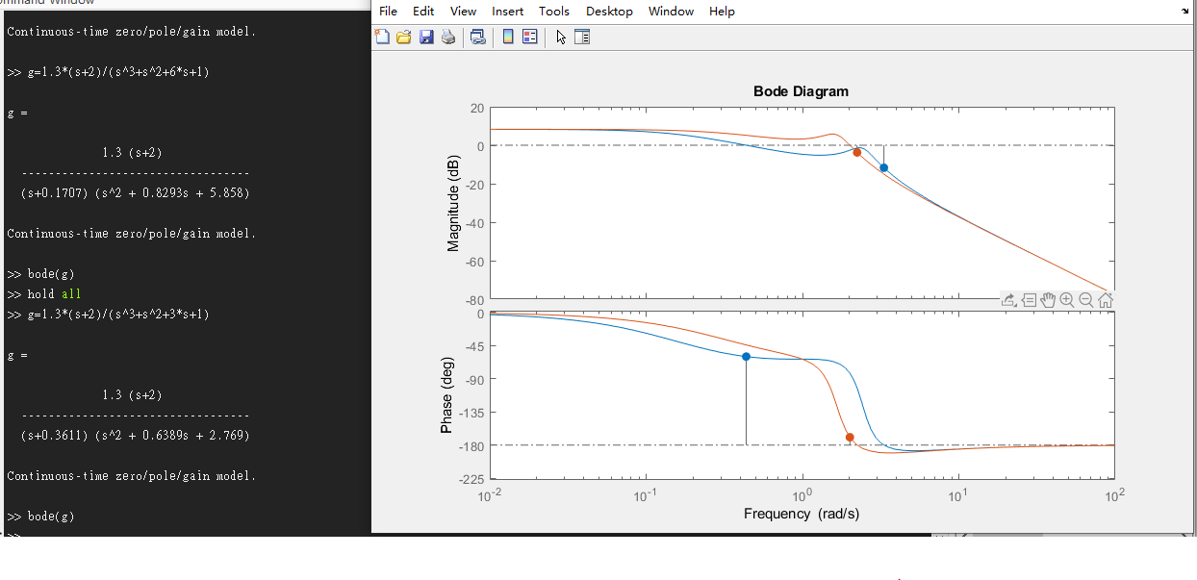


$${PM :120}^{°}$$
$${PM :11}^{°}$$

Slide 23
Compensation circuit
Circuit | Control | Operation region | Compensation circuit
Buck converter Forward converter Full-bridge converter | Voltage mode control | DCM
 |  | CCM | Type1 , Type2
 | Peak current control | DCM
 |  | CCM | Type3 , Type2
Flyback converter Buck–boost converter Boost converter | Voltage mode control | DCM | Type1 , Type2
 |  | CCM | Type1 , Type2
 | Peak current control | DCM | Type1 , Type3
 |  | CCM | Type1 , Type2
REF.切換式電源轉換器-吳義利
Notes:
降壓-升壓變換器和返馳式變換器等效

Slide 24
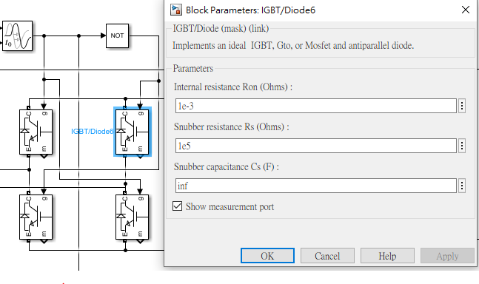
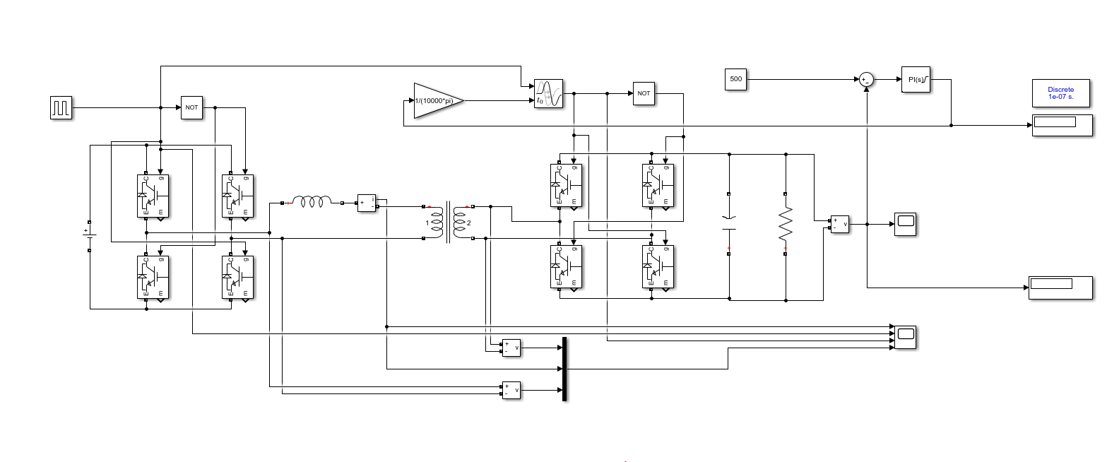
IBDC_DAB with PI control
IBDC_DAB by PI control in SPS way
Switching tunable
Silmiler to ltspice simulation result

Slide 25
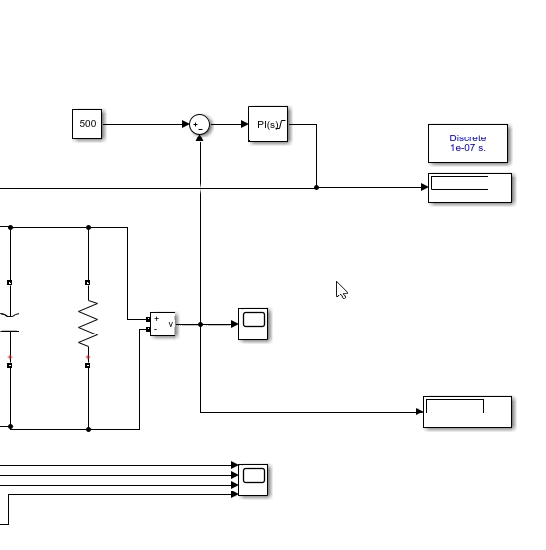
SPS control without Algorithom
Goal value
Error
Delay parameter
System output voltage

Slide 26
Future work
Proposal problem should be redefined
Discrete control design
SNN training software implementation
STDP(2015)
STBP(2018)
TSSL-BP(2020)

Slide 27
End
Thank you for listening

Slide 28
Traditional control architecture
Algorithom
MNPC(Minimum Non-Active Power Transmission Time Control)
GMBPC (Global Minimum Backflow Power Control)
REF. Backflow Power Optimization Control for Dual Active Bridge DC-DC Converters
Beijing Jiaotong University Fei Xiong accepted by MDPI in 10 August 2017

Slide 29
Expectation effect and problem
Problem1:
Condition:
optimized duty cycle(after ML training) don’t have the big difference compare with initial duty cycle(mathmetical model )
The optimized duty cycle is 30%(after ML training)
Switching Initial start from 25% (mathmetical model )
Problem2:
Condition :
optimized duty cycle(after ML training) don’t have the big difference compare with initial duty cycle(mathmetical model )
optimized duty cycle is 24% Initial start from 25%

Slide 30
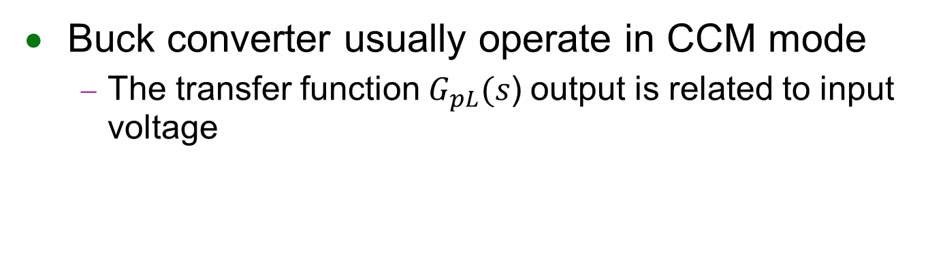
Feedback Stability (Voltage mode control)
Buck converter usually operate in CCM mode
The transfer function$G_{pL}(s$) output is related to input voltage
REF.切換式電源轉換器-吳義利
Notes:
須負載低於一定的值 才會操作在DCM

