Slide 1
Weekly Report
Presenter: Kuan-Hsun-Duh
Advisor: Cheng-Wen Wu
2021/10/26

Slide 2
Outline
Background
Architecture
Switching Component
Driving Circuit
Control Background
Backflow Power
Conclusion

Slide 3
Outline
Background
Architecture
Switching Component
Driving Circuit
Control Background
Backflow Power
Conclusion

Slide 4
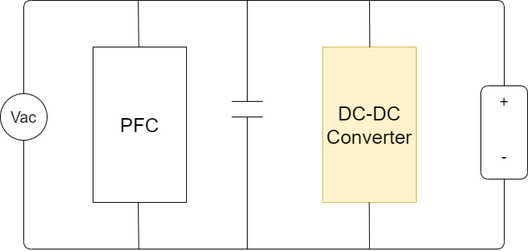
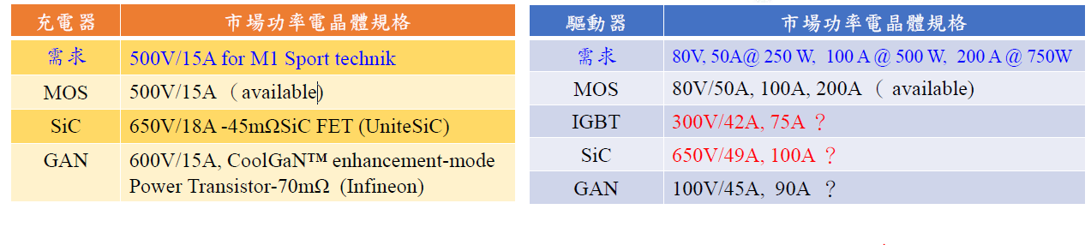
Background
Application : charging circuit
PFC : power factor circuit

Slide 5
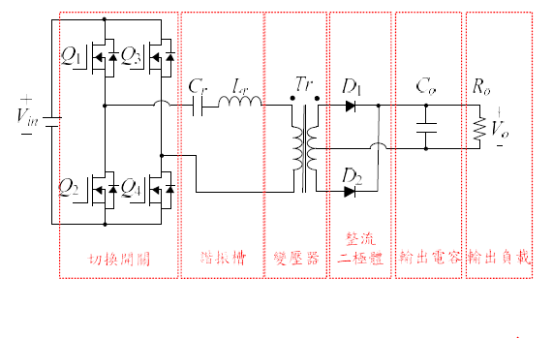
Architecture (Prof. Pai)
Full bridge converter with center‑tapped transformer
REF. 切換式電源轉換器 吳義利編著

Slide 6
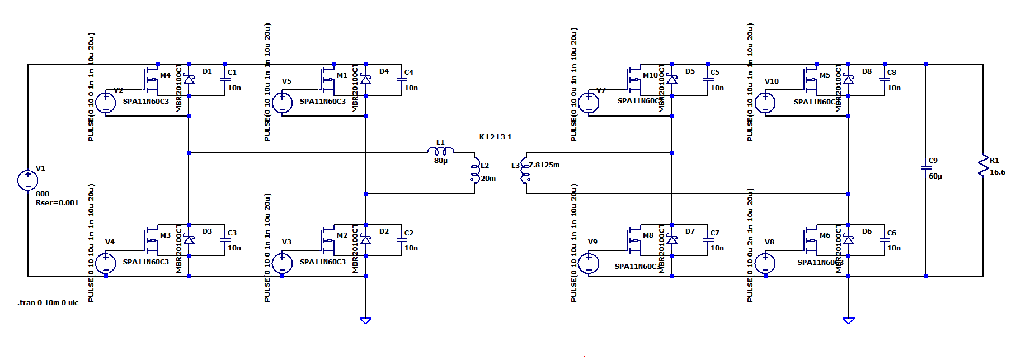
Architecture (Research)
A Study on Switching component of Dual Active Bridge DC-DC Converter for Battery Storage system

Slide 7
Switching Component
Background : SiC with high operating frequency with low conduction loss compared with IGBT & mosfet
Notes:
SiC $≅$ 300kHz 但頻率太高也不是說很建議
目前設計規格落在150K
IGBT < 100kHz for charging system
Mosfet $≅$ 100kHz for charging system
Cool mosfet 規格可更高
驅動器電路 $≅$ 20-30 kHz
PFC system <100kHz 但高電壓
GAN $≅$ 500kHz Apple 手機 低電壓
頻率越高 可以降低 感性的元件的設計 以及transformer 的設計大小
頻率越高也可以抑制 輸出的電壓連波

Slide 8
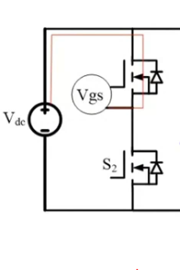
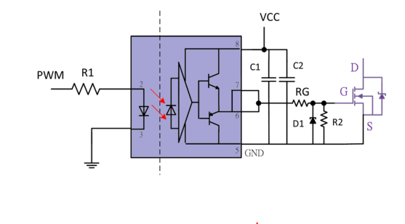
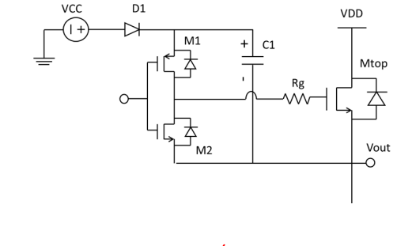
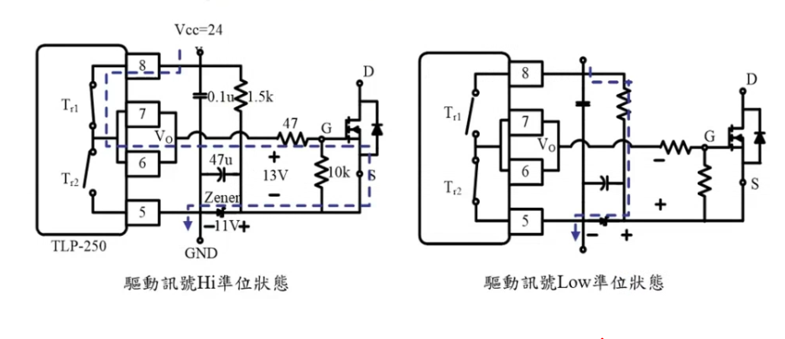
Driving Circuit
R1 限制電流大小
RG 控制驅動速度
Figure 1.
光耦合驅動 電→光→電
Figure 2.
自舉式隔離電路
Figure 3.
Figure 4.工作原理

Slide 9
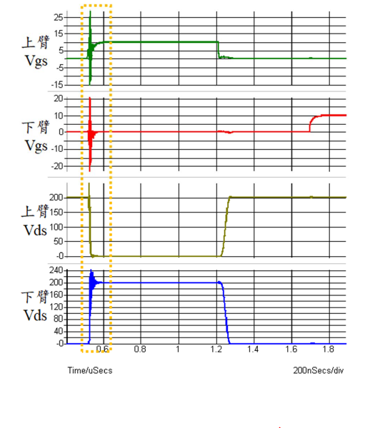
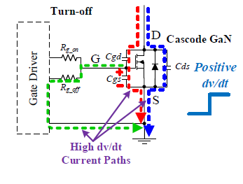
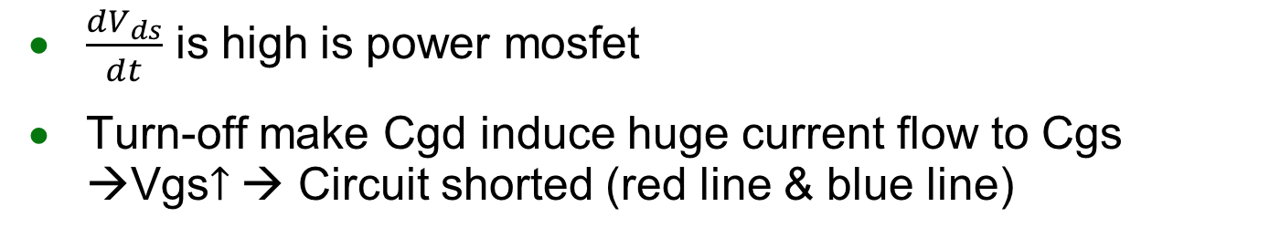
Driving Circuit Problem
$\frac{{dV}_{ds}}{dt}$ is high is power mosfet
Turn-off make Cgd induce huge current flow to Cgs →Vgs$↑$→ Circuit shorted (red line & blue line)

Slide 10
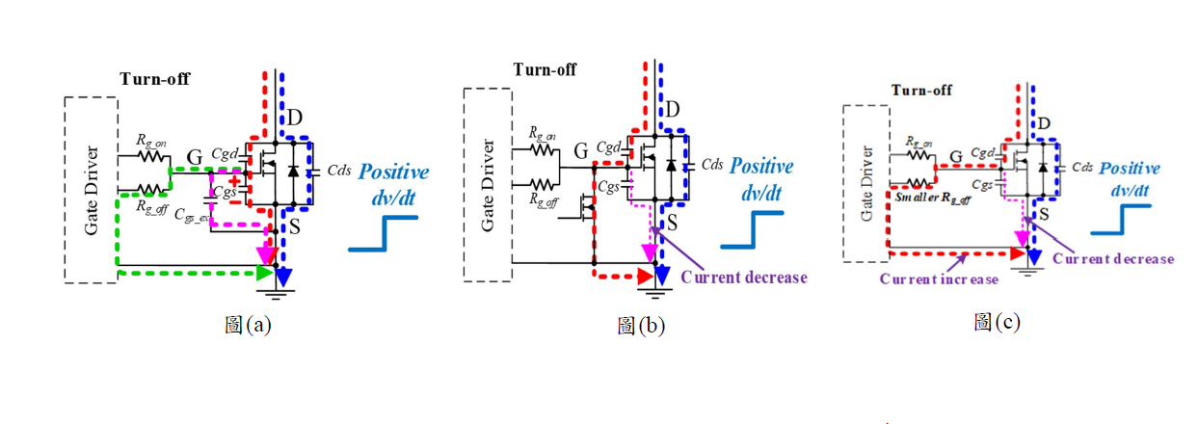

Driving Circuit Solution
Increase Cgs
Active Miller Clamp
${\text{Resistance}}_{off}↓$

Slide 11
Outline
Background
Architecture
Switching Component
Driving Circuit
Control Background
Backflow Power
Conclusion

Slide 12
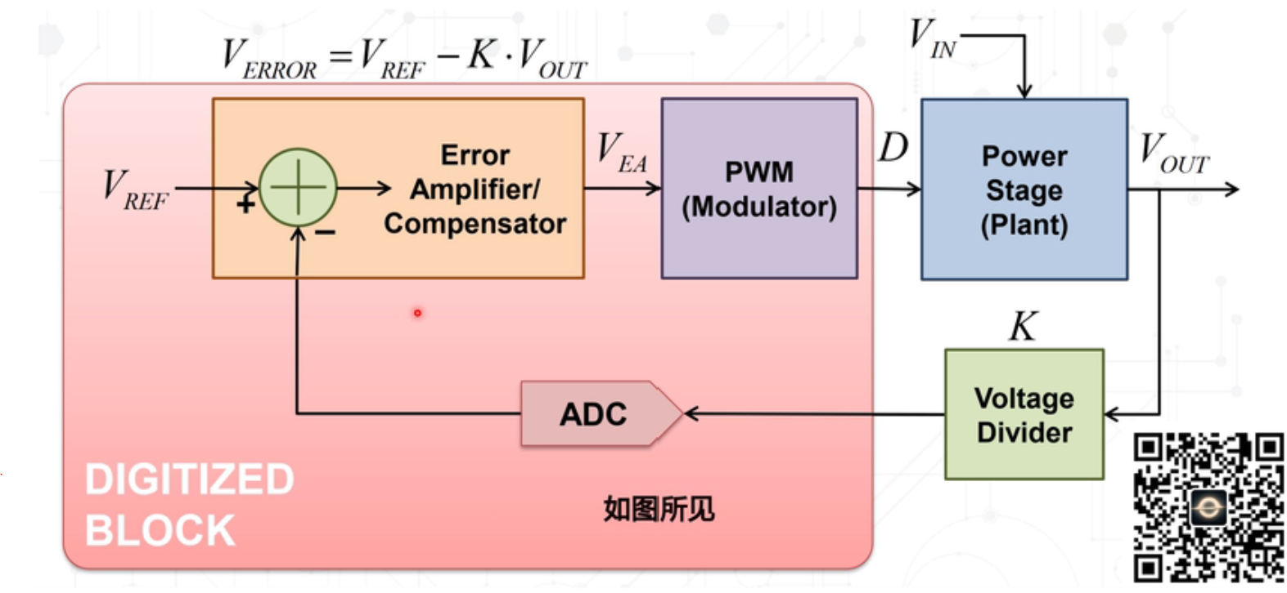
Control Background
Digital Control is less susceptible environmental variations , less sensitive to noise, easily adjusting
FPGA , Microcontroller unit
Sample freq > 10 freq

Slide 13
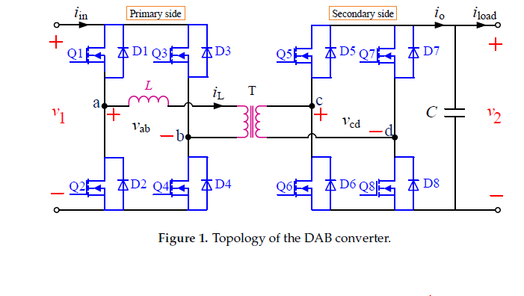
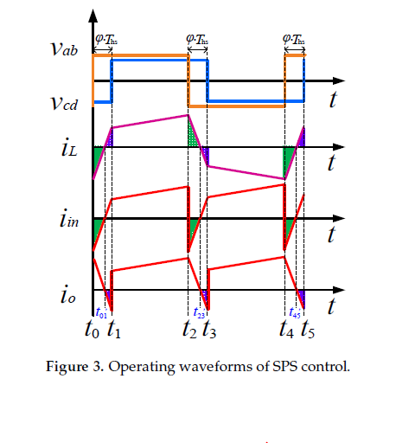
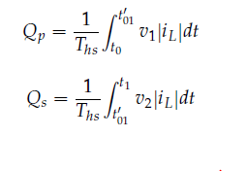
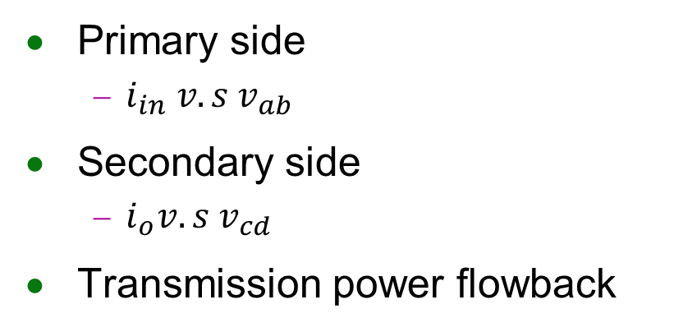
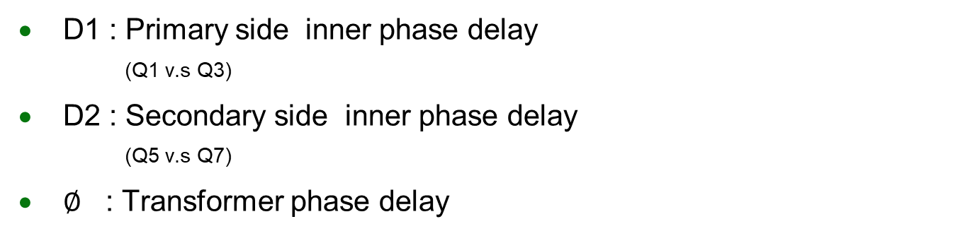
Backflow Power
Primary side
$i_{in} v.s v_{ab}$
Secondary side
$i_{o}v.s v_{cd}$
Transmission power flowback
D1 : Primary side inner phase delay
(Q1 v.s Q3)
D2 : Secondary side inner phase delay
(Q5 v.s Q7)
$∅$ : Transformer phase delay
REF. Backflow Power Optimization Control for Dual Active Bridge DC-DC Converters
Beijing Jiaotong University Fei Xiong accepted by MDPI in 10 August 2017

Slide 14
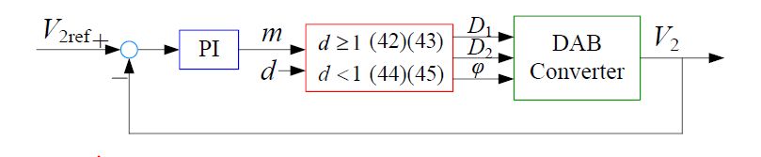
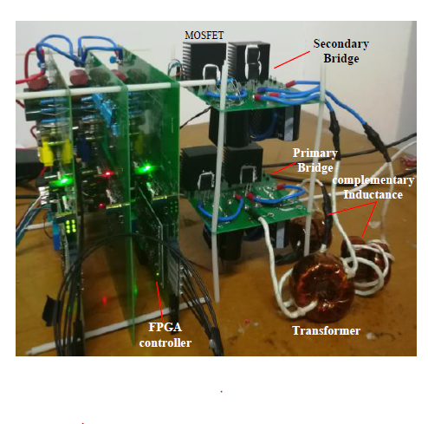
Implementation
Experiment flow
REF. Backflow Power Optimization Control for Dual Active Bridge DC-DC Converters
Beijing Jiaotong University Fei Xiong accepted by MDPI in 10 August 2017

Slide 15
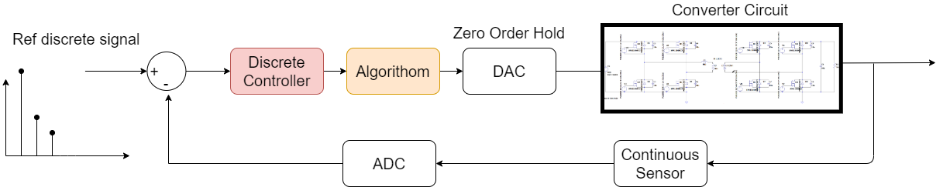
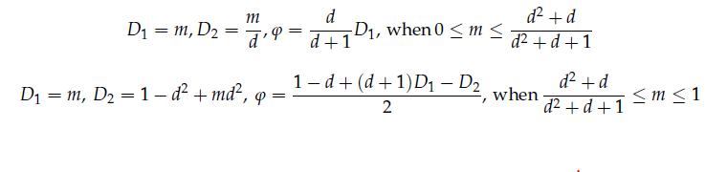
Experiment
Environment :
Matlab Simulink
Matlab Simscape library
REF. Backflow Power Optimization Control for Dual Active Bridge DC-DC Converters
Beijing Jiaotong University Fei Xiong accepted by MDPI in 10 August 2017

Slide 16
Outline
Background
Architecture
Switching Component
Driving Circuit
Control Background
Backflow Power
Conclusion

Slide 17
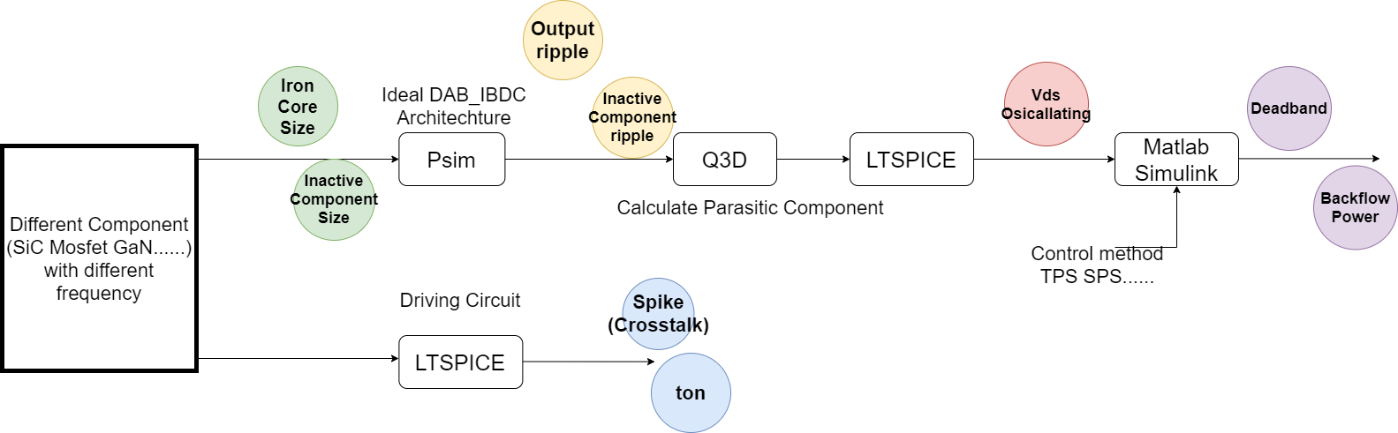
Conclusion
Future Work
Analyze different component (SiC Mosfet GaN......)operate at different frequency in DAB_IBDC
Experiment on LTSPICE & PSIM & Q3D
Experiment on Matlab for discrete control system

