Slide 1
Weekly Report
Presenter: Kuan-Hsun-Duh
Advisor: Cheng-Wen Wu
2021/11/09

Slide 2
Outline
Background
Proposal
Conventional Architecture
Proposed Architecture
Experiment Flow
Conclusion
Future Work
Preview Seminar
Prof.Pai & ITRI comment

Slide 3
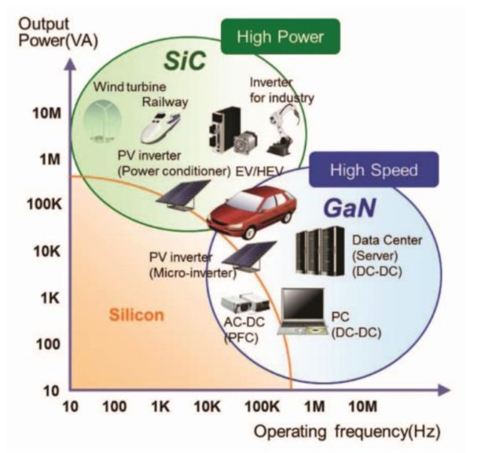
Background
In high power applications , in which the discrete power switches are mounted on separate heatsinks , an overload of a semiconductor device leads to a local excessive thermal stress and eventually to a failure of the system.
Notes:
降thermal
基於有redundant 的 architecture 變動 Control 策略
基於 附載端降載 的策略

Slide 4
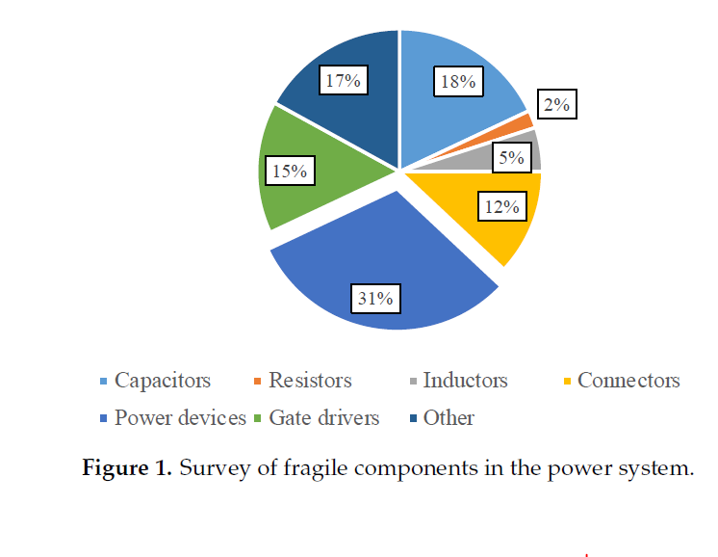
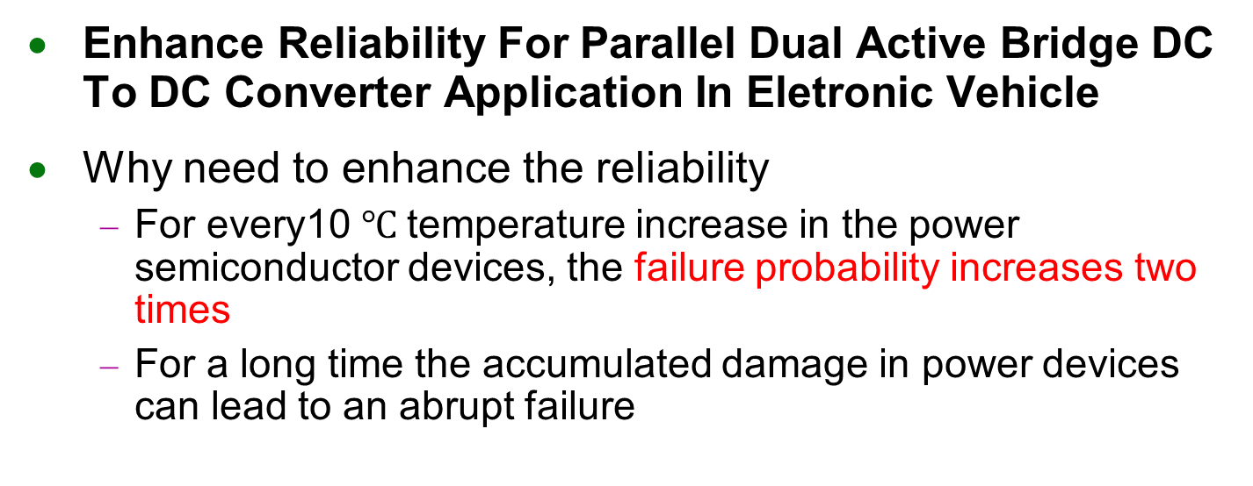
Proposal
Enhance Reliability For Parallel Dual Active Bridge DC To DC Converter Application In Eletronic Vehicle
Why need to enhance the reliability
For every10 $℃$temperature increase in the power semiconductor devices, the failure probability increases two times
For a long time the accumulated damage in power devices can lead to an abrupt failure
Notes:
Why choose DAB_IBDC?
Reducing transformer size compare with the center taped transformer
The switch is many need conduction loss concern but SiC can solve this problem

Slide 5
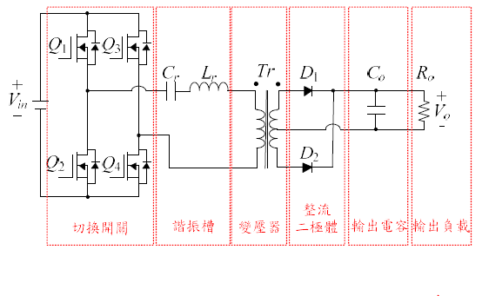
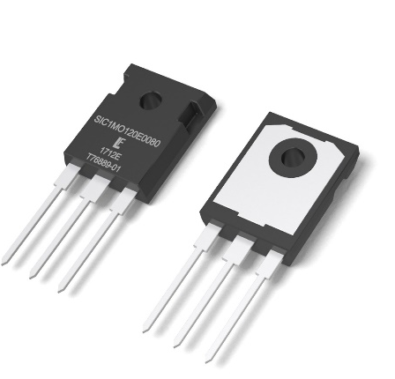
Proposal
Enhance Reliability of Semiconductor Devices In Dual Active Bridge DC To DC Converter
Why choose DAB_IBDC?
Reducing transformer size compare with the center taped transformer
Figure 1.
Center taped converter
Figure 2.
SiC Transistor
REF. Enhance Reliability of Semiconductor Devices in Power Converters
Chung-Ang University, Korea
Author : Minh Hoang Nguyen Sangshin Kwak
Accepted by MDPI 2 December 2020

Slide 6
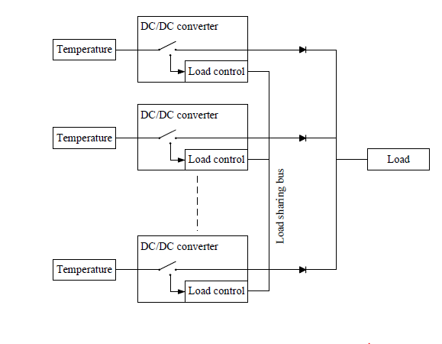
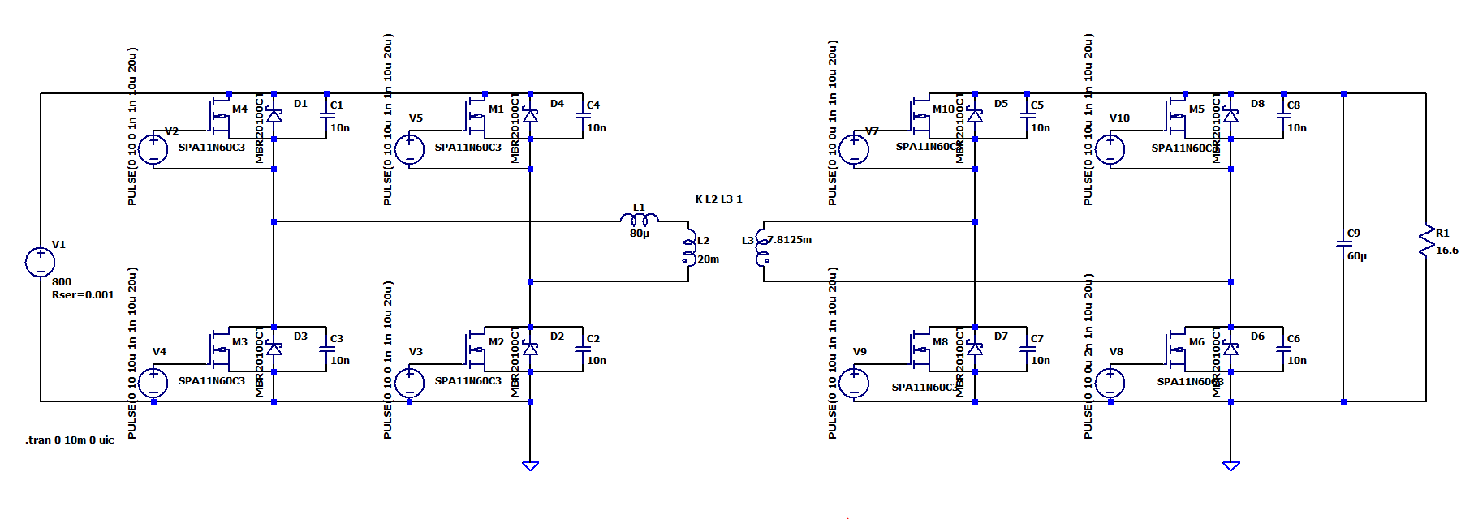
Conventional Architecture
Parallel Dual Active Bridge DC To DC Converter
Switching Component : SiC, GaN
Control method : Parallel , Droop control
Figure 1.
DAB_IBDC Architecture
Figure 2.
Parallel Control

Slide 7
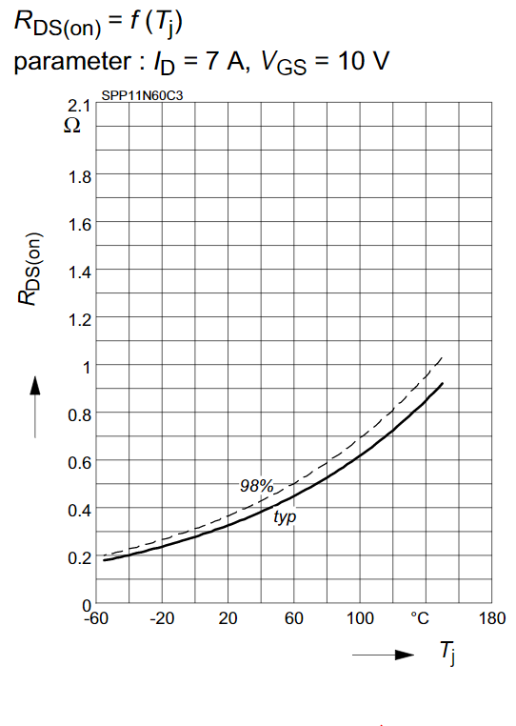
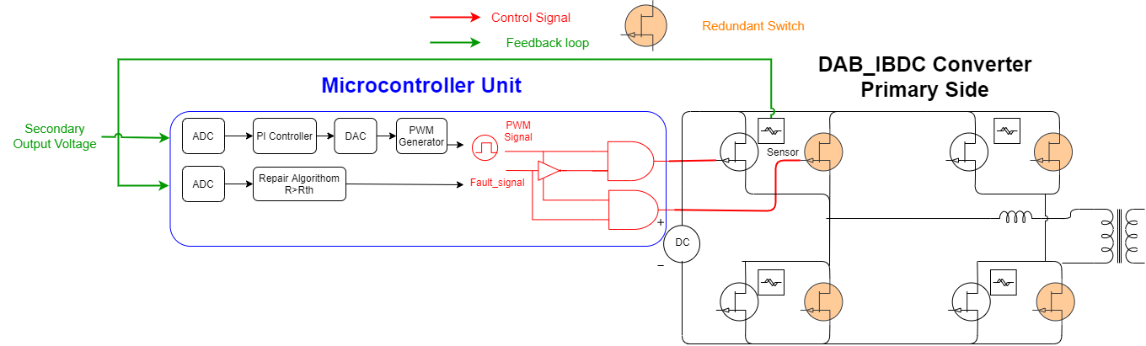
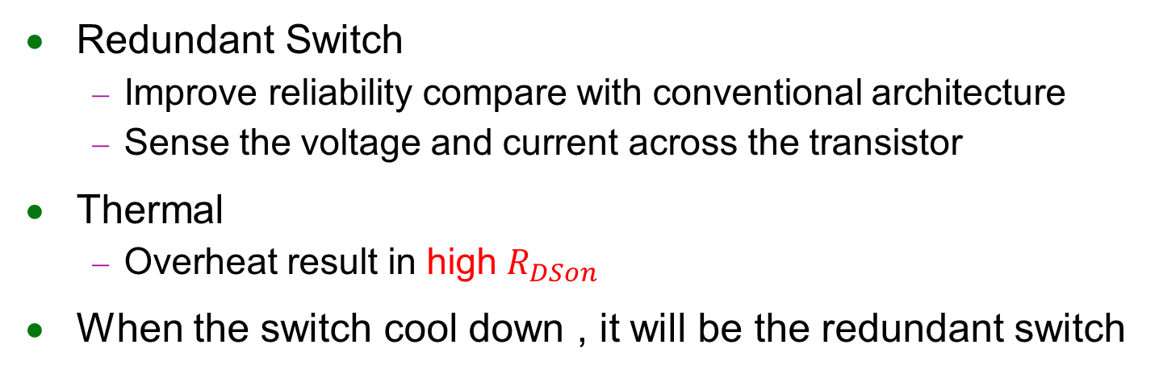
Proposed Architecture
Redundant Switch
Improve reliability compare with conventional architecture
Sense the voltage and current across the transistor
Thermal
Overheat result in high $R_{DSon}$
When the switch cool down , it will be the redundant switch
Notes:
Add nothing in this architechture
Schottky diode），又譯肖特基二極體，是一種導通電壓降較低、允許高速切換的二極體，
Parallel Capacitor for fast switching design
實際布線 會遠離線路 溫度傳遞應不會影像到另一顆 SWITCH
考慮狀況 同時FAIL 的時候 要怎麼設計 誰先repair
若反覆幾次溫度都一直升高是否要切換switch 還是就乾脆捨棄
Rth can adjust by the real circuit experiment
Because the digital control is flexibility

Slide 8
Advantages
Redundant Switch enable the system operate in high efficenicy instead decreasing the load
Droop control lead to a slight increase in the failure rate can be solved
The repair algorithom is flexible which can be adjust by the real circuit situation
Although there is trade-off between reliability & cost the cost for implementing the system is not high though
Without adding extra component compare to the parallel converter system
Notes:
Problem1
Conventional circuit has problem with upper switch short with lower switch especially in high frequency
the crosstalk situation will become terrible caused by parasitic component osicalating
Problem2
Power mosfet has high dv/dt rate which cause a spike when turning on

Slide 9
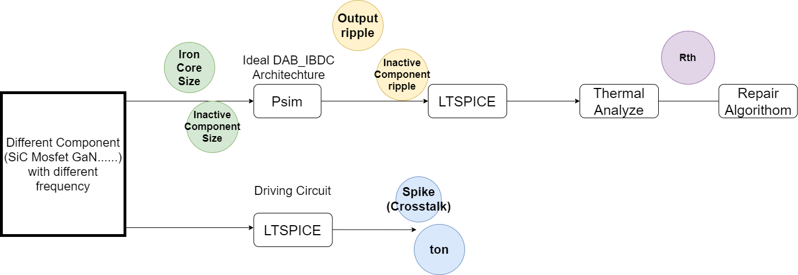

Experiment Flow
Find suitable component for the application
Switching parameter $t_{on} , { t}_{off }$effect the repair algorithom
Adjustment the $R_{threshold }$as the time passed
Multiple switch overheat problem
Notes:
Switching 排列方式的不同會導致 砸散元件的分布不同
不同的元件需要不同的repair 演算法 來完成 因為ton toff 時間不一定
需考量worst case 同時導通的狀況 電容有大電流
Need time buffer desigh for safe turn on
優勢
不用降低 負載 可持續運轉充電
利用率得到提高

Slide 10
Conclusion
Future Work
Analyze different component (SiC Mosfet GaN......)operate at different frequency in DAB_IBDC
Experiment on LTSPICE & PSIM
Build up the Repair Algorithom

Slide 11
Conclusion
Prof.Fang
Is the component has the overheat problem ?
Si mosfet has the thermal run-away charteristic ?
Is the cost too high for the system ?
Do we nee to implement to the real chip ?
ITRI Supervisor
Do we need to have a relationship with SiC component in my research
Temprature problem is too straight forward for a research
Is the redundant switch is only for backup ?
Control strategy should be more specific
Capability for single phase and three phase at the same time
Pridict the future situation
Notes:
A : Using psim & ltspice to stimulate the circuit behavior

Slide 12
Conclusion
Seminar topic
Reviews recent advances in the area of reliability research for power semiconductor devices
REF.Enhance Reliability of Semiconductor Devices in Power Converters
Chung-Ang University, Korea
Author : Minh Hoang Nguyen Sangshin Kwak
Accepted by MDPI 2 December 2020
Estimation techniques
Condition Monitoring
Active Thermal Control
Remaining useful lifetime
Notes:
llow journal
MDPI or Multidisciplinary Digital Publishing Institute is a publisher of open access scientific journals

Slide 13
Comment
ITRI Supervisor
Redundancy is not permit to do in real case
If I have 2 switch it should be 1 switch is working the other 1 switch on when it is heavy load situation they work at the same time
If temperature detection is valid we should concern about how to switch on & switch off (control method)
Power system redundancy importance < Power system protection
Stimulation and real case
連結 fault tolerance 與車用 是可以的
1.感測機制 2.預測到未來的狀況
作動機制 是不是要探討切換時要 smooth(已經幾乎被探討玩了)

Slide 14
Note
Application for on borad charger 380V 3 phase
The charger support for single phase and 3 phase at the same time
3 independent single phase converter
Current 偵測為 Average 或是偵測暫態

Slide 15
End
Thank you for listening

Slide 16
Backup

Slide 17
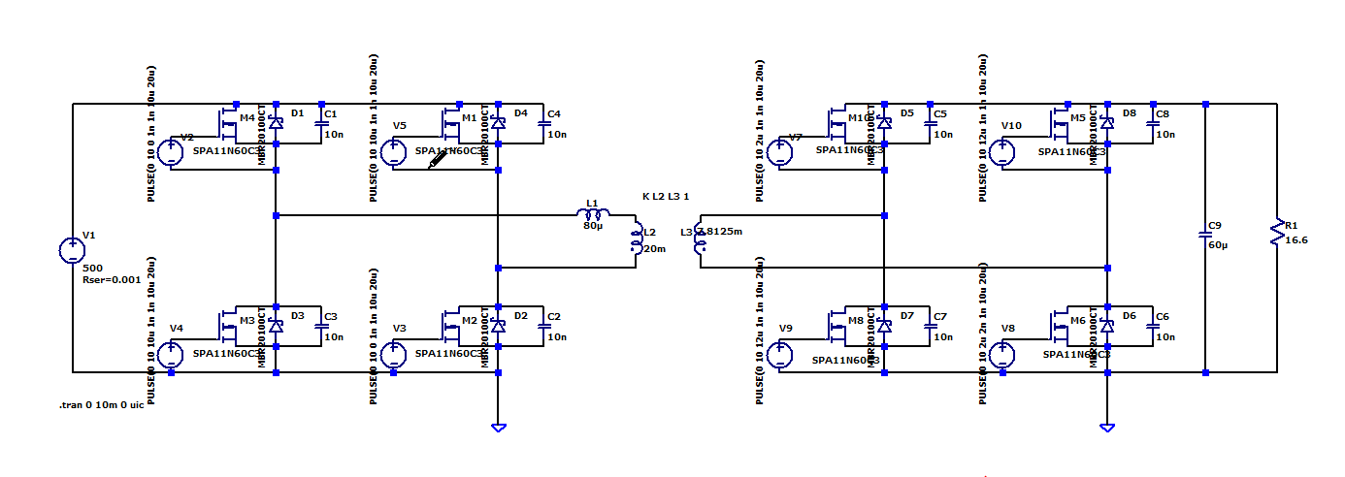
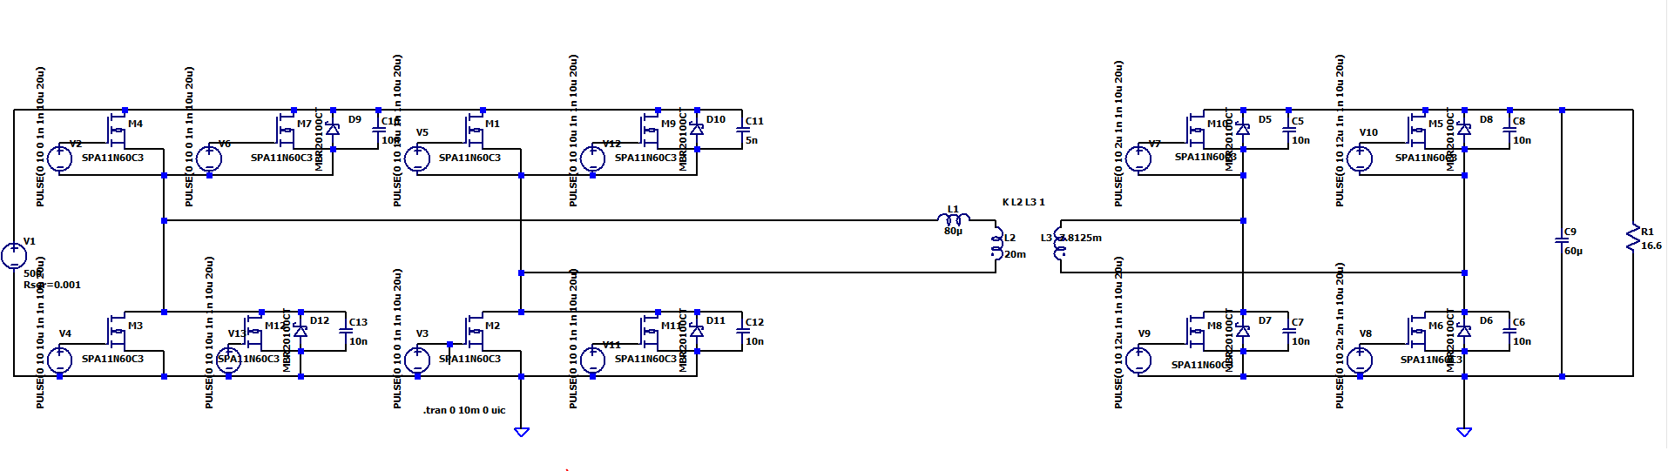
Experiment
Conventional
Proposed(2 pair switch on the same time)

Slide 18
Experiment
Conventional
Proposed(2 pair switch on the same time)

Slide 19
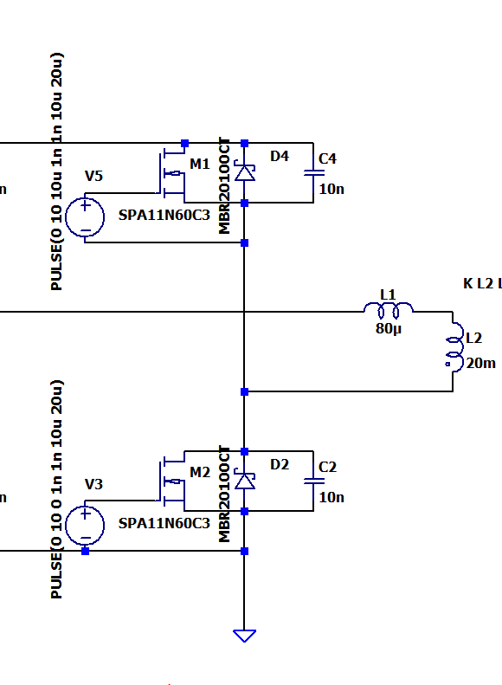
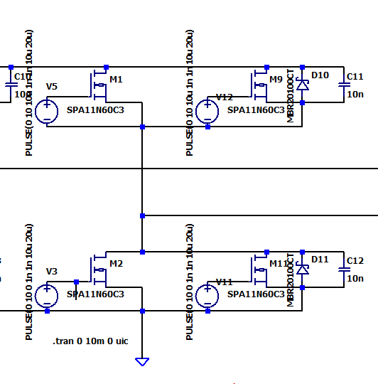
Experiment Result
 | Convertional | Parallel(2 pair switch on the same time)
Capacitor up(ON) | -41 | -48
Capacitor up(OFF) | 41 | 48
TOTAL(OFF) | 56.97088 | 113
TOTAL(ON) | 40.89 | 109
Capacitor_Down(ON) | 40 | 73
Capacitor_Down(OFF) | -40 | -73
Proposed(2 pair switch on the same time)

Slide 20
Question About Architecture
Why not choose series architecture
一個switch fail 另一個也就不能運作
Why not choose parallel architecture
Switch 上的電流並不會比較小
Why not add resistance
產生不必要的loss 再resistance上

Slide 21
Note
Failure type
Failures derived from development or manufacturing errors
Overstresses (electrical, mechanical, thermal) related to the application and not listed as such by the user (the occurrence of the overstress remained concealed).

