Slide 1
Seminar
Enhance Reliability Of Semiconductor Devices
In Power Converters
Institute : Chung-Ang University, Seoul, Korea
Author : Mr. Hoang Nguyen , Sangshin Kwak
Accepted by MDPI at 2 December 2020
Presenter: Kuan-Hsun-Duh
Advisor: Cheng-Wen Wu
2021/11/23
Notes:
llow journal
MDPI or Multidisciplinary Digital Publishing Institute is a publisher of open access scientific journals

Slide 2
Outline
Background
Proposal
Conventional Architecture
Proposed Architecture
Experiment Flow
Conclusion
Future Work
Preview Seminar
Prof.Pai & ITRI comment

Slide 3
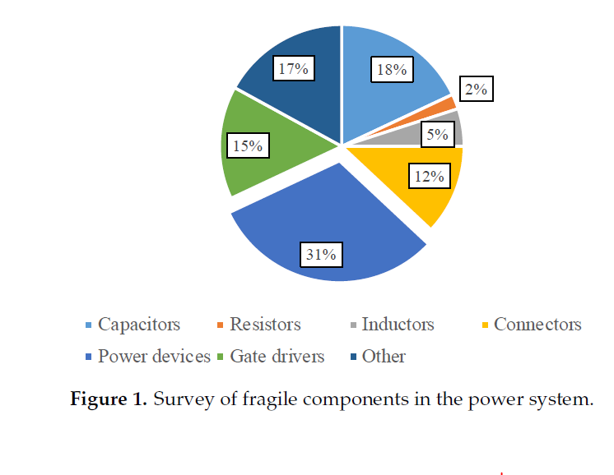
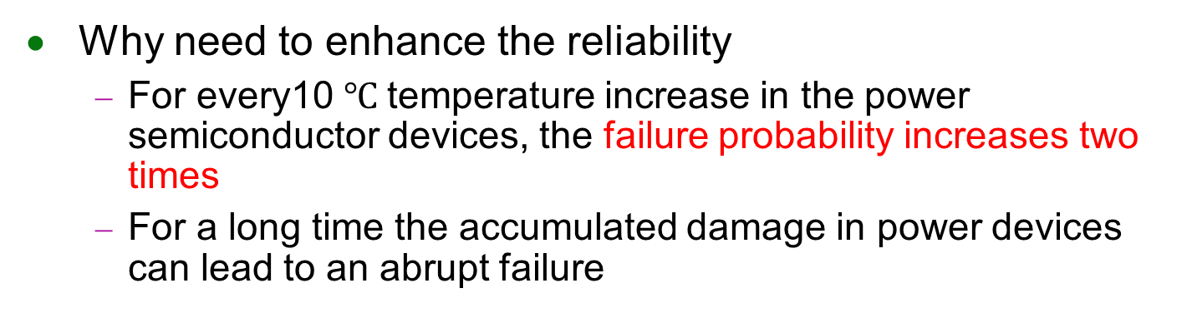
Background
Why need to enhance the reliability
For every10 $℃$temperature increase in the power semiconductor devices, the failure probability increases two times
For a long time the accumulated damage in power devices can lead to an abrupt failure
Notes:
Why choose DAB_IBDC?
Reducing transformer size compare with the center taped transformer
The switch is many need conduction loss concern but SiC can solve this problem

Slide 4
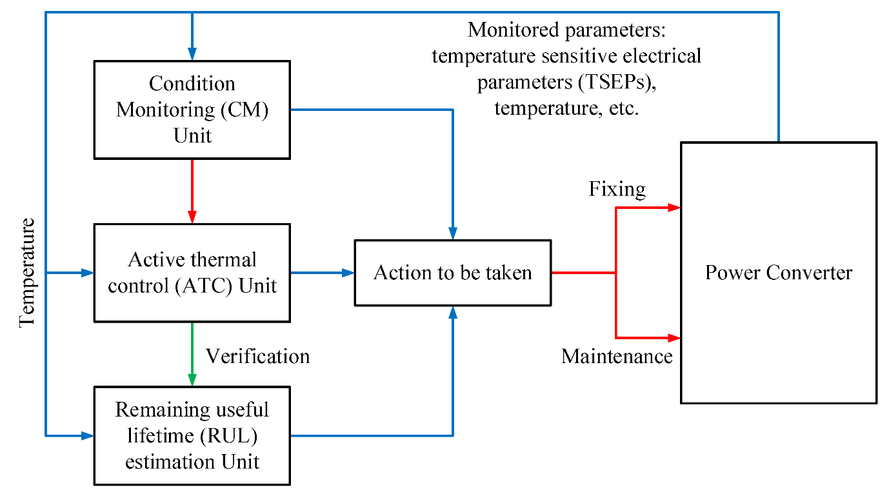
Estimation techniques
Condition Monitoring
Phsical measurement
Active Thermal Control
Thermal stress control
Remaining useful lifetime
Verify the ATC effect
Notes:
The basis of CM is to select a physical measurement, which indicates that failures or degradation can occur in the power system. Based on the result of CM, the proper actions can be applied to avoid sudden system shutdown or scheduled maintenance. The implementation of CM requires a power semiconductor device’s failure mechanism knowledge, which will be presented and discussed in this paper.
In addition to CM, ATC is another method to improve the reliability of power semiconductor devices. As depicted in Figure 2, the degradation indicator information obtained from online CM techniques can be applied, to not only passively update, but also actively control the system lifetime, using ATC.
As stated before, thermal stress is the root cause of the failures in power semiconductor devices. The ATC method eases the thermal stress of the components either by lowering the temperature fluctuation amplitude or by lowering the average temperature, while the converter does not need any modification, meaning that there may be no extra cost for the enhancement of the converter design or components.
However, the trade-off between the thermal control capability and the performance of the power system should be considered. Regarding the RUL estimation technique, it is generally utilized to design ATC and verify the effect of ATC

Slide 5
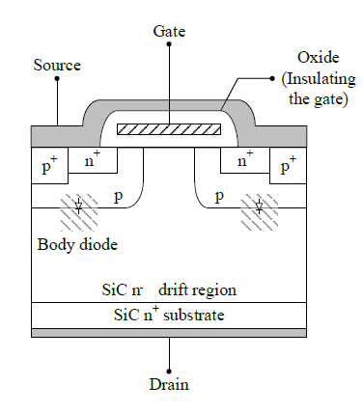
Failure Mechanism
High temperature high electric field stress → Gate oxidation degradation → Vth increase ; gate leakage current increase ; gate oxide capacitance increase → Miller plateau increase
Forward bias volatage stress → Body diode degradation ; Rdson increase dran leakage current increase

Slide 6
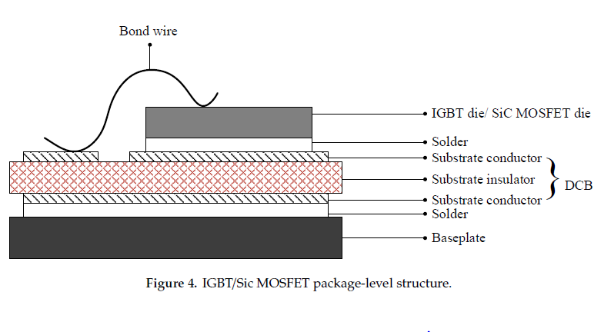
Failure Mechanism
Different CTE → Bond wire crack , lift-off→Rdson increase(Vds)
Temperature increase CTE mismatch→The solder failure → increase in Thermal resistance(junction to case temperature)
Notes:
Because monitoring all of the electrical parameters is not practicable in a power converter, specific parameters should be recognized depending on the dominant aging failure mechanism.
Rdson as indicator in package failure
→ Bond wire crack (些微斷裂) lif-off(直接斷裂)→Rdson increase(IGBT 量測 Vce Mosfet 量測 Vds)

Slide 8
Conclusion
Seminar topic
Reviews recent advances in the area of reliability research for power semiconductor devices
REF.Enhance Reliability of Semiconductor Devices in Power Converters
Chung-Ang University, Korea
Author : Minh Hoang Nguyen Sangshin Kwak
Accepted by MDPI 2 December 2020

Slide 9
End
Thank you for listening

Slide 10
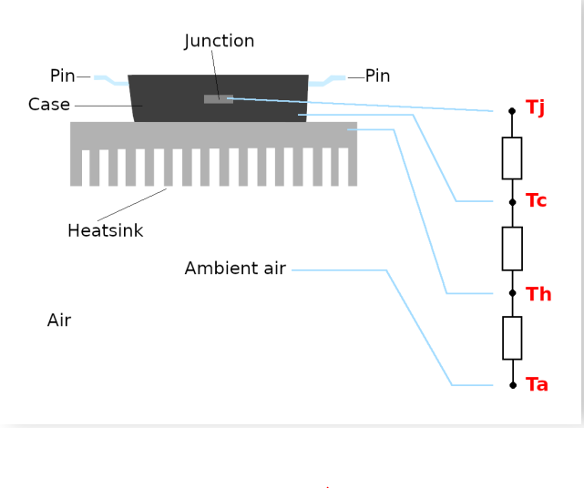
Backup

