Slide 1
Weekly Report
Presenter: Kuan-Hsun-Duh
Advisor: Cheng-Wen Wu
2021/04/01

Slide 2
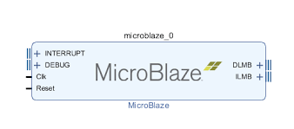
UART communication with FPGA
IP List
MicroBlaze(soft-core processor)
Architechture can be configurable
Enable interrupt mode
Interrupt module cannot have empty connection
Uart_16550
Axi_uartlite cannot be used
Connect the interrupt line to the microblaze
CP2102 has a max baud rate of 1 Mbps.
Notes:
architechture cache size, pipeline depth (3-stage, 5-stage, or 8-stage), embedded peripherals, memory management unit, and bus-interfaces
MicroBlaze's overall throughput is substantially less than a comparable hard CPU core (such as the ARM Cortex-A9 in the Zynq).
32-bit/64-bit

Slide 3
SDK C code design
Prog Image_filter
Step1 PC send a photo (bmp format )to FPGA and store data in local cache.
Step2 microblaze processor do some calculation with pixel value(255-pixel value)
Step3 FPGA send back the calculated data to PC port and store the data as bmp format.

Slide 4
SDK C code design
使用 teraterm 傳送資料時 必須選用二進制
使用 日記生成圖片時 必須選用二進制
若程式中迴圈失效 可能是FPGA 設計的memory 不足夠使用導致 迴圈設計失效 FPGA design 的memory 大小可於 Linker Script 文件中查看
Uart 傳輸中若遇到資料遺失 可用兩種方法解決#include “sleep.h” 加入wait 的設計 若上述方法仍無法解決則可依 缺失的資料數補足 dummy data 0x00
#include “xuartns550_i.h”#include “xuartns550.h“ uart driver C code 函式庫
#include <stdlib.h> 記憶體宣告函式庫

Slide 5

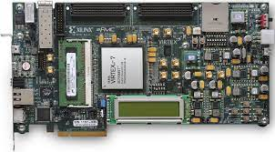

System design flow
1. Image 512*512 bmp format
3. Send back data to PC
2. Filter process
(255-pixel value)
Teraterm is used monitoring COM PORT

Slide 6
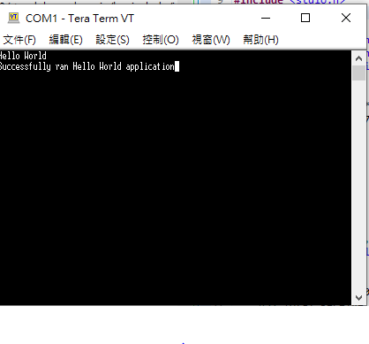
Prog1 Result

Slide 7
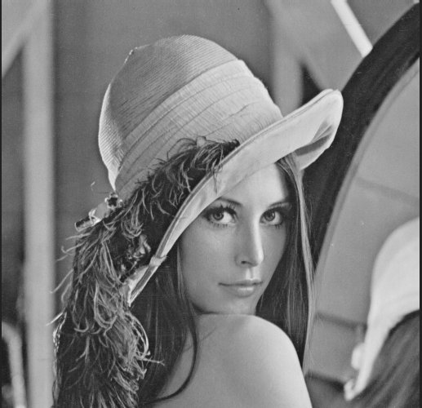
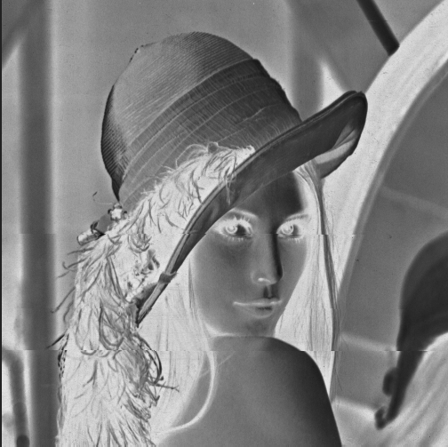
Prog2 Result
Image filter

Slide 8
Future Work
與昱佑 PC 端 程式互接 傳送圖片或 影像
與亞淇 的control module 互接

