Slide 1
Weekly Report
Presenter: Kuan-Hsun-Duh
Advisor: Cheng-Wen Wu
2021/04/01

Slide 2
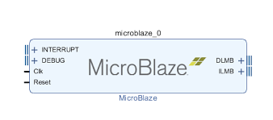
UART communication with FPGA
IP List
MicroBlaze(soft-core processor)
Architechture can be configurable
Enable interrupt mode
Interrupt module cannot have empty connection
Uart_16550
Axi_uartlite cannot be used
Connect the interrupt line to the microblaze
CP2102 has a max baud rate of 1 Mbps.
Notes:
architechture cache size, pipeline depth (3-stage, 5-stage, or 8-stage), embedded peripherals, memory management unit, and bus-interfaces
MicroBlaze's overall throughput is substantially less than a comparable hard CPU core (such as the ARM Cortex-A9 in the Zynq).
32-bit/64-bit

Slide 3
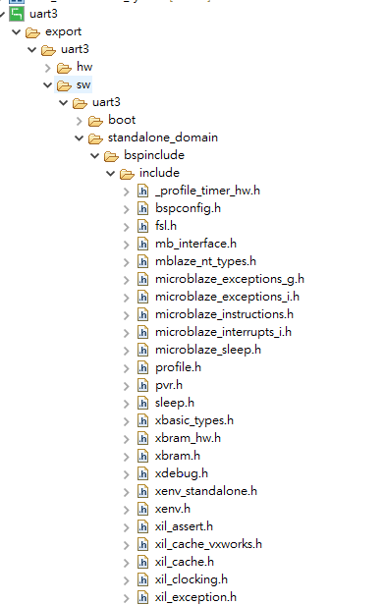
SDK C code design
Environment:Vitis Software Platform
Prog1 FPGA Send Message To UART
The microblaze send message by byte to PC port and display the result in terminal
Library : xil_printf.h
Src資料夾右鍵>New>other>C/C++
>Source file(新增C code file)
Xil_printf 函式

Slide 4
SDK C code design
Prog2 Image_filter
Step1 PC send a photo (bmp format )to FPGA and store data in local cache.
Step2 microblaze processor do some calculation with pixel value(255-pixel value)
Step3 FPGA send back the calculated data to PC port and store the data as bmp format.

Slide 5
SDK C code design
使用 teraterm 傳送資料時 必須選用二進制
使用 日記生成圖片時 必須選用二進制
若程式中迴圈失效 可能是FPGA 設計的memory 不足夠使用導致 迴圈設計失效 FPGA design 的memory 大小可於 Linker Script 文件中查看
Uart 傳輸中若遇到資料遺失 可用兩種方法解決#include “sleep.h” 加入wait 的設計 若上述方法仍無法解決則可依 缺失的資料數補足 dummy data 0x00
#include “xuartns550_i.h”#include “xuartns550.h“ uart driver C code 函式庫
#include <stdlib.h> 記憶體宣告函式庫

Slide 6

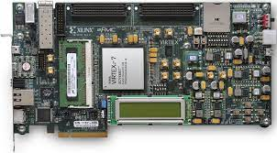

System design flow
1. Image 512*512 bmp format
3. Send back data to PC
2. Filter process
(255-pixel value)
Teraterm is used monitoring COM PORT

Slide 7
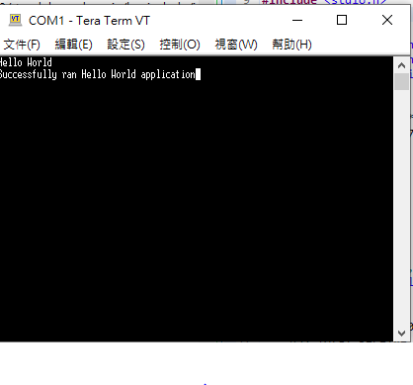
Prog1 Result

Slide 8

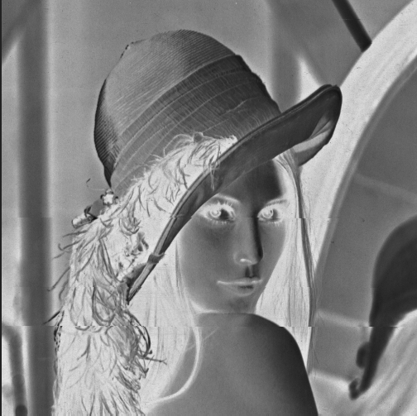
Prog2 Result
Image filter

Slide 9
Future Work
與昱佑 PC 端 程式互接 傳送圖片或 影像
與亞淇 的control module 互接

Slide 10
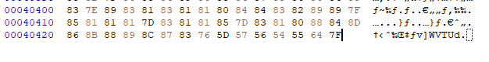
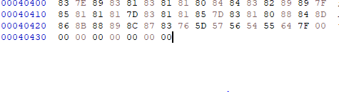
Missing image data
補足DATA

Slide 11
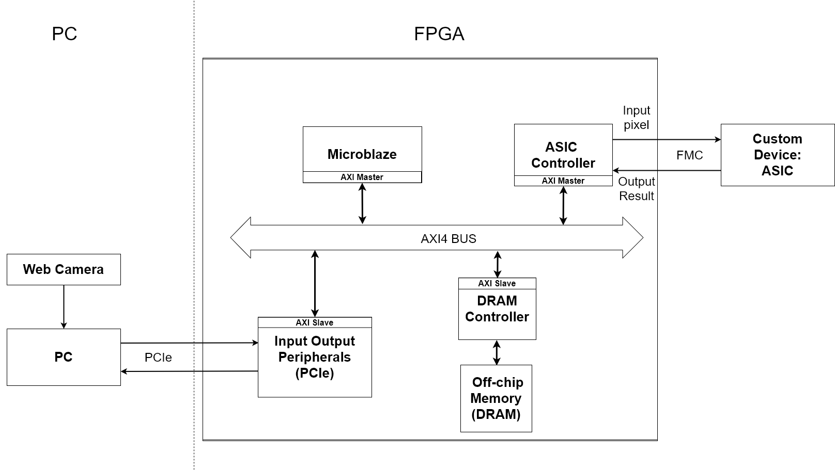
Block diagram

Slide 12
SRAM
set_property CLOCK_DEDICATED_ROUTE BACKBONE [get_nets design_1_i/clk_wiz_1/inst/clk_in1_design_1_clk_wiz_1_0]
Clock port 針對不同頻率 設計出不同的port 相接

Slide 13
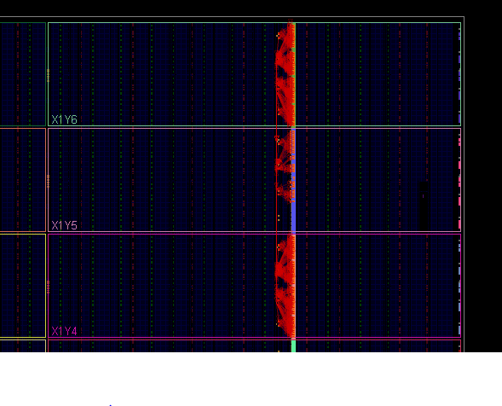
system clock design

Slide 14
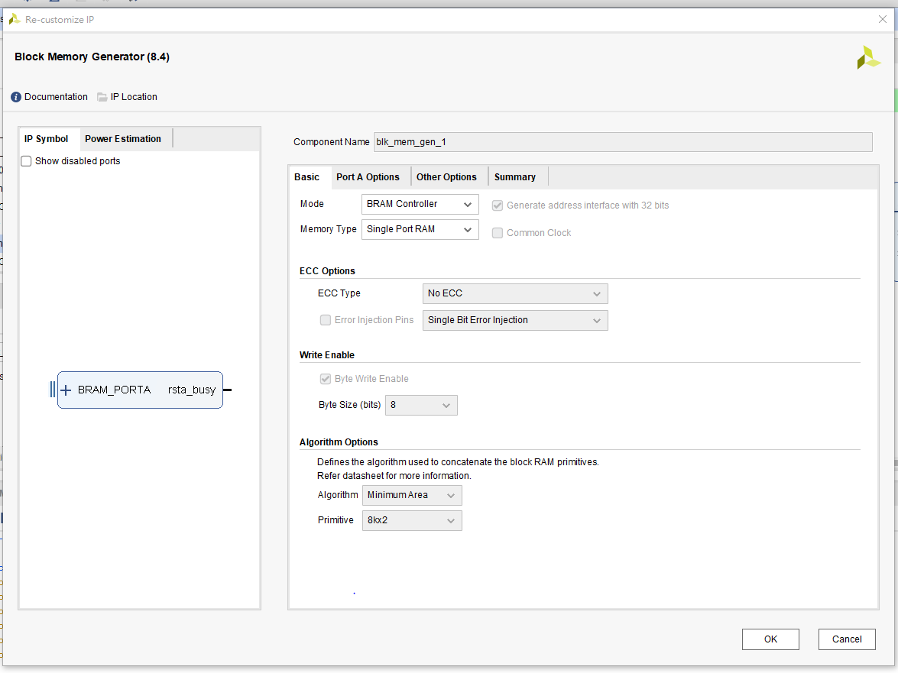
Block mem default

Slide 15
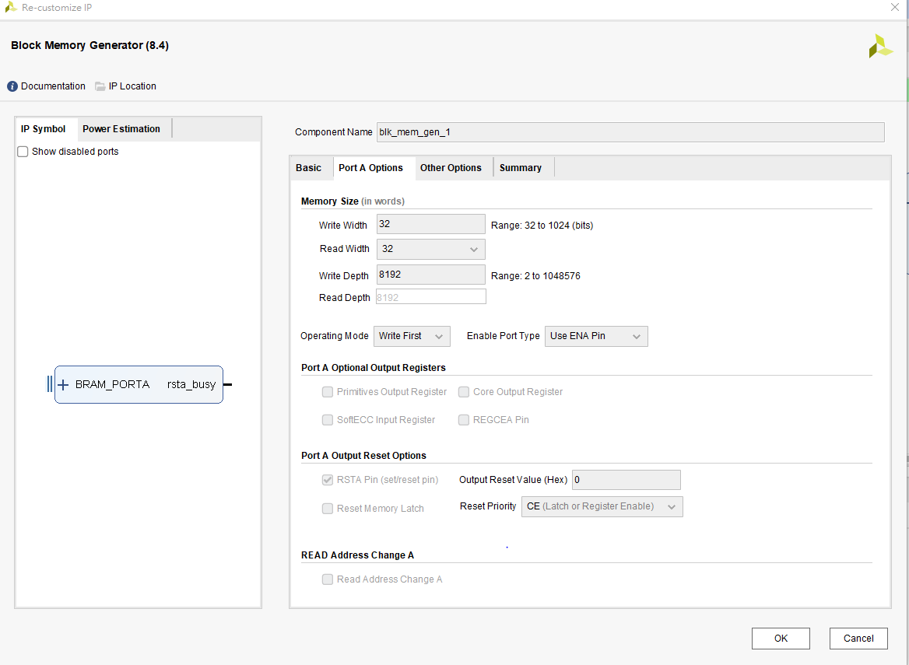
Block mem default

Slide 16
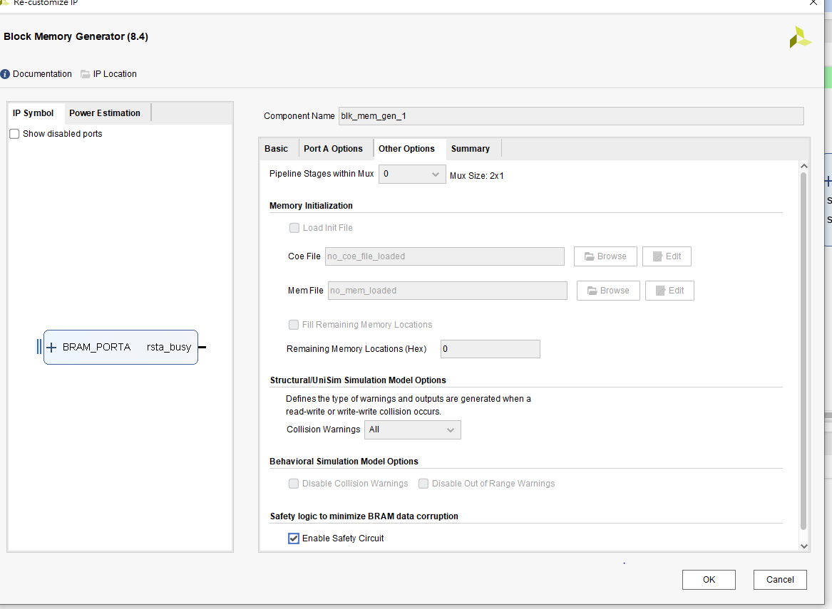
Block mem default

Slide 17
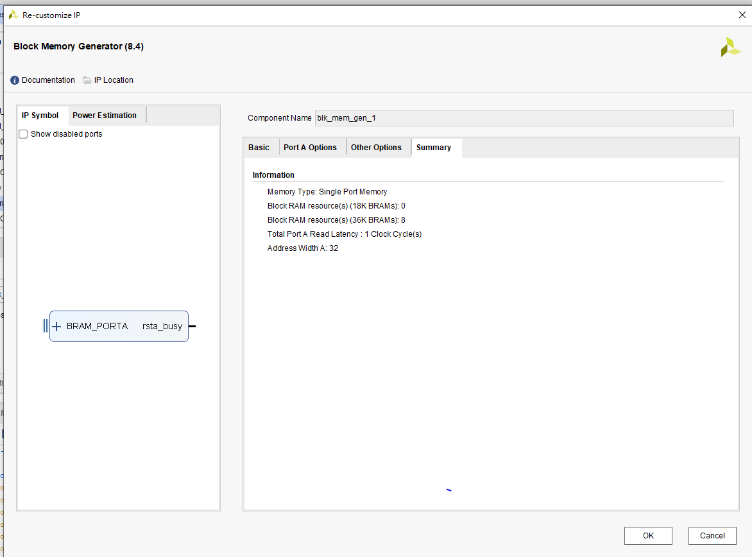
Block mem default

Slide 18
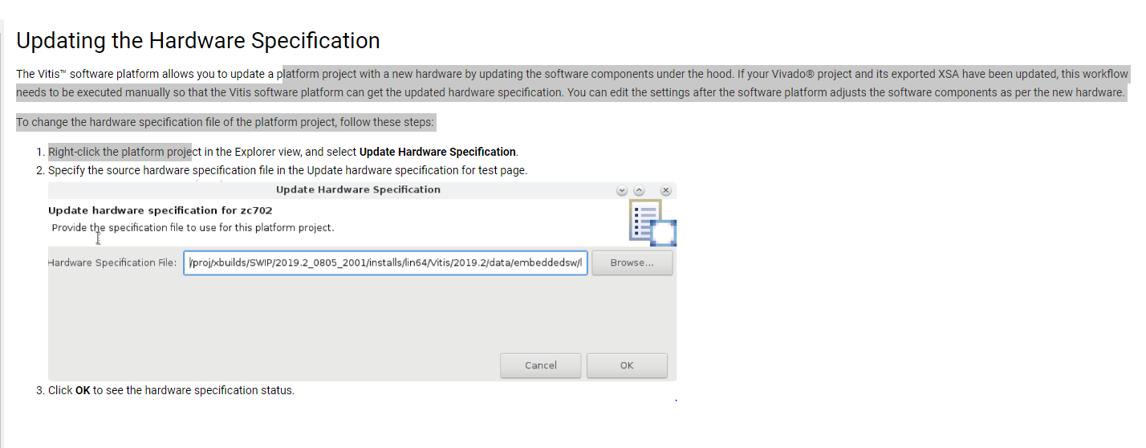
XSA file update in IDE

Slide 19
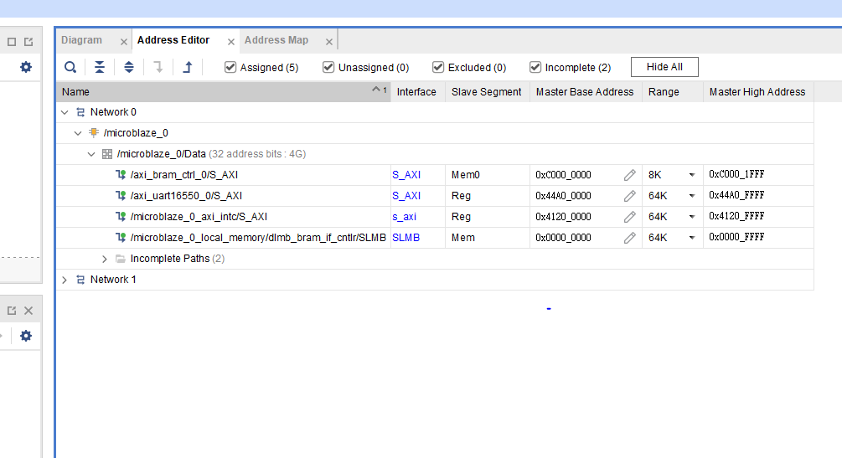

Mem size adjustment
KB
Click HDL Wrapper will update design
8K=$2^{13}=2^{4^{3}}∗2^{1}$=0x2000(byte mem address)

Slide 20
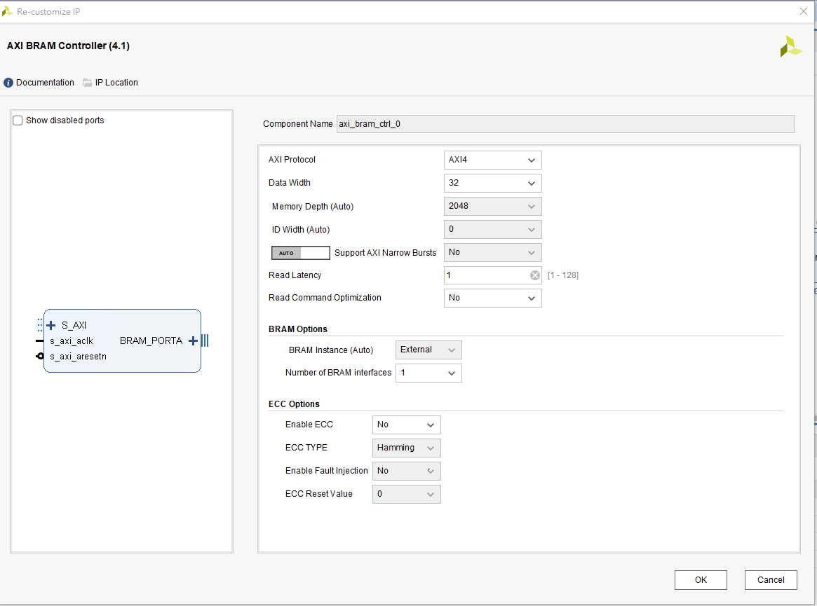

MEM ckeck
8K= $2^{13}$=4(1word 4 byte)=> $2^{11}(2048)$

Slide 21
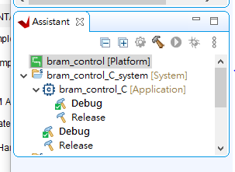
XSA file update in IDE

Slide 22
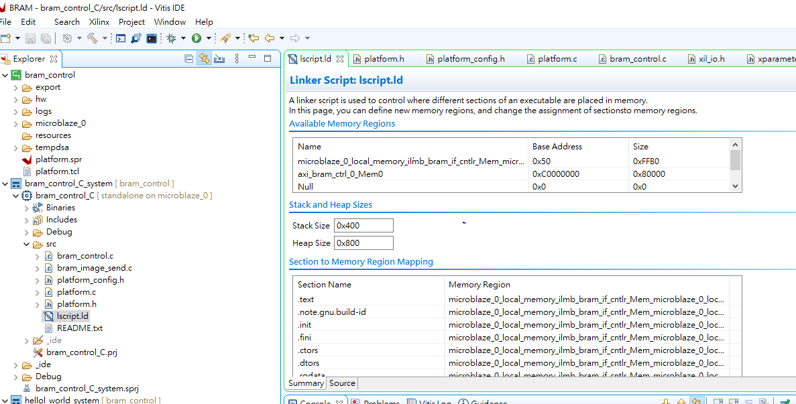
IDE mem adjustment

Slide 23
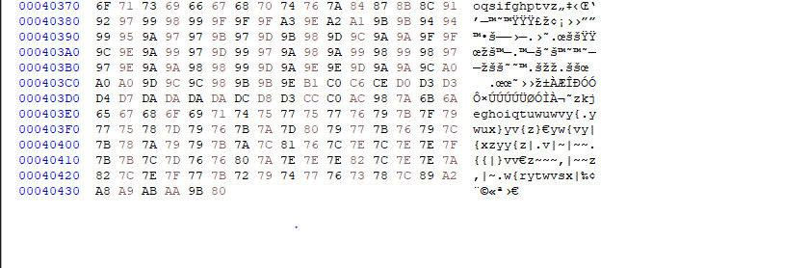
BMP file format
是從0開始計數 故要+1

Slide 24
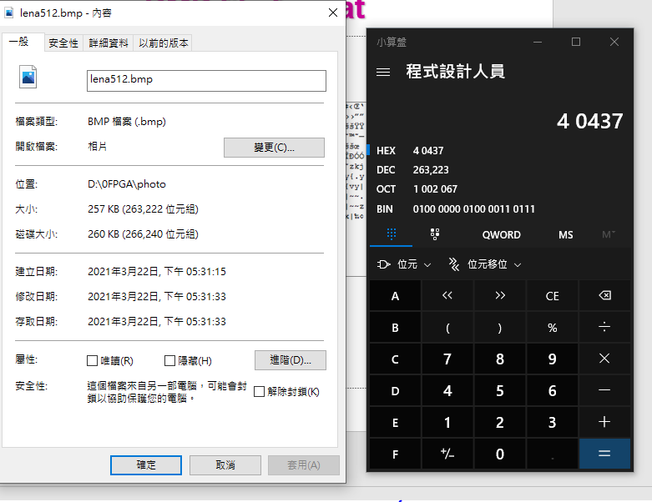
BMP file format

Slide 25
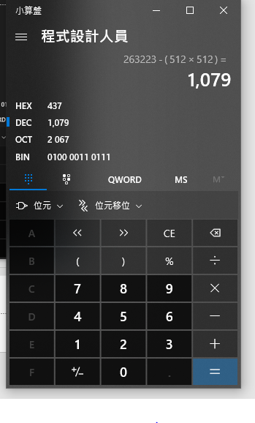
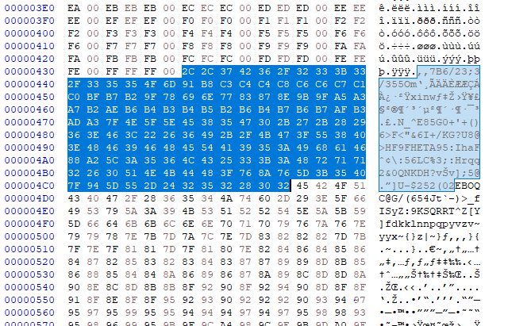
BMP file format header file
REAL IMG

Slide 26
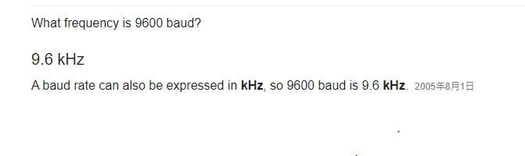
Baud rate vs clk frequency

Slide 27
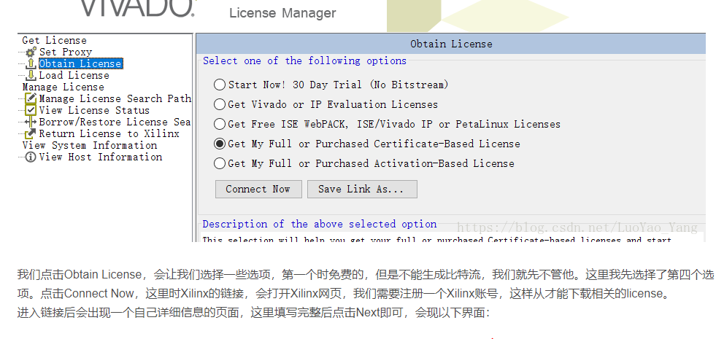
License
點擊上面欄位 License manager

Slide 28
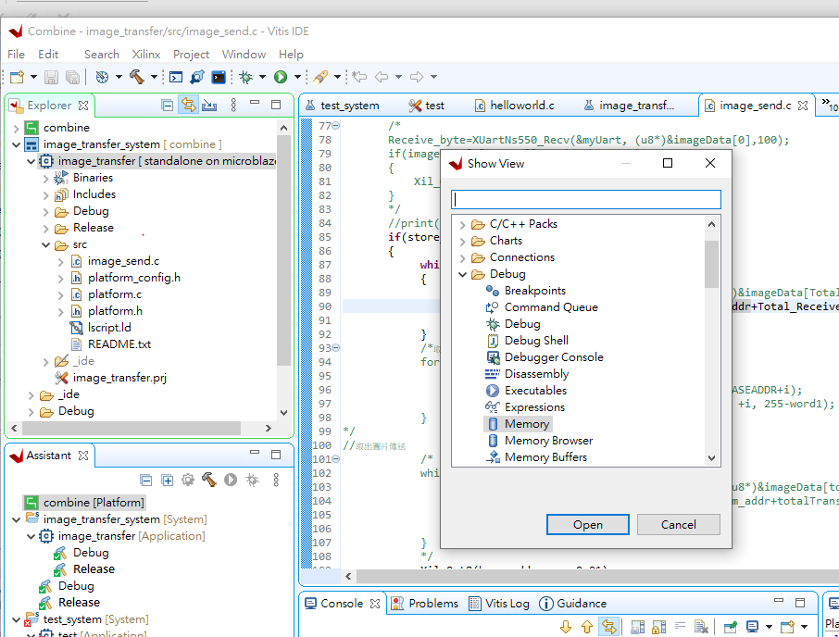
Memory Debug
Windows>>show view >> debug
Windows>>show view >> Memory

Slide 29
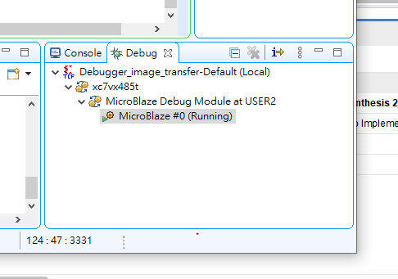
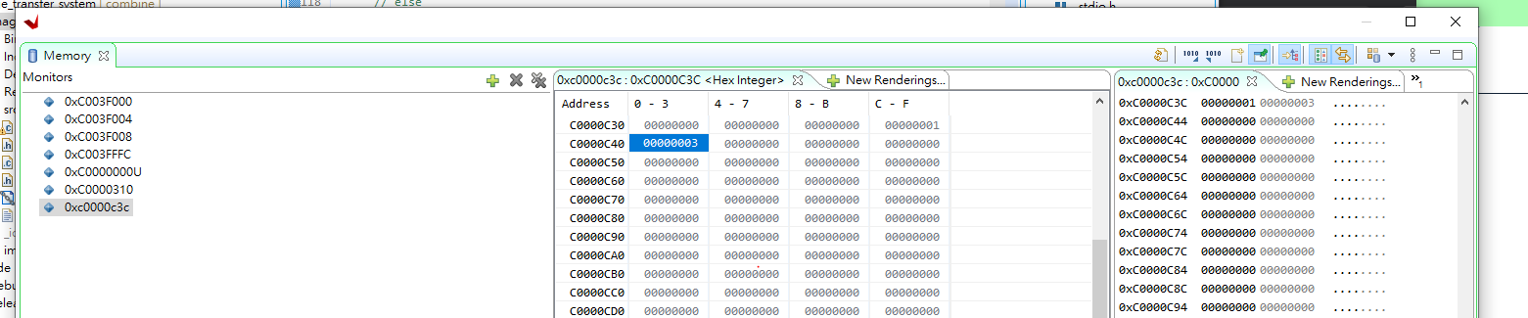
Memory debug
Microblaze
ADD ADDRESS monitor
REFRESH
<HSB LSB>

Slide 30
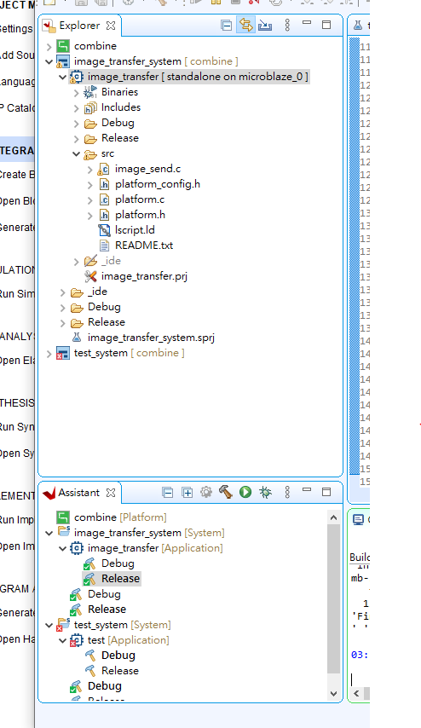
Compile with Vitis IDE
右鍵>build project
Run as >> 第二個

Slide 31
Notepad
若mobaxterm 連上 不能編輯 通常因為 bash 檔 有寫指令

