Slide 1
CMOS-Based Neuromorphic Hardware Design
Laboratory of Reliable Computing
Department of Electrical Engineering
National Tsing Hua University
Hsinchu, Taiwan

Slide 2
Review
Binary-weight SNN
Train binary-weight DNNs, then convert to SNNs
Inputs are binary {0, 1}
Weights are binary {-1, 1}
One flip-flop for one weight
One flip-flop for one input spike

Slide 3
2D Convolution
For ( int h = 0 ; h < H ; h ++ )
For ( int w = 0 ; w < W ; w ++)
For ( int r = 0 ; r < R ; r ++)
For ( int s = 0 ; s < S ; s ++)
Psum(h, w) += F(r, s) * Fmap(h+r, w+s)
Fmap
Psum
R
F
H
S
W

Slide 4
2D Convolution with 3D input
* Eyeriss: row stationary
For ( int t = 0 ; t < T ; t ++ )
For ( int l = 0 ; l < L ; l ++)
For ( int k = 0 ; k < K ; k ++)
For ( int h = 0 ; h < H ; h ++)
For ( int w = 0 ; w < W ; w ++ )
For ( int c = 0 ; c < C ; c ++)
For ( int r = 0 ; r < R ; r ++)
For ( int s = 0 ; s < S ; s ++)
O(t, l, k, h, w) += F(l, k, c, r, s) * Fmap(t, l, c, h+r, w+s)

Slide 5
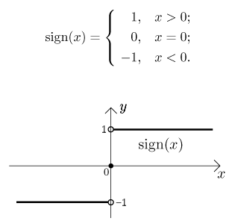
Step 1: Train Binary-Weight DNN
Reference paper:
Rastegari, Mohammad, et al.
"Xnor-net: Imagenet classification using binary convolutional neural networks."
European Conference on Computer Vision. Springer, Cham, 2016.
Training algorithm:
(Original dataflow)
(binary-weight)
$$Y$$
$$Y$$
(FP)
(FP)
sign(x)
Gradient of sign(x)
ReLU
ReLU
$$\frac{d sign\left(x\right)}{d x}=\left\{\begin{aligned}1，if \left|x\right|<1 \\ 0，o.w. \end{aligned}\right.$$
$$β$$
Batch Norm
$$β$$
Batch Norm
$$γ$$
$$γ$$
1
Conv2D
Conv2D
{-A, A}
-1
1
$$A=\frac{\sum{|W_{i}|}}{n}$$
(FP)
(FP)
(FP)
{-1, 1}
sign()
$$X$$
$$W$$
$$X$$
$$W$$

Slide 6
Step 2: Convert Binary-Weight DNN to SNN
(DNN inference dataflow)
(SNN inference dataflow)
$$Y$$
$$Out spike$$
(FP)
{0, 1}
ReLU
$$V_{th}=round\left(\frac{σ}{γA}\frac{p^{l}}{p^{l−1}}\right)$$
Check fire gen spike
$$\frac{γA}{σ}$$
$$bias=round\left(\frac{1}{p^{l−1}}\left(\frac{βσ}{Aγ}−\frac{μ}{A}\right)\right)$$
Update V
$$bias=\frac{βσ}{Aγ}−\frac{μ}{A}$$
Conv2D
V
Wsum
{-1, 1}
Conv2D
(FP)
{-1, 1}
{0, 1}
sign()
sign()
$$X$$
$$W$$
$$In spike$$
$$W$$

Slide 7
Recurrence Equation for Spiking CNN
Spiking Convolutional Neural Network
For ( int t = 0 ; t < T ; t ++ ) // tick
For ( int l = 0 ; l < L ; l ++ ) // layer
For ( int k = 0 ; k < C[l] ; k ++ ) // channel
For ( int x = 0 ; x < X[l] ; x ++ ) // output image height
For ( int y = 0 ; y < Y[l] ; y ++ ) // output image width
For ( int c = 0 ; c < C[l-1] ; c ++ ) // channel in previous layer
For ( int i = 0 ; i < I[l] ; i ++ ) // filter height
For ( int j = 0 ; j < J[l] ; j ++ ) // filter width
Wsum(t, l, k, x, y) += Filter(l, k, c, i, j) * Spike(t-1, l-1, c, x+i, y+j) ;
V(t, l, k, x, y) += Wsum(t, l, k, x, y) ;
Spike(t, l, k, x, y) = ( V(t, l, k, x, y) > V_{th}(l, k) ) ? 1:0 ;
V(t, l, k, x, y) -= ( Spike(t, l, k, x, y) ) ? V_{th}(l, k):0 ;
Systolic
array
Synapse
Neuron

Slide 8
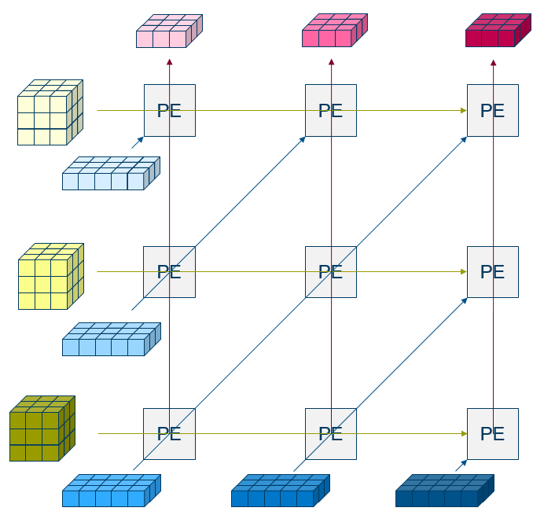
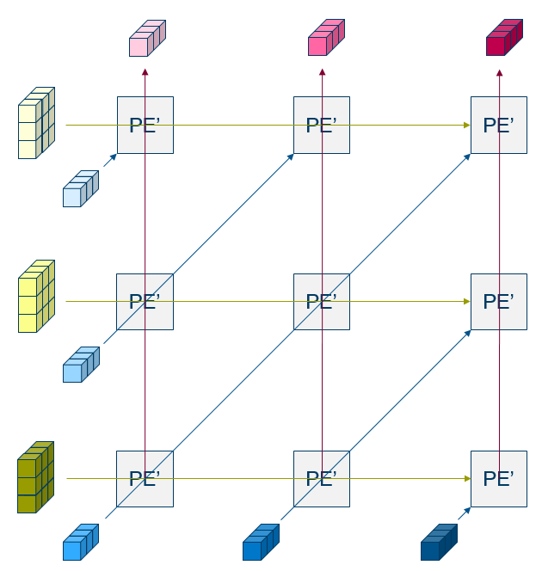
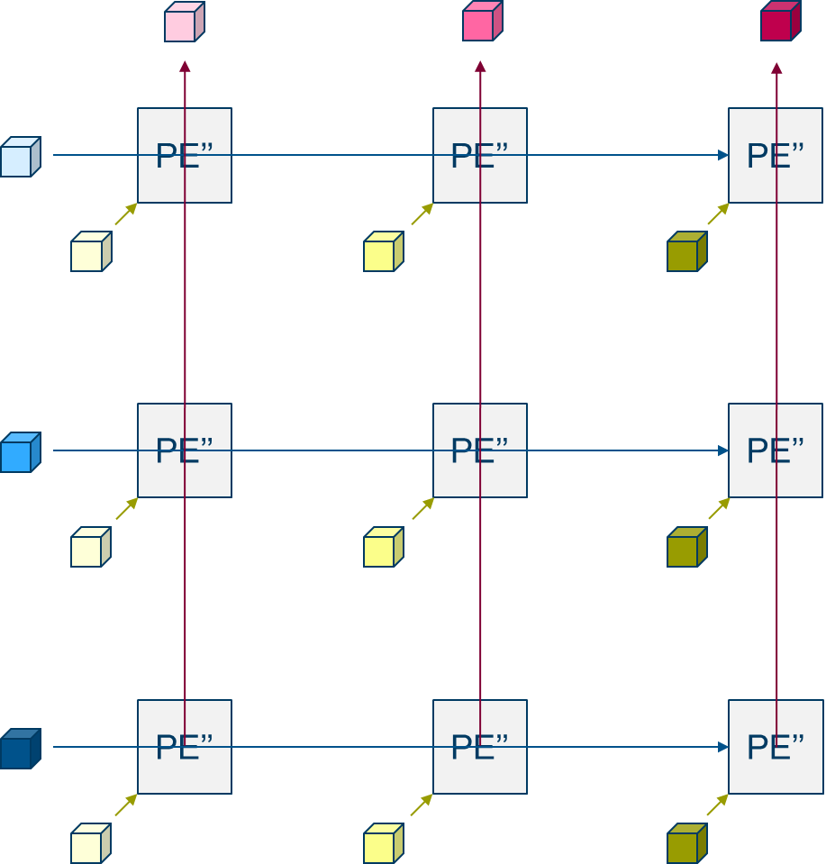






Hierarchy of Systolic Array
L3 PE array
Height: I (filter height)
Width: X (output height)
L2 PE’ array
Height: J (filter width)
Width: Y (output width)
L1 PE’’ array
Height: C (input channel)
Width: K (output channel)
Temporal space
$$S_{X}$$
Temporal space
$$S_{Y}$$
Spatial space
$$S_{K}$$
Spatial space
Spatial space
Spatial space
$$S_{I}$$
$$S_{J}$$
$$S_{C}$$

Slide 9
Specification
Application: cocktail liquor & juice image recognition (Accuracy > 90% each.)
Input:16 bits
Output: 6 bits (6 types)
Algorithm: Spiking CNN
Operating clock rate: 100MHz
Support image throughput: 300 fps
Platform topology:

Slide 10
Recurrence Equation in a Layer at a Tick
Layer (space)
L = 0
L = 1
Neuron
Synapse
Neuron
Synapse
Neuron
Synapse
Neuron
Synapse
Neuron
Spike^{l-1}
Wsum
Spike^{l}
For ( int k = 0 ; k < K ; k ++ ) // channel
For ( int x = 0 ; x < X ; x ++ ) // output image height
For ( int y = 0 ; y < Y ; y ++ ) // output image width
For ( int c = 0 ; c < C ; c ++ ) // channel in previous layer
For ( int i = 0 ; i < I ; i ++ ) // filter height
For ( int j = 0 ; j < J ; j ++ ) // filter width
Wsum(k, x, y) += Filter(k, c, i, j) * Spike^{l-1}(c, x+i, y+j) ;
V(k, x, y) += Wsum(k, x, y) ;
Spike^{l}(k, x, y) = ( V(k, x, y) > V_{th}(k) ) ? 1:0 ;
V(k, x, y) -= ( Spike^{l}(k, x, y) ) ? V_{th}(k):0 ;
Tick
(time)

Slide 11
Dataflow in a Convolutional Layer
Wsum(k, x, y) += Filter(k, c, i, j) * Spike^{l-1}(c, x+i, y+j) ;
V(k, x, y) += Wsum(k, x, y) ;
Spike^{l}(k, x, y) = ( V(k, x, y) > V_{th}(k) ) ? 1:0 ;
V(k, x, y) -= ( Spike^{l}(k, x, y) ) ? V_{th}(k):0 ;
Neuron state ($V^{l}$)
Neuron
K
Compare with Vth
16
16
16
16
16
16
16
16
16
16
16
16
16
16
16
16
16
16
16
16
…
16
16
16
16
16
16
16
16
K
16
16
16
16
16
16
16
16
16
16
16
16
16
16
16
16
16
16
16
16
16
X
16
16
16
16
16
16
16
16
16
16
16
16
16
16
16
16
16
16
16
Synapse
Layer
kernels
Y
Output spikes ($s^{l}$)
Input spikes ($s^{l−1}$)
C
Add into V
K
1
1
1
1
8b
8b
8b
1
1
1
1
8b
8b
8b
1
1
1
1
0
0
0
1
8b
8b
8b
1
1
1
1
8b
8b
8b
1
1
1
1
I
8b
8b
8b
Weight sum
1
1
1
1
1
1
1
1
C
8b
8b
8b
1
1
1
1
8b
8b
8b
1
1
1
1
8b
8b
8b
1
1
1
1
K
1
0
0
1
1
1
1
1
8b
8b
8b
1
1
1
1
1
1
1
1
X
1
1
1
1
1
1
1
1
1
1
1
1
J
0
1
0
0
1
1
0
1
16
16
16
16
1
1
1
1
16
16
16
16
1
1
1
1
16
16
16
16
1
1
1
1
16
16
16
16
1
1
1
1
16
16
16
16
1
1
1
1
=
16
16
16
16
1
1
1
1
*
16
16
16
16
1
1
1
1
1
0
1
1
16
16
16
16
1
1
1
1
…
K
16
16
16
16
Y
1
1
1
1
16
16
16
16
1
1
1
1
16
16
16
16
1
1
0
0
16
16
16
16
H
X
16
16
16
16
16
16
16
16
16
16
16
16
C
16
16
16
16
8b
8b
8b
8b
8b
8b
8b
8b
8b
8b
8b
8b
I
8b
8b
8b
Y
W
8b
8b
8b
8b
8b
8b
8b
8b
8b
8b
8b
8b
J

Slide 12
Systolic Dataflow
osmap
K
a0
a0
b0
a0
b0
e0
f0
C
e0
f0
PE
K
W
a0
b0
c0
d0
a0
a0
b0
c0
d0
a0
b0
a1
b1
e0
f0
g0
h0
a0
b0
OX
a1
b1
e0
f0
g0
h0
I
e0
f0
a2
b2
X
i0
j0
k0
l0
e0
f0
a2
b2
i0
j0
k0
l0
l0
m0
n0
o0
p0
C
m0
n0
o0
p0
J
OY
Y
…
(K kernels)
C
K
…
…
…
C
Y
ismap

Slide 13
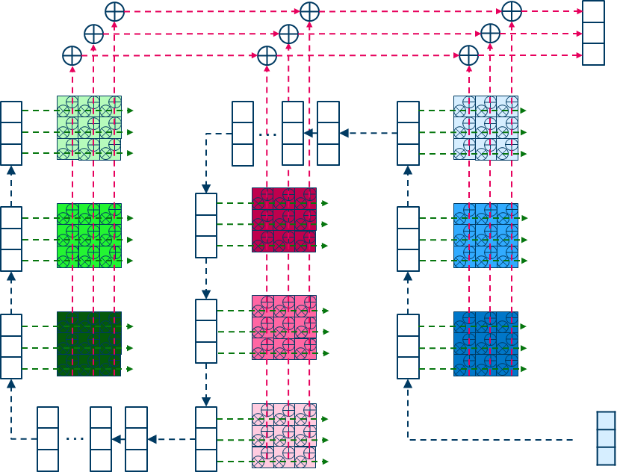
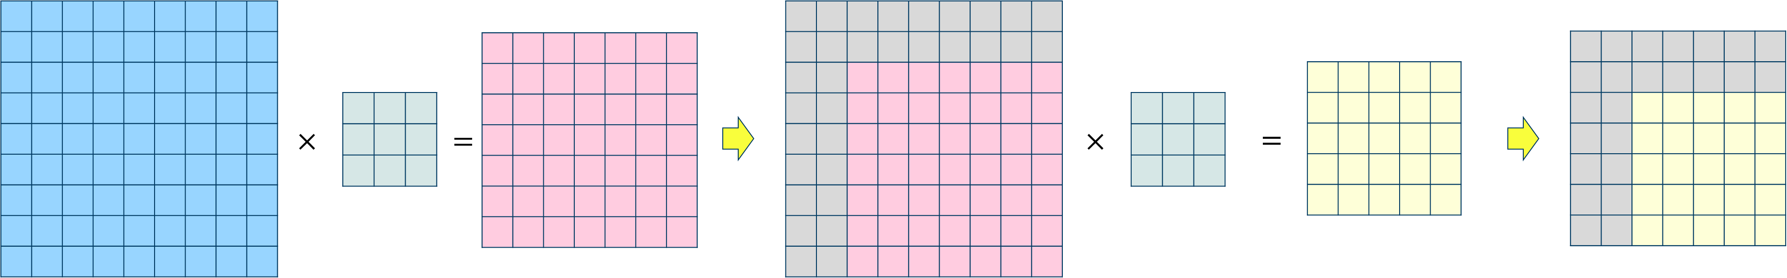
Layer Module
Custom device: SCNN ASIC
Synapse
Layer
Synapse
Synapse
Neuron
Neuron
Neuron
in_spike[c]
Wsum <<
Shift (2-bit)
Vth (9-bit)
0
out_spike[k]
test_si
test_se
test_md
1
Bias (9-bit)
test_so
BIST
BistFinish
BistFail
ErrMap
Flow Controller
out_valid
Fmap_cnt (8-bit)
in_valid
BistMode

Slide 14
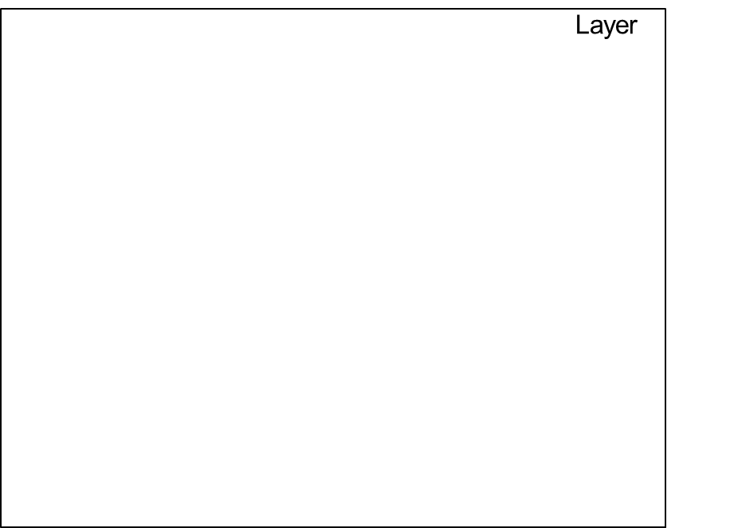
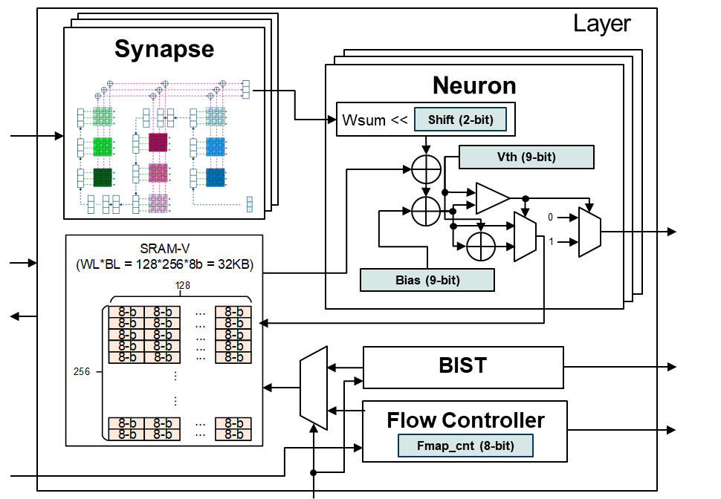
Top Module
Custom device: SCNN ASIC
out_spike[5:0]
BistFinish
BistFail
ErrMap
in_spike[2:0]
test_si
test_se
test_md
out_valid
test_so
in_valid
BistMode

Slide 15
Layout
Total area: 4.742 mm² → 4.016 mm²
Power: 35mW 100Mhz
Total on-chip memory: 12.75 KB
Gate count:‭ 731,448 ‬
No. of signal/ power pads: 46/54
2.176mm
2.179mm

Slide 16
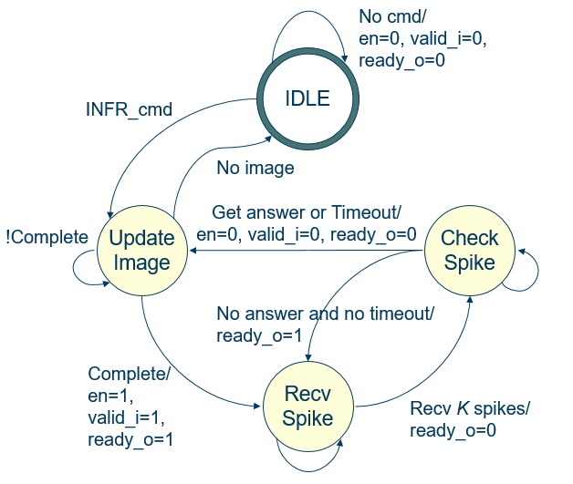
Flow Chart & Hardware Mapping
Start
CPU
Controller (FPGA)
Neuromorphic Chip
Tick = 0
Input spikes (16x16 bits)
SNN
(State machine)
Tick ++
Output spikes
Spike Accumulator
Spike count
No
Tick == 1000?
Yes
Output k
Stop

Slide 17
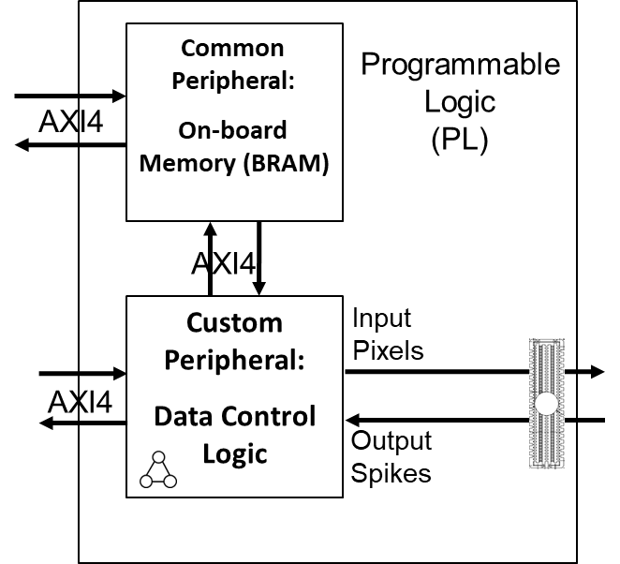
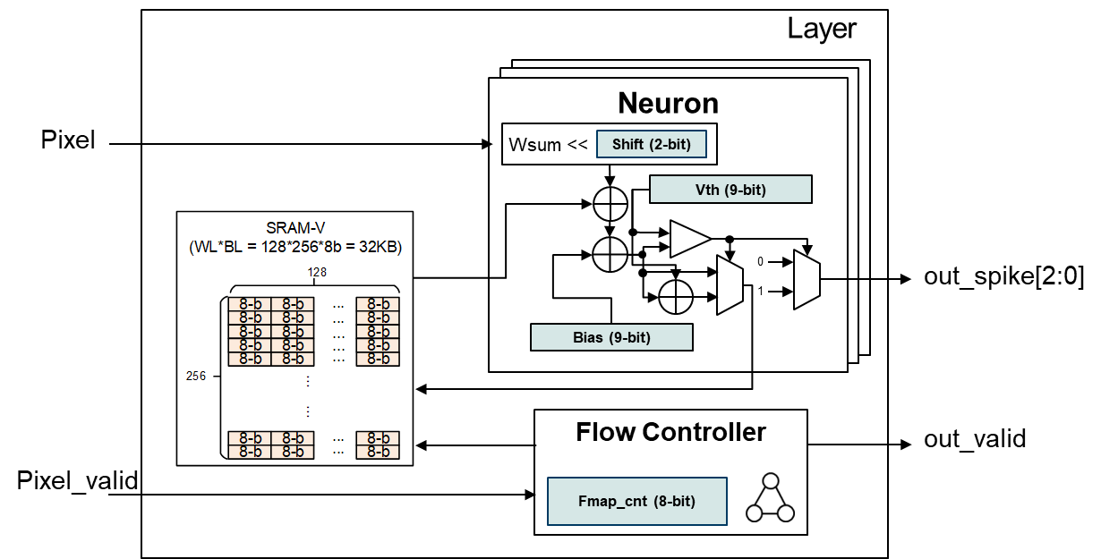
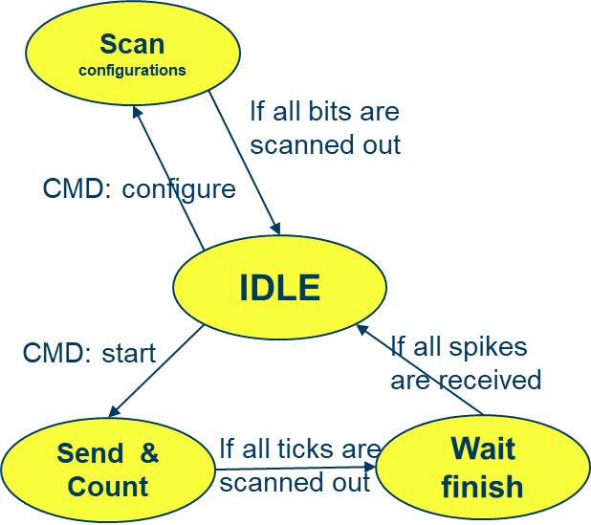
Layer 0 (in FPGA)
start
finish
Command registers
control (32-bit)
Pulse generator
IRQ generator
AXI protocol
configuration (32-bit)
IRQ clear (1-bit)
Spikes counter (32-bit)
*6 ➔
Max type (32-bit)
Result
IRQ

Slide 18
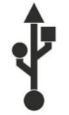
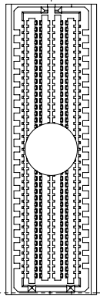
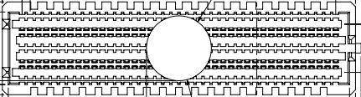

FPGA Configuration
High-Level Block Diagram in FPGA
Off-chip DRAM
Memory Interfaces
Common Peripheral:
On-board Memory (BRAM)
Programmable
Logic
(PL)
Processing System
(PS)
AXI4
AXI4
Application Processor Unit (APU)
Custom Peripheral:
Data Control Logic
Input
Pixels
FMC
Custom device:
SCNN ASIC
Input Output Peripherals (IOP)
USB
AXI4
Interconnect
Output
Spikes
High-Bandwidth AMBA AXI Interfaces
RJ45

Slide 19
Software – Device Drivers
Custom device driver:
PBUF_v01、TCL_v01
Two controllable device nodes
/dev/axi_bram_ctrl
Read/Write Board-RAM (Pixel buffer) through AXI protocol BUS
Can be used by linux general command
Read example: cat /dev/axi_bram_ctrl
Write example: echo “abc” > /dev/axi_bram_ctrl
Two applications
STROE: store a file to pixel buffer
READ: read a certain size of content from pbuf
/dev/l0_circuit
Send/Receive command to custom controller through AXI protocol BUS
Command set:
Start (write only)
Write 1: Generate a positive pulse to FSM
Write 0: Reset software waiting IRQ event
Configuration
Set 0: Inference mode
Set 1: Scan-in configuration mode
Set 2: Scan-out debugging mode
static ssize_t PBUF_v01_read(struct file *f, char __user * buf, size_t len, loff_t * off){
void *obj_dev = list_entry( pos, struct PBUF_v01_local, dev_list );
copy_to_user(buf, (obj_dev->base_addr), len);
return len;
}
static ssize_t PBUF_v01_write(struct file *f, const char __user * buf, size_t len, loff_t * off){
void *obj_dev = list_entry( pos, struct PBUF_v01_local, dev_list );
copy_from_user((obj_dev->base_addr), buf, len);
return len;
}
static ssize_t TCL_v01_read(struct file *f, char __user * buf, size_t len, loff_t * off){
void *obj_dev = list_entry( pos, struct TCL_v01_local, dev_list );
copy_from_user(&val, buf, sizeof(unsigned int));
*cmd = parsing_cmd(val); offset = get_offset(cmd);
copy_from_user(&val, (obj_dev->base_addr+offset), sizeof(unsigned int));
return val;
}
static ssize_t TCL_v01_write(struct file *f, char __user * buf, size_t len, loff_t * off){
void *obj_dev = list_entry( pos, struct TCL_v01_local, dev_list );
copy_from_user(&val, buf, sizeof(unsigned int));
*cmd = parsing_cmd(val); offset = get_offset(cmd);
copy_to_user(&val, (obj_dev->base_addr+offset), sizeof(unsigned int));
wait_event_interruptible(wq, flag != 0);
return val;
}

Slide 20

Block Diagram for Data flow
Board APU
Controller
BRAM
ASIC
Load configurations from host
Transfer configurations
Scan-in configurations
Send interrupt
Load pixels of an image from host
Transfer pixels of an image
Scan-in tick No.1
Scan-in tick No.2
Receive result No. 1
Scan-in tick No. 1000
Receive result No. 1000
Send interrupt

Slide 21
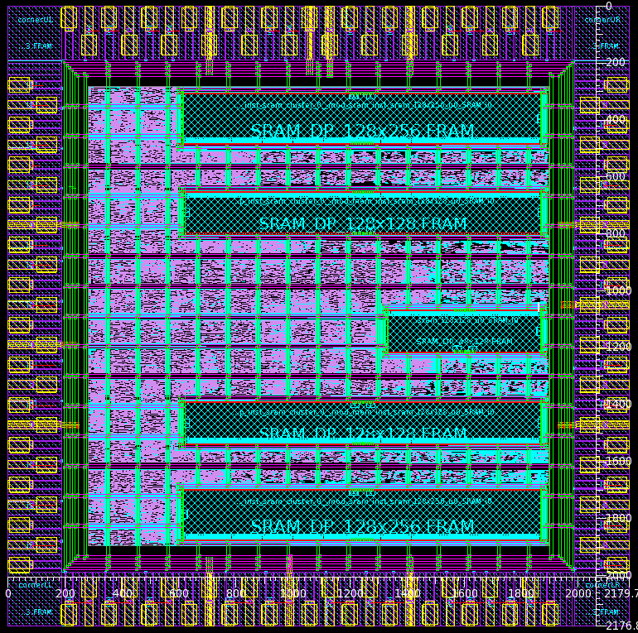
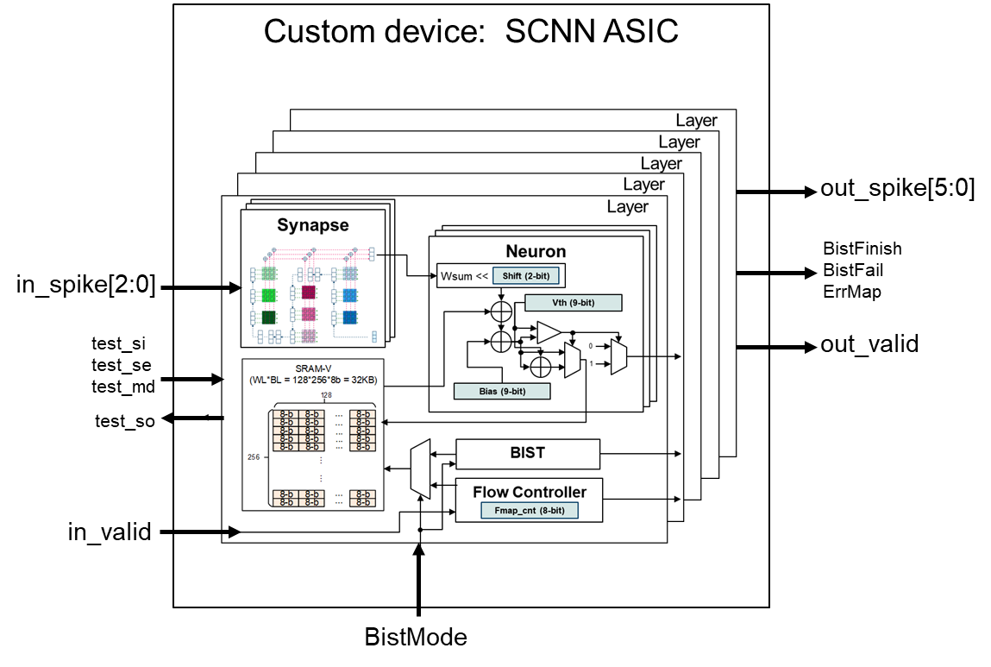

Slide 22

Layer
Neuron
Neuron
Scan configurations
Neuron
Pixel
Wsum <<
Shift (2-bit)
If all bits are scanned out
Vth (9-bit)
CMD: configure
0
out_spike[2:0]
1
IDLE
Bias (9-bit)
CMD: start
If all spikes are received
Flow Controller
out_valid
Pixel_valid
Send & Count
If all ticks are scanned out
Wait finish
Fmap_cnt (8-bit)

Slide 23
For ( int t = 0 ; t < T ; t ++ ) // tick
For ( int l = 0 ; l < L ; l ++ ) // layer
For ( int k = 0 ; k < C[l] ; k ++ ) // channel
For ( int x = 0 ; x < X[l] ; x ++ ) // output image height
For ( int y = 0 ; y < Y[l] ; y ++ ) // output image width
For ( int c = 0 ; c < C[l-1] ; c ++ ) // channel in previous layer
For ( int i = 0 ; i < I[l] ; i ++ ) // filter height
For ( int j = 0 ; j < J[l] ; j ++ ) // filter width
Wsum(t, l, k, x, y) += Filter(l, k, c, i, j) * Spike(t-1, l-1, c, x+i, y+j) ;
V(t, l, k, x, y) += Wsum(t, l, k, x, y) ;
Spike(t, l, k, x, y) = ( V(t, l, k, x, y) > V_{th}(l, k) ) ? 1:0 ;
V(t, l, k, x, y) -= ( Spike(t, l, k, x, y) ) ? V_{th}(l, k):0 ;
Systolic
array
Synapse
Neuron

Slide 24
(DNN inference dataflow)
(SNN inference dataflow)
$$Y$$
$$Out spike$$
(FP)
{0, 1}
ReLU
$$V_{th}=round\left(\frac{σ}{γA}\frac{p^{l}}{p^{l−1}}\right)$$
Check fire gen spike
$$\frac{γA}{σ}$$
$$bias=round\left(\frac{1}{p^{l−1}}\left(\frac{βσ}{Aγ}−\frac{μ}{A}\right)\right)$$
Update V
$$bias=\frac{βσ}{Aγ}−\frac{μ}{A}$$
Conv2D
V
Wsum
{-1, 1}
Conv2D
(FP)
{-1, 1}
{0, 1}
sign()
sign()
$$X$$
$$W$$
$$In spike$$
$$W$$

Slide 25
L3 PE array
Height: I (filter height)
Width: X (output height)
L2 PE’ array
Height: J (filter width)
Width: Y (output width)
L1 PE’’ array
Height: C (input channel)
Width: K (output channel)
Temporal space
$$S_{X}$$
Temporal space
$$S_{Y}$$
Spatial space
$$S_{K}$$
Spatial space
Spatial space
Spatial space
$$S_{I}$$
$$S_{J}$$
$$S_{C}$$

Slide 26
Layer (space)
L = 0
L = 1
Neuron
Synapse
Neuron
Synapse
Neuron
Synapse
Neuron
Synapse
Neuron
Spike^{l-1}
Wsum
Spike^{l}
For ( int k = 0 ; k < K ; k ++ ) // channel
For ( int x = 0 ; x < X ; x ++ ) // output image height
For ( int y = 0 ; y < Y ; y ++ ) // output image width
For ( int c = 0 ; c < C ; c ++ ) // channel in previous layer
For ( int i = 0 ; i < I ; i ++ ) // filter height
For ( int j = 0 ; j < J ; j ++ ) // filter width
Wsum(k, x, y) += Filter(k, c, i, j) * Spike^{l-1}(c, x+i, y+j) ;
V(k, x, y) += Wsum(k, x, y) ;
Spike^{l}(k, x, y) = ( V(k, x, y) > V_{th}(k) ) ? 1:0 ;
V(k, x, y) -= ( Spike^{l}(k, x, y) ) ? V_{th}(k):0 ;
Tick
(time)

Slide 27
osmap
K
a0
a0
b0
a0
b0
e0
f0
C
e0
f0
PE
K
W
a0
b0
c0
d0
a0
a0
b0
c0
d0
a0
b0
a1
b1
e0
f0
g0
h0
a0
b0
OX
a1
b1
e0
f0
g0
h0
I
e0
f0
a2
b2
X
i0
j0
k0
l0
e0
f0
a2
b2
i0
j0
k0
l0
l0
m0
n0
o0
p0
C
m0
n0
o0
p0
J
OY
Y
…
(K kernels)
C
K
…
…
…
C
Y
ismap

