Slide 1
Facebook API
Document
Computational Thinking and Problem Solving Fall 2020

Slide 2
CONTENT
Part 01
Part 02
Web Crawler
Data Structure
Selenium Beautifulsoup
Json file
Part 03
Part 04
Database
API Function
Google Cloud
Python

Slide 3
Part 01
Web Crawler
Facebook club

Slide 4
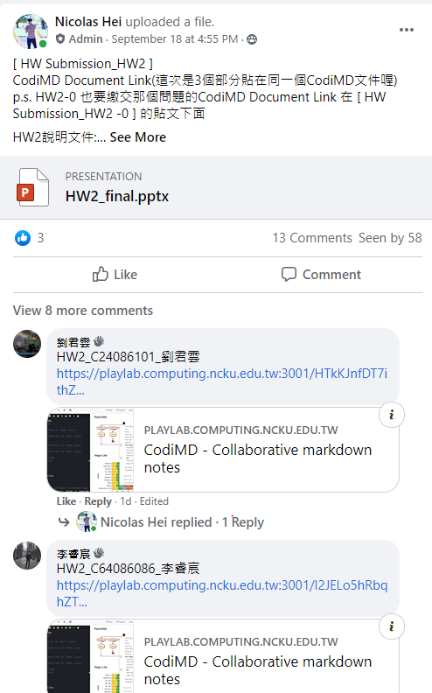
Web Crawler
Post
Comment
Comment of the post
comment of the comment
Emoji
7 kinds of reaction
Link
Content contain gif link image

Slide 5
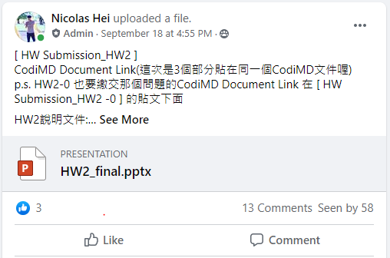
Web Crawler
Post
Comment
Comment of the post
comment of the comment
Emoji
7 kinds of reaction
Link
Content contain gif link image

Slide 6
Part 02
Data Structure
Json file

Slide 7
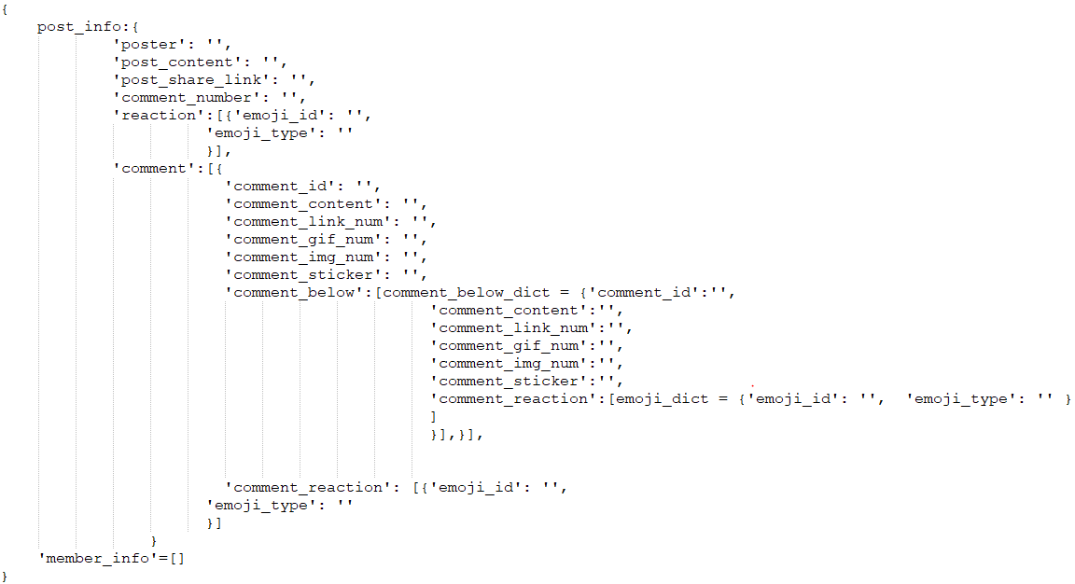
Data Structure

Slide 8
Part 03
Database
Google Cloud

Slide 9

Data Flow
Produce json file
Google cloud
User download data
Web Crawler
Python google api
Gdown package

Slide 10
Part 04
API Function

Slide 11

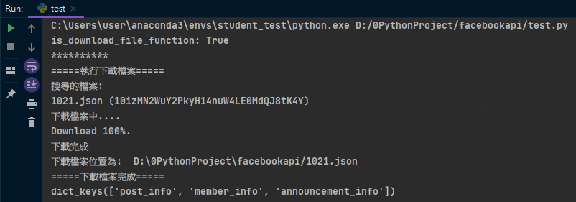
API Function
dataset = fbapi.get_json_from_cloud(date='1021')
What Function do

Slide 12
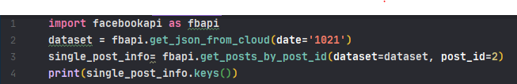
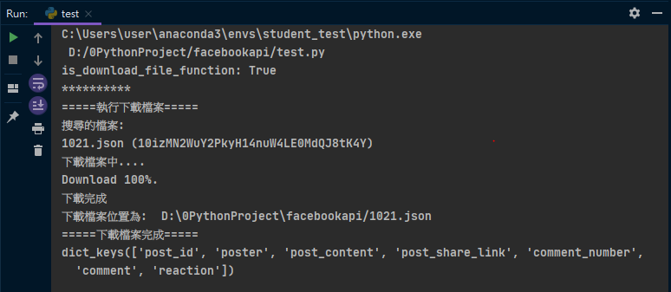
API Function
single_post_info= fbapi.get_posts_by_post_id(dataset=dataset, post_id=2)
What Function do

Slide 13

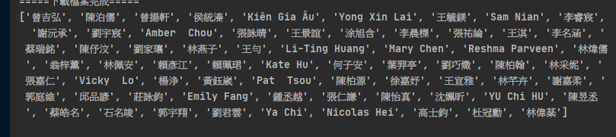
API Function
userid_list = fbapi.get_all_user_ids(dataset)
What Function do

Slide 14
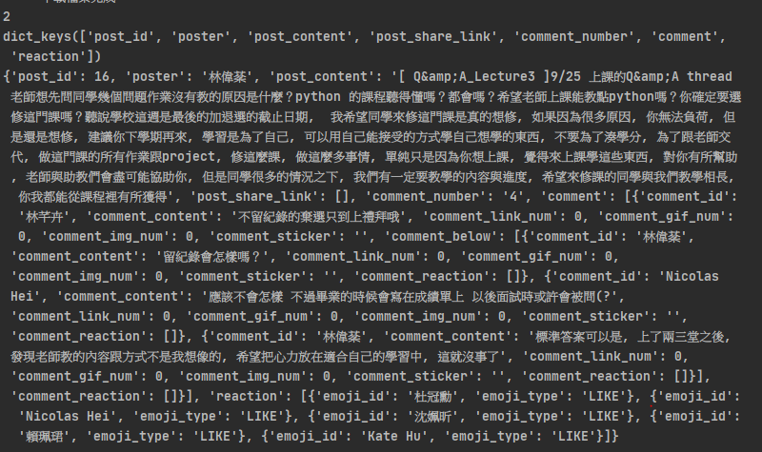
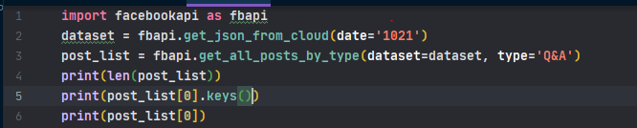
API Function
post_list = fbapi.get_all_posts_by_type(dataset=dataset, type='Q&A')
What Function do

Slide 15
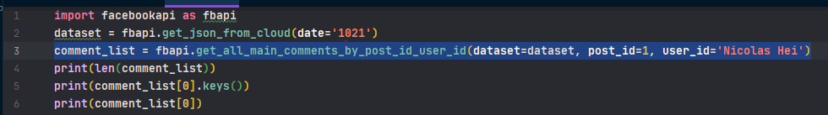
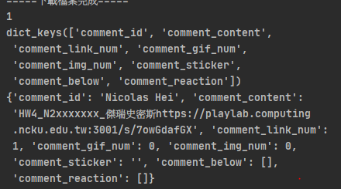
API Function
comment_list = fbapi.get_all_main_comments_by_post_id_user_id(dataset=dataset, post_id=1, user_id='Nicolas Hei')
What Function do

Slide 16
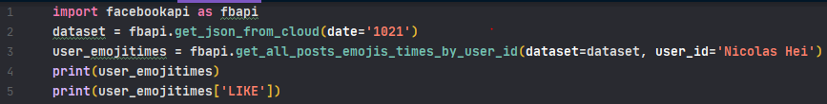

API Function
user_emojitimes = fbapi.get_all_posts_emojis_times_by_user_id(dataset=dataset, user_id='Nicolas Hei')
What Function do

Slide 17
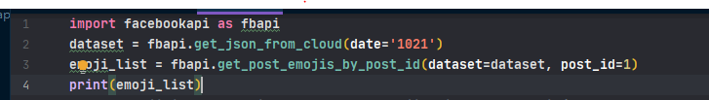
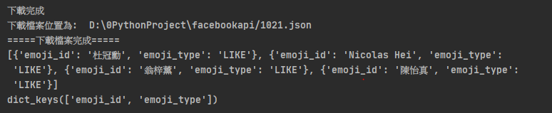
API Function
emoji_list = fbapi.get_post_emojis_by_post_id(dataset=dataset, post_id=1)
What Function do

Slide 18
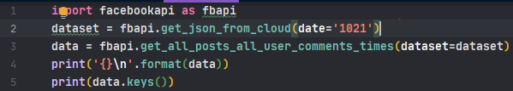
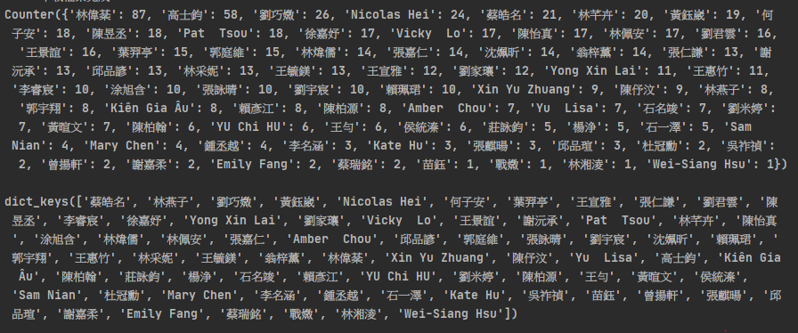
API Function
data = fbapi.get_all_post_all_user_comments_times(dataset=dataset)
What Function do

Slide 19
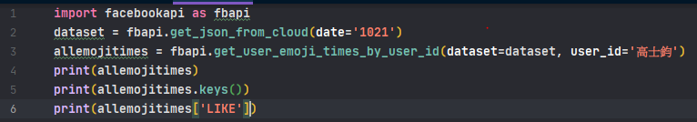
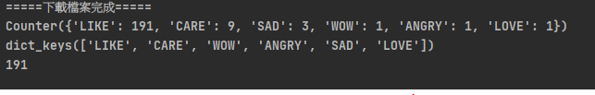
API Function
allemojitimes = fbapi.get_user_emoji_times_by_user_id(dataset=dataset, user_id='高士鈞')
What Function do

Slide 20
Thanks for watching
Computational Thinking and Problem Solving Fall 2020

