Slide 1
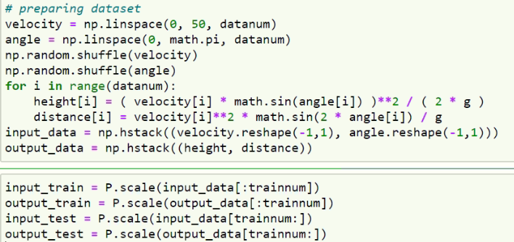
Preparing Dataset

Slide 2
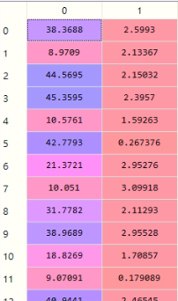
Preparing Dataset

Slide 3
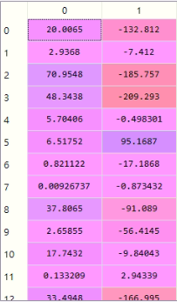
Preparing Dataset

Slide 4
Preparing Dataset
切割資料
使資料標準化(使用sklearn.preprocessing.scale)

Slide 5
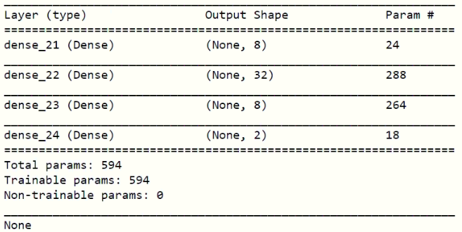
Building the Network
Activation: Relu
Loss Function: mean squared error
Optimizer: Adam
Epochs = 1000
Batch size = 200

Slide 6
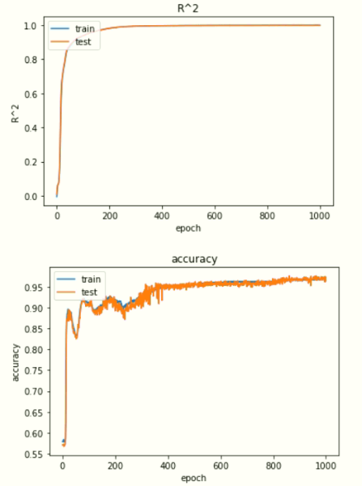
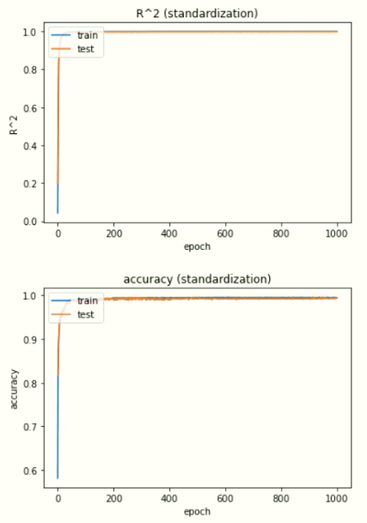
Result

Slide 7
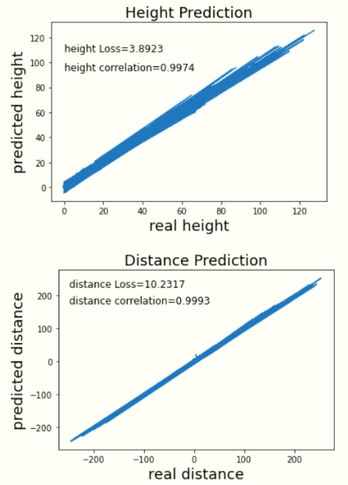
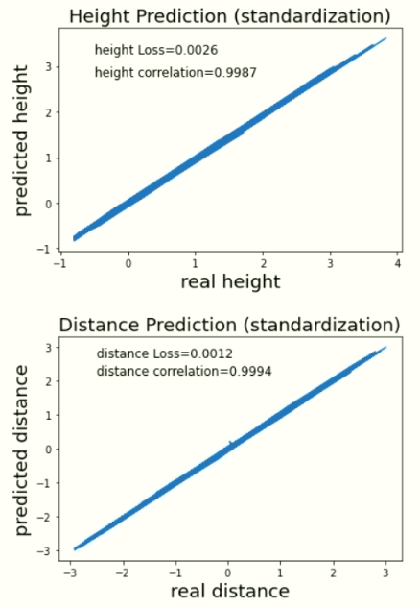
Result (cont.)
Lower Loss & Higher Correlation

