Slide 1
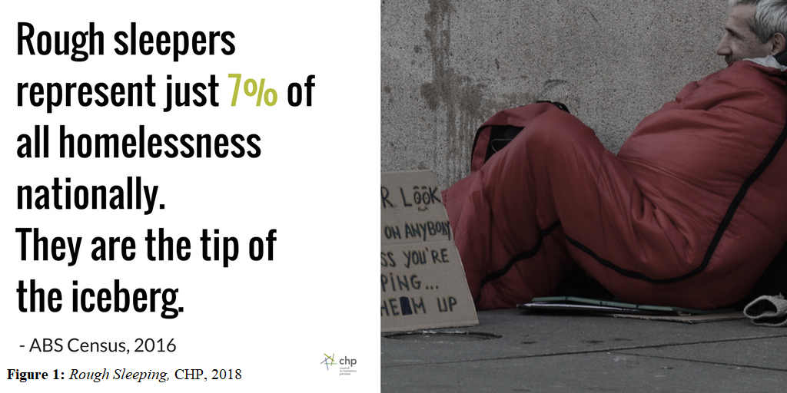

Slide 2
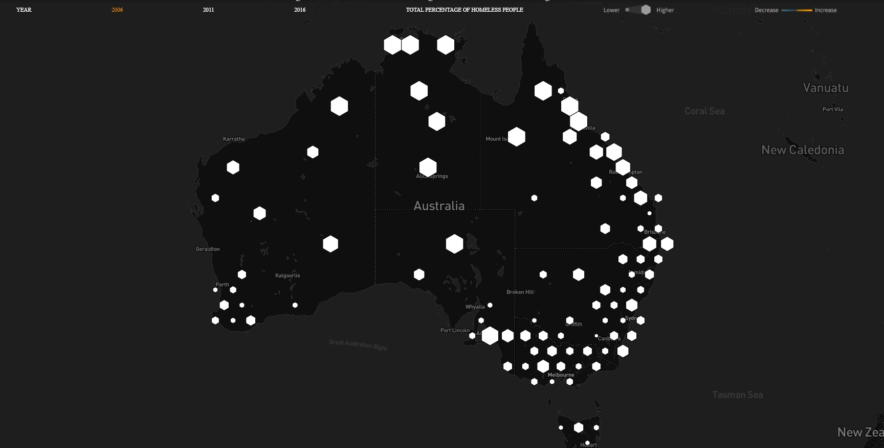

Slide 3
In 2006, the number of homeless in Australia stood at 89,728

Slide 4
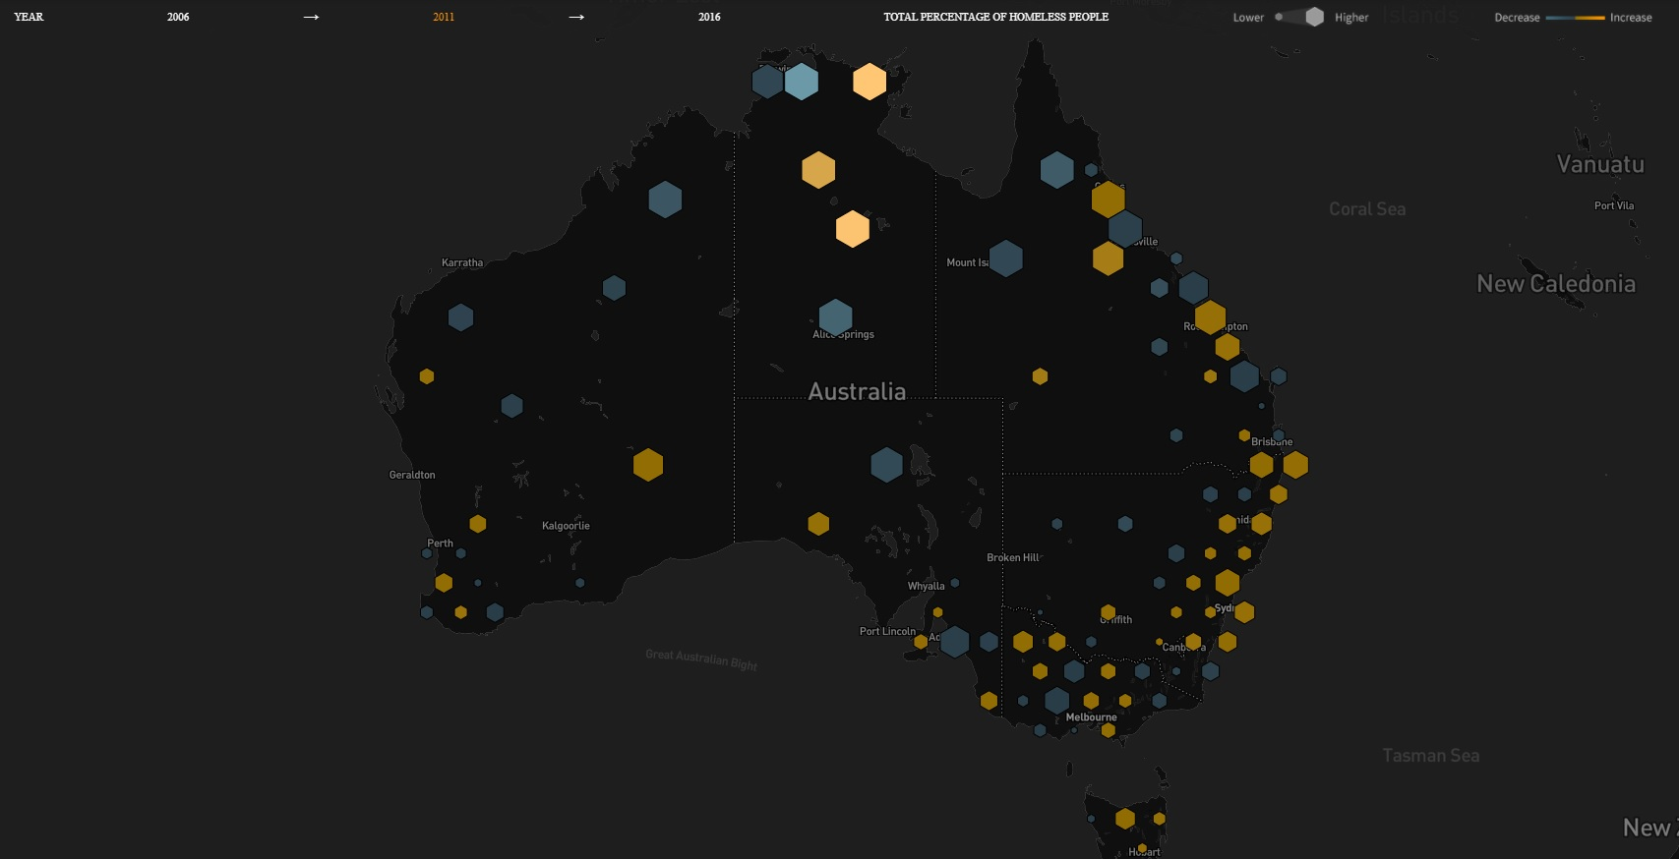
By 2011, this number had risen to 105,237 nationwide, an increase of 17%.

Slide 5
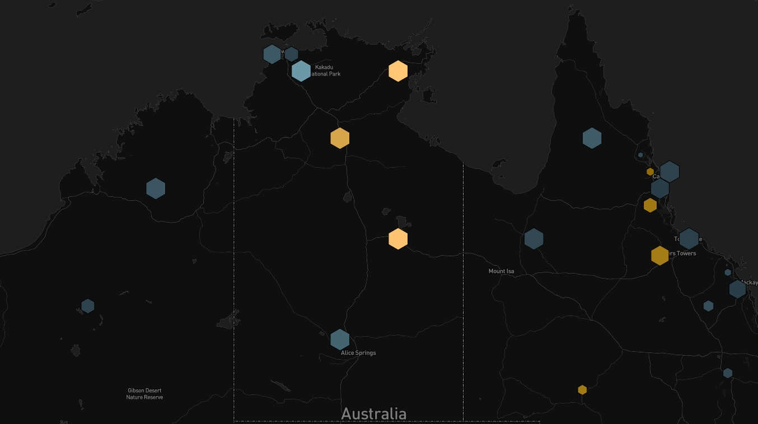
The Northern Territory only saw an overall 1.4% increase

Slide 6
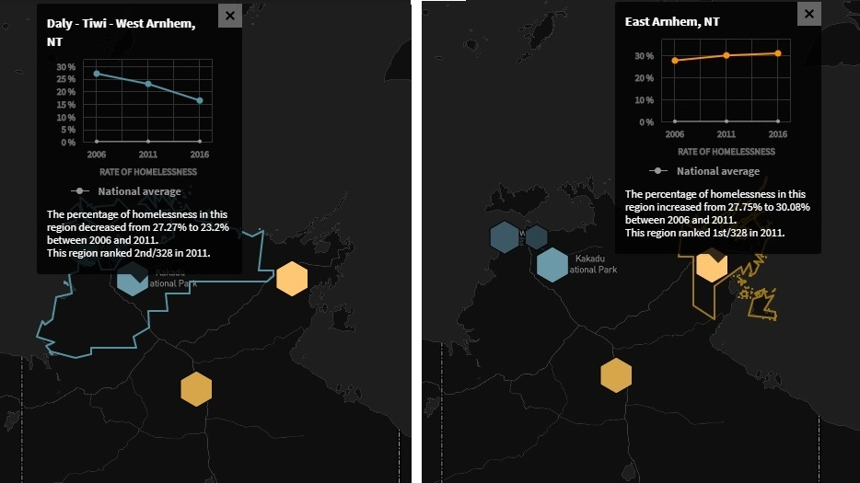

Slide 7
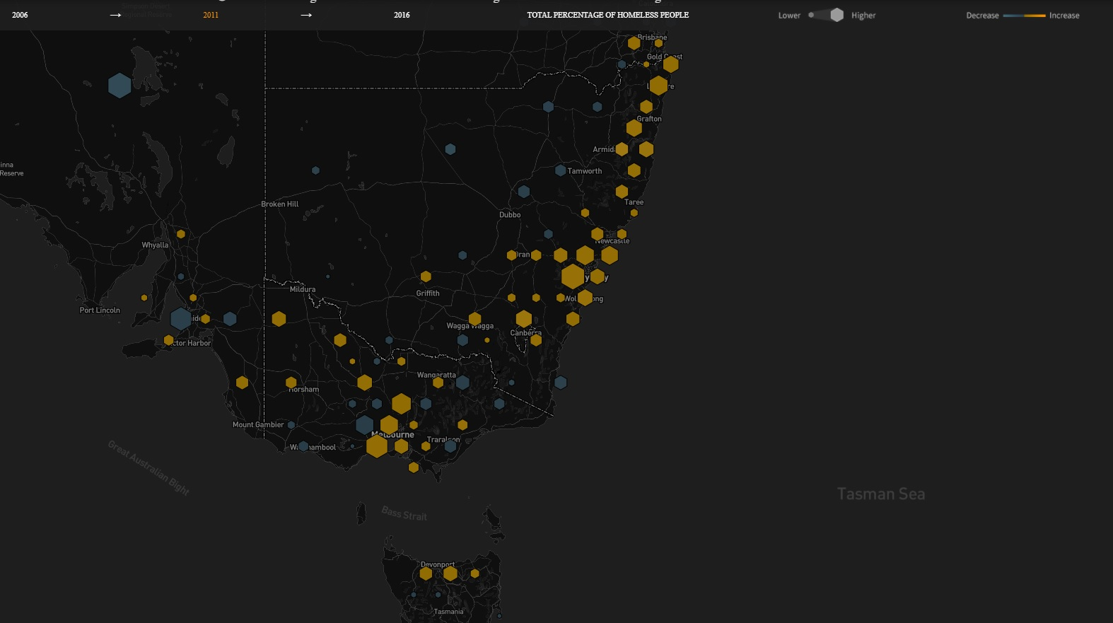
New South Wales increased 27%
Victoria increased 31%
Tasmania increased 38%

Slide 8
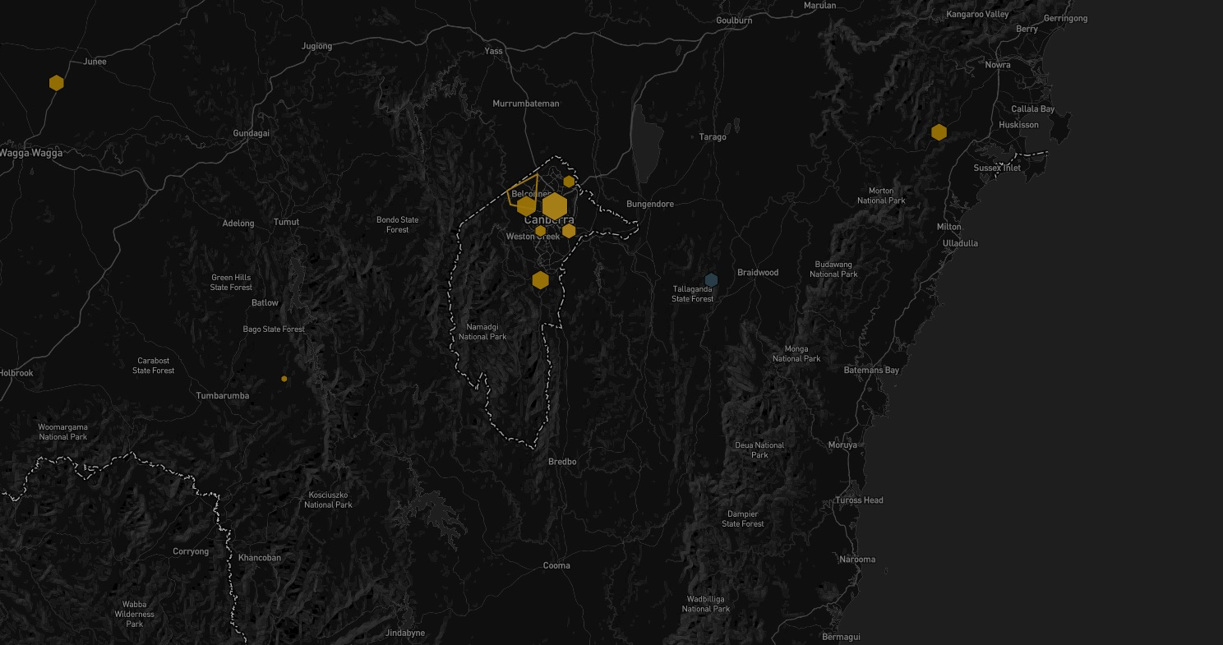
ACT
increased 88%

Slide 9
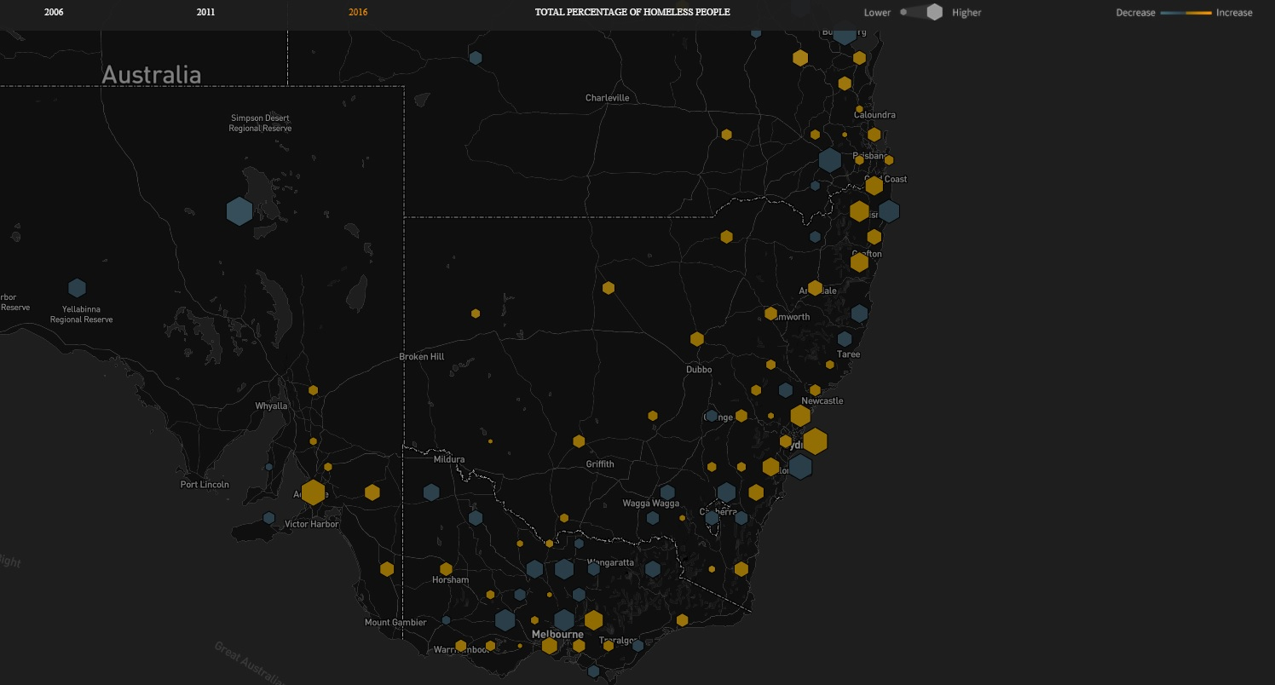
Over the decade to 2016, NSW’s rate of homelessness had increased by 49 %.

Slide 10
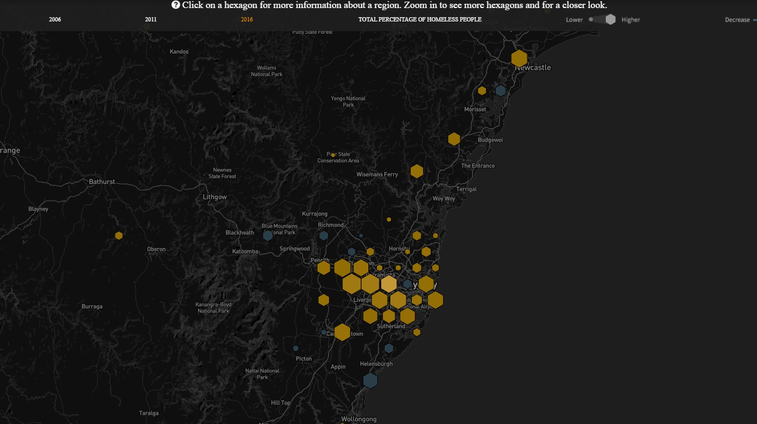
Numbers in many Sydney suburbs increased above the national average

Slide 11
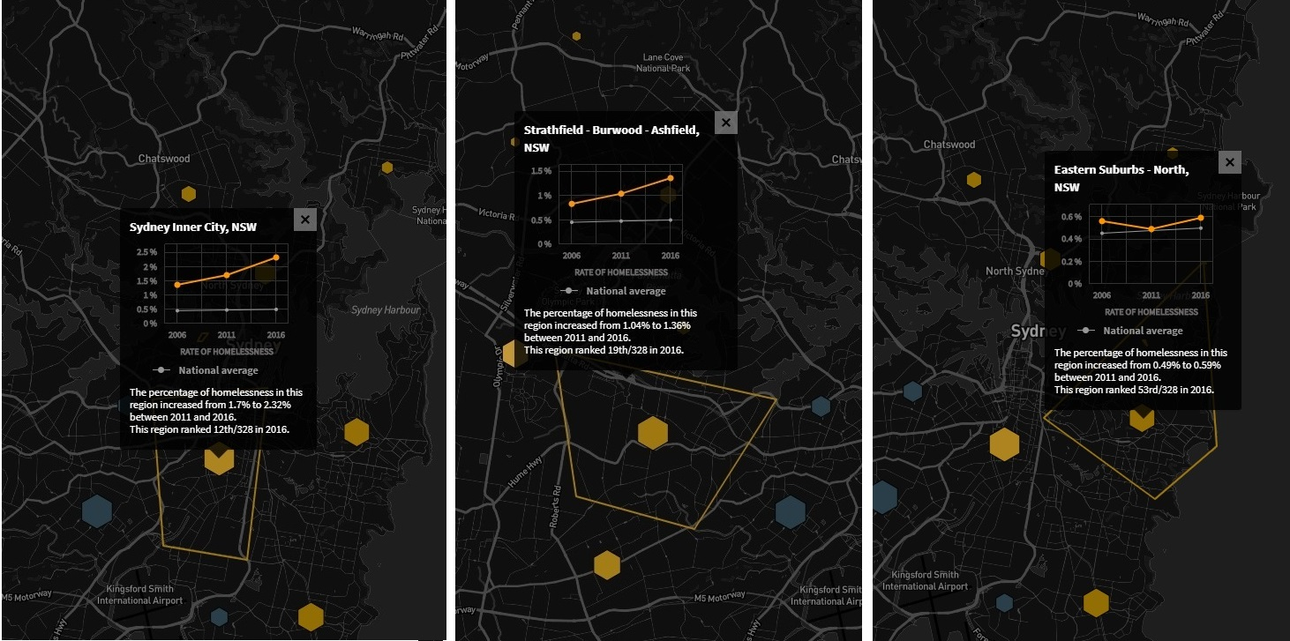

Slide 12
On Census night in 2016, more than 116,000 homeless. Over the previous decade homelessness had risen 30%.

Slide 13
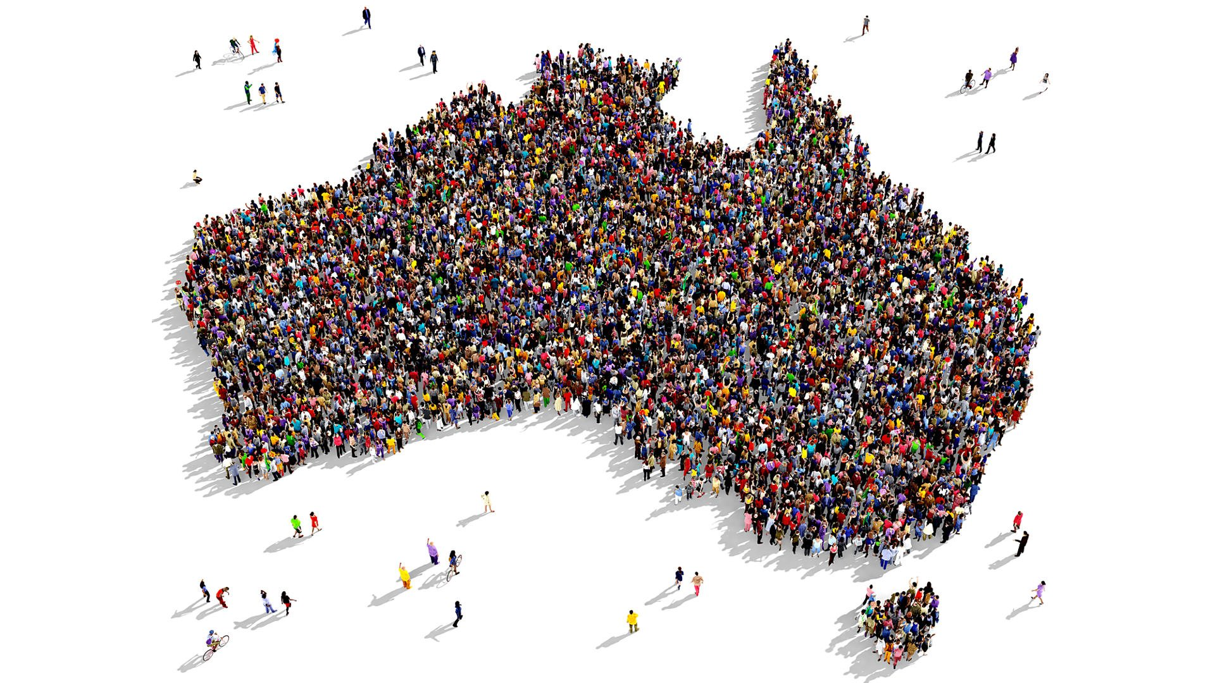
Census 2021?

Slide 14
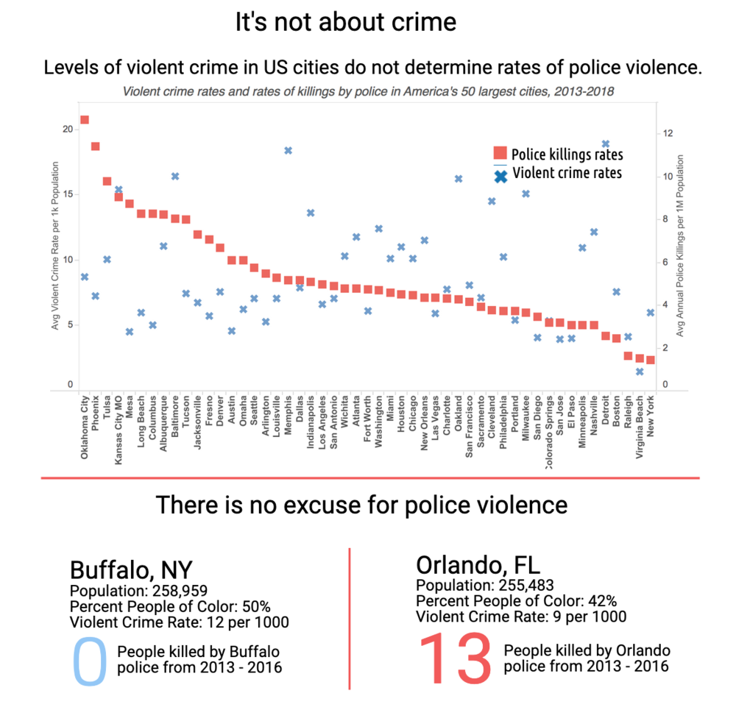

Slide 15
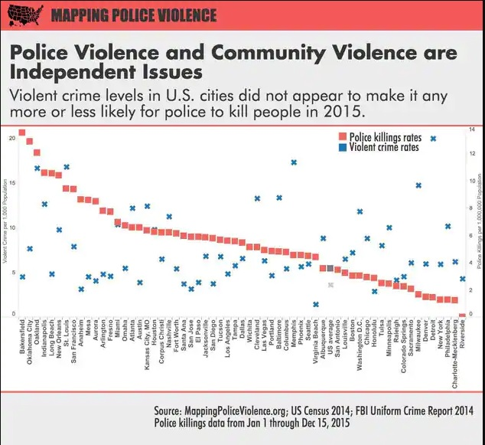
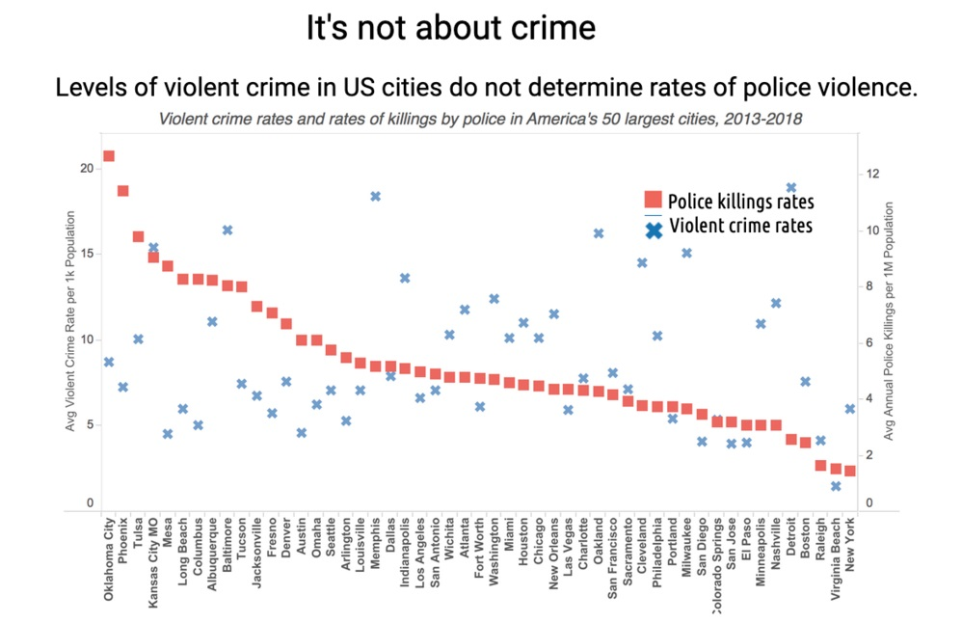

Slide 17
References
Australian Bureau of Statistics n.d (ABS),Census, Australian Bureau of Statistics, viewed 13 November 2020, <https://www.abs.gov.au/census>
Australian Bureau of Statistics 2016 (ABS 2016), Census of Population and Housing: Estimating Homelessness, cat. no. 2049.0., ABS, Canberra, viewed 13 November 2020, < https://www.abs.gov.au/statistics/people/housing/census-population-and-housing-estimating-homelessness/2016>
Australian Housing and Urban Research Institute 2014, Homelessness: re-shaping the policy agenda?, Final report no. 221, Australian Housing and Urban Research Institute, Melbourne
Australian Institute of Health and Welfare (AIHW) 2019, Homelessness and homelessness services, viewed 13 November 2020, <https://www.aihw.gov.au/reports/australias-welfare/homelessness-and-homelessness-services>
Baglin, J 2020, Data Visualisation: From Theory to Practice, RMIT, Australia
Banks, D 2010, 'Tweeting in court: why reporters must be given guidelines', The Guardian, 15 December, viewed 25 November 2015, <http://www.theguardian.com/law/2010/dec/15/tweeting-court-reporters-julian-assange>.
CHP 2018, Rough sleeping, photograph, CHP, viewed 13 November 2020, <https://chp.org.au/wp-content/uploads/2018/03/Rough-Sleeping-768x384.png>
Evergreen, S & Emery A 2016, Data Visualisation Checklist, viewed 13 November 2020,<http://stephanieevergreen.com/wp-content/uploads/2016/10/DataVizChecklist_May2016.pdf>
Fung, K. 2014. Junk Charts Trifecta Checkup: The definitive guide, viewed 13 November 2020, <.https://junkcharts.typepad.com/junk{\_}charts/junk-charts-trifecta-checkup-the-definitive-guide.html.>
Livsey, A 2017, ‘Homeless in Australia: the shifting numbers and definitions’, The Guardian, 7th August 2017, viewed 13 November 2020,<https://www.theguardian.com/society/datablog/2017/aug/07/homeless-in-australia-the-shifting-numbers-and-definitions>
Lowery, W 2016, Aren’t more white people than black people killed by police? Yes, but no, Washington Post, viewed 13 November 2020 <https://www.washingtonpost.com/news/post-nation/wp/2016/07/11/arent-more-white-people-than-black-people-killed-by-police-yes-but-no/>
Mallot, S 2004, ‘Understanding Home: A Critical Review of the Literature’, The Sociological Review, vol. 52 issue: 1, pp. 62-89
Mapping Police Violence n.d., Mapping Police Violence, Mapping Police Violence, viewed 13 November 2020 <https://mappingpoliceviolence.org/>
Mission Hills Christian Church 2020, A Christian Perspective: Defunding American Totalism, Mission Hills Christian Church, viewed 13 November 2020, <https://missionhillsla.com/sermons-podcast/defund-american-totalism>
RMIT ABC Fact Check n.d., Without a home, RMIT ABC Fact Check, viewed 13 November 2020, <https://www.abc.net.au/interactives/homeless/#section1-2>
Smith, J 2020, Federal Budget reveals millions to be cut from vital homelessness services, Homelessness Australia, viewed 13 November 2020, <https://www.homelessnessaustralia.org.au/sites/homelessnessaus/files/2020-10/201006%2520federal%2520budget%2520media%2520release_HA_final.pdf>
Sousa, G 2019, Australian States and Territories By Population, WorldAtlas, viewed 13 November 2020, <https://www.worldatlas.com/articles/the-largest-states-and-territories-of-australia.html>
Youth Projects n.d., 5 common misconceptions about homelessness, Youth Projects, viewed 13 November 2020, <https://www.youthprojects.org.au/news/5-common-misconceptions-about-homelessness>

