Slide 1
LetsTalk
The best place to talk with your friends!

Slide 2




The team
Jason Yeung
Manuel Guanipa Larice
Kazi Farzana Saad
Joshua Kwong Chip
Project Manager
and Network programmer
System Integrator and Network programmer
Tester
and GUI programmer
System Integrator, Tester and GUI programmer

Slide 3
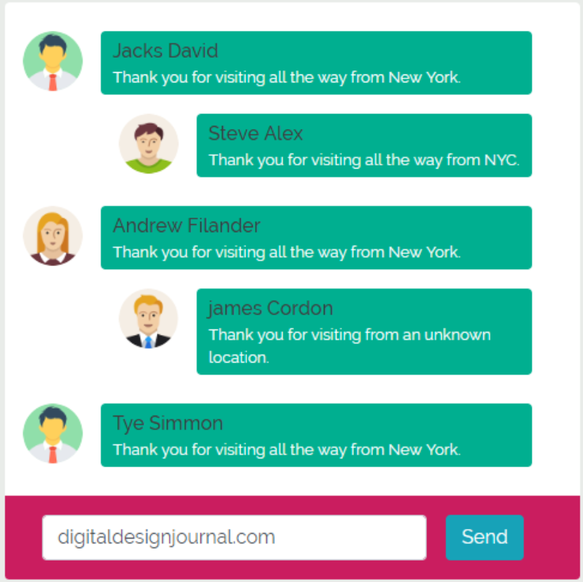
Introduction
The purpose of this project was to design and implement an online instant messenger that can support multiple clients through the usage of sockets and a main server.

Slide 4

Mission statement: Privacy, Robustness, and Security is
our main
goal.

Slide 5
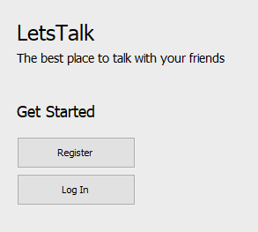
The solution
Java
Socket Programming
Interactive graphical user interface (GUI)
Login and registration
Database for storage of user information
Github/Google Drive
Unit/System testing

Slide 6
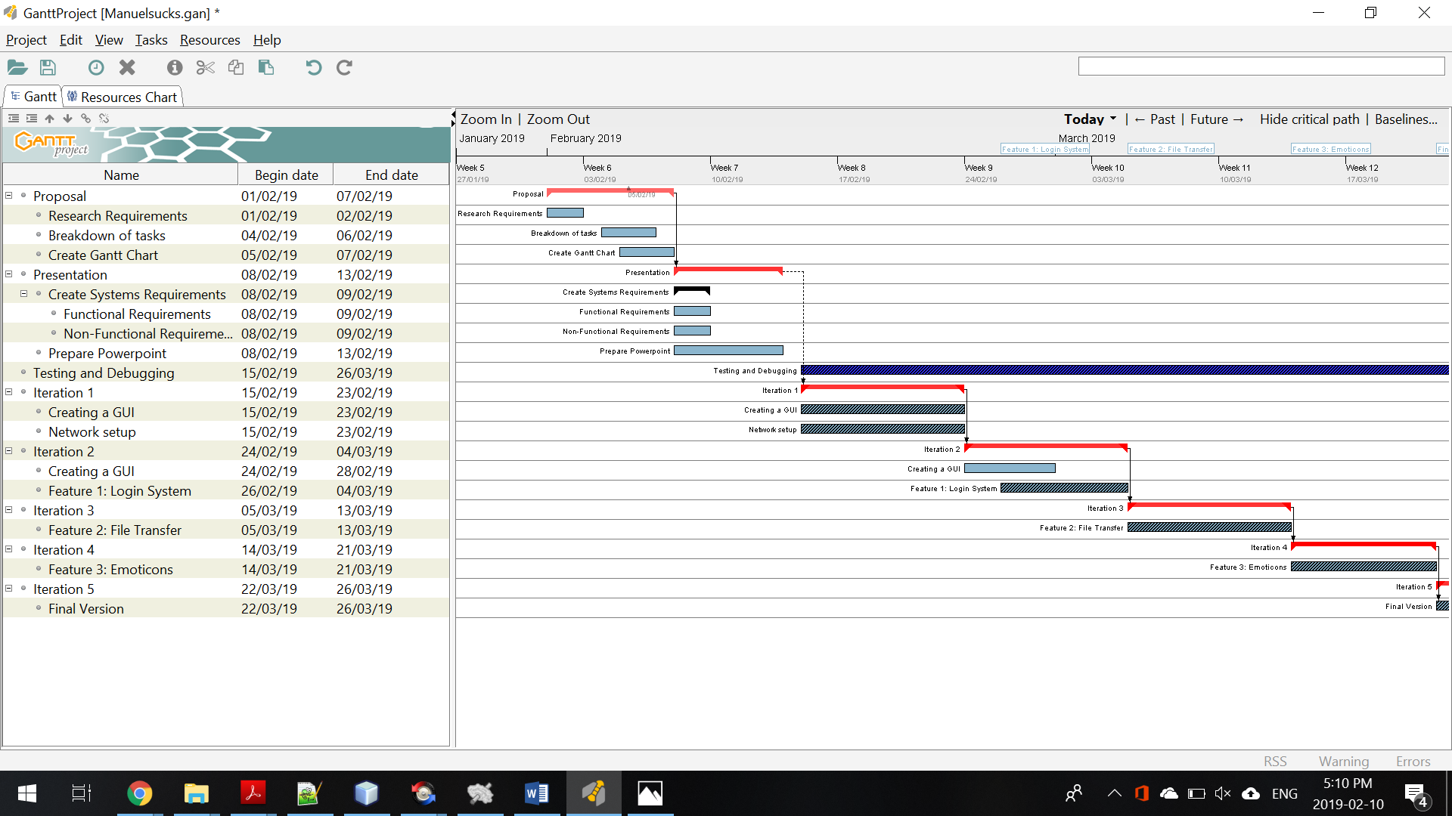
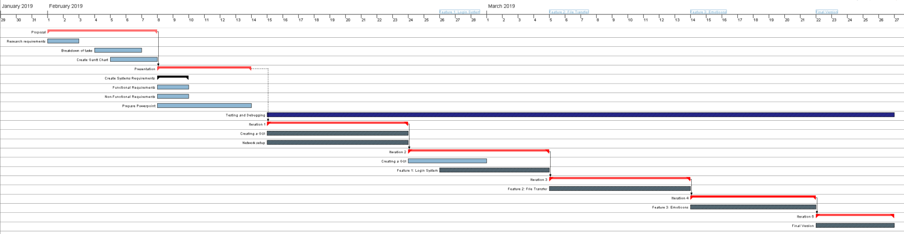
Initial Timeline

Slide 7
Timeline and Milestones
June 20XX
13th February 2019
3rd March 2019
April 2019
23rd February 2019
29th March 2019
-Initial Planning, -Work breakdown, -Proposal Submission -Presentation
-Login/Registration
-Socket Programming
-Testing
Final Report Submission
Jan | Feb | Mar | Apr
Initial GUI setup
Socket Programming
Testing
-Database Setup - List of Online Users -Testing -Final Presentation

Slide 8
Complications
Some features (such as the database implementation) required more time than intended
Resolution: Revisit features, Decide which features to keep/important, and design new milestones (such as the private messaging, and list of online users).
Github was not the main web-based hosting service due to improper commits and unfamiliar usage
Resolution: Use google drive and archive the iterations and features in dated folders with clear descriptions and README files.
Notes:
Jason to add

Slide 9
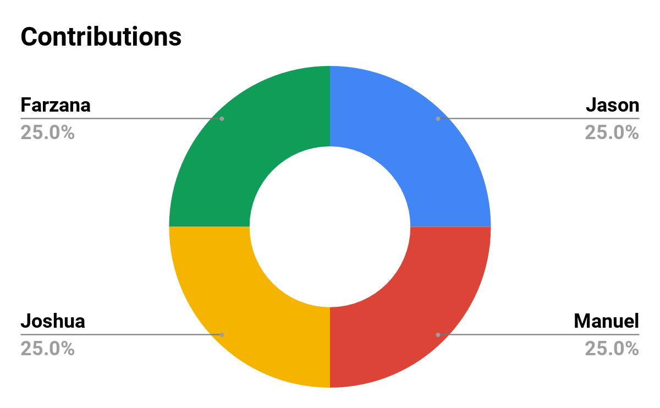
Contributions
Jason: - Project Management
- Socket Programming
- Testing
Manuel: - Socket Programming
- GUI Integration
- Testing
Farzana: - GUI Design
- Testing
- Documentation
Joshua: - GUI Design
- Testing
- Database Implementation

Slide 10
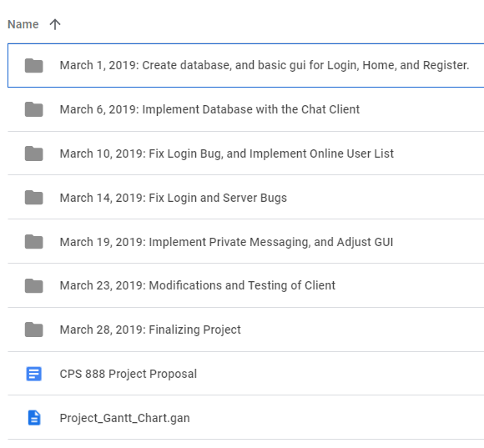
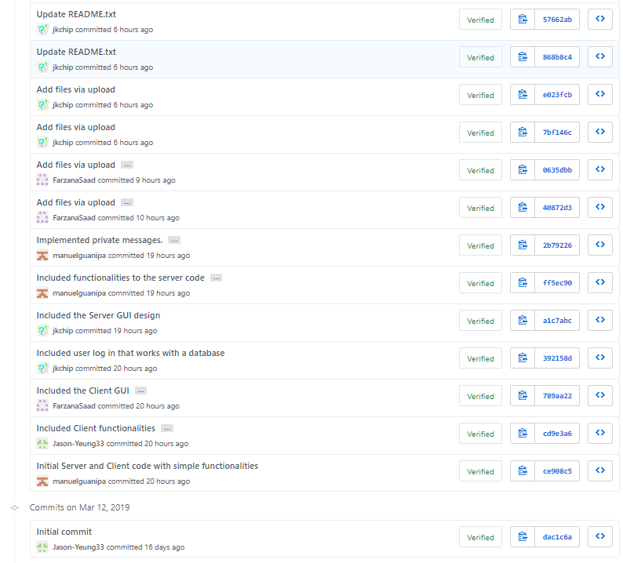
Github / Google Drive
Notes:
Manuel- jot down how did he spilt up the github commits

Slide 11
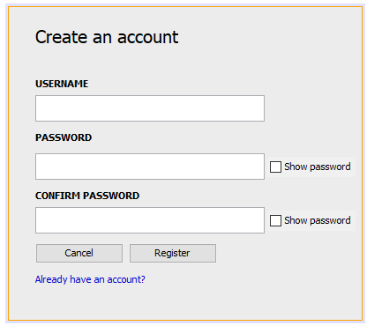
Features
Login and registration system with a local database
Guest login
Messaging
Private messaging
Online users list
DES Encryption

Slide 12
Database Set up
User Information on MySql database
XAMPP
Apache Port
MySql Port
Phpmyadmin
*Next step would be to implement the database on a cloud server so that this step can be eliminated.
Notes:
What can we put instead?

Slide 13
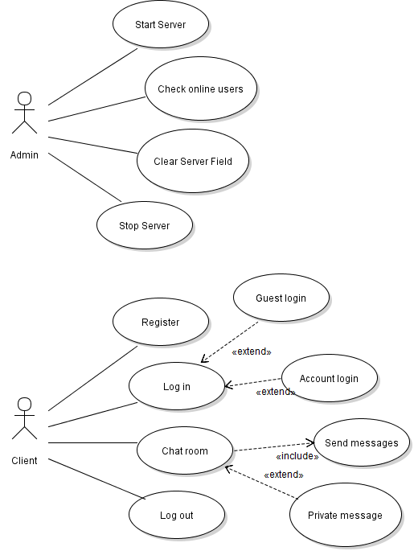
Use cases

Slide 14
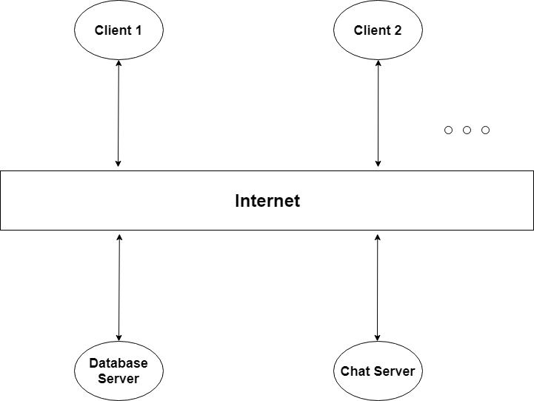
Architecture 1
Client-server architectural pattern

Slide 15
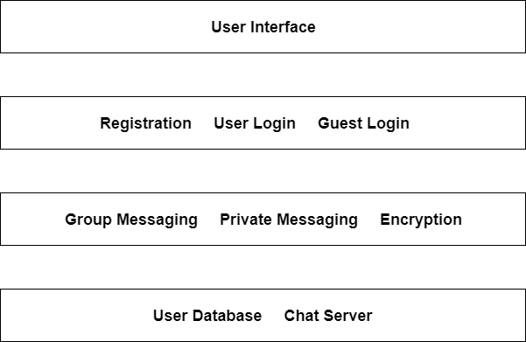
Architecture 2
2) Layered architectural pattern

Slide 16
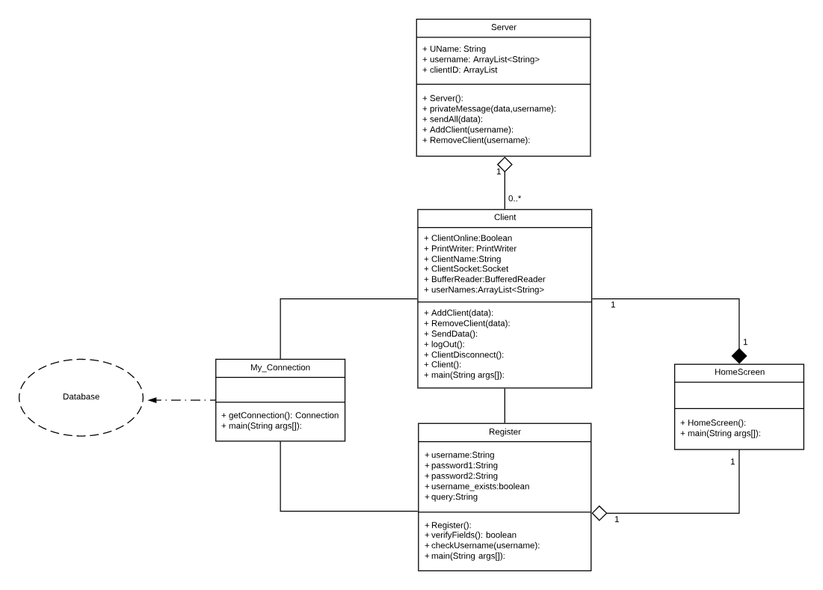
Class Diagram

Slide 17
Non-Functional Requirements
Fluidity - Features work with each other
Useability - How it’s easy for users to use
Accessibility - Anyone can use this messenger because the softwares used in this project are all open-source (Xampp, Netbeans, MySQL)
Security - DES Symmetric data Encryption and key distribution

Slide 18
How it works
Step 3
Step 2
Step 1
Talk!
Run the application
Set up the Local Database
Notes:
Use case Diagram

Slide 19

DEMO :)

Slide 20
User Feedback
“Ever Since I started using LetsTalk, i haven't used any other Chat application :)” -Kit
“Wow” -Aesha
“Absolutely LOVE the personal message in a group convo feature”- Ashwin
**Disclaimer: All reviews used in presentation are fictitious. Names of individuals used with permission..

Slide 21
Next Step
Takeaways
Make the LogIn DB run on a cloud server so the manual setup can be avoided
Make the application Android/IOS compatible
Enforce greater security in communication
Learnt to Implement Java Swing
Familiarized with Github and its commands
Learnt how socket programming works

Slide 22
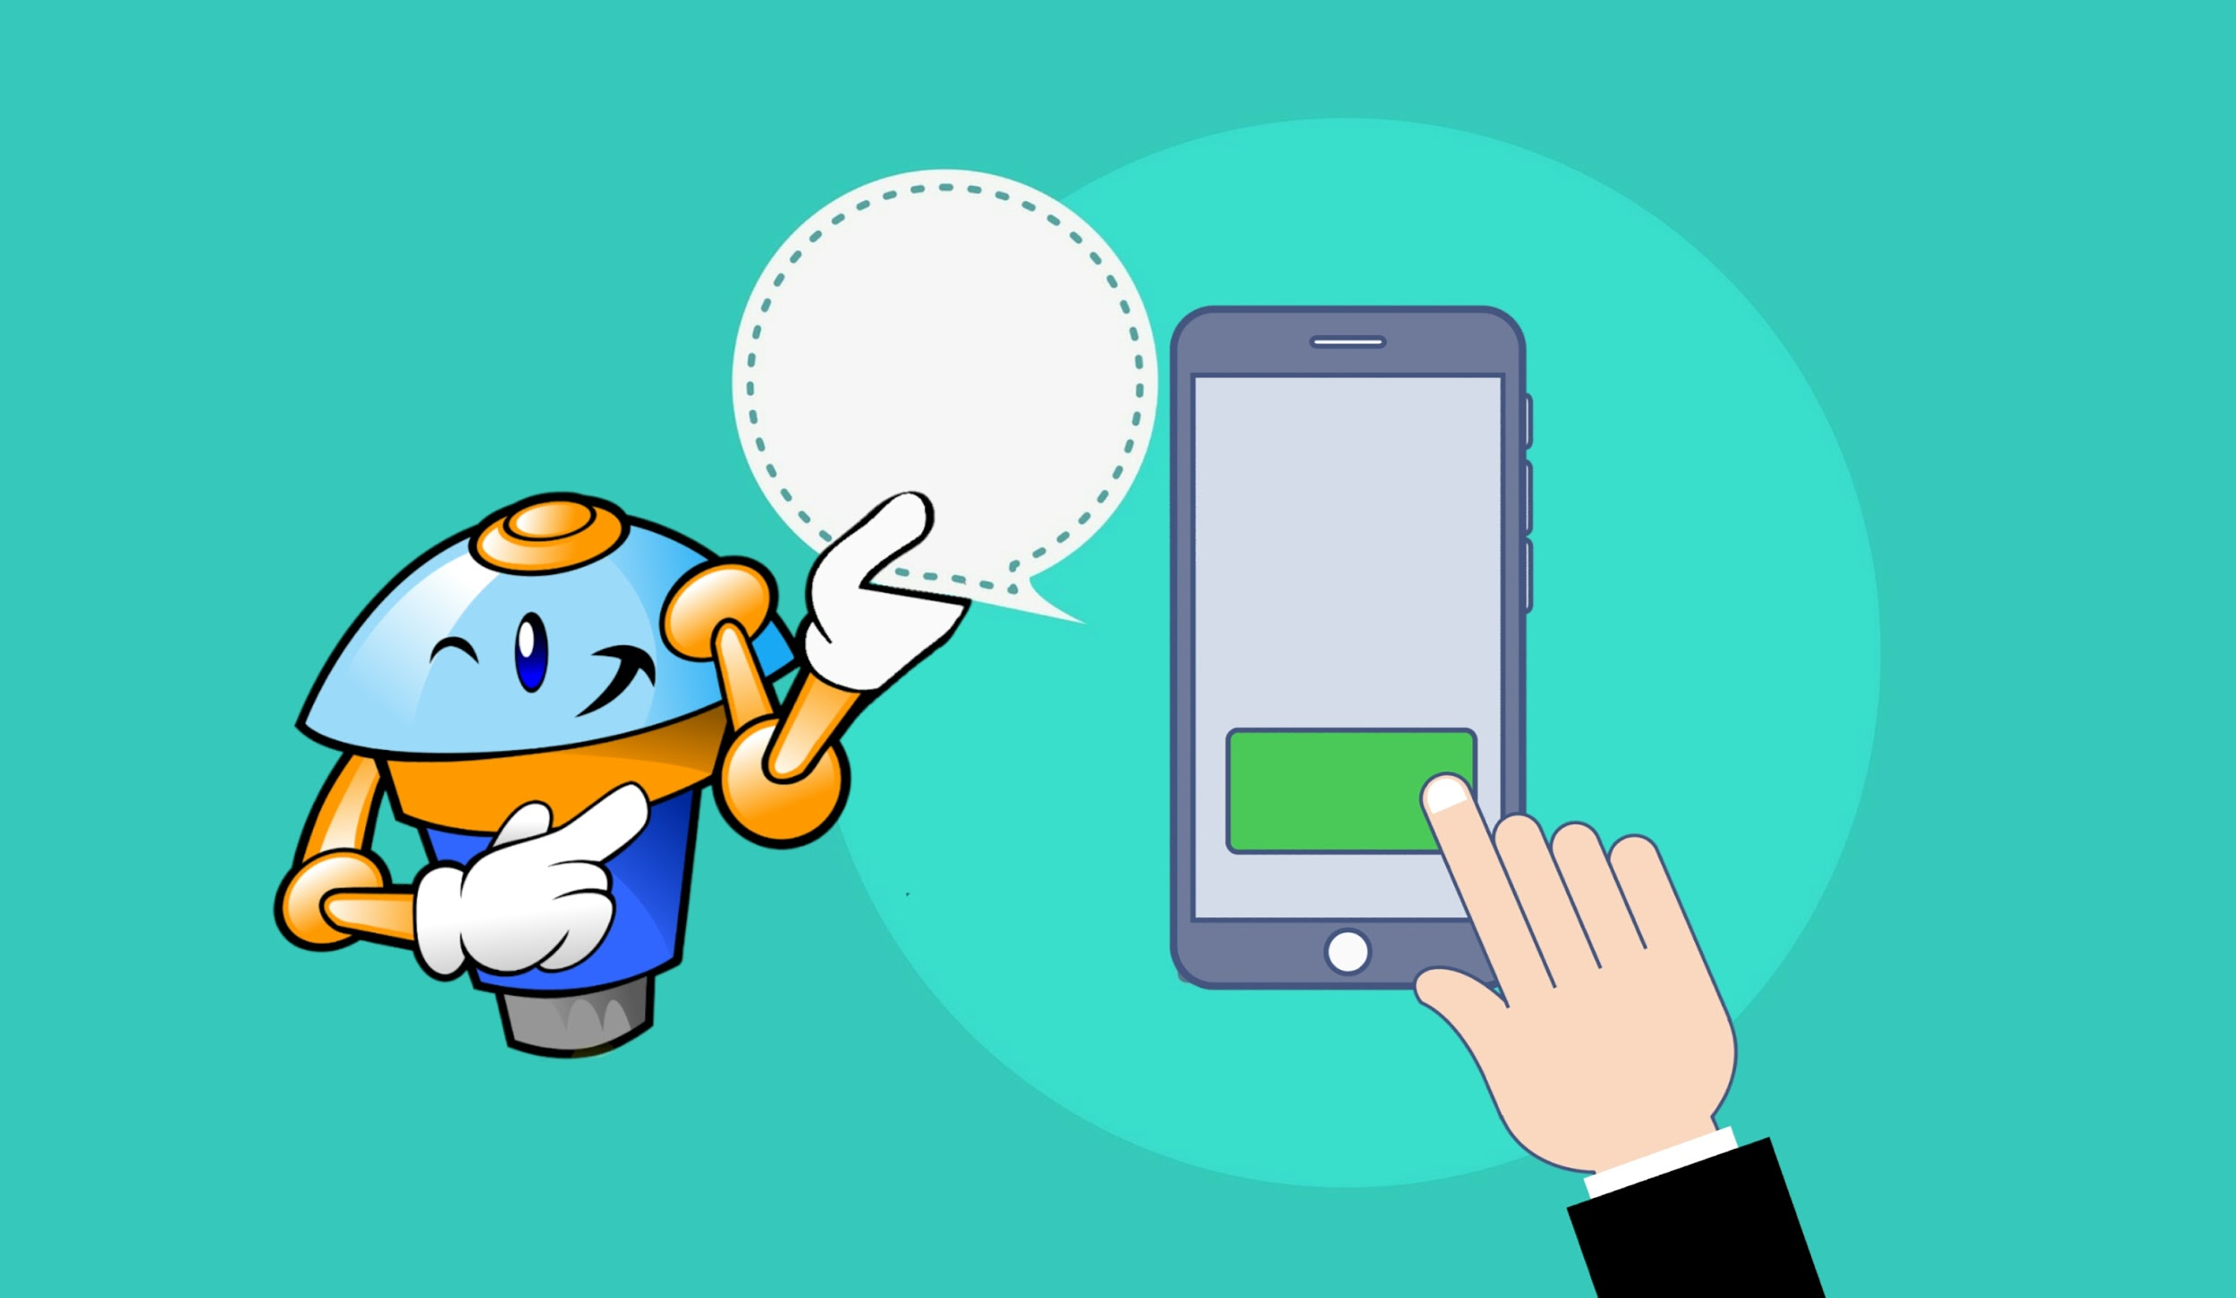
Thank you for watching :)

