Slide 1
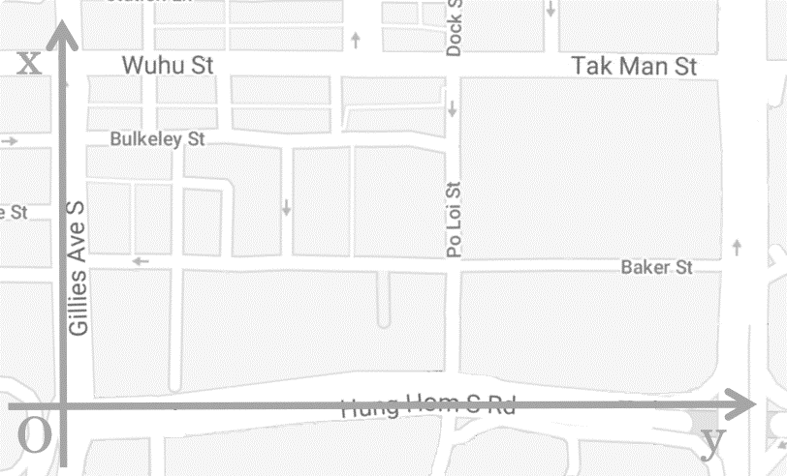








































$$Lp_{7}$$
$$Rd_{32}$$
$$Rd_{31}$$
$$Rd_{30}$$
$$Lp_{8}$$
$$Rd_{29}$$
$$Rd_{28}$$
$$Rd_{27}$$
$$Rd_{19}$$
$$Rd_{21}$$
$$Rd_{26}$$
$$Rd_{18}$$
$$Rd_{25}$$
$$Rd_{24}$$
$$Rd_{15}$$
$$Rd_{20}$$
$$Rd_{23}$$
$$Rd_{22}$$
$$Lp_{6}$$
$$Lp_{5}$$
$$Rd_{17}$$
$$Rd_{16}$$
$$Rd_{14}$$
$$Rd_{13}$$
$$Rd_{11}$$
$$Rd_{12}$$
$$Rd_{8}$$
$$Rd_{9}$$
$$Lp_{4}$$
$$Rd_{10}$$
$$Rd_{7}$$
$$Lp_{3}$$
$$Rd_{6}$$
$$Rd_{5}$$
$$Rd_{1}$$
$$Rd_{2}$$
$$Lp_{1}$$
$$Rd_{3}$$
$$Rd_{4}$$
$$Lp_{2}$$

Slide 2
$$Rd_{29}$$
$$Rd_{28}$$
$$Rd_{27}$$
$$Rd_{26}$$
$$Rd_{32}$$
$$Rd_{25}$$
$$Rd_{31}$$
$$Rd_{30}$$
$$Rd_{20}$$
$$Rd_{23}$$
$$Rd_{22}$$
$$Rd_{19}$$
$$Rd_{21}$$
$$Rd_{18}$$
$$Rd_{24}$$
$$Rd_{15}$$
$$Rd_{17}$$
$$Rd_{16}$$
$$Rd_{14}$$
$$Rd_{13}$$
$$Rd_{11}$$
$$Rd_{12}$$
$$Rd_{8}$$
$$Rd_{9}$$
$$Rd_{10}$$
$$Rd_{7}$$
$$Rd_{6}$$
$$Rd_{5}$$
$$Rd_{1}$$
$$Rd_{2}$$
$$Rd_{3}$$
$$Rd_{4}$$

