Slide 1




Shop $A$
Shop $B$
$$RP_{A}$$
$$RP_{B}$$

Slide 2
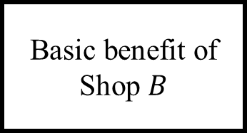








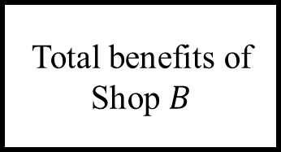
$$RP_{A}$$
Extra benefits from Shop $A$
Shop $A$
Total benefits of Shop $B$
Basic benefit of Shop $B$
Basic benefits of Shop $A$
Total benefits of Shop $A$
Extra benefits from Shop $B$
$$RP_{B}$$
Original benefits
Shop $B$
Additional benefits brought by the alliance

