Slide 1
CTPIP Module Architecture
Clinical Trial Protocol Intelligence Platform
How the system is built: modules, responsibilities and how they connect • Explained in simple terms

Slide 2
What CTPIP does
One sentence: it reads trial protocol PDFs and turns them into a searchable, evidence-linked knowledge graph
• Reads: 187 breast-cancer clinical trial protocol PDFs (19,413 pages)
• Understands: finds drugs, diseases, doses, eligibility rules, endpoints and links them as facts
• Remembers: stores facts in a graph database (Neo4j) and the passages in SQLite
• Answers: plain-English questions, graph exploration, side-by-side comparison
• Proves: every fact links to the exact PDF page and quote
• Explains: a local AI (Ollama) explains protocols in plain language and answers questions with sources
• Runs locally: no cloud; the AI is optional
187
95,181
protocols
evidence passages
29,047
175,589
clinical facts
graph links
693
0
shared entities
failed documents
CTPIP | Module Architecture
2

Slide 3
System architecture – the big picture
Three layers: what you see, the engine, and the storage
BROWSER / USER LAYER
ENGINE (Python FastAPI backend)
STORAGE LAYER
React Web App
9 pages, D3 graph
REST API (/api/*)
documents, graph, query, evidence, compare
Neo4j Graph DB
nodes + relationships
HTTP/JSON
Ingestion Worker
thread + 4 processes
Query Engine + AI
GraphRAG, RAG, agent
SQLite (WAL + FTS5)
jobs, chunks, history
Web browser
Chrome / Edge
optional
Extraction + Resolution
dictionary + rules
Graph Writer / Client
Cypher, read-only
File storage data/
PDFs, .json.gz checkpoints
Local AI (Ollama)
port 11434 – optional
Serves built web pages
CTPIP | Module Architecture
3

Slide 4
Tech stack
Everything used to build CTPIP
Backend (Python 3.11+)
PDF & language processing
Data stores
Frontend (TypeScript)
• FastAPI + Uvicorn – web API
• Pydantic / pydantic-settings – validation, config
• python-multipart – file upload
• httpx – optional AI calls
• pytest – test runner
• PyMuPDF – text, fonts, tables, page images
• RapidOCR (ONNX) – scanned pages, offline
• Curated lexicon + regex rules
• Python stdlib: process pool, threads, gzip, hashlib
• Neo4j 5 + Cypher – knowledge graph
• neo4j Python driver 5.28+
• SQLite (WAL, FTS5) – metadata + search
• gzip JSON – checkpoints
• React 18.3 + React Router 6
• TanStack Query 5 – data fetching
• D3 7.9 – graph drawing
• Tailwind CSS 3.4 + lucide icons
• Vite 5 – dev server and build
Launcher: start.bat starts Neo4j (needs Java 21), prepares the Python and Node environments, starts the backend on port 8000 and opens the browser.
CTPIP | Module Architecture
4

Slide 5
Backend module map
backend/app/ – eight packages, each with one job
api/
core/
ingest/
extraction/
The doors
The notebook
The reader
The fact finder
documents, graph, query, assistant, evaluation
metadb.py – SQLite tables + helpers
pipeline, worker, pdf_extract, structure, chunker
lexicon, entities, relations, providers + resolution/resolver
llm/
graph/
query/
main.py + config.py
The explainer (local AI)
The graph keeper
The answerer
Start-up & settings
client, retrieval, prompts, protocol_brief, glossary, agent, grounding
schema, writer, neo4j_client
planner, linker, templates, engine, traversal, answer, compare, serialize
FastAPI app, .env settings
CTPIP | Module Architecture
5

Slide 6
Module: ingest – reading PDFs
From a PDF file to structured, page-aware passages
pipeline.py
the recipe
pdf_extract.py
reader + OCR
• worker.py: polls the durable job queue, runs analysis in up to 4 processes, persists results in one writer thread, retries up to 3 times, re-queues jobs after a crash
• pipeline.py: stage functions: register_pdf, analyze_document, store_analysis, apply_resolution, persist_document, delete_document_everywhere
• pdf_extract.py: PyMuPDF text with fonts and boxes; RapidOCR for pages with under 40 characters; table finder
• structure.py: PDF outline first, then layout heuristics; ordered keyword rules assign categories
• chunker.py: never crosses sections; keeps each criterion/dose/endpoint whole; table rows get headers
worker.py
the foreman
structure.py
headings + categories
chunker.py
evidence passages
Checkpoints: extraction.json.gz and analysis.json.gz – a retry skips finished work.
CTPIP | Module Architecture
6

Slide 7
Modules: extraction + resolution – understanding the text
Dictionary and rules first; AI is optional and always verified
File | Role | How it works
lexicon.py | The dictionary | Curated breast-oncology terms: drugs, brands, codes, abbreviations, biomarkers, endpoints, side effects; distinct molecules stay distinct
entities.py | Spotter + metadata | Longest-match term finding; learns abbreviations defined in each document; reads NCT, sponsor, phase, version
relations.py | Fact builder | Creates claims from section meaning + sentence patterns; each claim carries quote, page, confidence; no facts from co-occurrence alone
providers.py | Extractor switch | Rule-based (default) or OpenAI-compatible model; model output kept only if schema-valid and the quote appears verbatim
resolver.py | Name checker | Exact match → document abbreviation → stored human decision → provisional entity; ≥84% look-alikes go to human review, never auto-merged
Example: “PR” means progesterone receptor only near ER/HER2 wording; otherwise it is likely “partial response”.
CTPIP | Module Architecture
7

Slide 8
Module: graph – the knowledge graph
A rulebook (schema), a writer, and a safe connection
• schema.py: 40 node types and 42 relationship types; each relationship lists which types it may connect
• writer.py: idempotent per document – removes the old contribution, merges shared entities, creates document nodes and one relationship per claim with provenance
• neo4j_client.py: admin account for writing only; every question uses a read-only transaction with a timeout, optionally a reader-only account
Drug
INVESTIGATES
Disease / Subtype
STUDIES
Protocol
Endpoint
HAS_PRIMARY_ENDPOINT
DESCRIBED_IN
Criterion
Category | Meaning
clinical | Protocol facts – must have claim, page, quote
structural | Documents, versions, evidence links
terminology | Reference drug classes (not evidence)
mention | Mentioned only – no clinical meaning
HAS_INCLUSION_CRITERION
Document
Every clinical link also points to an Evidence Chunk (page + quote) through its claim.
CTPIP | Module Architecture
8

Slide 9
Module: query – answering questions (GraphRAG)
Retrieve real facts first, then summarise only those facts
planner.py
Detect intent
linker.py
Find entities
templates.py
Safe Cypher only
engine.py
Run + rank + validate
traversal.py
BFS / DFS tree
answer.py
Evidence-only text
• Question text never becomes database code: it only fills parameters of pre-written, read-only templates (the allowlist)
• Unsupported questions: return “unsupported” with an explanation – no guessing
• Validation layer: every edge must exist; every clinical edge must have claim, document, quote and page; paths must use only returned edges
• Answer labels: supported by multiple / one passage · inferred · background · reference terminology · mention only · uncertain
• compare.py: 2–4 protocols field by field → same / similar / different / conflicting / unavailable
• serialize.py: packs graph objects into safe JSON for the screens
CTPIP | Module Architecture
9

Slide 10
Module: llm – the local AI assistant
Plain-language explanations, protocol study, Ask AI and an agent – always with sources
Question / protocol
Retrieve sources
Number S1..Sn
Local model (Ollama)
Grounding check
Answer + sources
File | Role
retrieval.py | Full-text search with synonym expansion and section-aware ranking + validated graph facts; records why each source was chosen
protocol_brief.py + glossary.py | Plain-language structure of a protocol, medical terms and drug classes explained (works without AI)
prompts.py | Clinical-trial protocol expert persona; use only numbered sources; cite [S#]; no medical advice
agent.py | Research agent: plans up to 4 tool calls (find protocols, overview, text search, graph search, compare)
grounding.py | Explainability: cited vs automatically matched statements, invalid citations, numbers not found in sources
client.py + settings.py | Ollama native API or any OpenAI-compatible server; settings page overrides .env; streaming
Measured on a 4 GB GPU with qwen2.5:3b: full protocol explanation about 23 s, questions about 6-13 s; 80-90% of statements supported by sources.
CTPIP | Module Architecture
10

Slide 11
API layer – the doors the screens use
About 35 REST endpoints in four route files
Group | File | Main endpoints
Documents | api/documents.py | upload, import-folder, list, detail, sections, chunks, tables, entities, file, page image, retry, reprocess, delete, jobs
Graph | api/graph.py | schema, stats, overview, traverse, neighborhood, paths, entity search / detail
Query & evidence | api/query.py | query, query/structured, templates, evidence search / chunk / edge, compare
Quality & history | api/query.py | quality summary / warnings / review / conflicts, history queries + audit, dashboard stats
Evaluation | api/evaluation.py | run, runs, run detail (helper module runner.py not yet present)
Local AI | api/assistant.py | status, settings, test, pull model, protocol brief, explain protocol, chat (RAG / agent), explain query / evidence / compare (streamed)
System | main.py | /api/health, optional X-API-Token guard, static web app, /docs, first-start auto-import
Security: optional API token; CORS limited to the dev server; unhandled errors return clean 500/503 messages; graph outage never takes the document library down.
CTPIP | Module Architecture
11

Slide 12
Frontend architecture
React single-page app, served by the backend on the same port
pages/ (one per screen)
components/ (reusable)
lib/ + app shell
Dashboard (+ Quality panel)
AiAnswer (citations, sources, check)
api.ts – typed API client
Documents – Protocols
ChatPanel (quick answer / agent)
DocumentDetail – Study (5 tabs)
Md (answer formatting, citation chips)
graphStyle.ts – colours
Assistant – Ask AI
GraphCanvas (D3)
traverse.ts – BFS / DFS
Search (QueryWorkspace + EvidenceExplorer)
DetailPanel
Compare
EvidenceCard
App.tsx – menu + routes
GraphExplorer
SourceViewer (PDF page + highlight)
History
TraversalPlayer (BFS/DFS replay)
main.tsx – starts the app
Settings – local AI
TreeView + Legend + ui.tsx
+ ai.ts – streaming AI client, status, AI switches
CTPIP | Module Architecture
12

Slide 13
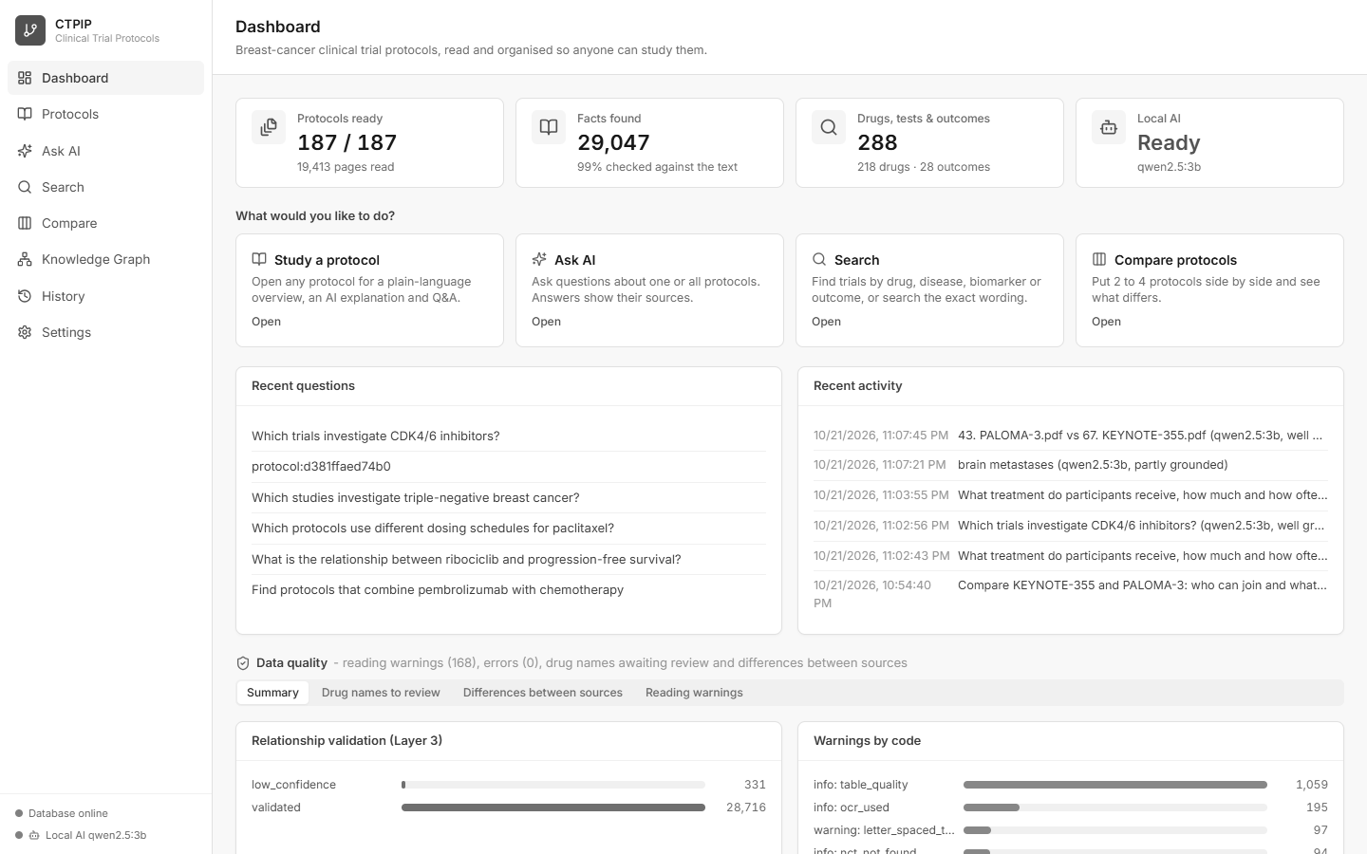
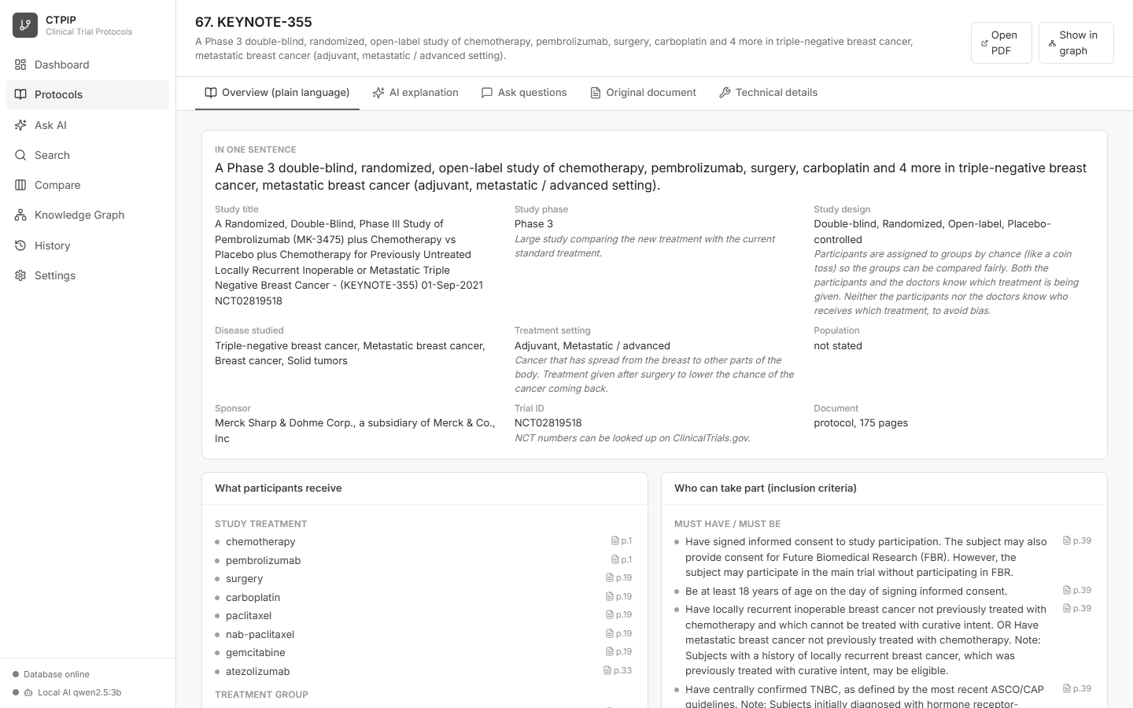
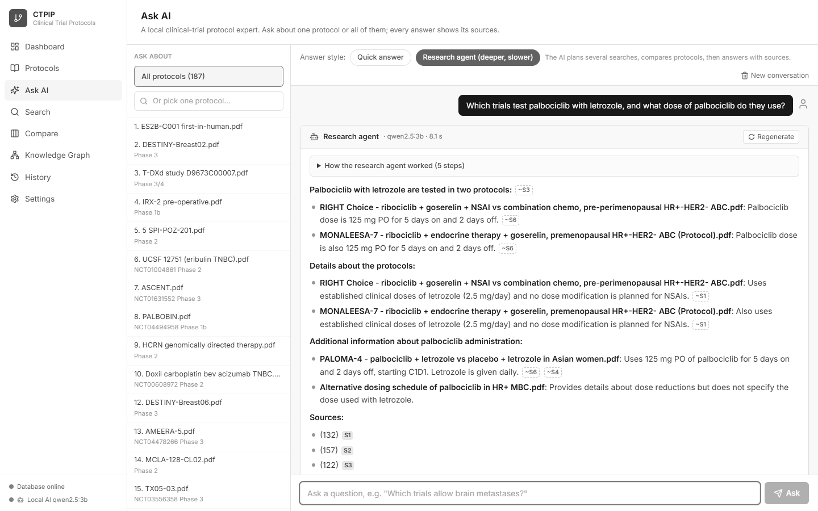
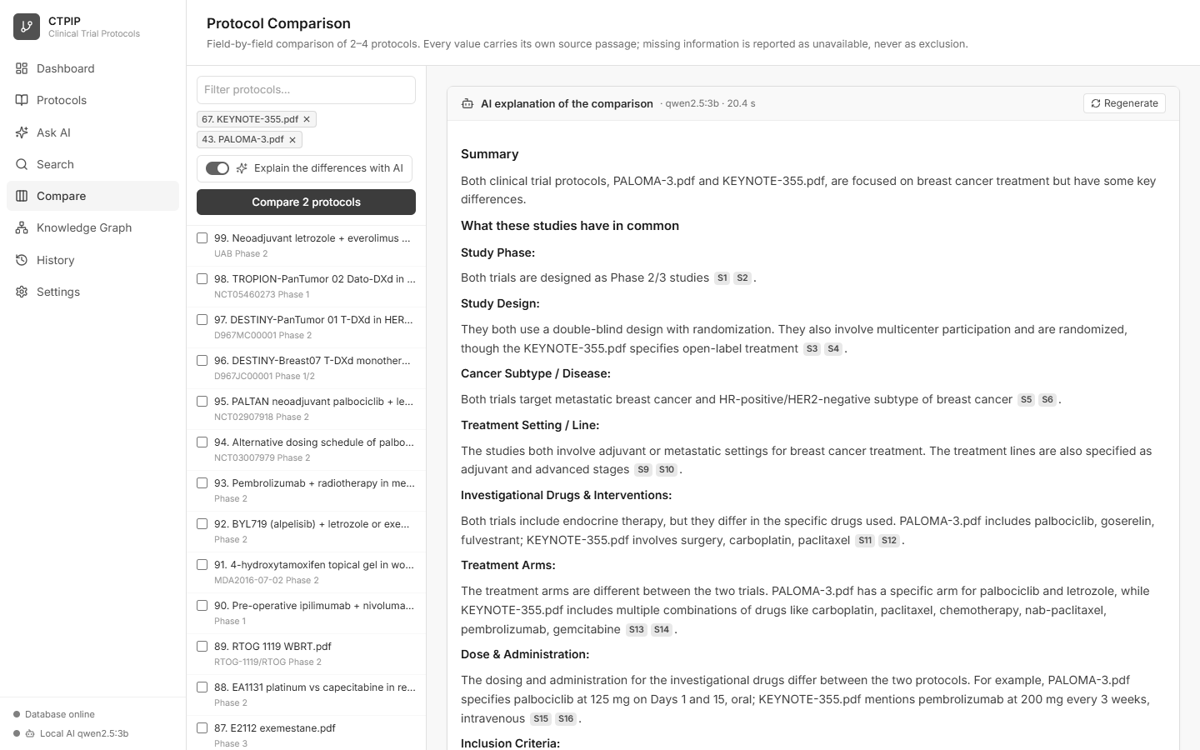
Application screens
Simple navigation: Dashboard, Protocols, Ask AI, Search, Compare, Knowledge Graph, History, Settings
Dashboard
Study a protocol (plain language)
CTPIP | Module Architecture
Ask AI (research agent)
Compare with AI explanation
13

Slide 14
Data stores – what lives where
Each store does what it is best at
Store | Holds | Why this store
Neo4j (database ctpip) | Entities, claims, relationships with provenance, evidence nodes | Graph traversal and path finding
SQLite data/ctpip.sqlite3 | Documents, jobs, sections, chunks (+ full-text index), tables, mentions, warnings, review items, audit, query history | Local, transactional, FTS5 keyword search
data/pdfs/ | Copy of each uploaded PDF | Page images with highlighted passages
data/artifacts/<doc>/ | extraction.json.gz and analysis.json.gz | Resume / re-graph without re-reading the PDF
data/logs/ | server.log | Troubleshooting
SQLite: app_settings, ai_explanations | Local AI settings; saved protocol explanations per model | Instant reopening; settings survive restarts
Original PDF folders are the source of truth: if data/ or the graph is lost, “Import dataset folder” rebuilds everything.
CTPIP | Module Architecture
14

Slide 15
Runtime view – processes and threads
What is actually running when CTPIP is started
start.bat
Neo4j (Java)
port 7687
uvicorn: FastAPI
port 8000
Browser
graph
HTTP
starts Neo4j, then the backend
Ollama (optional)
port 11434
Inside the backend process
Request threads
API calls
Ingest dispatcher thread
polls jobs table
Process pool (4)
analyse PDFs
Writer (same thread)
SQLite + Neo4j writes
• Start-up: create SQLite schema → create Neo4j constraints/indexes → warm dictionary matcher → start worker
• If Neo4j is down the API still serves the library and history; graph endpoints return 503
• Shutdown: worker stopped, Neo4j driver closed
CTPIP | Module Architecture
15

Slide 16
Design principles and safety
Why the results can be trusted
Evidence first
Deterministic by default
AI answers from sources only
Every clinical edge: claim id, document, chunk, page, verbatim quote, confidence.
Rules + dictionary; same input gives same output; works offline.
Local AI uses numbered sources, cites them, and every answer is checked (citations, numbers).
No raw queries
Never silently merge
Restartable and clean
Allow-listed read-only templates, timeouts, result limits, reader account.
Look-alike drug names go to human review; terminology edges are labelled.
Checkpoints, retries, idempotent writes, full delete of a document.
CTPIP | Module Architecture
16

Slide 17
Summary
Remember these five points
• Reader (ingest) → Fact finder (extraction + resolution) → Graph keeper (graph) → Answerer (query)
• Three stores: Neo4j (graph), SQLite (text + history), files (PDFs + checkpoints)
• A background worker keeps the website responsive while PDFs are processed
• Every fact is traceable to a PDF page and quote; questions can never run free-form database code
• A local AI explains protocols in plain language for non-experts – always with sources and an explainability check
• Everything is documented in docs/: user manual, how to run, dataset info, pipeline explanation, slides, demo video
CTPIP | Module Architecture
17

