Slide 1
CTPIP Pipeline
From a PDF to a verified answer, step by step
Two pipelines: Ingestion (PDF → knowledge graph) and Query (question → evidence-backed answer) • with a real worked example

Slide 2
The big idea
A careful research assistant that never guesses and always shows its source
PDF protocols
upload or import folder
Ingestion pipeline
7 stages
Stores
SQLite + Neo4j + files
Query pipeline
10 steps
Answer + sources
page and quote
• Reads each page and notes the headings
• Cuts the text into small labelled passages
• Underlines every drug, disease, dose and rule
• Writes an index card for each fact: what, where (page), proof (quote)
• Files the cards on a wall; related cards are joined by string (the graph)
• Later: finds the right cards, double-checks them against the source and answers using only those
Three promises:
1. No fact without a source (page + quote)
2. No guessing – unclear things are flagged
3. Restartable – progress is saved after every stage
CTPIP | Pipeline
2

Slide 3
Ingestion pipeline – seven stages
Heavy reading in parallel worker processes, database writing in one safe thread
WORKER PROCESSES (parallel, up to 4) – stages 1–5
1 Register
PDF check, SHA-256
2 Extract
text, tables, OCR
3 Structure
sections, categories
4 Chunk
evidence passages
5 Extract facts
entities, claims
analysis.json.gz checkpoint
WRITER THREAD (one at a time) – stages 6–7
6 Store in SQLite
sections, chunks, search index
7 Resolve + write graph
Neo4j nodes + relationships
Done
searchable
Progress marker saved after each stage: registered → extracted → analyzed → stored → graphed → done
CTPIP | Pipeline
3

Slide 4
Stage 1 – Register (the front desk)
Input: a PDF file • Output: a document record + a queued job
• Check: file starts with %PDF, is not password-protected, opens correctly, is under 200 MB
• Fingerprint: SHA-256 of the file contents; same fingerprint = duplicate, stop here
• Identify: document id = “d” + first 12 characters of the fingerprint
• Store: copy saved to data/pdfs/
• Queue: new rows in the documents and jobs tables (status: queued)
• Audit: “document.registered” entry written
Rejected
not a PDF • encrypted • corrupt • too big
Duplicate
same content already loaded (even if renamed)
Queued
accepted and waiting for a worker
CTPIP | Pipeline
4

Slide 5
Stage 2 – Extract (reading the pages)
Tools: PyMuPDF for text and tables, RapidOCR for scanned pages
Page with text layer
read directly
PyMuPDF
lines + fonts + boxes
Page record
text, position, method, confidence
extraction.json.gz
checkpoint 1
Page without text
< 40 characters
RapidOCR
local, offline
• Every line keeps its coordinates: needed later to highlight a passage on the PDF page
• Tables: found by ruling lines or a “Table” caption, kept as rows and columns
• Quality: each page gets a method (pymupdf / ocr) and a confidence; problems become warnings
• Docling was evaluated and not used: needs PyTorch and large models – too heavy for 200 local PDFs
CTPIP | Pipeline
5

Slide 6
Stage 3 – Structure (finding the headings)
Output: a tree of sections, each labelled with a category
• 1st choice: the PDF's built-in bookmarks (outline)
• Otherwise: numbered headings (“5.1 Inclusion Criteria”), bold / larger short lines, ALL-CAPS lines
• Ignore: printed table-of-contents pages (dot leaders)
• Classify: ordered keyword rules; first match wins; unclear titles stay “unknown”; children inherit the parent's category
Heading found | Category assigned
1 PROTOCOL SYNOPSIS | synopsis
2.2 Primary Endpoint | primary_endpoints
4.1 Arm A: Pembrolizumab + Nab-paclitaxel | treatment_arms
4.3 Dose Modifications | dosing
5.1 Inclusion Criteria | inclusion_criteria
5.2 Exclusion Criteria | exclusion_criteria
6 SCHEDULE OF ASSESSMENTS | schedule_of_assessments
8 STATISTICAL ANALYSIS | statistics
Real result for the demo sample: 21 sections found
CTPIP | Pipeline
6

Slide 7
Stage 4 – Chunk (evidence passages)
Hierarchy: Document → Section → Paragraph / List item / Table → Evidence chunk
• Never crosses a section boundary
• Eligibility, dosing, arms and endpoint items stay whole – a criterion is never cut in half
• Tables: one table chunk + one chunk per row, each row with its column headings
• Long paragraphs split only at sentence ends (about 1,100 characters target, 2,200 maximum)
• Short neighbouring paragraphs are merged
• Each chunk remembers pages and bounding boxes (for highlighting)
Section 4.1 Arm A
Evidence chunk chk_c02a7c6aca0ab00d
“Patients in Arm A will receive pembrolizumab 200 mg administered intravenously on Day 1 of each 21-day cycle, in combination with nab-paclitaxel 100 mg/m2 …”
page 2 • method pymupdf • confidence 1.0 • box (62.7, 626.9) – (532.3, 668.7)
CTPIP | Pipeline
7

Slide 8
Stage 5 – Extract facts (entities and claims)
Dictionary and rules first. Every claim carries its evidence
Title page data
Entities
Claims (facts)
Optional AI helper
• NCT number
• Sponsor, phase
• Version, date, amendment
• Protocol or SAP
• Curated breast-oncology lexicon
• Longest match wins
• Learns document abbreviations
• Unknown drug-like words = candidates
• Meaning of the section
• Sentence patterns (“in combination with”, “versus”)
• Quote + page + confidence
• Co-occurrence alone = no fact
• Proposes extra claims
• Must use an allowed predicate
• Entities must resolve
• Quote must appear verbatim
Example: a drug in the dosing / arms / synopsis section → INVESTIGATES. The same drug in an exclusion criterion → REFERENCES_DRUG (a prior-therapy rule), not a treatment.
Result saved as analysis.json.gz (checkpoint 2) together with quality warnings.
CTPIP | Pipeline
8

Slide 9
Stages 6–7 – Store, resolve and write the graph
Safe, repeatable, no duplicates
6 SQLite
7 Resolve + Graph
• Old rows of the document deleted, new ones written in one transaction
• Sections, chunks (+ full-text index), tables, mentions, warnings
• Document details updated (NCT, phase, sponsor, version)
• Resolve names: lexicon → document abbreviation → human decision → provisional
• ≥84% look-alike? → review queue, never auto-merged
• Validate each claim against the schema
• Write Neo4j: remove old contribution, merge shared entities, create document nodes, one relationship per claim
• Link versions by NCT number
Relationship properties: claim_id • source_document_id • source_chunk_id • pages • supporting_quote • confidence • validation_status
CTPIP | Pipeline
9

Slide 10
Reliability – job control and failures
Nothing is lost if something goes wrong
Situation | What the system does
Normal run | queued → running → done (document: queued → processing → processed)
Server stopped mid-way | On restart, running jobs return to the queue and resume after the last finished stage
Unexpected error | Up to 3 attempts; then status failed with the error text; the Retry button restarts from the checkpoint
Bad input | Fails immediately, shows the reason (no pointless retries)
Pause / resume | Queue can be paused; running jobs finish
Delete document | Removes graph contribution, search rows, stored PDF and checkpoints
Human review decision | Stored; affected documents are re-graphed from checkpoint 2 (no PDF re-reading)
CTPIP | Pipeline
10

Slide 11
Worked example – a real document through the pipeline
Sample_Protocol_SAMPLE-PEMBRO-001.pdf (synthetic demo file, 4 pages) – processed in about 10 seconds
Stage | Real result
1 Register | id d68610bec6b23 • 4 pages • queued
2 Extract | text PDF • pymupdf • confidence 1.0 • no OCR needed
3 Structure | 21 sections (synopsis, endpoints, arms, inclusion, exclusion …)
4 Chunk | 30 evidence chunks
5 Extract facts | NCT99999999 • Phase 2 • 79 entities • 110 mentions • 89 claims
6 Store | sections + chunks saved and searchable
7 Graph | 73 entities • 89 relationships • 0 rejected • 0 warnings
Claim type | n
MONITORS_ADVERSE_EVENT | 11
ASSOCIATED_WITH_BIOMARKER | 9
REQUIRES_ASSESSMENT | 9
REFERENCES_CONDITION | 8
HAS_INCLUSION_CRITERION | 7
HAS_EXCLUSION_CRITERION | 7
HAS_SECONDARY_ENDPOINT | 5
others (18 types) | 33
Same pipeline for a 150-page protocol: roughly 20–60 seconds.
CTPIP | Pipeline
11

Slide 12
Worked example – one fact, from text to graph
Every fact keeps its proof
“Patients in Arm A will receive pembrolizumab 200 mg administered intravenously on Day 1 of each 21-day cycle, in combination with nab-paclitaxel 100 mg/m2 …” (page 2, section 4.1)
Claim COMBINED_WITH
nab-paclitaxel → pembrolizumab
Claim HAS_DOSE_SPECIFICATION
pembrolizumab 200 mg, Day 1, IV
Claim HAS_DOSE_SPECIFICATION
nab-paclitaxel 100 mg/m2, Days 1, 8, 15
Property | Value (from the real output)
claim id | clm_4511b3a59da5b9fb
method / type | rule:connector • explicit
confidence | 0.9 (dose claims 0.88)
evidence | page 2 quotes (2 supporting passages)
validation | schema-checked → written to Neo4j as a relationship with claim_id, document, chunk, pages, quote
CTPIP | Pipeline
12

Slide 13
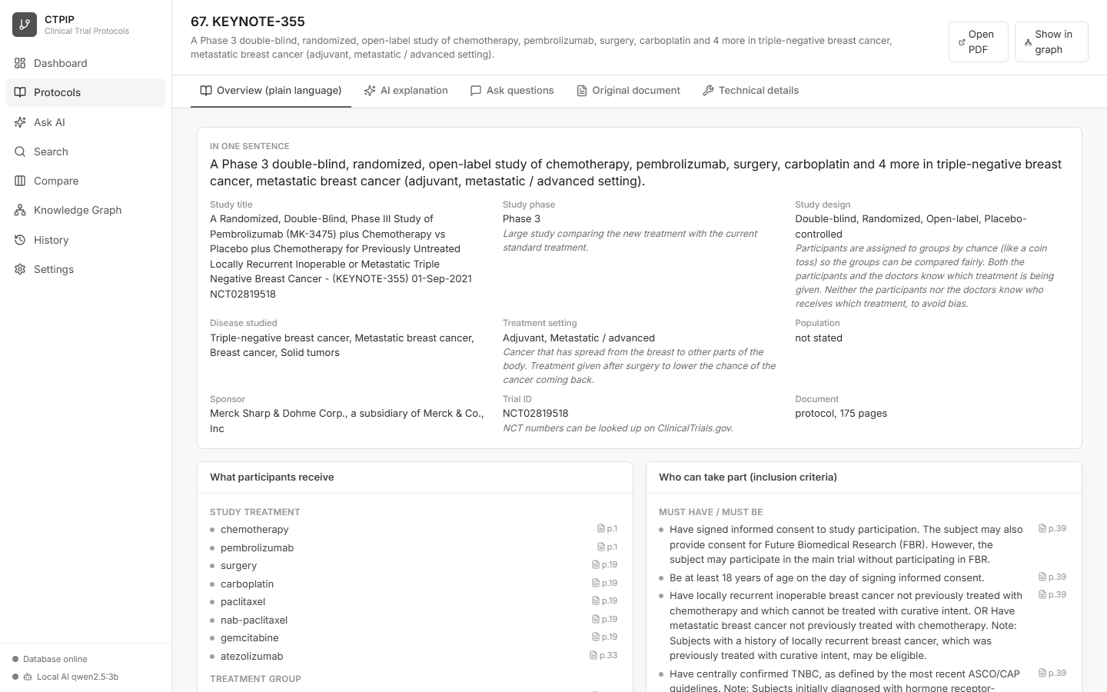
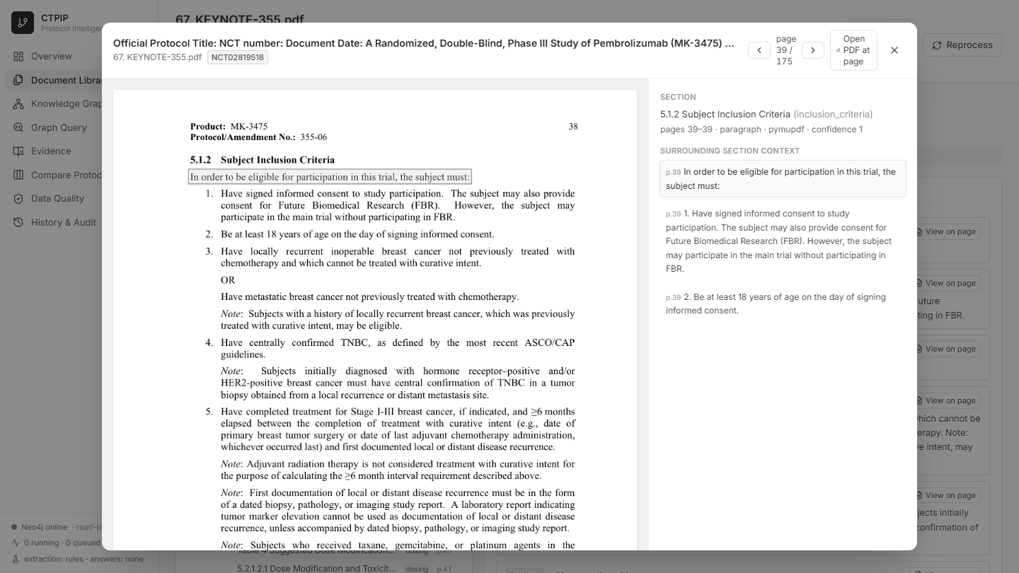
In the application
The same protocol as a plain-language overview, and the original PDF page for any fact
Source viewer: the real PDF page
Protocol overview built from the extracted facts (page links on every item)
• Every fact and passage lists its page; "View on page" opens it
• "View on page" jumps to the original PDF page with the passage highlighted
• Claims in the graph point back to these same passages
CTPIP | Pipeline
13

Slide 14
Query pipeline – from question to verified answer
GraphRAG: retrieve real facts first, then summarise only those facts
1 Parse
intent + types
2 Link terms
to graph entities
3 Plan
pick templates
4 Run Cypher
read-only, timeout
5 Collect
nodes, edges, paths
10 Answer + audit
evidence-only
9 Validate
provenance check
8 Answer tree
BFS / DFS paths
7 Rank
confidence x evidence
6 Evidence
claims + passages
Safety rule: the question text never becomes database code. It only selects and fills pre-written, read-only templates.
CTPIP | Pipeline
14

Slide 15
Query pipeline – what each step does
# | Step | What happens
1 | Parse | Regex cues find the intent: trials for a drug, combination, similar trials, dosing differences, paths …
2 | Link terms | NCT ids → curated dictionary → graph full-text index; each match verified to exist in the graph
3 | Plan | Intent + entity types choose allow-listed templates; unmappable = “unsupported” with explanation
4 | Execute | Parameterised Cypher in a read-only transaction; timeout 15 s; limit 400 results
5 | Collect | Chains of real stored nodes and relationships only
6 | Evidence | Claims and supporting passages (page, quote) fetched for every clinical edge
7 | Rank | confidence × amount of evidence, reduced for longer paths
8 | Tree | BFS / DFS spanning tree, visit order with queue/stack state, root-to-answer paths
9 | Validate | Edges exist; clinical edges have claim, document, quote, page; evidence from the same document
10 | Answer | Deterministic evidence-only text with support labels; plan + evidence saved in History
CTPIP | Pipeline
15

Slide 16
Trust layer – validation and support labels
Final safety net before anything is shown
Layer 4 – Validation
Layer 5 – Support labels on every statement
• Every returned edge still exists in Neo4j
• Every clinical edge has claim id, source document, supporting quote and page
• Claim evidence comes from the same document
• Every path uses only returned edges and nodes
• Result: verified • verified with warnings • no results
• supported by multiple passages
• supported by one passage
• inferred from a validated path
• background literature statement
• reference terminology (not protocol evidence)
• mentioned only
• uncertain
Never adds medical knowledge, never turns a mention into a treatment claim, never implies causality.
CTPIP | Pipeline
16

Slide 17
Worked query example
Question: “Find protocols that combine pembrolizumab with chemotherapy”
Step | Result
Intent | combination
Linked entities | pembrolizumab (drug) • chemotherapy (intervention)
Retrieved | 13 nodes • 22 relationships • 19 reasoning paths
Validation | verified – every clinical edge has claim, document, quote, page
Answer | 5 protocols, e.g. 67 KEYNOTE-355 (NCT02819518), 183 Pembrolizumab + chemotherapy in metastatic TNBC, 142 Pembrolizumab + carboplatin vs carboplatin, 26, 107
Speed | about 0.5 s warm (first question after start-up about 10 s)
Click any result to open the original PDF page with the passage highlighted.
CTPIP | Pipeline
17

Slide 18
Local AI pipeline – explain, ask, research
A local model (Ollama) writes plain-language answers using only numbered sources
1 Question
or a protocol
2 Retrieve
text + facts
3 Number
sources S1..Sn
4 Generate
expert prompt
5 Check
grounding
6 Show
answer + sources
• Retrieve: full-text search with synonyms (e.g. palbociclib = Ibrance) and section-aware ranking; graph facts for corpus questions; the protocol's own facts for single-protocol questions
• Generate: clinical-trial protocol expert persona; plain language; explain terms; use only the sources; cite [S#]; no medical advice
• Protocol explanation: ten fixed sections (who can join, treatments, measures, safety, design, key terms ...); saved per protocol
• Stream: answers appear word by word in the browser
qwen2.5:3b on a 4 GB GPU: full protocol explanation about 23 s; questions about 6-13 s. Larger models (qwen2.5:7b) cite more but are slower on small GPUs.
CTPIP | Pipeline
18

Slide 19
Research agent
The model plans tool calls, every step is shown, then it answers from everything found
Tool | What it does
find_protocols | List protocols matching a drug, disease, trial name or sponsor
protocol_overview | Structured summary of one protocol (its facts)
search_text | Passages from the protocol text (optionally inside one protocol)
graph_search | Validated facts across all protocols
compare | 2-4 protocols on 11 key fields
• Plans one step at a time in JSON (max 4 tools)
• Repeated steps are blocked
• Unknown protocols are reported, never guessed
• All tool results join one numbered source pool
• Final answer cites the pool
Example: "Compare KEYNOTE-355 and PALOMA-3: who can join and what treatments are given?" – agent calls compare, then answers with cited eligibility and treatment facts (about 13 s).
CTPIP | Pipeline
19

Slide 20
Explainability check on every AI answer
So that a non-expert can trust – and verify – what the AI says
Check | How it works | Shown as
Cited statements | Model's own [S#] tags (also on their own line for a paragraph) | Blue chip S3
Matched statements | Uncited sentences matched to the best source by word overlap (30%+) | Dashed chip ~S3
Invalid citations | Tags pointing to sources that were not given | Warning
Number check | Doses, percentages and durations searched in the sources (trial IDs ignored) | "Not found in the sources: ..."
Verdict | 70%+ supported and no problems = well grounded; 40%+ = partly; else weakly | Coloured box
Each source also says why it was chosen (matched words, relevant section, graph fact) and opens the original PDF page.
CTPIP | Pipeline
20

Slide 21
Pipeline at a glance
Stage | Main tool | Runs in | Saved as
1 Register | SHA-256, PyMuPDF check | API request | documents + jobs rows
2 Extract | PyMuPDF, RapidOCR | Worker process | extraction.json.gz
3 Structure | Layout + keyword rules | Worker process | analysis.json.gz
4 Chunk | Rule-based splitter | Worker process | analysis.json.gz
5 Extract facts | Lexicon, regex, optional LLM | Worker process | analysis.json.gz
6 Store | SQLite WAL + FTS5 | Writer thread | SQLite tables
7 Graph | Resolver, schema validator, Neo4j | Writer thread | Neo4j graph
Query | Planner, templates, Cypher, validator | API request | queries + audit tables
Local AI | Retrieval, Ollama model, agent, grounding check | API request (streamed) | audit log; cached explanations
Remember: every fact has a page and a quote. Nothing is invented. Every stage can be resumed.
CTPIP | Pipeline
21

