Slide 1
The Minimax Algorithm
Notes:
https://www.tutorialandexample.com/minimax-strategy
https://www.javatpoint.com/mini-max-algorithm-in-ai

Slide 2
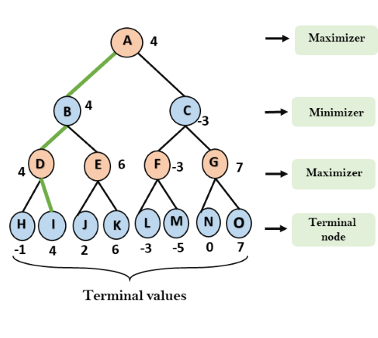
Overview
The Minimax Algorithm
It aims to find the optimal strategy for MAX to win the game.
It follows the approach of DFS.
In the game tree, optimal leaf node could appear at any depth of the tree.

Slide 3
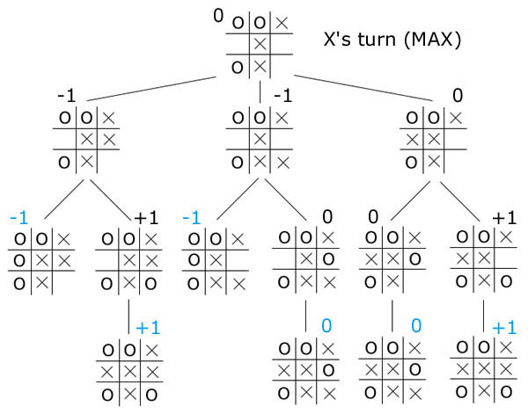
The Minimax Algorithm
The Minimax Algorithm
Keep on generating the game tree/ search tree till a limit d.
Compute the values of the leaf nodes using a heuristic function.
Propagate the values from the leaf node till the current position following the minimax strategy.
Make the best move from the choices.

Slide 4
The Minimax Algorithm
The Minimax Algorithm
function minimax(node, depth, max_player): if depth == 0 or node is a terminal node: return h(node) if max_player: # for MAX player max_val = -∞ for each child of node do: val = minimax(child, depth-1, false) max_val = max(max_val , val) return max_val else: # for MIN player min_val = +∞ for each child of node do: val = minimax(child, depth-1, true) min_val = min(min_val, val) return min_val
Initial call: minimax(root, depth, true)

Slide 5
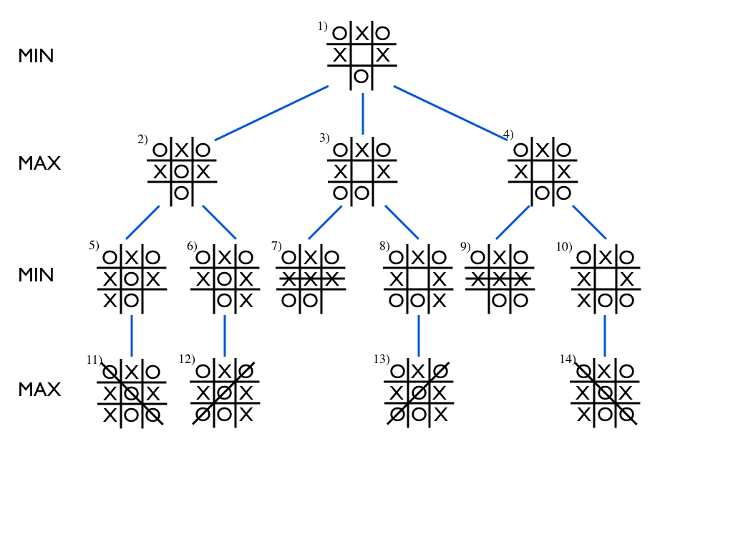
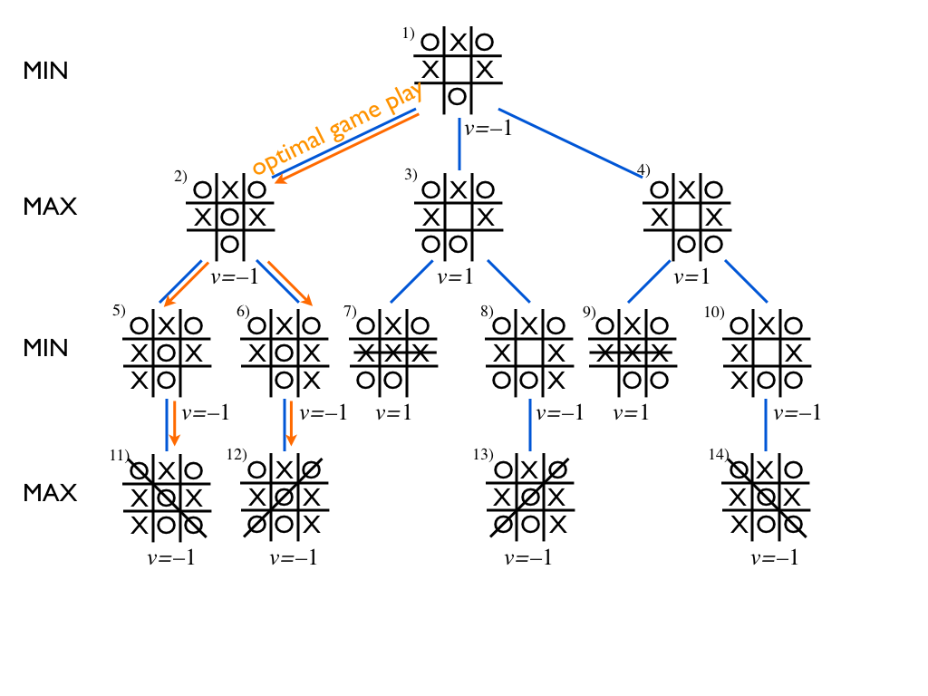
Example
The Minimax Algorithm

Slide 6
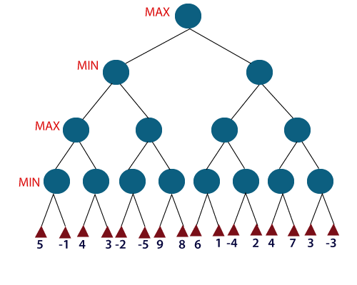
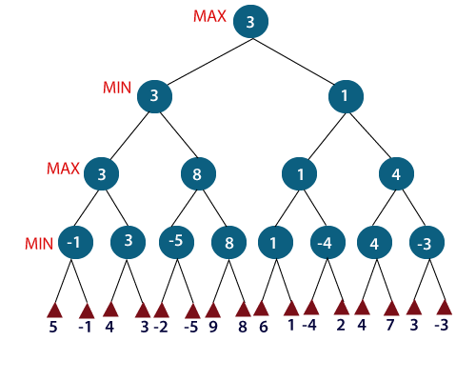
Example
The Minimax Algorithm

Slide 7
Alpha-Beta Pruning Algorithm

Slide 8
Overview
Alpha-Beta Pruning Algorithm
Alpha-beta pruning is an optimization technique for the minimax algorithm.
It removes all the nodes which are not really affecting the final decision → it makes the algorithm fast.
The two-parameter can be defined as:
Alpha: The best (highest-value) choice we have found so far at any point along the path of Maximizer. The initial value of alpha is -∞.
Beta: The best (lowest-value) choice we have found so far at any point along the path of Minimizer. The initial value of beta is +∞.
The main condition which required for alpha-beta pruning is: α>=β

Slide 9
Key points about Alpha-Beta Pruning
Alpha-Beta Pruning Algorithm
The Max player will only update the value of alpha.
The Min player will only update the value of beta.
While backtracking the tree, the node values will be passed to upper nodes instead of values of alpha and beta.
The alpha & beta will only be passed to the child nodes.

Slide 10
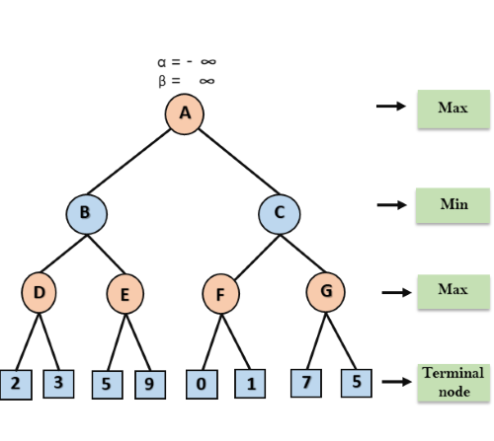
Alpha-Beta Pruning Algorithm
Alpha-Beta Pruning Algorithm
The alpha-beta pruning condition is: α>=β
function alpha_beta(node, depth, alpha, beta, max_player): if depth == 0 or node is a terminal node: return h(node) if max_player: # for MAX player max_val = -∞ for each child of node do: val = alpha_beta(child, depth-1, alpha, beta, false) max_val = max(max_val , val) alpha = max(alpha, max_val) if alpha>=beta: break return max_val else: # for MIN player min_val = +∞ for each child of node do: val = alpha_beta(child, depth-1, alpha, beta, true) min_val = min(min_val, val) beta = min(beta, min_val) if alpha>=beta: break return min_val
Initial call: alpha_beta(root, depth, -∞, +∞, true)

Slide 11
Example – Step 1
Alpha-Beta Pruning Algorithm
The alpha-beta pruning condition is: α>=β
Max player will start first move from node A where α=-∞, β=+∞
Node A passes down α=-∞, β=+∞ to node B
Node B passes down the same values to its child D
α=-∞
β=∞
α=-∞
β=∞

Slide 12
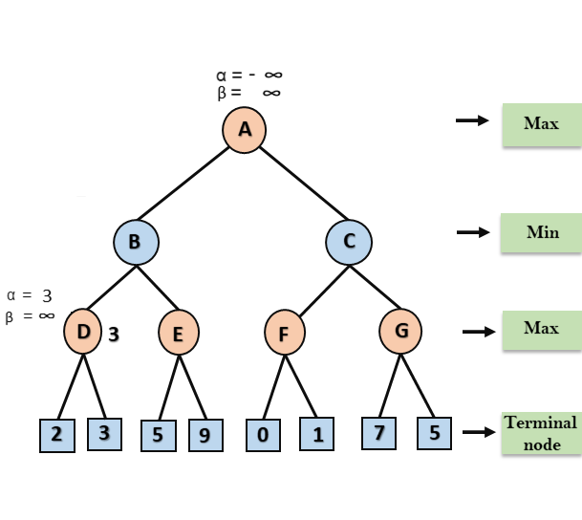
Example – Step 2
Alpha-Beta Pruning Algorithm
The alpha-beta pruning condition is: α>=β
At Node D, α will be calculated for Max
α = max(α, 2) = max(-∞, 2) = 2
α = max(α, 3) = max(2, 3) = 3
Now α=3, β=∞
α=-∞
β=∞

Slide 13
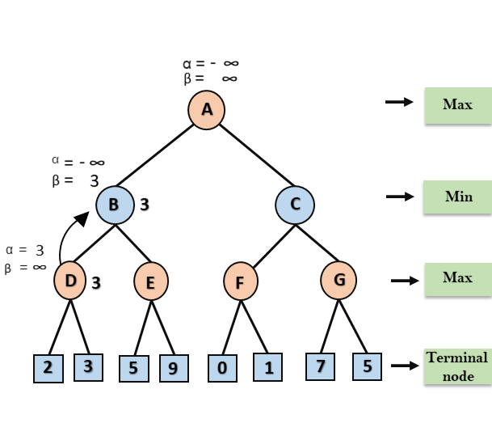
Example – Step 3
Alpha-Beta Pruning Algorithm
The alpha-beta pruning condition is: α>=β
At node B, β will be calculated for Min
β = min(β, 3) = min(+∞, 3) = 3
Now α=-∞, β=3

Slide 14
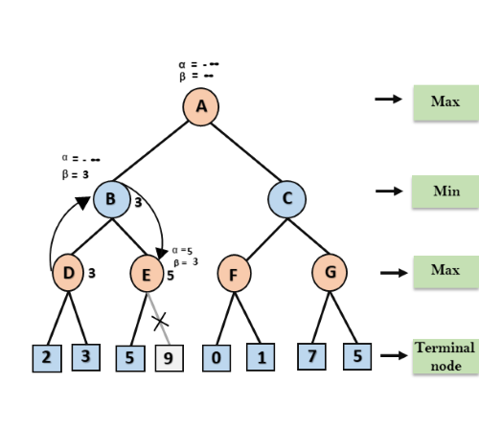
Example – Step 4
Alpha-Beta Pruning Algorithm
The alpha-beta pruning condition is: α>=β
At node E, α will be calculated for Max
α=-∞, β=3
α = max(α, 5) = max(-∞, 5) = 5
Because α>=β, so the right successor of E will be pruned, and algorithm will not traverse it, and the value at node E will be 5

Slide 15
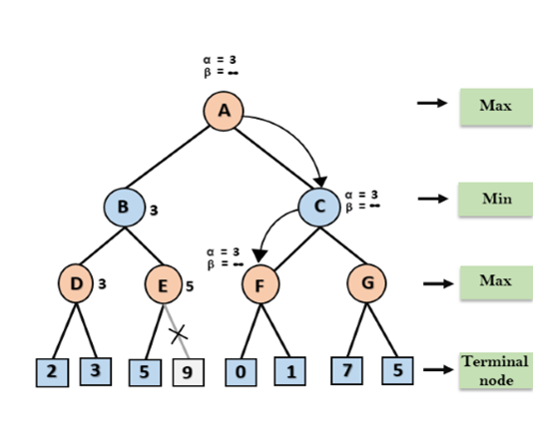
Example – Step 5
Alpha-Beta Pruning Algorithm
The alpha-beta pruning condition is: α>=β
Algorithm again backtrack the tree, from node B to node A.
At node A, α will be calculated for Max
α = max(α, 3) = max(-∞, 3) = 3
β = +∞
α, β are passed to right successor of A which is Node C
At node C, α = 3 and β = +∞, and the same values will be passed on to node F

Slide 16

Example – Step 6
Alpha-Beta Pruning Algorithm
The alpha-beta pruning condition is: α>=β
At node F, again α will be compared with left child which is 0, and max(3,0) = 3, and then compared with right child which is 1, and max(3,1)= 3 still α remains 3, but the node value of F will become 1.

Slide 17
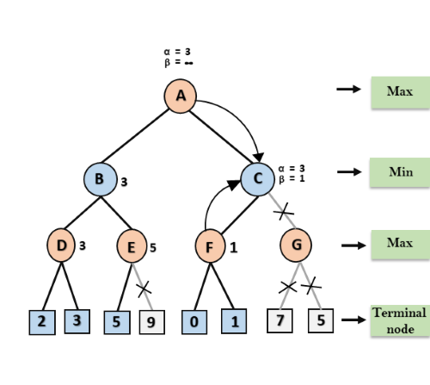
Example – Step 7
Alpha-Beta Pruning Algorithm
The alpha-beta pruning condition is: α>=β
Node F returns the node value 1 to node C
At C, α = 3 and β = +∞, here β will be changed.
β = min(β, 1) = min(+∞, 1) = 1
Now at C, α =3 and β = 1, satisfies the condition α>=β, so the next child of C which is G will be pruned, and the algorithm will not compute the entire sub-tree G.

Slide 18
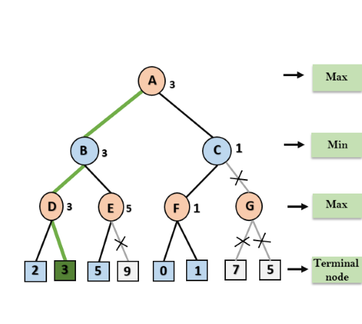
Example – Step 8
Alpha-Beta Pruning Algorithm
The alpha-beta pruning condition is: α>=β
C now returns the value of 1 to A here the best value for A is max (3, 1) = 3.
The final game tree which is the showing the nodes which are computed and nodes which has never computed.
Hence the optimal value for the maximizer is 3 for this example.

Slide 19
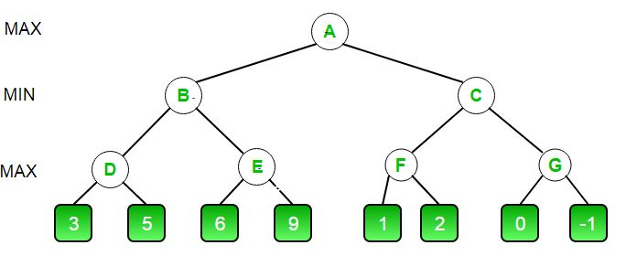
Practice
Alpha-Beta Pruning Algorithm
The alpha-beta pruning condition is: α>=β
function alpha_beta(node, depth, alpha, beta, max_player): if depth == 0 or node is a terminal node: return h(node) if max_player: # for MAX player max_val = -∞ for each child of node do: val = alpha_beta(child, depth-1, alpha, beta, false) max_val = max(max_val , val) alpha = max(alpha, max_val) if alpha>=beta: break return max_val else: # for MIN player min_val = +∞ for each child of node do: val = alpha_beta(child, depth-1, alpha, beta, true) min_val = min(min_val, val) beta = min(beta, min_val) if alpha>=beta: break return min_val
Initial call: alpha_beta(root, depth, -∞, +∞, true)
Notes:
https://www.geeksforgeeks.org/minimax-algorithm-in-game-theory-set-4-alpha-beta-pruning/
https://fars.io/minimax_mancala/

Slide 20
Practice – Step 1
Alpha-Beta Pruning Algorithm
The alpha-beta pruning condition is: α>=β
Max player will start first move from node A where α=-∞, β=+∞
Node A passes down α=-∞, β=+∞ to node B
Node B passes down the same values to its child D
α = - ∞
β = +∞
α = - ∞
β = +∞
α = - ∞
β = +∞
Notes:
https://www.geeksforgeeks.org/minimax-algorithm-in-game-theory-set-4-alpha-beta-pruning/
https://fars.io/minimax_mancala/

Slide 21
Practice – Step 2
Alpha-Beta Pruning Algorithm
The alpha-beta pruning condition is: α>=β
At Node D, α will be calculated for Max
α = max(α, 3) = max(-∞, 3) = 3
α = max(α, 5) = max(3, 5) = 5
Now α=5, β=∞
α = - ∞
β = +∞
α = - ∞
β = +∞
α = 5
β = +∞
5
Notes:
https://www.geeksforgeeks.org/minimax-algorithm-in-game-theory-set-4-alpha-beta-pruning/
https://fars.io/minimax_mancala/

Slide 22
Practice – Step 3
Alpha-Beta Pruning Algorithm
The alpha-beta pruning condition is: α>=β
At node B, β will be calculated for Min
β = min(β, 5) = min(+∞, 5) = 5
Now α=-∞, β=5
α = - ∞
β = +∞
α = - ∞
β = 5
α = 5
β = +∞
5
5
Notes:
https://www.geeksforgeeks.org/minimax-algorithm-in-game-theory-set-4-alpha-beta-pruning/
https://fars.io/minimax_mancala/

Slide 23
Practice – Step 4
Alpha-Beta Pruning Algorithm
The alpha-beta pruning condition is: α>=β
At node E, α will be calculated for Max
Currently α=-∞, β=5
α = max(α, 6) = max(-∞, 6) = 6
Because α>=β, so the right successor of E will be pruned, and algorithm will not traverse it, and the value at node E will be 6
α = - ∞
β = +∞
α = - ∞
β = 5
α = 5
β = +∞
α = 6
β = 5
5
5
6
//
Notes:
https://www.geeksforgeeks.org/minimax-algorithm-in-game-theory-set-4-alpha-beta-pruning/
https://fars.io/minimax_mancala/

Slide 24
Practice – Step 5
Alpha-Beta Pruning Algorithm
The alpha-beta pruning condition is: α>=β
Algorithm again backtrack the tree, from node B to node A.
At node A, α will be calculated for Max
α = max(α, 5) = max(-∞, 5) = 5
β = +∞
α, β are passed to right successor of A which is Node C
At node C, α = 5 and β = +∞, and the same values will be passed on to node F
α = 5
β = +∞
α = - ∞
β = 5
α = 5
β = +∞
5
α = 5
β = +∞
α = 6
β = 5
α = 5
β = +∞
5
5
6
//
Notes:
https://www.geeksforgeeks.org/minimax-algorithm-in-game-theory-set-4-alpha-beta-pruning/
https://fars.io/minimax_mancala/

Slide 25
Practice – Step 6
Alpha-Beta Pruning Algorithm
The alpha-beta pruning condition is: α>=β
At F, again α will be compared with left child which is 1, and max(5,1) = 5, and then compared with right child which is 2, and max(5,2)= 5 still α remains 5, but the node value of F will become 2.
α = 5
β = +∞
α = - ∞
β = 5
α = 5
β = +∞
5
α = 5
β = +∞
α = 6
β = 5
α = 5
β = +∞
5
5
6
//
2
Notes:
https://www.geeksforgeeks.org/minimax-algorithm-in-game-theory-set-4-alpha-beta-pruning/
https://fars.io/minimax_mancala/

Slide 26
Practice – Step 7
Alpha-Beta Pruning Algorithm
The alpha-beta pruning condition is: α>=β
Node F returns the node value 2 to node C
At C, α = 5 and β = +∞, here β will be changed.
β = min(β, 2) = min(+∞, 2) = 2
Now at C, α =5 and β = 2, satisfies the condition α>=β, so the next child of C which is G will be pruned, and the algorithm will not compute the entire sub-tree G.
α = 5
β = +∞
α = - ∞
β = 5
α = 5
β = 2
5
α = 5
β = +∞
α = 6
β = 5
α = 5
β = +∞
5
2
//
5
6
//
2
Notes:
https://www.geeksforgeeks.org/minimax-algorithm-in-game-theory-set-4-alpha-beta-pruning/
https://fars.io/minimax_mancala/

Slide 27
Practice – Step 8
Alpha-Beta Pruning Algorithm
The alpha-beta pruning condition is: α>=β
C now returns the value of 2 to A here the best value for A is max (5, 2) = 5.
The final game tree which is the showing the nodes which are computed and nodes which has never computed.
Hence the optimal value for the maximizer is 5 for this example.
α = 5
β = +∞
α = - ∞
β = 5
α = 5
β = 2
5
α = 5
β = +∞
α = 6
β = 5
α = 5
β = +∞
5
2
//
5
6
//
2
Notes:
https://www.geeksforgeeks.org/minimax-algorithm-in-game-theory-set-4-alpha-beta-pruning/
https://fars.io/minimax_mancala/

Slide 28
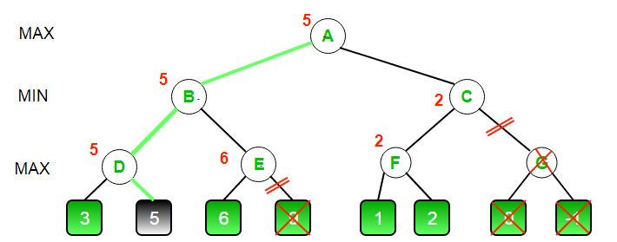
Practice – Final
Alpha-Beta Pruning Algorithm
The alpha-beta pruning condition is: α>=β
α = 5
β = +∞
α = - ∞
β = 5
α = 5
β = 2
5
α = 5
β = +∞
α = 6
β = 5
α = 5
β = +∞
5
2
//
5
6
//
2
Notes:
https://www.geeksforgeeks.org/minimax-algorithm-in-game-theory-set-4-alpha-beta-pruning/
https://fars.io/minimax_mancala/

Slide 29
Practice – Final
Alpha-Beta Pruning Algorithm
The alpha-beta pruning condition is: α>=β
α = 5
β = +∞
α = - ∞
β = 5
α = 5
β = 2
5
α = 5
β = +∞
α = 6
β = 5
α = 5
β = +∞
5
2
//
5
6
//
2
Notes:
https://www.geeksforgeeks.org/minimax-algorithm-in-game-theory-set-4-alpha-beta-pruning/
https://fars.io/minimax_mancala/

Slide 30
Practice
Alpha-Beta Pruning Algorithm
https://www.geeksforgeeks.org/minimax-algorithm-in-game-theory-set-4-alpha-beta-pruning/
https://fars.io/minimax_mancala/

