Slide 1
Exercise: Simple 2-Ply Game with Minimax

Slide 2












Exercise: Simple 2-Ply Game
MV
Max
$$a_{1}$$
$$a_{2}$$
$$a_{3}$$
MV
MV
MV
Min
$$a_{1}$$
$$a_{3}$$
$$a_{1}$$
$$a_{3}$$
$$a_{1}$$
$$a_{3}$$
$$a_{2}$$
$$a_{2}$$
$$a_{2}$$
Utility for Max
2
0
5
-5
-2
7
5
-7
4
Compute all MV (minimax values).
What is the optimal action for Max?
Notes:
MAX chọn a1, vì trong trường hợp xấu nhất do MIN gây ra, a1 vẫn cho kết quả tốt nhất cho MAX.

Slide 3
Exercise: Simple 2-Ply Game with Alpha-Beta Pruning

Slide 4
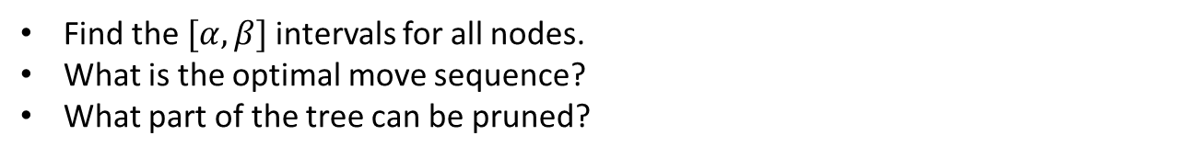

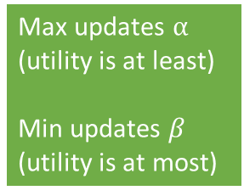



Exercise: Simple 2-Ply Game with Alpha-Beta Pruning
Max updates $α$
(utility is at least)
Min updates $β$
(utility is at most)
$$[α,β]$$
Max
$$a_{1}$$
$$a_{2}$$
$$a_{3}$$
$$[α,β]$$
$$[α,β]$$
$$[α,β]$$
Min
$$a_{1}$$
$$a_{3}$$
$$a_{1}$$
$$a_{3}$$
$$a_{1}$$
$$a_{3}$$
$$a_{2}$$
$$a_{2}$$
$$a_{2}$$
Utility for Max
-5
2
5
7
0
2
5
-7
-4
Find the $[α,β]$ intervals for all nodes.
What is the optimal move sequence?
What part of the tree can be pruned?

Slide 5
Exercise: Simple 2-Ply Game with Alpha-Beta Pruning and Move Ordering

Slide 6



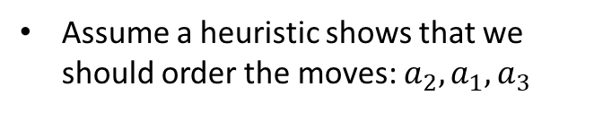





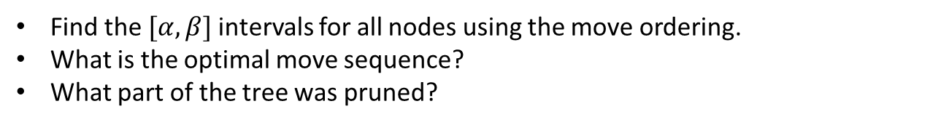








Exercise: Simple 2-Ply Game with Alpha-Beta Pruning and Move Ordering
Max updates $α$
(utility is at least)
Min updates $β$
(utility is at most)
Assume a heuristic shows that we should order the moves: $a_{2}, a_{1},a_{3}$
$$[α,β]$$
Max
$$a_{1}$$
$$a_{2}$$
$$a_{3}$$
$$[α,β]$$
$$[α,β]$$
$$[α,β]$$
Min
$$a_{1}$$
$$a_{1}$$
$$a_{1}$$
$$a_{3}$$
$$a_{3}$$
$$a_{3}$$
$$a_{2}$$
$$a_{2}$$
$$a_{2}$$
Utility for Max
-5
2
5
7
0
2
5
-7
-4
Find the $[α,β]$ intervals for all nodes using the move ordering.
What is the optimal move sequence?
What part of the tree was pruned?

