Slide 1

One Simple Thing To Immediately Make Extreme Classification Easy
Find Out What Rachel McAdams and Harrison Ford have to say about it

Slide 2
One Simple Thing To Immediately Make Extreme Classification Easy
Joint work with
Nikos Karampatziakis
Find Out What Rachel McAdams and Harrison Ford have to say about it

Slide 3
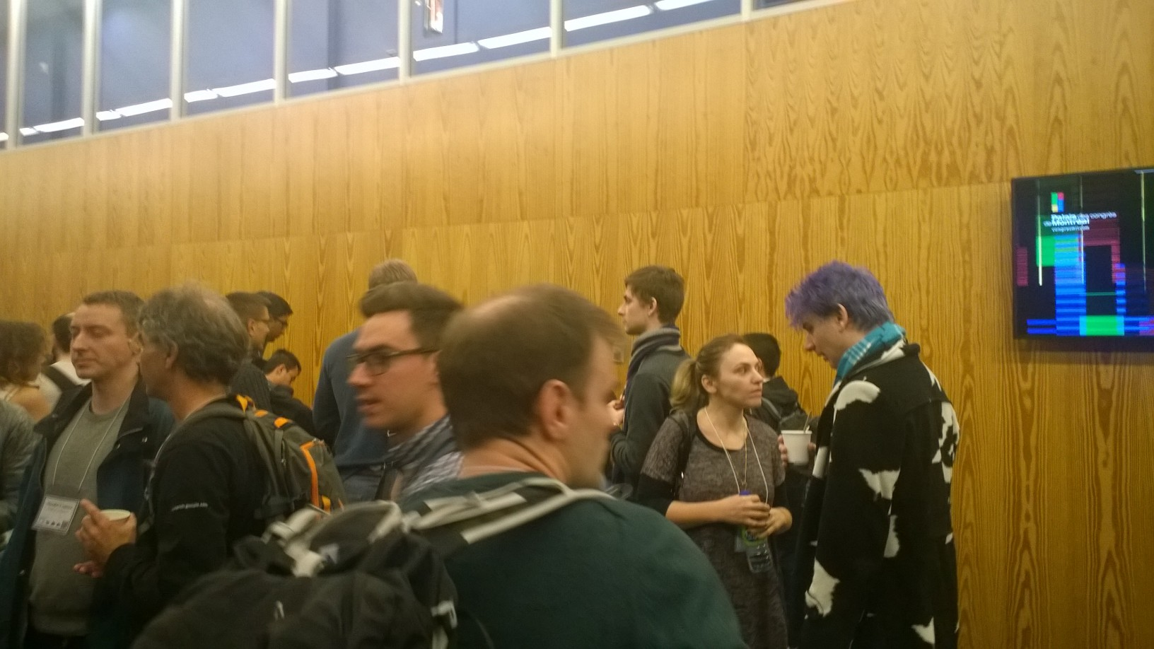

Slide 4
Facebook arguably has the data to solve this, but …
how to do it?

Slide 5
Facebook arguably has the data to solve this, but …
how to do it?
There are billions of possible labels.

Slide 6
Facebook arguably has the data to solve this, but …
how to do it?
There are billions of possible labels.
Computational challenges.
Statistical challenges.

Slide 8
Can we quickly identify plausible labels?

Slide 9
Can we quickly identify plausible labels?
without sacrificing quality?

Slide 10
Can we quickly identify plausible labels?
without sacrificing quality?
or even, improving quality?

Slide 11
Strategy:
Given an example:
1. Compute small set of plausible labels
2. Invoke expensive classifier over plausible labels only.

Slide 12


${10}^{9}$ labels

Slide 13

${10}^{4}$ labels

Slide 14
Strategy:
Given an example:
1. Compute small set of plausible labels
2. Invoke expensive classifier over plausible labels only.

Slide 15
Strategy:
Not a new idea
Given an example:
1. Compute small set of plausible labels
2. Invoke expensive classifier over plausible labels only.

Slide 16
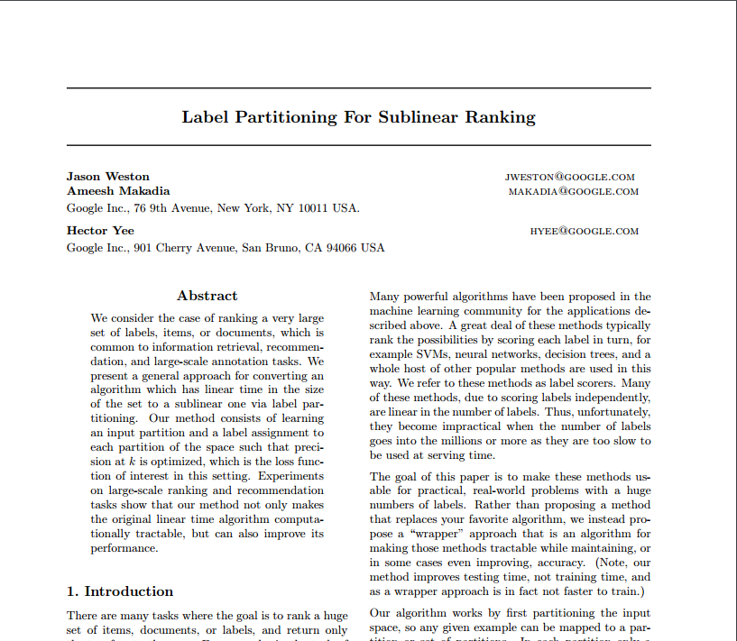

Slide 17
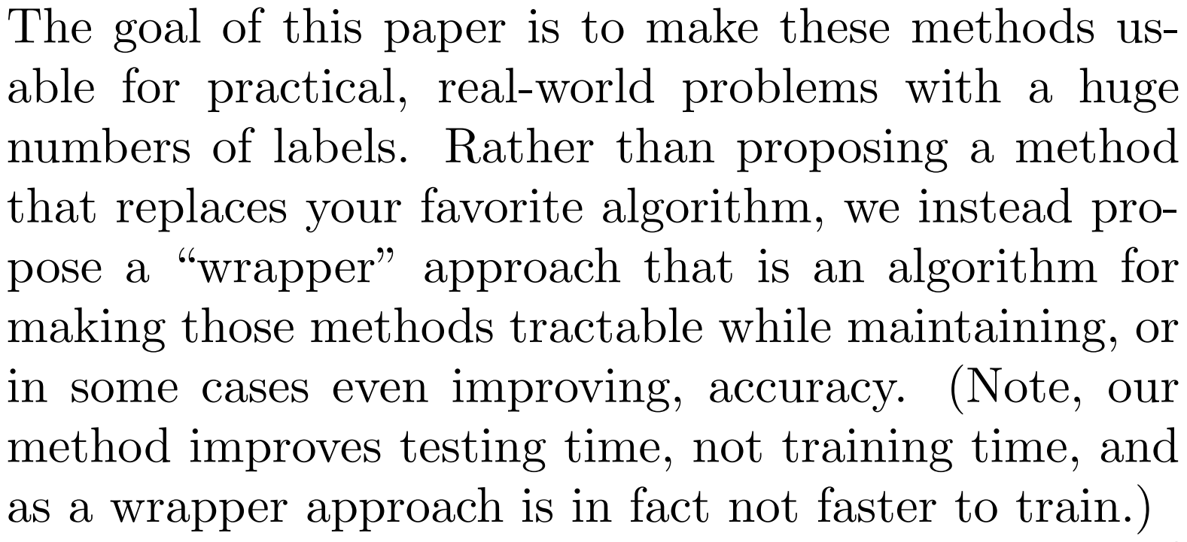

Slide 18
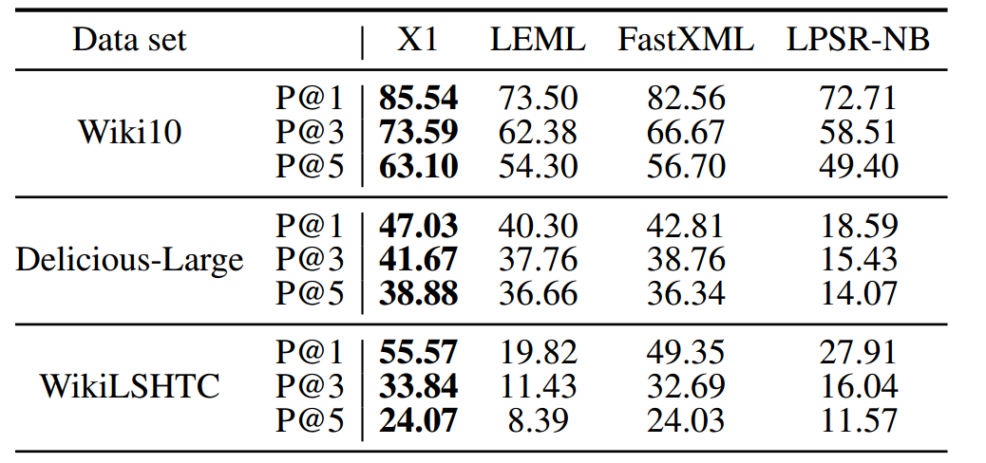

Slide 19
Speeding up inference is nice but …
Speeding up learning is critical.

Slide 20
Strategy:
Given an example:
1. Compute small set of plausible labels
2. Invoke expensive classifier over plausible labels only.

Slide 21
Idea: cheaply make a classifier that identifies plausible labels.
Strategy:
Given an example:
1. Compute small set of plausible labels
2. Invoke expensive classifier over plausible labels only.

Slide 22
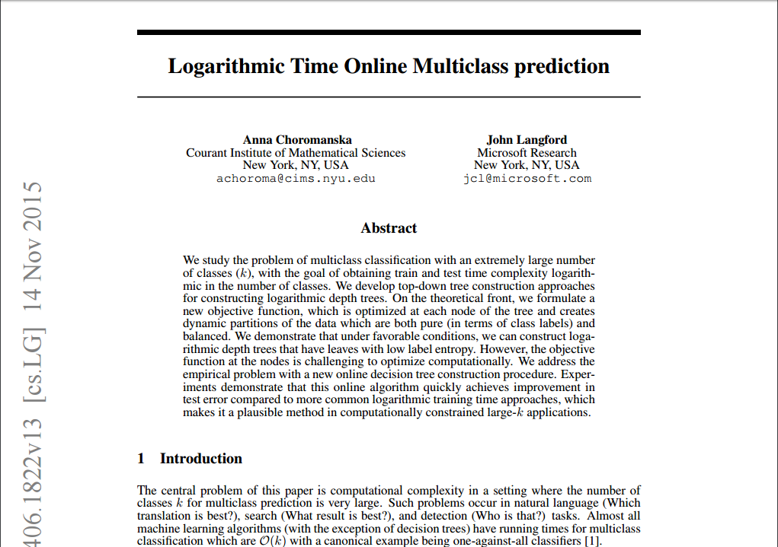

Slide 23
Pretend we’re doing multiclass for a minute …
Build a tree
At each node try to send each
class’s examples exclusively left or right
While sending roughly the same number
of examples left or right in aggregate

Slide 24
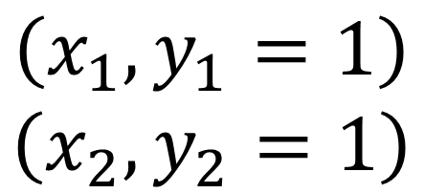
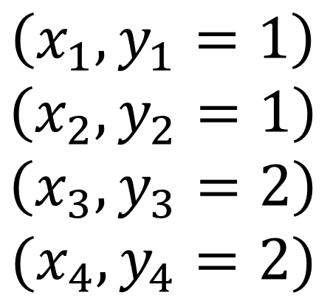
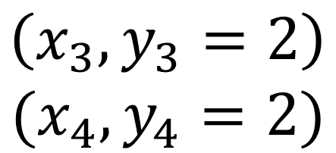
$$\left(x_{1},y_{1}=1\right)$$
$$\left(x_{2},y_{2}=1\right)$$
$$\left(x_{3},y_{3}=2\right)$$
$$(x_{4},y_{4}=2)$$
$$\left(x_{1},y_{1}=1\right)$$
$$\left(x_{2},y_{2}=1\right)$$
$$\left(x_{3},y_{3}=2\right)$$
$$(x_{4},y_{4}=2)$$

Slide 25
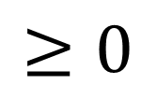
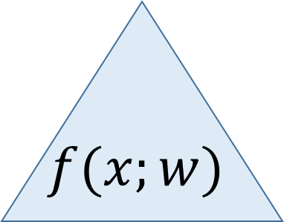

$$\left(x_{1},y_{1}=1\right)$$
$$\left(x_{2},y_{2}=1\right)$$
$$\left(x_{3},y_{3}=2\right)$$
$$(x_{4},y_{4}=2)$$
$$f(x;w)$$
$$\left(x_{1},y_{1}=1\right)$$
$$\left(x_{2},y_{2}=1\right)$$
$$\left(x_{3},y_{3}=2\right)$$
$$(x_{4},y_{4}=2)$$
$$<0$$
$$≥0$$

Slide 26
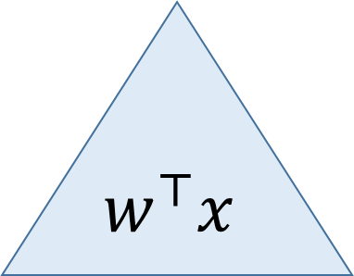
$$\left(x_{1},y_{1}=1\right)$$
$$\left(x_{2},y_{2}=1\right)$$
$$\left(x_{3},y_{3}=2\right)$$
$$(x_{4},y_{4}=2)$$
$$w^{⊤}x$$
$$\left(x_{1},y_{1}=1\right)$$
$$\left(x_{2},y_{2}=1\right)$$
$$\left(x_{3},y_{3}=2\right)$$
$$(x_{4},y_{4}=2)$$
$$<0$$
$$≥0$$

Slide 27
Achieve this via an eigenvalue problem

Slide 28
Achieve this via an eigenvalue problem
``Push all class-conditional means away from zero’’

Slide 29
Achieve this via an eigenvalue problem
``Push all class-conditional means away from zero’’
``while having average value of zero’’

Slide 30
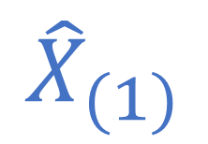
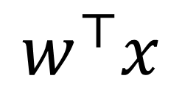
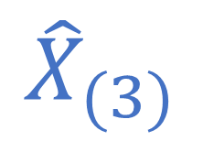
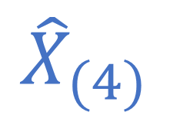
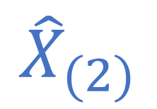
Achieve this via an eigenvalue problem
``Push all class-conditional means away from zero’’
``while having average value of zero’’
$${\hat{X}}_{(3)}$$
$${\hat{X}}_{(1)}$$
$$w^{⊤}x$$
$${\hat{X}}_{(4)}$$
$${\hat{X}}_{(2)}$$

Slide 31



$$maximize w^{⊤}({\hat{X}}^{⊤}\hat{X}) w$$
$$s.t. w^{⊤}w≤1$$
$$1^{⊤}X^{⊤}w=0$$

Slide 32
$$maximize w^{⊤}(X^{⊤}Y{\left(Y^{⊤}Y\right)}^{−1}Y^{⊤}X) w$$
$$s.t. w^{⊤}w≤1$$
$$1^{⊤}X^{⊤}w=0$$

Slide 33
$$maximize{ w}^{⊤}(X^{⊤}Y{\left(Y^{⊤}Y\right)}^{−1}Y^{⊤}X) w$$
$$s.t. w^{⊤}w≤1$$
Works for multilabel!
$$1^{⊤}X^{⊤}w=0$$

Slide 34
Problem
In high dimensions, most vectors are orthogonal
routing margins tend to be small
So we use randomized routing during training

Slide 35
$$\left(x_{1},y_{1}=1\right)$$
$$\left(x_{2},y_{2}=1\right)$$
$$\left(x_{3},y_{3}=2\right)$$
$$(x_{4},y_{4}=2)$$
$$w^{⊤}x$$
$$\left(x_{1},y_{1}=1\right)$$
$$\left(x_{2},y_{2}=1\right)$$
$$\left(x_{3},y_{3}=2\right)$$
$$(x_{4},y_{4}=2)$$
$$<0$$
$$≥0$$

Slide 36
Training the ``plausible label’’ filter:
Build a tree
At each internal node, solve eigenvalue problem
Route examples and recurse to desired depth
At leaf nodes, most frequent classes are ``plausible’’

Slide 37
Training the ``plausible label’’ classifier:
How deep should the tree be?
How many classes to include at each leaf?
Build a tree
At each internal node, solve eigenvalue problem
Route examples and recurse to desired depth
At leaf nodes, most frequent classes are ``plausible’’

Slide 38
Reminder
Once we have the plausible label filter,
We train an underlying classifier.
(Logistic regression)

Slide 39
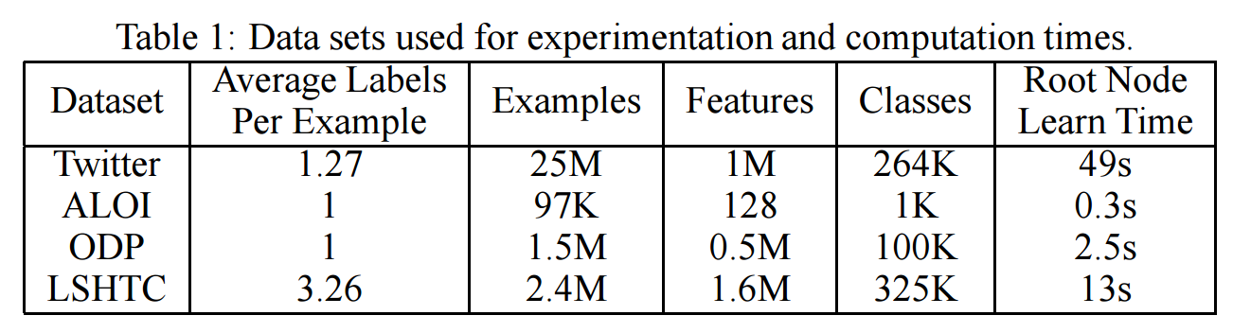

Slide 40
Twitter
Predict hashtags from tweets
Labels = hashtags
Features = words (unigrams + bigrams)
Build tree only

Slide 41
#jobs #it #nowplaying #manager #dev #engineering #ff #java #marketing #php #job #net #project #developer #hiring #programmer #engineer #consultant #customer #flash

Slide 42
#ascendant #mediumcoeli #nowplaying #leo #cancer #sagittarius #scorpio #virgo #libra #gemini #ff #capricorn #jobs #taurus #aquarius #aries #pisces #fb #news #tweetmyjobs

Slide 43
#nowplaying #ff #jobs #retweetthisif #bieberbemine #happybirthdayjustin #babyonitunes #biebcrbemine #justinbiebcr #fb #tweetmyjobs #damnhowtrue #followfriday #biebcrgasm #1 #grindmebieber #quote #news #retweetthis #followmejp

Slide 44
Twitter
Leaf nodes look promising, but …
Popular tags everywhere.

Slide 45
LSHTC
Kaggle competition
Predict Wikipedia tags from documents (token counts)

Slide 46
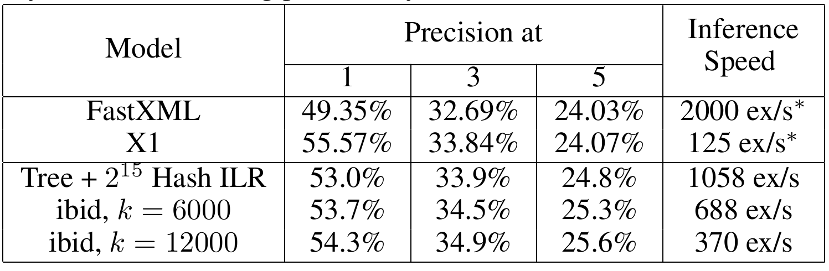
LSHTC

Slide 47
Overall
Statistical performance is good
Computational performance is good

Slide 48

Limitations
Only works when linear classifier is good
Linear routing node
Using linear predictor of $X$ given $Y$
Not deep!

Slide 49
Next Steps
Online learning version
Statistical questions
Deep routing nodes

Slide 50
Summary
Wrapper approach for
accelerating extreme learning
Leverages (super-scalable)
eigenvalue strategy
Good for text

Slide 51
https://github.com/pmineiro/xlst
http://arxiv.org/abs/1511.03260

