Slide 1
uBrain: A Unary Brain Computer Interface
Di Wu, Jingjie Li, Zhewen Pan, Younghyun Kim, and Joshua San Miguel
ISCA ’22
Chieh-Cheng, Yu

Slide 2
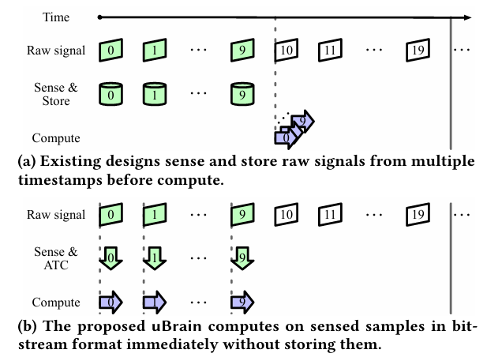
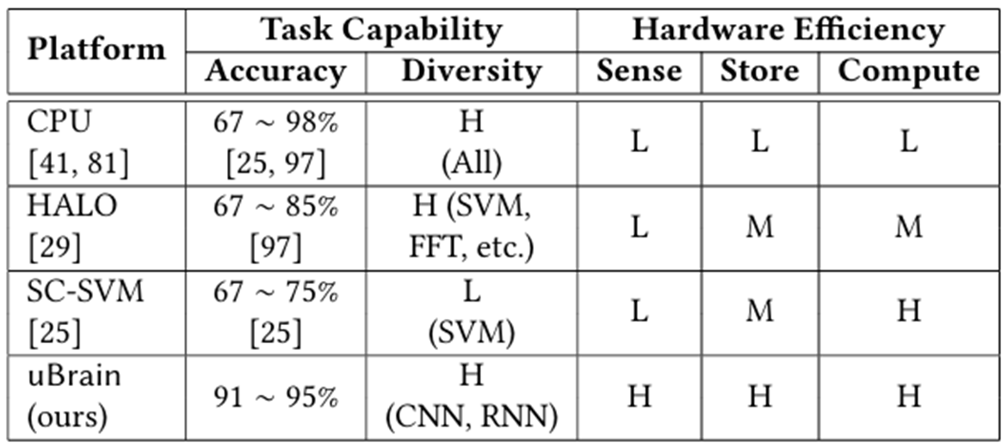
Ubrain
A system design to measure the signal from brain.
Voltage signal => ATC => DNN => result
Contribution:
immediate signal processing after sensing
Low-cost ATC and hardware
DNN with high accuracy

Slide 3
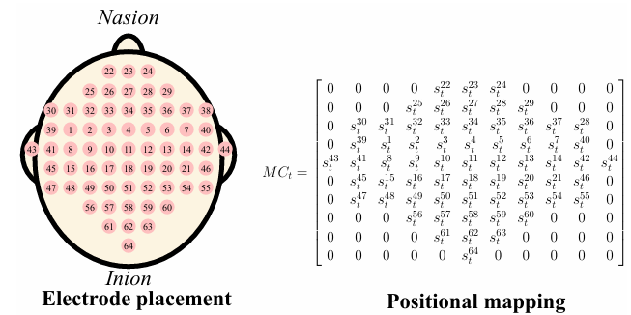
Brain computer interface (BCI)
Measure signal from brain
EEG is a common method to get the brain signal
Time and space resolution are both important
high resolution leads to high cost

Slide 4
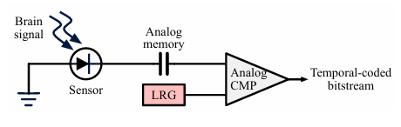

Analog-to-Temporal Conversion (ATC)
The converter output temporal coded signal.
ATC use the number of 1 to present the input analog data.
There are random and deterministic distributions.
00000111111
LRG: linear ramp generator CMP: comparator

Slide 5
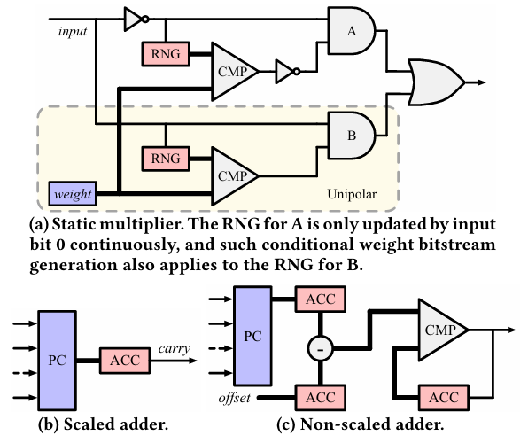
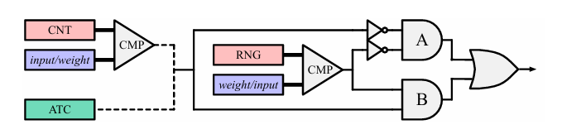
Unary Computing
computing paradigm that works with serial bitstreams
The bitstreams can be either rate-coded or temporal-coded
simple and efficient hardware implementations of operations like multiplication and addition
Multiplier applied by uBrain
RNG: Random Number Generator PC: Parallel Counter ACC: Accumulator CNT: counter

Slide 6
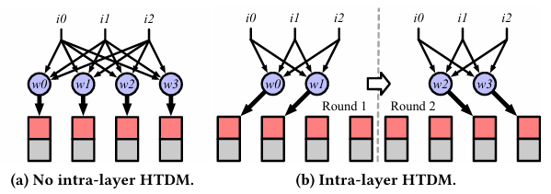
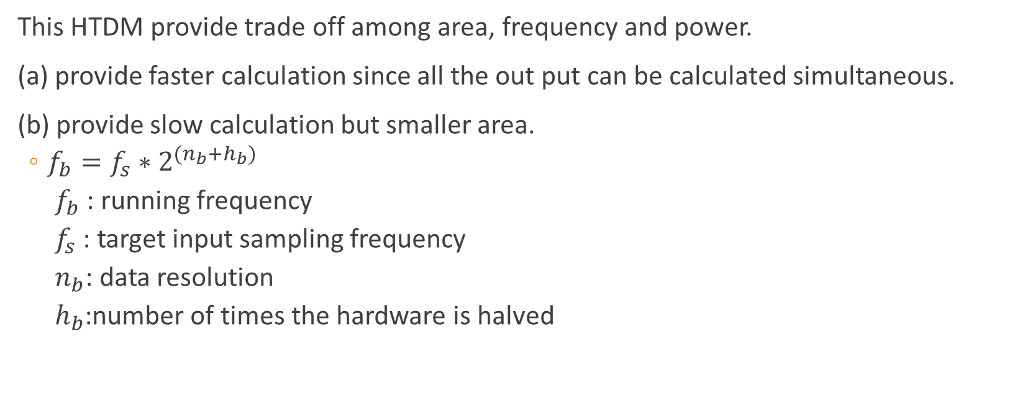
Inter-Layer Hardware Time-Division Multiplexing (HTDM)
This HTDM provide trade off among area, frequency and power.
(a) provide faster calculation since all the out put can be calculated simultaneous.
(b) provide slow calculation but smaller area.
$f_{b}=f_{s}∗2^{(n_{b}+h_{b})}$
$f_{b}$: running frequency
$f_{s}$: target input sampling frequency
$n_{b}$: data resolution
$h_{b}$:number of times the hardware is halved

Slide 7
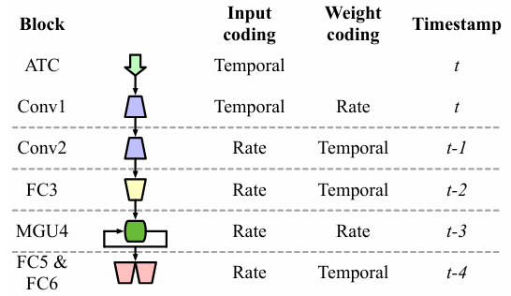
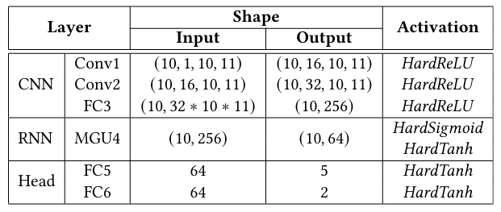

Customized DNN
The input of the DNN is temporal
Convolutional layers for spatial feature extraction
MGU layers for temporal feature extraction
double buffering use to reduce the delay of reading weight from DRAM

Slide 8
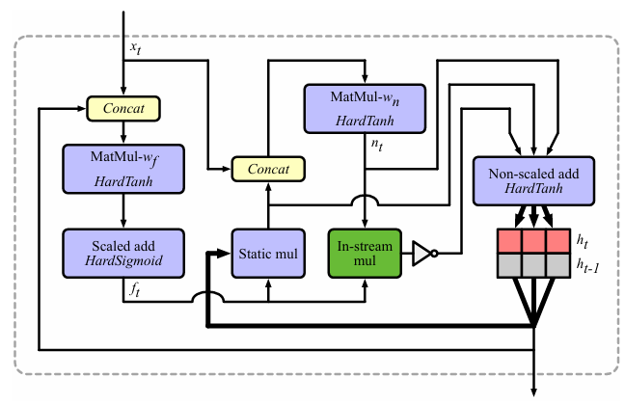
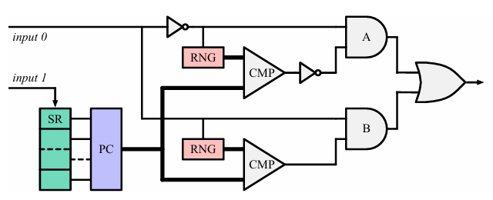
MGU Layer
Input and weight are all rate coding. Reduce the cost of converting between unary and binary
Shift register (SR) record recent history of one input
Parallel counter (PC) accumulate bits, approximating binary value
Thin and thick lines represent unary and binary connections, respectively.
In-stream multiplier

Slide 9
Experimental Setup
Dataset:
motor imagery dataset contains five categories (468024 training and 156235 testing samples).
Seizure prediction dataset contains two categories (117265 training and 39263 testing samples).
Ubrain: TSMC 32nm technology, systolic baseline is 400MHz
CPU: quad-core ARM A57 with a maximum frequency of 1479MHz and a 4GB LPDDR4 using one core.
Result reported by analyzing the DNN execution results with built-in tools and by an open-source systolic array simulator.

Slide 10
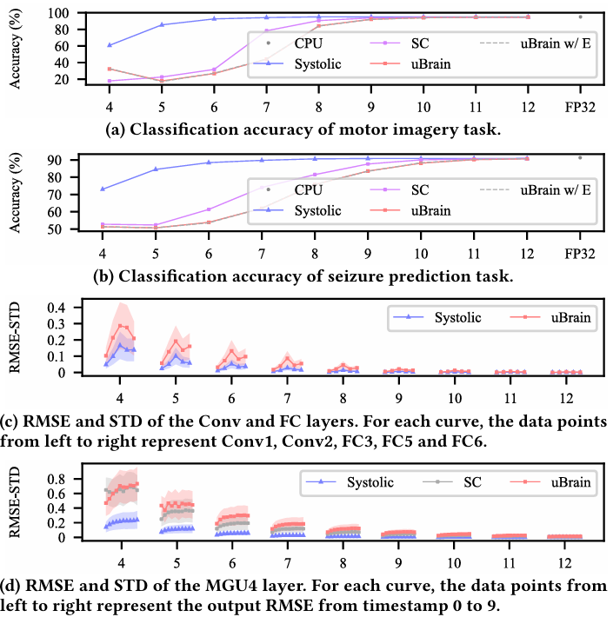
Result
uBrain latency: 14 timestamps (109.375ms)
Total power: improve 5.5X
On-chip power: improve 9X

Slide 11
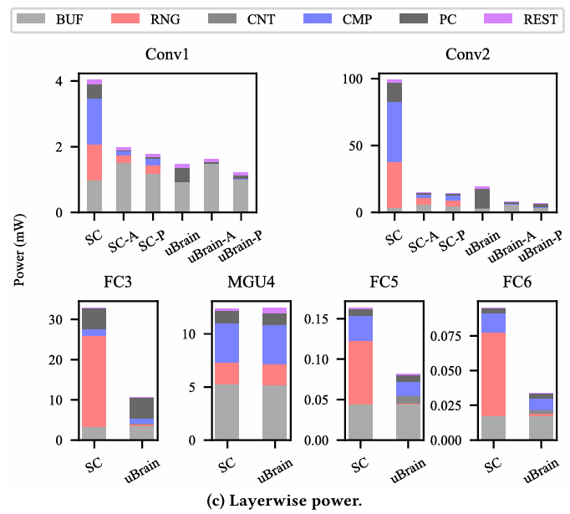
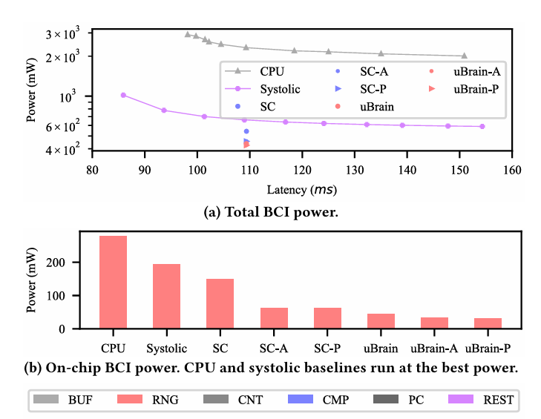
Result(power)

Slide 12
reference
[1] D. Wu, J. Li, Z. Pan, Y. Kim, and J. S. Miguel, "uBrain: a unary brain computer interface," presented at the Proceedings of the 49th Annual International Symposium on Computer Architecture, New York, New York, 2022. [Online]. Available: https://doi.org/10.1145/3470496.3527401.
[2] D. Wu, J. Li, R. Yin, H. Hsiao, Y. Kim, and J. S. Miguel, "uGEMM: unary computing architecture for GEMM applications," presented at the Proceedings of the ACM/IEEE 47th Annual International Symposium on Computer Architecture, Virtual Event, 2020. [Online]. Available: https://doi.org/10.1109/ISCA45697.2020.00040.

