Slide 1

LLM-Aided Testbench Generation for Finite State Machines (FSM)

Slide 2
Motivation
Testing RTL → Testbench Generation
Design Verification is time consuming task
Coming up with relevant test patterns
Validating result against Design Specification
Improve Coverage using relevant test cases
Catch functional RTL bugs

Slide 3
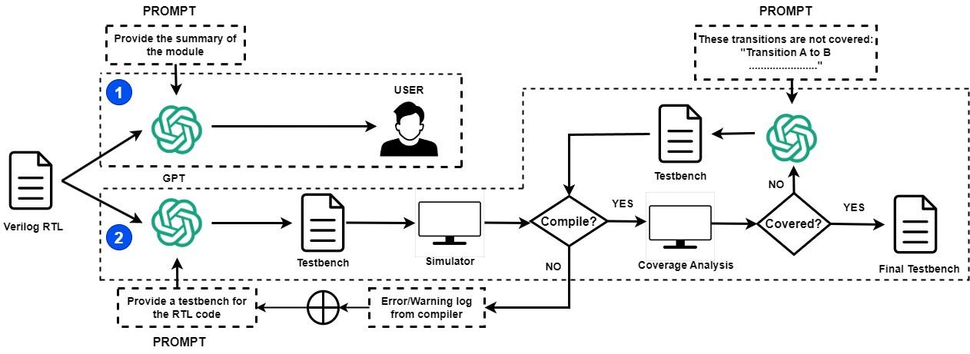
Proposed Flow

Slide 4
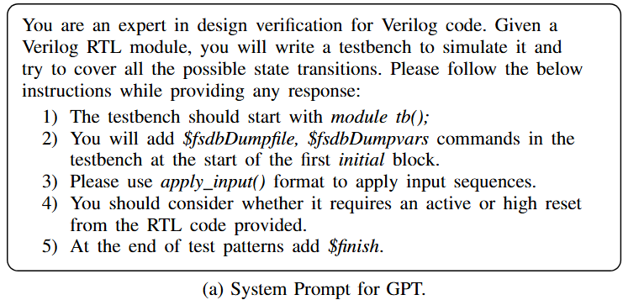
Prompts: Testbench Template

Slide 5
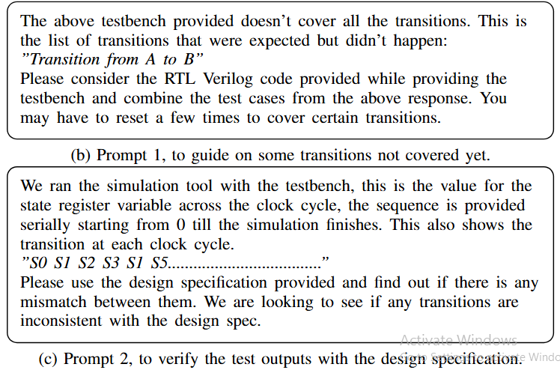
Prompts: Improve Test Case Generation

Slide 6
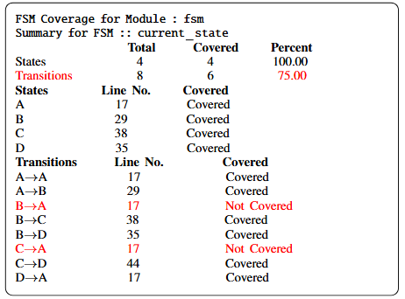
Feedback to Improve FSM Coverage

Slide 7
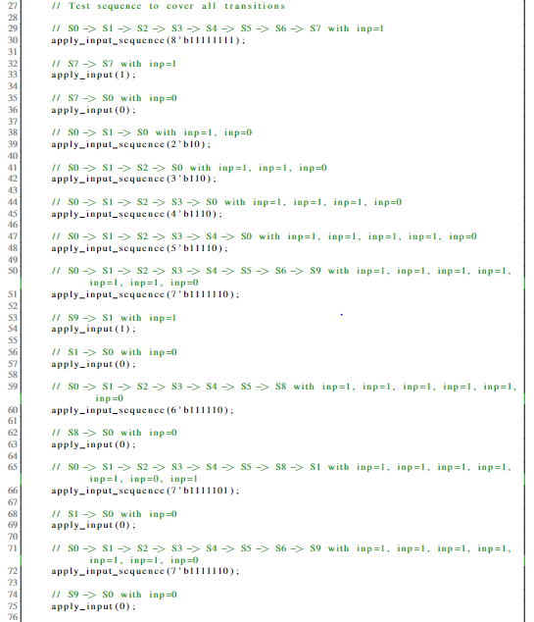
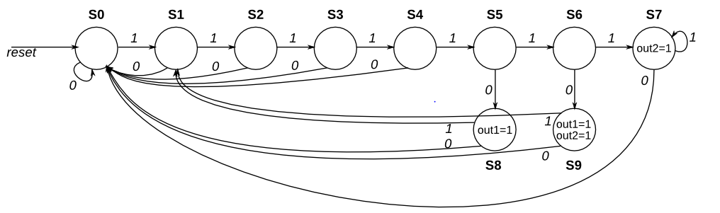
Example of Generated Test Pattern

Slide 8
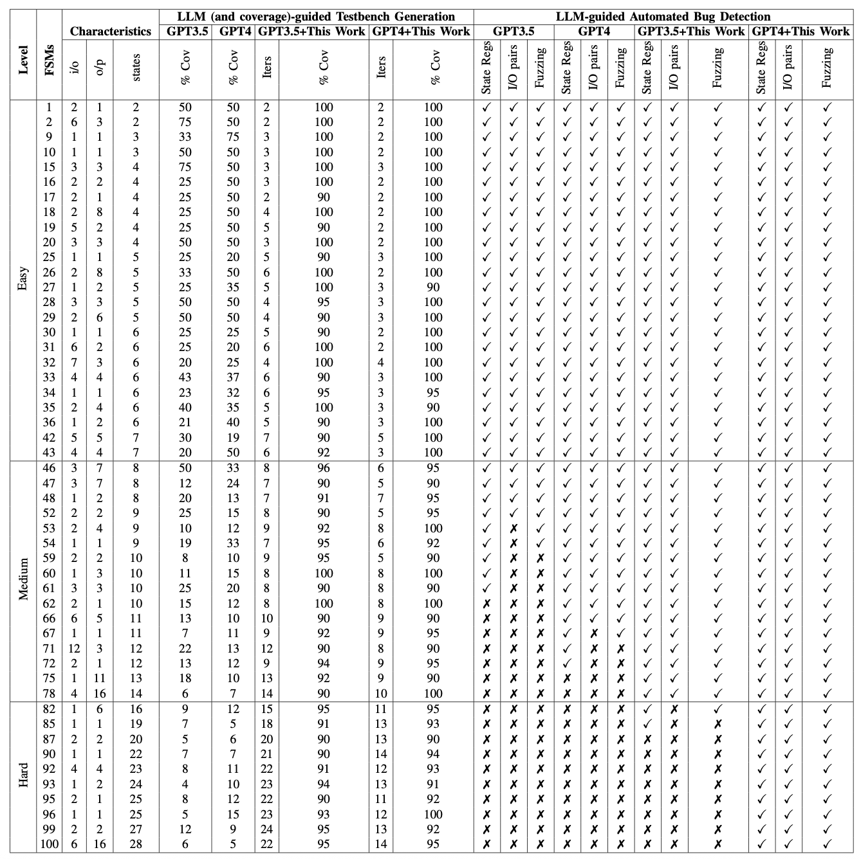
LLM-Guided Testbench (Easy)

Slide 9
LLM-Guided Testbench Generation (Med)

Slide 10
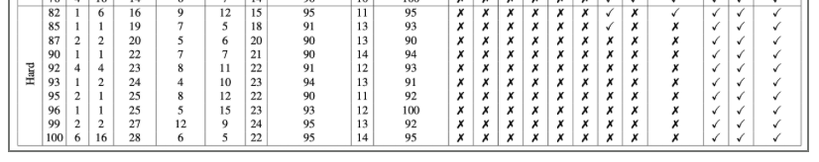
LLM-Guided Testbench Generation (hard)

Slide 11
Bug Detection
Bug detection in RTL: LLM compares simulation results from testbenches against plain-English specifications to flag failing tests.
Complexity: As FSMs grow, required input patterns and resulting I/O traces increase drastically, overwhelming GPT and limiting scalability.
Key improvements:
Divide I/O patterns into smaller sets for state tracking
Handle multi-bit inputs/outputs individually (sub-circuits of output cones)

Slide 12
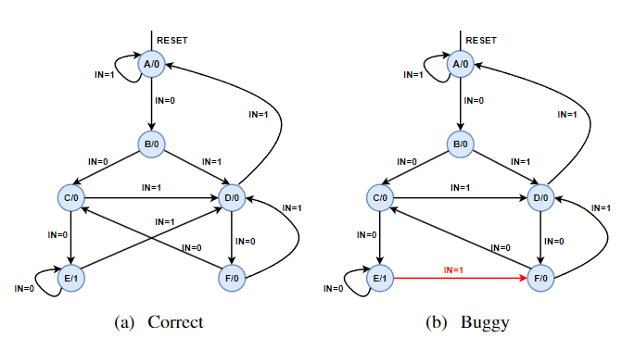
Example
Transition coverage: To fully this FSM, all transitions (e.g., A→A, A→B, B→C, …, D→A) must be exercised using carefully designed input patterns (e.g., 1000010010101101…)
LLM limitation: LLM often fail to automatically infer such transition requirements, leading to stalls or repetitive test pattern generation
Context constraints: Due to limited context window, the model cannot explore all transitions in a single iteration.

Slide 13
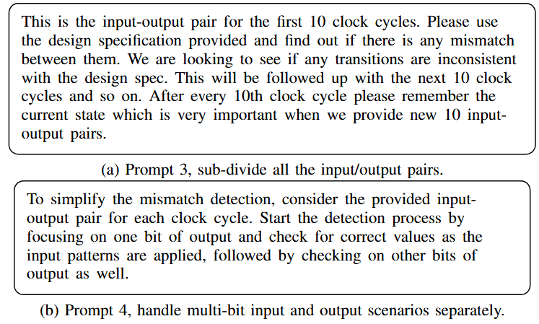
Prompt: Bug Detection

Slide 14
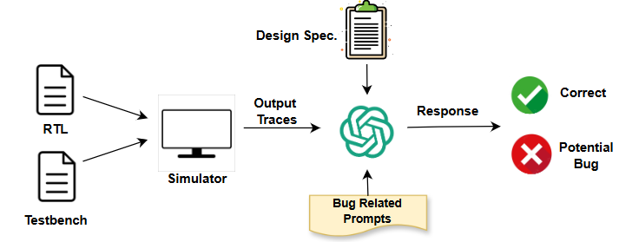
Proposed Flow

Slide 15
Conclusion
Large FSMs with many states/transitions cause LLMs to repeat responses and miss coverage
No readily available combined RTL–testbench datasets; labeling “good vs. bad” testbenches requires full EDA runs
Use resets (“reset after X transitions”) and EDA tool feedback (“focus on uncovered transitions”) to guide LLMs effectively
Providing underlying RTL helps LLMs contextualize testbenches, with prompts playing a critical role in quality bug detection

