Slide 1
Unit 7 Loop Optimization and Pipelining
EL-GY 9463: Introduction to Hardware Design
ProfS. Sundeep Rangan, Siddharth Garg

Slide 2
Learning Objectives
Manually pipeline simple sequential modules in System Verilog
Measure initiation interval, latency, and total latency
Control auto-pipelining in Vitis HLS
Extract resource and pipelining data from Vitis HLS synthesis reports
Unroll loops in Vitis HLS
Mitigate memory bottlenecks in unrolled loops with:
Increased memory bit width
Memory partitioning

Slide 3
Outline
Pipelining in SystemVerilog
Loop Pipelining in Vitis HLS
Loop Unrolling and Memory Constraints

Slide 4
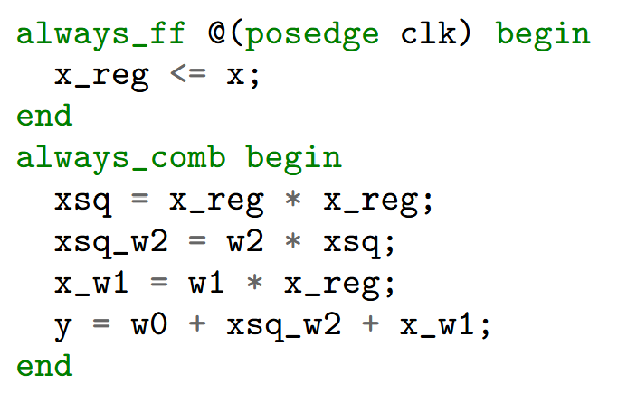
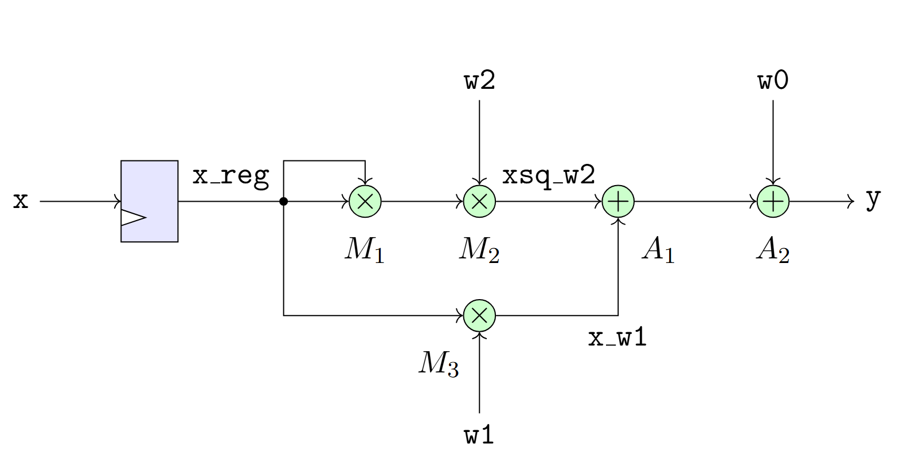

Quadratic Example
Consider a quadratic function: $y=w_{2}x^{2}+w_{1}x+w_{0}$ (from previous unit)
For simplicity, assume $w_{0},w_{1},w_{2}$ are fixed parameters
Single cycle implementation to the right
Marked multiplier units $M_{1},M_{2}, M_{3}$

Slide 5
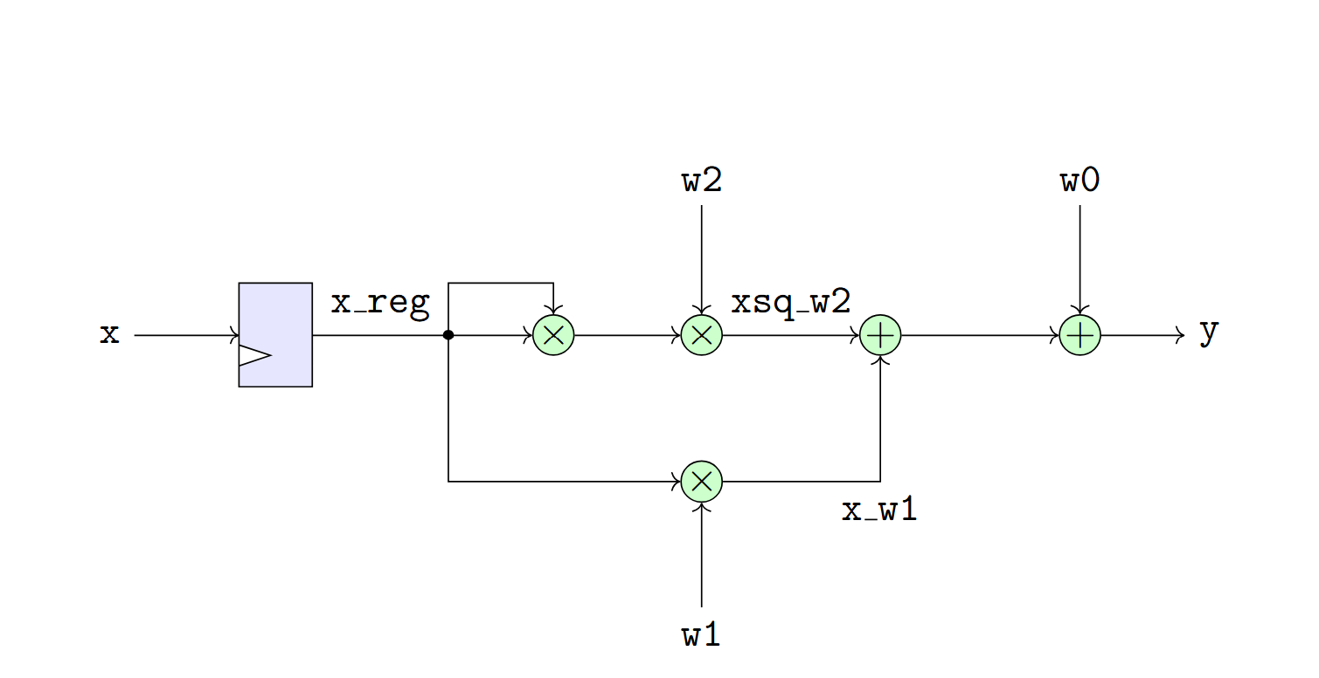
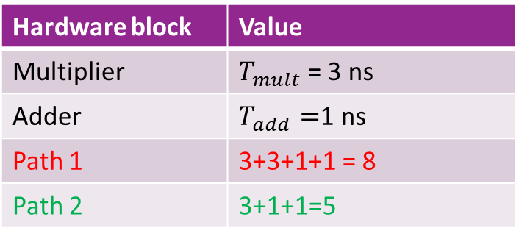
Finding the Critical Path
Hardware block | Value
Multiplier | $T_{mult}$ = 3 ns
Adder | $T_{add}=$1 ns
Path 1 | 3+3+1+1 = 8
Path 2 | 3+1+1=5
Consider implementation with times in table
Find critical path
Not including clk-Q and setup time
Two paths:
Path 1: x, x_reg, xsq_w2, y
2 mults, 2 adders = 8.5 ns
Path 2: x, x_reg, x_w1, y
1 register, 1 mult, 2 adders = 5.5 ns
Path 1 is critical

Slide 6
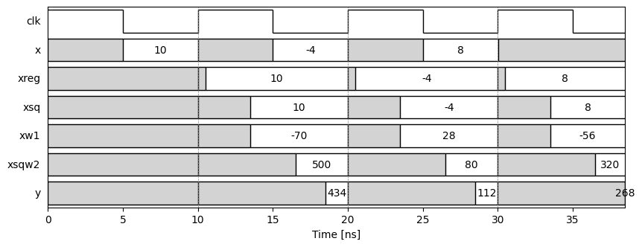

Timing Diagram
Timing diagram with $T_{clk}=10$ ns (100 MHz)

Slide 7
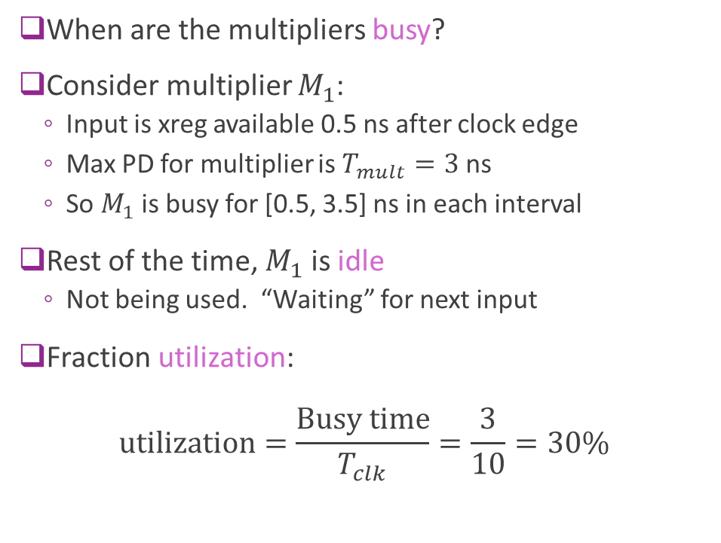
Multiplier Utilization
When are the multipliers busy?
Consider multiplier $M_{1}$:
Input is xreg available 0.5 ns after clock edge
Max PD for multiplier is $T_{mult}=3$ ns
So $M_{1}$ is busy for [0.5, 3.5] ns in each interval
Rest of the time, $M_{1}$ is idle
Not being used. “Waiting” for next input
Fraction utilization: $\text{utilization}=\frac{\text{Busy} \text{time}}{T_{clk}}=\frac{3}{10}=30\%$

Slide 8
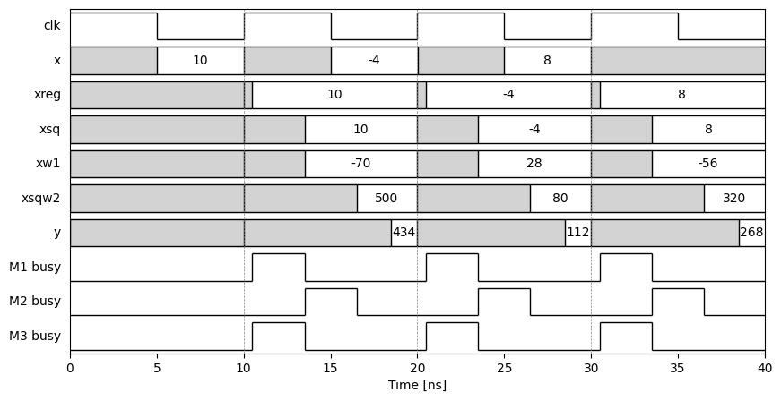


Plotting the Utilization
Each multiplier busy only once in clock period
$M_{1}, M_{3}$ busy
$M_{2}$ busy

Slide 9
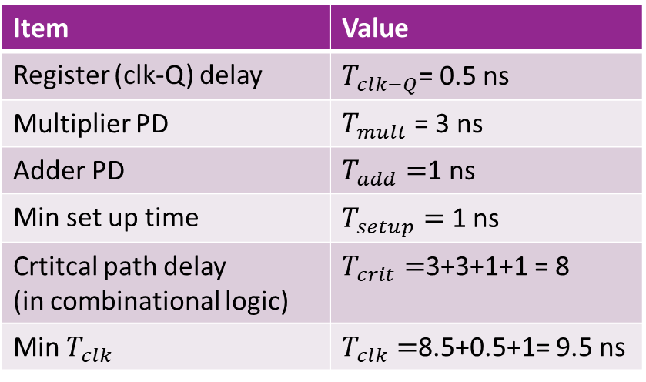
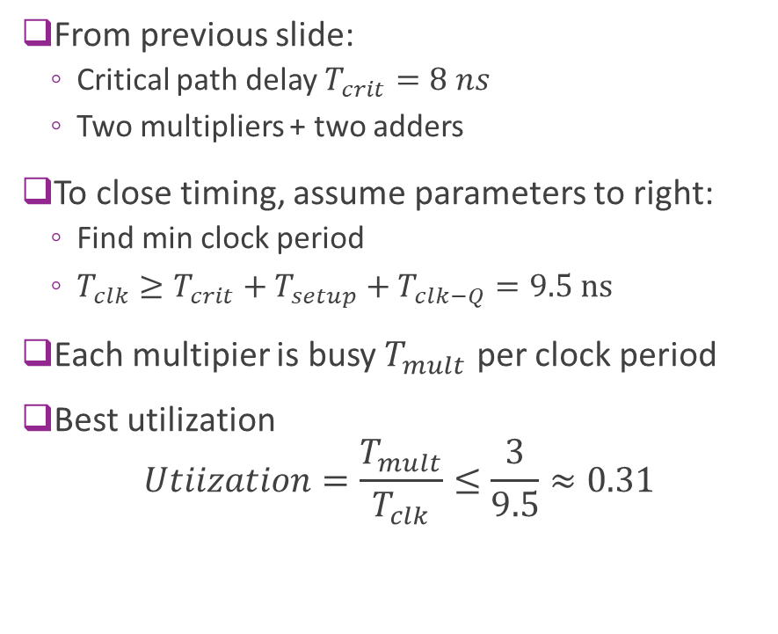
Best Utilization with Single Cycle Design
From previous slide:
Critical path delay $T_{crit}=8 ns$
Two multipliers + two adders
To close timing, assume parameters to right:
Find min clock period
$T_{clk}≥T_{crit}+T_{setup}+T_{clk−Q}=9.5 ns$
Each multipier is busy $T_{mult}$ per clock period
Best utilization $Utiization=\frac{T_{mult}}{T_{clk}}≤\frac{3}{9.5}≈0.31$
Item | Value
Register (clk-Q) delay | $T_{clk−Q}$= 0.5 ns
Multiplier PD | $T_{mult}$ = 3 ns
Adder PD | $T_{add}=$1 ns
Min set up time | $T_{setup}=$ 1 ns
Crtitcal path delay (in combinational logic) | $T_{crit}=$3+3+1+1 = 8
Min $T_{clk}$ | $T_{clk}=$8.5+0.5+1= 9.5 ns

Slide 10
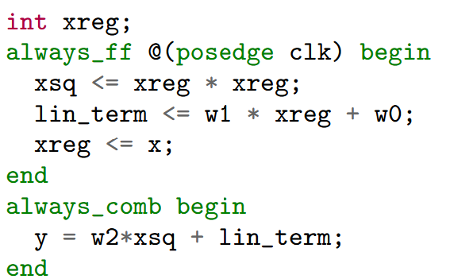
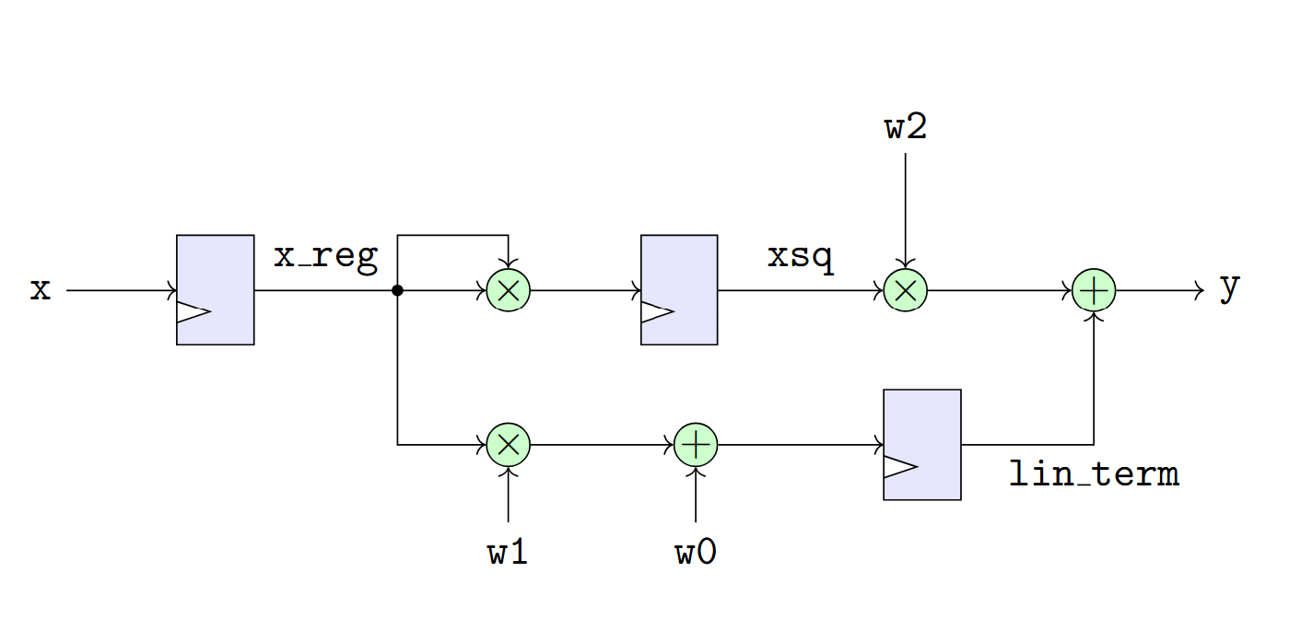
A Two Cycle Design
We can improve throughput by breaking computation over two cycles
Register two intermediate terms:
xsq = xreg * xreg
lin_term = w1*xreg + w0

Slide 11

Three Stages
Design is processed in three stages = 2 cycles
Stage 0
Register input $x$ to xreg
Stage 1: Compute and register:
xsq = xreg * xreg
lin_term = w1*xreg + w0
Stage 2: Compute output
y = w2*xsq + lin_term

Slide 12
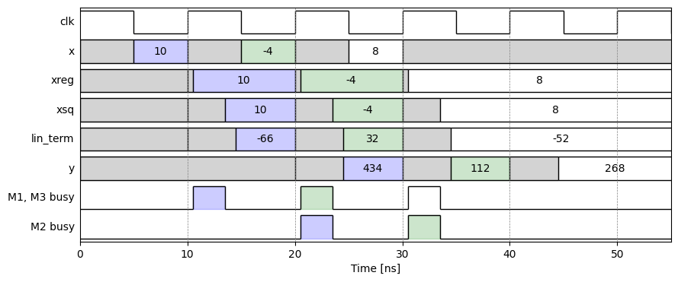
Pipelining Timing Diagram
Processing via a “pipeline”
Multipliers working simultaneously

Slide 13
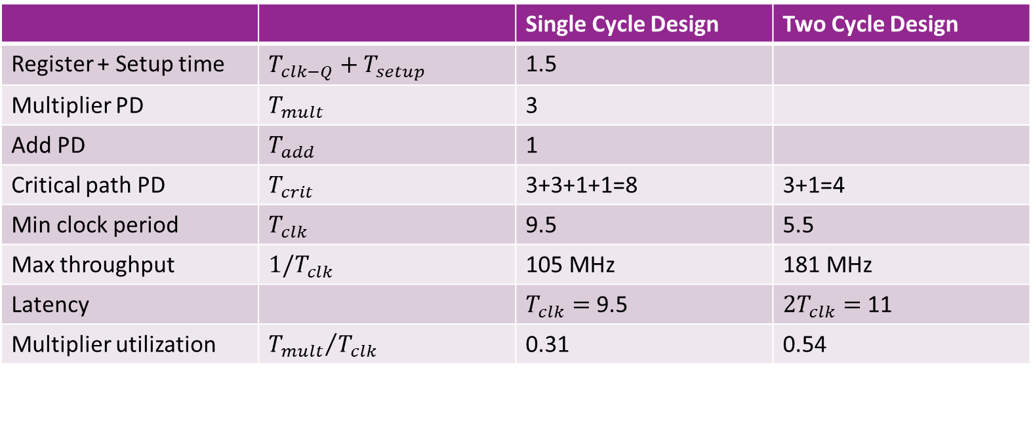
Comparison
 |  | Single Cycle Design | Two Cycle Design
Register + Setup time | $T_{clk−Q}+T_{setup}$ | 1.5
Multiplier PD | $T_{mult}$ | 3
Add PD | $T_{add}$ | 1
Critical path PD | $T_{crit}$ | 3+3+1+1=8 | 3+1=4
Min clock period | $T_{clk}$ | 9.5 | 5.5
Max throughput | $1/T_{clk}$ | 105 MHz | 181 MHz
Latency |  | $T_{clk}=$ 9.5 | $2T_{clk}=$ 11
Multiplier utilization | ${T_{mult}}/{T_{clk}}$ | 0.31 | 0.54
Pipelining: Higher throughput via better utilization

Slide 14
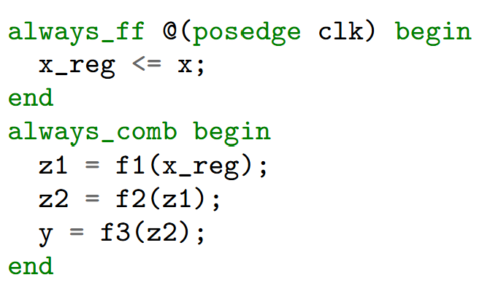
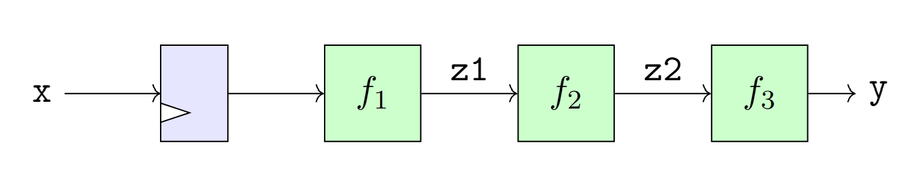
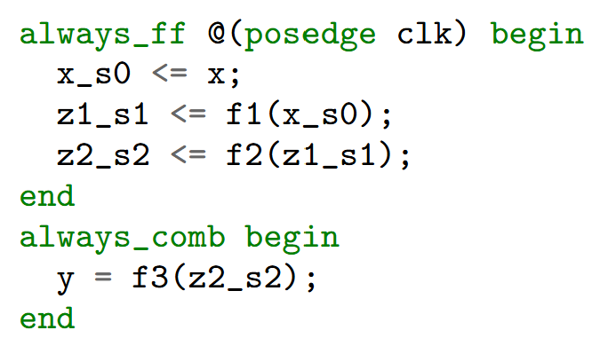
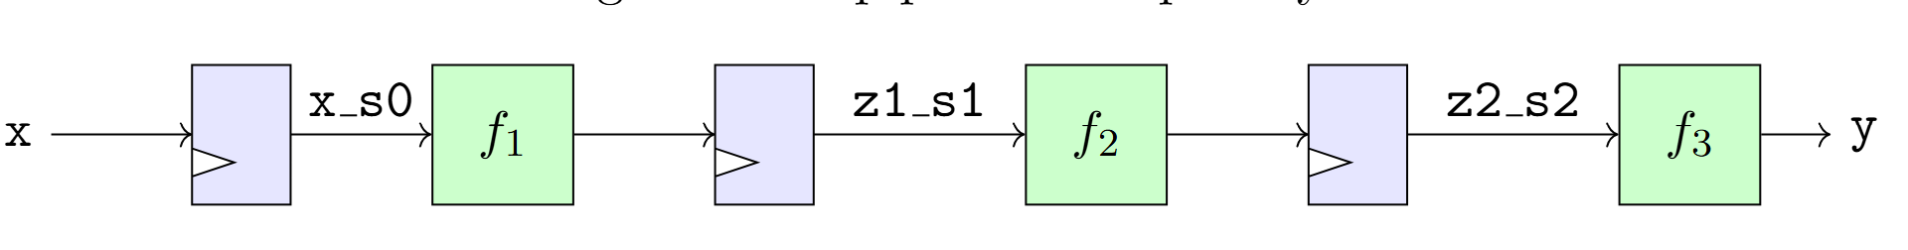
General Pipelining for a Series
Insert registers on each stage
Use suffixes s0, s1, s2 to indicate stage

Slide 15
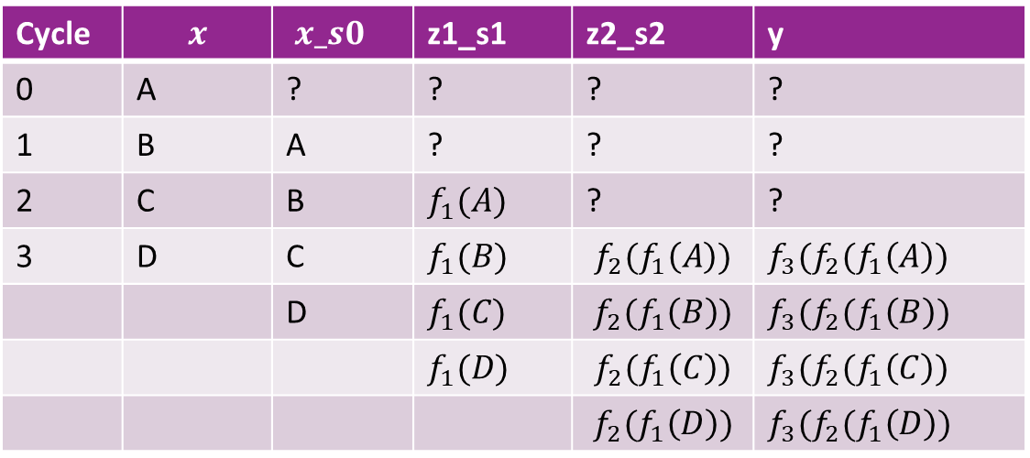
Cycle-by-Cycle Timing
Cycle | $$x$$ | $x_s0$ | z1_s1 | z2_s2 | y
0 | A | ? | ? | ? | ?
1 | B | A | ? | ? | ?
2 | C | B | $f_{1}(A)$ | ? | ?
3 | D | C | $f_{1}(B)$ | $$f_{2}(f_{1}\left(A\right))$$ | $f_{3}(f_{2}(f_{1}\left(A\right))$
 |  | D | $f_{1}(C)$ | $$f_{2}(f_{1}\left(B\right))$$ | $f_{3}(f_{2}(f_{1}\left(B\right))$
 |  |  | $f_{1}(D)$ | $$f_{2}(f_{1}\left(C\right))$$ | $f_{3}(f_{2}(f_{1}\left(C\right))$
 |  |  |  | $$f_{2}(f_{1}\left(D\right))$$ | $f_{3}(f_{2}(f_{1}\left(D\right))$

Slide 16
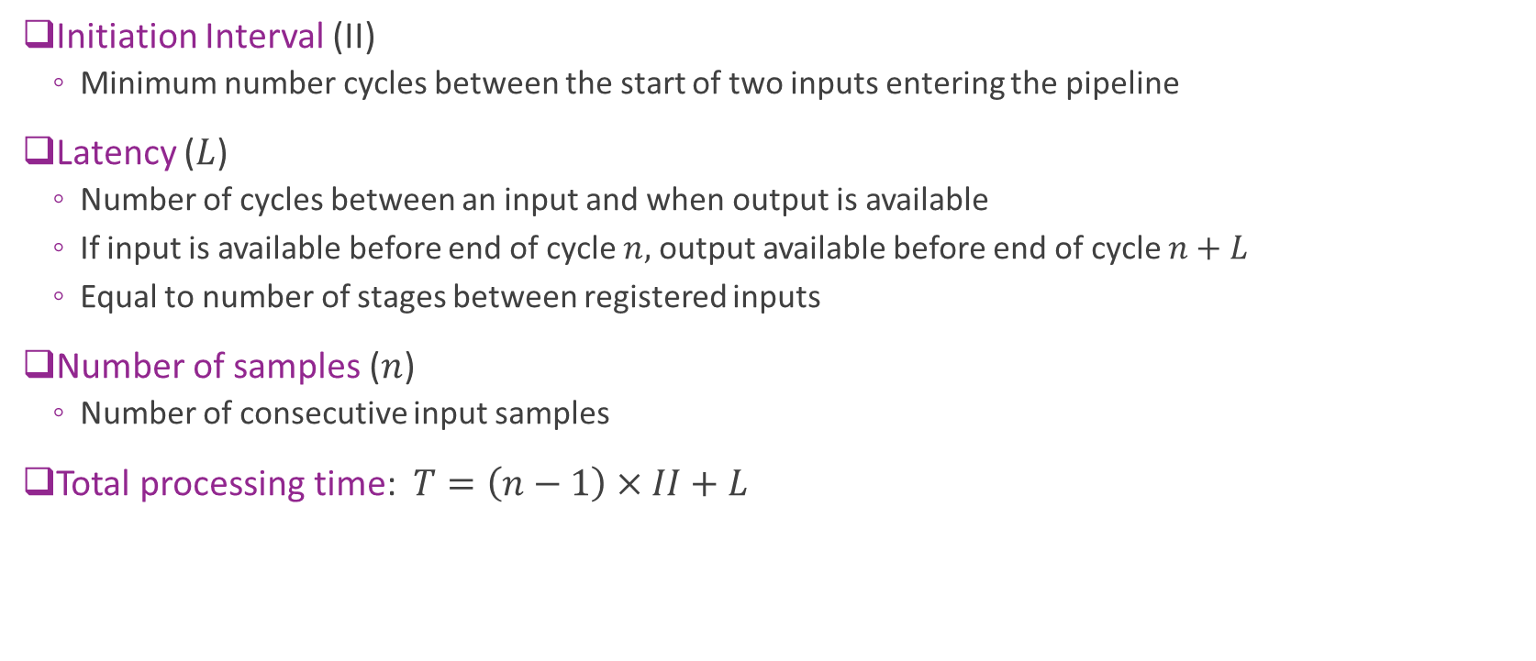
Timing Terminology
Initiation Interval (II)
Minimum number cycles between the start of two inputs entering the pipeline
Latency ($L$)
Number of cycles between an input and when output is available
If input is available before end of cycle $n,$ output available before end of cycle $n+L$
Equal to number of stages between registered inputs
Number of samples ($n$)
Number of consecutive input samples
Total processing time: $T=\left(n−1\right)×II+L$

Slide 17
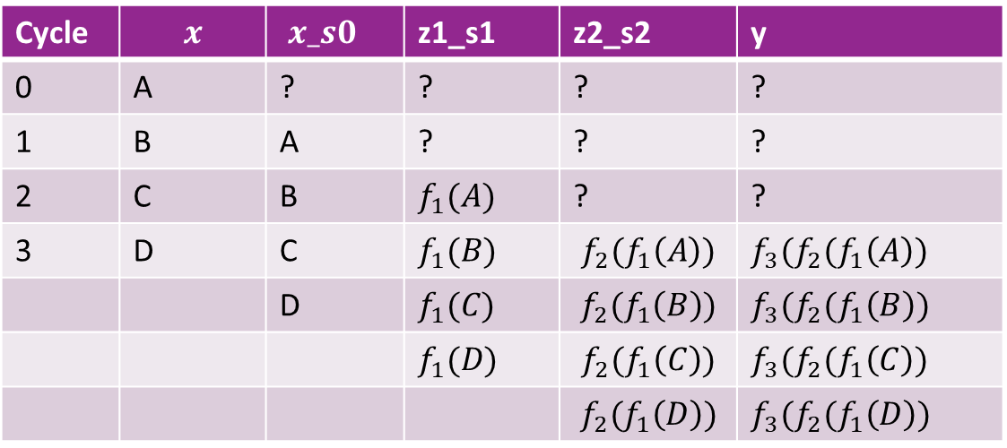


Timing Terminology Visualized
Cycle | $$x$$ | $x_s0$ | z1_s1 | z2_s2 | y
0 | A | ? | ? | ? | ?
1 | B | A | ? | ? | ?
2 | C | B | $f_{1}(A)$ | ? | ?
3 | D | C | $f_{1}(B)$ | $$f_{2}(f_{1}\left(A\right))$$ | $f_{3}(f_{2}(f_{1}\left(A\right))$
 |  | D | $f_{1}(C)$ | $$f_{2}(f_{1}\left(B\right))$$ | $f_{3}(f_{2}(f_{1}\left(B\right))$
 |  |  | $f_{1}(D)$ | $$f_{2}(f_{1}\left(C\right))$$ | $f_{3}(f_{2}(f_{1}\left(C\right))$
 |  |  |  | $$f_{2}(f_{1}\left(D\right))$$ | $f_{3}(f_{2}(f_{1}\left(D\right))$
$$II=1$$
$$L=3$$
Insert registers on each stage
Use suffixes s0, s1, s2 to indicate stage

Slide 18
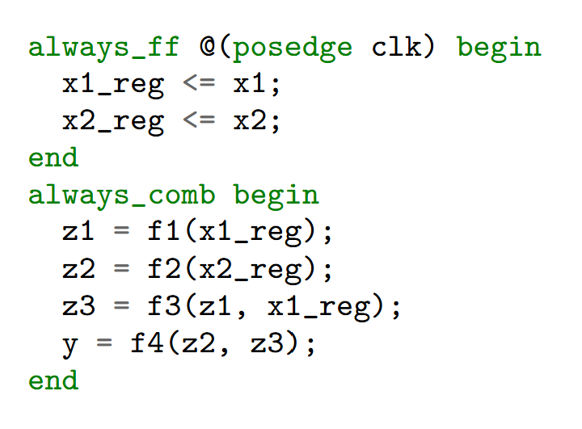
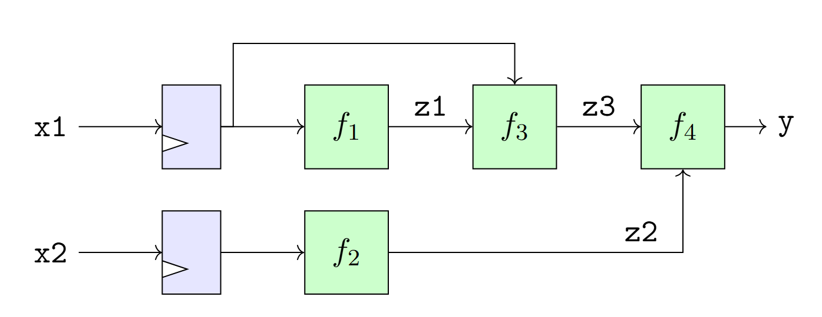
Pipelining with Multiple Paths
Now consider a more complex example with multiple paths
How do we pipeline this?

Slide 19
Multi-Path Pipelining: Identify Stages
First, we draw the stages
Shown in the vertical lines
Stage 0: Inputs to registers
This stage will exist in non-pipeline code
Stage 1, 2, …
Will end where we will put registers
Ensure that each stage can be computed in sufficient time
Output stage is combinational
Stage 0
Stage 1
Stage 2
Combinational

Slide 20
Multi-Path Pipelining: Register Locations
Place registers at stage crossing
Shown in blue circles
Note: Need register even when
Signal is just a pass through
Stage 0
Stage 1
Stage 2
Combinational
Register locations

Slide 21
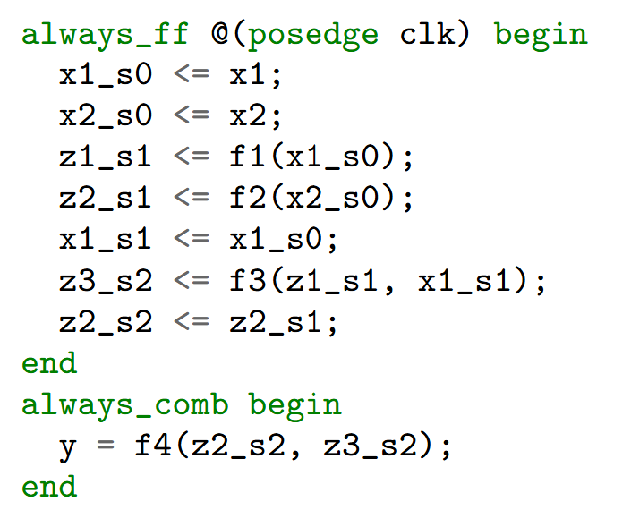
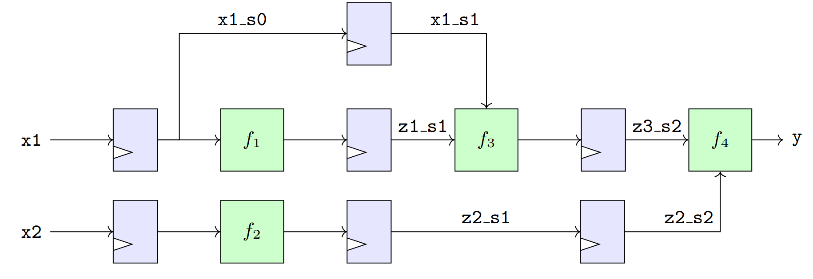
Final Pipelined Diagram and Code
Stage 0
Stage 1
Stage 2

Slide 22
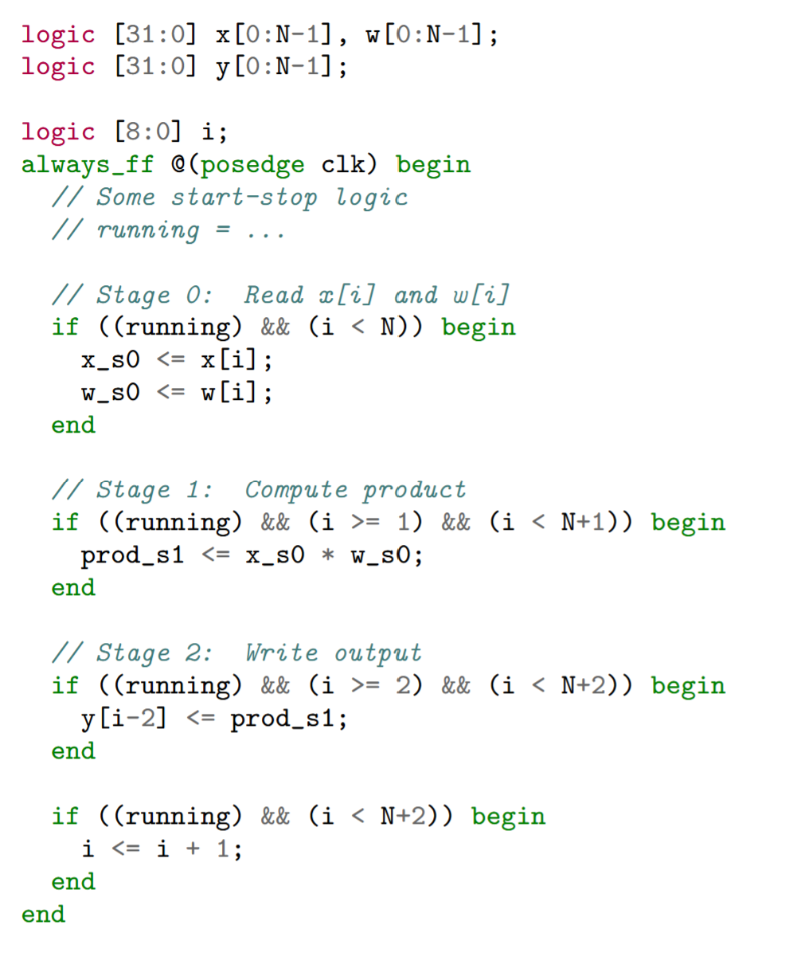
Memory Accesses
Memory reads and writes:
Generally take at least on cycle delay
Hardware provides an address
Memory location fetched with an address decoder
Pipelining must account for this delay
Example to the right:
Takes elementwise product
Load, product, and store are on separate cycles
Note the pipeline flush
Tail of the pipeline for stages 1,

Slide 23
Outline
Pipelining in SystemVerilog
Loop Pipelining in Vitis HLS
Loop Unrolling and Memory Constraints

Slide 24
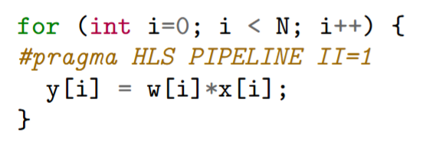
Why Use Vitis HLS?
Manual pipelining in System Verilog:
Tedious
Prone to mistakes
Hard to optimize schedule
Need to re-optimize on each technology
Vitis HLS C++
Fully automated pipelining
High-level description

Slide 25
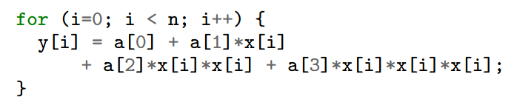
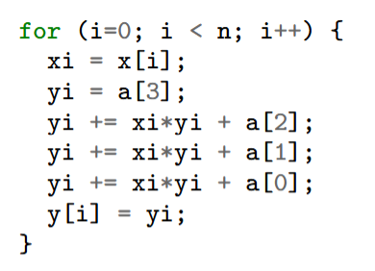
Polynomial Loop Example
Loop over cubic polynomial
Implemented with Horners method
Bottom right
Each iteration involves
One load from the array
Three multiplications
Three adds
One store
We will implement in floating point FP32
These are themselves pipelined
Would be hard to implement manually

Slide 26


Message Passing Protocol
Similar protocol to previous unit
Processing in blocks
Coefficients sent in a header
Followed by data
Transaction ID
Used to ensure synchronization
Robust to dropped packets
CmdHdr: Coefficients num samples, trans ID
RespFtr: TransId
Vitis kernel
Testbench or PS
SampDatIn: Values of $x[i]$
Perform polynomial evaluation
SampDataOut: Values $y[i]$
RespFtr: Error Code, num read

Slide 27
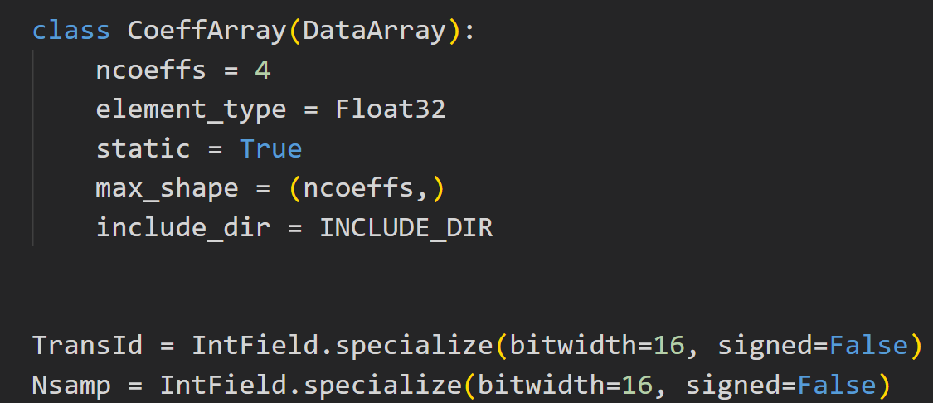
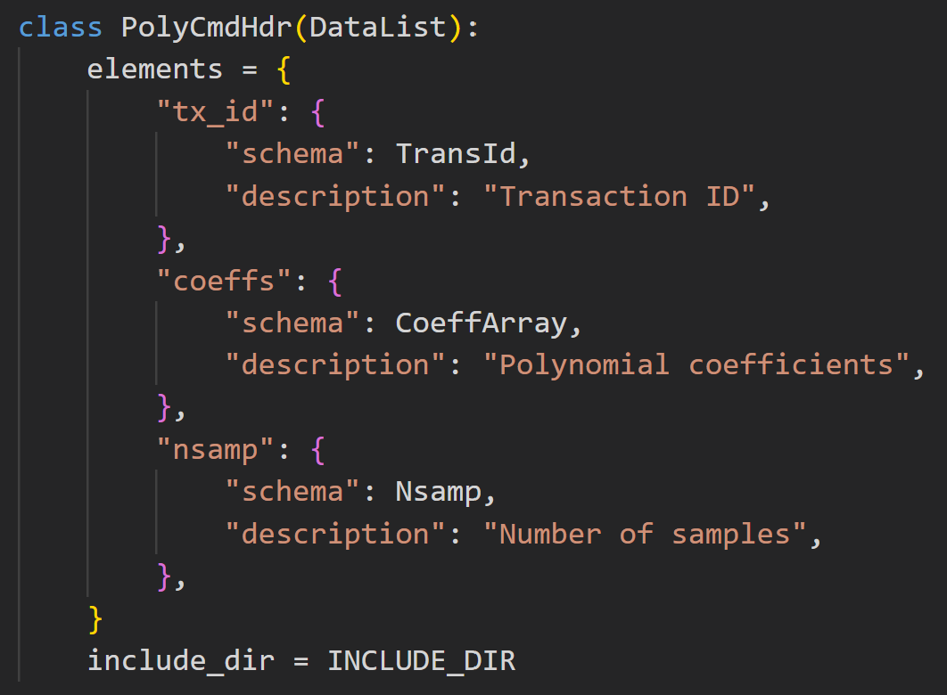
Define Data Structures
Use xilinxutils package
Define data structures in python

Slide 28
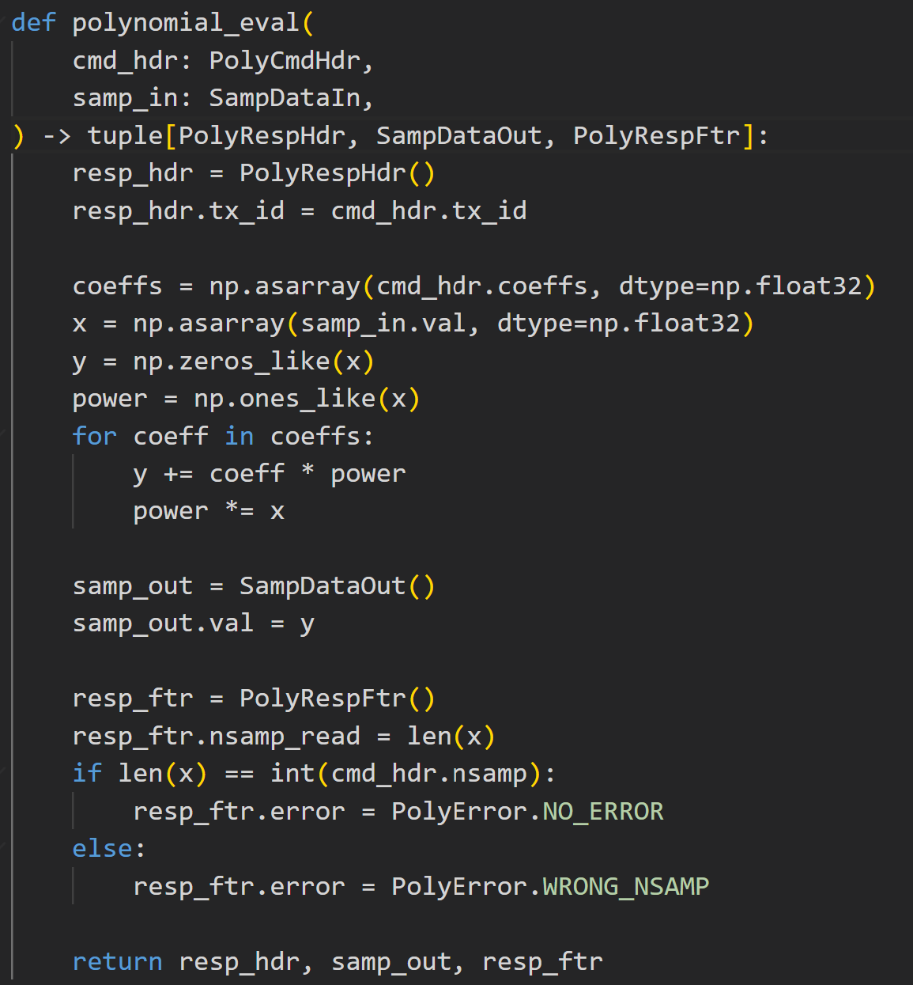
Create a Python Golden Model
Python Golden model
Simulates the same messages
Runs python polynomial evaluation

Slide 29
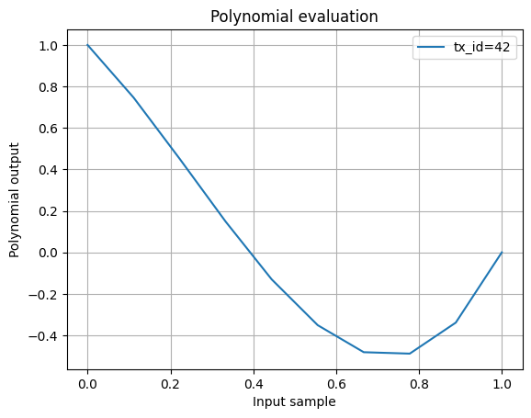
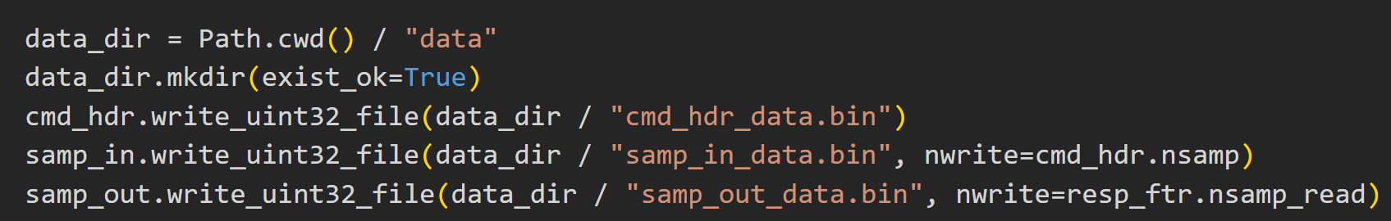
Running the Golden Model
Run the Golden model
Generate:
Inputs
Expected outputs

Slide 30
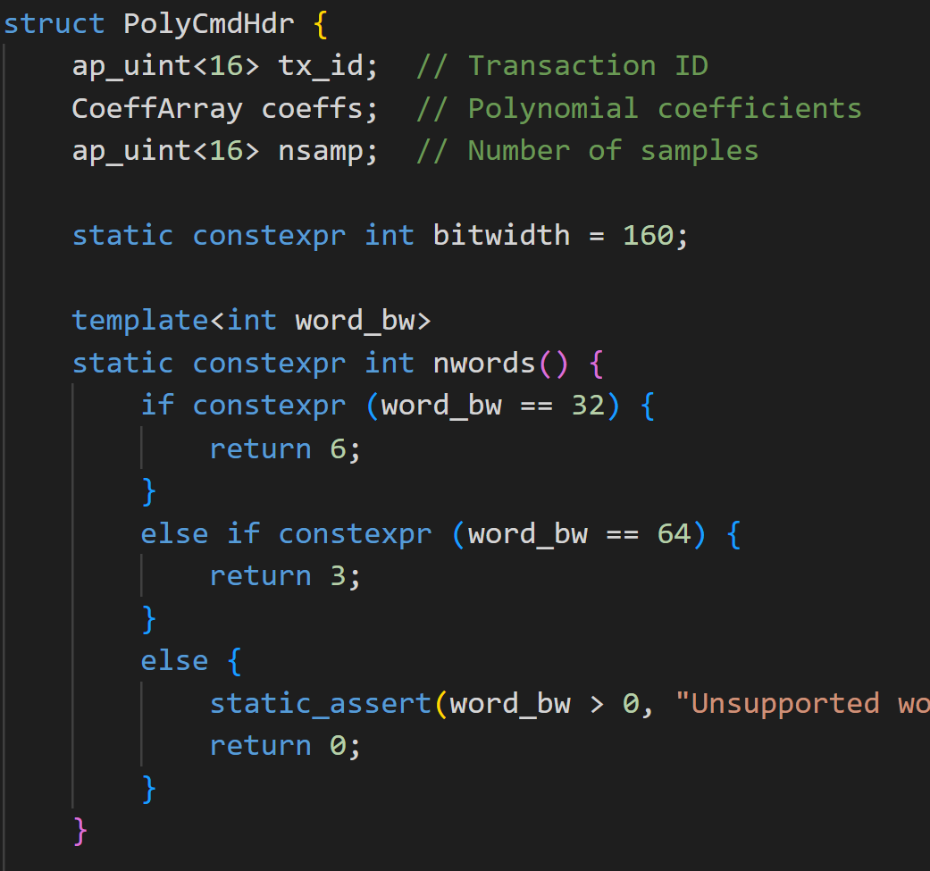
Auto-Generate the Header Files
For each class, we generate a header file
Header files include:
Fields in the data structure
Methods for serializing and deserializing

Slide 31
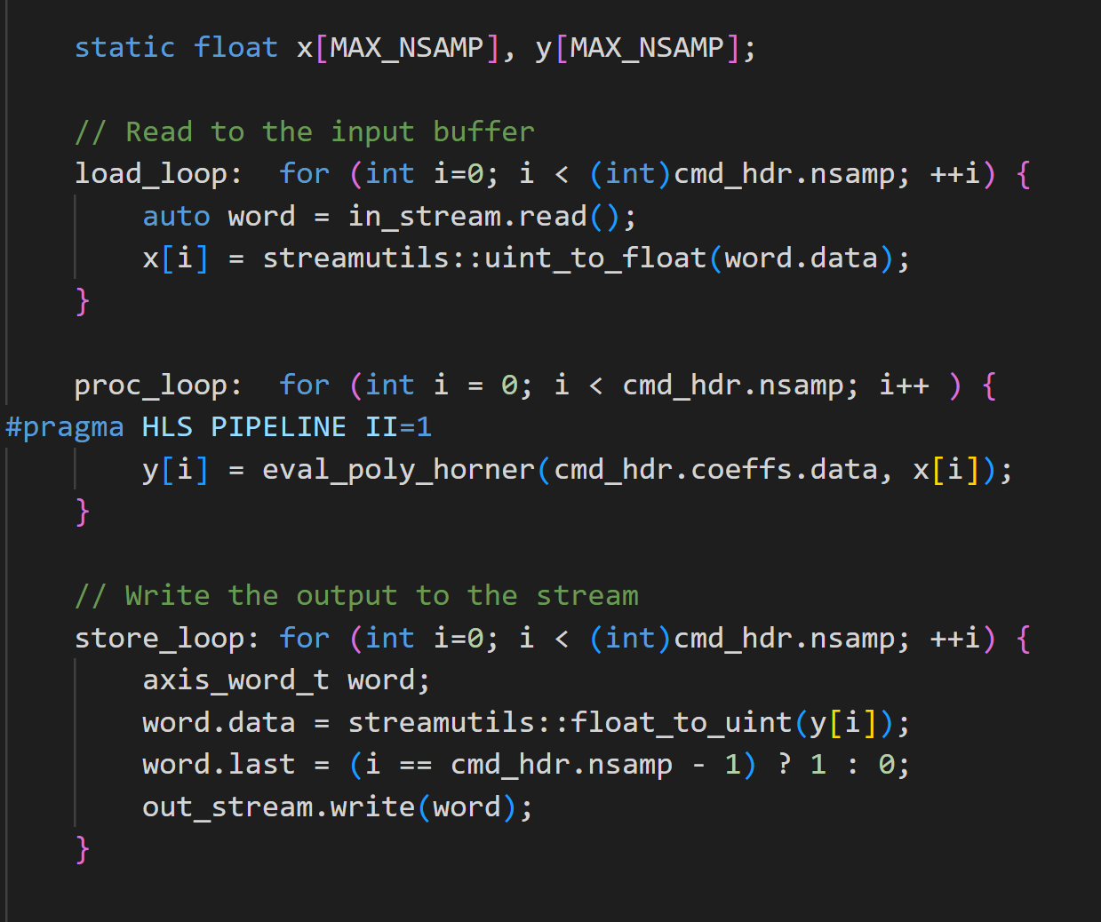
Vitis Kernel Implementation
Use array:
Load to array, compute, write array to stream
Computationally, adds an extra step
But allows easy loop optimization analysis
Main loop is very simple
Note pragma HLS PIPELINE II=1
Indicates to Vitis to try to pipeline this loop
Try to find a schedule with II=1

Slide 32
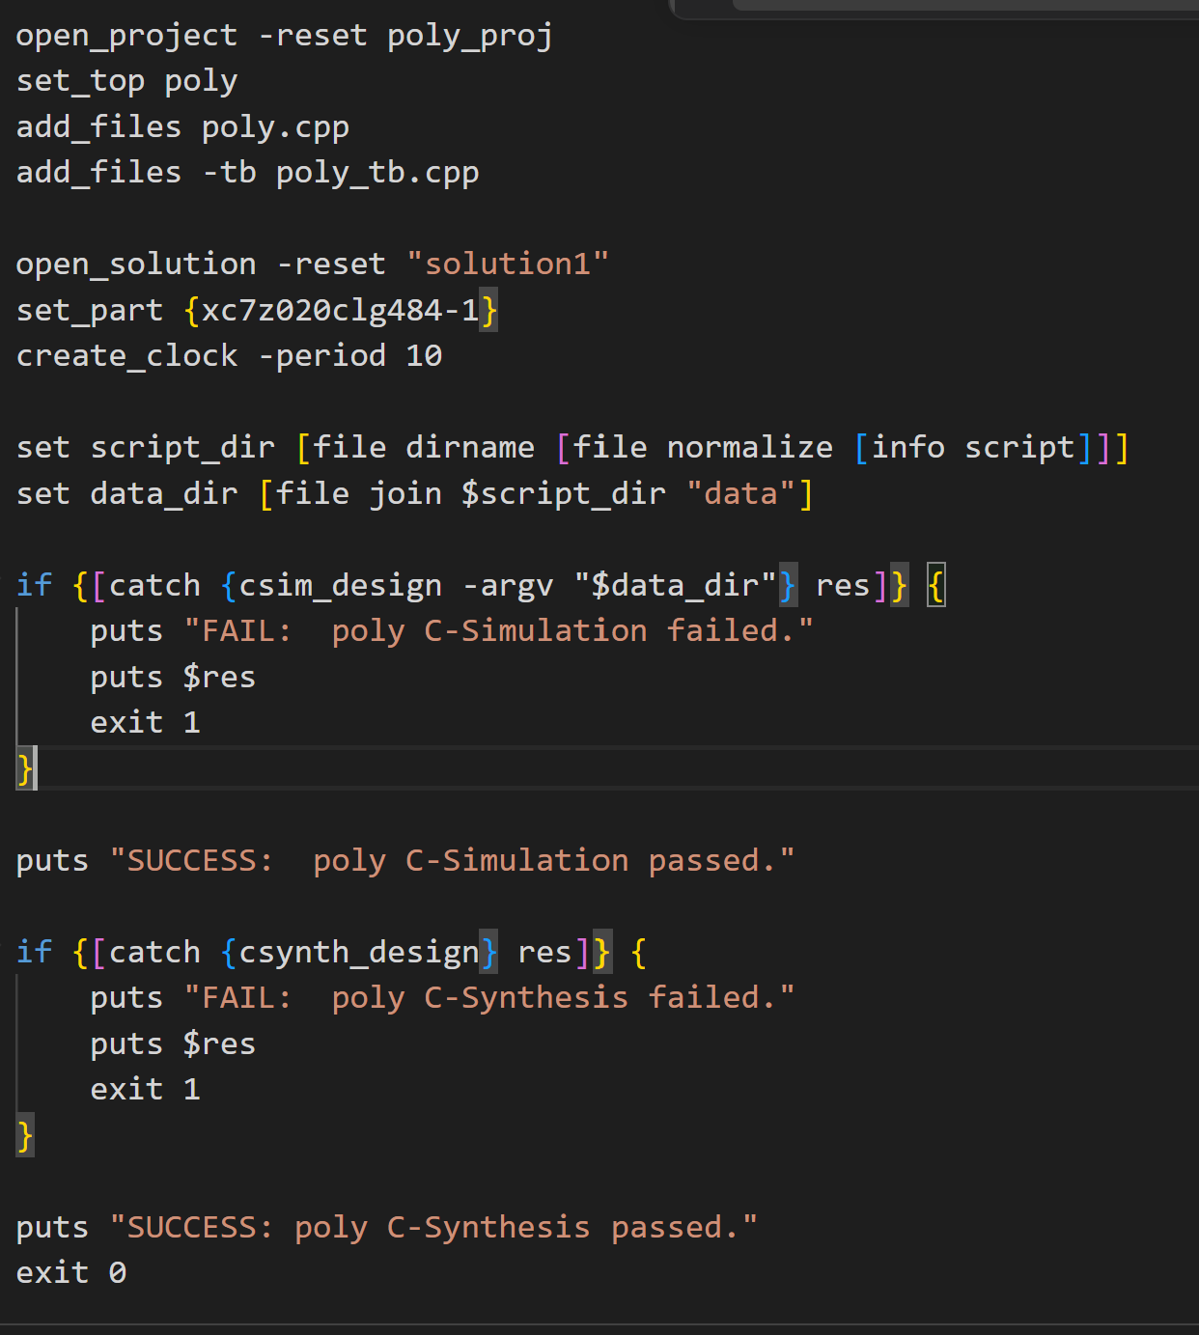
Running Vitis CS
Run C-simulation
Performs functional validation
Run C-synthesis
Performs pipelining
Mapping of functions to resources
File to right: TCL script

Slide 33
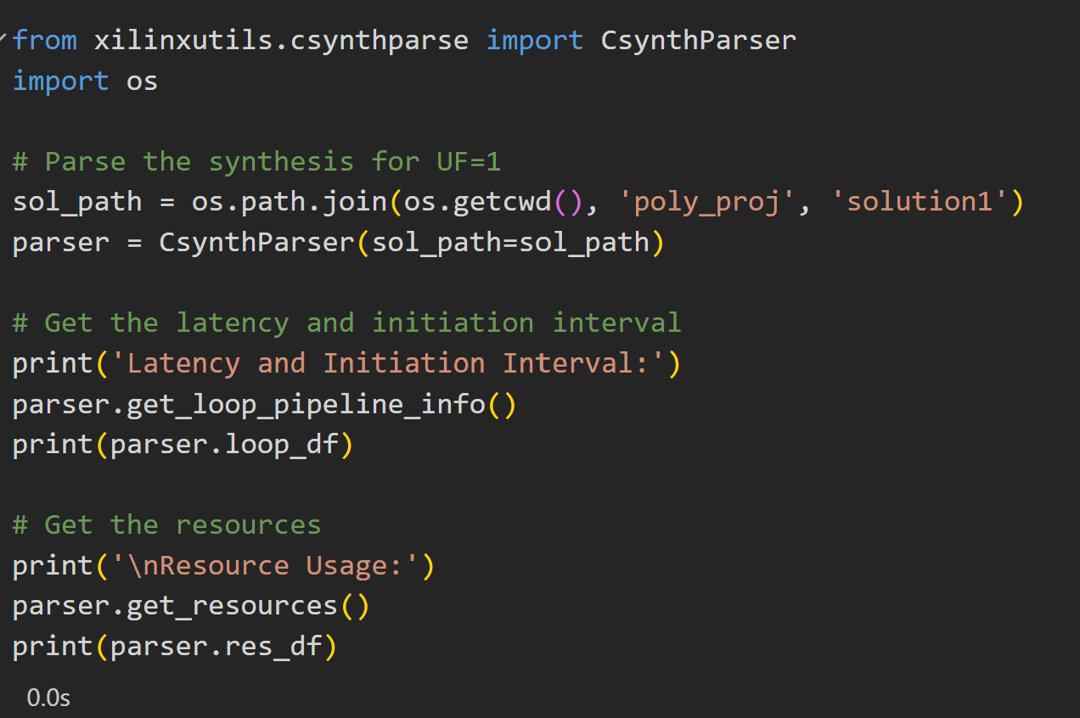
Parsing the Results
Vitis loop optimization results stored in XML file
Can parse results in xilinxutils CsynthParser
Allows easy automation

Slide 34
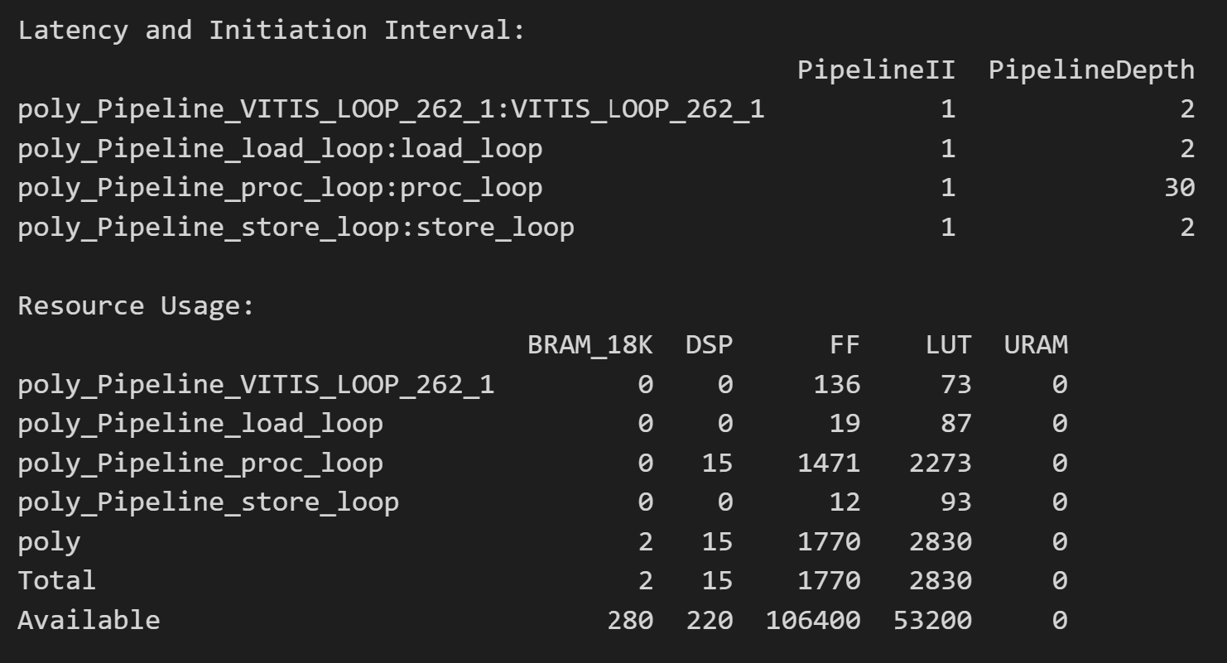
Pipelining Results
Main processing loop
Obtains II=1
High latency L=30
Needed for many FP32 multiplies

Slide 35
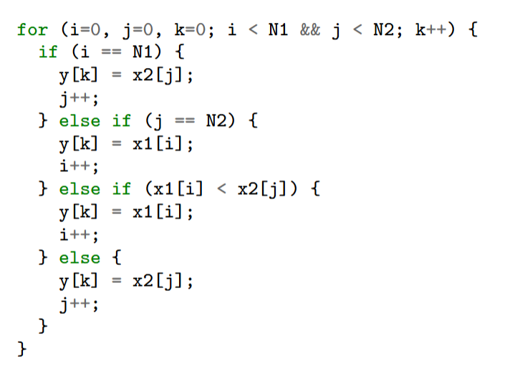

Loop Carry Dependency
Not all loops can be pipelined
Consider merge sort
Given two sorted lists $x_{1}\left[i\right], x_{2}[j]$
Find a merged sorted list $y[k]$
Algorithm:
C code to the right
Compare current $x_{1}[i]$ and $x_{2}[j]$
Places smaller one on list
Increments counter for the selected element

Slide 36
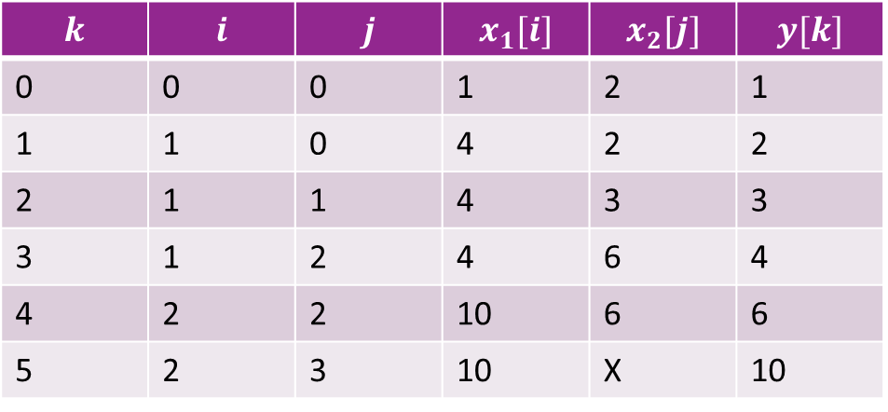
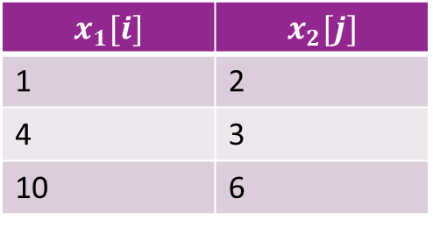
Merge Sort Example
$$k$$ | $$i$$ | $$j$$ | $$x_{1}[i]$$ | $$x_{2}[j]$$ | $$y[k]$$
0 | 0 | 0 | 1 | 2 | 1
1 | 1 | 0 | 4 | 2 | 2
2 | 1 | 1 | 4 | 3 | 3
3 | 1 | 2 | 4 | 6 | 4
4 | 2 | 2 | 10 | 6 | 6
5 | 2 | 3 | 10 | X | 10
$$x_{1}[i]$$ | $$x_{2}[j]$$
1 | 2
4 | 3
10 | 6

Slide 37
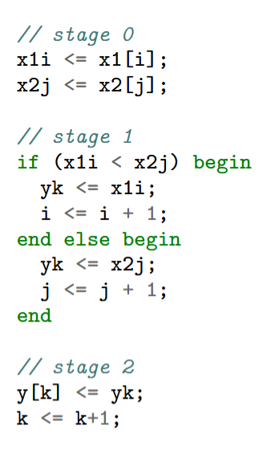
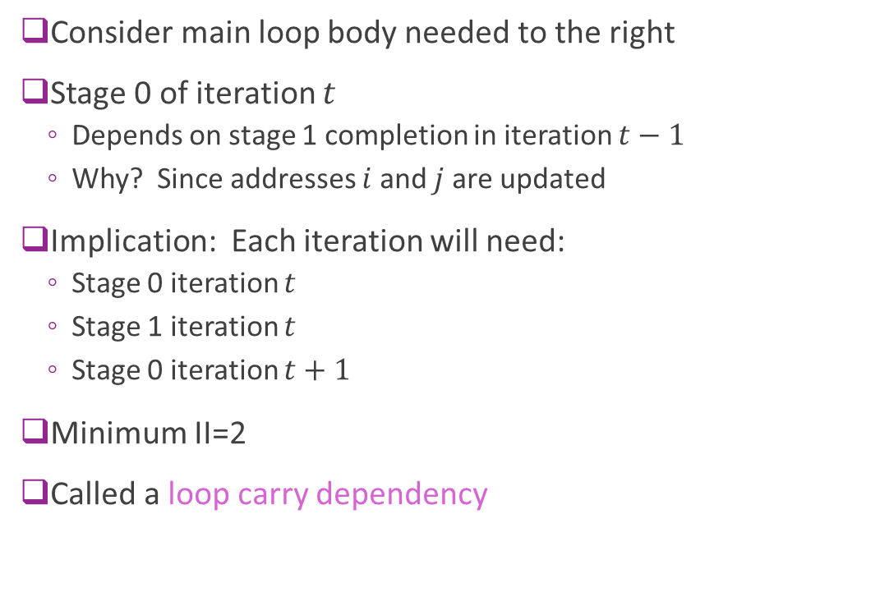
Pipelining Limit
Consider main loop body needed to the right
Stage 0 of iteration $t$
Depends on stage 1 completion in iteration $t−1$
Why? Since addresses $i$ and $j$ are updated
Implication: Each iteration will need:
Stage 0 iteration $t$
Stage 1 iteration $t$
Stage 0 iteration $t+1$
Minimum II=2
Called a loop carry dependency

Slide 38
Outline
Pipelining in SystemVerilog
Loop Pipelining in Vitis HLS
Loop Unrolling and Memory Constraints

Slide 39
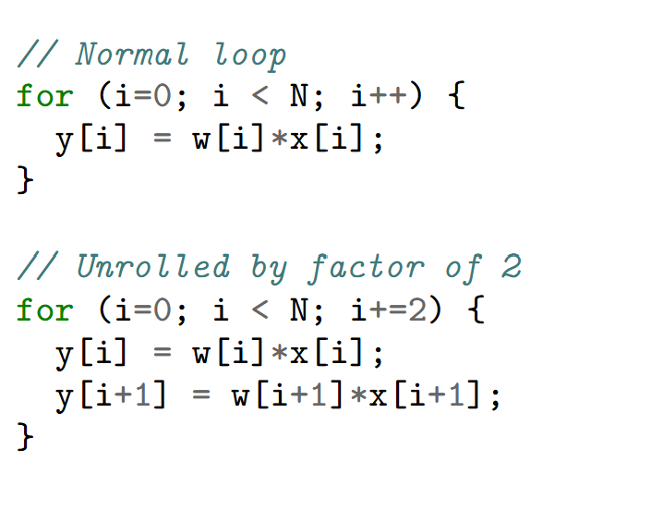
Loop Unrolling
Simple idea: Repeat processing in each cycle
Unroll by 2
Need half the number of iterations
But double the logic

Slide 40
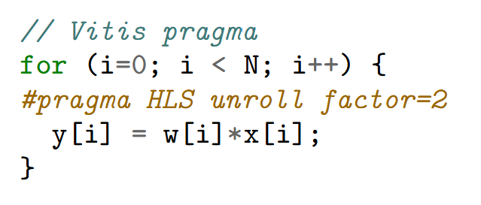
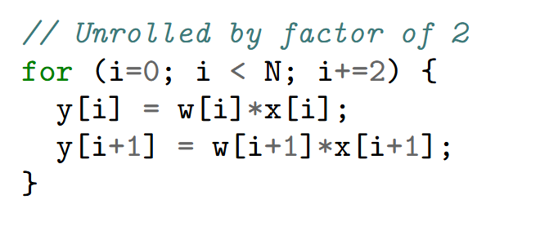

Loop Unrolling in Vitis
Can be done with a simple pragma
No need to manually unroll!
Handles cases when $N$ is not divisible by unroll factor
=

Slide 41
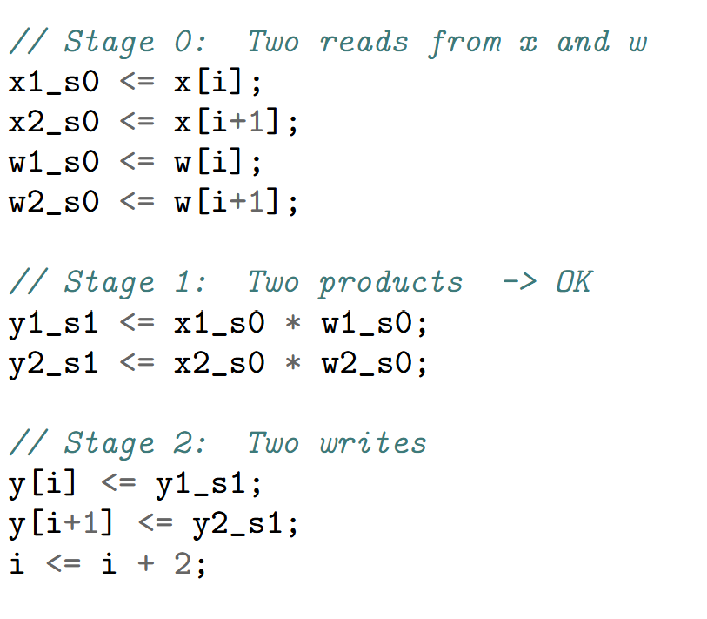

Memory Bottleneck
Memory bottleneck
Loop unrolling is often limited by memory accesses
Consider vector multiply SV code
Stage 0 needs:
Two reads from $x$ and two reads from $w$
Stage 2 needs:
Two writes to $y$

Slide 42






Single Port Memory
Recall memory architecture from Unit 4
Basic memories are single port
There is a single address decoder
Can read / write one word in a cycle
$N$ data words
Data Bus
R/W
$N$ wordlines
Address input $\log_{2}{(N)}$bits
$$⋮$$
$$⋮$$
Address decoder Selects one of
$N$ wordlines

Slide 43
Three Solutions
Solution 1: Use a true multi-port RAM
Most general. Allows read and write from any combination of addresses
Xilinx FGPA BRAMs are two port
But most costly in hardware
Solution 2: Use a wider bitwidth
Say 64 bits to read two 32 bit numbers
Works only when the accesses are contiguous
Solution 3: Bank or partition memory
Divide memory into partitions
Each partition has its own decoder
Works if accesses can be across different partitions

Slide 44


Mutli-Port RAMs
Allow arbitrary read / writes
Except for read-write collisions to same address in same cycle
BRAM in FPGAs generally only support true two port
BMutli-port SRAMs in ASICs are expensive
Memory
Address Decoder 1
Data1, Addr1
$$⋮$$
Data2, Addr2
Address Decoder 2

Slide 45

Using Wider Bit widths
Narrow bit width design
Access only one word per cycle
Memory bottleneck
Wide bit width design
Only one R/W to each array
Can pipeline with II=1
But need accesses to be contiguous

