Slide 1
Unit 8 Shared Memory Transactions
EL-GY 9463: Introduction to Hardware Design
ProfS. Sundeep Rangan, Siddharth Garg

Slide 2
Learning Objectives
Describe the basic components of random access memory
Address and data bus, address decoder, storage
Identify which types of memory should be used for storage
External vs. internal
Registers vs. block memory
Describe and analyze timing for the AXI4-Lite protocol for reading and writing registers
Implement a simple IP with AXI4-Lite control registers using Vitis HLS
Synthesize and simulate the IP and analyze the timing diagrams
Deploy the IP on an FPGA board and interface with the IP via PYNQ

Slide 3
Outline
Shared Memory and Interconnects
Shared Memory Transactions
AXI4-Memory Mapped Protocol
Implementing Shared Memory in Vitis HLS

Slide 4

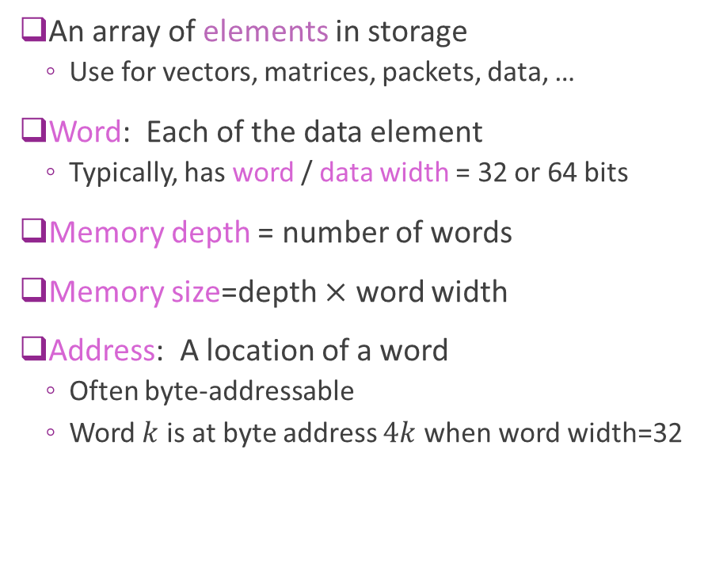


Addressable Memory
An array of elements in storage
Use for vectors, matrices, packets, data, …
Word: Each of the data element
Typically, has word / data width = 32 or 64 bits
Memory depth = number of words
Memory size=depth $×$ word width
Address: A location of a word
Often byte-addressable
Word $k$ is at byte address $4k$ when word width=32
Byte address
Data
0
Word 0
4
Word 1
8
Word 2
$$4(N−1)$$
Word $N−1$
Example 32-bit memory with $N$ depth

Slide 5
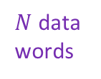
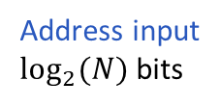

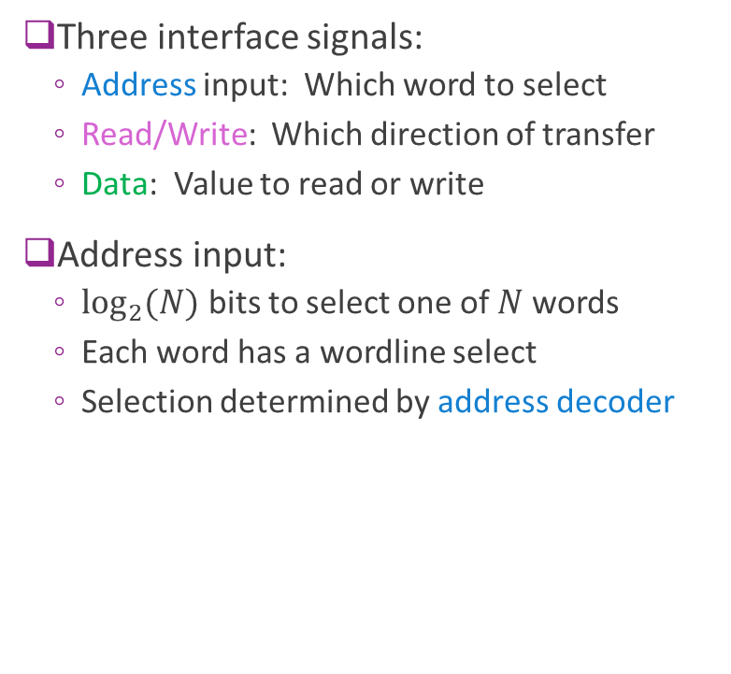


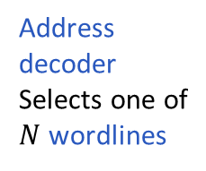
Typical RAM Architecture
Data Bus
Three interface signals:
Address input: Which word to select
Read/Write: Which direction of transfer
Data: Value to read or write
Address input:
$\log_{2}{(N)}$ bits to select one of $N$ words
Each word has a wordline select
Selection determined by address decoder
$N$ data words
R/W
$N$ wordlines
Address input $\log_{2}{(N)}$bits
$$⋮$$
$$⋮$$
Address decoder Selects one of
$N$ wordlines

Slide 6
Dedicated vs Shared Memory
Memory
Dedicated memory
Memory that is dedicated to a single hardware module
Shared memory
Memory shared between modules
Also processing system and peripheral I/O
Module
Module 1
Memory
PS
Module 2
Peripheral I/O

Slide 7
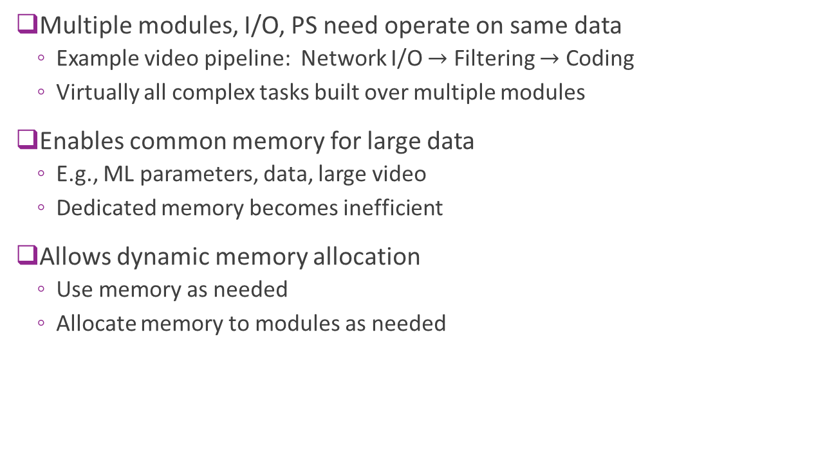
Why Share Memory?
Multiple modules, I/O, PS need operate on same data
Example video pipeline: Network I/O $→$ Filtering $→$ Coding
Virtually all complex tasks built over multiple modules
Enables common memory for large data
E.g., ML parameters, data, large video
Dedicated memory becomes inefficient
Allows dynamic memory allocation
Use memory as needed
Allocate memory to modules as needed
Module 1
Memory
PS
Module 2
Peripheral I/O

Slide 8
How to Build Shared Memory
Method 1. Multi-Port memory Each module has a dedicated port
Method 2. Interconnect
Modules use connect infrastructure
Interconnect
Modules
Ports
Memory
Modules
Memory

Slide 9
Single and Multi-Port Memories
Memory
Single port
HW module has dedicated use of a memory
Memory has a single port
Port exposes address, data lines with address decoder
Does not permit transfer of data between modules
Dual or multi-port
Multiple modules connect to the memory
Each module has a dedicated port
Allow simultaneous writes in same clock cycle
Most efficient
Module
Port
Module 1
Port 1
Memory
Module 2
Port 2

Slide 10
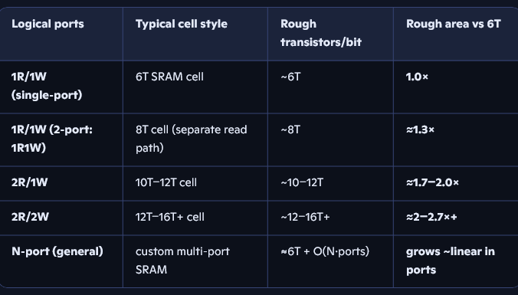

Problems with Multi-Port RAMs
Mutli-port SRAMs in ASICs are expensive
Typically limited to small memorys
Limited ports (e.g., 2R/2W)
Memory
Address Decoder 1
Data1, Addr1
$$⋮$$
Data2, Addr2
Address Decoder 2

Slide 11
Interconnect
Interconnect:
Physical and logical infrastructure for data communication
Between two or more functional units
Cores, memory controllers, I/O.
Topology (Physical):
Wire layout or links (bus, mesh, crossbar, ring)
Protocol (Logical):
Signals and timing for access (e.g., AXI4, TileLink, …)
Arbitration (Control):
Method to resolve contention
Interconnect
Modules
Memory
Controller

Slide 12


Transactions, Master and Slaves
Transactions:
A transfer of data over the interconnect
Masters
Request transactions (reads or writes)
Ex: processors
Kernels that need to access memory
Slaves
Respond to transactions (reads or writes)
Read transactions: Provide data to a master
Write transactions: Accept data from a master
Arbiter
Determines which transaction is used in each cycle
Interconnect
Master 1
Slave 1
Master $M$
Slave $S$
Arbiter

Slide 13
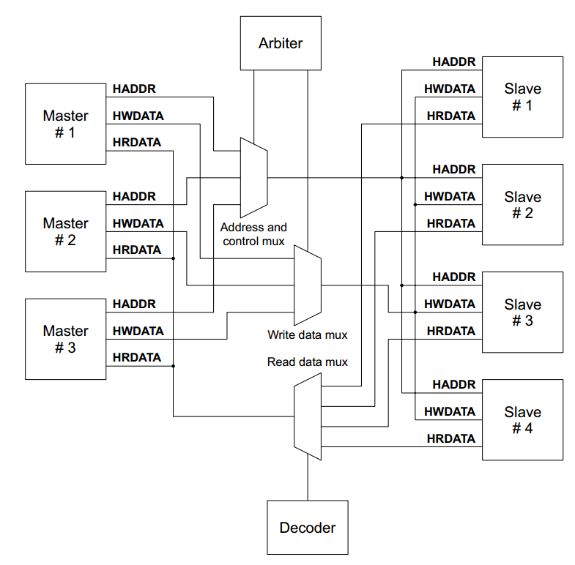
Bus Topology
One data path
Only one master-pair link in each cycle
Ex: ARM AHB (Advanced High-Performance Bus)
Pre-cursor to AXI
Traditional shared medium
Each master has dedicated side channel to arbiter
Arbiter selects a master and slave based on requests
Figure from The Advanced Microcontroller Bus Architecture: An Introduction

Slide 14
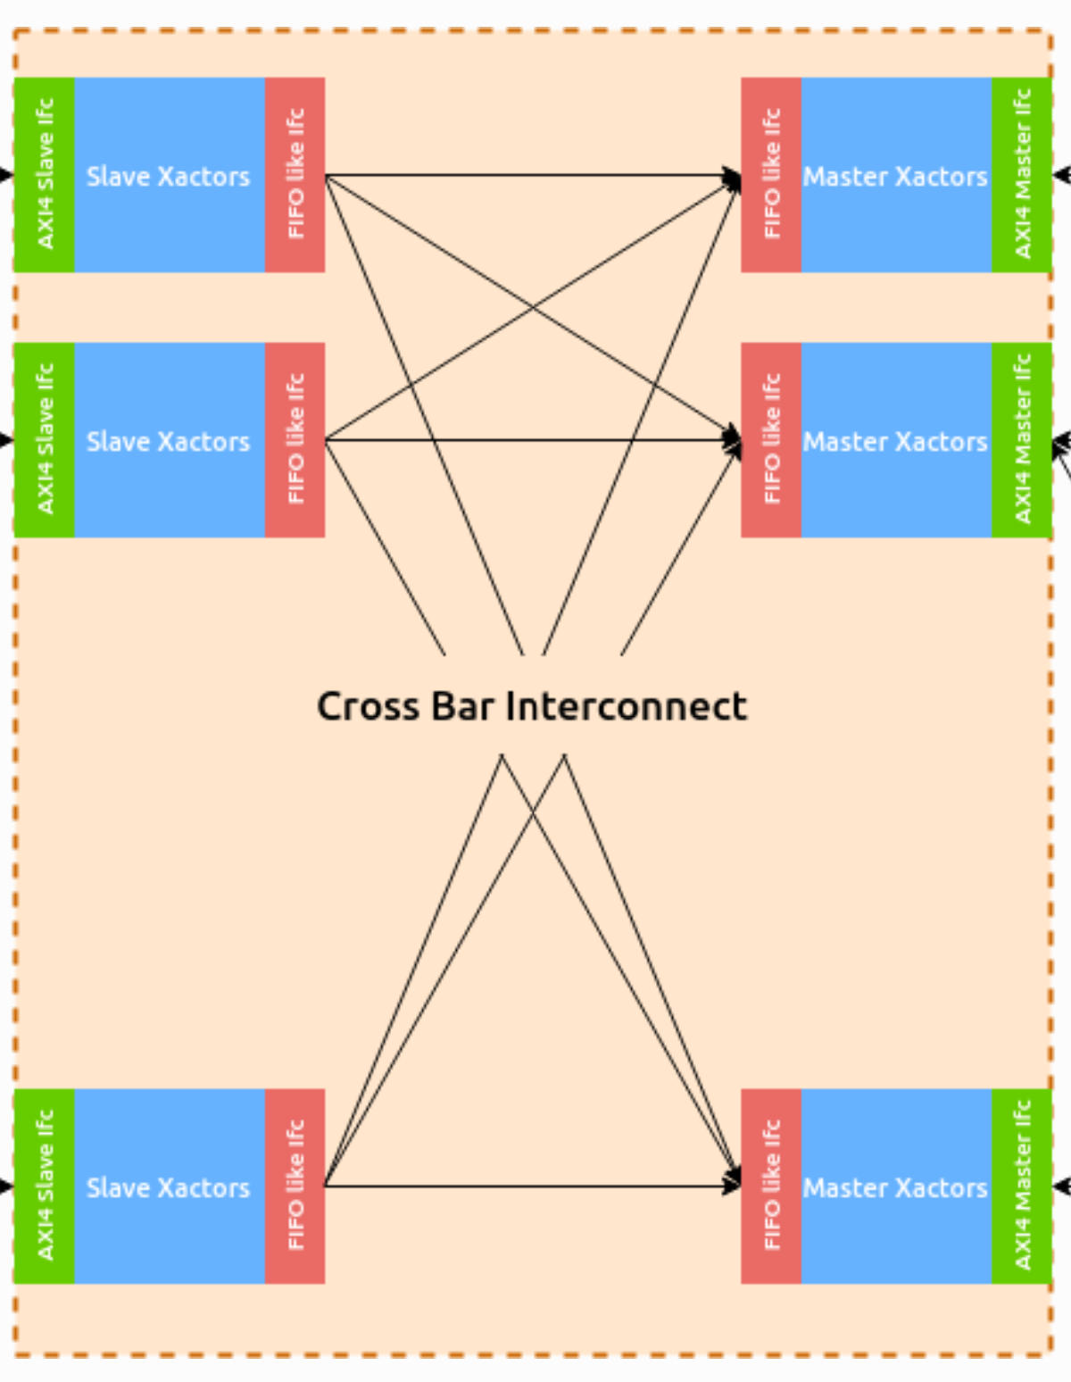
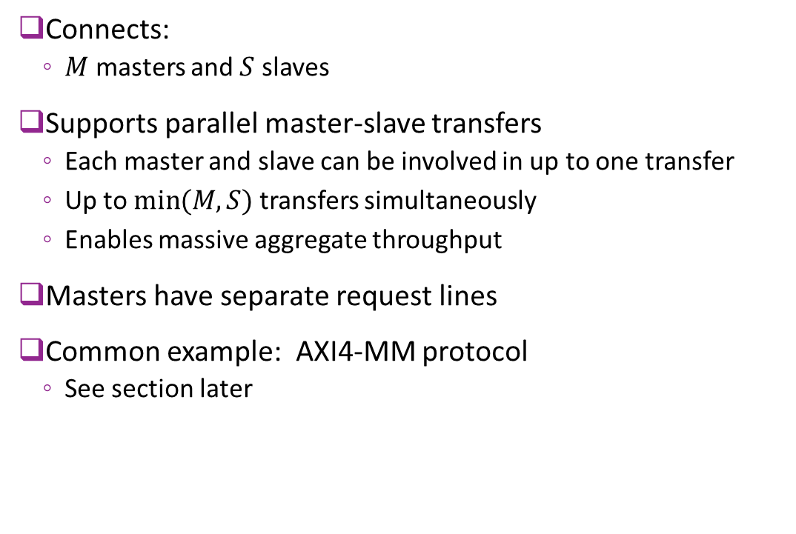
Crossbar Topology
Connects:
$M$ masters and $S$ slaves
Supports parallel master-slave transfers
Each master and slave can be involved in up to one transfer
Up to $min⁡(M,S)$ transfers simultaneously
Enables massive aggregate throughput
Masters have separate request lines
Common example: AXI4-MM protocol
See section later

Slide 15
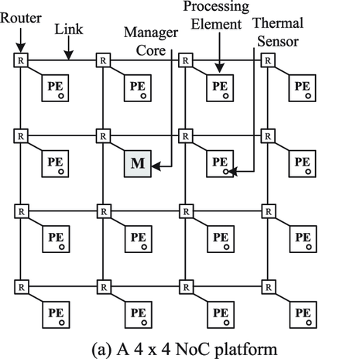
Other Topologies
Ring, Mesh, NoC
Widely-used in large Systems on Chips
Advanced topic beyond this class
Figure from Chatterjee, Navonil, Suraj Paul, and Santanu Chattopadhyay. "Fault-tolerant dynamic task mapping and scheduling for network-on-chip-based multicore platform." ACM Transactions on Embedded Computing Systems (TECS) 16.4 (2017): 1-24.

Slide 16
Outline
Shared Memory and Interconnects
Implementing Simple Transactions over Shared Memory
AXI4-Memory Mapped Protocol
Implementing Shared Memory in Vitis HLS

Slide 17
Stream vs. Shared Memory Transactions
Dedicated stream transactions (Unit 5)
Send data & control on stream
Shared memory transaction (This unit)
Send control on dedicated stream
Transfer data via shared memory
PS
PS
Bus
Command stream
Control + input data
Kernel
Data
Response stream
control
Command stream
control
Memory
Response stream
Response + output data
Data
IP kernel

Slide 18
Stream Transfer (Unit 5)
Consider processing system (PS) sending job to kernel
Use two streams
Command stream: PS is master and sends to kernel
Command message descriptor
Input data to process
Response stream: Kernel is master and sends to PS
Processed output data
Response descriptor (e.g., error codes, …)
PS
Command stream
Control + input data
Kernel
Response stream
Response + output data

Slide 19
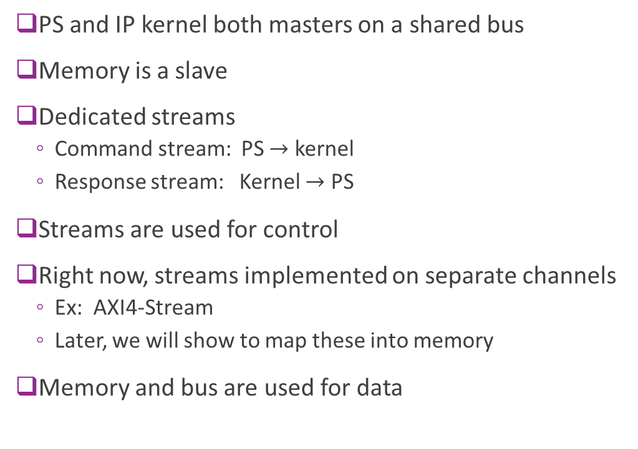
Shared Memory Transaction
PS and IP kernel both masters on a shared bus
Memory is a slave
Dedicated streams
Command stream: PS $→$ kernel
Response stream: Kernel $→$ PS
Streams are used for control
Right now, streams implemented on separate channels
Ex: AXI4-Stream
Later, we will show to map these into memory
Memory and bus are used for data
PS
Interconnect
Data
Memory slave
Response stream
control
Command stream
control
Data
IP kernel

Slide 20
Shared Mem Transaction: Command Phase
PS
Bus
PS writes input data into memory
Data to be processed
PS sends input command to kernel
Input address: Where data resides
Output address: Where output should reside
Command info: What to do with data
Input data
Input command
IP kernel

Slide 21
Shared Mem Transaction: Compute Phase
PS
Bus
Kernel reads input data from memory
Uses input address sent in command
Kernel processes input data
Input data
Computes
results
IP kernel

Slide 22
Shared Mem Transaction: Response Phase
PS
Bus
Kernel writes output data to memory
Uses output address sent in command
Kernel sends
Input data
Response
Output data
IP kernel

Slide 23
Streaming vs. Shared Memory
 | Streaming | Shared Memory
Access model | Sequential | Random
Control | Producer pushes data when available | Consumer pulls data when needed
Latency | Deterministic; minimal variation | Variable; depends on arbitration and usage
Arbitration | None if point-to-point | Required
Complexity |  | Simple design but adds
Resources | Dedicated resources per link, no statistical multiplexing | Shared resources, enables

Slide 24
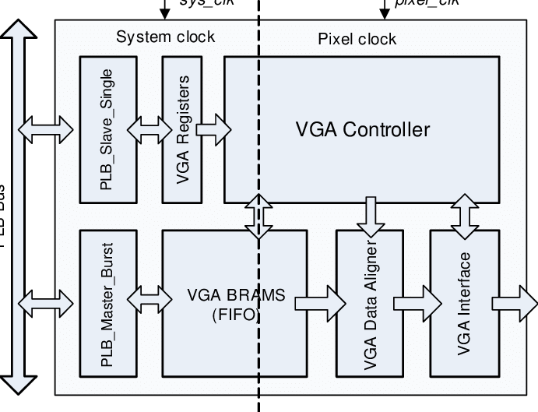
Streaming Example: Simple Video Processing
Deterministic sequential flow
Need dedicated high-speed links
Buffering is memory intensive
Need minimal reconfiguration
Tran, Van-Huan, and Xuan-Tu Tran. "An efficient architecture design for VGA monitor controller." 2011 International Conference on Consumer Electronics, Communications and Networks (CECNet). IEEE, 2011.

Slide 25
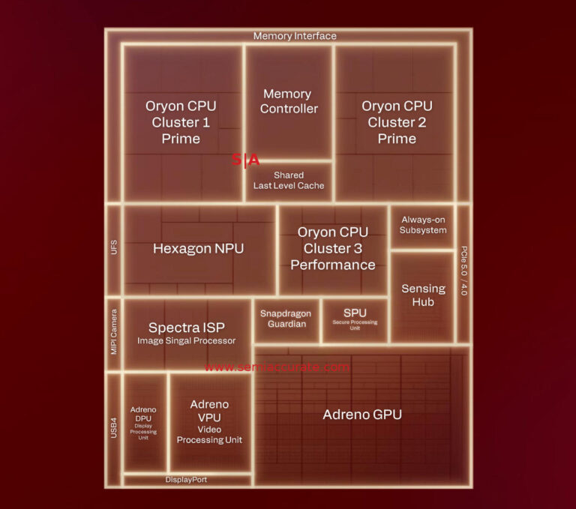
Shared Memory Ex: Mobile SoC
Example:
Qualcomm Snapdragon, Apple MacBook M3
NPU, CPU, GPU have access to common DDR memory
CPU can write address to NPU, GPU
NPU, GPU stores / retrieves data from memory
Widely-used in virtually all SoC

Slide 26
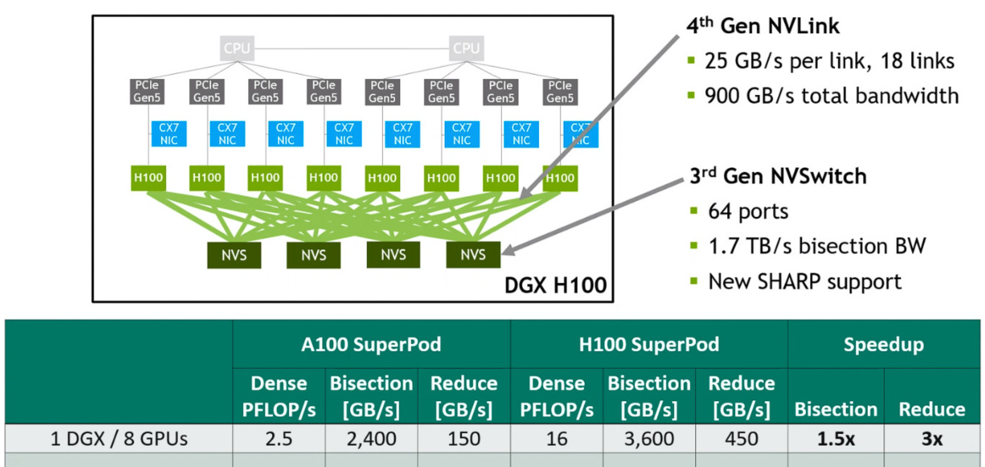
Shared Memory Ex: Nvidia DGX H100
LLMs stored in massive shared memory
H100 GPUs fetch data as need
Use high throughput NvLink

Slide 27
Outline
Shared Memory and Interconnects
Implementing Simple Transactions over Shared Memory
AXI4-Memory Mapped Protocol
Implementing Shared Memory in Vitis HLS

Slide 28
AXI Family of Protocols
AXI4-Stream (Covered in Unit 5)
Point-to-point link, flow control with TVALID / TREADY
1 read/ write per clock cycle
Optional framing with TLAST
AXI4-Lite (Covered in Unit 4)
Simple memory mapped protocol. Ideal for control registers
1 read / 1 write per 3-5 clock cycles
AXI4-Full (This unit).
Officially called AXI4 in AMD, but we use AXI4 for the family of protocols in this class
Builds on AXI4-Lite memory mapped
Handshaking signals to enable high throughput 1 read / write per clock cycle
Terminology: We will use AXI-MM to mean both AXI4-Lite and AXI4-Full

Slide 29
AXI4 Memory Mapped Features
Most widely-used interconnect fabric in industry
Multiple outstanding requests
Master can issue several requests while others are ongoing
Full-duplex with independent read and write channels
Handshaking:
Independent VALID/READY for requests and data and read and write.
Provides flow control and modular design.
Out of order protocols:
Flows marked with an ID. Order is preserved within an ID.
But controller may rearrange packet order for different IDs enabling prioritization
Support for massive memories: DDR, HBM, not just on-chip RAM

Slide 30
AXI4-MM Architecture
Interconnect is a crossbar
Configurable number of masters and slaves
Each master places transaction request
Crossbar typically queues requests for each slave

Slide 31
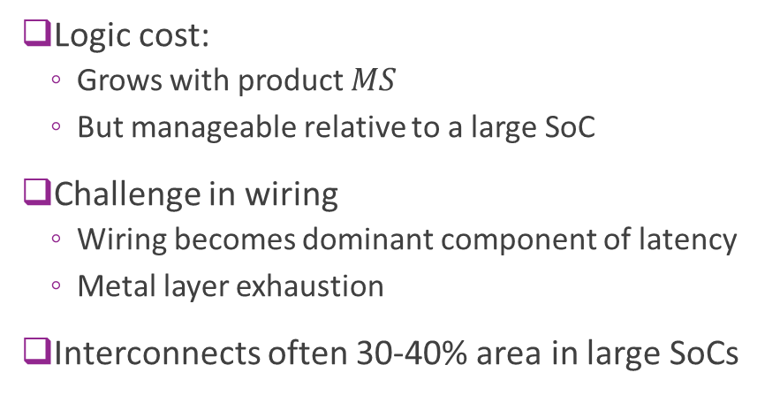
Cost of Crossbars
Logic cost:
Grows with product $MS$
But manageable relative to a large SoC
Challenge in wiring
Wiring becomes dominant component of latency
Metal layer exhaustion
Interconnects often 30-40% area in large SoCs
Configuration | Est. Area (16nm) | Est. Gate Count (NAND2 equiv)
2 x 2 | ~0.008 mm² | ~25k - 35k
4 x 4 | ~0.035 mm² | ~100k - 140k
8 x 8 | ~0.140 mm² | ~450k - 550k
16 x 16 | ~0.600 mm² | ~2M+ (Serious congestion)
Logic estimates for AXI crossbar
64-bit address and data in TSMC 16 nm
How data flows is key to high throughput design

Slide 32
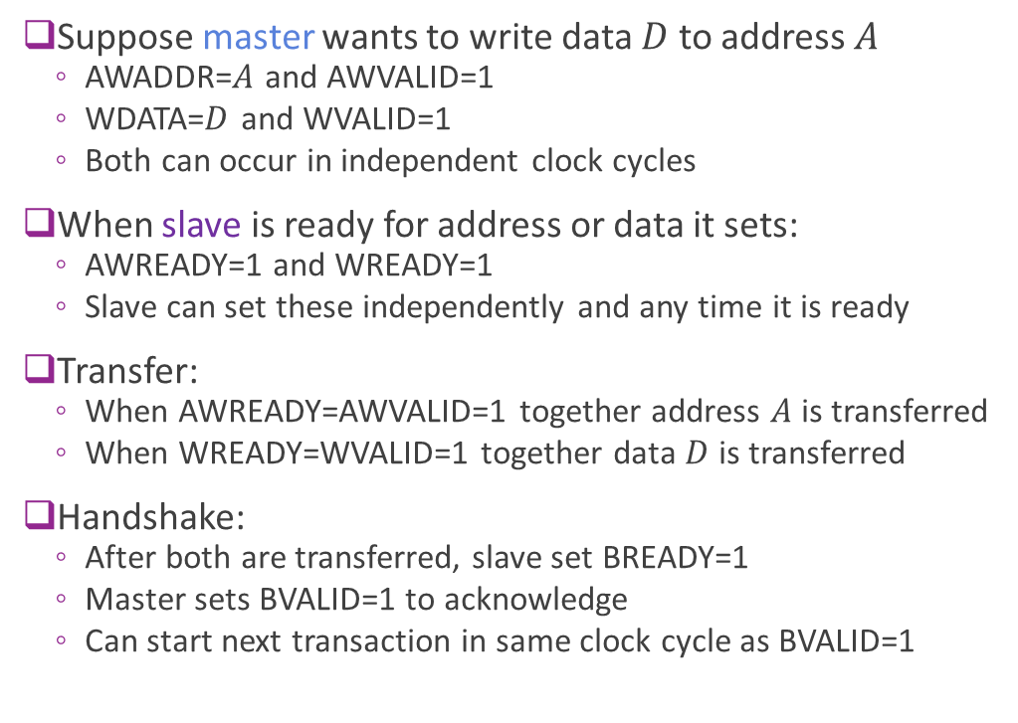
Review: AXI4-Lite Write Protocol
Suppose master wants to write data $D$ to address $A$
AWADDR=$A$ and AWVALID=1
WDATA=$D$ and WVALID=1
Both can occur in independent clock cycles
When slave is ready for address or data it sets:
AWREADY=1 and WREADY=1
Slave can set these independently and any time it is ready
Transfer:
When AWREADY=AWVALID=1 together address $A$ is transferred
When WREADY=WVALID=1 together data $D$ is transferred
Handshake:
After both are transferred, slave set BREADY=1
Master sets BVALID=1 to acknowledge
Can start next transaction in same clock cycle as BVALID=1
MASTER
SLAVE
AWADDR, AWVALID
AWREADY
WDATA, WVALID
WREADY
BVALID
BREADY

Slide 33
AXI4-Full Burst Signals
AXI4-Full supports bursts of data
1 cycle per read / write
Much faster than AXI4-Lite (typically 3-5 cycles)
Additional signals sent on request:
AxLEN: Number of “beats” to transfer
AxSIZE: Width of transfer (for downward compatibility)
AxBURST: Type of burst (fixed or increment address)
Transfer stage: Unchanged
Same WDATA, WVALID, WREADY
Termination: Add WLAST
Indicates final beat (can terminate for AWLEN)
MASTER
SLAVE
AWADDR, AWVALID
AWLEN, AWSIZE, AWBURST
AWREADY
WDATA, WVALID
WREADY
WLAST
BVALID
BREADY

Slide 34
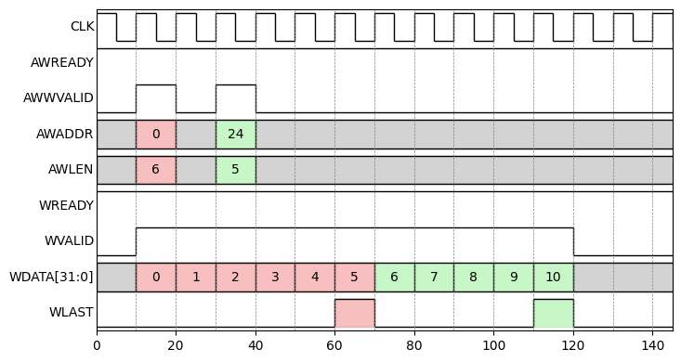
AXI4 Write Example
Two write burst requests
Burst 0: AWLEN=0
Burst 1: AWLEN=5
Request 1 early
Before write burst 0 completed
WLAST at end of each burst

Slide 35
AXI4 Indexing
Each transaction associated with an index
Index is not unique
Typical design:
Each master has a unique ID; or
One ID for priority class
Crossbar will maintain order within an ID
But may re-order between IDs
Can be used for prioritization
Advanced topic

Slide 36
Outline
Shared Memory and Interconnects
Implementing Simple Transactions over Shared Memory
AXI4-Memory Mapped Protocol
Implementing Shared Memory in Vitis HLS

Slide 37
Two Memory Interfaces in Vitis
Native:
Typically used for direct connection to internal memories
Synthesized with a simple address decoder
Word indexed
Supported in Vivado with BRAM
AXI4-MM
Typically used for DRAM or BRAM on a bus
Kernel connects to AXI4 memory controller (a block in Vivado)
AXI4-MM is always byte addressed

Slide 38
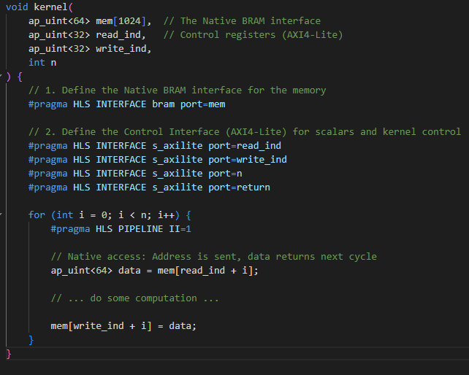
BRAM
Creates native interface to BRAM
AXI4-Lite
Read and write pointer
Length n
Can read from memory in kernel

Slide 39
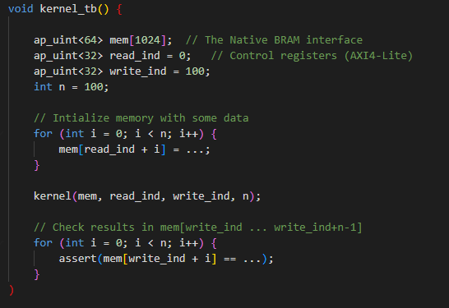
BRAM TB
Creates BRAM emulation
Or actual memory

Slide 40
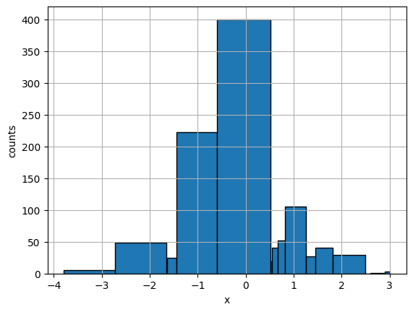
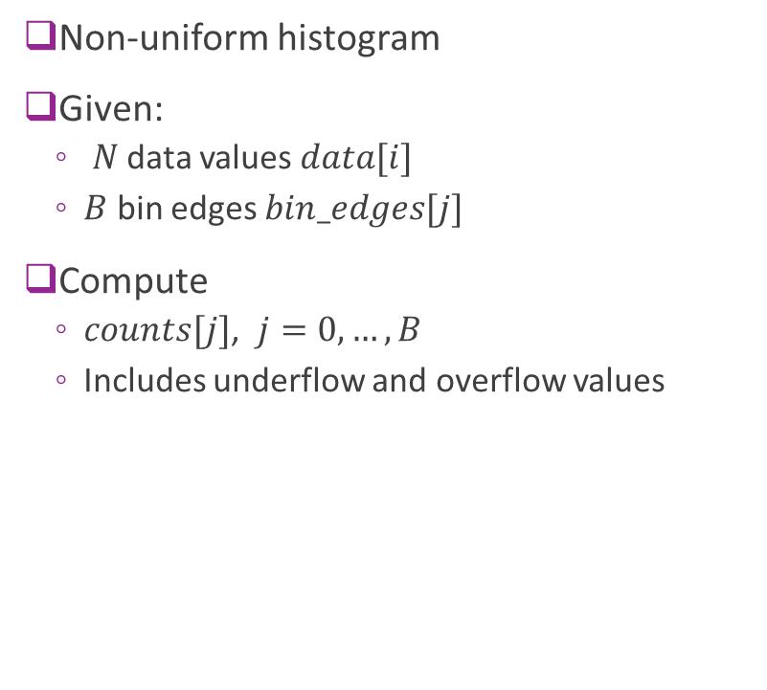
AXI4 Histogram Example
Non-uniform histogram
Given:
$N$ data values $data[i]$
$B$ bin edges $bin_edges[j]$
Compute
$counts[j]$, $j=0,…, B$
Includes underflow and overflow values

Slide 41
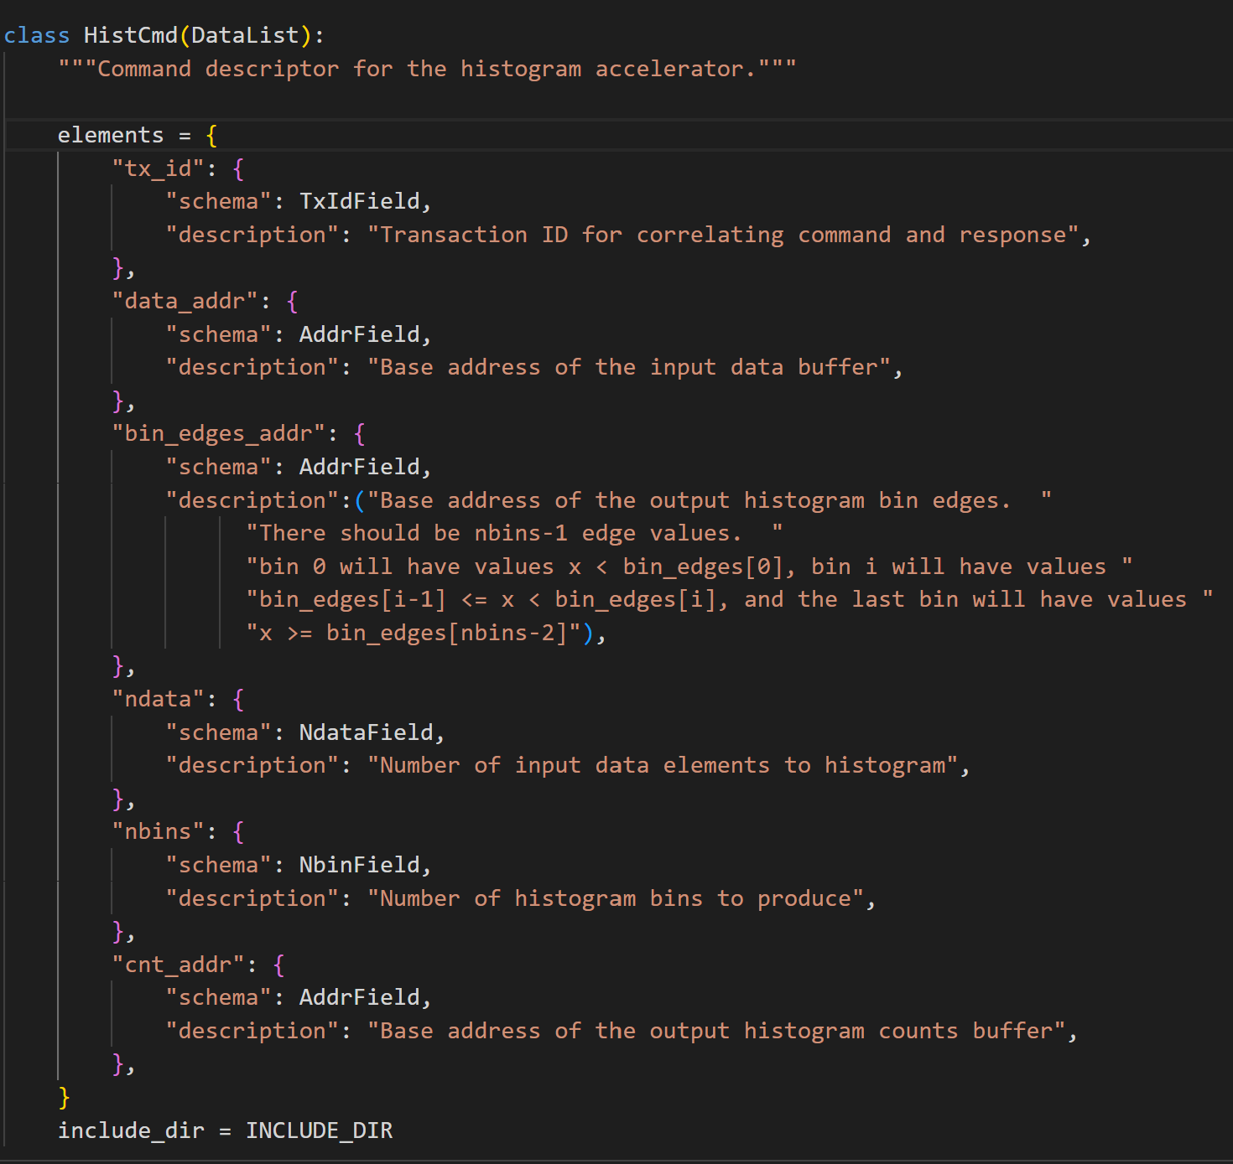
Histogram Command Input
Gives input addresses:
Data
Bin edges
Output addresses
Counts
Transaction IDs and lengths

Slide 42
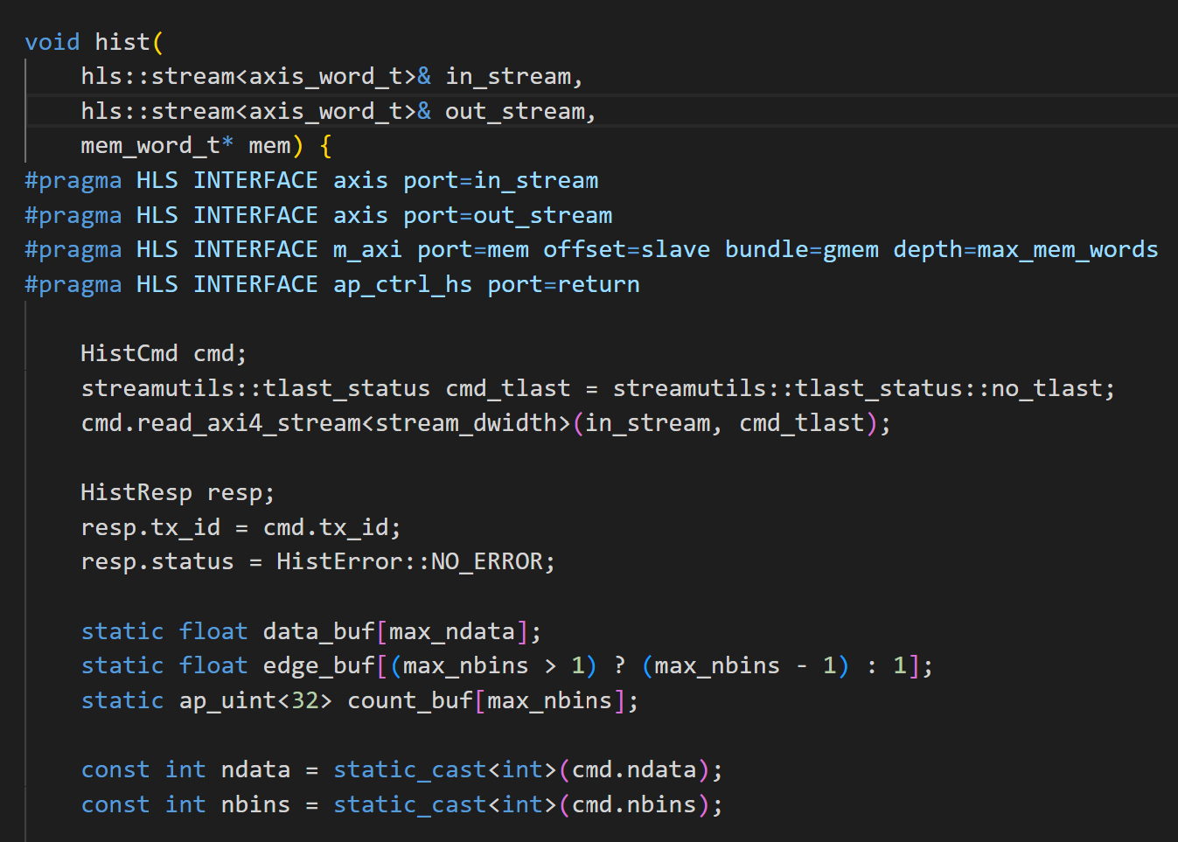
Histogram Interface
AXI4 streams
For command and response
These could have been memory-mapped
AXI4-Full access to memory
Read command from AXI4 stream

Slide 43
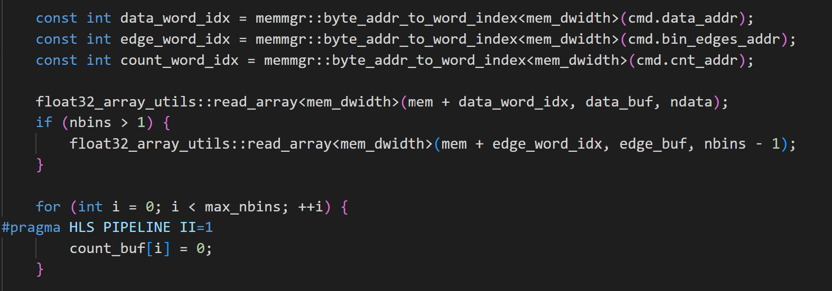
Histogram Read Phase
Read data and bin edges to a local buffer
Local buffer is not strictly needed for data
Easy to illustrate

Slide 44
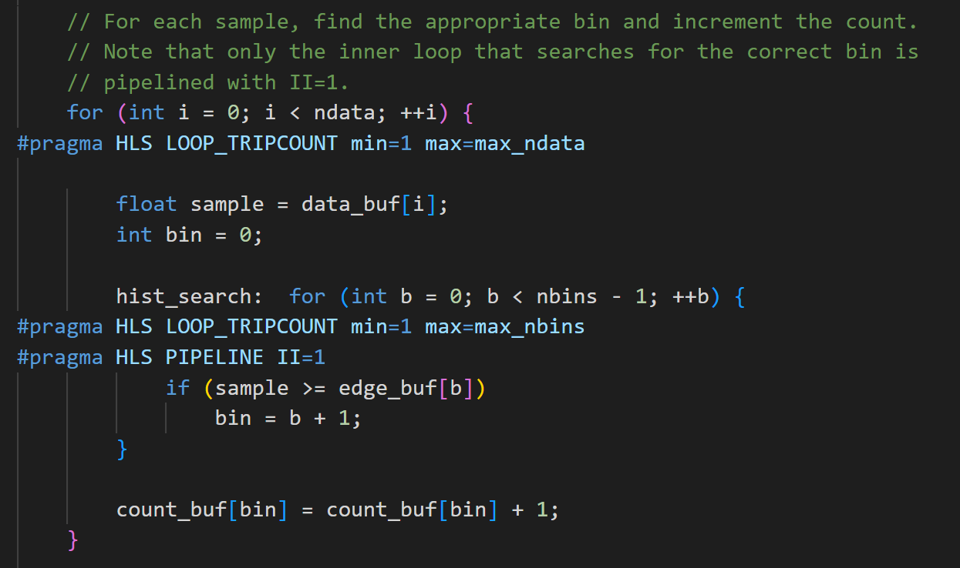
Core Histogram Loop
Nested loop
Outer loop is not pipelined
Must be careful of inner loop pipelining
Will show synthesis reports in class

Slide 45
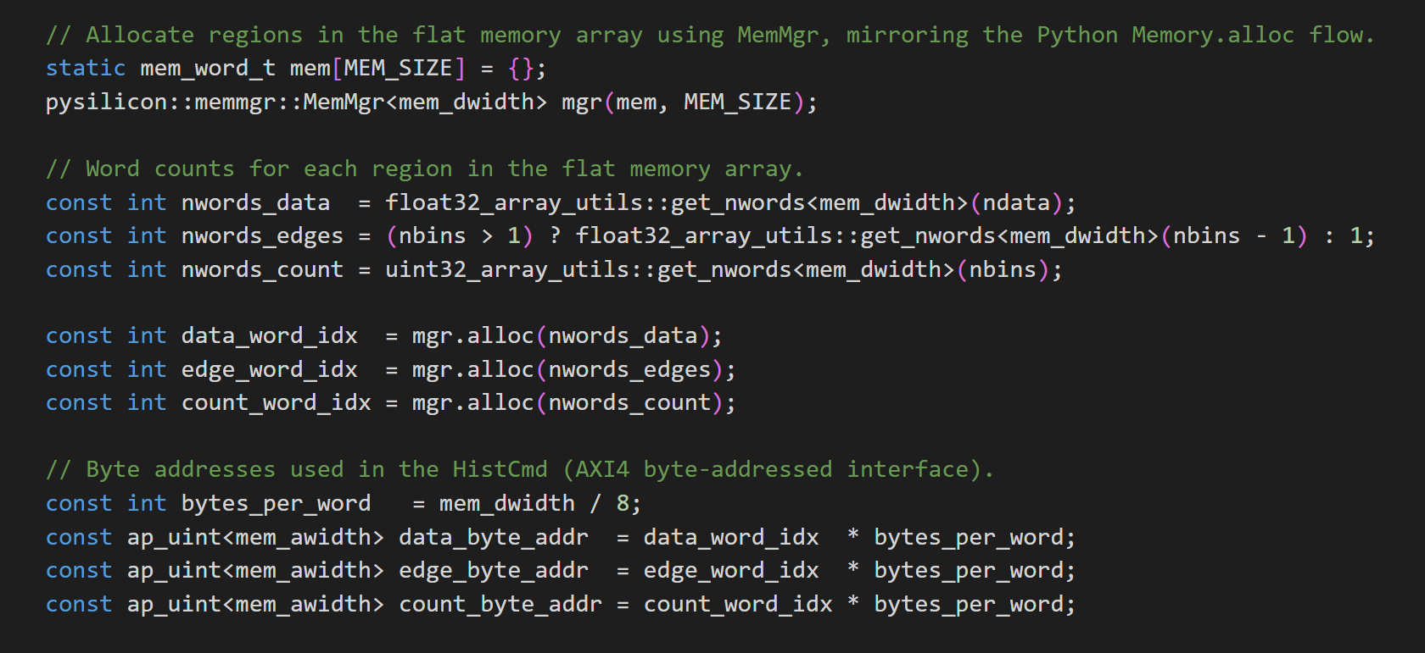
Testbench Memory Allocation
Testbench creates memory
Allocates blocks in memory
Computes byte addresses

Slide 46
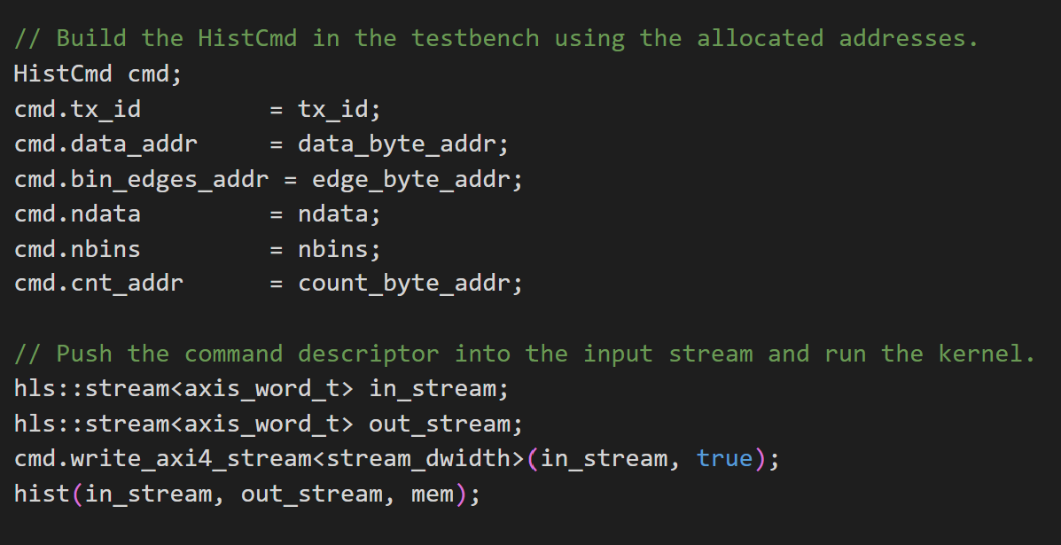
Testbench Command
Writes addresses in command
Upon receipt of response
Retieves data
Compares against test vectors

Slide 47
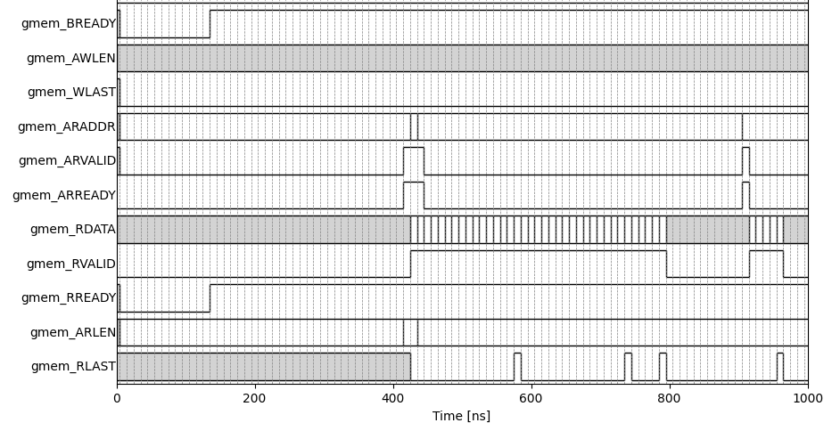
Timing: Read Phases
Test parameters
7 bins
37 data points
Partitioning
Data broken into three busts
16, 16, and 5
Requests given at beginning

