Slide 1
Unit 1 Basic Digital Logic
EL-GY 9463: Introduction to Hardware Design
ProfS. Sundeep Rangan, Siddharth Garg

Slide 2
Learning Objectives
Write simple functions with combinational logic in SystemVerilog and draw block diagrams
Define finite state machines and identify inputs, outputs, and states
Implement FSMs with synchronous logic in SystemVerilog
Break and implement functions over multiple clock cycles
Write a testbench for the hardware modules
Simulate, and synthesize the SystemVerilog using Vivado tools

Slide 3
Outline
Combinational Logic
Registers, Clocks and Sequential Logic and Finite State Machines
Splitting Long Computations
Simulating and Synthesizing Simple Modules in Vivado

Slide 4
Outline
Combinational Logic
Registers, Clocks and Sequential Logic and Finite State Machines
Splitting Long Computations
Simulating and Synthesizing Simple Modules in Vivado

Slide 5
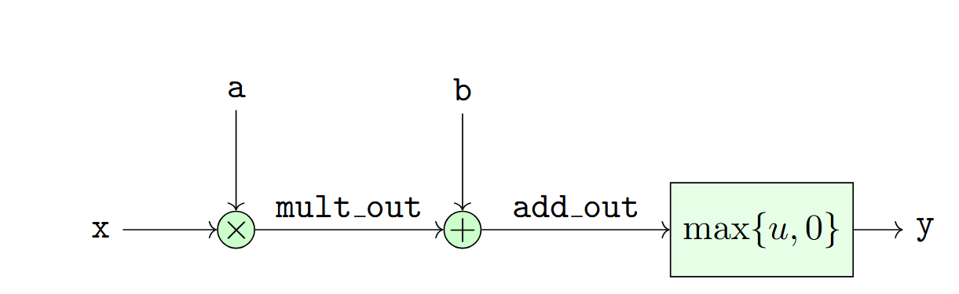
Limitations of Combinational Logic
No memory — cannot store past values
Output changes immediately with input changes (no control over timing)
Long combinational paths lead to large propagation delays
Hard to build large systems without controlled timing boundaries
Glitches and hazards can propagate freely
No notion of “steps” or “cycles” — everything is continuous

Slide 6
Synchronous (Sequential) Logic
Introduces state via flip‑flops or registers
Breaks long logic into clocked stages, improving performance
Provides predictable timing — changes only occur on clock edges
Makes large systems modular and easier to reason about
Eliminates most hazards/glitches from propagating across stages
Enables pipelining, finite‑state machines, and sequential algorithms
Allows clean interfaces between modules (valid/ready, handshakes, etc.)
Synchronous logic is the dominant paradigm for design

Slide 7
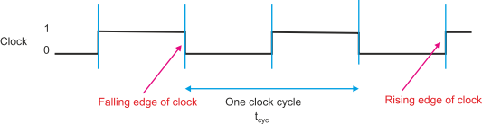

Clock Signal
Clock: An alternating binary signal
Visualized as a square wave
Each period is called a clock cycle
Typically, between two rising edges
Parameters:
Clock period $T$
Frequency $f=\frac{1}{T}$
Typical parameters:
FPGA logic: 100 to 500 MHz
ASIC: 500 MHz to 1 GHz

Slide 8
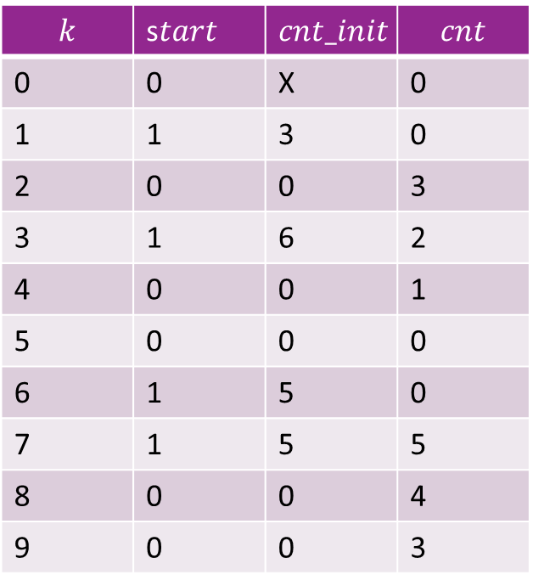
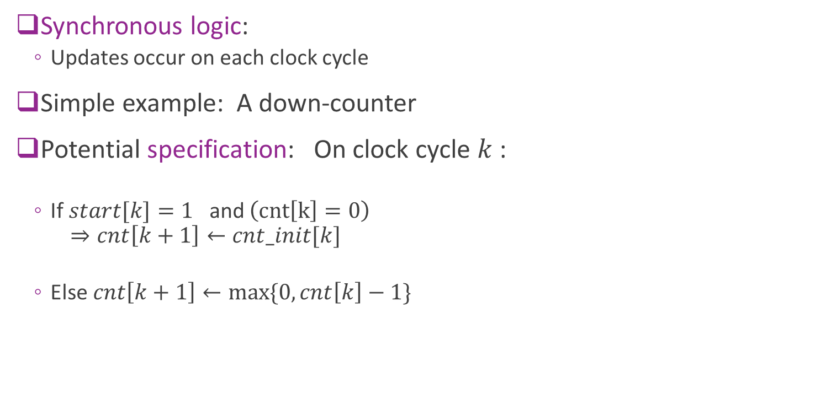
Synchronous Logic Example: Counter
Synchronous logic:
Updates occur on each clock cycle
Simple example: A down-counter
Potential specification: On clock cycle $k$ :
If $start[k]=1$ and $\left(cnt\left[k\right]=0\right)$ $⇒cnt\left[k+1\right]←cnt_init[k]$
Else $cnt\left[k+1\right]←\max{\{0, cnt\left[k\right]−1\}}$
$$k$$ | s$tart$ | $$cnt_init$$ | $$cnt$$
0 | 0 | X | 0
1 | 1 | 3 | 0
2 | 0 | 0 | 3
3 | 1 | 6 | 2
4 | 0 | 0 | 1
5 | 0 | 0 | 0
6 | 1 | 5 | 0
7 | 1 | 5 | 5
8 | 0 | 0 | 4
9 | 0 | 0 | 3

Slide 9
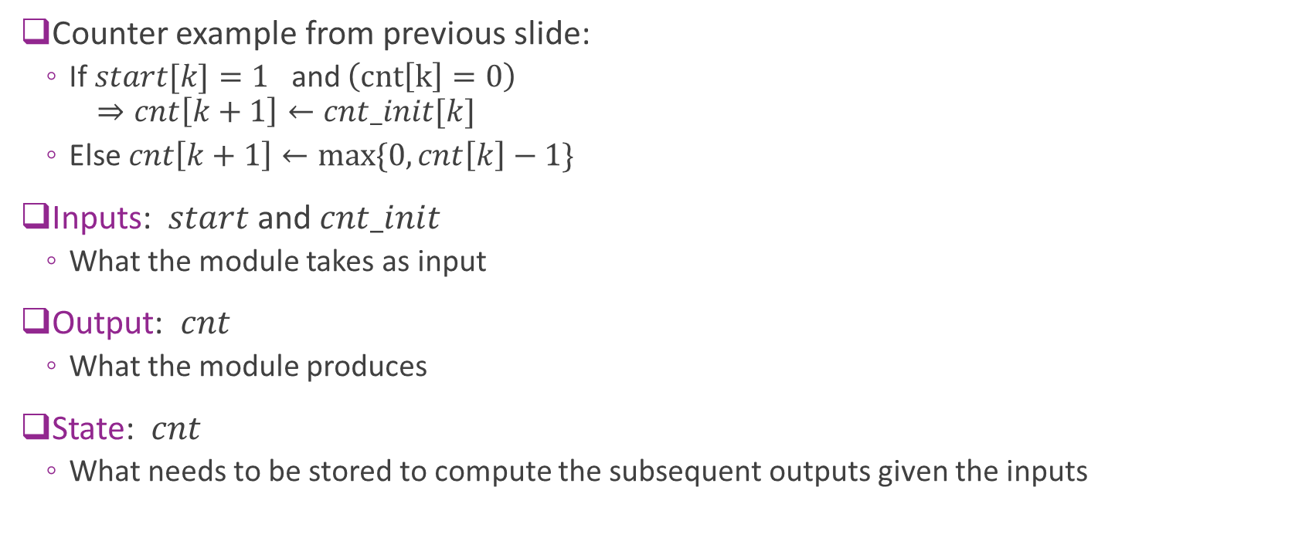
Key Components of a Module
Counter example from previous slide:
If $start[k]=1$ and $\left(cnt\left[k\right]=0\right)$ $⇒cnt\left[k+1\right]←cnt_init[k]$
Else $cnt\left[k+1\right]←\max{\{0, cnt\left[k\right]−1\}}$
Inputs: $start$ and $cnt_init$
What the module takes as input
Output: $cnt$
What the module produces
State: $cnt$
What needs to be stored to compute the subsequent outputs given the inputs

Slide 10
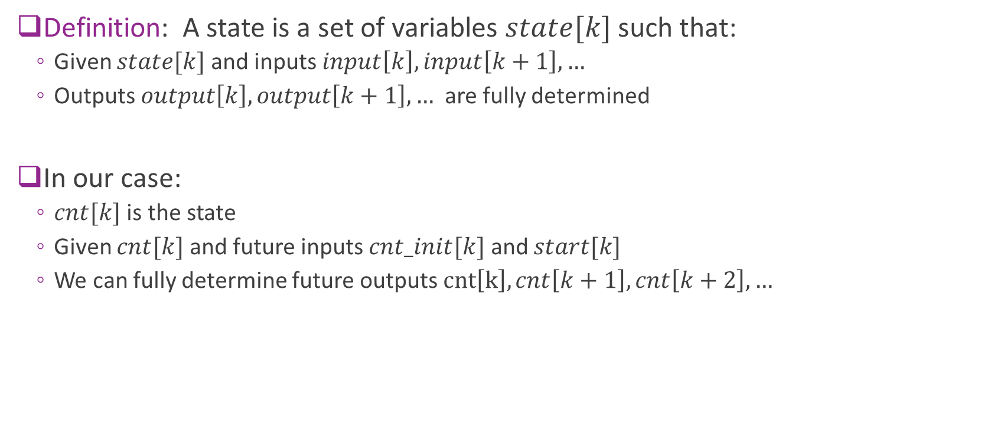
What is a State?
Definition: A state is a set of variables $state[k]$ such that:
Given $state[k]$ and inputs $input\left[k\right], input\left[k+1\right], …$
Outputs $output\left[k\right], output\left[k+1\right], …$ are fully determined
In our case:
$cnt[k]$ is the state
Given $cnt[k]$ and future inputs $cnt_init[k]$ and $start[k]$
We can fully determine future outputs $cnt\left[k\right], cnt\left[k+1\right], cnt\left[k+2\right], …$

Slide 11





Synchronous Logic as an FSM
General finite state machine
Update function:
$state\left[k+1\right]=F\left(state\left[k\right], input\left[k\right]\right)$
Describes how the state evolves
Output function:
$output\left[k\right]=G(state\left[k\right], input\left[k\right])$
Input$[k]$
State$[k]$
Update and output functions
O$utput[k]$
State$\left[k+1\right]=$state_next[k]

Slide 12



Building an FSM in Hardware
Input$[k]$
States are stored in registers
Basic storage element
Update and output functions
Implemented in combinational logic
No storage
Takes input and current state
Produces next state and output
Must finish within one clock cycle
Registers
State$[k]$
Update and output functions
O$utput[k]$
Combinational logic
State$\left[k+1\right]=$state_next[k]

Slide 13
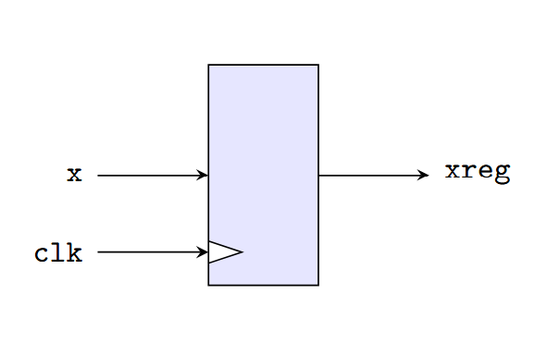
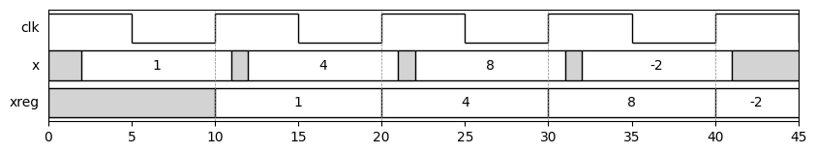
Register Physical Model
Basic storage element in synchronous logic
On each rising edge of clk:
Assigns xreg to x
Value of xreg is maintained even if x changes
Example below: Input is “sampled” at rising edges

Slide 14
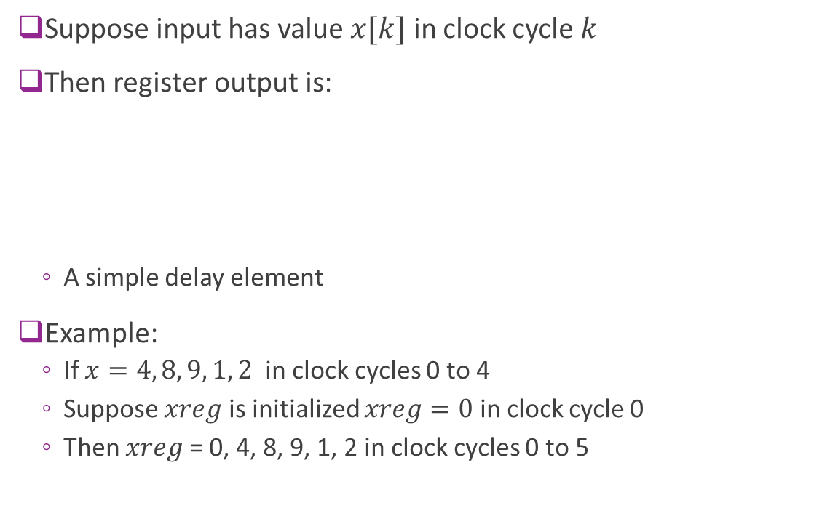
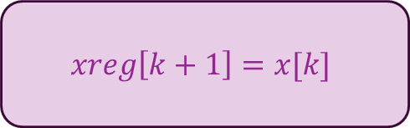
Register: Discrete-Time Model
Suppose input has value $x[k]$ in clock cycle $k$
Then register output is:
A simple delay element
Example:
If $x=4, 8, 9, 1, 2$ in clock cycles 0 to 4
Suppose $xreg$ is initialized $xreg=0$ in clock cycle 0
Then $xreg$= 0, 4, 8, 9, 1, 2 in clock cycles 0 to 5
$$xreg\left[k+1\right]=x[k]$$

Slide 15
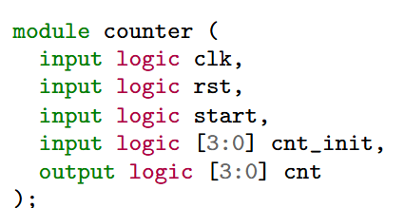
Writing the Counter in System Verilog
The counter is a module
The module definition describes:
Inputs and outputs
Must have a clock input
Typically, also a reset
Does not need the internal state
Unless it happens to be an output

Slide 16
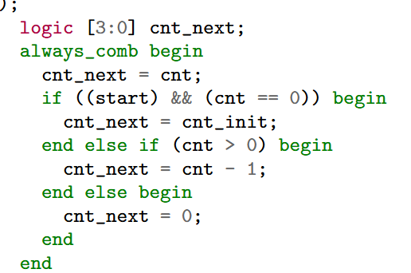
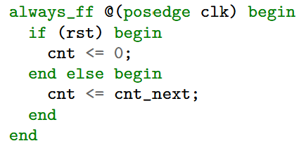
Counter Main Body
Combinational block (always_comb)
Takes current state and input
Describes next state and output
always_ff
Registers values for next state

Slide 17
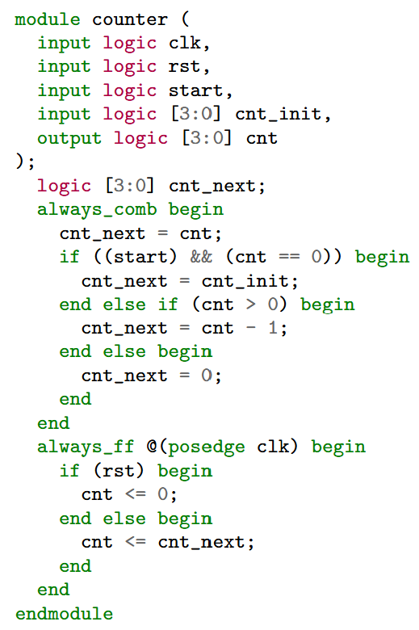
Putting it Together
We now have the FSM description
Three parts
Module declaration
Inputs, outputs
Always_comb block
Describes next state
Always_ff block
Updates state from next_state

Slide 18
Blocking vs. Non-Blocking
Blocking assignment
Use = in SV
Performed sequentially
Assigns temporary (i.e., non-state variables)
Used in always_comb or always_ff block
Non-blocking assignment
Use <= in SV
Assigns registers / states
Only in always_ff block
Always update in parallel

Slide 19
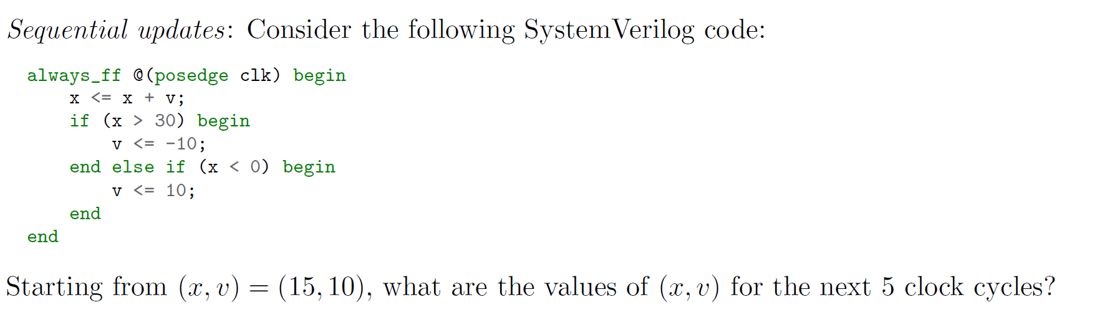
Example Problem

Slide 20
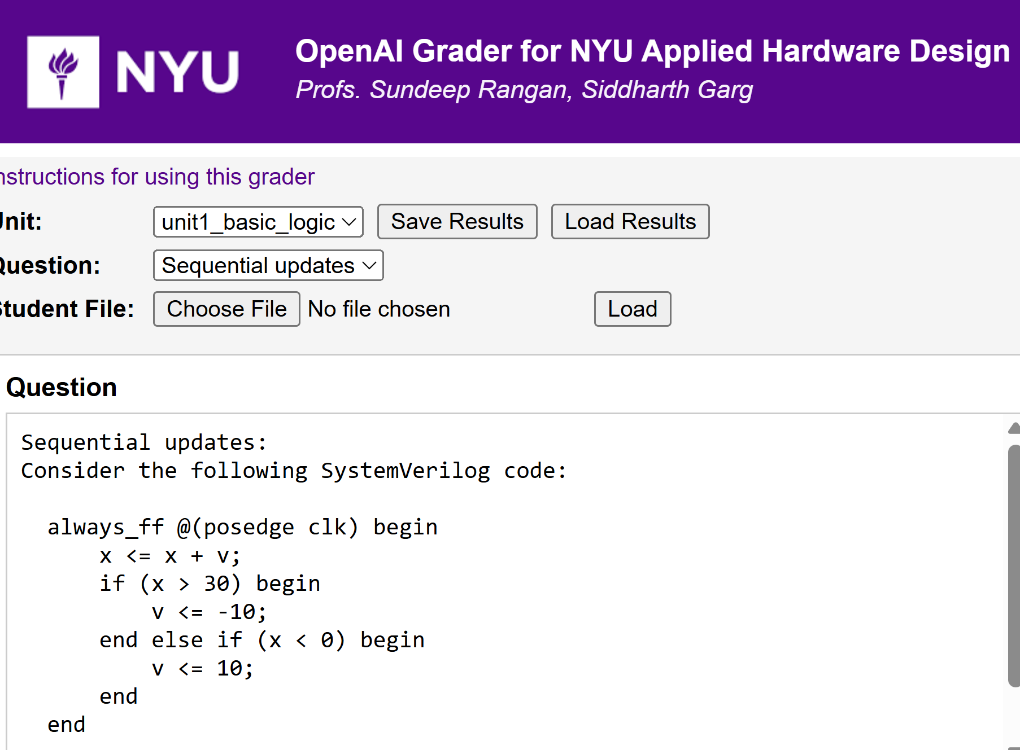
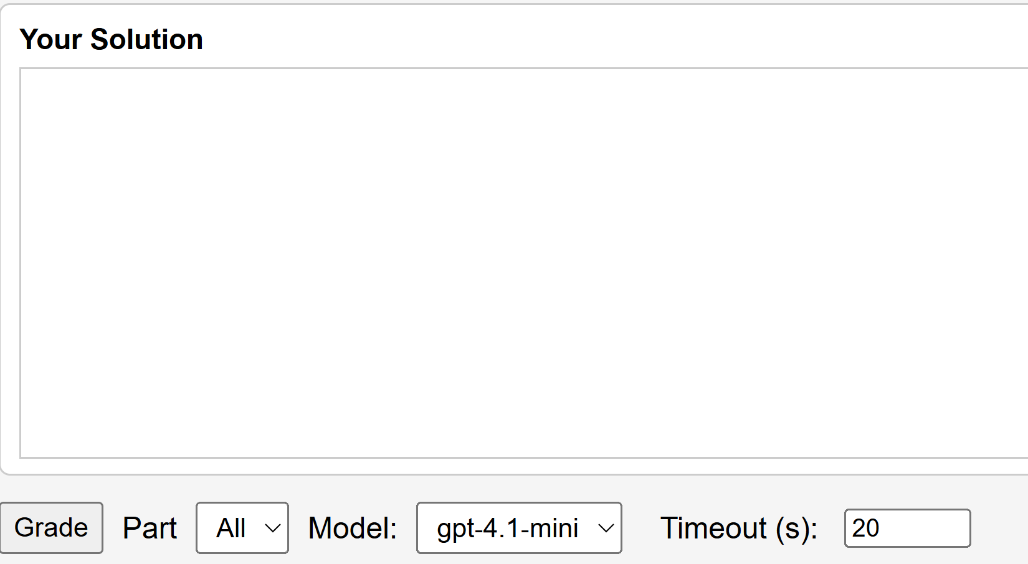
Try Answer on LLM Auto-Grader
Use AI to get instant feedback
Enter your answer
Hit Grade

Slide 21
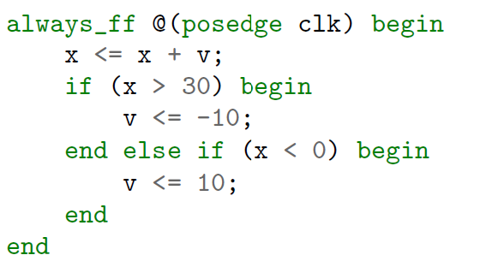

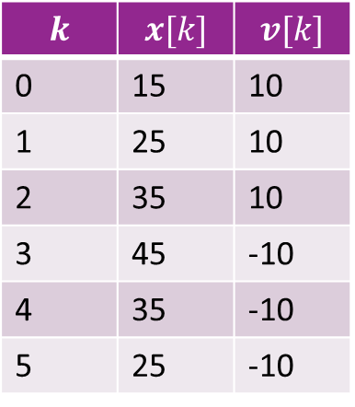

Solution: FSM Model
$$k$$ | $$x[k]$$ | $$v[k]$$
0 | 15 | 10
1 | 25 | 10
2 | 35 | 10
3 | 45 | -10
4 | 35 | -10
5 | 25 | -10
Write the FSM model
Remember: Updates in always_ff are in parallel
Test $x>30$ is based on current cycle value, not next cycle
Equivalent FSM model
$x\left[k+1\right]=x\left[k\right]+v\left[k\right]$ if $x\left[k\right]>30$
$v\left[k+1\right]=−10$
else if ($x\left[k\right]<0)$ $v\left[k+1\right]=10$ $v\left[k+1\right]=v[k]$

Slide 22
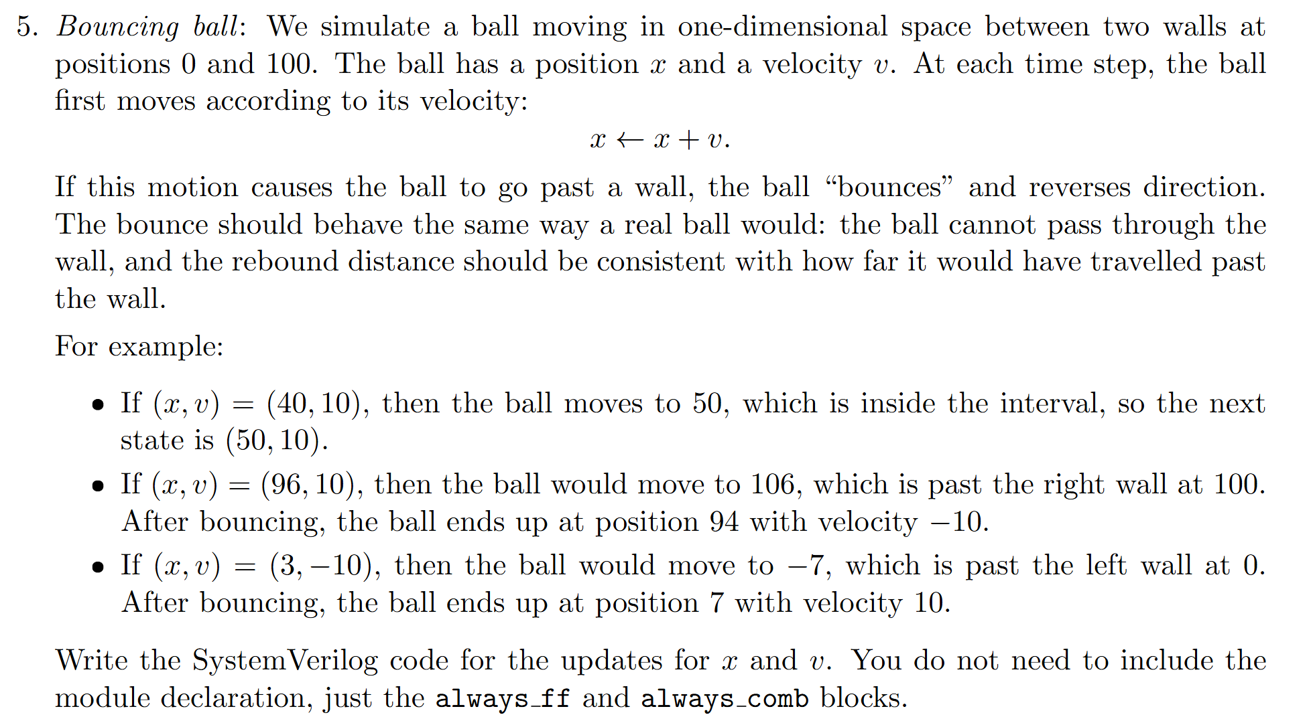
In-Class Exercise

Slide 23
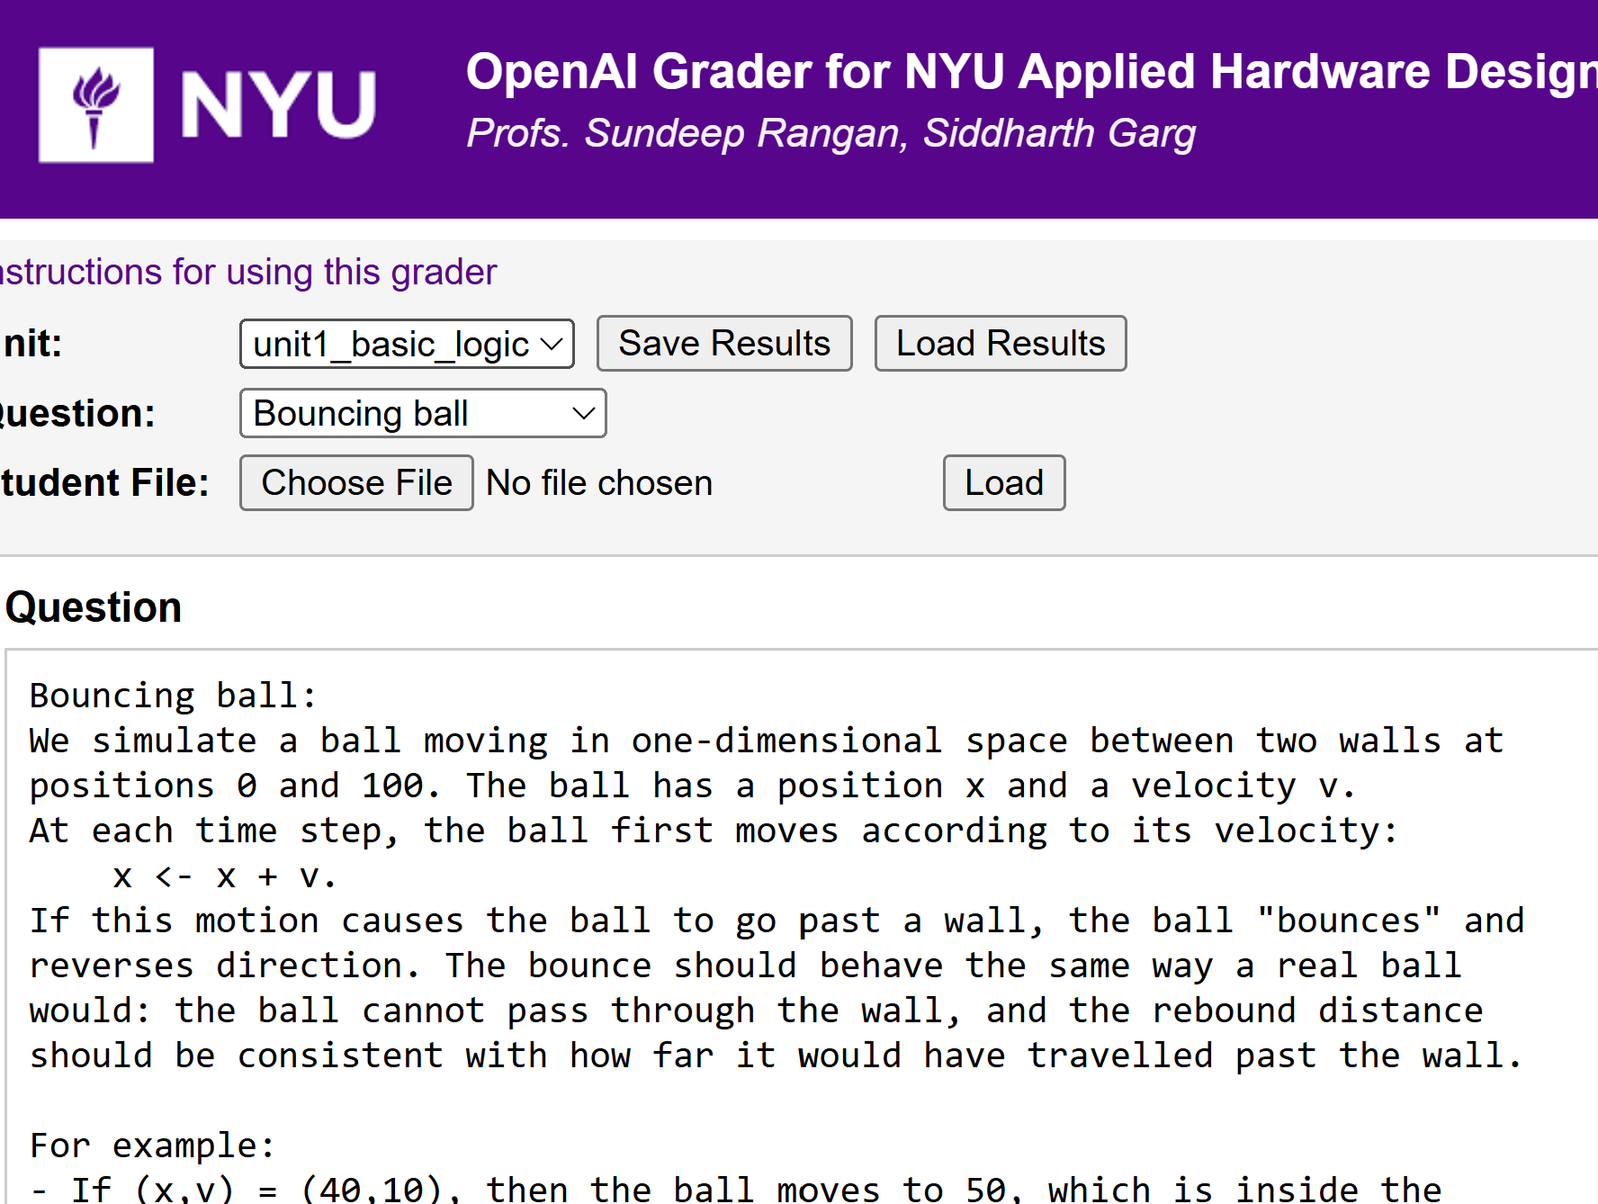
In-Class Exercise
Try answering on the auto-grader

Slide 24
Outline
Combinational Logic
Registers, Clocks and Sequential Logic and Finite State Machines
Splitting Long Computations
Simulating and Synthesizing Modules in Vivado

Slide 25
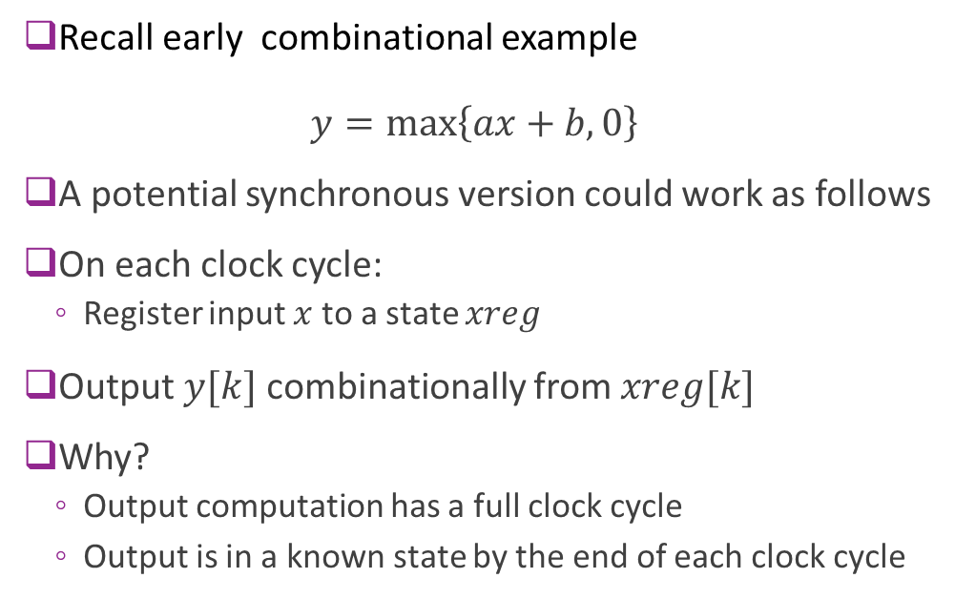
Synchronous Version of ReLU + Linear
Recall early combinational example $y=\max\left\{ax+b, 0\right\}$
A potential synchronous version could work as follows
On each clock cycle:
Register input $x$ to a state $xreg$
Output $y[k]$ combinationally from $xreg[k]$
Why?
Output computation has a full clock cycle
Output is in a known state by the end of each clock cycle

Slide 26
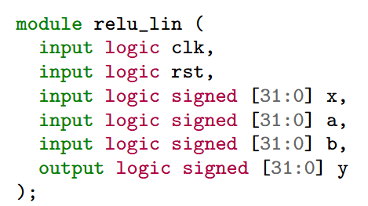
Synchronous Module Declaration
Making module synchronous is easy
First add two inputs to ports
Clock signal
Reset
Clock
Reset

Slide 27
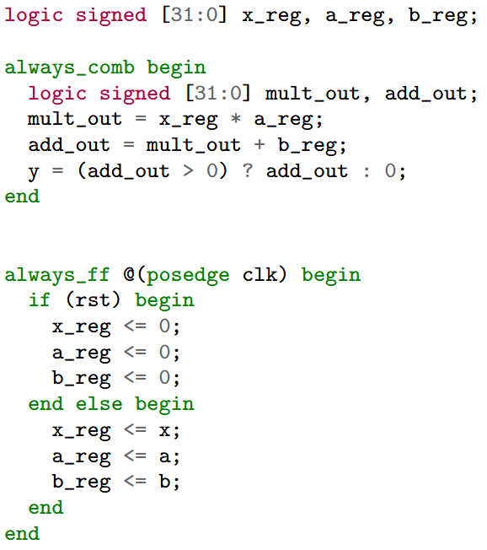
System Verilog Main Body
Synchronous logic has two parts
always_ff:
Assigns register outputs
All operations are in parallel (non-blocking)
Our example: Saves inputs to registers
always_comb:
Assigns signals via combinational logic
Operations are sequential (blocking)
Our example: Computes output from registered inputs

Slide 28
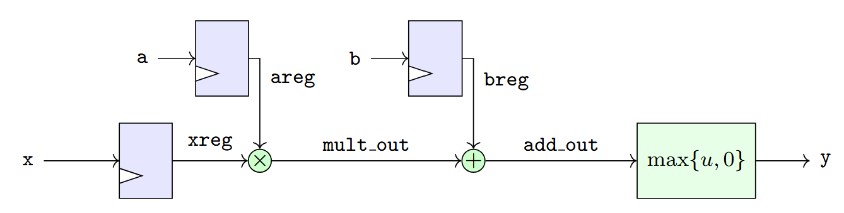
Synchronous Block Diagram
Inputs are registered
Output is combinational from input

Slide 29
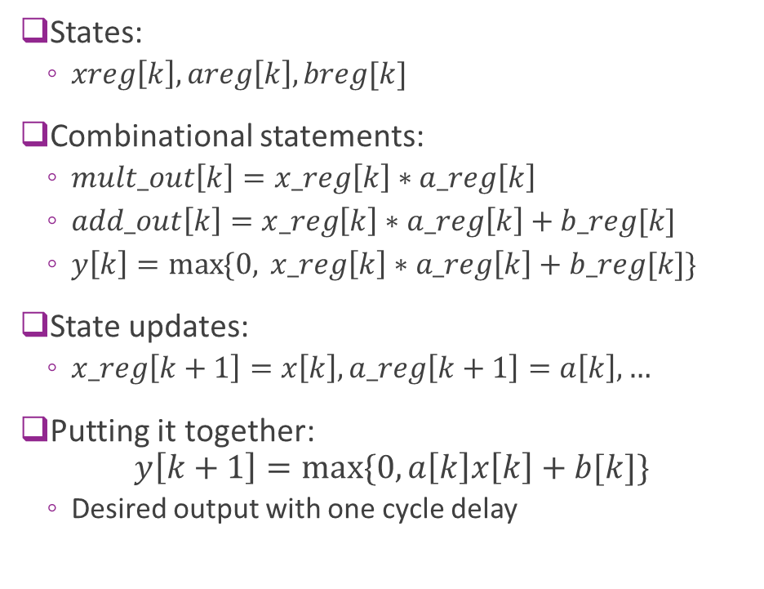
FSM Description
States:
$xreg\left[k\right], areg\left[k\right], breg[k]$
Combinational statements:
$mult_out\left[k\right]=x_reg\left[k\right]∗a_reg\left[k\right]$
$add_out\left[k\right]=x_reg\left[k\right]∗a_reg\left[k\right]+b_reg[k]$
$y\left[k\right]=\max{\{0, }x_reg\left[k\right]∗a_reg\left[k\right]+b_reg[k]\}$
State updates:
$x_reg\left[k+1\right]=x\left[k\right], a_reg\left[k+1\right]=a\left[k\right], …$
Putting it together: $y\left[k+1\right]=max⁡\{0, a\left[k\right]x\left[k\right]+b[k]\}$
Desired output with one cycle delay

Slide 30
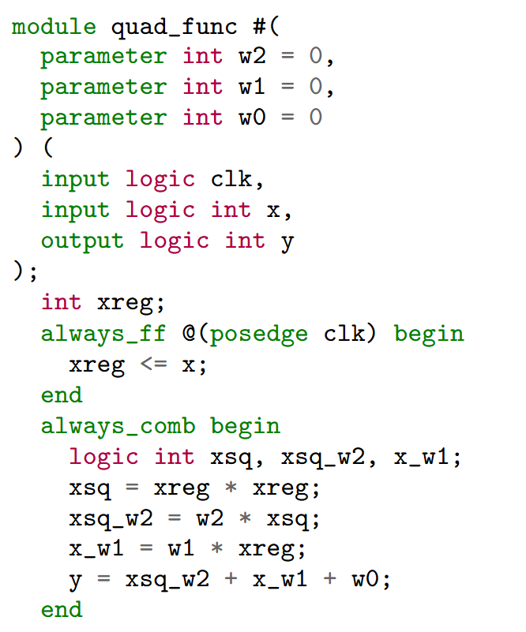
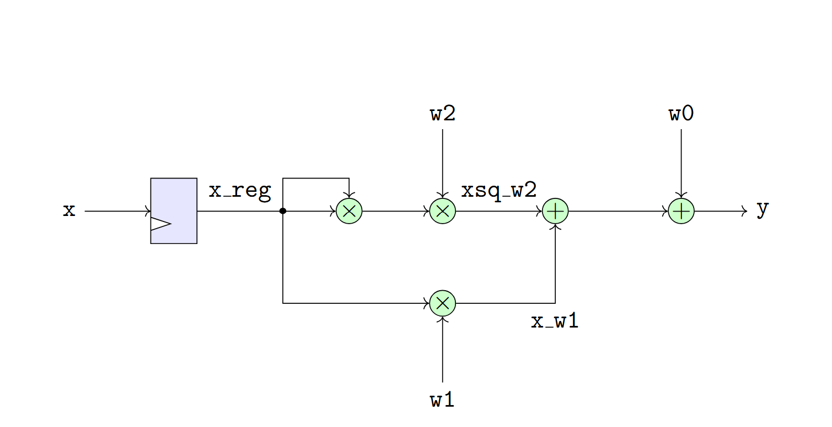

A More Complex Example
Consider a quadratic function: $y=w_{2}x^{2}+w_{1}x+w_{0}$
For simplicity, assume $w_{0},w_{1},w_{2}$ are fixed parameters
Single cycle implementation to the right

Slide 31
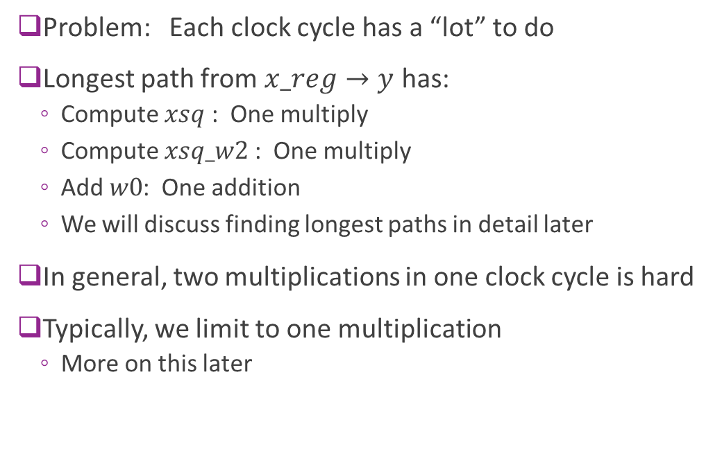
Problems with Single Cycle Implementation
Problem: Each clock cycle has a “lot” to do
Longest path from $x_reg→y$ has:
Compute $xsq$ : One multiply
Compute $xsq_w2$ : One multiply
Add $w0$: One addition
We will discuss finding longest paths in detail later
In general, two multiplications in one clock cycle is hard
Typically, we limit to one multiplication
More on this later

Slide 32
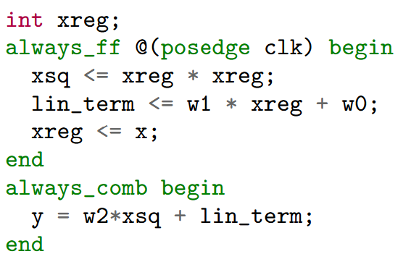
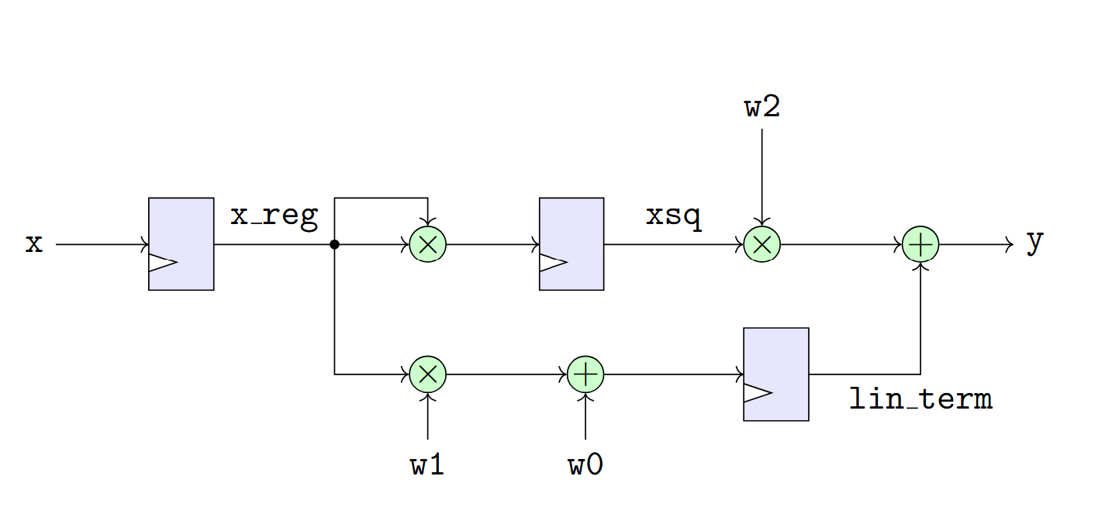
A Two Cycle Design
We can reduce the computation per cycle by breaking operation in two cycles
Register two intermediate terms:
xsq = xreg * xreg
lin_term = w1*xreg + w0

Slide 33
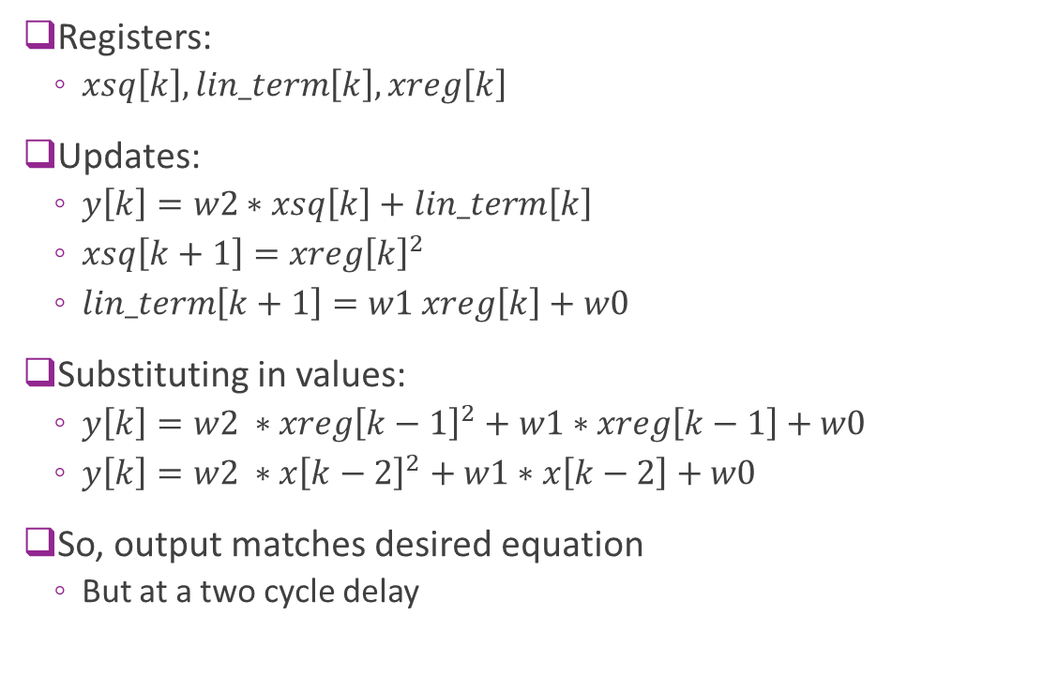
Analysis
Registers:
$xsq\left[k\right], lin_term\left[k\right], xreg\left[k\right]$
Updates:
$y\left[k\right]=w2∗xsq\left[k\right]+lin_term\left[k\right]$
$xsq\left[k+1\right]=xreg{\left[k\right]}^{2}$
$lin_term\left[k+1\right]=w1 xreg\left[k\right]+w0$
Substituting in values:
$y\left[k\right]=w2 ∗xreg{\left[k−1\right]}^{2}+w1∗xreg\left[k−1\right]+w0$
$y\left[k\right]=w2 ∗x{\left[k−2\right]}^{2}+w1∗x\left[k−2\right]+w0$
So, output matches desired equation
But at a two cycle delay

Slide 34
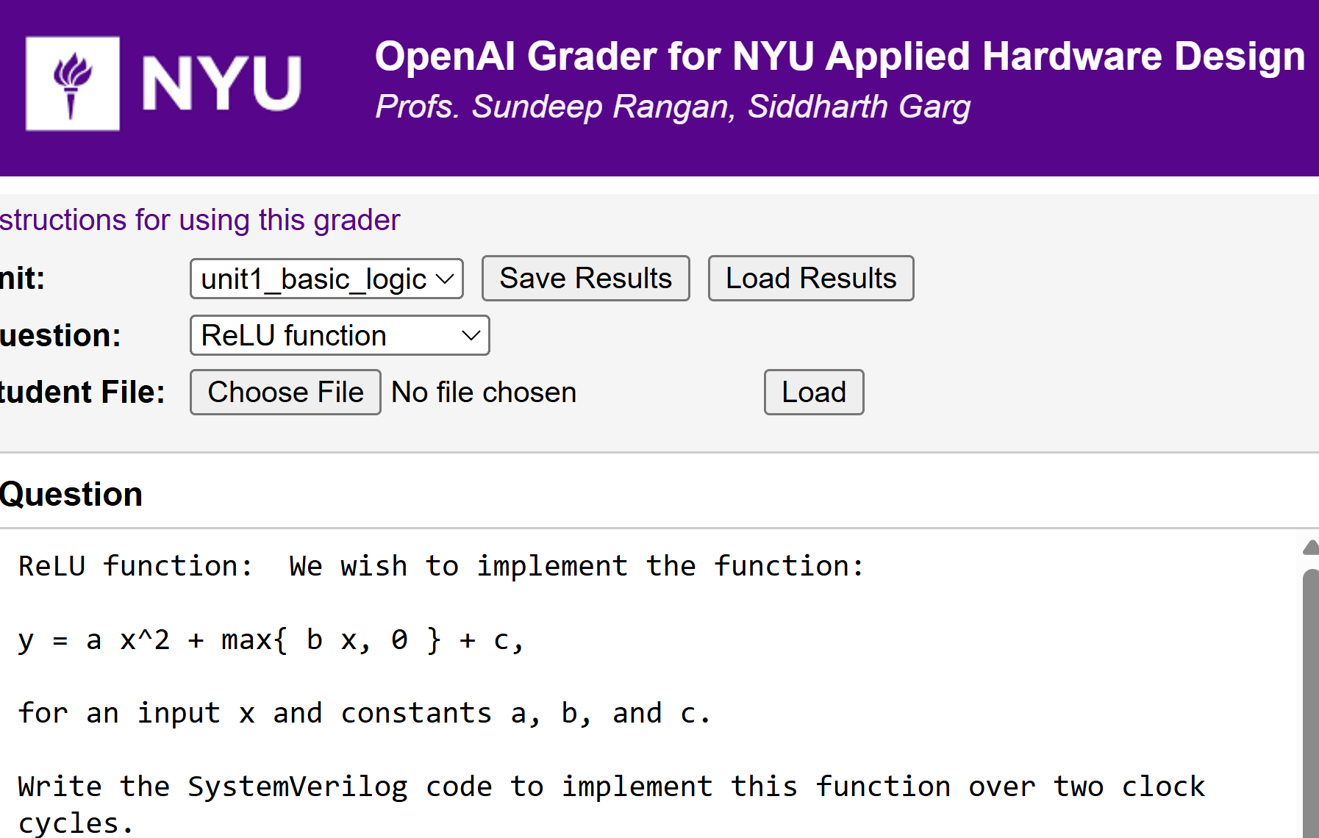
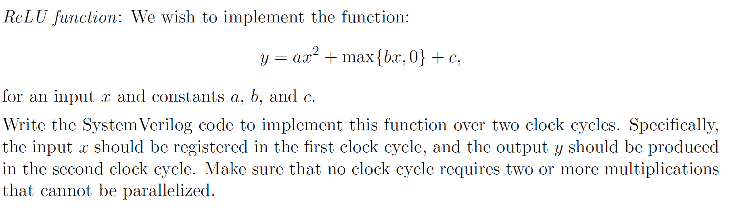

In Class Problem
Hint:
Write the computation graph for $x→y$
Add registers at input and intermediate variables

Slide 35
Outline
Combinational Logic
Registers, Clocks and Sequential Logic and Finite State Machines
Splitting Long Computations
Simulating and Synthesizing Modules in Vivado

Slide 36
Building the Hardware Roadmap
Design
Design:
Write a behavioral description (e.g., in SV)
What should the module should do exactly?
Functional simulation
Validate module does what it is supposed to do?
Logical mapping from inputs to outputs
Synthesis
Map the description into real hardware
Gates, FPGA components, …
Next steps
Place route, timing analysis, bitstreams, …
Functional simulation
This unit
Synthesis
Next steps
Later units…

Slide 37
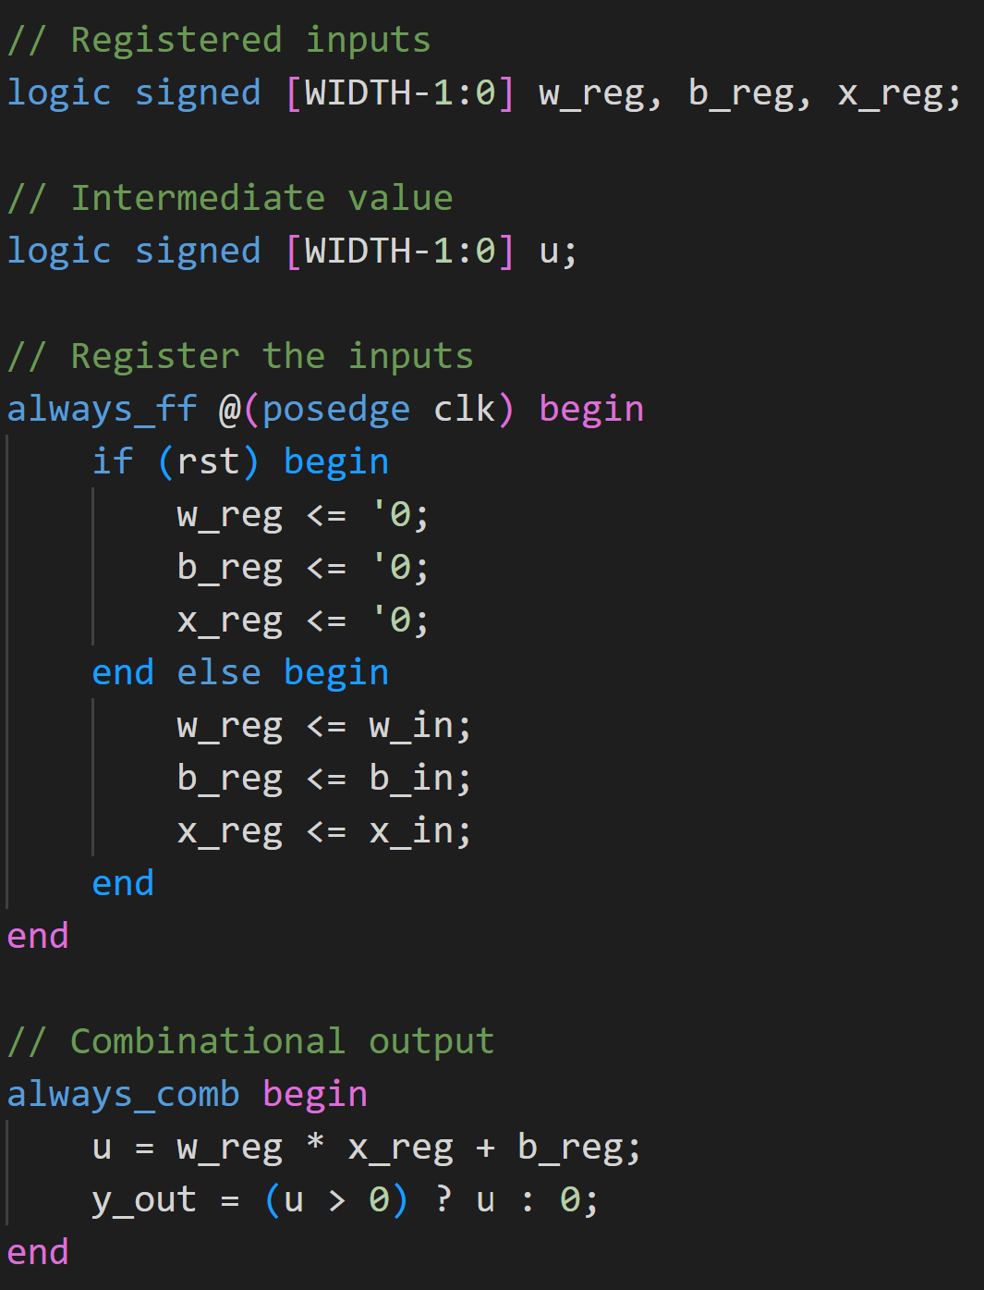
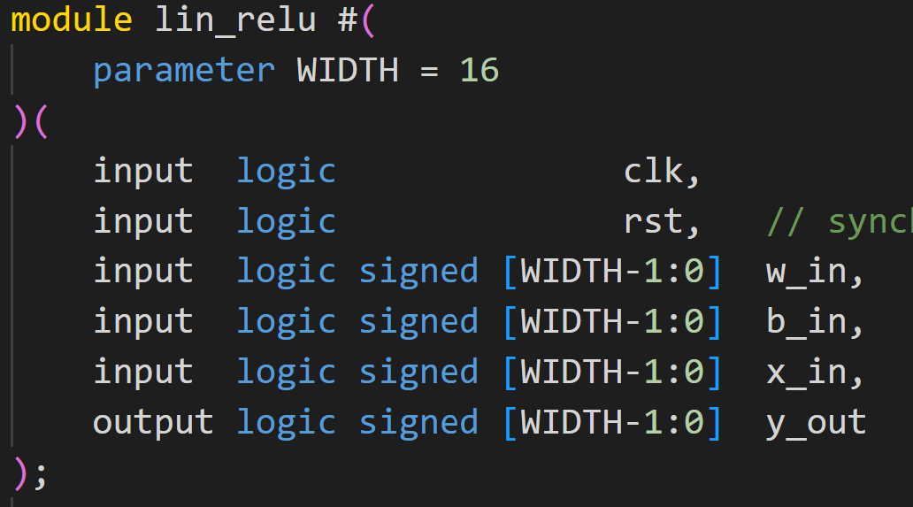
Linear+ReLU Example
All files in github repo: hwdesign/demos/fsm
Define counter in file counter.sv

Slide 38
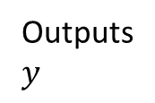
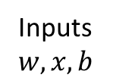
Next Step: Build a Testbench
Testbench
A second SV module
Connects to device under test (i.e, module we want to test)
TB provides DUT inputs
TB verifies DUT outputs are correct
Inputs $w, x, b$
Outputs $y$
Testbench tb_lin_rely.sv
DUT lin_relu.sv

Slide 39
Testbenches are not Synthesized
Testbenches are for simulation only
They will not be synthesized
Can include un-synthesizable constructs
Print statements
File read and write
Complex data structures
Modern trend:
Write TB in higher level language
E.g., python
Inputs $w, x, b$
Outputs $y$
Testbench tb_lin_rely.sv
DUT lin_relu.sv

Slide 40
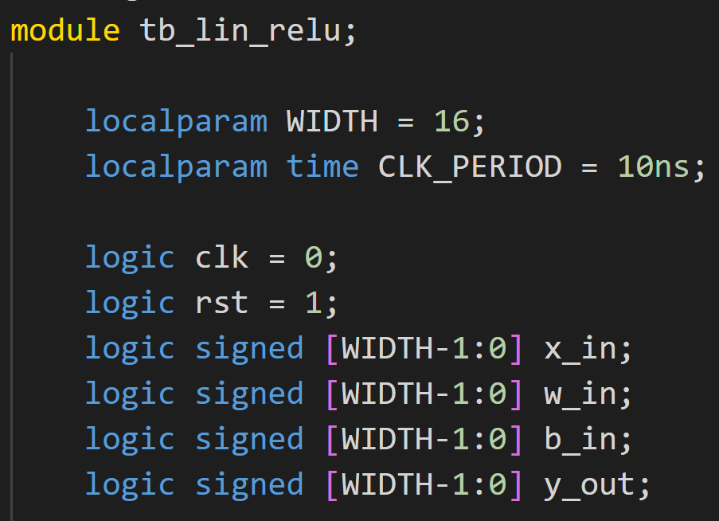
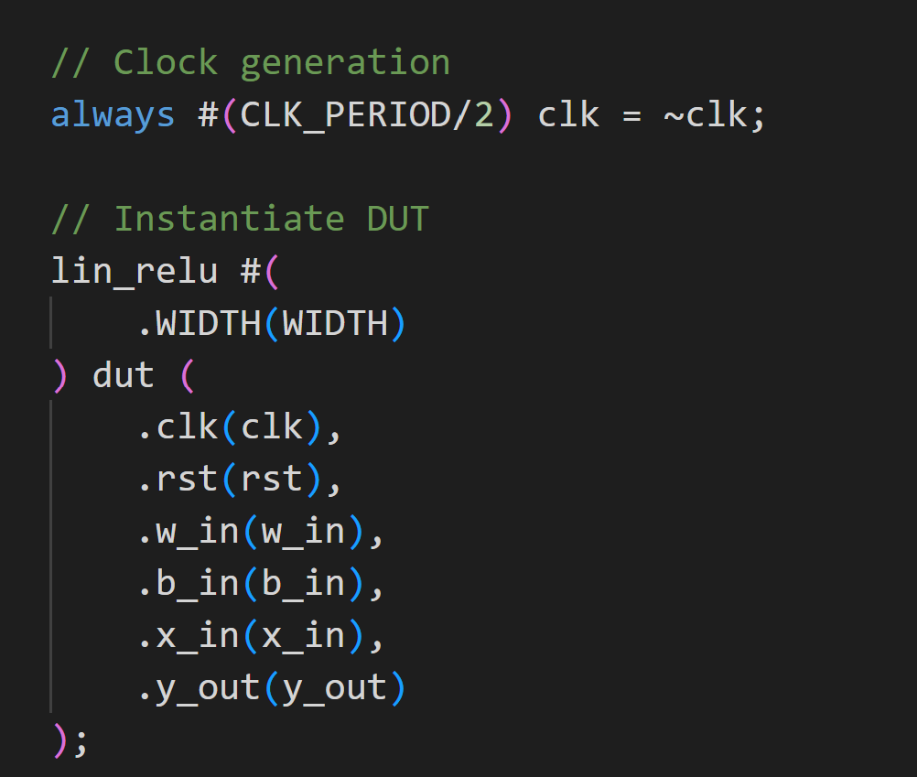
Testbench Declaration
Testbench: a module to test the module
Will not be synthesized
Can have un-synthesizable constructs
Ex: Read / write from file
Create a clock
Instantiate an instance of module to test
Called the DUT = device under test
Connect DUT to testbench signals

Slide 41
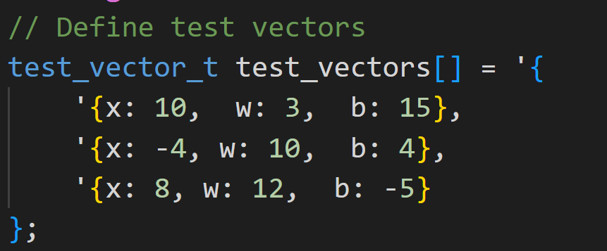
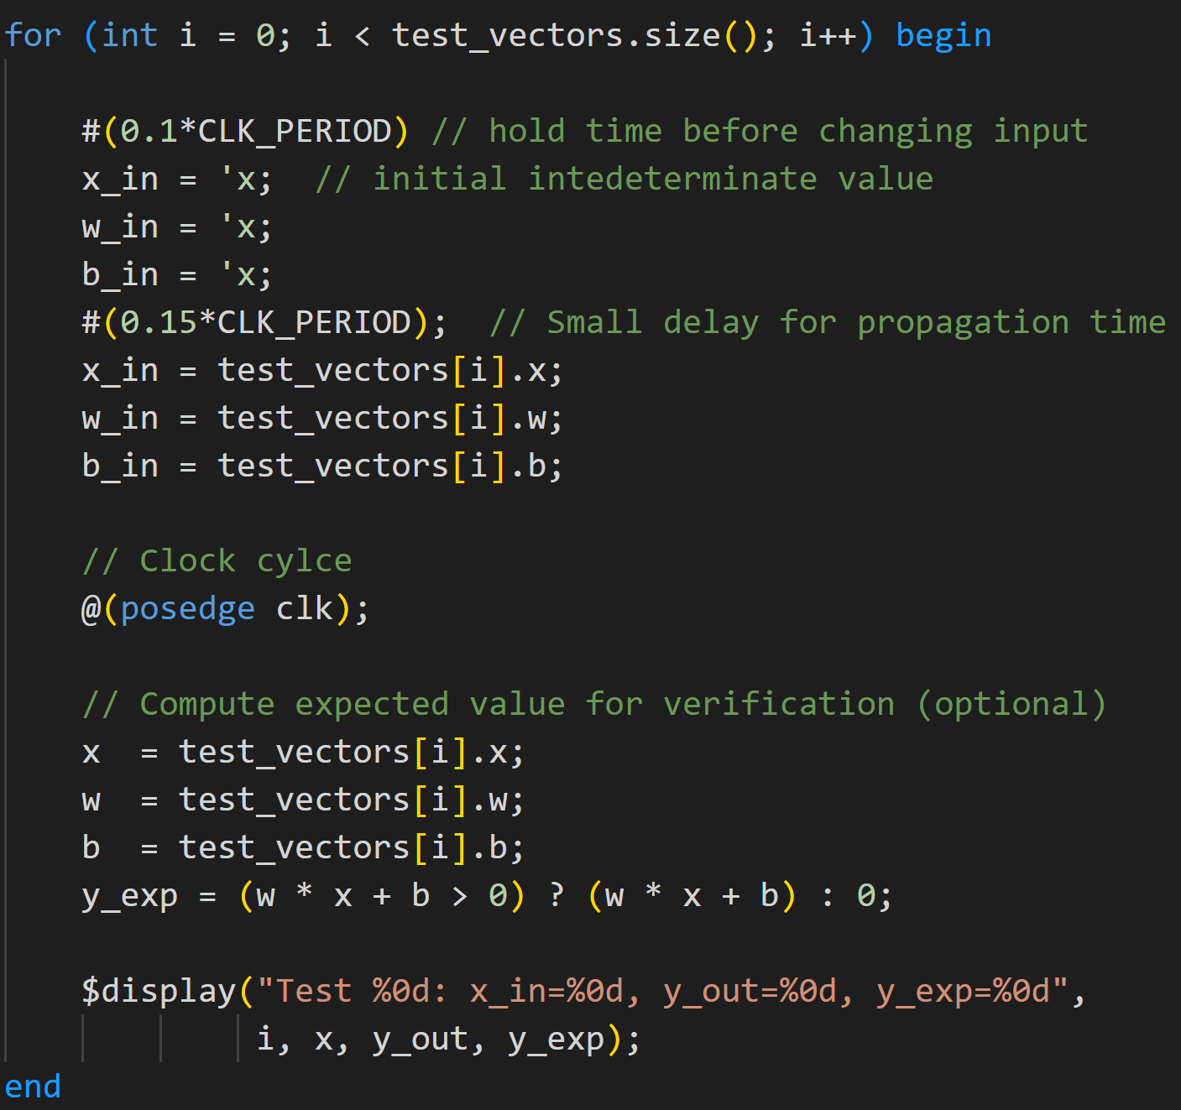
Test Vectors
Create a set of test inputs
Loop through inputs
Put one new input each clock cycle
Testbench uses an initial construct
Enables sequential set of events

Slide 42
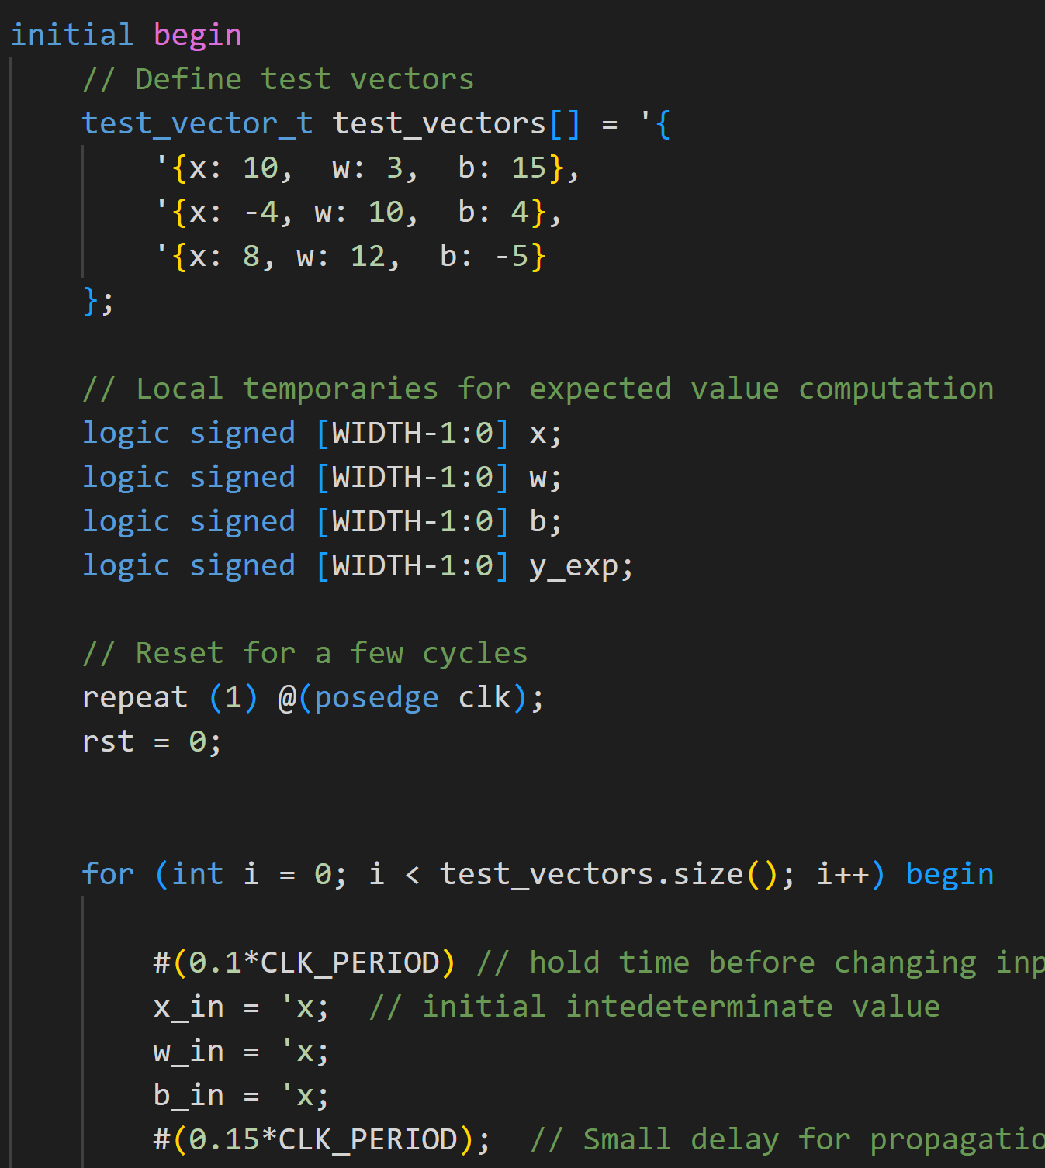
Initial Block
Runs once at time 0 of the simulation
(or at its scheduled start time if delayed).
Statements inside run sequentially
like a small program.
Not synthesizable for hardware
Simulation‑only construct.
Used for test benches
Concurrency:
initial blocks and always blocks.

Slide 43
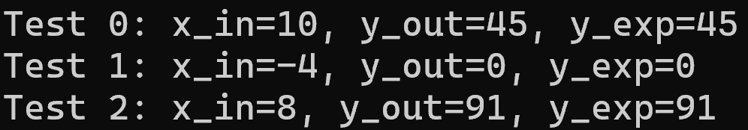
Test Results
Test results outputs
Match expected values

