Slide 1
Unit 5 FIFOs and Streaming Interfaces
EL-GY 9463: Introduction to Hardware Design
ProfS. Sundeep Rangan, Siddharth Garg

Slide 2
Learning Objectives
Describe the operation and work out the timing of FIFO reads and writes
Describe and simulate the AXI4-Streaming protocol
Pure streaming interfaces
Packetized streaming interfaces
Design simple streaming modules in Vitis HLS
Design robust command and response packets with:
Transactions IDs for detecting missed packets and error codes
Write serialization and deserialization methods
Manually and using an interface description language
Implement packet-based streaming modules in Vitis HLS

Slide 3
Outline
FIFO Interfaces
AXI4 Pure Streaming Interface
Limitations of Pure Streaming with Vitis
AXI4 Packetized Streaming

Slide 4
FIFO Motivation
To motivate FIFOs, we review two problems we have encounter
Problem 1: Low throughput on transfers with handshakes
Problem 2: Idle time on systems with polling

Slide 5
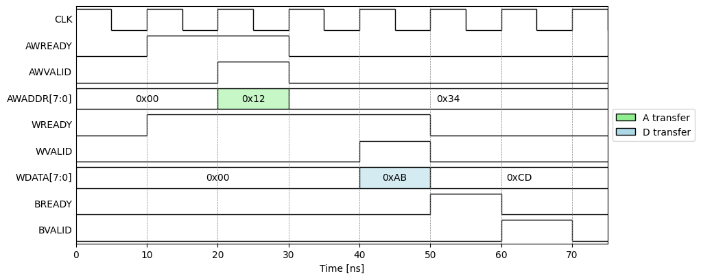
Problem 1: Handshaking Overhead
Last Unit: Transfers with handshake
Slave asserts READY
Master assert VALID
AXI4-Lite
Each read or write takes 2 to 4 cycles
Provides:
Guaranteed delivery
Flow control
But adds overhead
Transaction 4 cycles

Slide 6
Problem 2: Polling-Based Execution
Execution model in previous unit:
PS writes input data
PS sets ap_start
IP processes data
PS poll ap_ready until complete
PS reads output
Processing System (PS)
VITIS HLS IP
Write input
ap_start
ap_ready
Read output

Slide 7
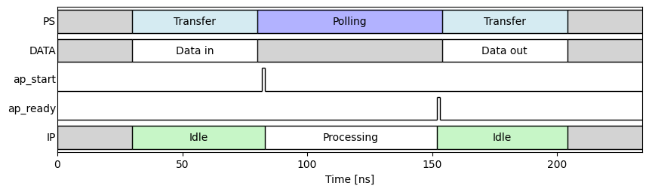
Problem 2: Time Wastage
Several overhead times on both the PS and IP
Transfer: PS spends time transferring data in and out of IP
Polling: PS must poll while IP is processing
Idle: IP is idle during transfer and wait for control

Slide 8
FIFO
FIFO (First-In First-Out) hardware queue
Stores data from a producer in order of arrival
Returns data to a consumer in same order
Decouples producer and consumer timing
Each side can run at their own pace
Built-in flow control
Producer checks if FIFO is full
Consumer checks if FIFO is not empty
Absorbs bursts of data
Enables streaming behavior
Producer
Consumer

Slide 9
FIFO Terminology
Producer: Module that writes to FIFO
Each write adds an element
Consumer: Modules that reads from FIFO
Each read removes an element
Element: Logical item stored in the FIFO
Element width: Size of each element
Typically, in bytes or bits
Depth: Maximum number of elements
Producer
Element width
Depth
FIFO element
Consumer

Slide 10
FIFO Order
Suppose FIFO writes A, B, C
Then:
A is at the head of the queue
C is at the tail
Consumer reads from the head
Will read in order A, B, C
Same order as the write
Producer writes A, B, C, …
Tail
C
B
Head
A
Consumer reads A, B, C

Slide 11
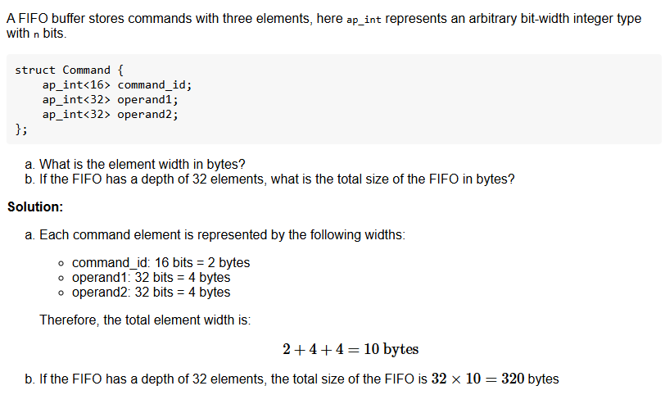
Example Problem

Slide 12
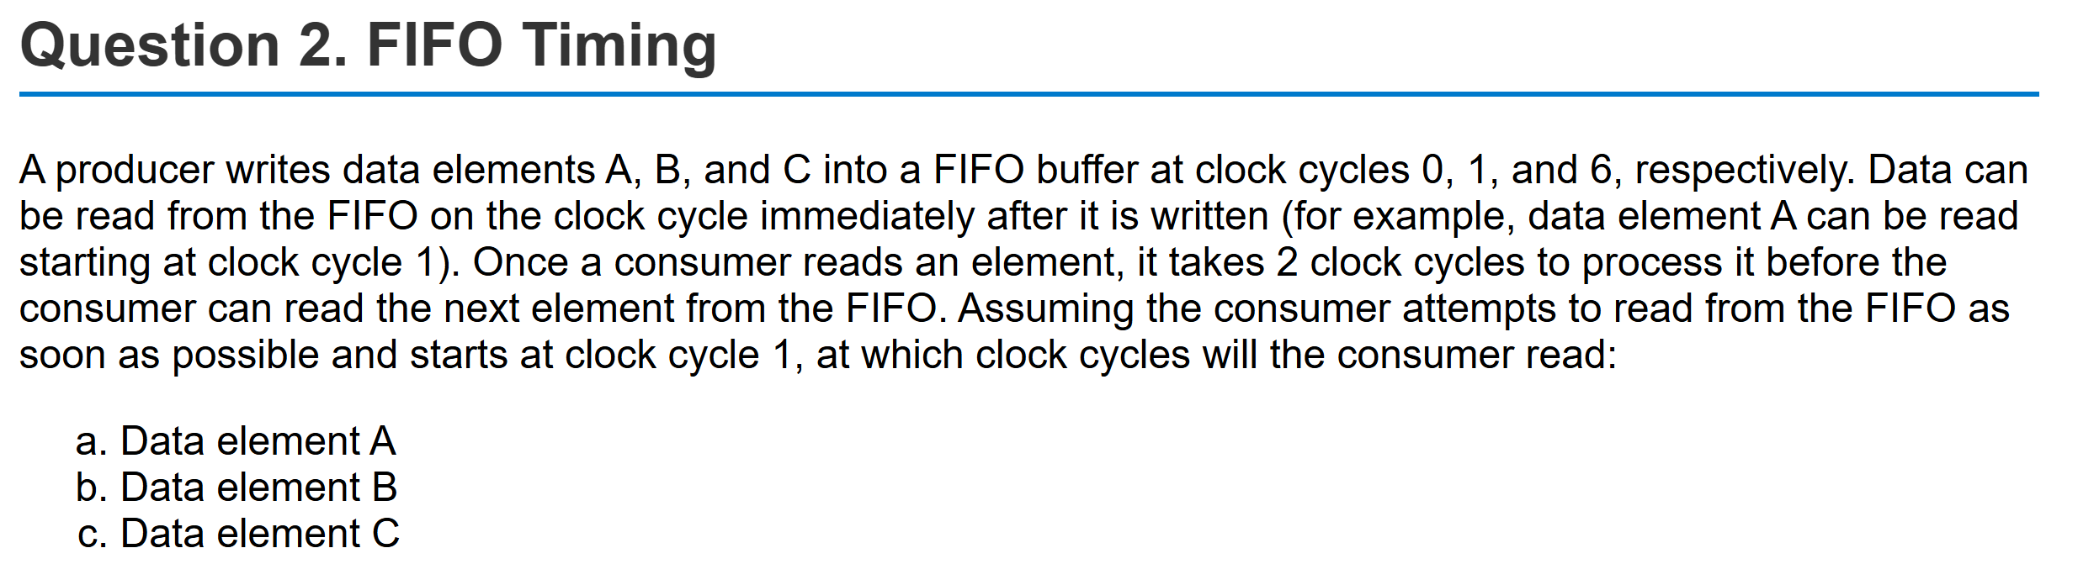
Example Problem

Slide 13
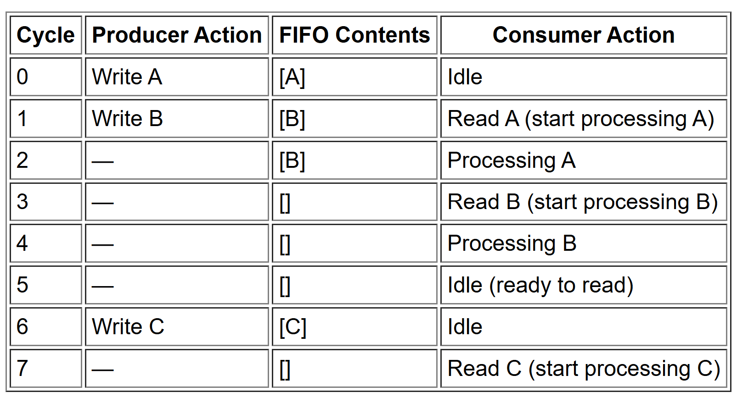
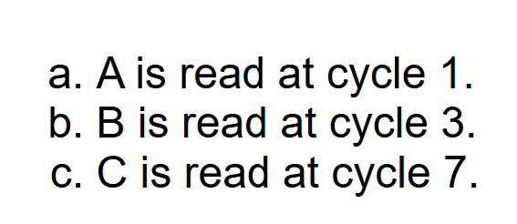
Solution

Slide 14
FIFO Overflow
Producer
Suppose producer tries to write an element when FIFO is full
Two possible behaviors
Blocking write
FIFO signal not READY
Producer waits
Default behavior in most hardware interfaces (including AXI-Stream)
Also called stall, backpressure or flow control
Drop
Drops some packet in queues
Head, tail, or random
Common in network routers
Consumer

Slide 15
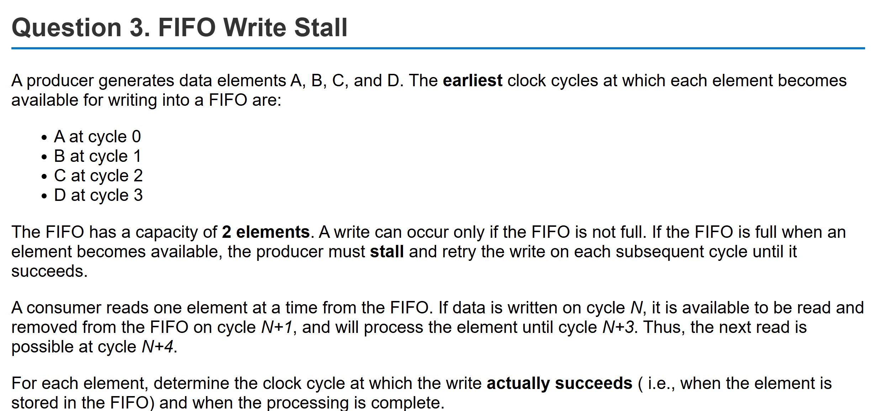
Example Problem

Slide 16
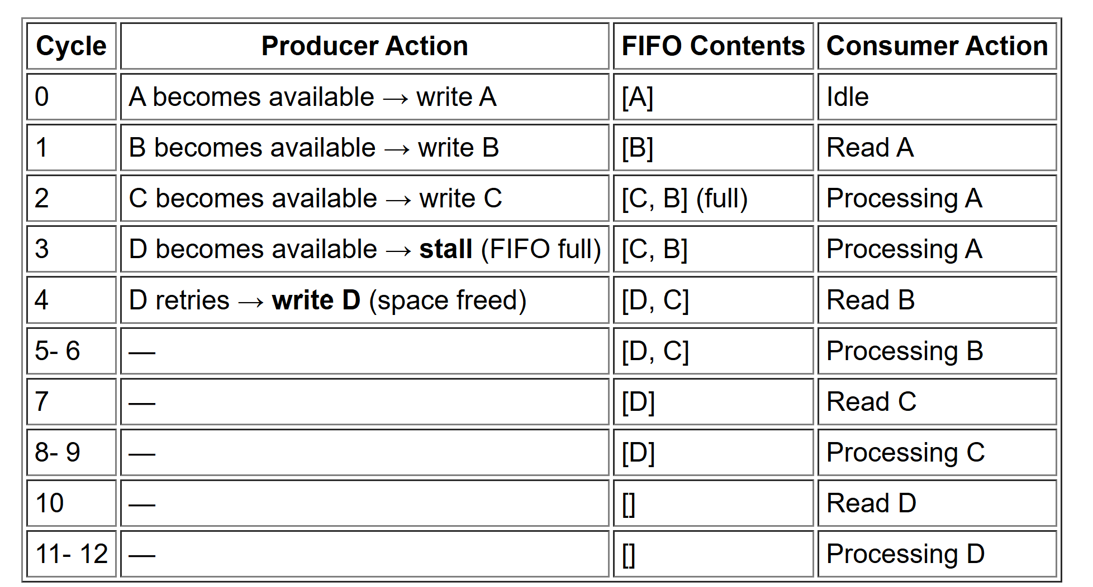
Solution

Slide 17
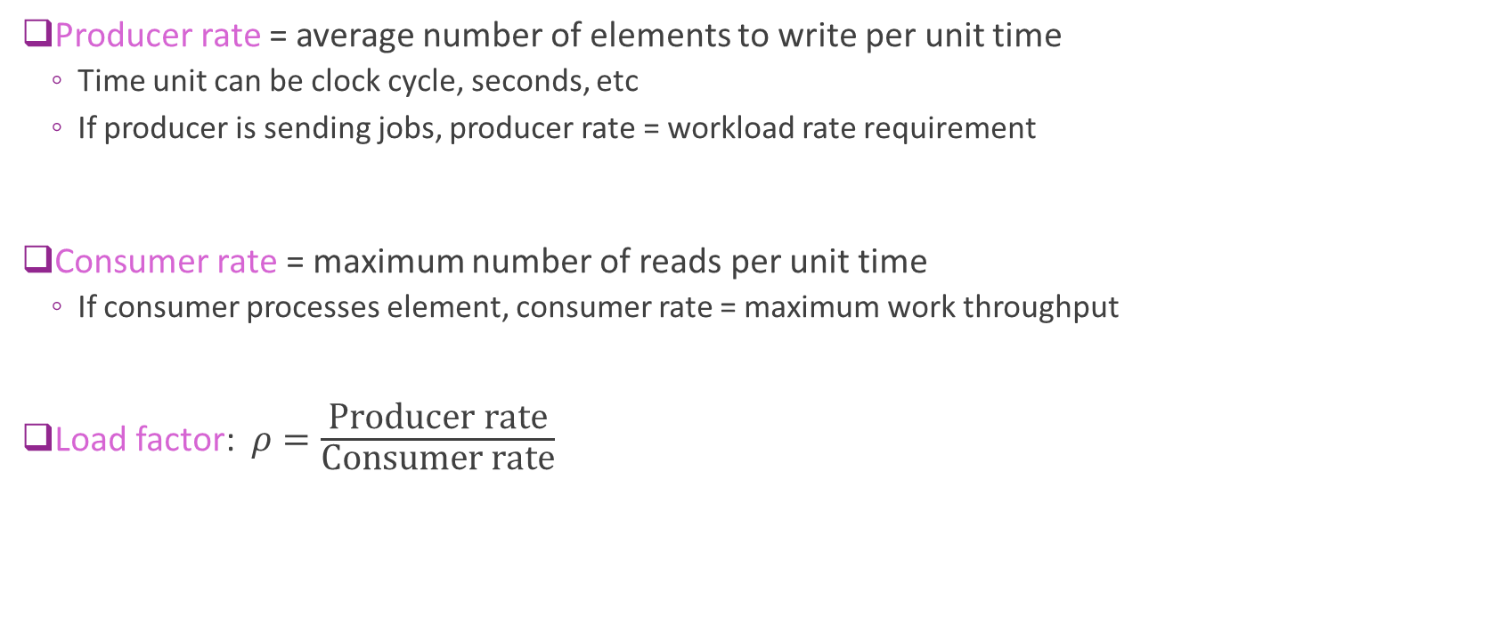
Producer and Consumer Rate
Producer rate = average number of elements to write per unit time
Time unit can be clock cycle, seconds, etc
If producer is sending jobs, producer rate = workload rate requirement
Consumer rate = maximum number of reads per unit time
If consumer processes element, consumer rate = maximum work throughput
Load factor: $ρ=\frac{\text{Producer} \text{rate}}{\text{Consumer} \text{rate}}$

Slide 18
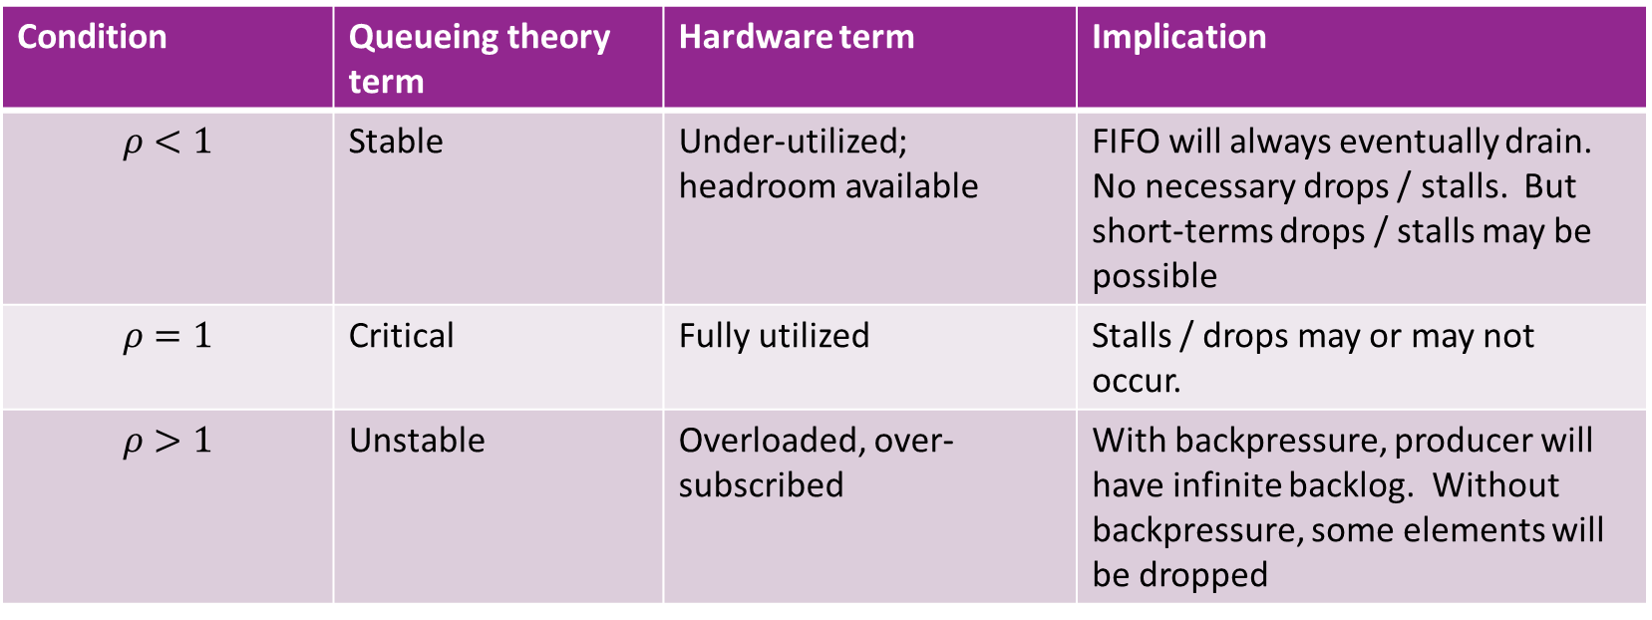
Load Factor and Stability
Condition | Queueing theory term | Hardware term | Implication
$$ρ<1$$ | Stable | Under-utilized; headroom available | FIFO will always eventually drain. No necessary drops / stalls. But short-terms drops / stalls may be possible
$$ρ=1$$ | Critical | Fully utilized | Stalls / drops may or may not occur.
$$ρ>1$$ | Unstable | Overloaded, over-subscribed | With backpressure, producer will have infinite backlog. Without backpressure, some elements will be dropped

Slide 19
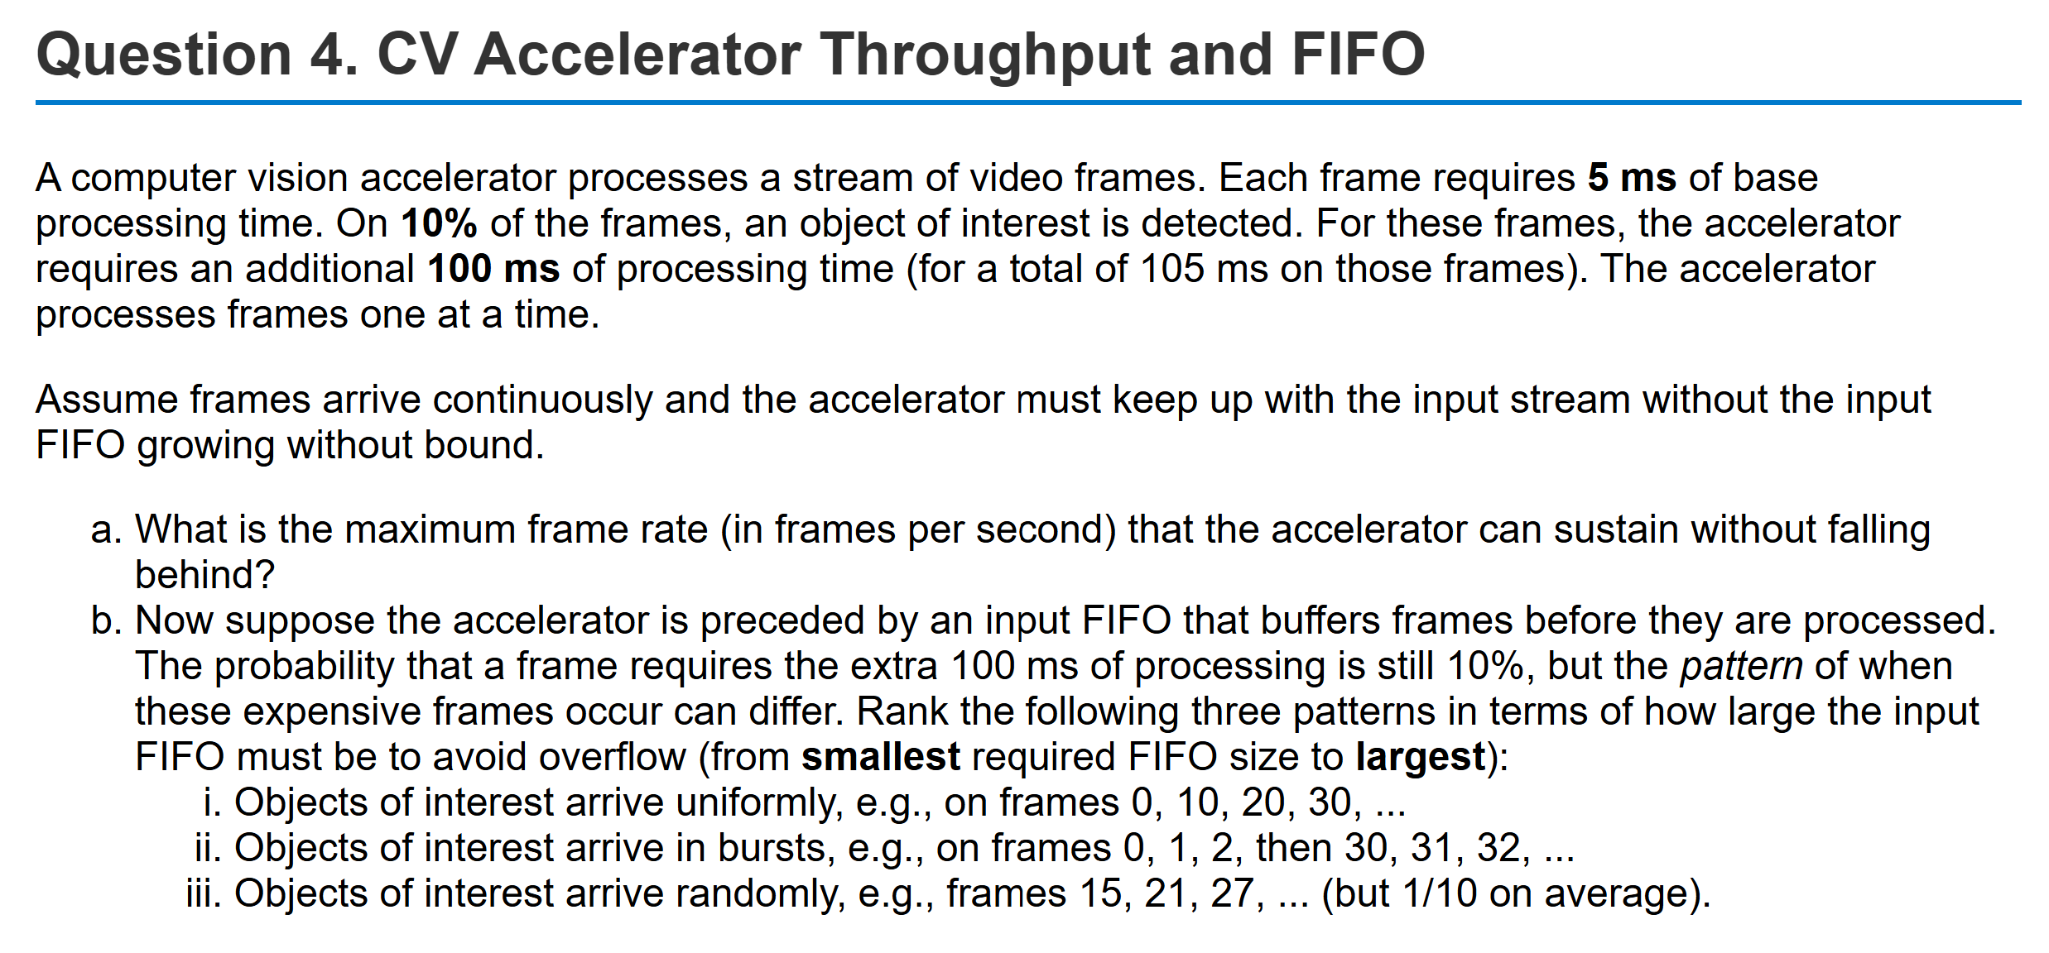
Sample Problem

Slide 20
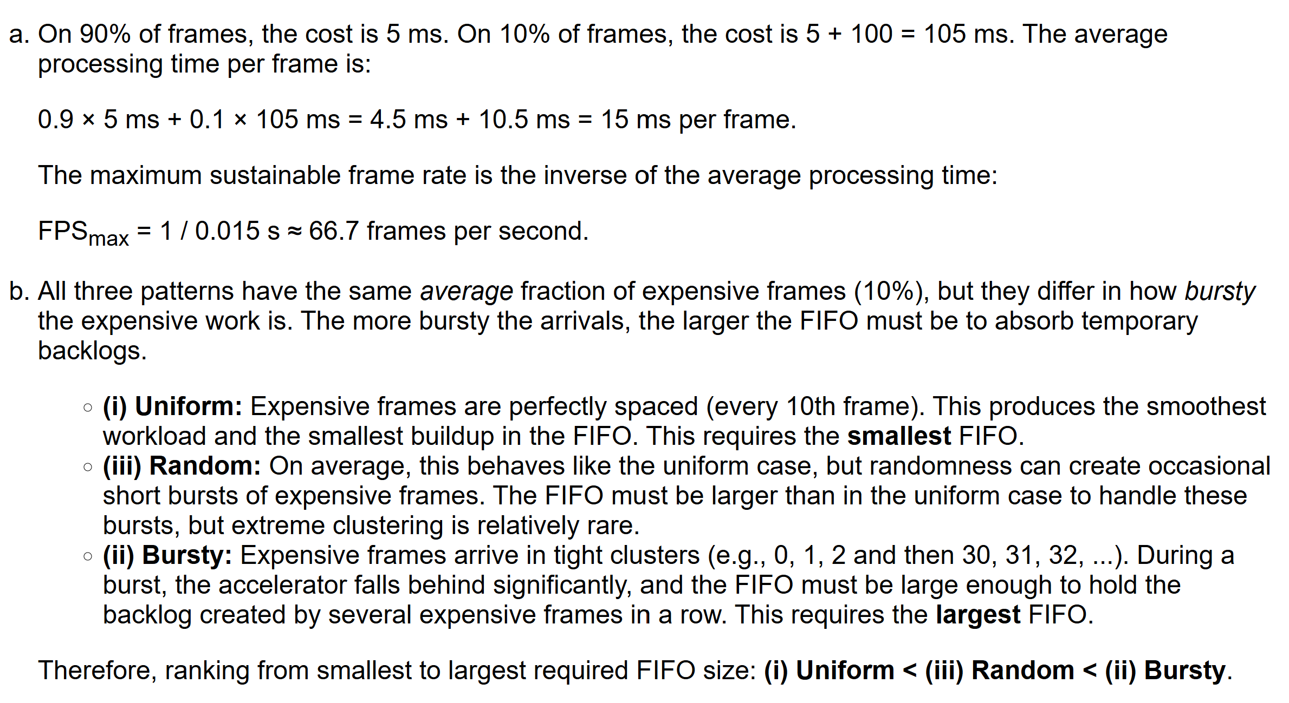
Solution

Slide 21
Queueing Theory
Models arrivals and departures probabilistically
Used widely in networking research
Determine probabilities of buffer overflow
Optimal routing and drop policies
Also used in network on chip
But requires mathematics
Markov chains, probability
Take NYU’s networking theory class if interested

Slide 22
Outline
FIFO Interfaces
AXI4 Pure Streaming Interface
Limitations of Pure Streaming with Vitis
AXI4 Packetized Streaming

Slide 23
Problem 1: Handshaking Overhead
Last Unit: Transfers with handshake
Slave asserts READY
Master assert VALID
AXI4-Lite
Each read or write takes 2 to 4 cycles
Provides:
Guaranteed delivery
Flow control
But adds overhead
Transaction 4 cycles

Slide 24
Solution: Streaming FIFO Interface
Consider a PS sending jobs to accelerator
Use FIFOs for jobs and responses
Decouples for timing
Transfer of data of the PS
Processing of data in the HW
Enables efficient burst transfers
Many elements can be transferred at once
Reduces handshaking overhead
Both PS and HW run at their own pace
If some jobs need a lot of time
Job FIFO buffers the jobs to process
Processing System
Hardware accelerator
Job FIFO
Processing Engine
Response FIFO

Slide 25
AXI4-Streaming Protocol
Industry standard streaming protocol
Available as the interface to many Xilinx IP blocks
Pre-built in Vitis HLS
All FIFO management is done for you
Part of the AXI4 family:
AXI4-Lite: Covered last unit
AXI4-Stream: This unit
AXI4-Memory mapped: Later
Provides a simple interface with DATA, READY, VALID
Additional capabilities (covered later in this unit):
Packetization
Addressing
Processing System
Hardware accelerator
Command AXI4-stream
Processing Engine
Response AXI4-stream

Slide 26
AXI4-Stream Terminology
MASTER
SLAVE
FIFO
AXI4-Stream
Each AXI4-Stream is uni-directional
Master is the producer / sender
Could be PS sending jobs or HW accelerator returning responses
Slave is the consumer / receiver
Could be PS receiving response or HW accelerator receiving jobs
FIFO is typically realized on the

Slide 27
AXI4-Stream Protocol
MASTER
SLAVE
Slave asserts TREADY on any cycle it can accept data
Typically, when FIFO has space
On any cycle has data to transfer, master:
Places data on TDATA
Asserts TVALID
If TREADY=TVALID=1, there is a transfer
Otherwise, master can re-assert TVALID on next cycle
Slave processes FIFO at its own pace
Backpressure to master via TREADY
Can transfer up to data element
TREADY
FIFO
TDATA
TVALID

Slide 28
Example Timing
Cycle | Master action | TVALID | TREADY | FIFO | Slave action | TREADY for next cycle
0 | Transfer A | 1 | 1 | [A] | - | 1
1 | Transfer B | 1 | 1 | [B] | Read A | 1
2 | Transfer C | 1 | 1 | [C,B] | Process A | 0
3 | D stalls | 1 | 0 | [C] | Read B | 1
4 | Transfer D | 1 | 1 | [D,C] | Process B | 0
5 | E stalls | 1 | 0 | [D] | Read C | 1
6 | Transfer E | 1 | 1 | [E,D] | Process C | 0
Master always has data
TVALID=1 always
Slave takes 2 cycles to:
Read data
Process data
FIFO depth = 2

Slide 29

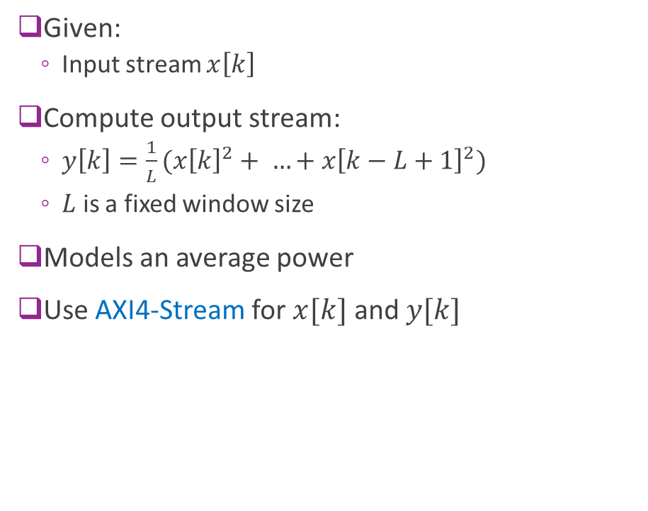

Example: Streaming Squared Average
Given:
Input stream $x\left[k\right]$
Compute output stream:
$y\left[k\right]=\frac{1}{L}(x{\left[k\right]}^{2}+ …+x{\left[k−L+1\right]}^{2})$
$L$ is a fixed window size
Models an average power
Use AXI4-Stream for $x[k]$ and $y[k]$
Hardware accelerator
$$x\left[k\right]$$ Input stream
Polynomial Eval
AXI4-Stream
$$y\left[k\right]$$ Input stream

Slide 30
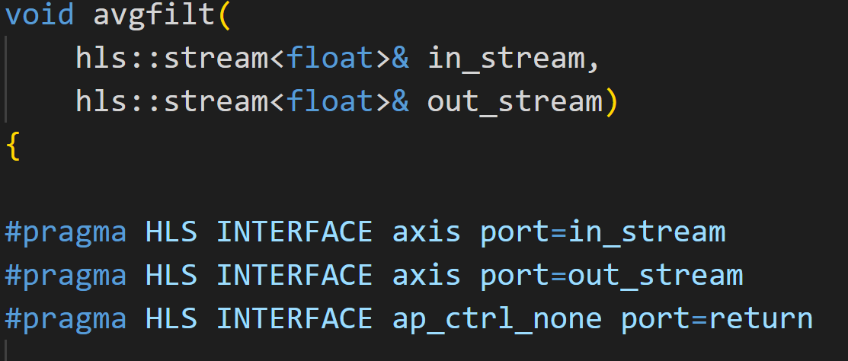
Vitis HLS Module Definition
Input and output streams
Declares that variables are AXI4-Stream Does not state if master or slave.
Declares that module has no explicit start stop

Slide 31
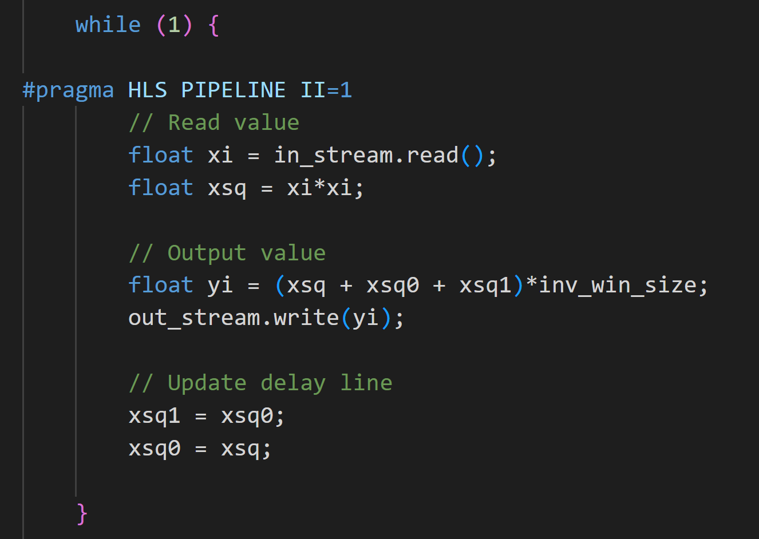
Vitis HLS Module Body
Reads input data
Computes average of current + past 2 values.
Writes output
Outputs past values

Slide 32
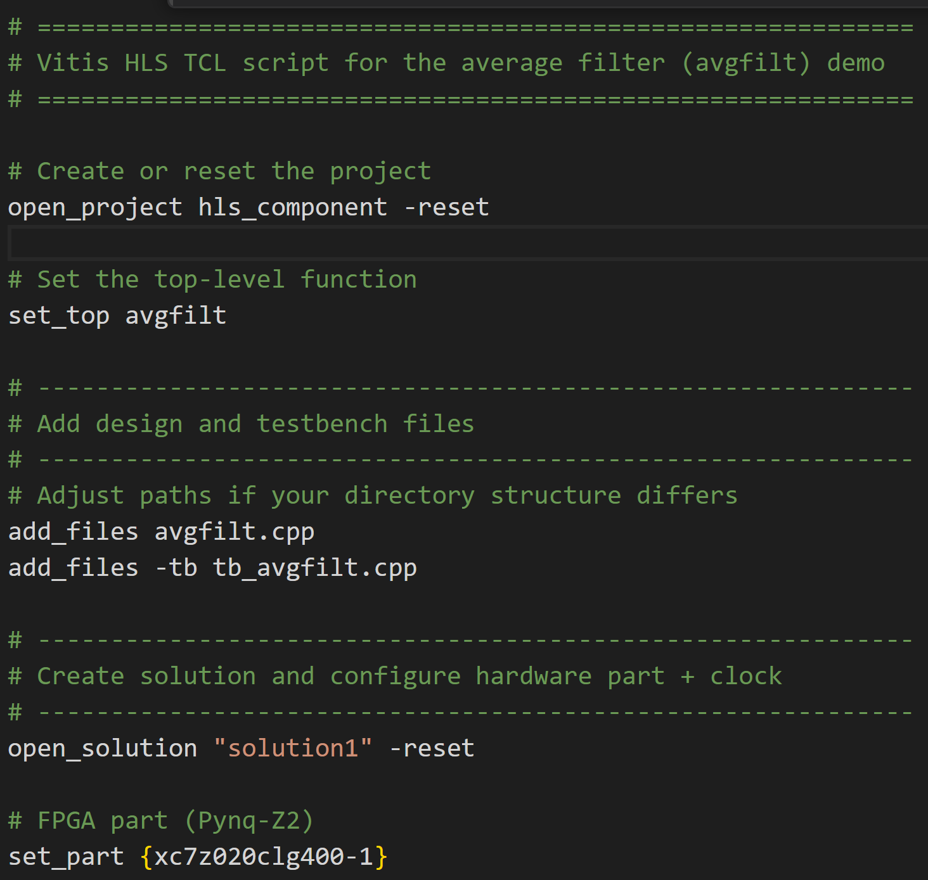
In-Class Demo
We will perform
C simulation
C synthesis
RTL co-simulation
VCD extraction

Slide 33
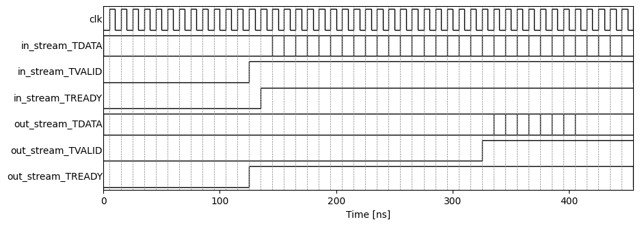
Simulation Results

Slide 34
Outline
FIFO Interfaces
AXI4 Pure Streaming Interface
Limitations of Pure Streaming with Vitis
AXI4 Packetized Streaming

Slide 35
Limitations of Pure Streaming
Problem 1: Many operations fundamentally operate in blocks
Pure streaming interface does not natively have a block boundary
Problem 2: Hard to synchronize control and data
Problem 3: Vitis is not well-equipped to simulate continuous kernels
Vitis has a fundamentally flawed execution model

Slide 36
Problem 1: Block-Based Operations
Many problems naturally work on blocks
Need to know boundaries
Ex: Image processing
Each input is a image
Images have a first and last element
Scanned in some particular order (e.g. row-wise)
Ex 2: Matrix multiply
Module needs two matrices
Each has to be read in some order
Pure streaming is not natively good for these operations
Individual elements
Blocks of elements

Slide 37
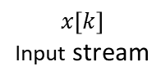
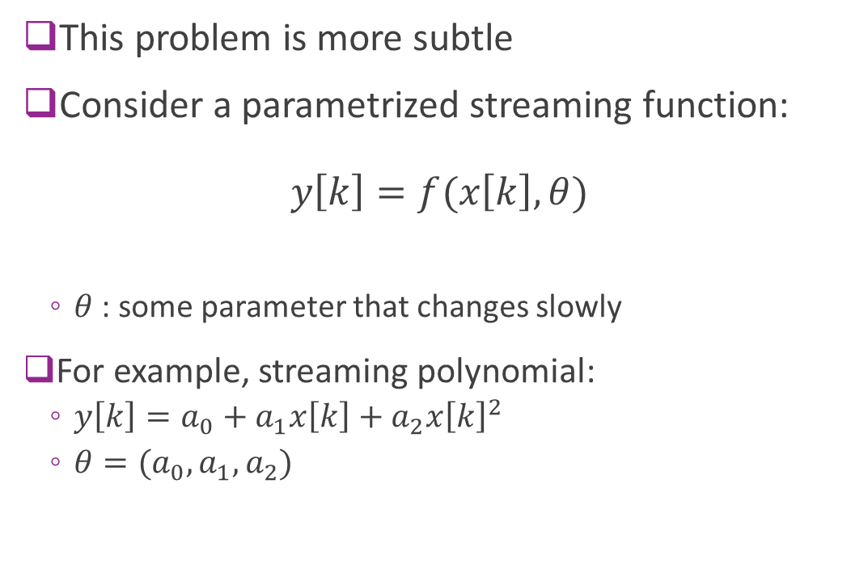

Problem 2: Control-Data Synchronization
This problem is more subtle
Consider a parametrized streaming function: $y\left[k\right]=f(x\left[k\right], θ)$
$θ$ : some parameter that changes slowly
For example, streaming polynomial:
$y\left[k\right]=a_{0}+a_{1}x\left[k\right]+a_{2}x{\left[k\right]}^{2}$
$θ=(a_{0}, a_{1}, a_{2})$
Hardware accelerator
Control $θ$
$$x\left[k\right]$$ Input stream
Polynomial Eval
$$y\left[k\right]$$ Input stream

Slide 38
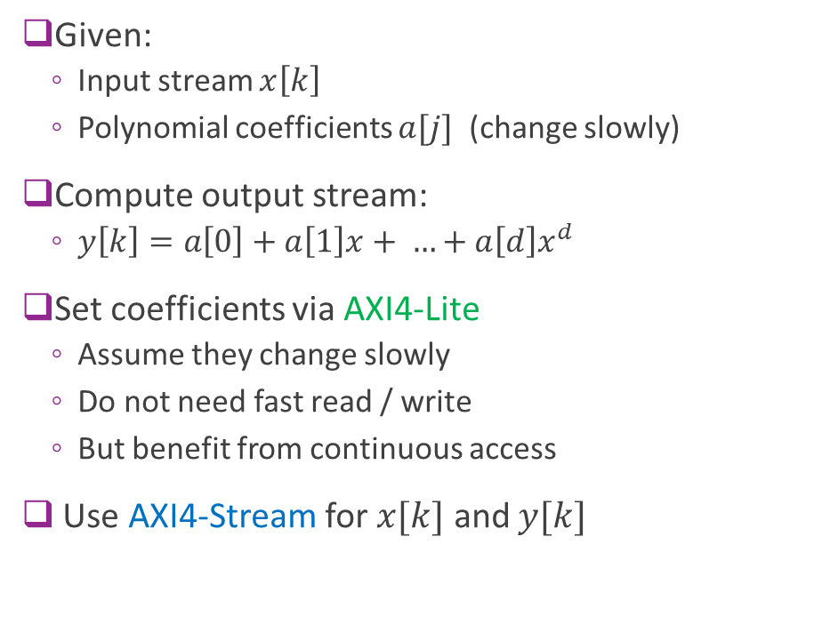

Solution: Mix AXI4-Lite and AXI4-Stream?
Given:
Input stream $x\left[k\right]$
Polynomial coefficients $a[j]$ (change slowly)
Compute output stream:
$y\left[k\right]=a\left[0\right]+a\left[1\right]x+ …+a\left[d\right]x^{d}$
Set coefficients via AXI4-Lite
Assume they change slowly
Do not need fast read / write
But benefit from continuous access
Use AXI4-Stream for $x[k]$ and $y[k]$
Hardware accelerator
$$a[j]$$ Coefficients
AXI4-Lite
$$x\left[k\right]$$ Input stream
Polynomial Eval
AXI4-Stream
$$y\left[k\right]$$ Input stream

Slide 39
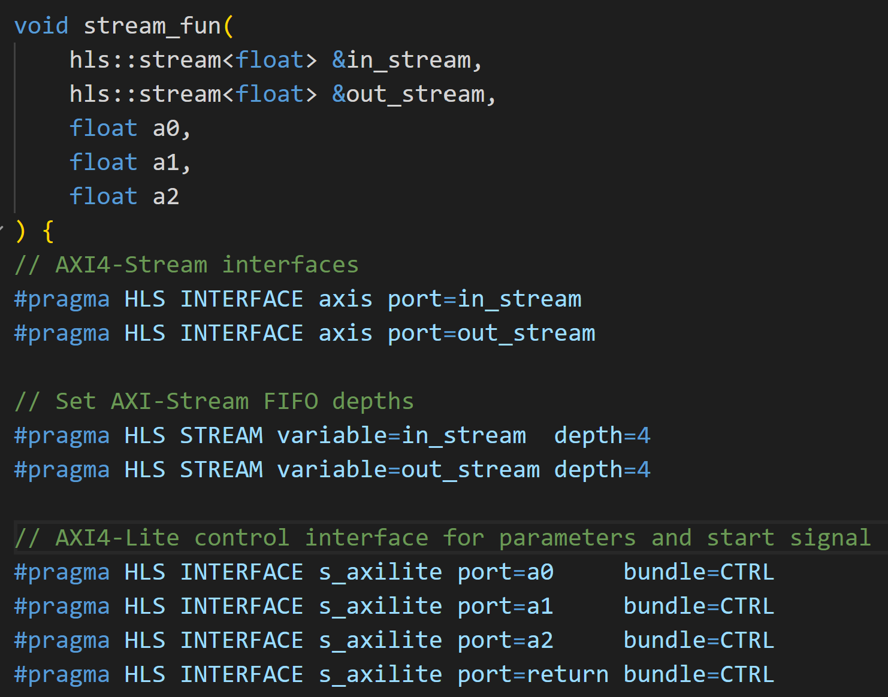
A Potential HLS Module Definition
Input and output streams
Coefficients
Declares that variables are AXI4-Stream Does not state if master or slave.
Direction will be inferred
AXI4-Stream FIFO depth
Declares that coefficients are AXI4-Lite

Slide 40


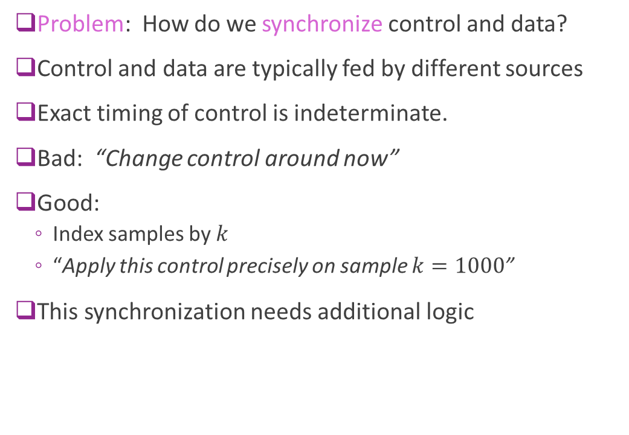
Problem Mixing AXI4-Lite and AXI4-Stream
Problem: How do we synchronize control and data?
Control and data are typically fed by different sources
Exact timing of control is indeterminate.
Bad: “Change control around now”
Good:
Index samples by $k$
“Apply this control precisely on sample $k=1000$”
This synchronization needs additional logic
Hardware accelerator
$$a[j]$$ Coefficients
AXI4-Lite
$$x\left[k\right]$$ Input stream
Polynomial Eval
AXI4-Stream
$$y\left[k\right]$$ Input stream

Slide 41
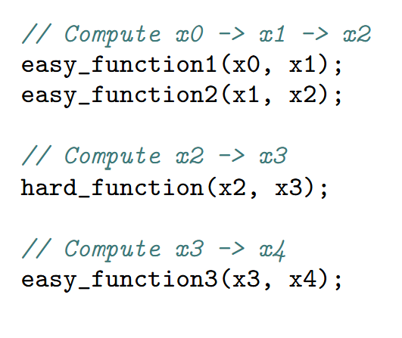


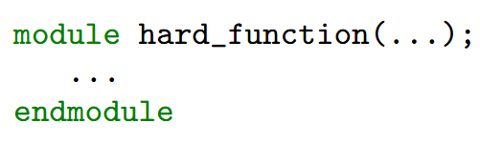
Problem 3: Vitis’ Flawed Execution Model
I need to
accelerate this step
Vitis generated RTL equivalent code
Drop-in replacement for SW call
Called with sequential manner
Software
developer

Slide 42
Vitis Execution Model Flaws
Item | Vitis Assumption | Proper hardware model
Execution paradigm | Module is “called” like a C function | Modules operate continuously and respond to events
Interface | C-like call | Hardware channels e.g., FIFOs and memory-mapped interfaces
Concurrent behavior | Obscured | Made explicit
Hardware is not software

Slide 43
Outline
FIFO Interfaces
AXI4 Pure Streaming Interface
Limitations of Pure Streaming with Vitis
AXI4 Packetized Streaming

Slide 44
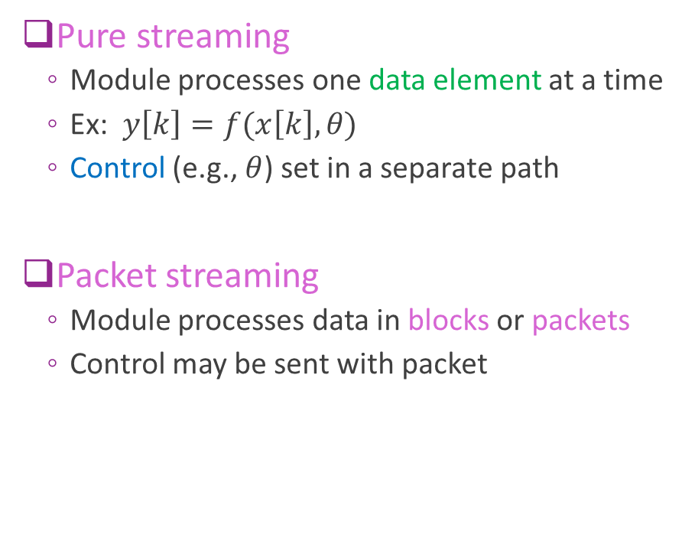
Pure vs. Packetized Streaming
Pure streaming
Module processes one data element at a time
Ex: $y\left[k\right]=f(x\left[k\right], θ)$
Control (e.g., $θ$) set in a separate path
Packet streaming
Module processes data in blocks or packets
Control may be sent with packet
Control
Output data
Input data
HW module
Control
Data
HW module
Control
Data

Slide 45
AXI4-Stream Protocol with Packetization
MASTER
SLAVE
Add a TLAST line
TLAST = 1 on the last transfer
Indicates the end of packet
Packets are transferred in bursts
Begins with first TVALID = 1
Ends TLAST=1 and successful transfer
Cycles in a burst are called beats
Transfer beat (TVALID=TREADY=1)
Idle beat (TVALID=0)
Stall beat (TVALID=1, TREADY=0)
Last beat (TVALID=TREADY=TLAST=1)
TREADY
FIFO
TDATA
TVALID
TLAST

Slide 46
Example Burst Timing
TDATA | TVALID | TREADY | TLAST | Beat Type
A | 1 | 1 | 0 | A transfers
B | 1 | 0 | 0 | B stalls (Slave not ready)
B | 1 | 1 | 0 | B transfers
- | 0 | 1 | 0 | Idle (Master has no data)
C | 1 | 1 | 0 | C transfers
D | 1 | 0 | 1 | D stalls
D | 1 | 1 | 1 | D transfers with end of burst

Slide 47
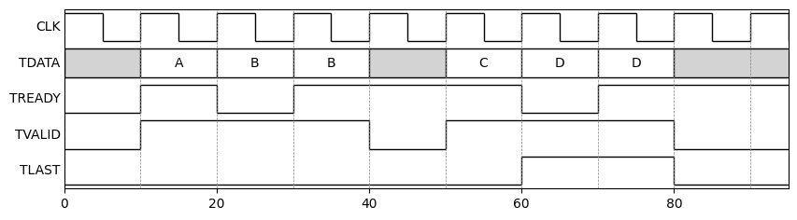
Example Burst Timing Illustrated
7 Beats and 4 Transfers

Slide 48
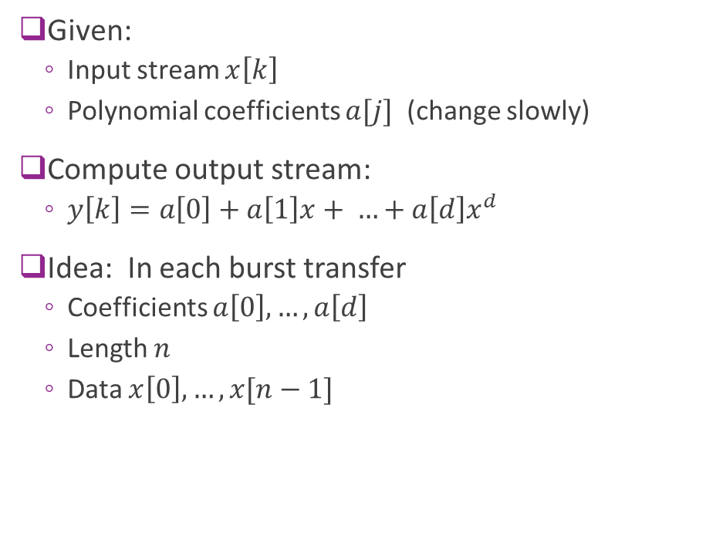
Example: Block Polynomial Accelerator
Given:
Input stream $x\left[k\right]$
Polynomial coefficients $a[j]$ (change slowly)
Compute output stream:
$y\left[k\right]=a\left[0\right]+a\left[1\right]x+ …+a\left[d\right]x^{d}$
Idea: In each burst transfer
Coefficients $a\left[0\right], …, a\left[d\right]$
Length $n$
Data $x\left[0\right], …, x[n−1]$
Input stream
Polynomial Eval
AXI4-Stream
Output stream

Slide 49
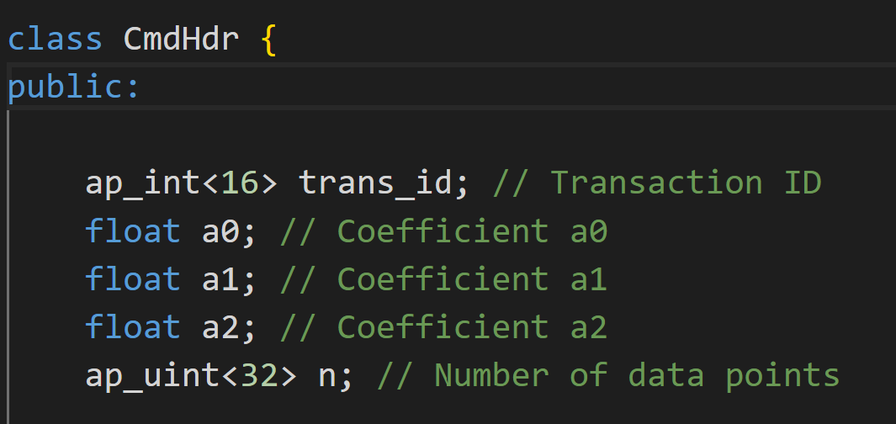

Command Packet Structure
Command Header
Data
Transaction ID (see later)
Coefficients
Length
$$x\left[0\right], …, x[n−1]$$

Slide 50
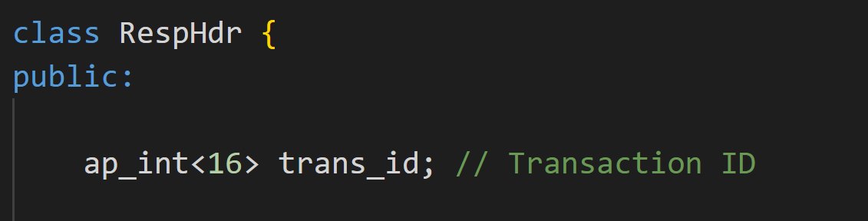
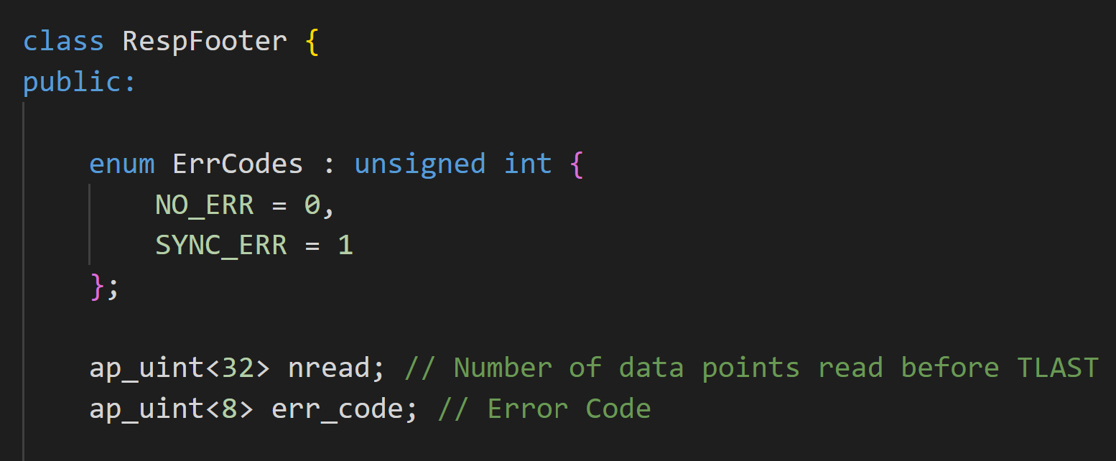

Response Packet Structure
Response Header
Response Footer
Data
Error code Num read
Transaction ID
$$y\left[0\right], …, y[n−1]$$

Slide 51
Serialization / Deserialization
Packets have arbitrary:
Structure (often different fields)
Arbitrary, sometimes variable, length
Hardware streams have specific bit widths
Ex: 32, 64, 128, …
Each stream element is a word
Serialization: Converts packets to array of stream words
Deserialization: Streams words to packets
Packet
uint32 words
uint32 words

Slide 52
Serialization / Deserialization Illustrated
TX Packet
AXI4-Stream
Deserialization
Serialization
Stream words (e.g., ap_uint<32>)
Stream words
RX Packet

Slide 53
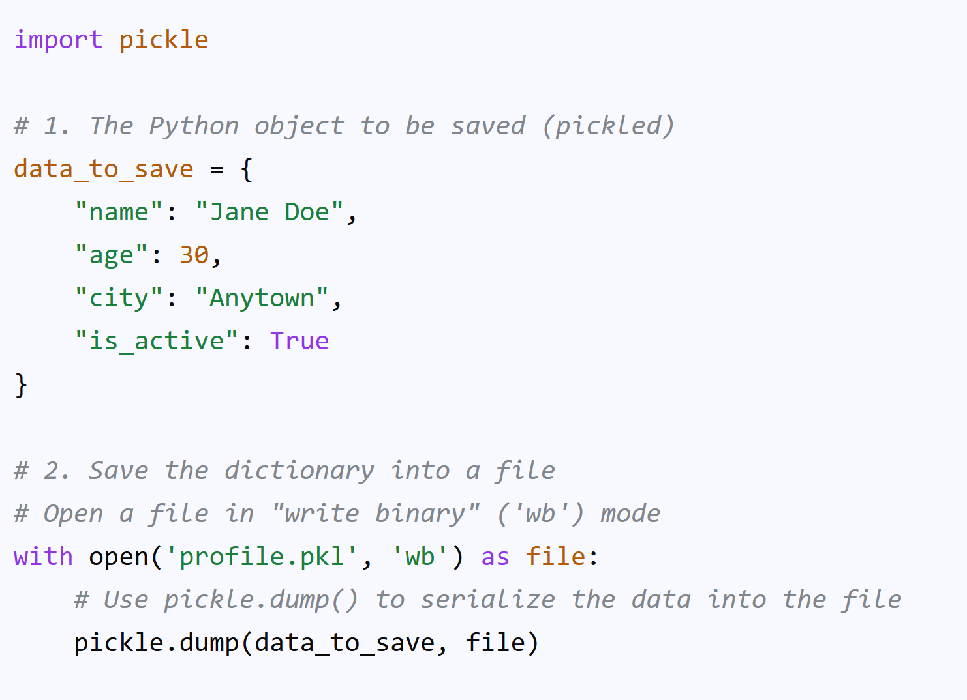
Serialization / Deserialization in Hardware
Python and C++ have widely-used serialization tools
Ex: Python pickle
Can serialize an arbitrary class
Serializes complex nested structures
Ex: Boost.serialization
Similar package in C++
No standard library in hardware
Often write custom serialization

Slide 54
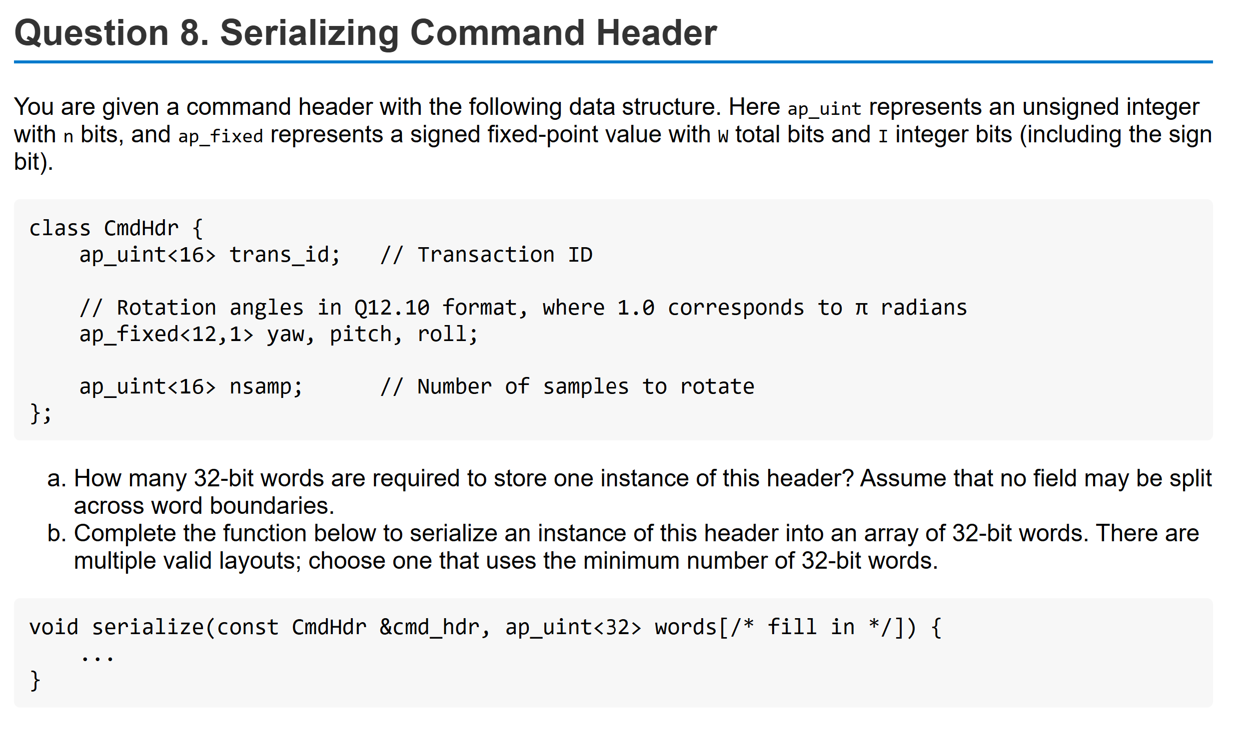
Example Problem

Slide 55
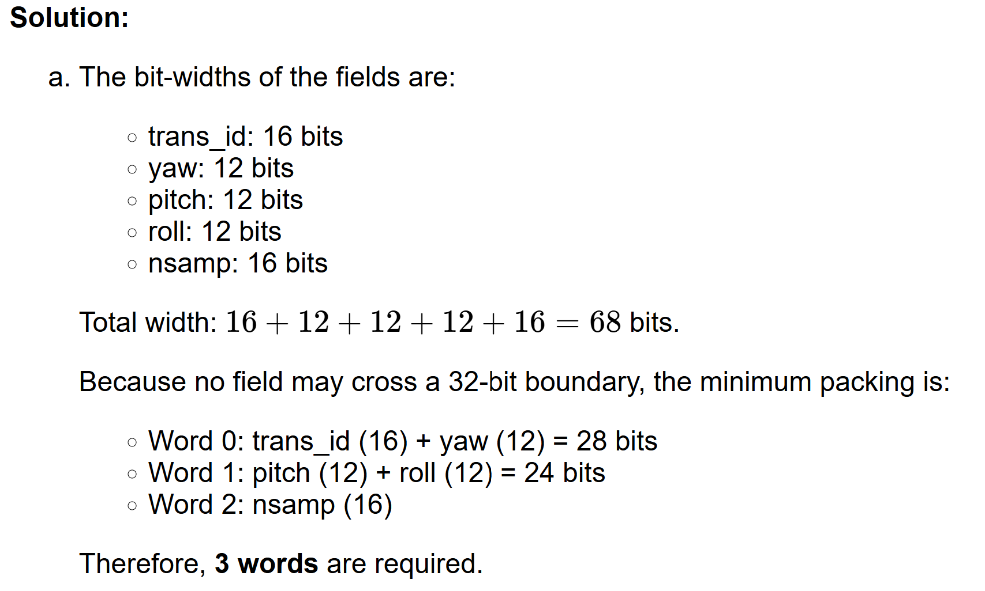
Solution: Counting the Number of Words

Slide 56
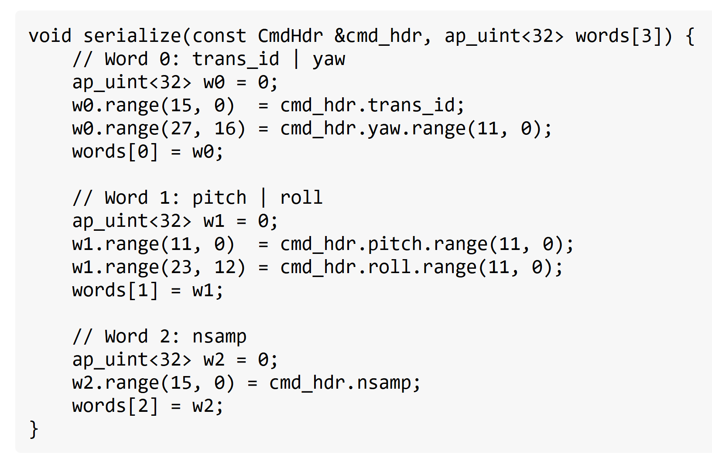
Solution: Serialization Code

Slide 57
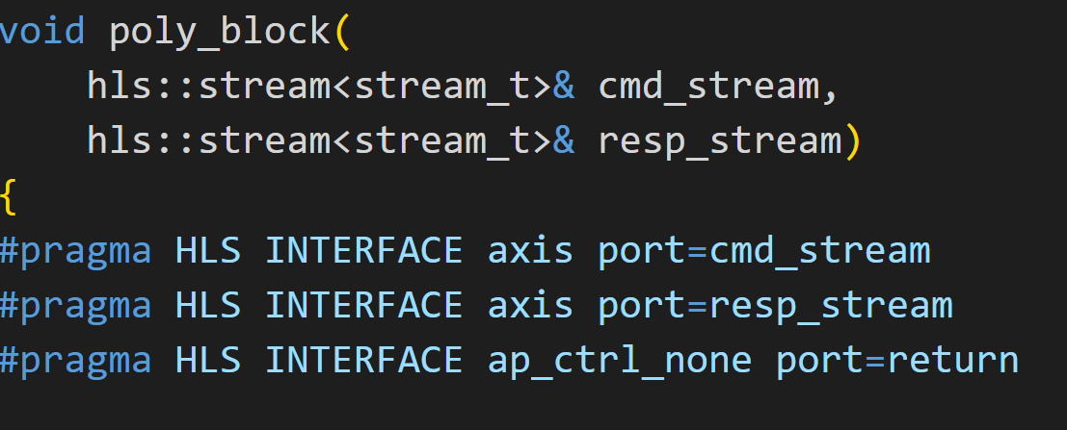
Vitis HLS Module Definition
Input and output streams
Declares that variables are AXI4-Stream Does not state if master or slave.
Declares that module has no explicit start stop

Slide 58
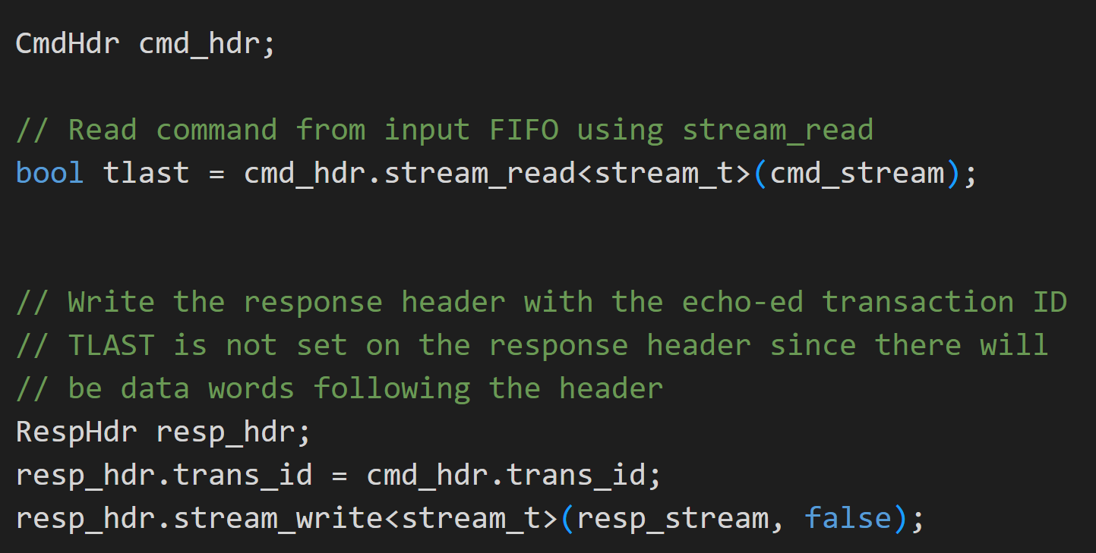
Vitis HLS Command and Response Header
Deserialize command header
Write response header Each transaction ID

Slide 59
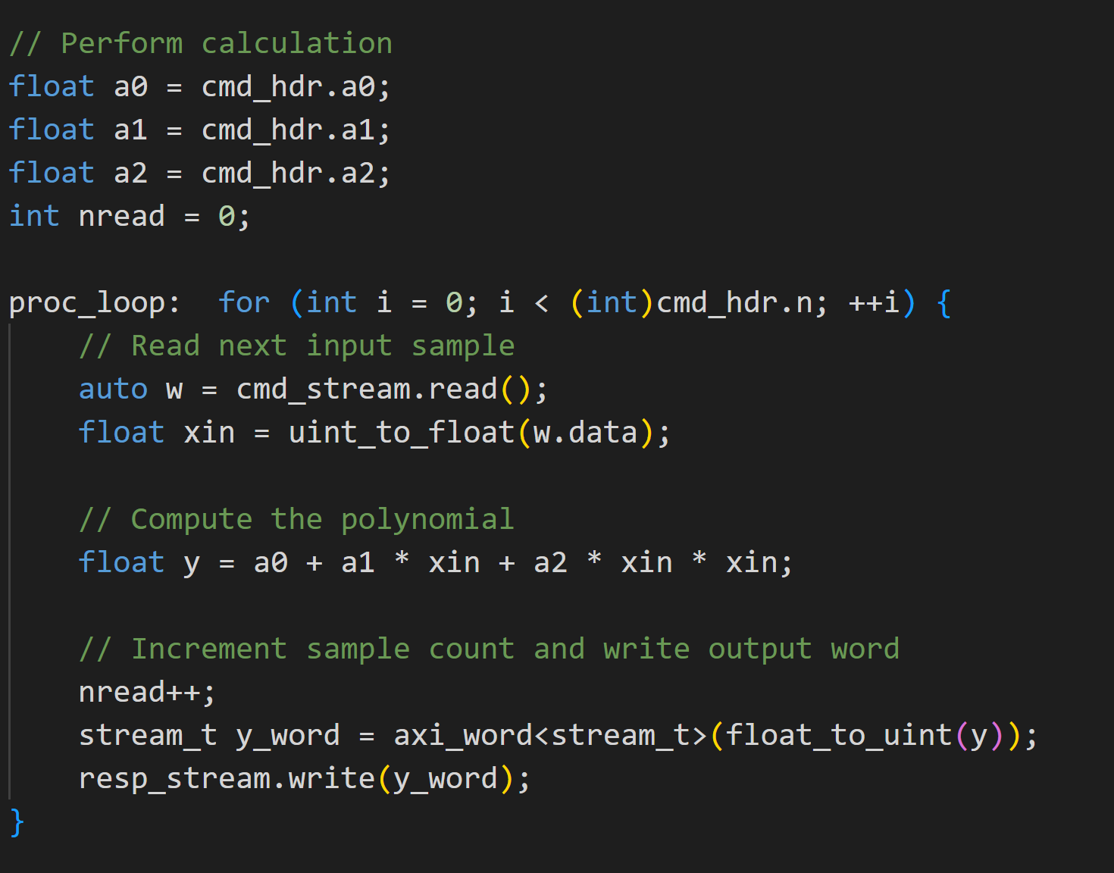
Main Process Loop
Read word
Compute polynomial
Write to output stream

Slide 60
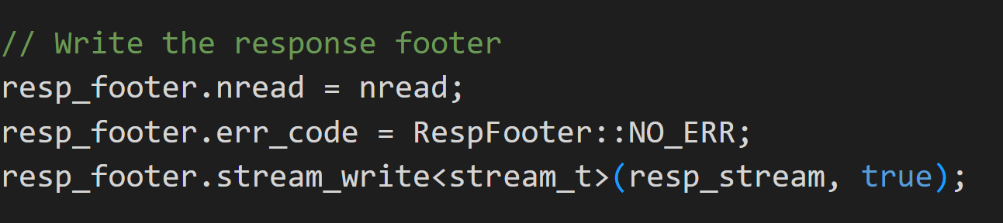
Response Footer and Error Handling
Check for synchronization error
TLAST not in expected position
If there are errors:
Sends response with error code
Flush queue to next TLAST
Key design error handling principles:
Hardware cannot terminate.
It must self-recover
Must provide visibility to errors

Slide 61
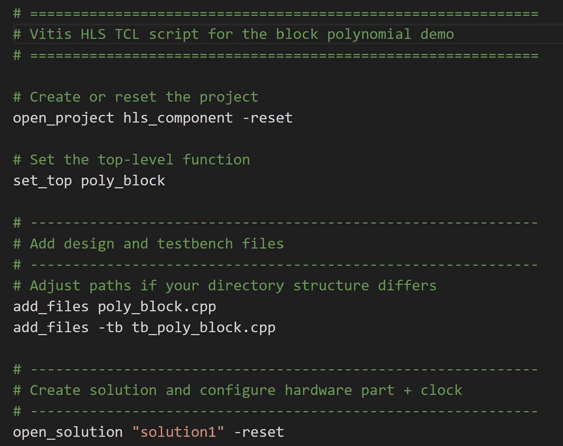
In-Class Demo
We will perform
C simulation
C synthesis
RTL co-simulation
VCD extraction

Slide 62
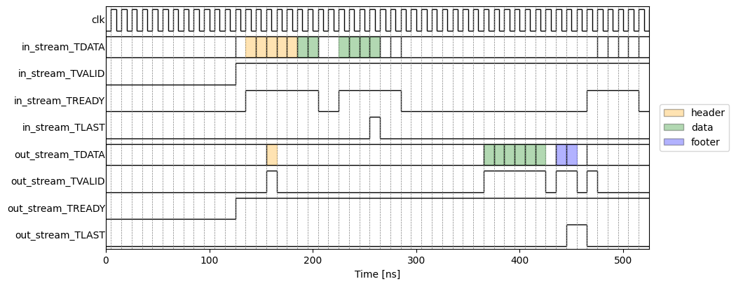
Simulation Result

Slide 63
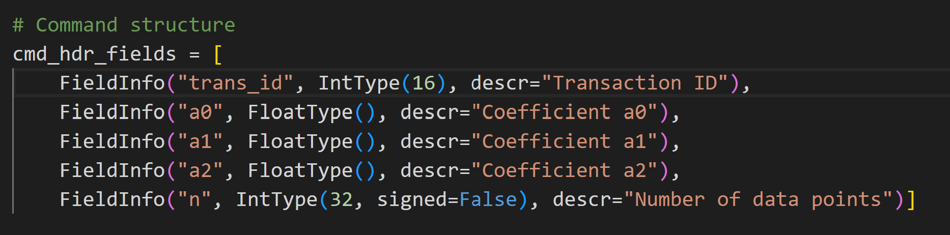
Using an Interface Description Language
Most professional designers do not hand write their serialization
Error prone, tedious
The class xilinxutils package has a simple interface description language:
Serves as a master description for python and Vitis

Slide 64
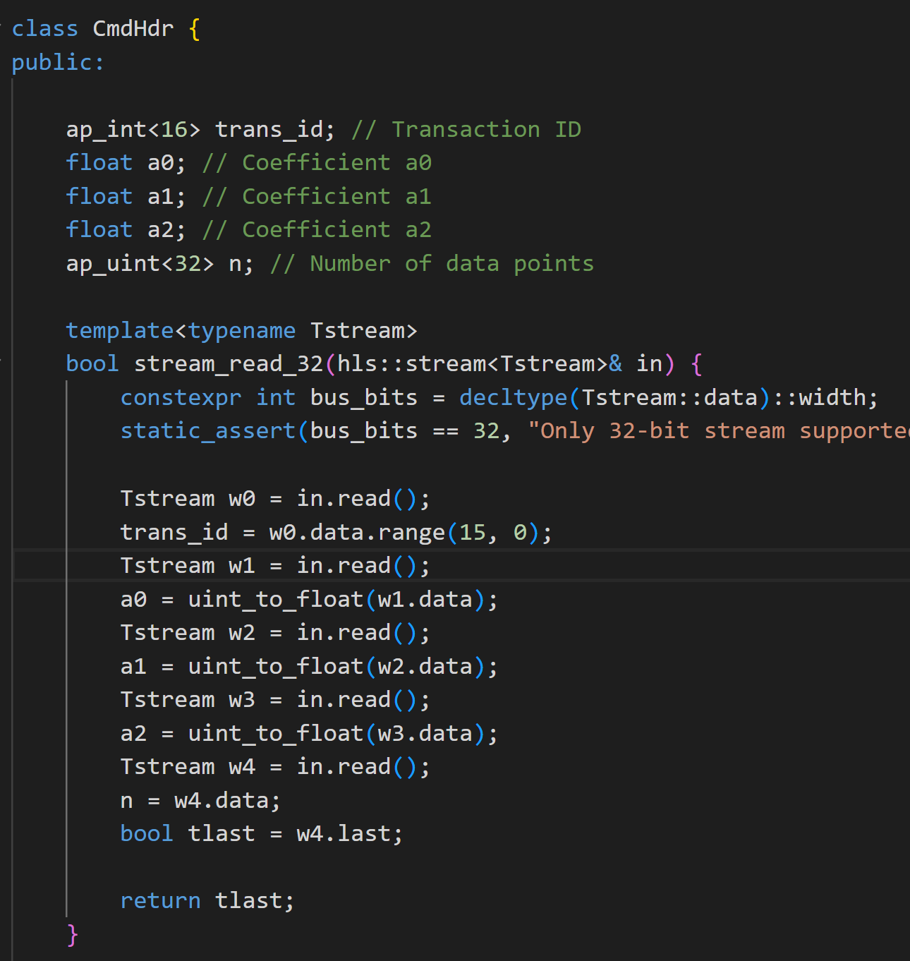
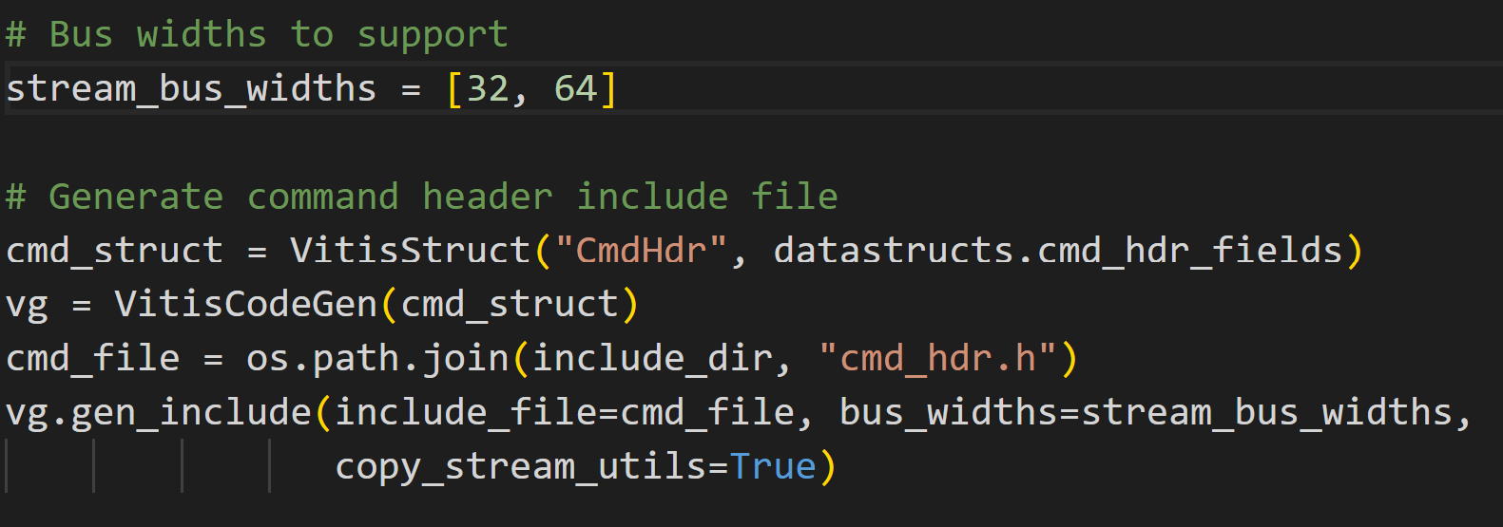
Vitis HLS Code Generation
The python descriptors can be used to autogenerate the Vitis HLS header files
No need to manually write the serialization
Auto-generated

