Slide 1
Unit 6 Timing and Critical Path Analysis
EL-GY 9463: Introduction to Hardware Design
ProfS. Sundeep Rangan, Siddharth Garg

Slide 2
Learning Objectives
Define undefined and stable periods for logical signals
Compute the maximum propagation delay of combination logics
Series circuits, conditional, multi-path
Perform static timing analysis of sequential logic
Determine the critical path of a circuit
Determine maximum frequency and detect timing violations
Draw timing diagrams, both real and cycle-accurate
Describe timing via value-change points
Extract VCD files from Vitis and display timing information in python

Slide 3
Outline
Static Timing Analysis in Combinational Logic
Static Timing Analysis in Sequential Logic
Sequential Logic Timing Diagrams
VCD Files and Timing Diagrams from Vitis

Slide 4
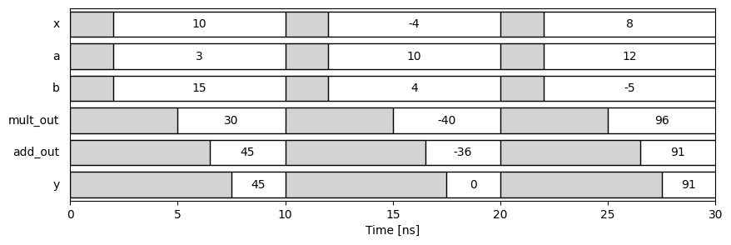
Static Timing Analysis
Timing analysis: Estimate delays through circuits
Visualize with a timing diagram
Critical for estimating:
Clock speed, latency, throughput, …
Static timing analysis:
Focus on maximum propagation delay
Timing that can be guaranteed for all inputs
Not data dependent
This analysis is conservative, but provides hard guarantees
Default analysis in industry

Slide 5
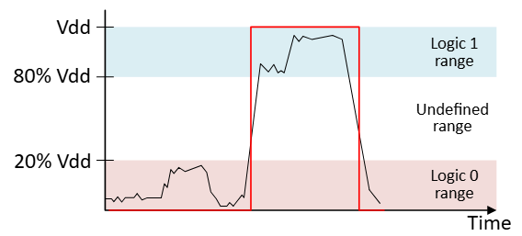
Implementing Signal Physically
To understand timing, we need to look at physical implementation of signals
Consider a binary signal from Unit 1
Two logical values: 0 or 1
What happens physically?
Typically, a voltage on a wire
Takes a continuous value
Obtain logical value by thresholding

Slide 6
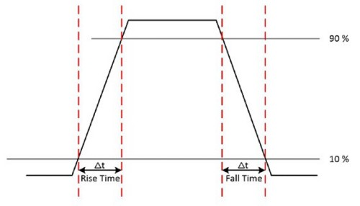
Undefined Logic Value: ‘X’ or ‘?’
Signals take time to transition
They are outputs of physical circuits
Gates, computational units, …
Creates an undefined period
Also called indeterminate, unknown, …
Usually denoted as X
We may use ? to avoid confusion with variable
So binary logic signals have three values:
0, 1 and X
Will discuss a fourth value Z later
0
X
1
X
0

Slide 7
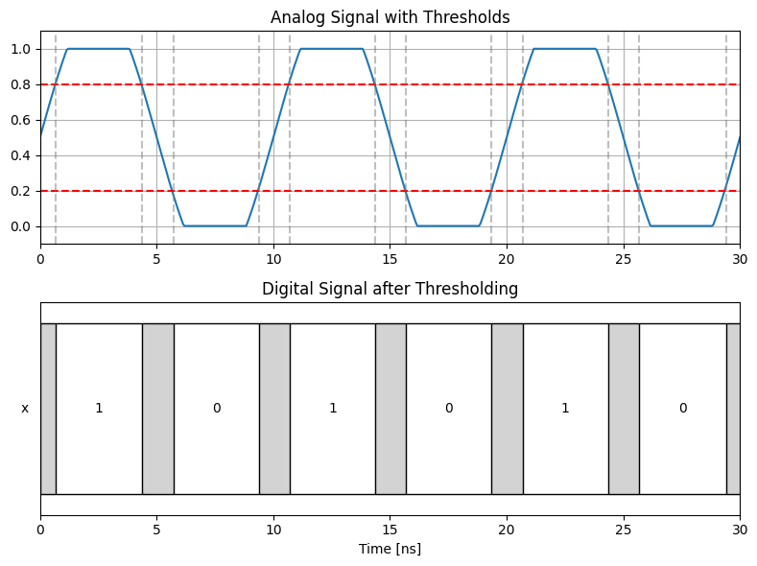
Undefined Regions Illustrated
Analog physical signal
Typically, a voltage
Continuous valued
Has finite transition periods
Digital logic signal
Three values 0, 1 and X
X value shown in gray
X
X
X
X
X

Slide 8
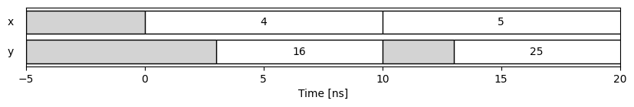


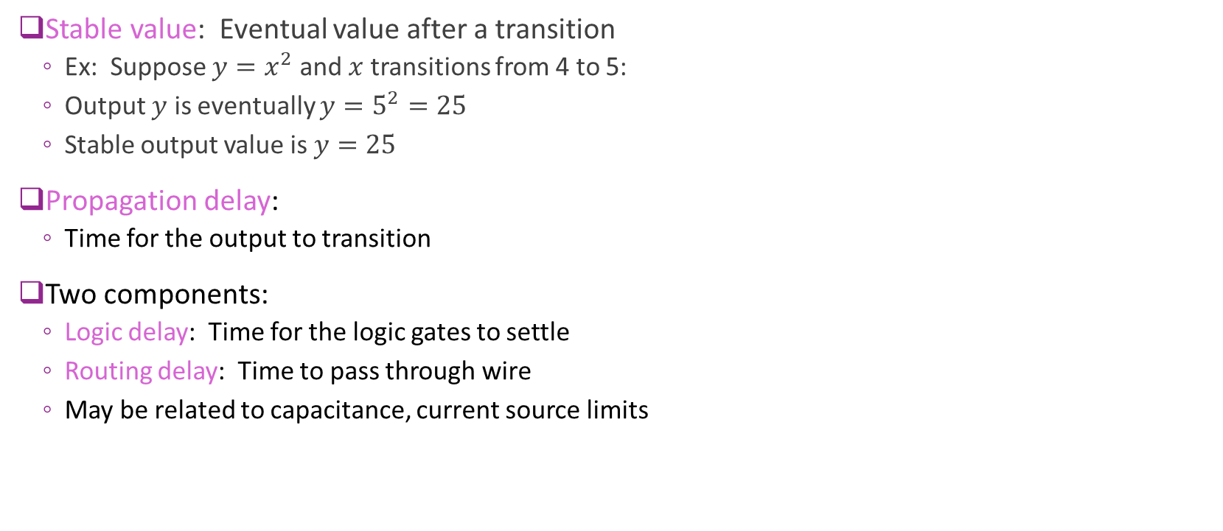


Stable Values and Propagation Delays
Stable value: Eventual value after a transition
Ex: Suppose $y=x^{2}$ and $x$ transitions from 4 to 5:
Output $y$ is eventually $y=5^{2}=25$
Stable output value is $y=25$
Propagation delay:
Time for the output to transition
Two components:
Logic delay: Time for the logic gates to settle
Routing delay: Time to pass through wire
May be related to capacitance, current source limits
$$x$$
$$y=x^{2}$$
$T_{prop}=3$ ns
$T_{prop}=3$ ns

Slide 9
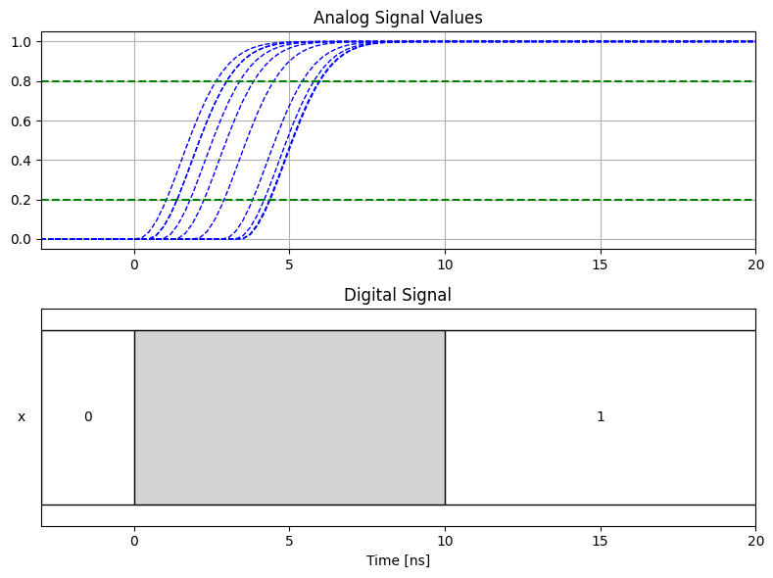
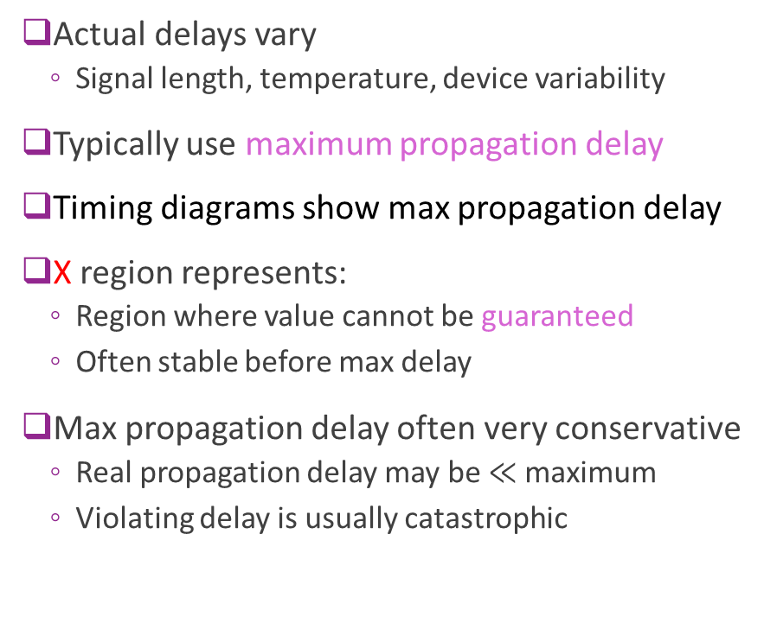

Maximum Propagation Delay
Actual delays vary
Signal length, temperature, device variability
Typically use maximum propagation delay
Timing diagrams show max propagation delay
X region represents:
Region where value cannot be guaranteed
Often stable before max delay
Max propagation delay often very conservative
Real propagation delay may be $≪$maximum
Violating delay is usually catastrophic
X
Worst-case $T_{prop}=10$ ns

Slide 10





Timing in a Series Circuit: ReLU + Linear
As example, consider a more complication circuit: $y=\max\left\{ax+b, 0\right\}$
Linear function + ReLU from Unit 2
Used widely in machine learning
$$x$$
Input ports
$$a$$
$$y$$
Output port
$$b$$

Slide 11
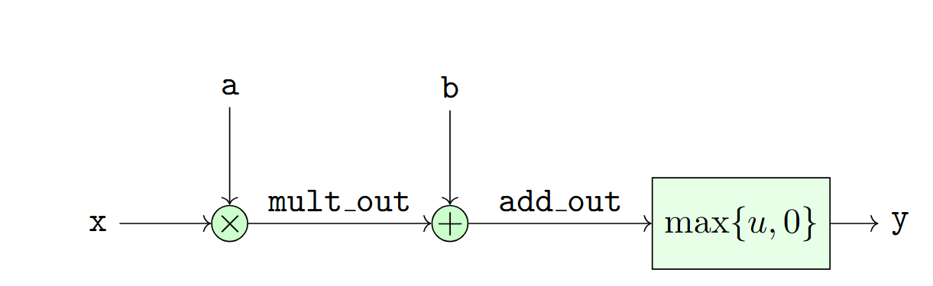
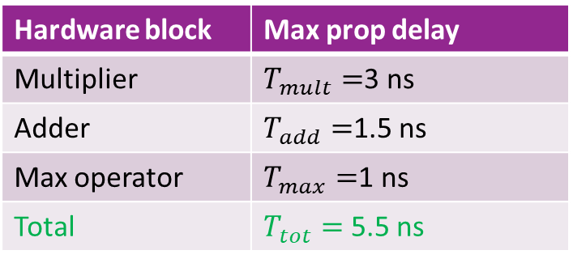
Timing Diagram for Series Connections
Linear + ReLU can be implemented as a series connection
In this case, three operations one after the other
For analysis, assume the max propagation delays in the table
Question: What does the timing diagram look like with changes in the input?
Hardware block | Max prop delay
Multiplier | $T_{mult}=$3 ns
Adder | $T_{add}=$1.5 ns
Max operator | $T_{max}=$1 ns
Total | $T_{tot}=$5.5 ns

Slide 12
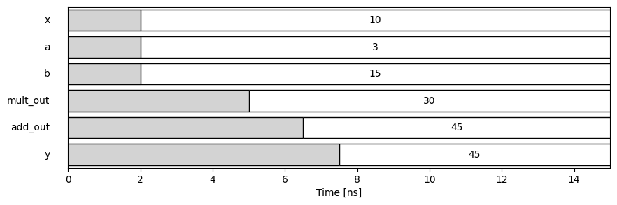
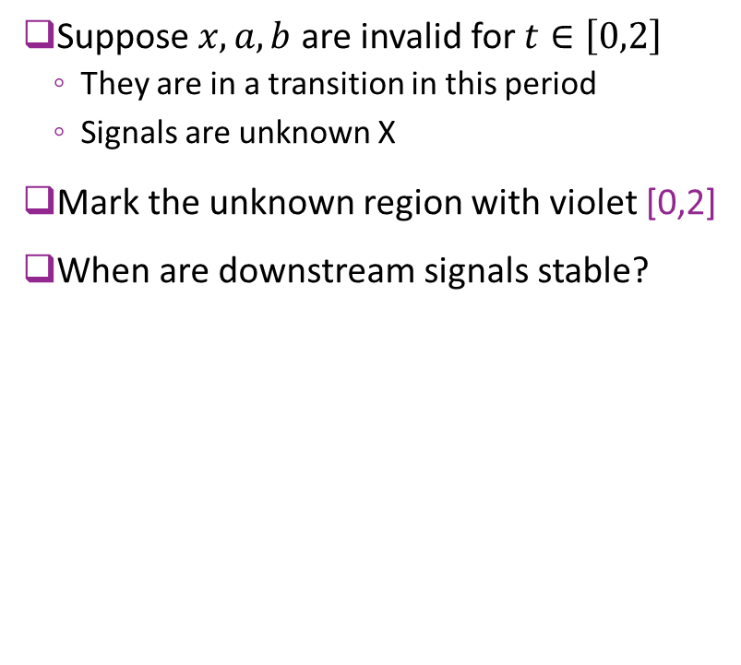
Timing Diagram of a Series
Suppose $x, a, b$ are invalid for $t∈\left[0,2\right]$
They are in a transition in this period
Signals are unknown X
Mark the unknown region with violet [0,2]
When are downstream signals stable?
[0,2]
?

Slide 13
Series Timing: Initial Component
Start with first component (multiplier)
Inputs are invalid in [0,2]
Max propagation delay of mult = 3 ns
Mult_out is invalid from [0,5]
Invalid for 3 ns longer than input
Final stable value:
Mult_out = 3*10 = 30
[0,2]
[0,5]
?

Slide 14
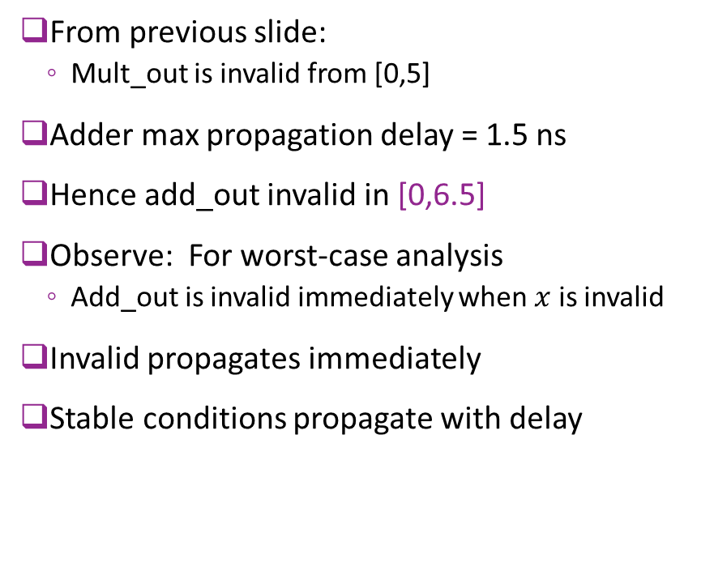
Series Timing: Second Component
From previous slide:
Mult_out is invalid from [0,5]
Adder max propagation delay = 1.5 ns
Hence add_out invalid in [0,6.5]
Observe: For worst-case analysis
Add_out is invalid immediately when $x$ is invalid
Invalid propagates immediately
Stable conditions propagate with delay
[0,2]
[0,5]
[0,6.5]
?

Slide 15
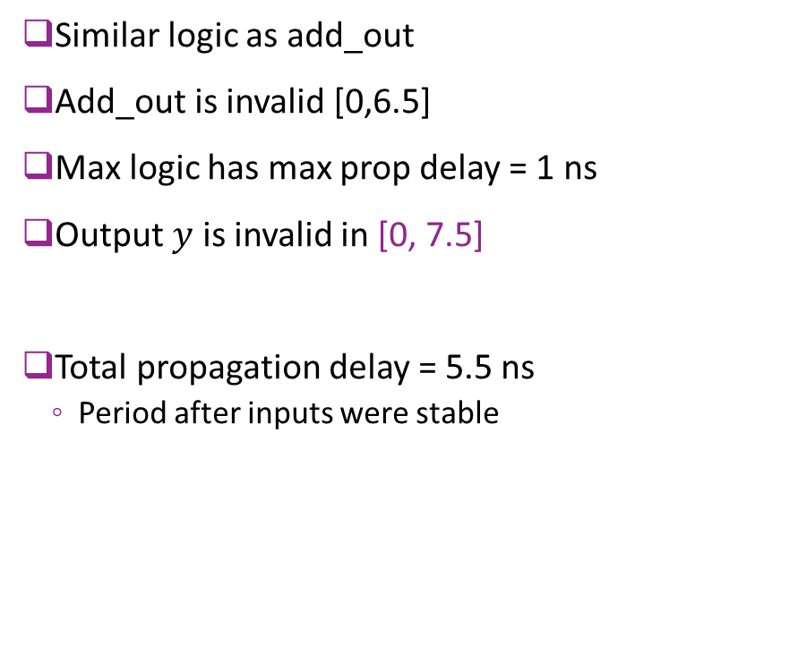
Series Timing: Third Component
Similar logic as add_out
Add_out is invalid [0,6.5]
Max logic has max prop delay = 1 ns
Output $y$ is invalid in [0, 7.5]
Total propagation delay = 5.5 ns
Period after inputs were stable
[0,2]
[0,5]
[0,6.5]
[0,7.5]

Slide 16


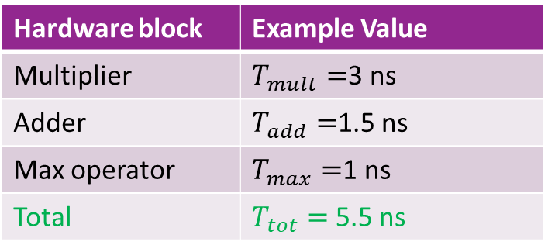


Example Total Propagation Delay
Hardware block | Example Value
Multiplier | $T_{mult}=$3 ns
Adder | $T_{add}=$1.5 ns
Max operator | $T_{max}=$1 ns
Total | $T_{tot}=$5.5 ns
$$T_{max}$$
$$T_{mult}$$
$$T_{add}$$
$T_{tot}=5.5$ns

Slide 17
Example Timing Over Multiple Inputs

Slide 18
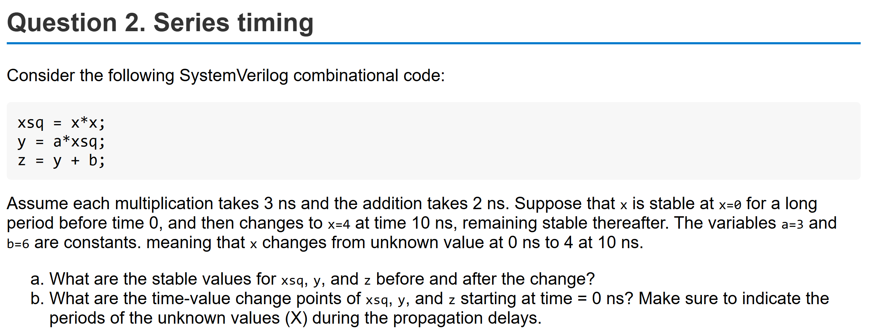
Example Problem

Slide 19
Typical Propagation Delays: Low-End FPGA
Hardware block | FPGA resource | Typical range
32-bit adder | LUT + dedicated carry chain | 1.5–3.0 ns
16-bit multiplier | DSP48E1 block | 2.5–5.0 ns
16-bit comparator | LUT logic + carry chain | 1.0–2.0 ns
Rough delays for a low-end FPGA (e.g., Pynq Z2)
We will explain the FPGA resources more in later units
Routing delays not included
May be large for more complex designs

Slide 20
Typical Propagation Delays: ASIC
Hardware block | Typical structure | Typical range
32-bit adder | Kogge‑Stone / Brent‑Kung / hybrid | 150-450 ps
16-bit multiplier | Wallace/Dadda tree + final adder | 300-700 ps
16-bit comparator | XOR/AND/OR chain with early‑out | 50-300 ps
Rough delays for TSMC 16nm
Custom ASICs are much faster than FPGAs
Easily 5 to 10x faster

Slide 21
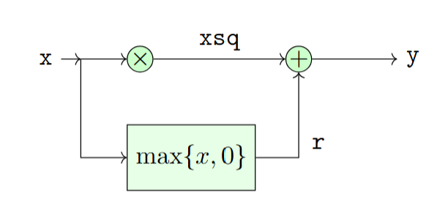
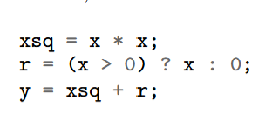
Timing Diagram with Multiple Paths
Now consider a circuit with multiple paths
Input to the adder has two paths:
One from xsq
Second from ReLU function r
How does the timing diagram work?

Slide 22
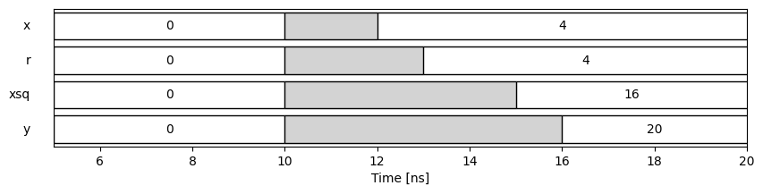

Timing Diagram: Inputs
[10,12]
Suppose input:
Transitions from $x=0$ to 4
Transition interval is $t∈[10,12]$ (marked as X)
?
s

Slide 23

Timing Diagram: First Steps
[10,15]
[10,12]
Square output $x^{2}$
Multiplication max delay is 3
Value X from [10, 15]
Then comes to stable value 16
ReLU output $r$
ReLU max delay is 1
Value X from [10, 13]
Then comes to stable value 4
These steps operate in parallel
[10,13]
s
?

Slide 24
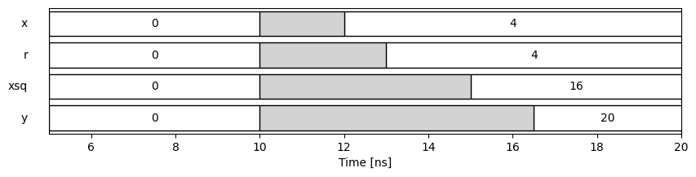
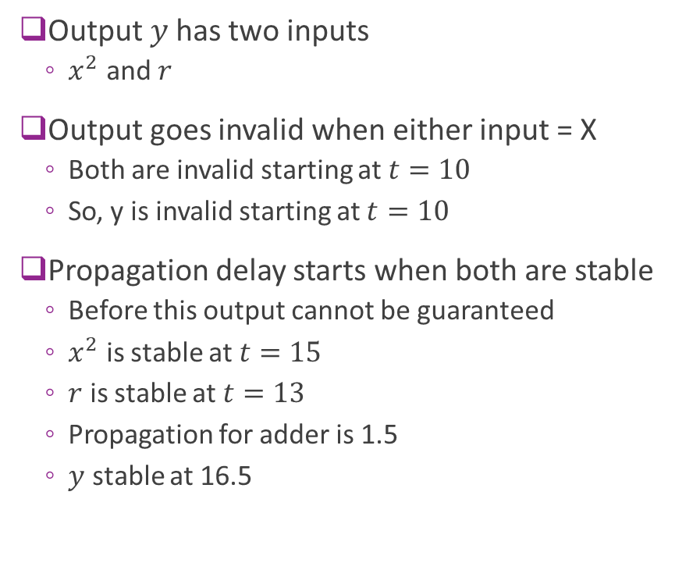
Multipath: Final Output
[10,15]
[10,16.5]
[10,12]
Output $y$has two inputs
$x^{2}$ and $r$
Output goes invalid when either input = X
Both are invalid starting at $t=10$
So, y is invalid starting at $t=10$
Propagation delay starts when both are stable
Before this output cannot be guaranteed
$x^{2}$ is stable at $t=15$
$r$ is stable at $t=13$
Propagation for adder is 1.5
$y$ stable at 16.5
[10,13]

Slide 25
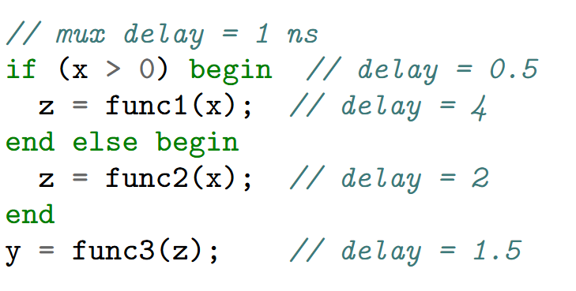
Conditional Circuits
Consider conditional block
How is it implemented?
What is the max propagation delay?

Slide 26
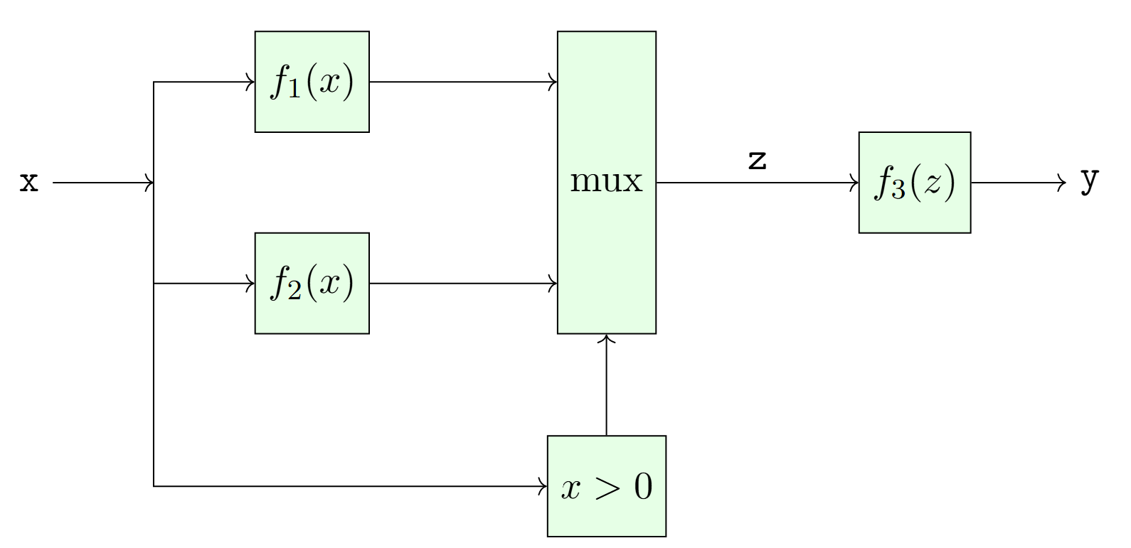
Implementing Conditional with Multiplexers
Multiplexer:
Circuit that selects one of a set of inputs
Uses a condition input
Inputs and conditions
All computed in parallel
But each need distinct hardware
No savings in hardware dependent on data
All possible inputs must be computed
Propagation delay starts with slowest input

Slide 27
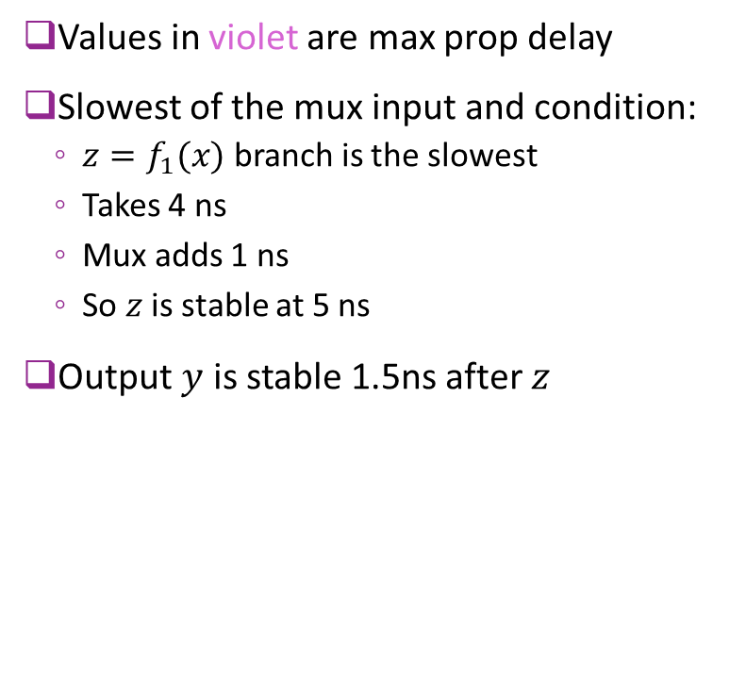
Propagation Delay with Multiplexers
Values in violet are max prop delay
Slowest of the mux input and condition:
$z=f_{1}(x)$ branch is the slowest
Takes 4 ns
Mux adds 1 ns
So $z$ is stable at 5 ns
Output $y$ is stable 1.5ns after $z$
4
4
4+1=5
5+1.5=6.5
2
0.5

Slide 28
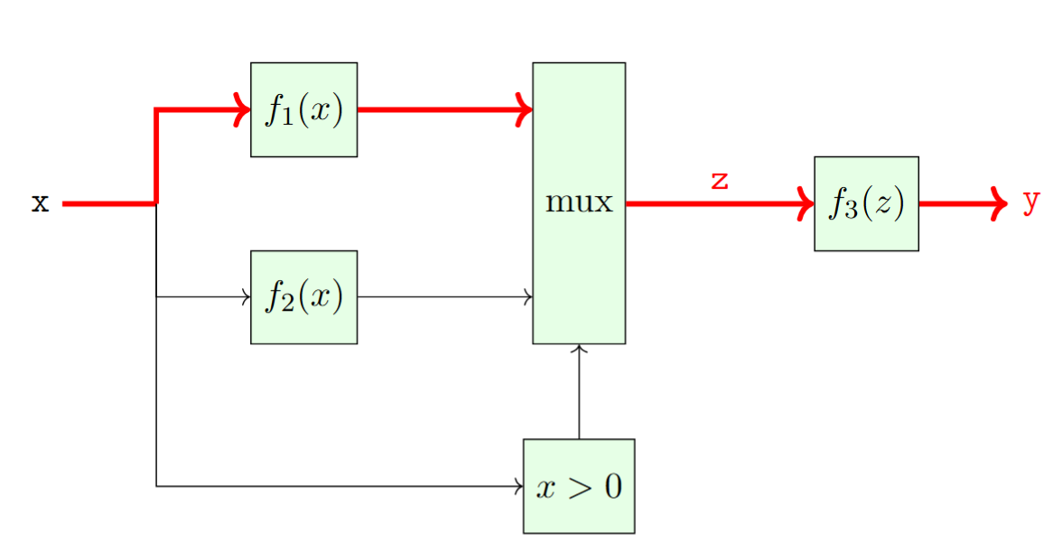
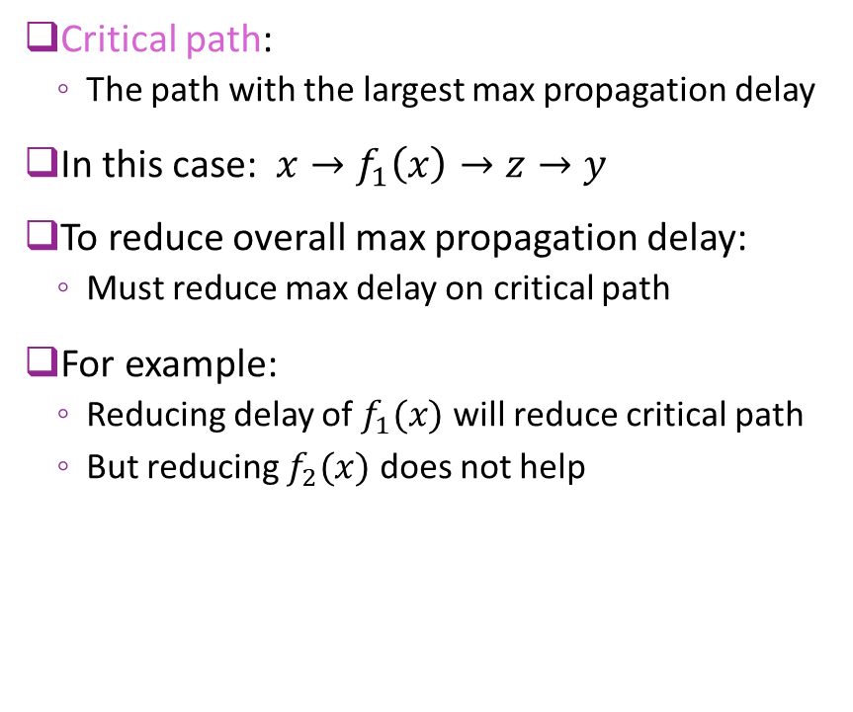
Critical Path
Critical path:
The path with the largest max propagation delay
In this case: $x→f_{1}\left(x\right)→z→y$
To reduce overall max propagation delay:
Must reduce max delay on critical path
For example:
Reducing delay of $f_{1}(x)$ will reduce critical path
But reducing $f_{2}(x)$ does not help
4
5
2
6.5
0.5

Slide 29
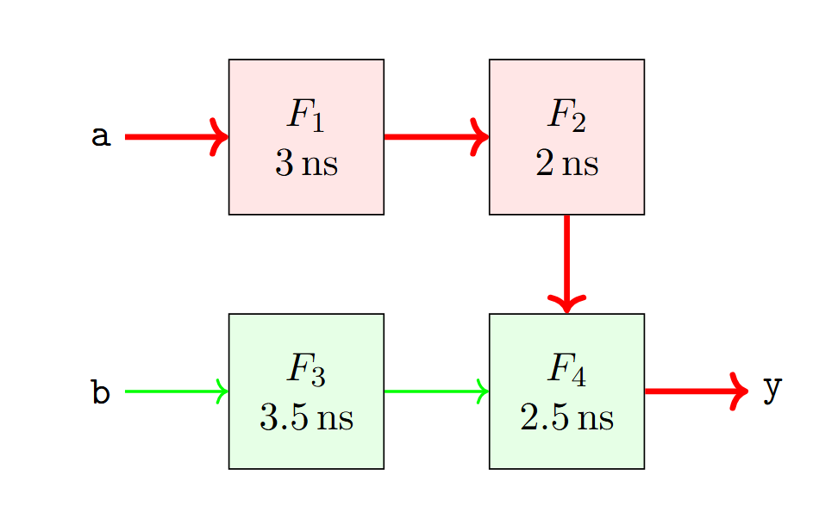
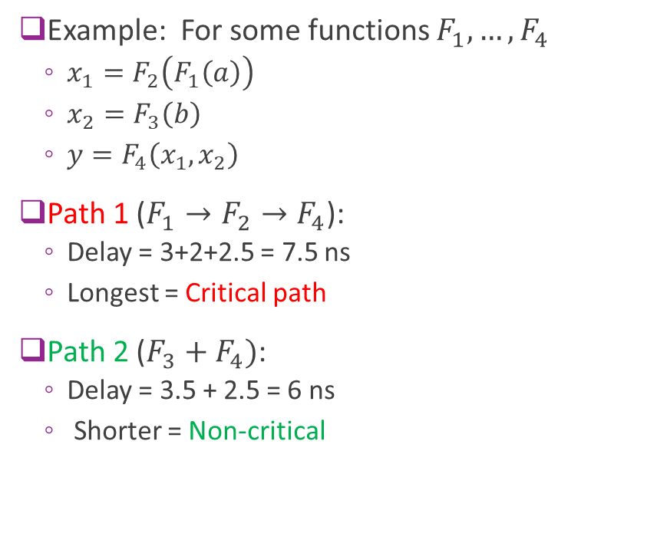
Critical Path Example
Example: For some functions $F_{1},…,F_{4}$
$x_{1}=F_{2}\left(F_{1}\left(a\right)\right)$
$x_{2}=F_{3}\left(b\right)$
$y=F_{4}\left(x_{1},x_{2}\right)$
Path 1 ($F_{1}→F_{2}→F_{4}$):
Delay = 3+2+2.5 = 7.5 ns
Longest = Critical path
Path 2 ($F_{3}+F_{4})$:
Delay = 3.5 + 2.5 = 6 ns
Shorter = Non-critical

Slide 30
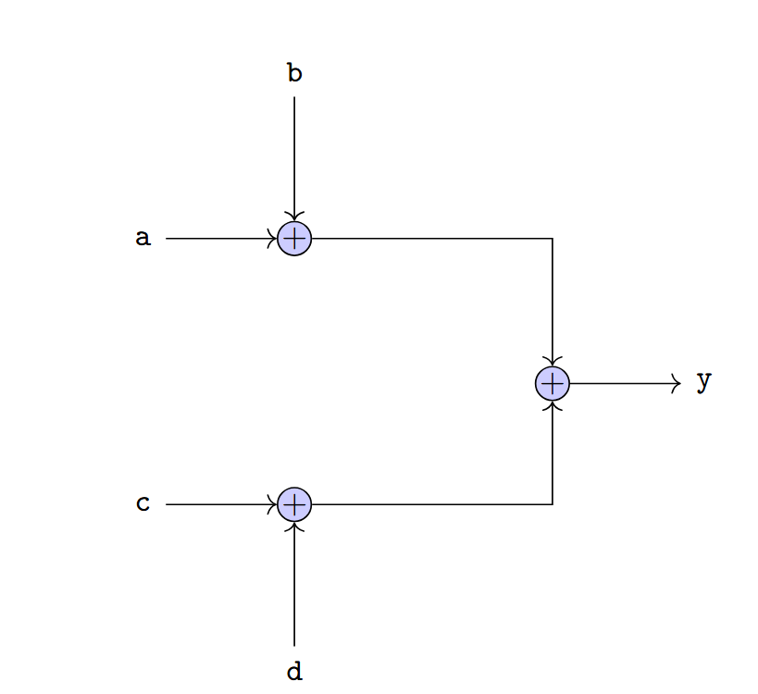
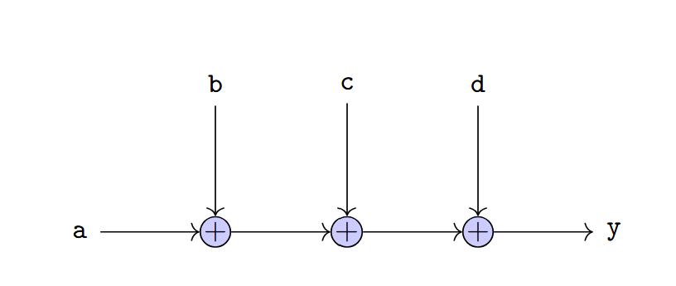

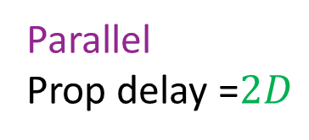
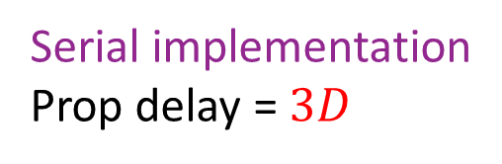
Delay Depends on Implementation
Example: Consider $y=a+b+c+d$
Suppose each add takes $D$ seconds
Synthesis tools try to find low delay implementations
Serial implementation
Prop delay = $3D$
Parallel
Prop delay =$2D$

Slide 31
Outline
Static Timing Analysis in Combinational Logic
Static Timing Analysis in Sequential Logic
Sequential Logic Timing Diagrams
VCD Files and Timing Diagrams from Vitis

Slide 32
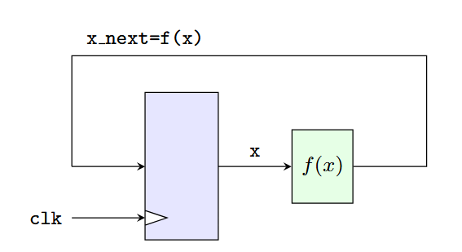
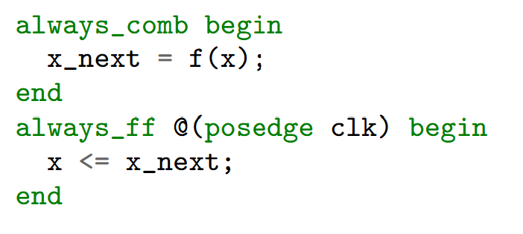
Synchronous Logic
We now perform static timing analysis for synchronous logic
This unit, we assume
All registers clocked on a common positive clock edge
All registers are perfectly synchronized (no clock skew)
No asynchronous reset

Slide 33
STA for Synchronous Logic Overview
STA considers all register-to-register paths
Every register output to register input
Tests two conditions
No paths arrive too late
Signals must arrive before next transition
Must meet a set-up time and clock-to-Q time
No paths arrive too early
Min delay > hold time
Registers inputs must be stable for a hold period

Slide 34
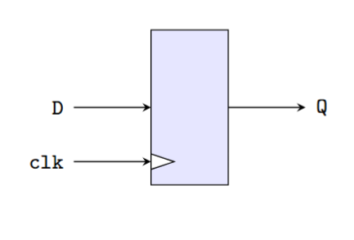
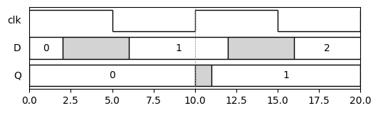
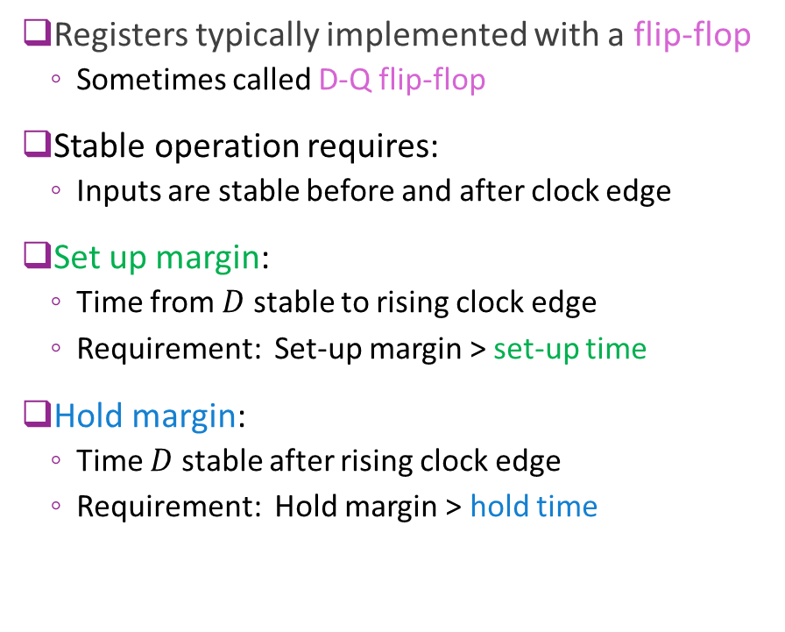
Set-Up and Hold Time
Registers typically implemented with a flip-flop
Sometimes called D-Q flip-flop
Stable operation requires:
Inputs are stable before and after clock edge
Set up margin:
Time from $D$ stable to rising clock edge
Requirement: Set-up margin > set-up time
Hold margin:
Time $D$ stable after rising clock edge
Requirement: Hold margin > hold time
Setup margin
Hold margin
(min)
set-up time
(min) hold time

Slide 35

Clock-to-Q time
Clock-to-Q time
Time from rising edge to stable output $Q$
Sometimes loosely called register delay
Physically time to transfer input to output
Clock-to-Q time

Slide 36
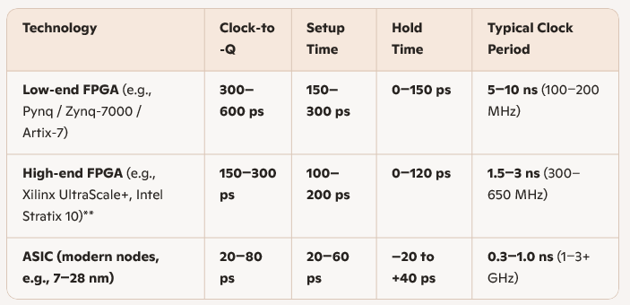
Typical Times
Note: Modern nodes may have a negative hold time!

Slide 37
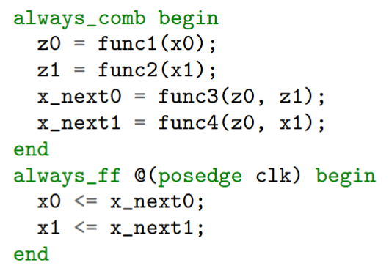
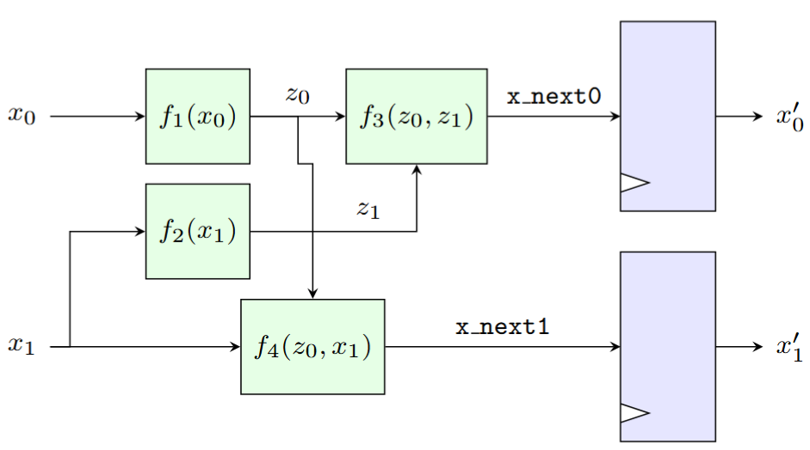
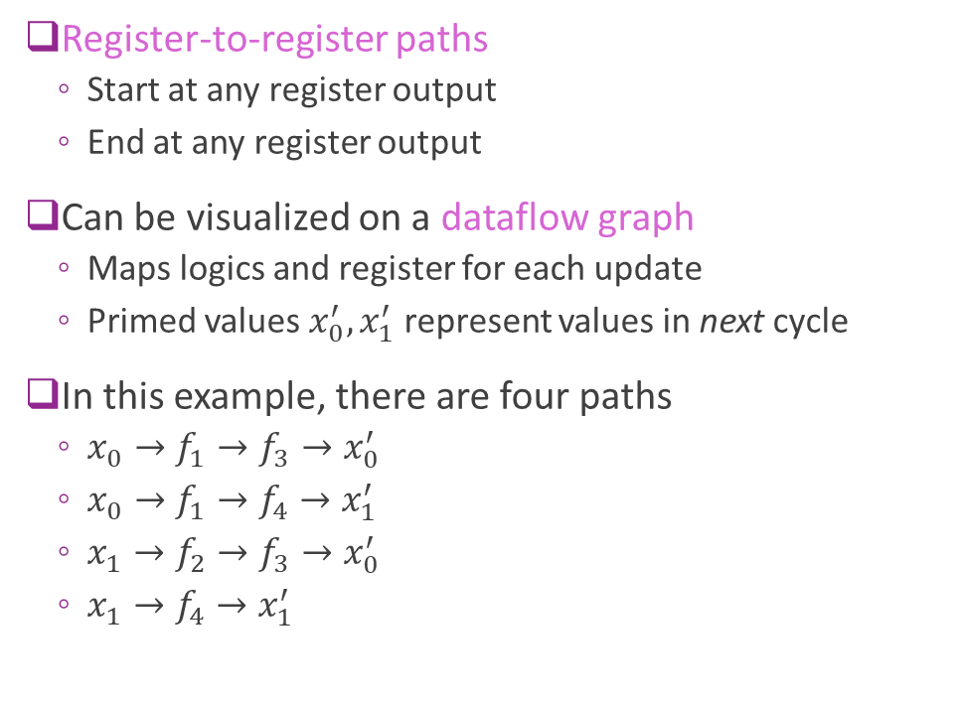
Register-to-Register Paths
Register-to-register paths
Start at any register output
End at any register output
Can be visualized on a dataflow graph
Maps logics and register for each update
Primed values $x_{0}^{′}, x_{1}^{′}$ represent values in next cycle
In this example, there are four paths
$x_{0}→f_{1}→f_{3}→x_{0}^{′}$
$x_{0}→f_{1}→f_{4}→x_{1}^{′}$
$x_{1}→f_{2}→f_{3}→x_{0}^{′}$
$x_{1}→f_{4}→x_{1}^{′}$

Slide 38
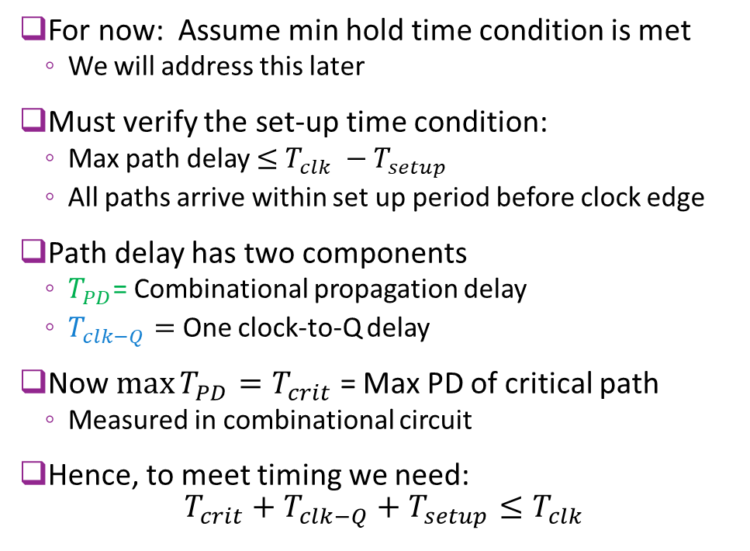
STA Analysis: Verifying the Set-Up Time
For now: Assume min hold time condition is met
We will address this later
Must verify the set-up time condition:
Max path delay $≤$ $T_{clk} −T_{setup}$
All paths arrive within set up period before clock edge
Path delay has two components
$T_{PD}$= Combinational propagation delay
$T_{clk−Q}=$ One clock-to-Q delay
Now $\max{T_{PD}}=T_{crit}$ = Max PD of critical path
Measured in combinational circuit
Hence, to meet timing we need: $T_{crit}+T_{clk−Q}+T_{setup}≤T_{clk}$
Combinational PD
Clock-to-Q time

Slide 39
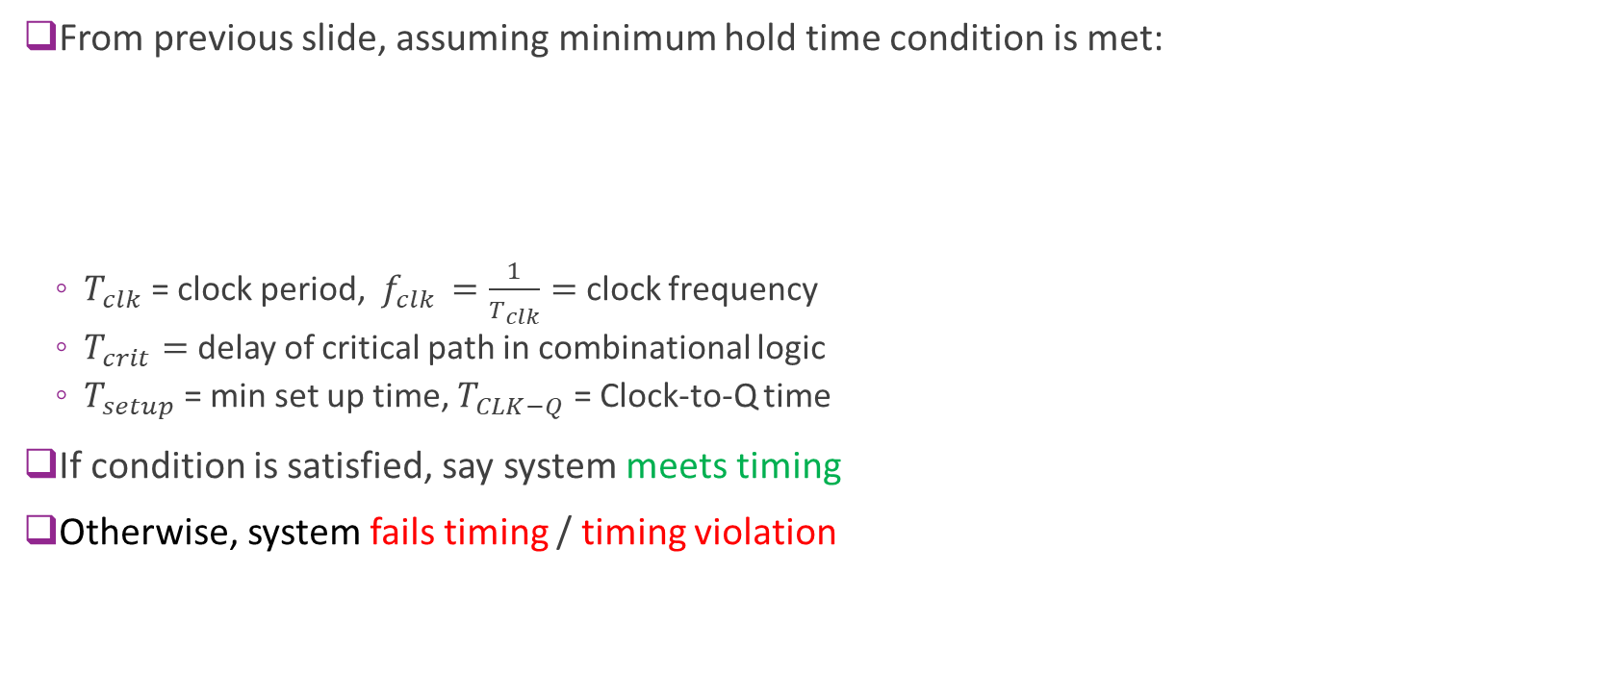
Meeting or Failing Timing
From previous slide, assuming minimum hold time condition is met:
$T_{clk}$ = clock period, $f_{clk }=\frac{1}{T_{clk}}=$ clock frequency
$T_{crit}=$ delay of critical path in combinational logic
$T_{setup}$ = min set up time, $T_{CLK−Q}$ = Clock-to-Q time
If condition is satisfied, say system meets timing
Otherwise, system fails timing / timing violation
To meet timing: $T_{clk}>T_{crit}+T_{setup}+T_{CLK−Q}$

Slide 40
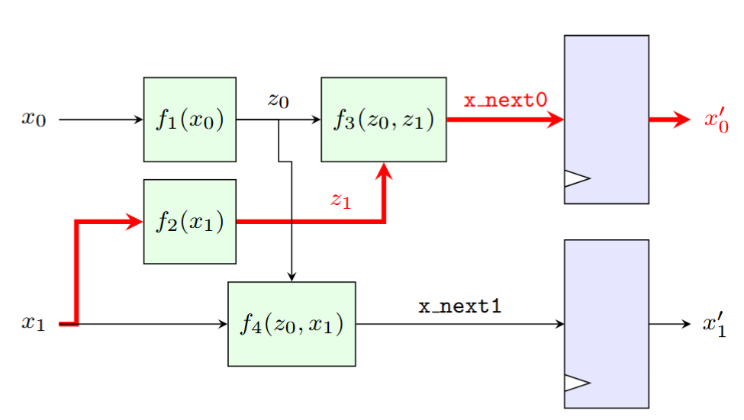
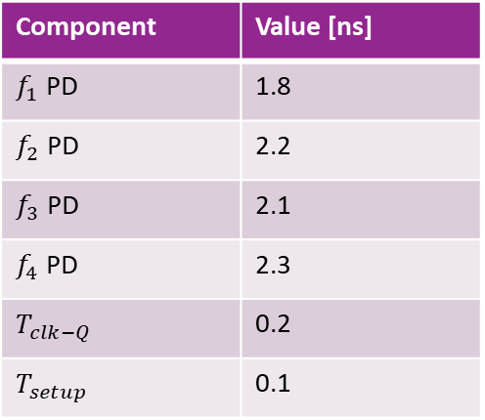
Example: Calculating Critical Path
Max propagation delay
Can be computed recursively
Identical to combinational section
2.2+2.3 =4.5
1.8
Component | Value [ns]
$f_{1}$ PD | 1.8
$f_{2}$ PD | 2.2
$f_{3}$ PD | 2.1
$f_{4}$ PD | 2.3
$T_{clk−Q}$ | 0.2
$T_{setup}$ | 0.1
4.5+0.2=4.7
2.2
1.8+2.1 =3.9
3.9+0.2=4.1

Slide 41


Example: Maximum Clock Frequency
Component | Value [ns]
$T_{crit}$ | 4.5
$T_{clk−Q}$ | 0.2
$T_{setup}$ | 0.1
$T_{clk}$ min | 4.8
From previous slide:
Critical path delay in combination logic: $T_{crit}=4.5$ ns
Therefore, to meet timing: $T_{clk}≥T_{crit}+T_{CLK−Q}+T_{setup}$ $=4.5+0.2+0.1=4.8$ ns
Max clock frequency $f_{clk }=\frac{1}{T_{clk}}≤208 MHz$
4.5
4.5+0.2=4.7

Slide 42



Meeting the Min Hold Time Constraint
Consider circuit to the right
A simple delay line
Naïve implementation
Very short path: Output $x_{0}→$ input $x_{1}$
Could violate minimum hold time
Typical solved in place & route
Physical design will insert delay elements
With reasonable synchronous design:
RTL design does not need to worry about this constraint
Short path. Could violate min hold

Slide 43
Outline
Static Timing Analysis in Combinational Logic
Static Timing Analysis in Sequential Logic
Sequential Logic Timing Diagrams
VCD Files and Timing Diagrams from Vitis

Slide 44




Synchronous Logic Detailed Timing Diagram
$$T_{clk−Q}$$
Consider counter: $f\left(x\right)=x+1$
Two delays in any synchronous circuit
Clk-to-Q delay: clock rising edge $→$ register output
This example shown as 2 ns
Combinational PD: register output $→$ next value
This example shown as 3 ns
$$T_{pd}$$

Slide 45
Detailed Timing Diagram
Timing diagram drawn called detailed diagram
Sometimes called the real timing diagram
Shows all details:
Register delays
All propagation delays in combinational paths
Good for reasoning about precise timing
Can compute computation speed, throughput, …
But too many details to understand functionality
$$T_{clk−Q}$$
$$T_{pd}$$

Slide 46



Abstract or Cycle Accurate Timing Diagram
Detailed timing diagram
Abstract timing diagram
Also called cycle-accurate diagram
All delays $→$ 0
Ignores computation time
No unknown (X or ?) regions
Simpler to see functionality
Values in each cycle represent
Value immediately before rising edge at end of cycle
Delays $→$ 0
Abstract timing diagram

Slide 47

ReLU + Linear Synchronous Module
Now consider synchronous version of ReLU + linear
Identical to Unit 2
We add two inputs to ports
Clock signal
Reset on negative edge
Clock
Reset

Slide 48

Synchronous Implementation
Use identical implementation as in Unit 2
Next values computed in always_comb block

Slide 49

STA
Hardware block | Max prop delay
Register | 0 ns
Multiplier | $T_{mult}=$3 ns
Adder | $T_{add}=$1.5 ns
Max operator | $T_{max}=$1 ns
Total =critical path | $T_{crit}=$5.5 ns
Assume the propagation delays in table
Delay in each stage shown in violet
Ignore CLK-Q time
0
0
0
3
3+1.5=4.5
4.5+1=5.5

Slide 50





ReLU+Linear Timing Diagram
Hardware block | Example Value
Multiplier | $T_{mult}=$3 ns
Adder | $T_{add}=$1.5 ns
Max operator | $T_{max}=$1 ns
Total =critical path | $T_{crit}=$5.5 ns
$T_{crit}=5.5$ns
Meets timing: $T_{clk}>T_{crit}$
$T_{clk}=10$ns

Slide 51

Max Clock Frequency Example
Max clock frequency in our example:
Min $T_{clk}=T_{crit}=5.5$ ns
Max clock frequency = $\frac{1}{5.5}≅180$MHz
$T_{crit}=5.5$ns
$T_{clk}=10$ns

Slide 52



Quadratic Example
Consider a quadratic function: $y=w_{2}x^{2}+w_{1}x+w_{0}$
For simplicity, assume $w_{0},w_{1},w_{2}$ are fixed parameters
Single cycle implementation to the right

Slide 53


Finding the Critical Path
Hardware block | Example Value
Register | $T_{reg}$= 1 ns
Multiplier | $T_{mult}$ = 4 ns
Adder | $T_{add}=$1.5 ns
Path 1 | 1+4+4+1.5+1.5 = 12
Path 2 | 1+4+1.5+1.5=8
Consider implementation with times in table
Two paths:
Path 1: x, x_reg, xsq_w2, y
1 register, 2 mults, 2 adders = 12 ns
Path 2: x, x_reg, x_w1, y
1 register, 1 mult, 2 adders = 8 ns
Path 1 is critical
Max clock frequency $=\frac{1}{12 ns}=83$ MHz
Would fail timing at $100$ MHz

Slide 54


A Two Cycle Design
We can improve throughput by breaking computation over two cycles
Register two intermediate terms:
xsq = xreg * xreg
lin_term = w1*xreg + w0

Slide 55

Three Stages
Design is processed in three stages = 2 cycles
Stage 0
Register input $x$ to xreg
Stage 1: Compute and register:
xsq = xreg * xreg
lin_term = w1*xreg + w0
Stage 2: Compute output
y = w2*xsq + lin_term

Slide 56


Critical Path with Three Stages
Hardware block | Example Value
Register | $T_{reg}$= 1 ns
Multiplier | $T_{mult}$ = 4 ns
Adder | $T_{add}=$1.5 ns
Path 1 | 1+4=5
Path 2 | 1+4+1.5=6.5
Path 3 | 1+4+1.5=6.5
Measure paths from register to register
Path 1: x, x_reg, xsq input
1 register, 1 mult = 5 ns
Path 2: x, x_reg, w1_x, lin_x input
1 register, 1 mult, 1 add = 6.5 ns
Path 3: xsq_reg, lin_x, w2_xsq, y
1 register, 1 mult, 1 add = 6.5 ns
Critical path delay = 6.5 ns
Max freq = $\frac{1}{6.5}≈153$ MHz

Slide 57


Two Cycle Timing Diagram
Example with
$w=[4,−7,5]$
$x$ inputs 10, -4, 8

Slide 58

Latency, Throughput and Pipelining
Suppose that we run at our design at 100 MHz clock
Latency:
Suppose input is valid on rising edge of clock $n$
Then output is valid before rising edge of clock $n+2$
Latency = 2 clock cycles = 20 ns
Throughput:
Circuit can take a new input each cycle
Throughput = 1 input / cycle = $100$ MHz
Process is called a pipeline
Circuit is processing multiple inputs at the same time

Slide 59

Performance Comparison
 | Single Cycle Design | Two Cycle Design
Critical path | 12 ns | 6.5 ns
Max clock frequency | $≈$ 80 MHz | $≈$ 150 MHz
Max throughput | 80 MHz | 150 MHz
Latency | 1 cycle = 12 ns | 2 cycles = 13 ns
Pipelining benefit: For small increase in latency, we dramatically improve throughput

Slide 60
Outline
Static Timing Analysis in Combinational Logic
Static Timing Analysis in Sequential Logic
Sequential Logic Timing Diagrams
VCD Files and Timing Diagrams from Vitis

Slide 61

Value-Change Points
Simulation tools trace values over time for large numbers of signals
Data on each signal is typically stored via value-change points
Value change points also called valued change events, transitions, …
Definition: A signal $x(t)$ has value-change points $\{\left(t_{i},x_{i}\right), i=0, …, n−1\}$ if: $$x\left(t\right)= \left\{\begin{matrix}X & t<t_{0} \\ x_{i} & t_{i}≤t<t_{i+1}, i=0,…,n−2 \\ x_{n−1} & t≥t_{n−1}\end{matrix}\right.$$

Slide 62


Timing Diagram and VCDs
Timing diagrams can be drawn from the VCDs
Example with two signals:
VC points for $x$ : {(3,5), (20,17), (40,8)}
VC points for $y$ : {(12,3), (25,12), (35,0)}
In this plot, times are in ns

Slide 63

Viewing Waveforms in Vivado
Vivado has a built-in waveform viewer
But no way to download the data
Stored in a proprietary format
Can only be seen in GUI
As far as I know

Slide 64



Viewing Timing Diagrams in this Class
Use course package xilinxutils
Many python utilities for Xilinx tools
Demonstrate on simple function demo
Covered in Unit 2
Sv_sim utility:
Modifies the vitis simulation files
Adds a VCD file
Creates a dump.vcd file
In python:
Load the VCD file
Use VCD package

Slide 65



Parsing the Signals in Python
Create a VcdParser object
Define signals to parse
Add signals to parser

Slide 66


Displaying the Signals in Python
Create a TimingDiagram object
Add the signals from the parser
Plot

Slide 67

Drawing Timing Diagrams in Python
Course repo contains a xilinxutils package
Custom package in this class
Many helper routines for Xilinx tools
Tools for parsing and visualizing VCD files
Code to produce timing diagram

