Slide 1
Unit 1
Data Types and Combinational Logic
EL-GY 9463: Introduction to Hardware Design
ProfS. Sundeep Rangan, Siddharth Garg

Slide 2
Learning Objectives
Represent signals in SystemVerilog of various types:
  Logical vectors and signed and unsigned integers
Implement arithmetic operations (additions, multiplications, bit operations)
Identify cases for overflow and truncation
Create simple combinational logic modules to implement functions
Draw a block diagram representation of the module

Slide 3
Outline
Basic Data Types: Logic and Integers
Truncation and Overflows
Bit Shifts
Simple Combinational Logic

Slide 4
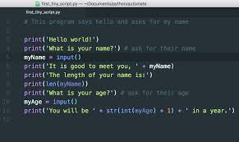
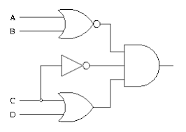
Hardware Description Language
Hardware Description Language (HDL)
  Example: Verilog, SystemVerilog
  Describes hardware structure and behavior
  Items natively run in parallel
  Code is synthesized
  Code becomes to logic elements, registers, …
  Also become testbenches
Software
  Example: C, python
  Describes sequential behavior
  One instruction after another
  Code is compiled
  Becomes machine code for a processor

Slide 5
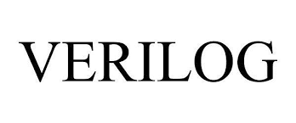

System Verilog vs Verilog
Verilog
  Created in 1983-84
  Standardized in 1995. Became mainstream RTL
  Largely used for legacy designs
System Verilog (this unit)
  Developed in 2002
  Extends Verilog
  Better abstraction, parameterization
  Significantly improved testbench
  Overwhelming design choice today

Slide 6

Logic and Logic Vectors
Logic: Basic data type in System Verilog
  Value 0, 1, X or Z
  X = unknown or unspecified
  Z = not connected
  We will discuss X and Z later
Logic vector
  A group of log bits
  Each vector has a bit width.

Slide 7
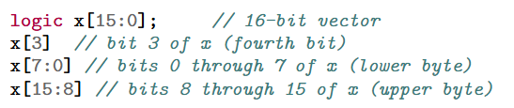
Bitwise Operations
System Verilog has natural ways to pack and unpack bits
Note bits are always counted from 0

Slide 8
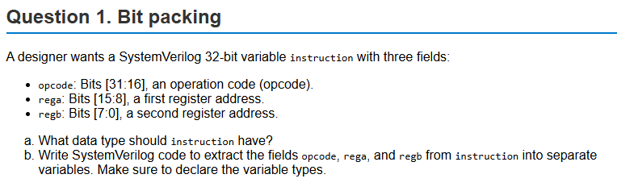
Example Problem

Slide 9
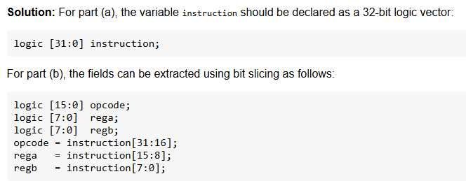
Solution

Slide 10

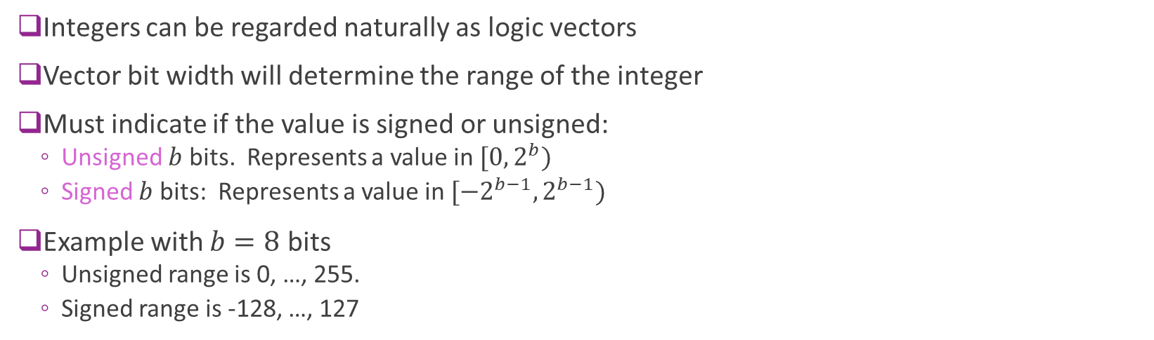
Integers
Integers can be regarded naturally as logic vectors
Vector bit width will determine the range of the integer
Must indicate if the value is signed or unsigned:
  Unsigned $b$ bits. Represents a value in $[0, 2^{b})$
  Signed $b$ bits: Represents a value in $[−2^{b−1}, 2^{b−1})$
Example with $b=8$ bits
  Unsigned range is 0, …, 255.
  Signed range is -128, …, 127

Slide 11
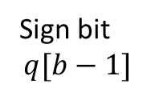
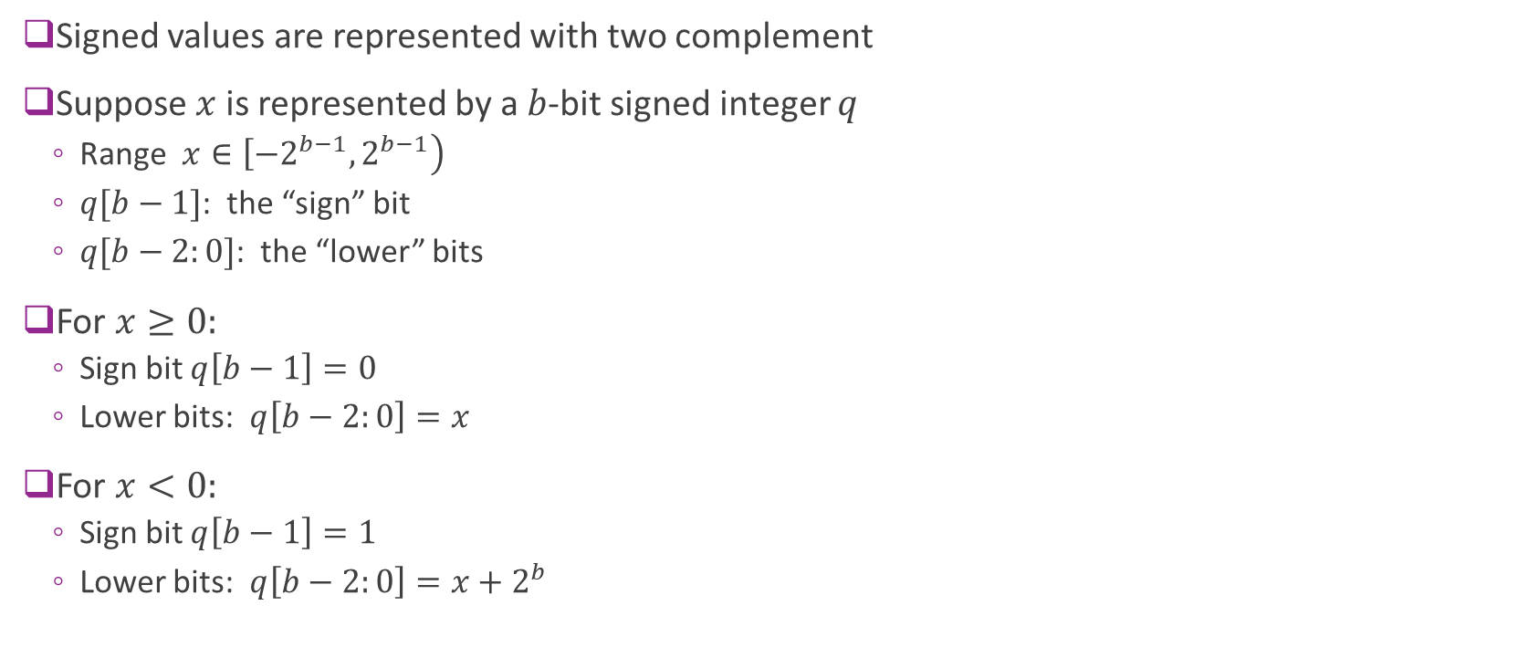
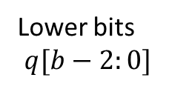
Two Complement
Signed values are represented with two complement
Suppose $x$ is represented by a $b$-bit signed integer $q$
  Range $x∈\left[−2^{b−1},2^{b−1}\right)$
  $q[b−1]$: the “sign” bit
  $q[b−2:0]$: the “lower” bits
For $x≥0:$
  Sign bit $q\left[b−1\right]=0$
  Lower bits: $q\left[b−2:0\right]=x$
For $x<0:$
  Sign bit $q\left[b−1\right]=1$
  Lower bits: $q\left[b−2:0\right]=x+2^{b}$
Sign bit
$$q[b−1]$$
Lower bits
$$q[b−2:0]$$

Slide 12
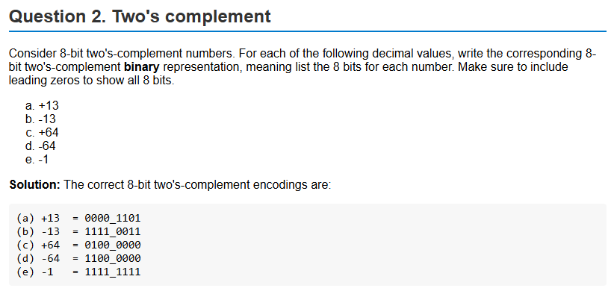
Example Problem

Slide 13
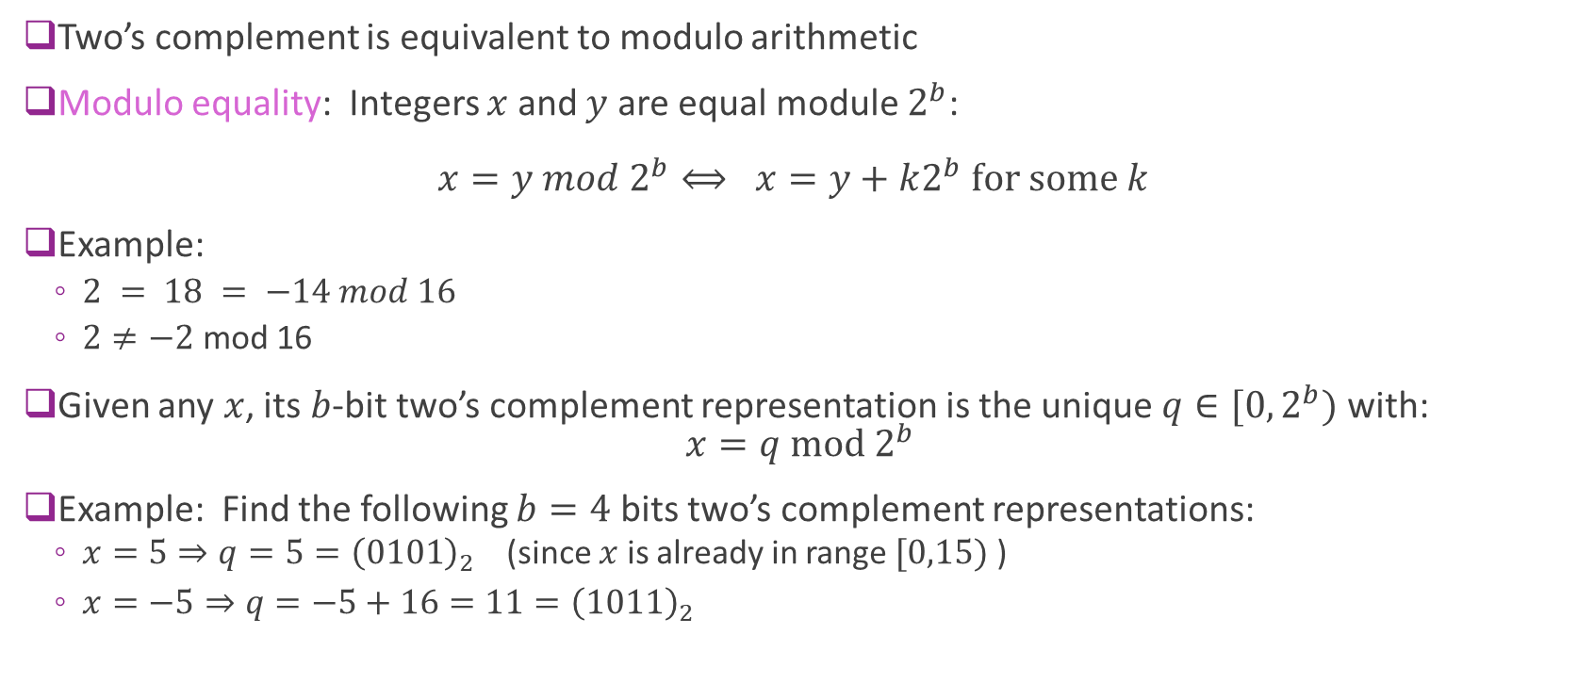
Two’s Complement = Modulo Arithmetic
Two’s complement is equivalent to modulo arithmetic
Modulo equality: Integers $x$ and $y$ are equal module $2^{b}$:
$x=y mod 2^{b}⟺ x=y+k2^{b} for some k$
Example:
  $2 = 18 = −14 mod 16$
  $2≠−2$ mod 16
Given any $x$, its $b$-bit two’s complement representation is the unique $q∈[0,2^{b})$ with:
$x=q mod 2^{b}$
Example: Find the following $b=4$ bits two’s complement representations:
  $x=5⇒q=5={\left(0101\right)}_{2}$ (since $x$ is already in range $[0,15)$ )
  $x=−5⇒q=−5+16=11={\left(1011\right)}_{2}$

Slide 14
System Verilog Literals and Constants
Literal: A value written directly in code (not stored in a storage element)
  Constant. Does not change
SV has a specific syntax: <size>'<base><digits>
  <size> = number of bits. If omitted, takes a default value, typically 32-bits
  <base> = b, o, d, h : binary, octal, decimal, hex
  <digits> = value
Examples:
  8'd13 → 8‑bit decimal 13
  8'b0101_1010 → 8‑bit binary
  4'hF → 4‑bit hex (1111)
  16'd8 → 16‑bit decimal 8
  8'b0101 → 8‑bit binary 0101
  -8'd5 → 5-bit two-complement decimal -5 (11111011)

Slide 15
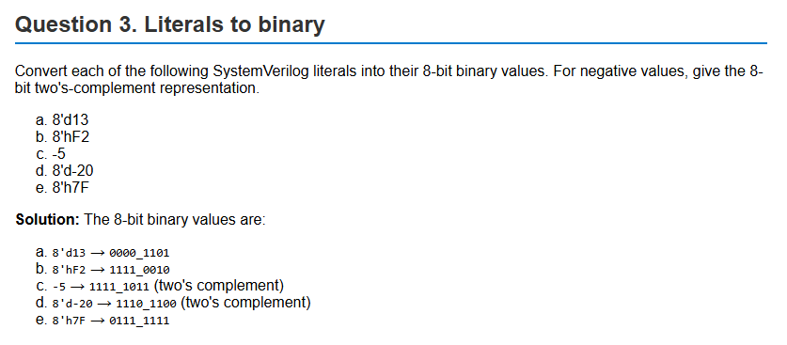
Example Problem

Slide 16
Outline
Basic Data Types: Logic and Integers
Truncation and Overflows
Bit Shifts
Simple Combinational Logic

Slide 17
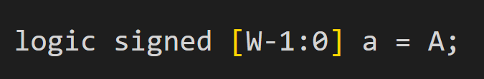
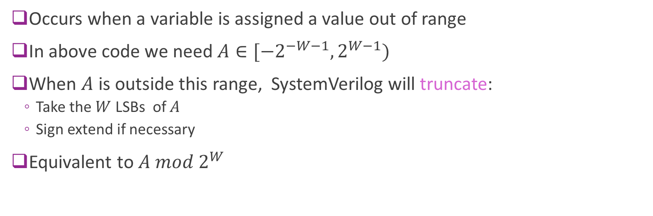
Truncation
Occurs when a variable is assigned a value out of range
In above code we need $A∈[{−2}^{−W−1},2^{W−1})$
When $A$ is outside this range, SystemVerilog will truncate:
  Take the $W$ LSBs of $A$
  Sign extend if necessary
Equivalent to $A mod 2^{W}$

Slide 18
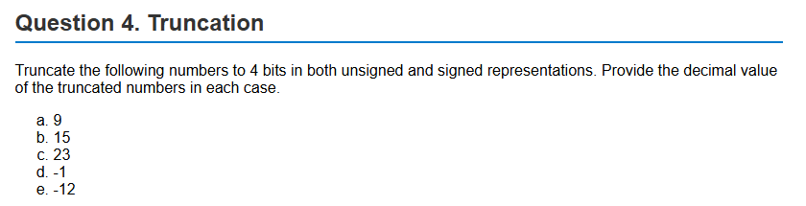
Sample Problem

Slide 19
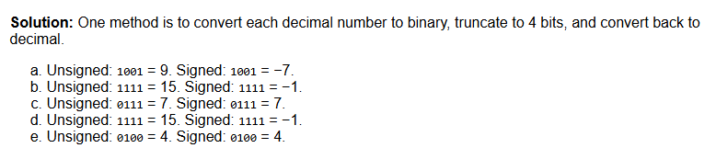
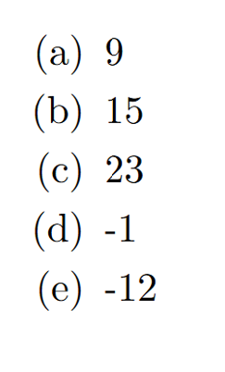
Solution using Binary Representations

Slide 20
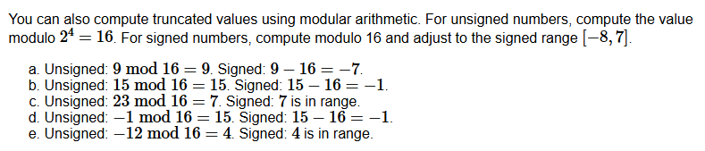
Solution using Modulo Arithmetic

Slide 21
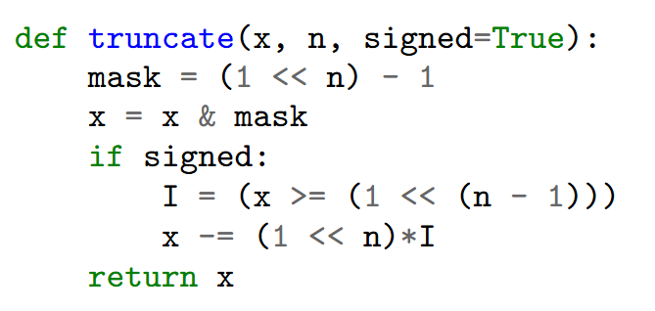

Simulating Truncation in Python
This code works for numpy arrays
Mask the $n$ LSB
Then sign extend if necessary

Slide 22
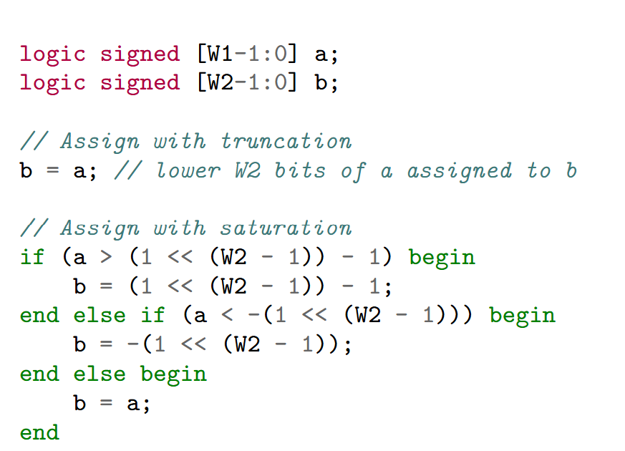

Saturation
Truncation results in values far different from original
  Ex: Truncate $9$ to 4 signed bits $⇒9−16=−7$
Alternatively, can saturate
  Clip to max or min values before assignment
  Ex: Truncate 9 to 7
  Provides less approximation error
  But adds a bit of extra logic
Example to right: $W_{2}<W_{1}$
  Want to assign $b=a$

Slide 23
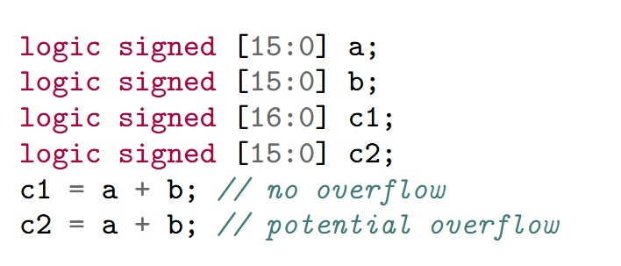
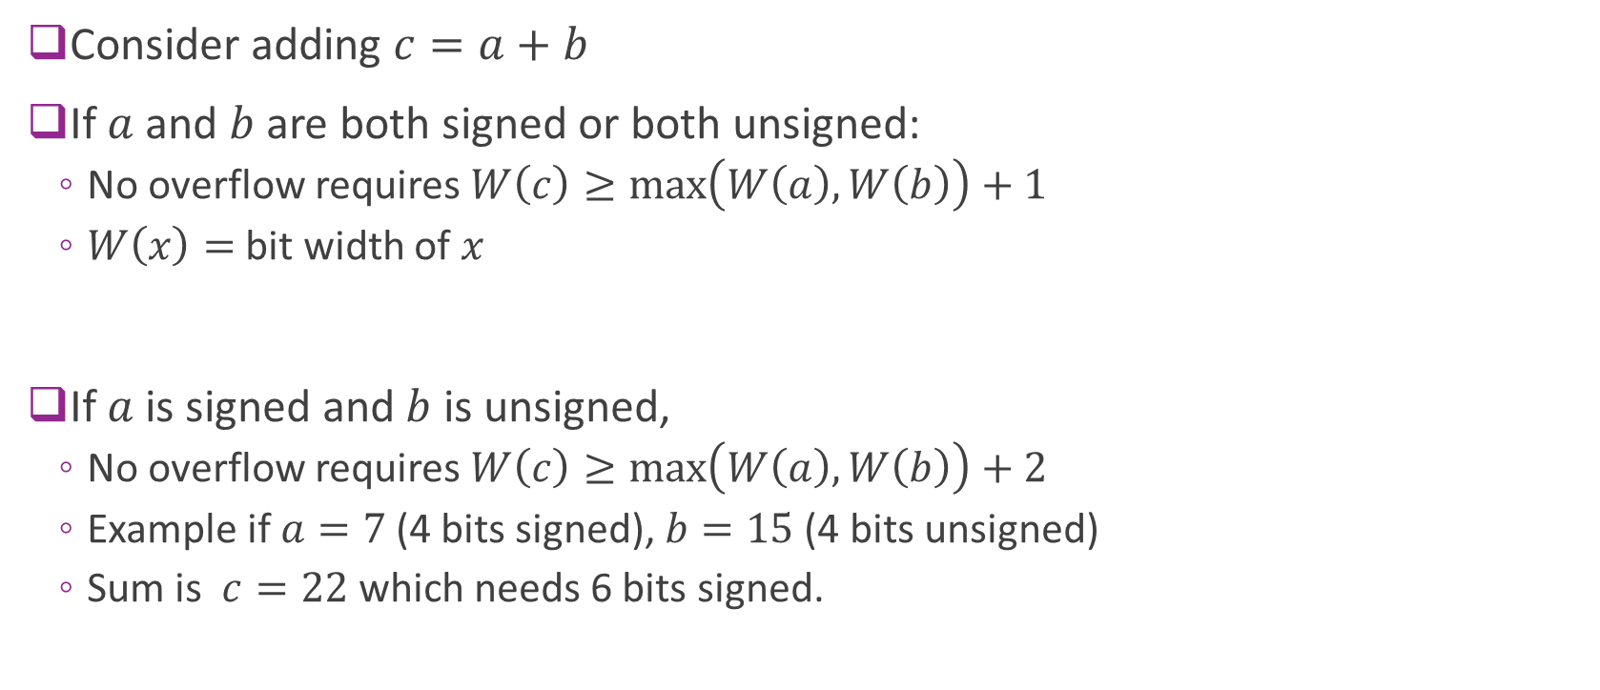
Addition Overflow Rules
Consider adding $c=a+b$
If $a$ and $b$ are both signed or both unsigned:
  No overflow requires $W\left(c\right)≥\max\left(W\left(a\right),W\left(b\right)\right)+1$
  $W\left(x\right)=$ bit width of $x$
If $a$ is signed and $b$ is unsigned,
  No overflow requires $W\left(c\right)≥\max\left(W\left(a\right),W\left(b\right)\right)+2$
  Example if $a=7$ (4 bits signed), $b=15$ (4 bits unsigned)
  Sum is $c=22$ which needs 6 bits signed.

Slide 24
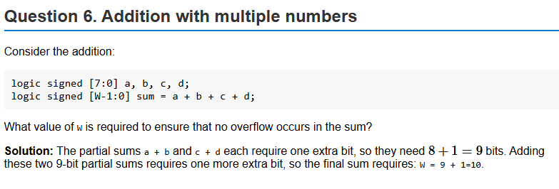
Sample Problem

Slide 25
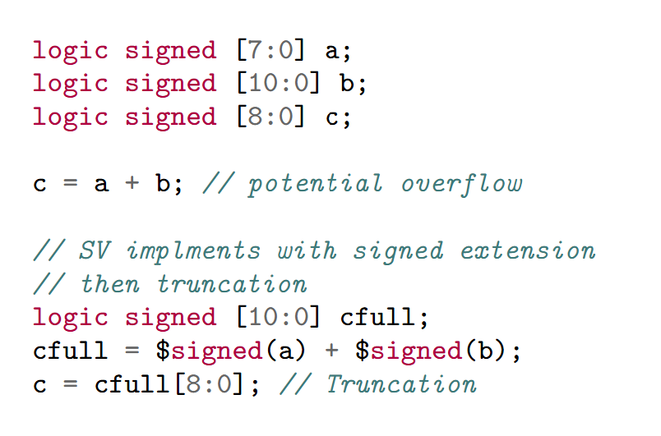
Addition with Truncation
Given a potential overflow, SV will:
  Create a temporary variable with no overflow
  Temporary variable has enough bits
  Then it will truncate to lower bits
Saturation must be implemented manually

Slide 26
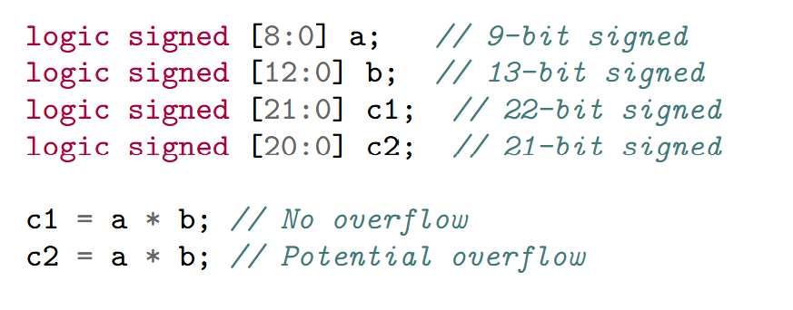
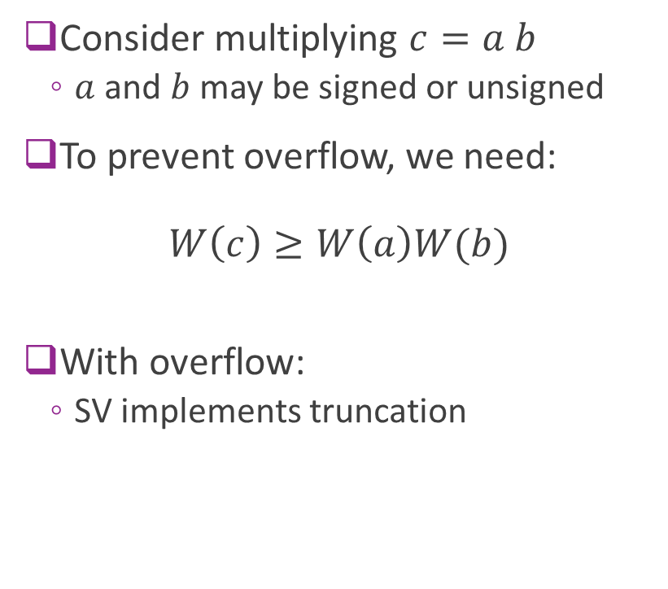
Multiplication Overflow
Consider multiplying $c=a b$
  $a$ and $b$ may be signed or unsigned
To prevent overflow, we need:
$W\left(c\right)≥W\left(a\right)W(b)$
With overflow:
  SV implements truncation

Slide 27
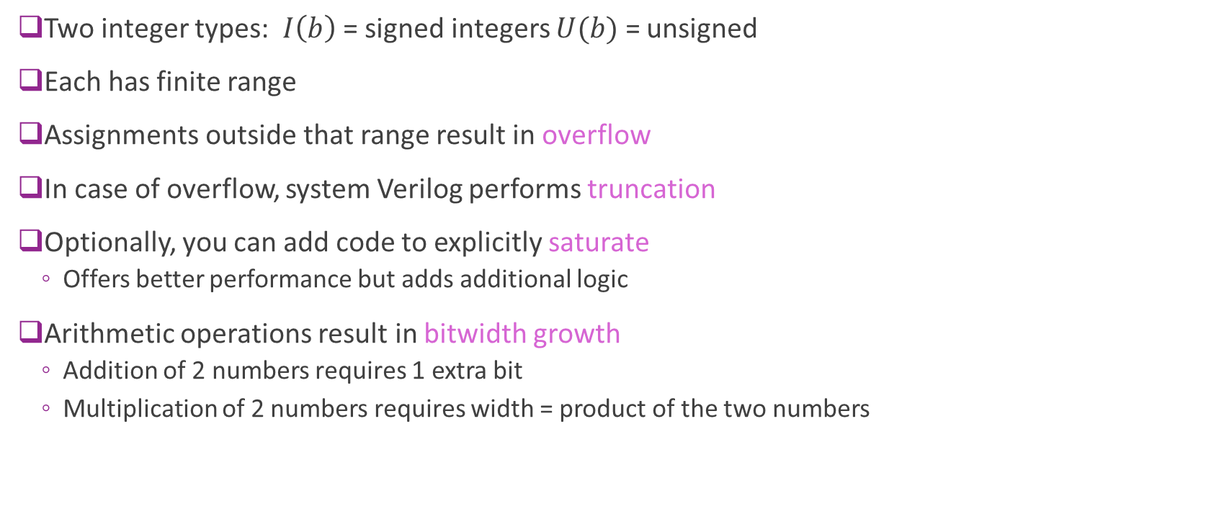
Summary
Two integer types: $I\left(b\right)$ = signed integers $U(b)$ = unsigned
Each has finite range
Assignments outside that range result in overflow
In case of overflow, system Verilog performs truncation
Optionally, you can add code to explicitly saturate
  Offers better performance but adds additional logic
Arithmetic operations result in bitwidth growth
  Addition of 2 numbers requires 1 extra bit
  Multiplication of 2 numbers requires width = product of the two numbers

Slide 28
Outline
Basic Data Types: Logic and Integers
Truncation and Overflows
Bit Shifts
Simple Combinational Logic

Slide 29

Logical Bit Shift
Bit shift operators:
  $x≫b$ and $x≪b$ Right and left shift by $b$ bits
  Fills in with zeros
Bit widths always stay the same.
  Hence, bits may be lost
Examples:
  ($1011 0110)≫4=\left(0000 1011\right)$
  ($1011 0110)≪3=\left(1011 0000\right)$

Slide 30
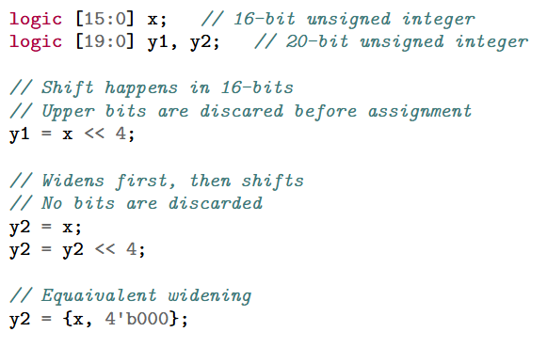
Logical Shift and Bit Widths
Caution:
  Logical bit shifts do not change width
  Some bits may be discarded
To avoid discarding:
  Widen first, then shift

Slide 31
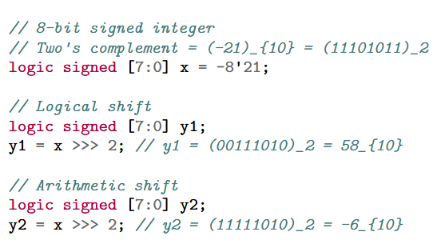
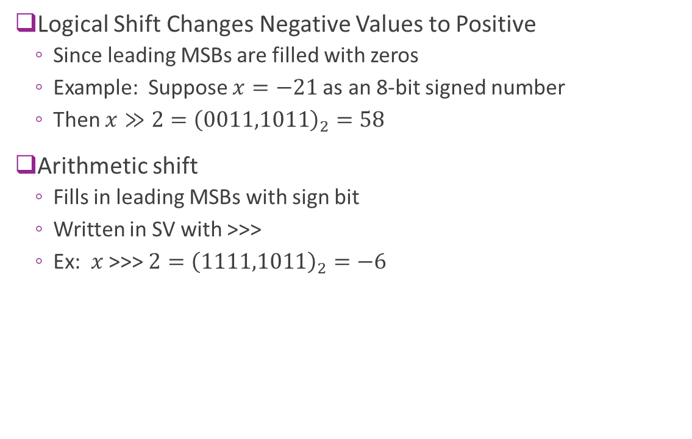
Arithmetic Shift
Logical Shift Changes Negative Values to Positive
  Since leading MSBs are filled with zeros
  Example: Suppose $x=−21$as an 8-bit signed number
  Then $x≫2={\left(0011,1011\right)}_{2}=58$
Arithmetic shift
  Fills in leading MSBs with sign bit
  Written in SV with >>>
  Ex: $x$ >>> $2={\left(1111,1011\right)}_{2}=−6$

Slide 32

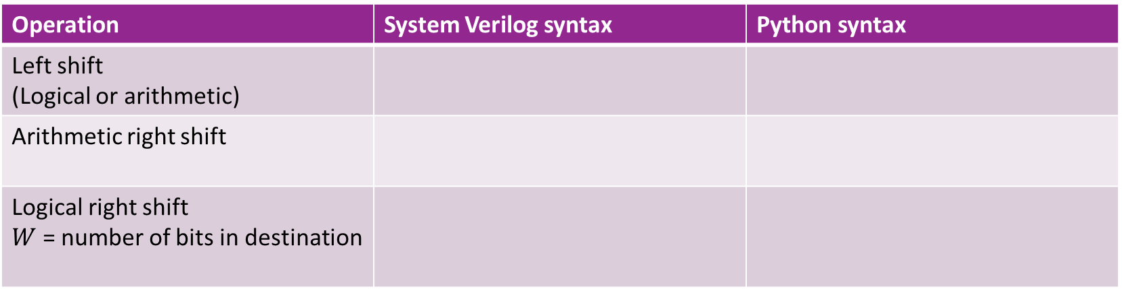
Python vs. SV
Operation | System Verilog syntax | Python syntax
Left shift (Logical or arithmetic)
Arithmetic right shift
Logical right shift $W$ = number of bits in destination
Note: All shifts in python are arithmetic
To emulate logical right shift need a mask

Slide 33
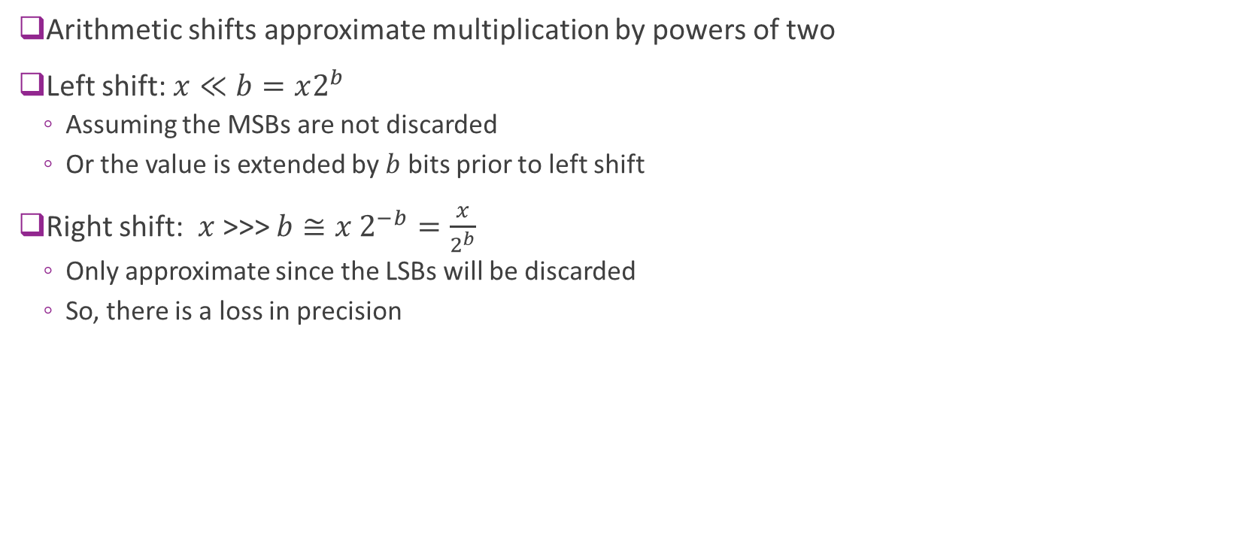
Arithmetic Shift and Powers of Two
Arithmetic shifts approximate multiplication by powers of two
Left shift: $x≪b=x2^{b}$
  Assuming the MSBs are not discarded
  Or the value is extended by $b$ bits prior to left shift
Right shift: $x$>>> $b≅x 2^{−b}=\frac{x}{2^{b}}$
  Only approximate since the LSBs will be discarded
  So, there is a loss in precision

Slide 34
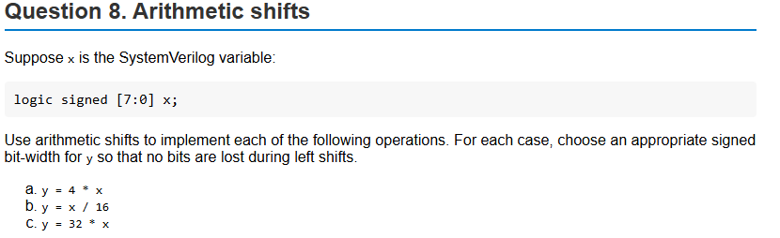
Example Problem

Slide 35
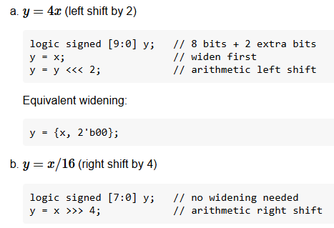
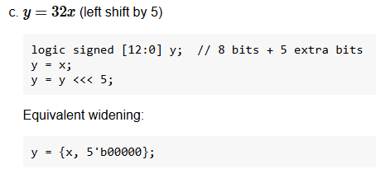
Solution

Slide 36
Outline
Basic Data Types: Logic and Integers
Truncation and Overflows
Bit Shifts
Simple Combinational Logic

Slide 37
Module and Combinational Logic
Module: A named circuit block with some inputs and outputs
  Fully self-contained
  Takes some input signals and produces some outputs
  May have sub-modules
Combinational logic: Outputs depend only on current inputs
  No memory
  No storage
  We will contrast this type of module with sequential logic in the next unit

Slide 38





Simple Example: ReLU + Linear
Goal: Implement a combinational logic module for the function
$$y=\max\left\{ax+b, 0\right\}$$
  Linear function + ReLU
  Used widely in machine learning
$$x$$
Input ports
$$a$$
$$y$$
Output port
$$b$$

Slide 39
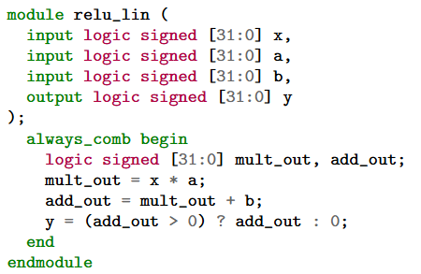
SystemVerilog Description
Each block is a module
  Has inputs and outputs
  Logical mapping from inputs to outputs
Description is behavioral only
  Does not say how it will be implemented
  We discuss that later

Slide 40
Module Components in SV
Module name
Ports:
  Defines inputs and outputs
  Each has a type (more detail later)
Behavioral description
  In this case, a combinational block
  Sequence of operations
  From input to output

Slide 41
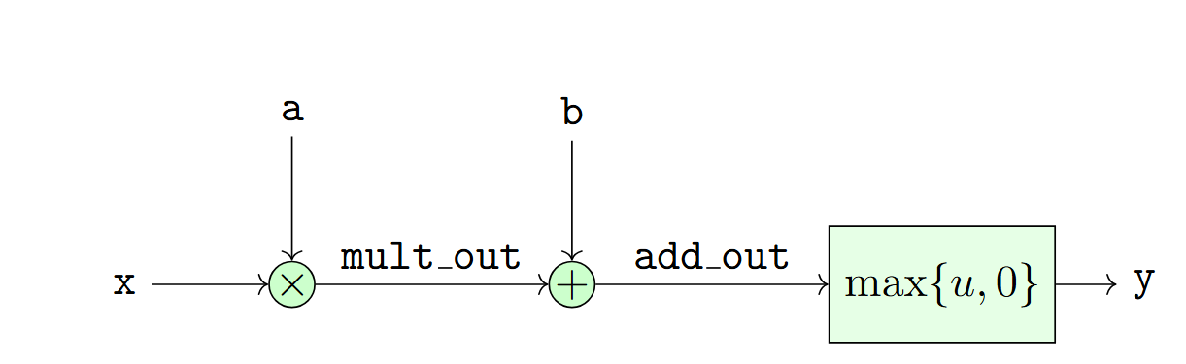
Block Diagram
Function of a module typically represented by a block diagram
Graphical representation of a potential implementation
Typically, diagram is at high-level
  Adders, multipliers not low-level details components like gates

Slide 42
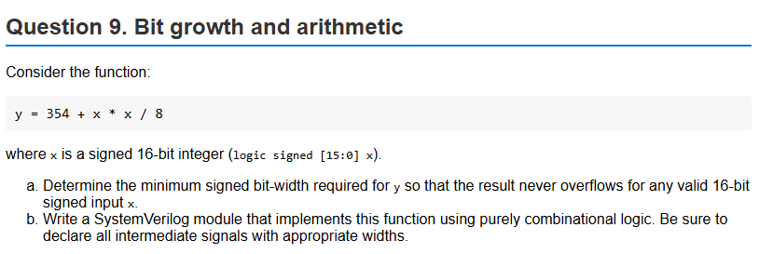
Problem
Assigned as homework
Note there is a conservative and more precise bit width analysis
  Both will receive full credit

