Slide 1
Unit 3
Floating and Fixed Point Numbers
EL-GY 9463: Introduction to Hardware Design
ProfS. Sundeep Rangan, Siddharth Garg

Slide 2
Today’s Lecture
The world is continuous and infinite, but computers are finite
How do we represent numeric values in a finite numbers of bits?
More generally, how can values be compressed?
What representations are computationally simple?
What representations result in good computational approximations?

Slide 3
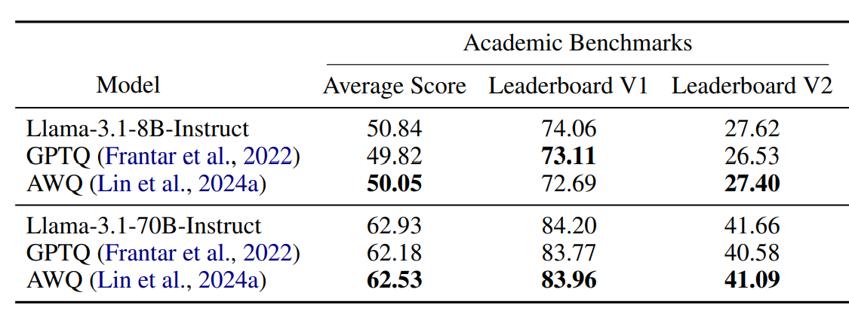

Example 1: Embedded LLMs
Full LLMs require massive amounts of memory
  Cannot work on embedded devices
Quantization
  Aggressive reduction in number of bits / parameter
  Ex: INT4 vs. FP32
New techniques have enabled very low footprint
  Often 1 to 1.5 GB
  Fits on commercial smartphones
Performance often remains excellent
  With judicious choice of approximation techniques
Kurtic, Eldar, et al. "“Give Me BF16 or Give Me Death”? Accuracy-Performance Trade-Offs in LLM Quantization." Proceedings of the 63rd Annual Meeting of the Association for Computational Linguistics (Volume 1: Long Papers). 2025.

Slide 4
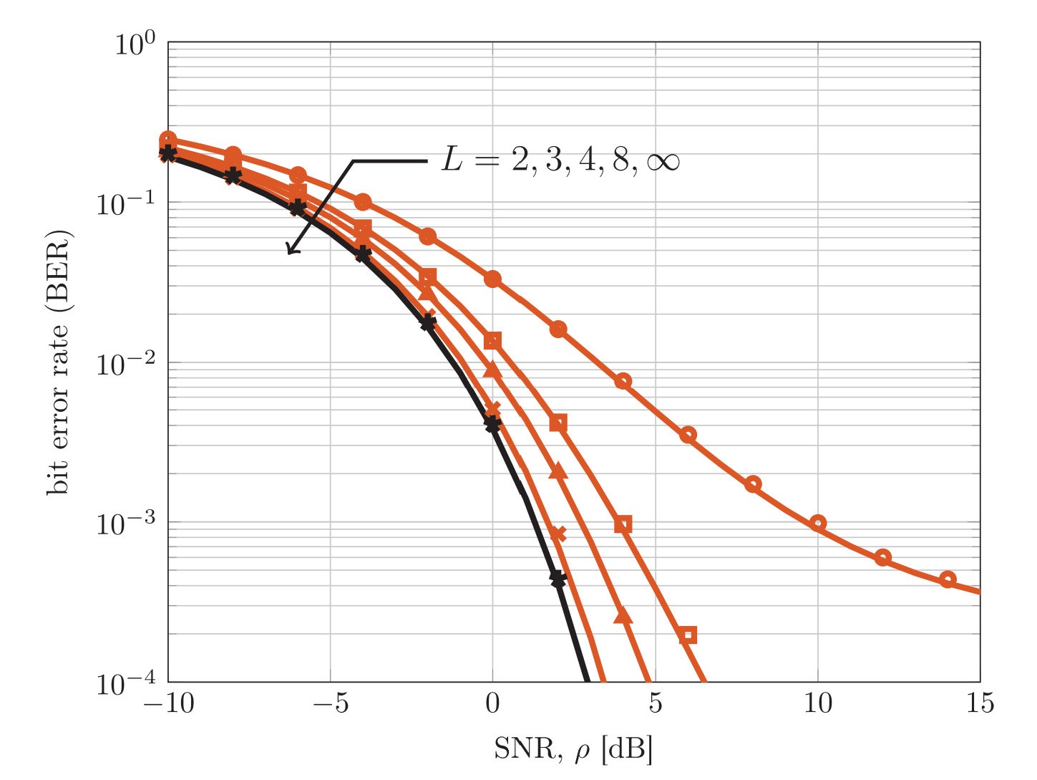
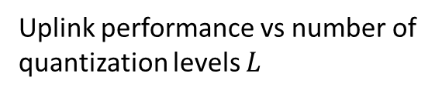
Example 2: Next-Generation Wireless
Massive MIMO systems in cellular base stations
  100s – 1000s of antennas
  Each antenna gets data at ~1 Gsamp/s
Data rate and processing is overwhelming
Very low-rate quantization has been key
  2- 4 bits per antenna
Uplink performance vs number of
quantization levels $L$
Jacobsson, S., Durisi, G., Coldrey, M., Gustavsson, U., & Studer, C. (2017). Throughput analysis of massive MIMO uplink with low-resolution ADCs. IEEE Transactions on Wireless Communications, 16(6), 4038-4051.

Slide 5

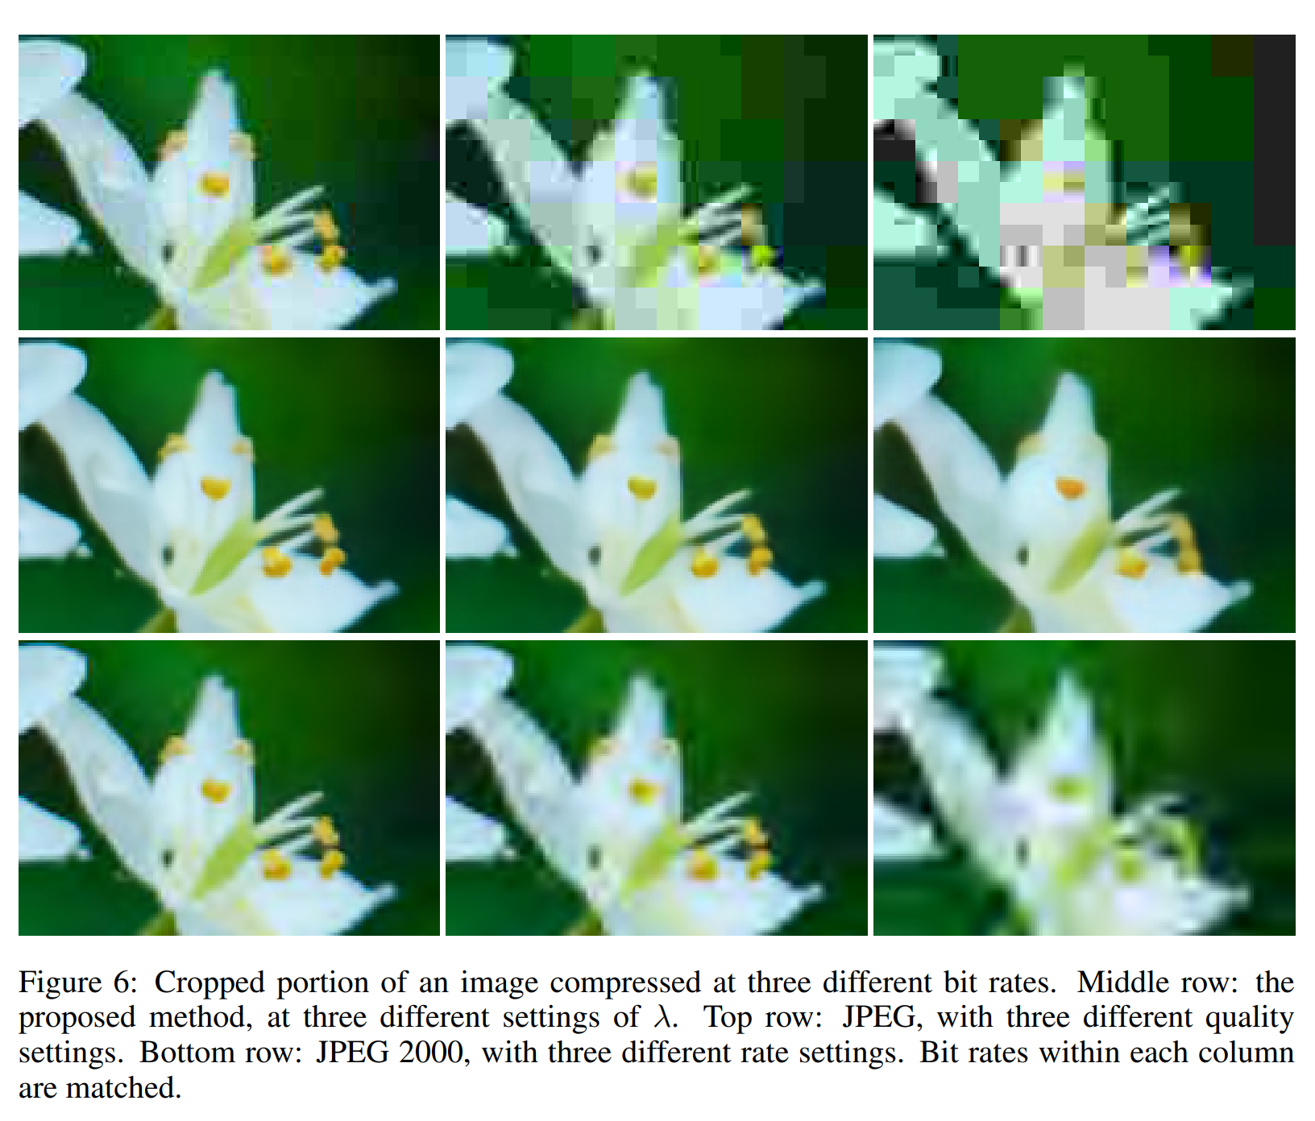
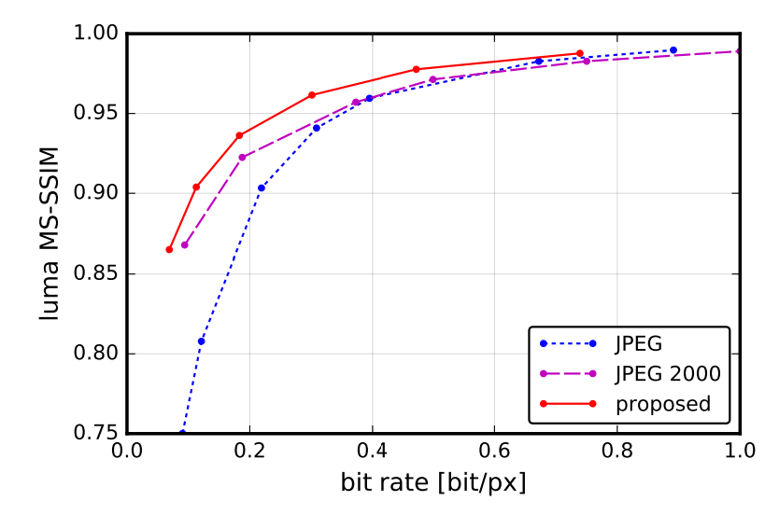
Compression Research at NYU
Ballé, J., Laparra, V., & Simoncelli, E. P. (2016). End-to-end optimized image compression. arXiv preprint arXiv:1611.01704.
ML techniques at the forefront for learning new compression
NYU has several leading researchers in the area
Jona Balle, NYU

Slide 6
Learning Objectives
Represent numbers in floating point and fixed point
Implement arithmetic operations efficiently in these formats
Identify cases for overflow
Evaluate approximation errors via simulation
Optimally select scaling factors and parameters for the formats
Convert floating point algorithms to fixed point

Slide 7
Outline
Floating Point Numbers
Fixed Point Numbers
Optimal Scaling of FixP Numbers
Converting Floating Point Algorithms to Fixed Point

Slide 8
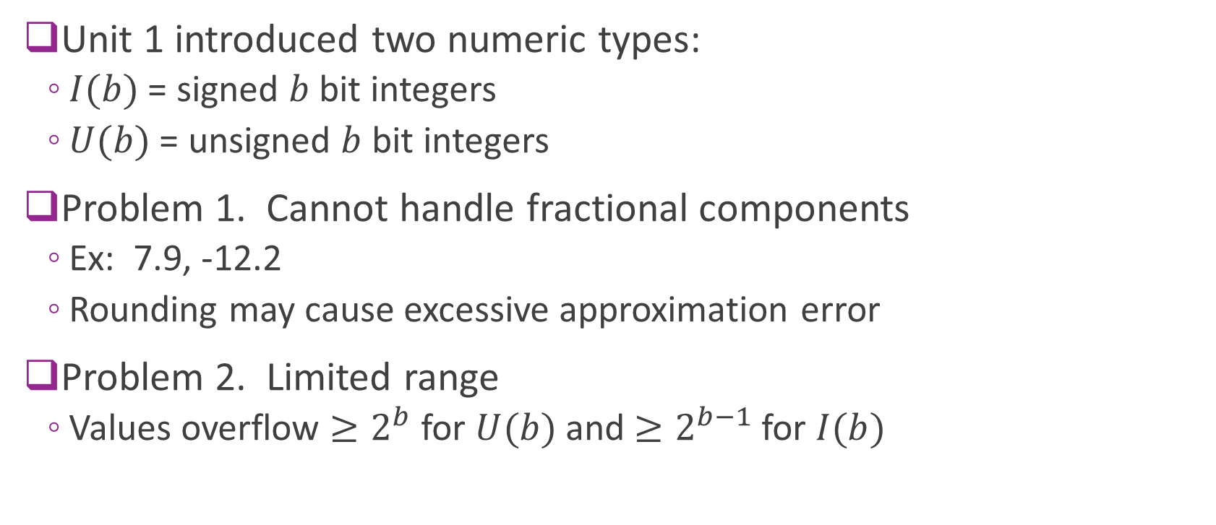
Limitations of Integers
Unit 1 introduced two numeric types:
  $I(b)$ = signed $b$ bit integers
  $U(b)$ = unsigned $b$ bit integers
Problem 1. Cannot handle fractional components
  Ex: 7.9, -12.2
  Rounding may cause excessive approximation error
Problem 2. Limited range
  Values overflow $≥2^{b}$ for $U(b)$ and $≥2^{b−1}$ for $I(b)$

Slide 9

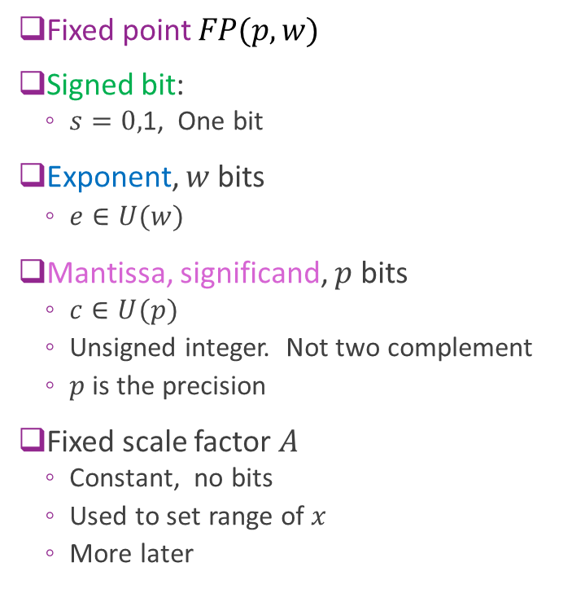
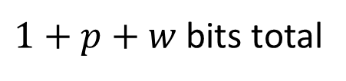


Simple Floating Point
Fixed point $FP(p,w)$
Signed bit:
  $s=0,$1, One bit
Exponent, $w$ bits
  $e∈U(w)$
Mantissa, significand, $p$ bits
  $c∈U(p)$
  Unsigned integer. Not two complement
  $p$ is the precision
Fixed scale factor $A$
  Constant, no bits
  Used to set range of $x$
  More later
$x=A{\left(−1\right)}^{s} 2^{e}$ $c$
Bits=
1
$$w$$
$$p$$
$1+p+w$ bits total

Slide 10
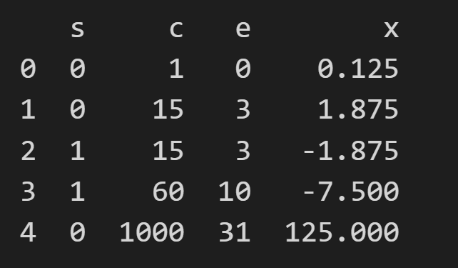
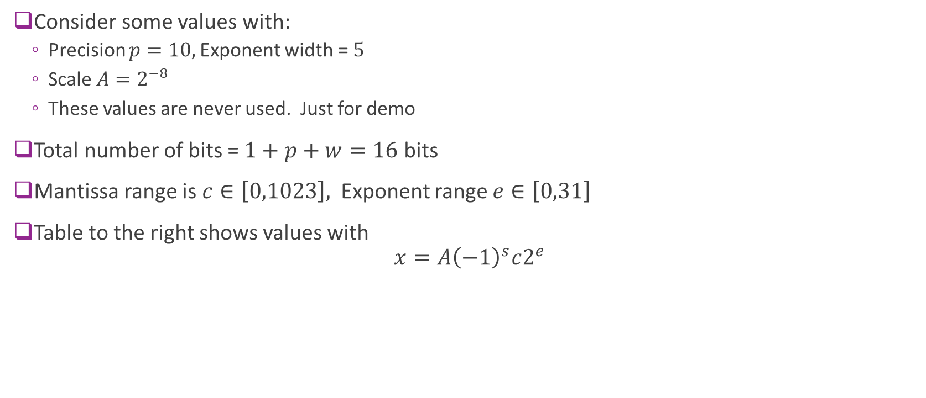
Example
Consider some values with:
  Precision $p=10,$Exponent width = $5$
  Scale $A=2^{−8}$
  These values are never used. Just for demo
Total number of bits = $1+p+w=16$ bits
Mantissa range is $c∈\left[0,1023\right],$ Exponent range $e∈\left[0,31\right]$
Table to the right shows values with
$x=A{\left(−1\right)}^{s}c2^{e}$

Slide 11
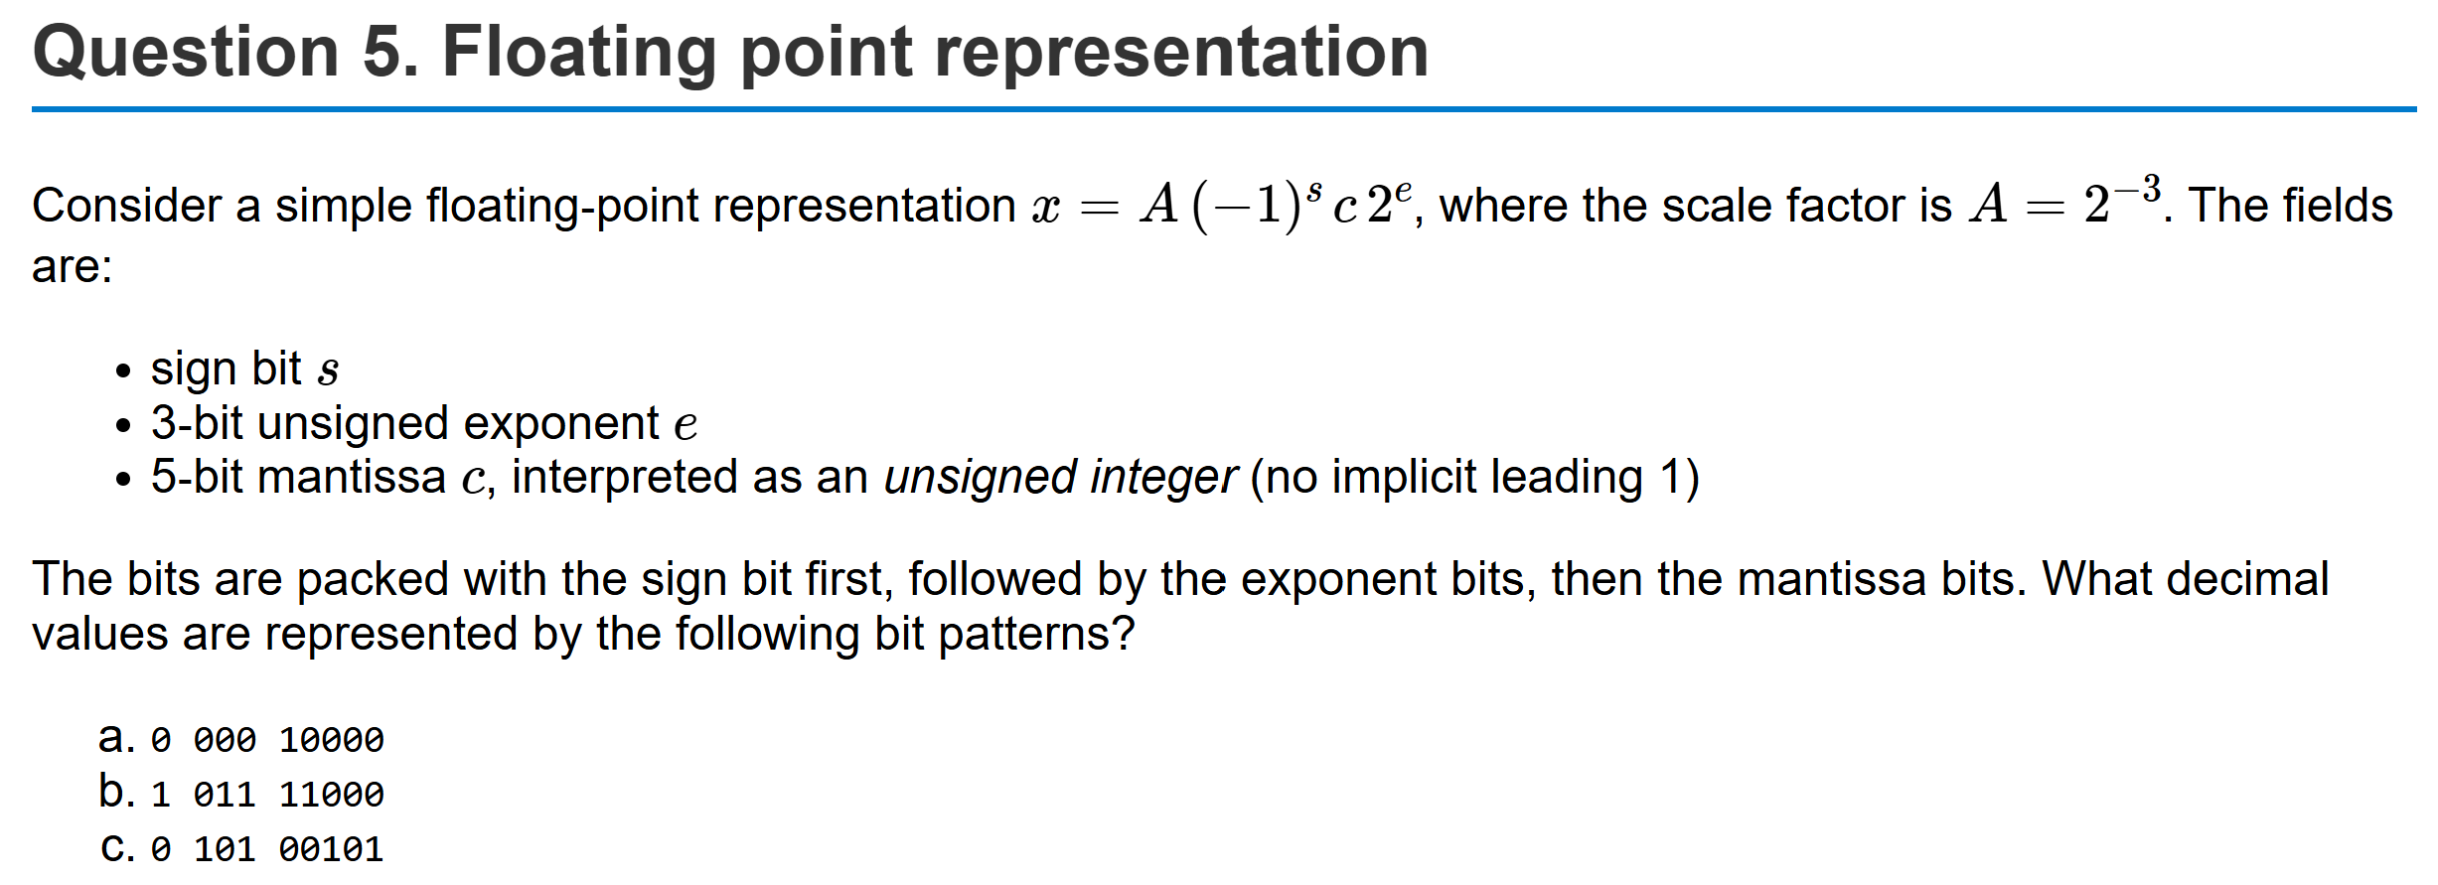
Example Problem

Slide 12
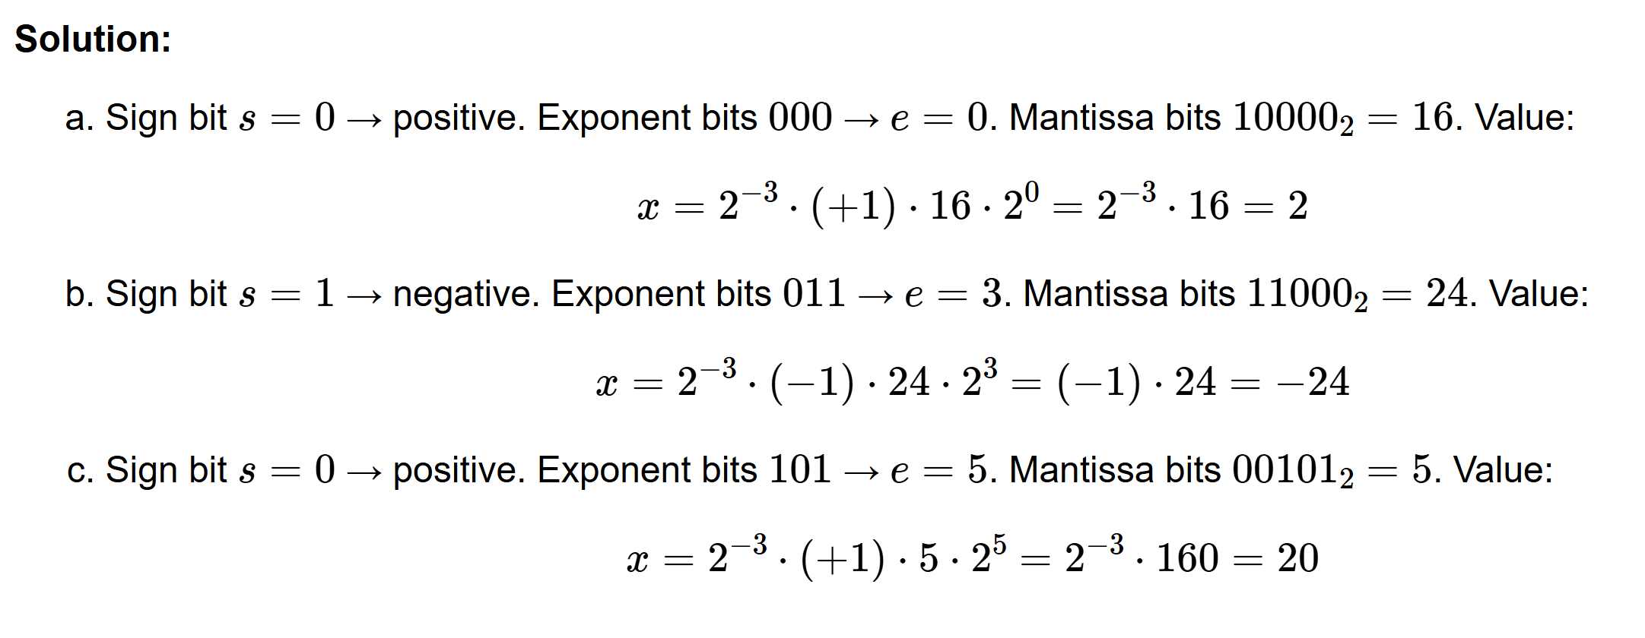
Solution

Slide 13
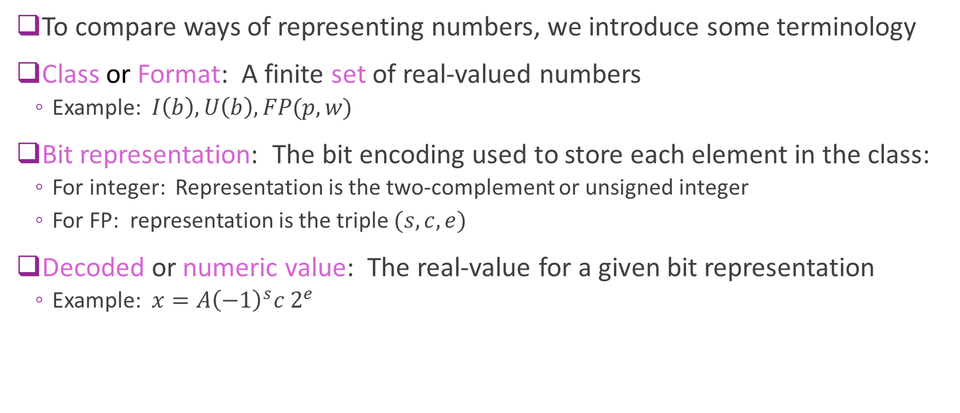
Terminology
To compare ways of representing numbers, we introduce some terminology
Class or Format: A finite set of real-valued numbers
  Example: $I\left(b\right), U\left(b\right), FP(p,w)$
Bit representation: The bit encoding used to store each element in the class:
  For integer: Representation is the two-complement or unsigned integer
  For FP: representation is the triple $(s, c, e)$
Decoded or numeric value: The real-value for a given bit representation
  Example: $x=A{\left(−1\right)}^{s}c 2^{e}$

Slide 14
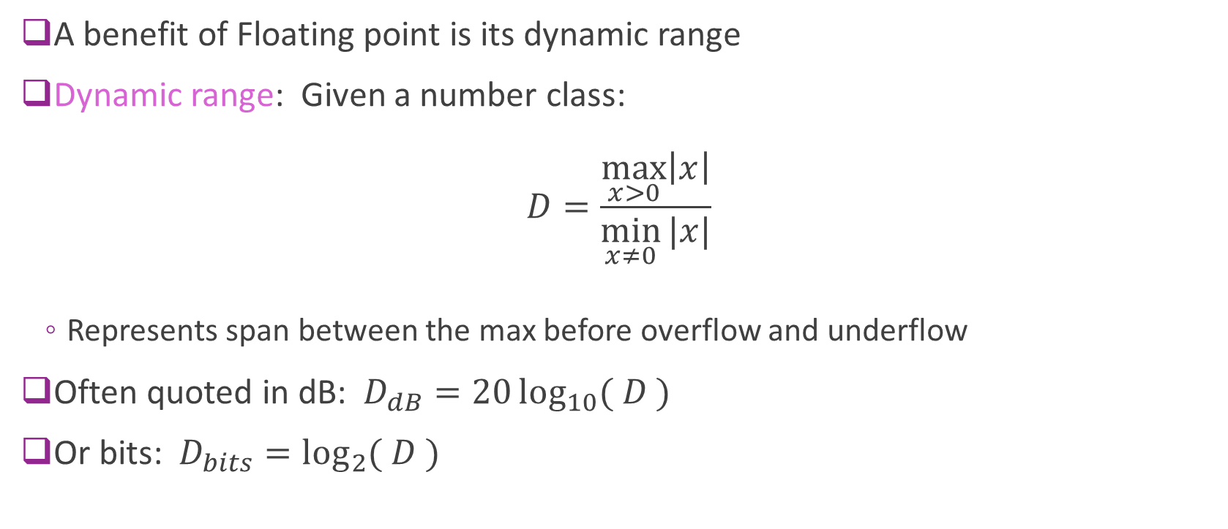
Dynamic Range
A benefit of Floating point is its dynamic range
Dynamic range: Given a number class:
$D=\frac{\max_{x>0}\left|x\right|}{\min_{x≠0}{|x|}}$
  Represents span between the max before overflow and underflow
Often quoted in dB: $D_{dB}=20\log_{10}{( D )}$
Or bits: $D_{bits}=\log_{2}{( D )}$

Slide 15
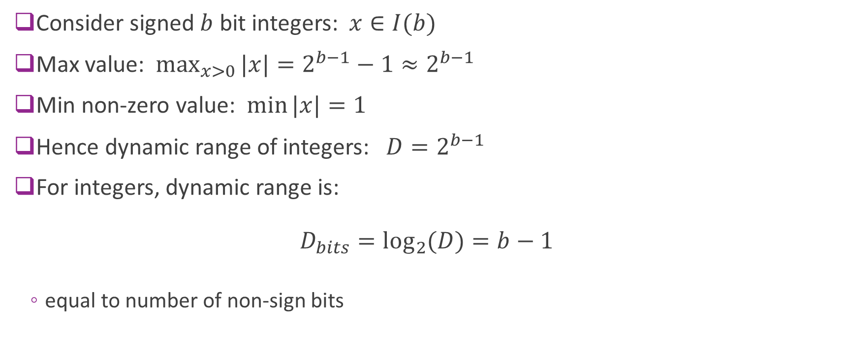
Dynamic Range of Integers
Consider signed $b$ bit integers: $x∈I(b)$
Max value: $\max_{x>0}{|x|}=2^{b−1}−1≈2^{b−1}$
Min non-zero value: $\min{|x|}=1$
Hence dynamic range of integers: $D=2^{b−1}$
For integers, dynamic range is:
$D_{bits}=\log_{2}{(D)}=b−1$
  equal to number of non-sign bits

Slide 16
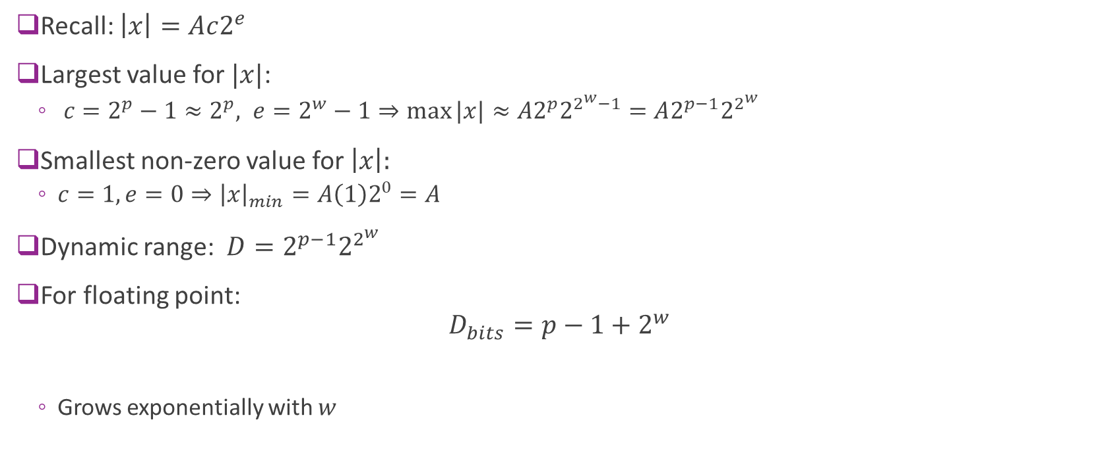
Floating-Point Dynamic Range
Recall: $\left|x\right|=Ac2^{e}$
Largest value for $|x|$:
  $c=2^{p}−1≈2^{p}, e=2^{w}−1⇒\max{|x|}≈A2^{p}2^{2^{w}−1}=A2^{p−1}2^{2^{w}}$
Smallest non-zero value for $\left|x\right|:$
  $c=1, e=0⇒{\left|x\right|}_{min}=A\left(1\right)2^{0}=A$
Dynamic range: $D=2^{p−1}2^{2^{w}}$
For floating point:
$D_{bits}=p−1+2^{w}$
  Grows exponentially with $w$

Slide 17
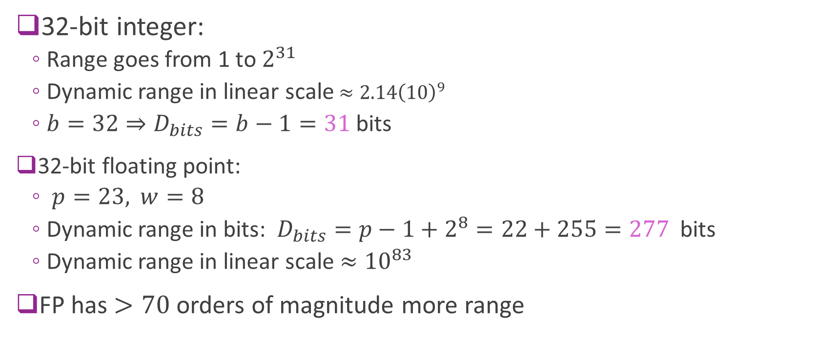
Example Comparison
32-bit integer:
  Range goes from 1 to $2^{31}$
  Dynamic range in linear scale $≈{2.14\left(10\right)}^{9}$
  $b=32⇒D_{bits}=b−1=31$ bits
32-bit floating point:
  $p=23,$ $w=8$
  Dynamic range in bits: $D_{bits}=p−1+2^{8}=22+255=277$ bits
  Dynamic range in linear scale $≈{10}^{83}$
FP has $>70$ orders of magnitude more range

Slide 18
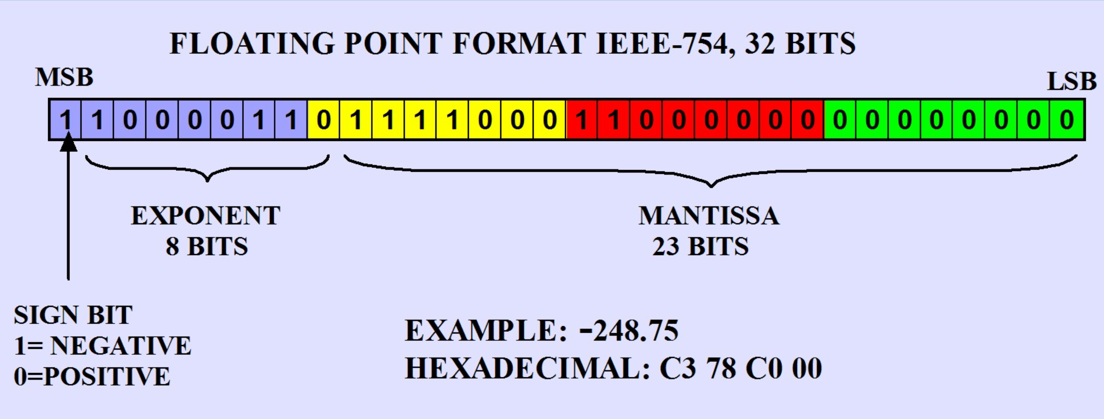
IEEE-754 Floating Point Standard
Format | Mantissa bits (stored) | Significand precision (with implicit 1) | Exponent bits
FP16 (half) | 10 | 11 | 5
FP32 (single) | 23 | 24 | 8
FP64 (double) | 52 | 53 | 11

Slide 19
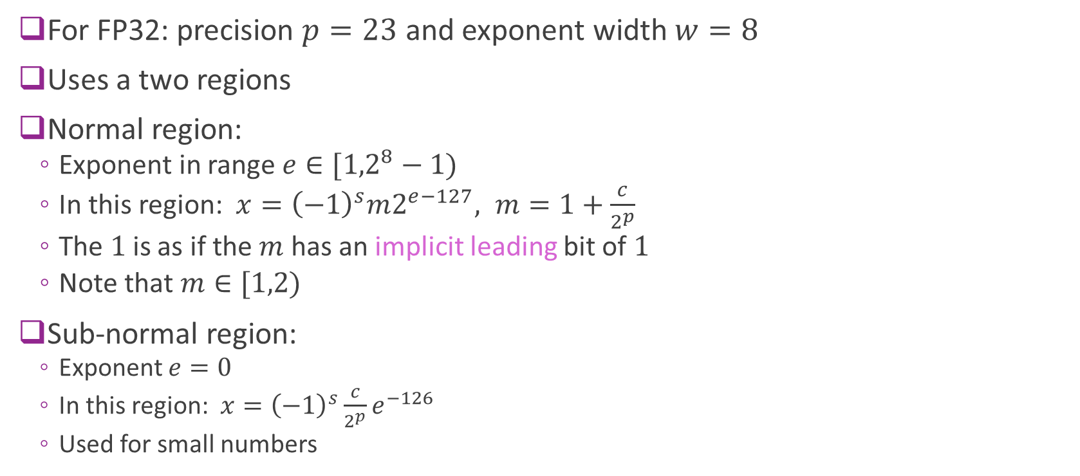
IEEE 754 Normal and Sub-Normal
For FP32: precision $p=23$ and exponent width $w=8$
Uses a two regions
Normal region:
  Exponent in range $e∈[{1,2}^{8}−1)$
  In this region: $x={\left(−1\right)}^{s}m2^{e−127}, m=1+\frac{c}{2^{p}}$
  The $1$is as if the $m$ has an implicit leading bit of $1$
  Note that $m∈[1,2)$
Sub-normal region:
  Exponent $e=0$
  In this region: $x={\left(−1\right)}^{s}\frac{c}{2^{p}}e^{−126}$
  Used for small numbers

Slide 20

IEEE 754 Properties
Single precision (FP32):
  Largest normal $≈3.4{\left(10\right)}^{38}$
  Smallest normal $≈1.18{\left(10\right)}^{−38}$
  Smallest sub-normal $≈{\left(10\right)}^{−45}$
  Vastly greater range than 32-bit integers
Double precision (FP64):
  Largest normal $≈1.80{\left(10\right)}^{308}$
  Smallest normal $≈2.23{\left(10\right)}^{−308}$
  Smallest sub-normal $≈{5\left(10\right)}^{−324}$

Slide 21
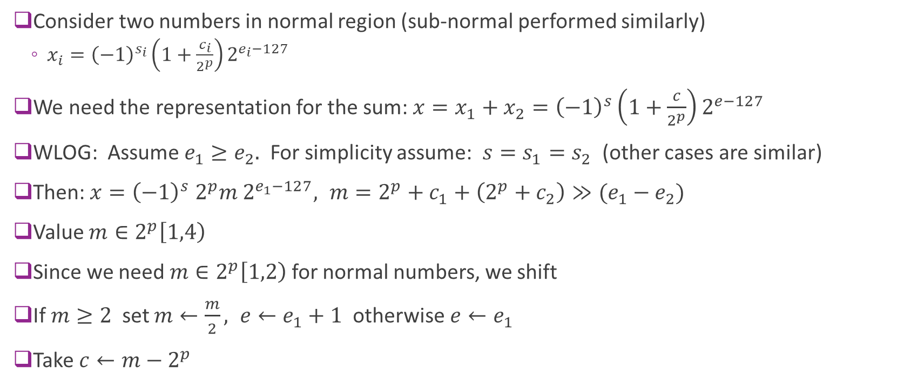
Floating Point Addition
Consider two numbers in normal region (sub-normal performed similarly)
  $x_{i}={\left(−1\right)}^{s_{i}}\left(1+\frac{c_{i}}{2^{p}}\right)2^{e_{i}−127}$
We need the representation for the sum: $x=x_{1}+x_{2}={\left(−1\right)}^{s}\left(1+\frac{c}{2^{p}}\right)2^{e−127}$
WLOG: Assume $e_{1}≥e_{2}.$ For simplicity assume: $s=s_{1}=s_{2}$ (other cases are similar)
Then: $x={\left(−1\right)}^{s} 2^{p}m 2^{e_{1}−127}, m=2^{p}+c_{1}+\left(2^{p}+c_{2}\right)≫(e_{1}−e_{2})$
Value $m∈2^{p}\left[1,4\right)$
Since we need $m∈2^{p}\left[1,2\right)$ for normal numbers, we shift
If $m≥2$ set $m←\frac{m}{2}, e←e_{1}+1$ otherwise $e←e_{1}$
Take $c←m−2^{p}$

Slide 22
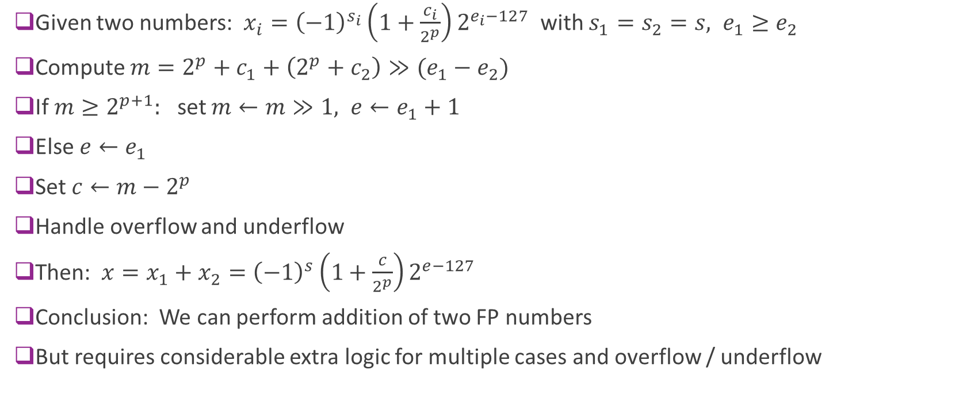
Resulting Algorithm
Given two numbers: $x_{i}={\left(−1\right)}^{s_{i}}\left(1+\frac{c_{i}}{2^{p}}\right)2^{e_{i}−127}$ with $s_{1}=s_{2}=s, e_{1}≥e_{2}$
Compute $m=2^{p}+c_{1}+\left(2^{p}+c_{2}\right)≫(e_{1}−e_{2})$
If $m≥2^{p+1}:$ set $m←m≫1, e←e_{1}+1$
Else $e←e_{1}$
Set $c←m−2^{p}$
Handle overflow and underflow
Then: $x=x_{1}+x_{2}={\left(−1\right)}^{s}\left(1+\frac{c}{2^{p}}\right)2^{e−127}$
Conclusion: We can perform addition of two FP numbers
But requires considerable extra logic for multiple cases and overflow / underflow

Slide 23
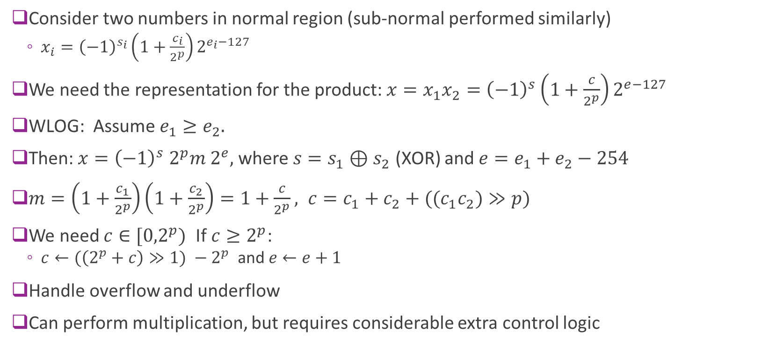
Floating Point Multiplication
Consider two numbers in normal region (sub-normal performed similarly)
  $x_{i}={\left(−1\right)}^{s_{i}}\left(1+\frac{c_{i}}{2^{p}}\right)2^{e_{i}−127}$
We need the representation for the product: $x=x_{1}x_{2}={\left(−1\right)}^{s}\left(1+\frac{c}{2^{p}}\right)2^{e−127}$
WLOG: Assume $e_{1}≥e_{2}.$
Then: $x={\left(−1\right)}^{s} 2^{p}m 2^{e},$where $s=s_{1}⊕s_{2}$ (XOR) and $e=e_{1}+e_{2}−254$
$m=\left(1+\frac{c_{1}}{2^{p}}\right)\left(1+\frac{c_{2}}{2^{p}}\right)=1+\frac{c}{2^{p}}, c=c_{1}+c_{2}+((c_{1}c_{2})≫p)$
We need $c∈[{0,2}^{p})$ If $c≥2^{p}$:
  $c←(\left(2^{p}+c\right)≫1) −2^{p}$ and $e←e+1$
Handle overflow and underflow
Can perform multiplication, but requires considerable extra control logic

Slide 24
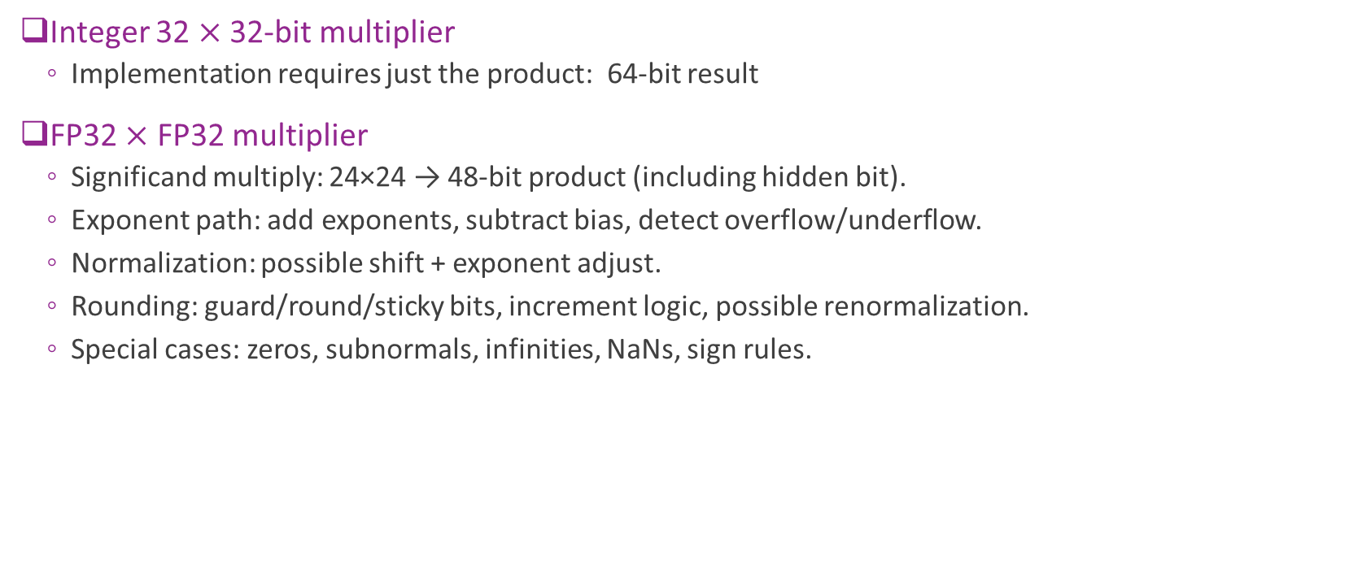
Comparison
Integer 32 $×$ 32-bit multiplier
  Implementation requires just the product: 64-bit result
FP32 $×$ FP32 multiplier
  Significand multiply: 24×24 → 48‑bit product (including hidden bit).
  Exponent path: add exponents, subtract bias, detect overflow/underflow.
  Normalization: possible shift + exponent adjust.
  Rounding: guard/round/sticky bits, increment logic, possible renormalization.
  Special cases: zeros, subnormals, infinities, NaNs, sign rules.
FP multiplication typically takes 2 to 4 $×$ complexity

Slide 25
Outline
Floating Point Numbers
Fixed Point Numbers
Optimal Scaling of FixP Numbers
Converting Floating Point Algorithms to Fixed Point

Slide 26
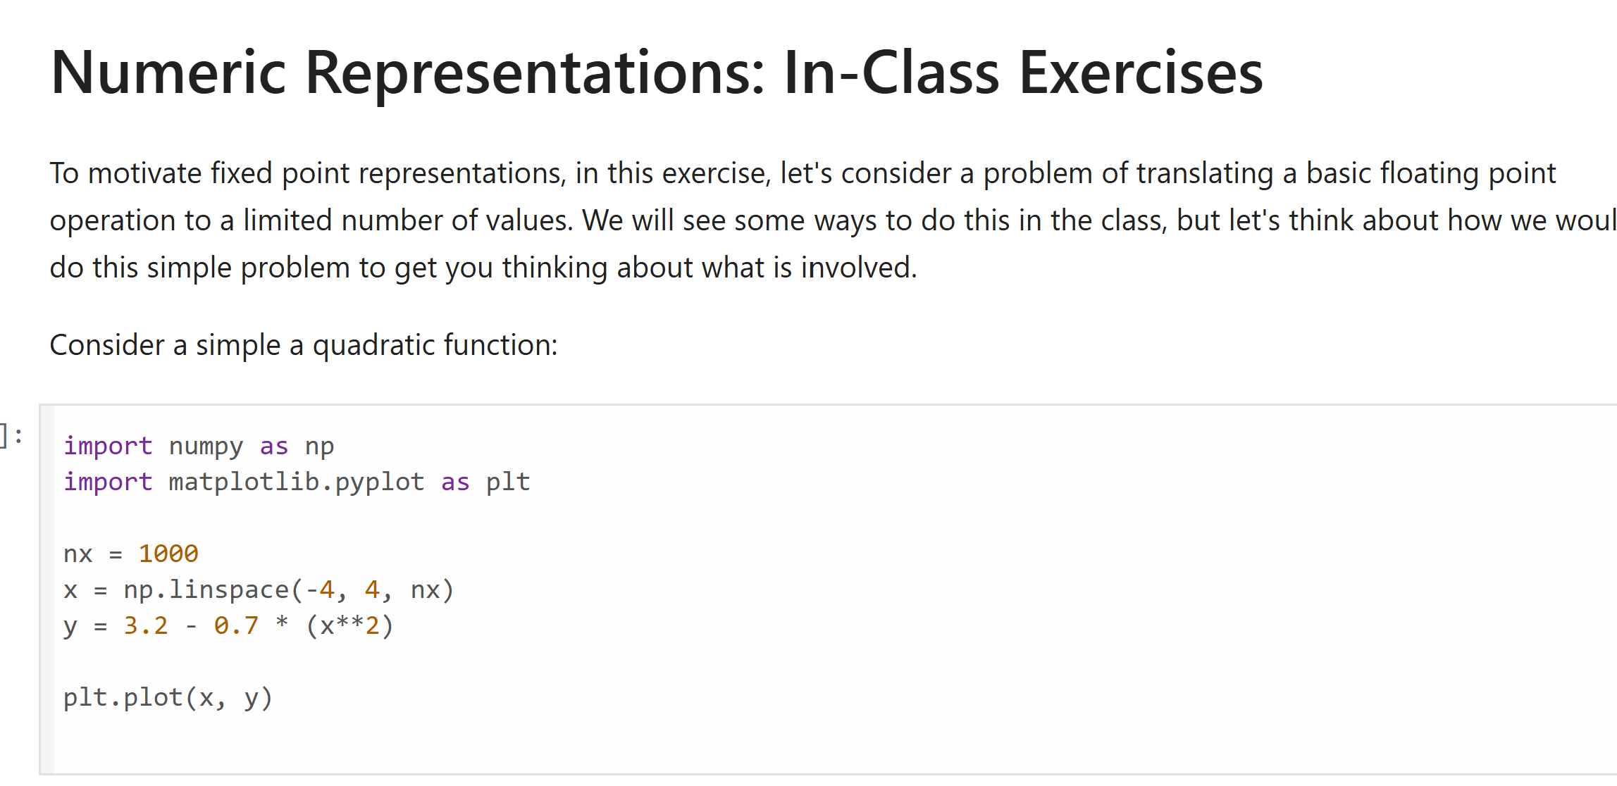
Motivating In-Class Exercise
Try the following jupyter notebook

Slide 27
Integers vs. Floating Point
Integers:
  Pro: Easy arithmetic. No extra bits for exponent
  Cons: Do not natively handle fractional components.
  Cons: Limited dynamic range
Floating point:
  Pro: Large dynamic range, handles fractional components
  Cons: Arithmetic is harder, some loss of precision to store exponent
Is there a way to handle fractions without increased computation overhead?

Slide 28
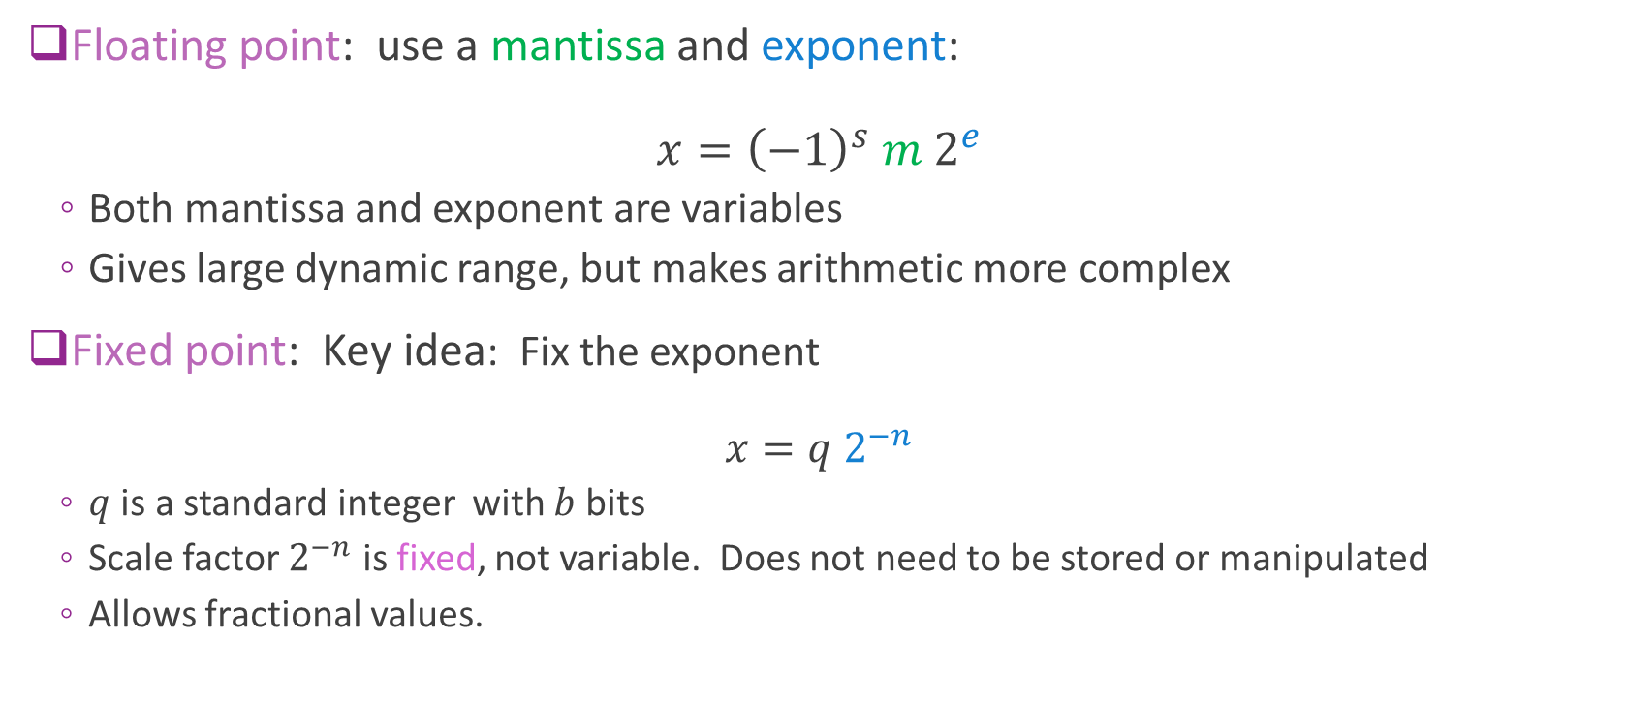
Fixed Point
Floating point: use a mantissa and exponent:
$x={\left(−1\right)}^{s} m 2^{e}$
  Both mantissa and exponent are variables
  Gives large dynamic range, but makes arithmetic more complex
Fixed point: Key idea: Fix the exponent
$x=q 2^{−n}$
  $q$ is a standard integer with $b$ bits
  Scale factor $2^{−n}$ is fixed, not variable. Does not need to be stored or manipulated
  Allows fractional values.

Slide 29
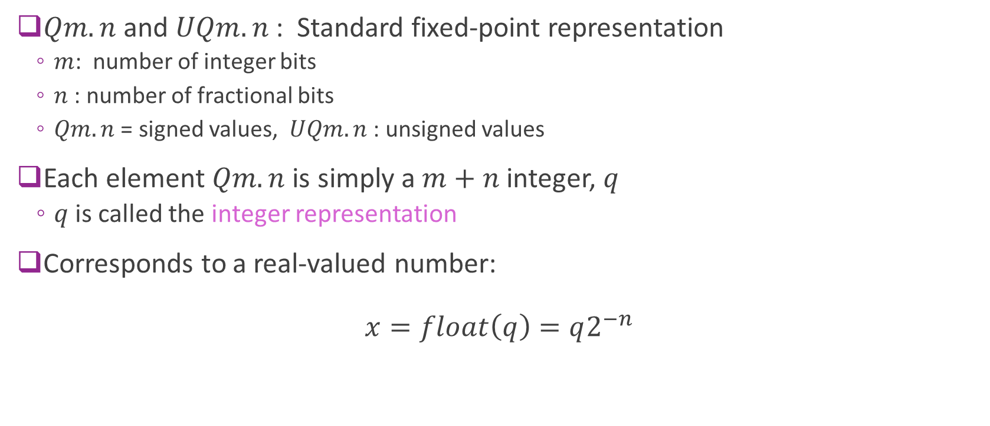
Fixed Point Q Notation
$Qm.n$ and $UQm.n$ : Standard fixed-point representation
  $m$: number of integer bits
  $n$ : number of fractional bits
  $Qm.n$ = signed values, $UQm.n$: unsigned values
Each element $Qm.n$ is simply a $m+n$ integer, $q$
  $q$ is called the integer representation
Corresponds to a real-valued number:
$x=float\left(q\right)=q2^{−n}$

Slide 30
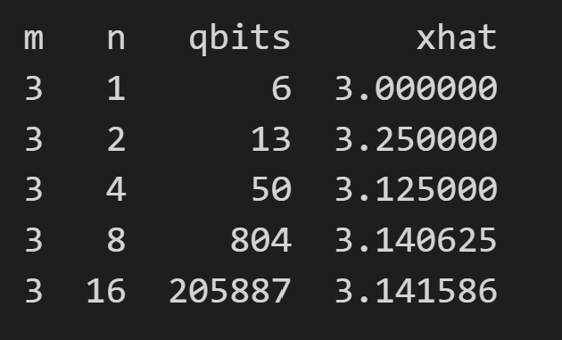
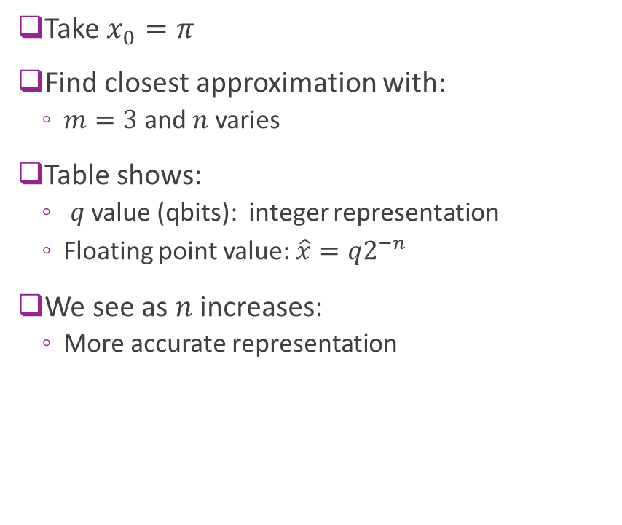
Examples
Take $x_{0}=π$
Find closest approximation with:
  $m=3$ and $n$ varies
Table shows:
  $q$ value (qbits): integer representation
  Floating point value: $\hat{x}=q2^{−n}$
We see as $n$ increases:
  More accurate representation

Slide 31
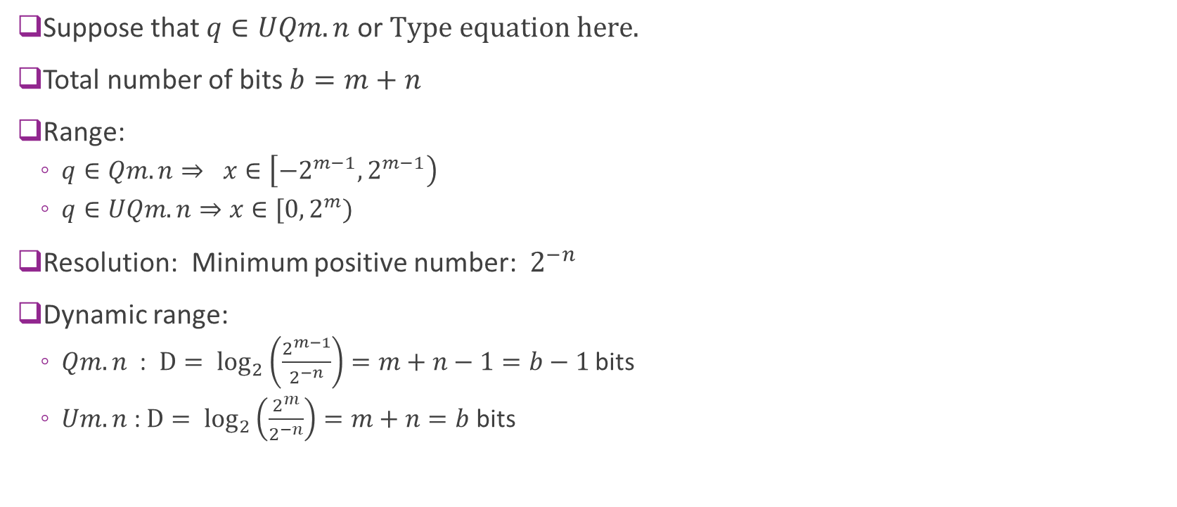
Properties
Suppose that $q∈UQm.n$ or
Total number of bits $b=m+n$
Range:
  $q∈Qm.n⇒ x∈\left[−2^{m−1},2^{m−1}\right)$
  $q∈UQm.n⇒x∈[0, 2^{m})$
Resolution: Minimum positive number: $2^{−n}$
Dynamic range:
  $Qm.n$ : $D= \log_{2}\left(\frac{2^{m−1}}{2^{−n}}\right)=m+n−1=b−1$ bits
  $Um.n$ : $D= \log_{2}\left(\frac{2^{m}}{2^{−n}}\right)=m+n=b$ bits

Slide 32
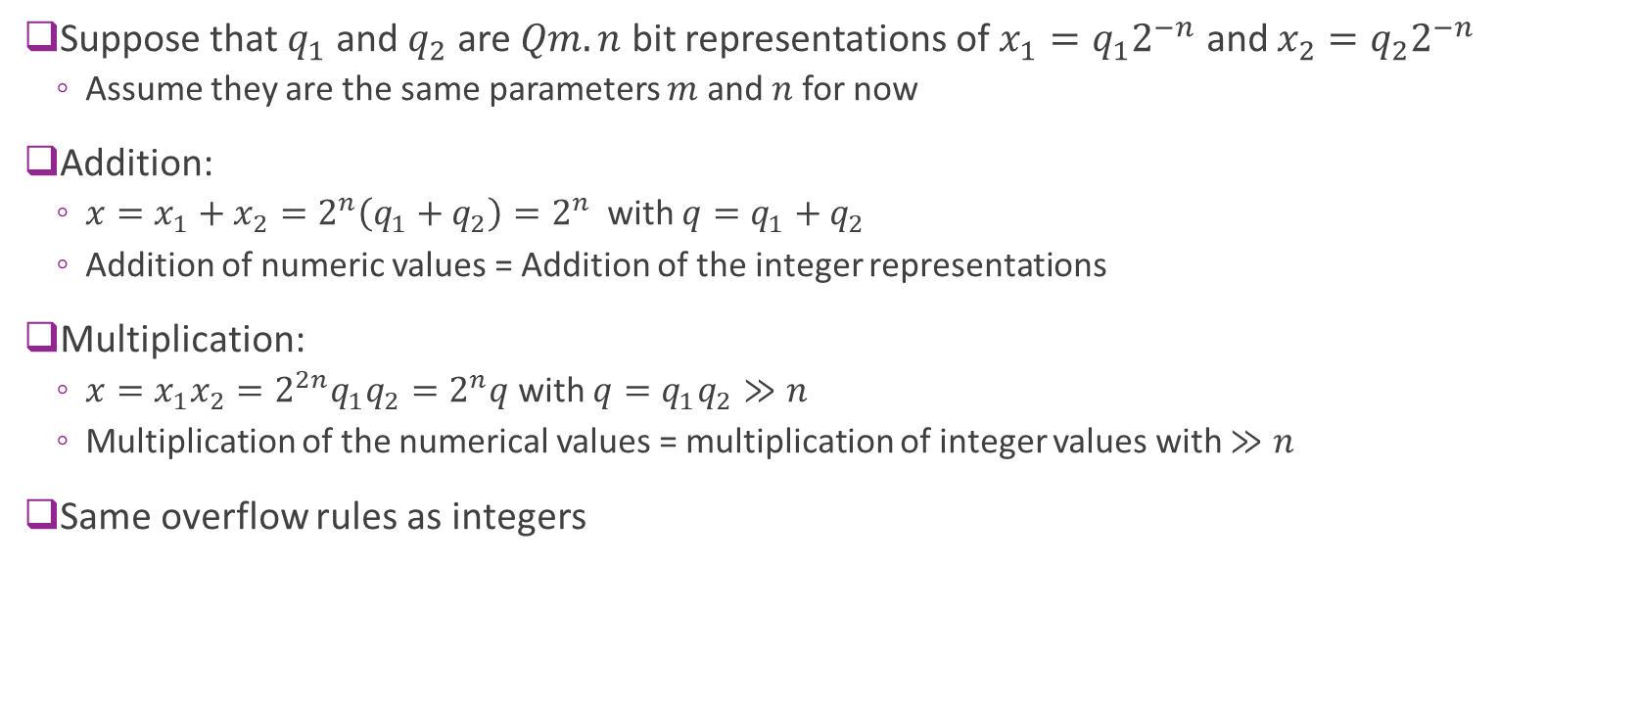
Arithmetic Operations
Suppose that $q_{1}$ and $q_{2}$ are $Qm.n$ bit representations of $x_{1}=q_{1}2^{−n}$ and $x_{2}=q_{2}2^{−n}$
  Assume they are the same parameters $m$ and $n$ for now
Addition:
  $x=x_{1}+x_{2}=2^{n}\left(q_{1}+q_{2}\right)=2^{n}$ with $q=q_{1}+q_{2}$
  Addition of numeric values = Addition of the integer representations
Multiplication:
  $x=x_{1}x_{2}=2^{2n}q_{1}q_{2}=2^{n}q$ with $q=q_{1}q_{2}≫n$
  Multiplication of the numerical values = multiplication of integer values with $≫n$
Same overflow rules as integers

Slide 33
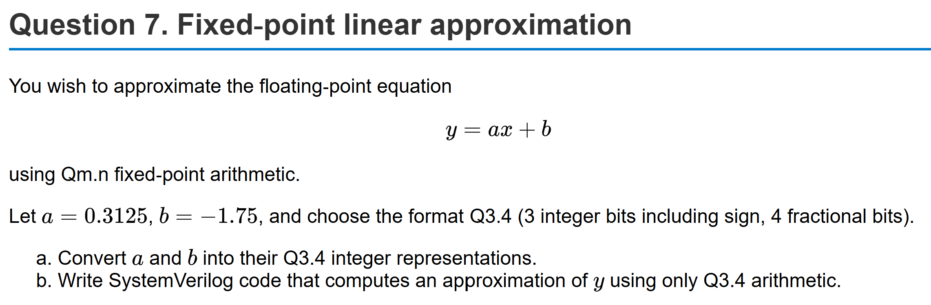
Example Problem

Slide 34
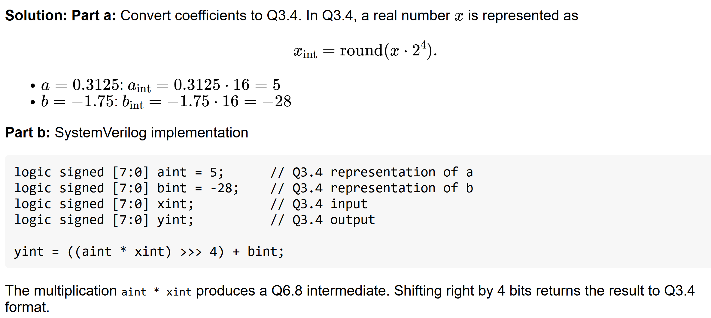
Solution

Slide 35
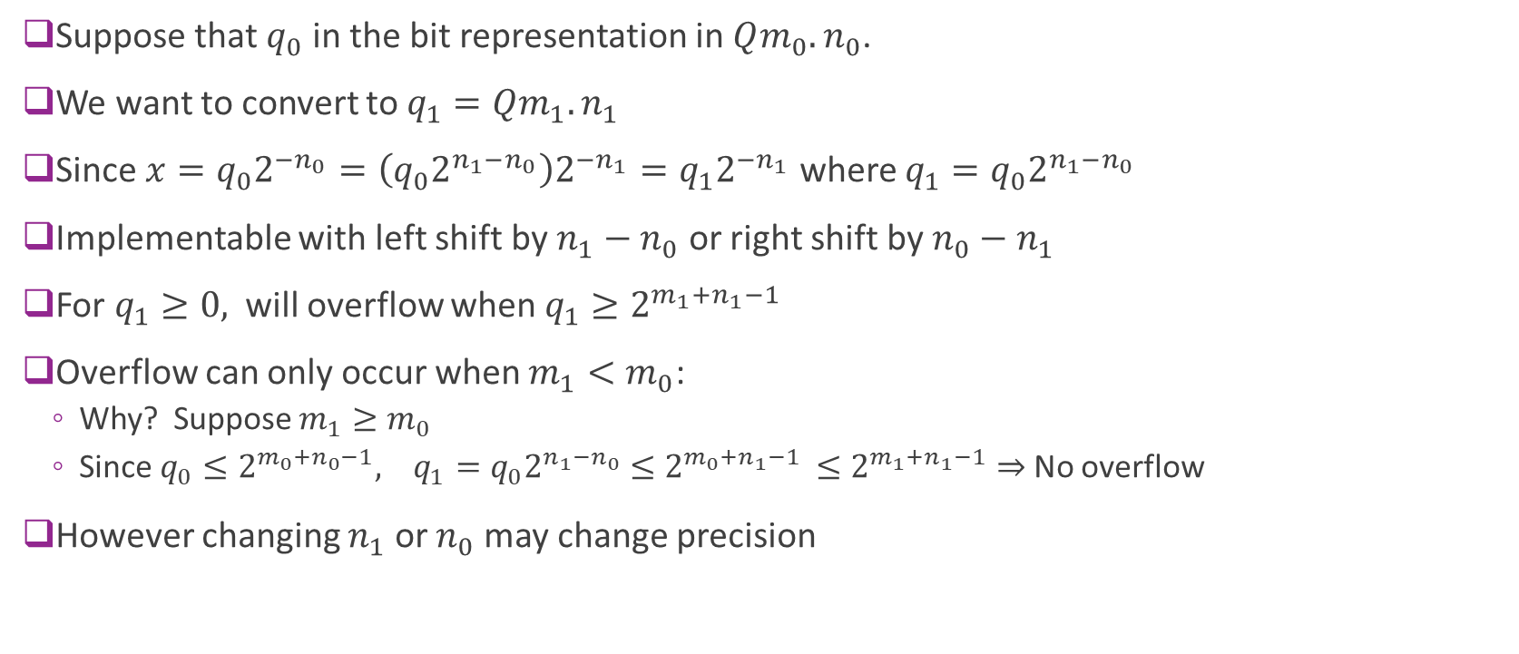
Type Casting
Suppose that $q_{0}$ in the bit representation in $Qm_{0}.n_{0}$.
We want to convert to $q_{1}=Qm_{1}.n_{1}$
Since $x=q_{0}2^{{−n}_{0}}=\left(q_{0}2^{n_{1}−n_{0}}\right)2^{−n_{1}}=q_{1}2^{−n_{1}}$ where $q_{1}=q_{0}2^{n_{1}−n_{0}}$
Implementable with left shift by $n_{1}−n_{0}$ or right shift by $n_{0}−n_{1}$
For $q_{1}≥0,$ will overflow when $q_{1}≥2^{m_{1}+n_{1}−1}$
Overflow can only occur when $m_{1}<m_{0}$:
  Why? Suppose $m_{1}≥m_{0}$
  Since $q_{0}≤2^{m_{0}+n_{0}−1}, q_{1}=q_{0}2^{n_{1}−n_{0}}≤2^{m_{0}+n_{1}−1 }≤2^{m_{1}+n_{1}−1}⇒$ No overflow
However changing $n_{1}$ or $n_{0}$ may change precision

Slide 36
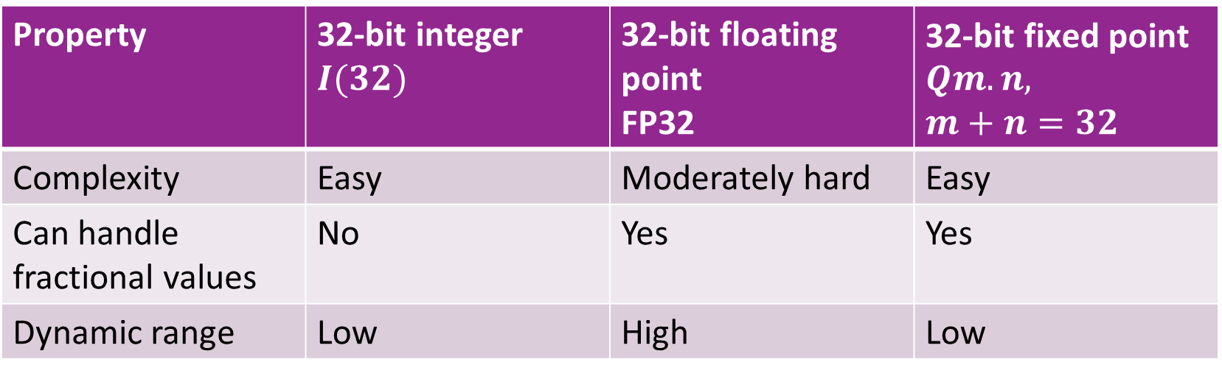
Comparison
Property | 32-bit integer $I(32)$ | 32-bit floating point FP32 | $\text{32−}\text{bit} \text{fixed} \text{point}$ $Qm.n,$ $m+n=32$
Complexity | Easy | Moderately hard | Easy
Can handle fractional values | No | Yes | Yes
Dynamic range | Low | High | Low

Slide 37
Outline
Floating Point Numbers
Fixed Point Numbers
Optimal Scaling of FixP Numbers
Converting Floating Point Algorithms to Fixed Point

Slide 38
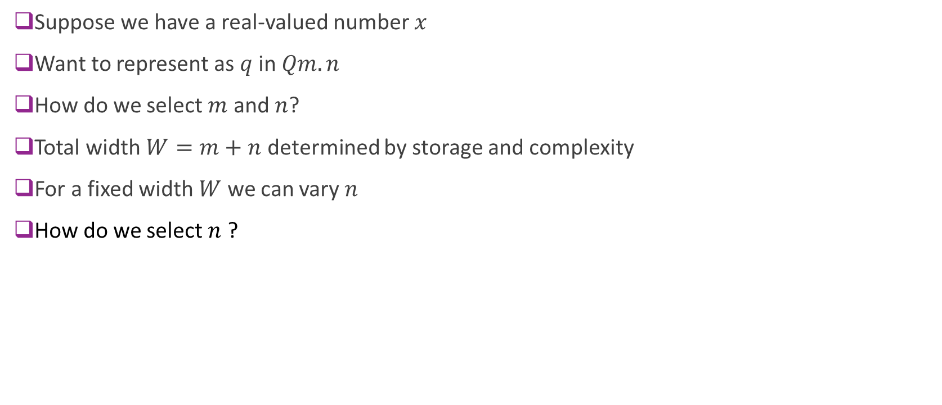
Selecting the Precision
Suppose we have a real-valued number $x$
Want to represent as $q$ in $Qm.n$
How do we select $m$ and $n$?
Total width $W=m+n$ determined by storage and complexity
For a fixed width $W$ we can vary $n$
How do we select $n$ ?

Slide 39
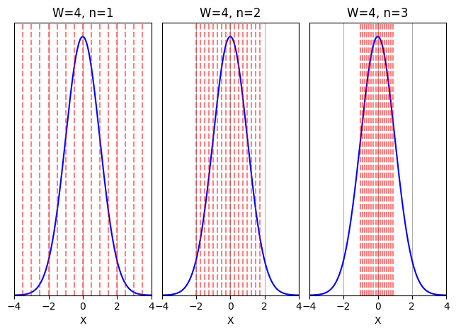

Probabilistic Analysis
Let $X=$ variable to quantize
Model $X$ as a random variable
  The HW will see different values over time
Example to right: $X\sim N(0,1)$
  Blue = PDF of $X$
  Fixed $W=m+n$ = total bitwidth
  Red lines = Qunatization bins for $Qm.n$
Selecting $n$
  Tradeoff of overflow and precision
More
integer bits
More
fractional bits
Minimal overflow
Low precision
High overflow
High precision

Slide 40


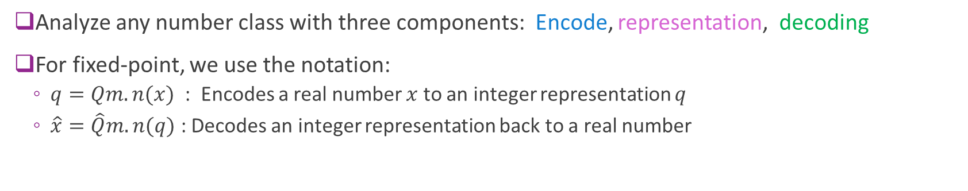



Encoding, Representation, and Decoding
Encode
Representation
Decode
Real
value
Quantized
Real value
$$x$$
$$\hat{x}$$
Ex: $Qm.n(⋅)$
$$q$$
$\hat{Q}m.n(⋅)$
Analyze any number class with three components: Encode, representation, decoding
For fixed-point, we use the notation:
  $q=Qm.n(x)$ : Encodes a real number $x$ to an integer representation $q$
  $\hat{x}=\hat{Q}m.n(q)$ : Decodes an integer representation back to a real number

Slide 41

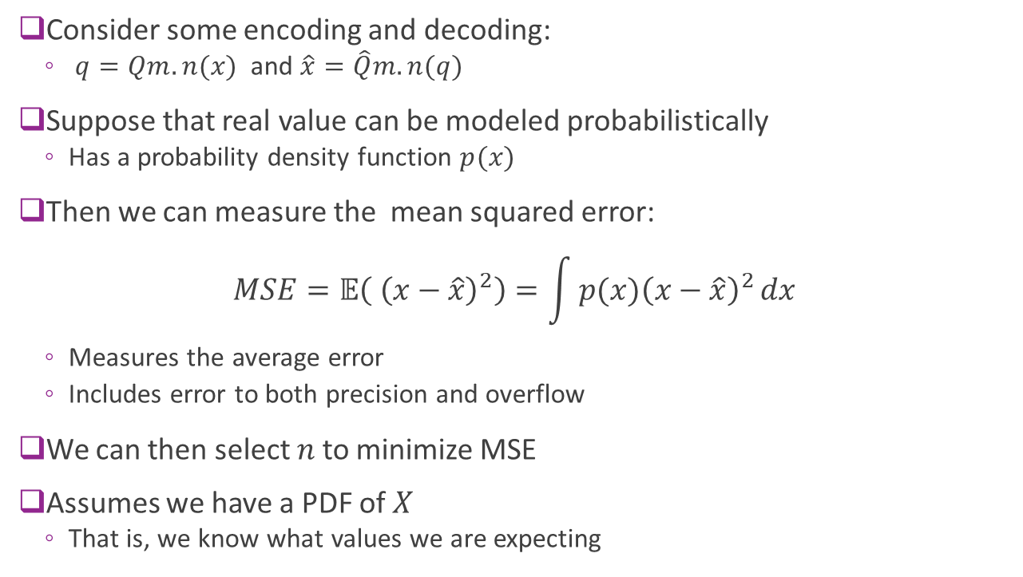


Mean Squared Error
Consider some encoding and decoding:
  $q=Qm.n(x)$ and $\hat{x}=\hat{Q}m.n(q)$
Suppose that real value can be modeled probabilistically
  Has a probability density function $p(x)$
Then we can measure the mean squared error:
$MSE=𝔼\left( {\left(x−\hat{x}\right)}^{2}\right)=\int{p(x){\left(x−\hat{x}\right)}^{2}}dx$
  Measures the average error
  Includes error to both precision and overflow
We can then select $n$ to minimize MSE
Assumes we have a PDF of $X$
  That is, we know what values we are expecting
$$x$$
$$\hat{x}$$
$$q$$

Slide 42
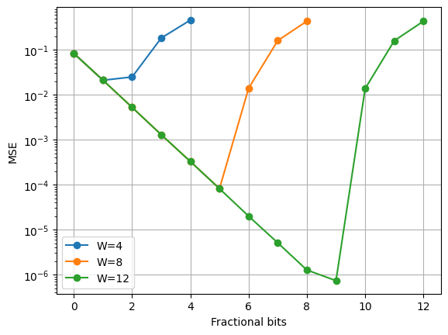
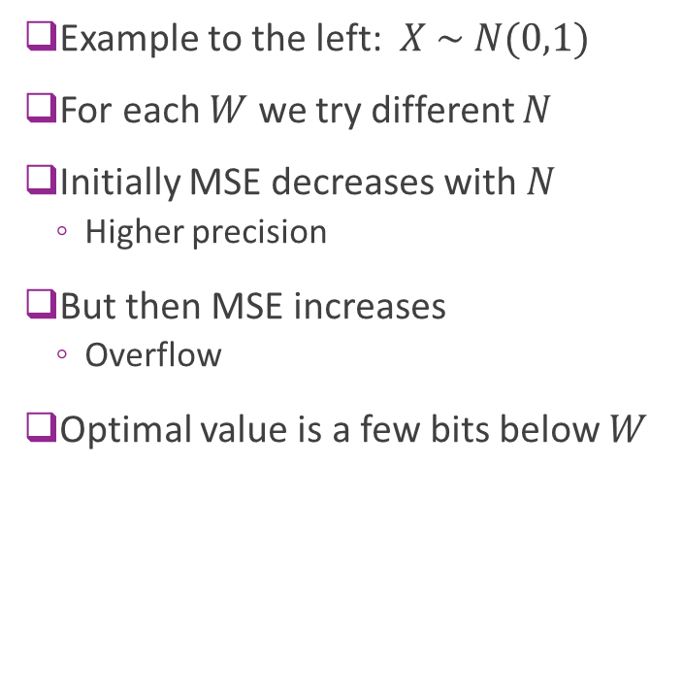
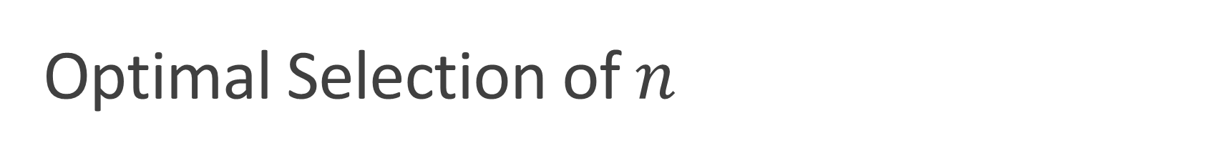
Optimal Selection of $n$
Example to the left: $X \sim N(0,1)$
For each $W$ we try different $N$
Initially MSE decreases with $N$
  Higher precision
But then MSE increases
  Overflow
Optimal value is a few bits below $W$

Slide 43
Outline
Floating Point Numbers
Fixed Point Numbers
Optimal Scaling of FixP Numbers
Converting Floating Point Algorithms to Fixed Point

