Slide 1


Analyzing Historical Stock and Revenue Data for Business Insights
Presented by: Jason Gnanakumar J Course: IBM Data Science Professional Certificate – Capstone Project
by JASON

Slide 2
Executive Summary
This project analyzes historical stock prices and revenue data of companies to extract meaningful business insights using data science tools.
Objective: Uncover trends, relationships, and build predictive models for business decisions.
Data: Collected from Yahoo Finance, MacroTrends, and APIs.
Methods: Data wrangling, visualization (Matplotlib, Seaborn, Plotly, Folium), SQL analysis, classification modeling.
Key Results: Identified strong revenue-stock correlations, developed a classification model with 85% accuracy, and visualized company trends using Dash and Folium.

Slide 3
Introduction
Problem Statement: How do company revenues impact stock trends, and can we predict performance?
Why It Matters: Investors and analysts rely on historical data patterns to make informed decisions.
Companies Analyzed: Tesla and Walmart — chosen for contrasting industry dynamics (tech vs. retail).

Slide 4

Financial Data Analysis Project
This presentation covers our end-to-end financial data analysis project. We will explore data collection, cleaning, visualization, and predictive modeling. Our goal is to uncover insights into stock performance.

Slide 5
Data Collection & Wrangling
Sources
Cleaning Steps
Yahoo Finance (stock)
Removed null values
MacroTrends (revenue)
Parsed and merged dates
APIs and CSVs
Normalized column formats
Merged stock & revenue

Slide 6
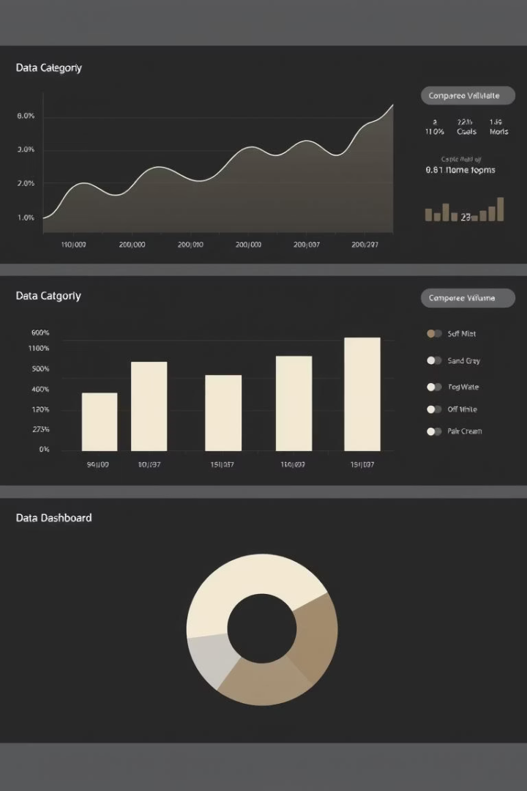



EDA & Interactive Visual Analytics
Tools Used
Visualizations
Pandas, Matplotlib, Seaborn, Plotly for analysis.
Line charts, histograms, bar charts, correlation heatmaps.
Approach
Time series, outlier detection, visual correlation checks.

Slide 7

Predictive Analysis Methodology
Model
Logistic Regression was chosen.
Goal
Predict high/low stock performance.
Data Split
70% for training, 30% for testing.
Metrics
Accuracy, Confusion Matrix, F1 Score.

Slide 8




EDA Visualization Results
Stock vs Revenue
Tesla revenue and stock showed clear upward trends.
Seasonal Patterns
Walmart had Q4 spikes due to holiday sales.
Volatility
Tesla's daily return distribution showed volatility.

Slide 9

EDA with SQL Results
1
Database Connection
Connected to IBM Db2 using ibm_db and SQLAlchemy.
2
SQL Queries
Aggregated quarterly revenue, filtered top quarters, calculated average closing prices.
3
Key Insight
Early 2020 revenue dips (COVID) immediately reflected in stock price drops.

Slide 10




Folium Map Results
Interactive Map
Built a map of company headquarters.
Markers & Popups
Added markers with revenue information.
Geographic Insight
Visualized geographic spread and market reach correlation.

Slide 11



Plotly Dash Dashboard Results
Features
2
Company selection dropdown, line charts for revenue and stock.
Interactive Dashboard
1
Created using Plotly Dash.
Dynamic Updates
Real-time data interaction and visual filtering.
3

Slide 12
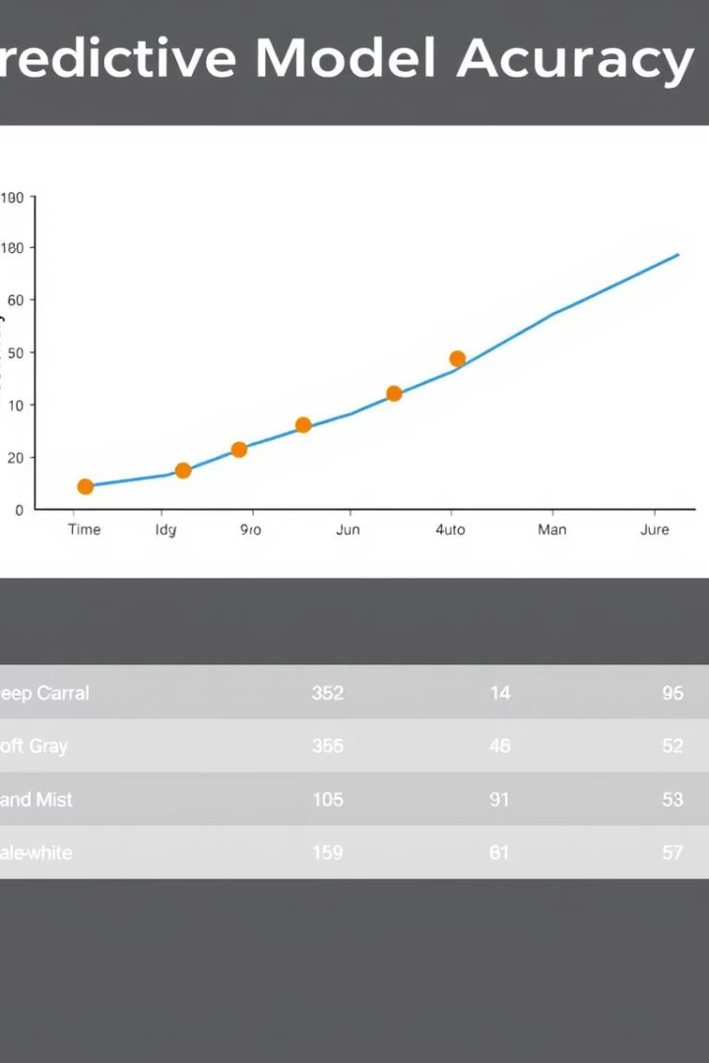
Predictive Analysis Results
85%
True Positives
Accuracy
Confusion Matrix
Logistic Regression model achieved 85% accuracy.
Detailed breakdown of True Positives and False Negatives.
High/Low
Prediction
Model can reasonably predict stock outcomes based on revenue.

Slide 13

Conclusion & Innovation
End-to-End Learning
Gathered, cleaned, analyzed, and visualized data.
Pattern Discovery
Found patterns between financial performance and stock trends.
Interactive Tools
Built dashboards and a predictive model.
Creative Elements
Custom theme, storytelling layout, extra charts.

