Slide 1
Class Project
Phase III

Slide 2
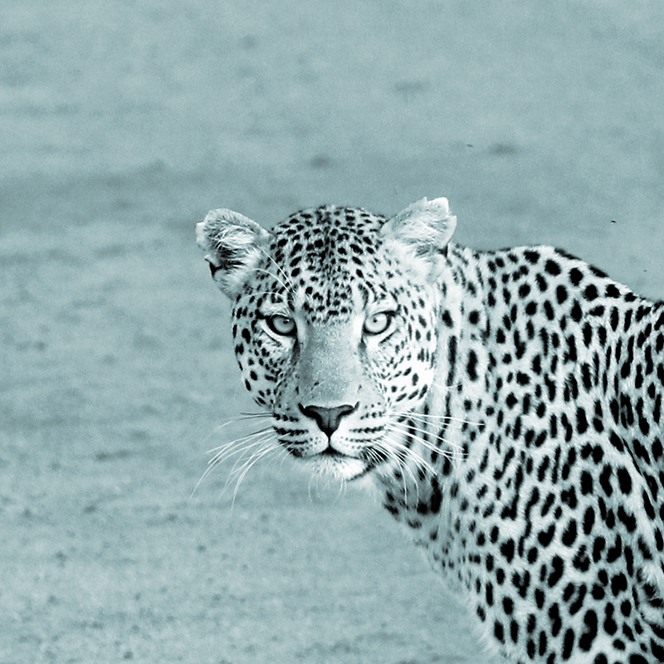
Hello!
I am Jason Leong
This is my project presentation for phase III.

Slide 3
1.
Project Idea
Introduction

Slide 4
Motivation: I have always been interested in app development. I feel like it is super beneficial to learn about all types of aspects of the technological world.
The App I decided to build was a calorie tracker.

Slide 5
2.
Class Diagram
Astah

Slide 6
Class Diagram
A representation of all classes in one manor.
How the classes are connected
Link to full image: https://drive.google.com/file/d/1oVS-5pu20Z6_s8FzxRpHFmiiJ25DmUiF/view?usp=sharing

Slide 7
3.
MVC Diagram
Astah

Slide 8
MVC Diagram
View
Controller
Model
Link to full image: https://drive.google.com/file/d/1oVS-5pu20Z6_s8FzxRpHFmiiJ25DmUiF/view?usp=sharing

Slide 9
4.
Implementation
Workings

Slide 10
Consistent Data
How the data is persistent with each reopening.

Slide 11
Data
Food
Food is stored as core data and is accessed throughout the app. For example the diary system takes every entry and portrays it in a table view.
Person
Person is stored as core data and is accessed and used in the different view controllers. For example the users information for the calories to take.

Slide 12

Demo
Calorie+

Slide 13
5.
Capabilities and limitations
Any Drawbacks?

Slide 14
IOS
Apple Developers Fee
In the Beginning I had to get experience with a new OS.

Slide 15
6.
Lessons learned
What skills have I acquired by working on this project.

Slide 16
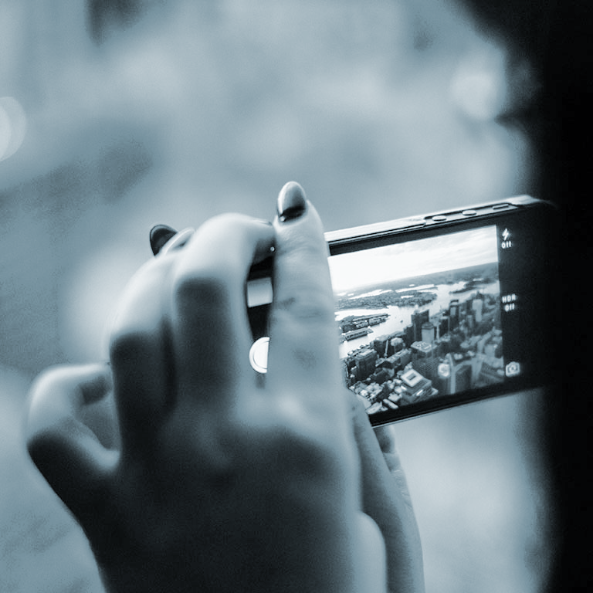
Ios and Android
I am glad that we followed a storyboard approach, with a little research I found that using android studio is almost the same with storyboarding as how we do it in XCode.

Slide 17
7.
improvements

Slide 18
My Thoughts
I personally enjoyed the class. It is a simple refresher and not too difficult on top of my other classes. The only thing I would like better is in class activities specifically in groups. I believe that working in small teams and groups really boost each others confidence in the subjects and helps individuals learn better.

Slide 19
8.
Conclusions
The End

Slide 20
Conclusions
I really enjoyed the subject. It opened my eyes to how different the mobile system compares to the desktop computing. Where you have to take into consideration of battery life, computing power, accessibility to internet access consistently.
After this class I want to learn more about the mobile world. We only touched a brief version of the whole idea and in just ios.
Thank you professor have a great winter break!

