Slide 1
….
….
….
FC
FC
256*256*3
1200
50

Slide 2
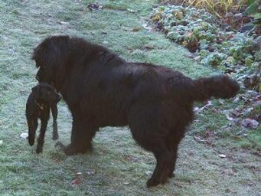
Input 256*256*3
252*252*6
126*126*6
122*122*16
61*61*16
59536
1200
800
Output 50
MaxPooling(2*2)
FC
FC
Convolutions(16, 5*5)
FC
FC
Convolutions(6, 5*5)
MaxPooling(2*2)

Slide 3
Input 254*254*3
252*252*6
126*126*6
124*124*16
62*62*16
60*60*26
30*30*26
23400
1200
840
Output 50
MaxPooling(2*2)
Convolutions(6, 3*3)
FC
FC
Convolutions(16, 3*3)
FC
FC
Convolutions(6, 3*3)
MaxPooling(3*3)
MaxPooling(3*3)

