Slide 1
Courschema
Team Members：
王天麒 11711613
赵志翔 11711621
于志洋 11712819
张艺凡 11711335
OOAD Project

Slide 2
Outline
Motivation
Silver bullet: Customization and tree-like diagram
Requirements
Architecture and Timeline

Slide 3
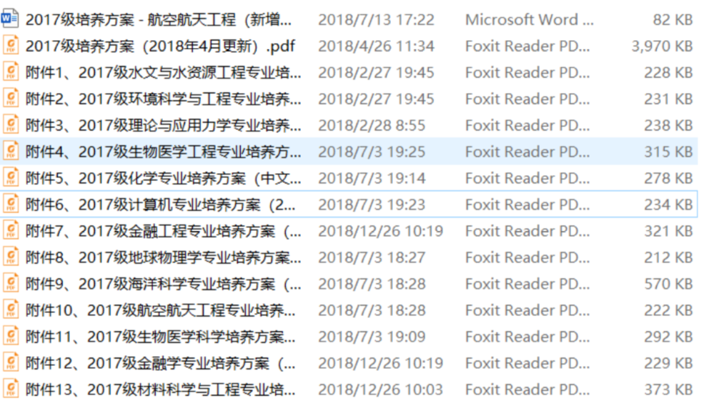
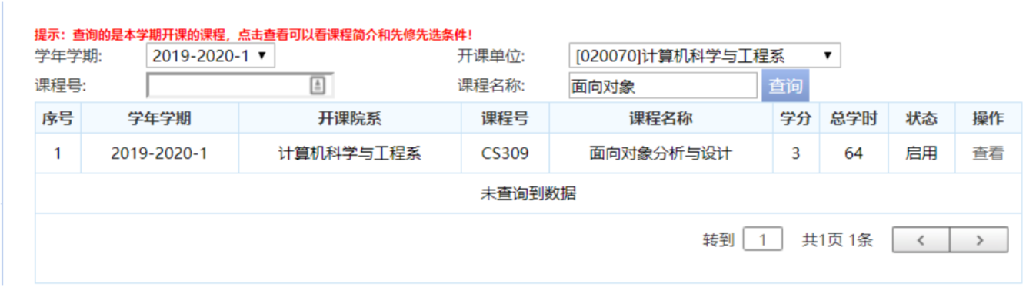
Motivation
Problems
Student's view:
1.The query process is complex.
2.Too many system
hard to find course introduction
Not easy to make a plan
3. out of date
some courses are not in curriculum

Slide 4
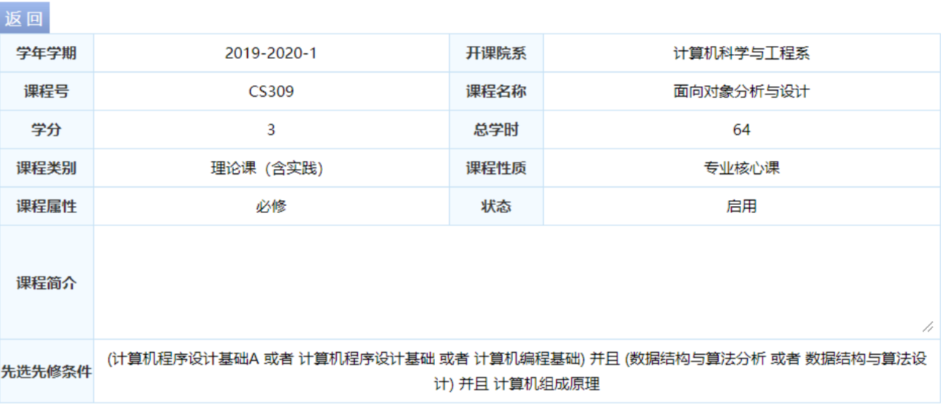

Slide 5
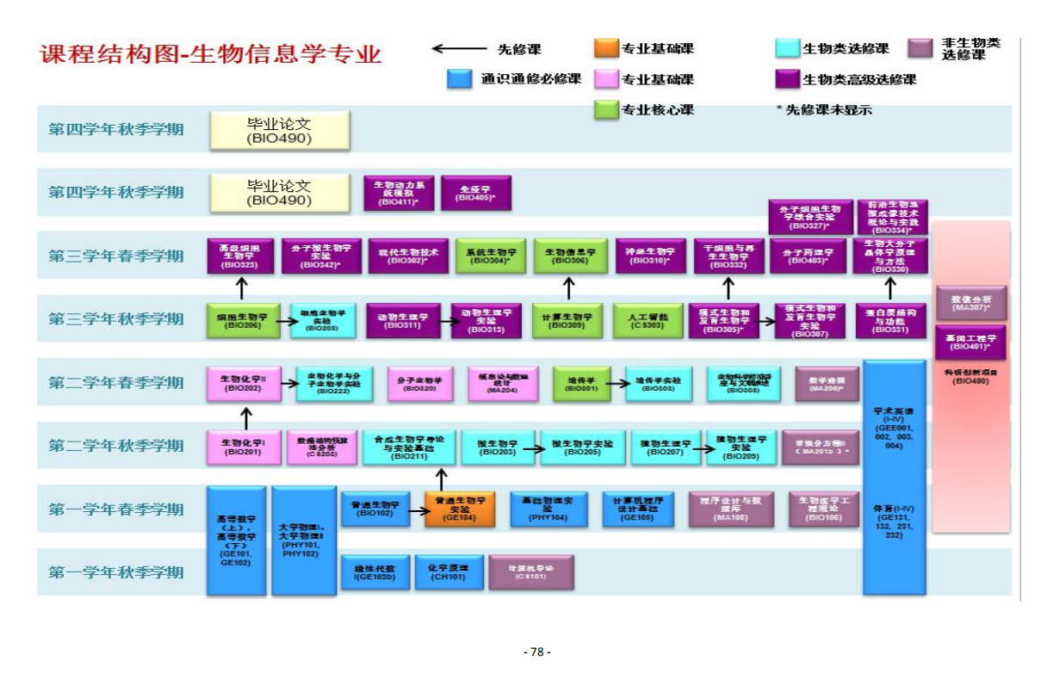
Problems
Motivation
Administrator’s view:
1. Updating curriculum is a hard task.
one updation need to upload a complete curriculum table.
2. Relation between courses are complex
If there are conflict between courses, table would tell you nothing

Slide 6
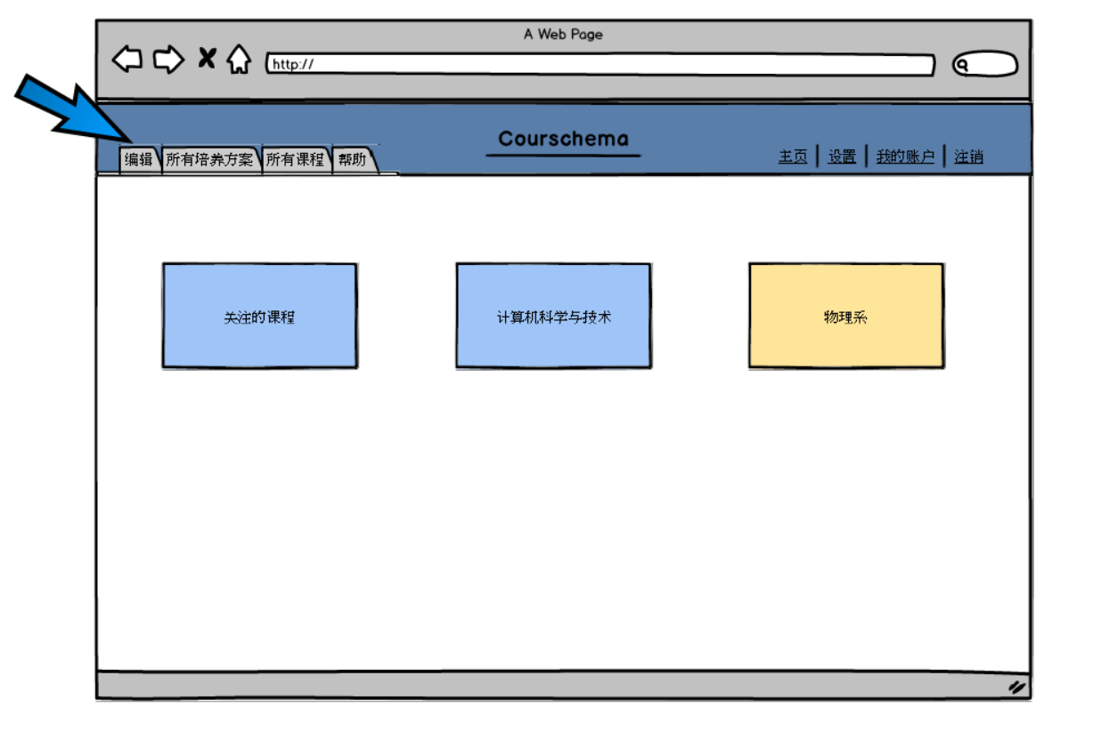
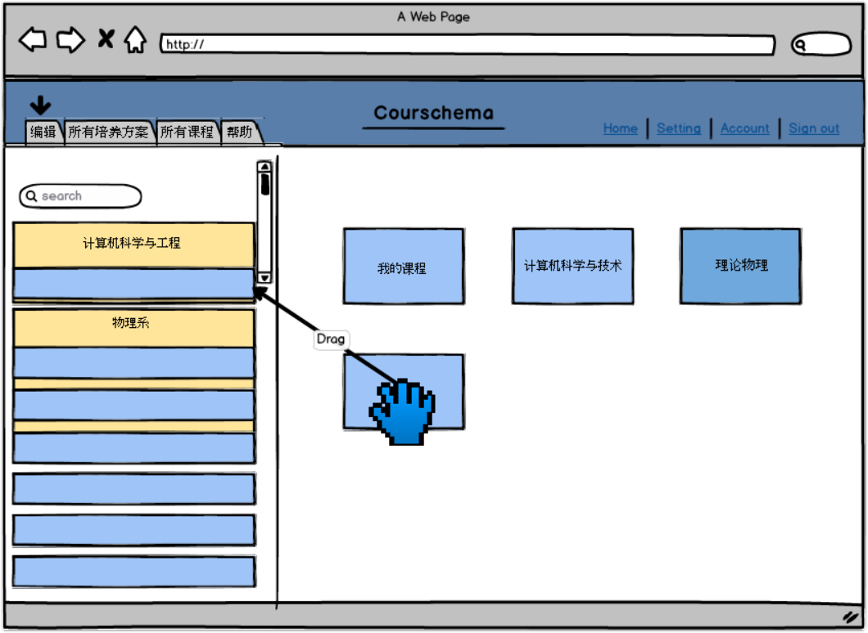
Our stratagy Silver bullets: Customizability
1.The query process is complex.

Slide 7
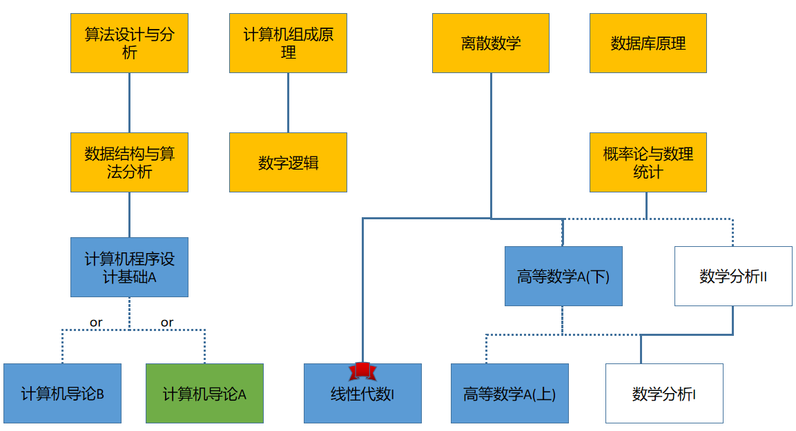
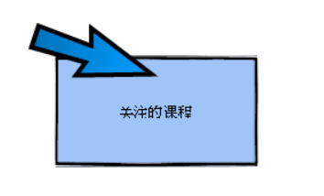
Our stratagy
专业先修课
通识必修课
专业选修课
无专业要求
已学课程标记
2. out of date
some courses are not in curriculum
3.Too many system
hard to find course introduction
Not easy to make a plan

Slide 9
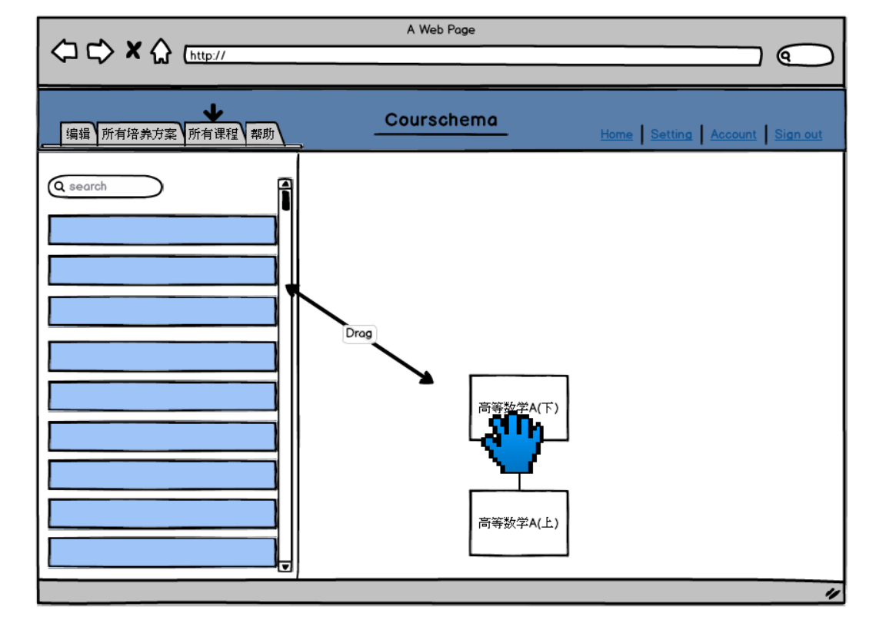
Our Stratagy
1. Updating curriculum is a hard task.
one updation need to upload a complete curriculum table.
2. Relation between courses are complex
If there are conflict between courses, table would tell you nothing

Slide 10
Requirements functional
Foundamental Requirement
Fetch data from curriculum table and generate tree-like diagram
Usesr can edit their home page
Show courses relationships and attendance
Q&A
Student
User
modify course information: credit, information, etc ...
modify relationship of courses: prerequired course
Administrator
User
Advanced Requirement
Recommendation System: Provide students with advice on choosing courses
User can mark courses in favorite

Slide 11
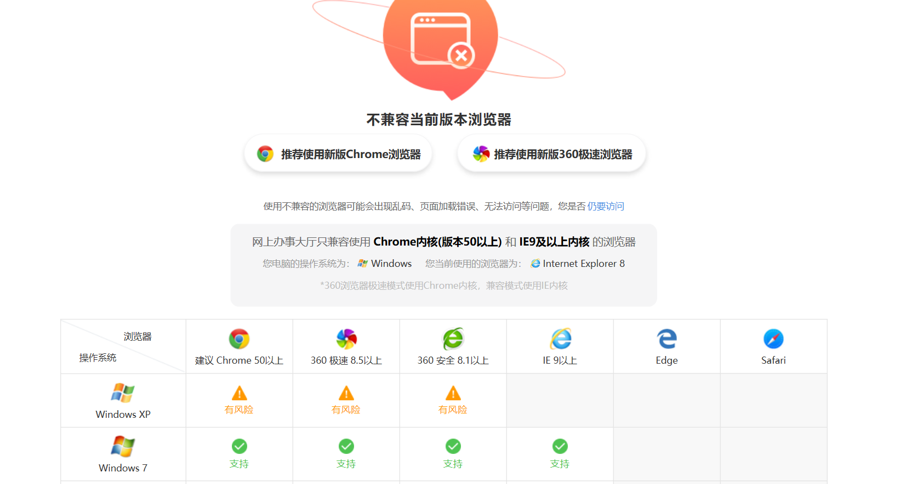
Requirements non-functional
1. Multi-platform compatibility
2. Multi-browser compatibility
Example: ehall
3. Mobile and PC compatibility

Slide 12
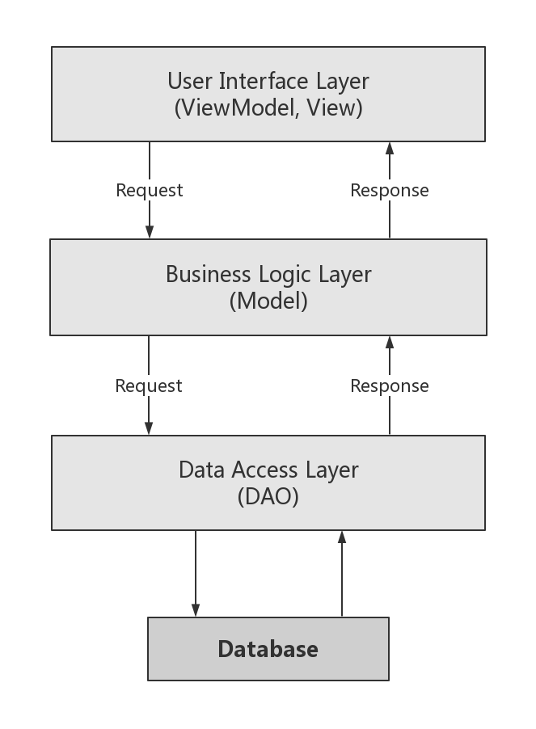
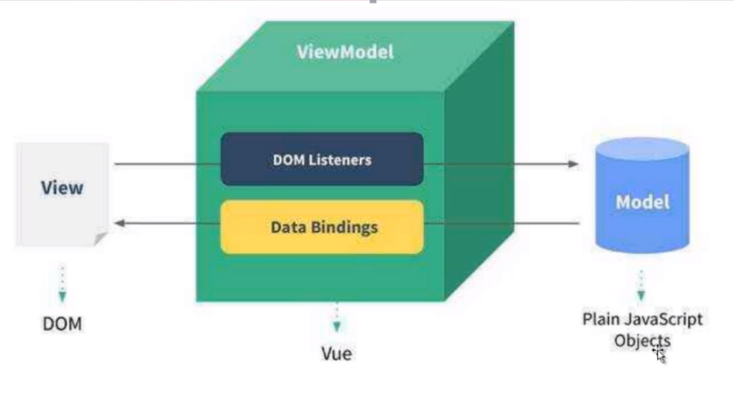
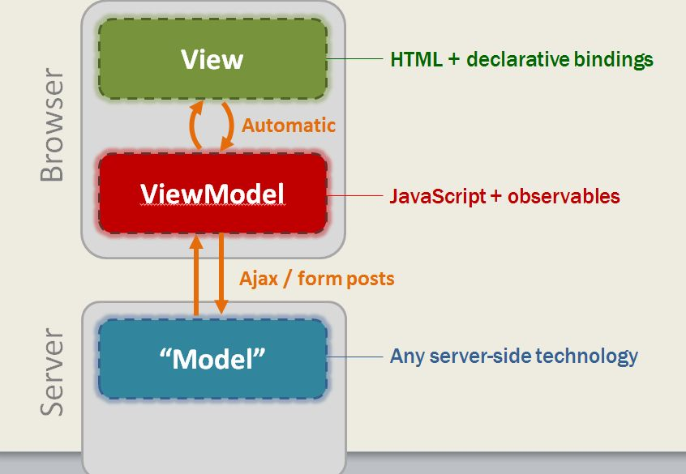
Architecture Hierarchy MVVM

Slide 13
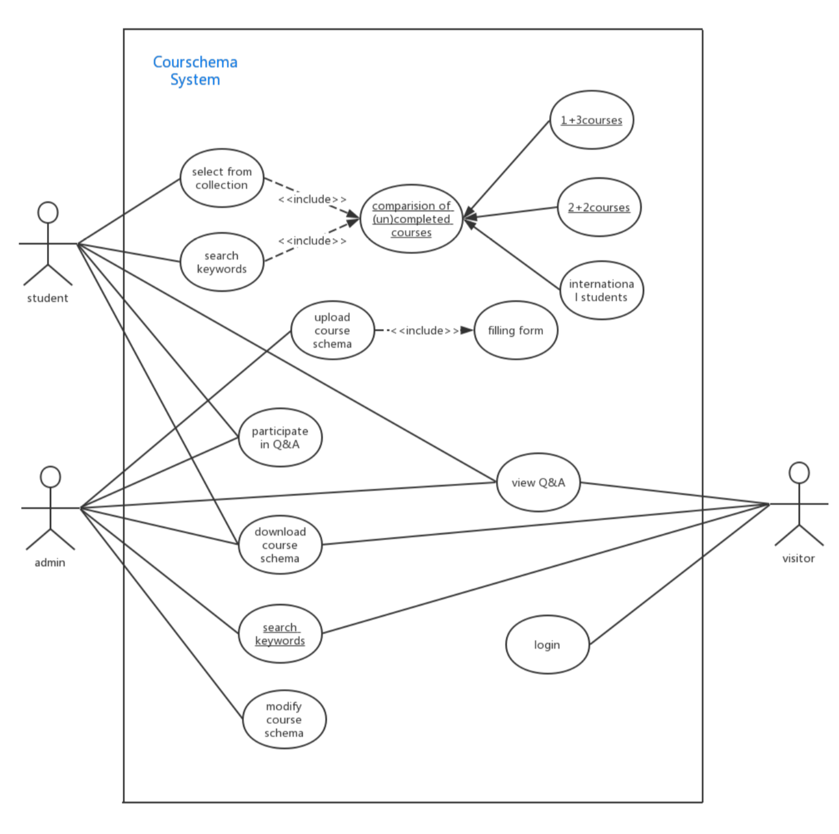
Architecture Use case diagram

Slide 14
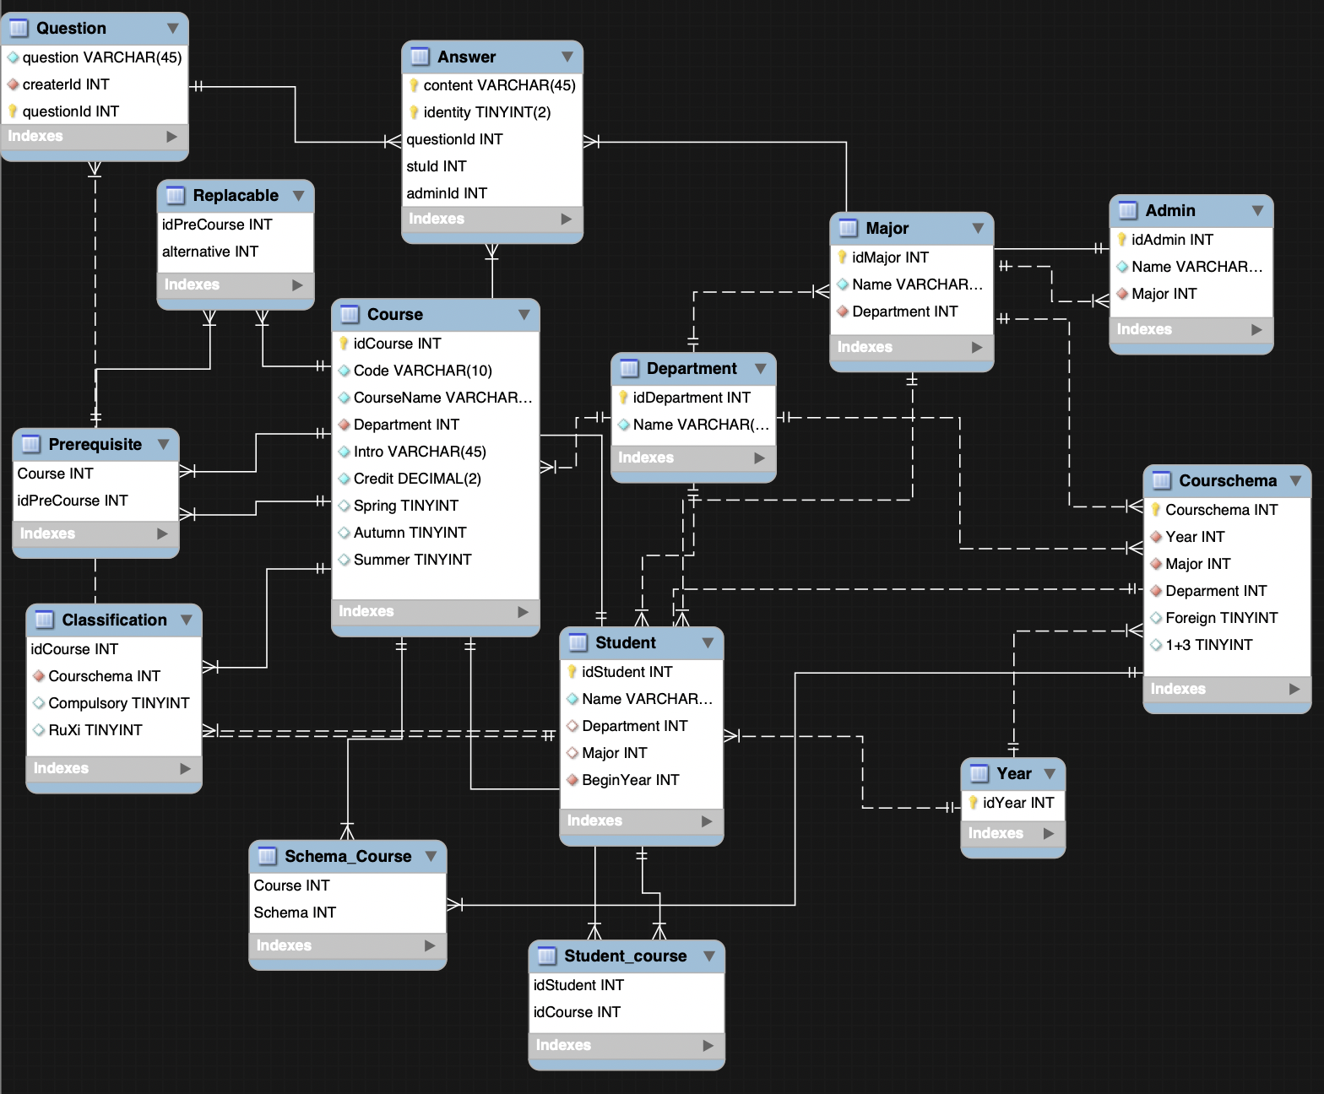
Architecture Database schema

Slide 15
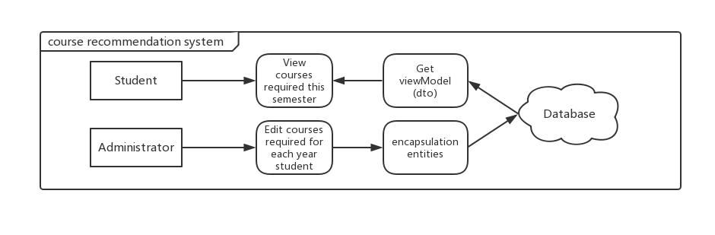
Architecture System example Course Recommendation

Slide 16
Feasibility
1. The visualization of courses, schemas needs us to build a roadmap editor for the administrator. It might be a problem for us to create such a WYSIWYG editor(what you see is what you get.

Slide 17
Useful APIs , Services and Technologies
1 . Vue
2. Bootstrap
3. Tomcat
4. Servlet
5. Doxygen

Slide 18
Timeline & Staffing plan
WEEK
Front-end Staff
Back-end Staff
front-end basic structure
Data import and processing
6-7
Tree-like diagram generate
Basic business logic implymentation
7-8
Front-end
王天麒
赵志翔
Back-end
张艺凡
于志洋
Frontend Backend conmmunication
Frontend Backend conmmunication
9-10
Debug
11-12
Debug

Slide 19
Question?

