Slide 1
Evaluation
Biztalk 2004

Slide 2
Table of Contents
Introduction to XML.
Anatomy of an XML document.
What is an XML Schema?
What is SOAP?
XML Web Services overview.
Biztalk 2004 overview.
Biztalk EDI overview.
Biztalk Demos.
Biztalk Planning.

Slide 3
Introduction to XML
XML is a markup language for documents.
XML provides a facility to define tags and the structural relationships between them.
XML is different from HTML because unlike HTML, XML is not restricted to a predefined number of tags.
XML is a meta-language for describing other markup languages so HTML and SGML are actually a subset of XML.

Slide 4
Anatomy of an XML Document
An XML document begins with an <?xml version="1.0"?> tag.
The xml document is made up of elements or nodes.
There is a root node which has child elements in it. The root node is the highest level entity in an xml document.
Each node is made up of a type and value part.
Some nodes are special and have attributes in them

Slide 5
What is an XML Schema?
The purpose of an XML Schema is to define the legal building blocks of an XML document i.e. it is used to validate an xml document.
An XML Schema:
  defines elements that can appear in a document
  defines attributes that can appear in a document
  defines which elements are child elements
  defines the order of child elements
  defines the number of child elements
  defines whether an element is empty or can include text
  defines data types for elements and attributes
  defines default and fixed values for elements and attributes

Slide 6
What is SOAP?
SOAP stands for Simple Object Access Protocol.
SOAP is a communication protocol.
SOAP is for communication between applications.
SOAP is a format for sending messages.
SOAP is designed to communicate via Internet.
SOAP is platform independent.
SOAP is language independent.
SOAP is based on XML.
SOAP is simple and extensible.

Slide 7
XML Web Services Overview
Used for exposing business objects and methods to external applications.
Allows inter-application communication and integration. Communicate with Java applications over HTTP.
Uses SOAP, XML, XML schema and other xml related technologies.
Legacy applications can be wrapped into an XML web service layer.
Demo calling http://localhost/Provider.asmx

Slide 8
Biztalk 2004 Overview
Biztalk is an ERP (Enterprise Application Integration) system.
Think of it as a central point for managing all your xml web services based applications.
It can be used for internal application integration. Allow POMS and Paltrax to call web methods from each other to correct data.
It can be used for external application integration. Use EDI to communicate with vendors etc.

Slide 9
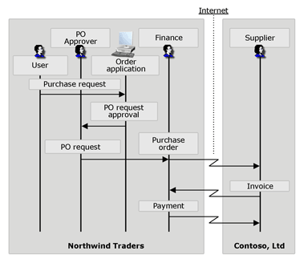
Biztalk EDI overview

Slide 10
Biztalk Demos
Demo 1: How to use visual studio .NET to develop Biztalk applications?
Demo 2: Securing Biztalk applications using WSE.
Demo 3: Advance Biztalk development.

Slide 11
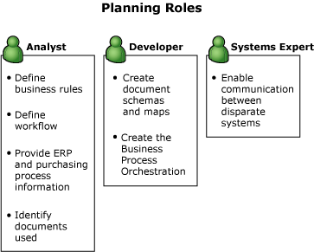
Biztalk Planning

Slide 12
Additional Resources
www.microsoft.com/biztalk/
www.msdn.com/biztalk/
blogs.msdn.com/Biztalk_Core_Engine
www.msdntv.com
msdn.microsoft.com/training/webcasts/

