Slide 1
Crystal Reports Training
Notes:
[Notes to trainer:
For detailed help in customizing this template, see the very last slide. Also, look for additional lesson text in the notes pane of some slides.
Macromedia Flash animations: This template contains Flash animations. These will play in PowerPoint 2000 and later. However: If you want to save this template in PowerPoint 2007, save it in the earlier PowerPoint file format: PowerPoint 97-2003 Presentation (*.ppt) or PowerPoint 97-2003 Template (*.pot) (you’ll see the file types in the Save As dialog box, next to Save as type).
Warning: If you save it in a PowerPoint 2007 file format, such as PowerPoint Presentation (*.pptx) or PowerPoint Template (*.potx), the animations won’t be retained in the saved file.
Also: Because this presentation contains Flash animations, saving the template may cause a warning message to appear regarding personal information. Unless you add information to the properties of the Flash file itself, this warning does not apply to this presentation. Click OK on the message.]

Slide 2
Training goals
Introduce Crystal Report products and tools
Develop reports using the report designer
Discuss setup, installation, configuration and administration of Crystal Enterprise Server
Discuss security features in crystal reports
Discuss crystal integration with .NET and the .NET SDK
Development, configuration and deployment of reports

Slide 3
Table of contents
Overview: Background
Overview: Crystal Products / Licensing
Overview: System Requirements
Overview: Features
Lesson 1: Administration / Maintenance
Lesson 2: Development

Slide 4

Overview: Background
Crystal Reports is a report writing software that was originally created by Crystal Services Inc., which produced versions 1.0 through 3.0. The company was subsequently acquired by Seagate Software, which later renamed itself to Crystal Decisions, and produced versions 4.0 through 9.0. Crystal Decisions was acquired in December 2003 by Business Objects, which has so far produced versions 10, 11 (XI) and the current version 12 (2008).
Business Objects is a market leader in the field of business intelligence. They have 43,000 customers and they have more than 6,200 employees world wide. Business Objects was recently acquired by SAP AG.

Slide 5
Overview: Crystal Products / Licensing
The crystal software suite is made up of three products
Crystal Reports – Application for developing crystal reports.
  Available versions are 6, 7, 8, 8.5, 9, 10, XI, 2008.
  Available licenses are Standard, Professional, Developer & Enterprise.
Crystal Enterprise – Web Server for housing / serving reports.
  This is the small-medium market version. There are other high end versions available also called Business Objects Enterprise and Business Objects Crystal.
  Comes with 1 report designer and 5 CAL licenses.
SDK and other components – Crystal Viewer, .NET SDK, Java SDK etc.
Note:- Click here for licensing details
Notes:
[Note to trainer: With Word 2007 installed on your computer, you can click the link in the slide to go to an online practice. In the practice, you can work through each of these tasks in Word, with instructions to guide you. Important: If you don’t have Word 2007, you won’t be able to access the practice instructions.]

Slide 6
Overview: System Requirements
Crystal Reports (Minimum Requirements)
  Operating system: Microsoft Windows 2000 SP4, XP, or later
  Processor: Pentium II or higher (Pentium III-class recommended)
  Memory:128 MB of RAM (256 MB recommended)
  Hard disk: 350 MB of free hard disk space (600 MB recommended
Crystal Enterprise Server (Minimum Requirements)
  Operating system: Microsoft Windows 2000 or 2003
  Processor: 700 MHz Pentium 3 processor
  Memory: 1GB of RAM
  Hard disk - 2.5GB
Notes:
[Note to trainer: With Word 2007 installed on your computer, you can click the link in the slide to go to an online practice. In the practice, you can work through each of these tasks in Word, with instructions to guide you. Important: If you don’t have Word 2007, you won’t be able to access the practice instructions.]

Slide 7
Overview: Features
Comes with 35 data drivers. Compatible data sources are:
  Sybase, IBM DB2, Ingres, Microsoft Access, Microsoft SQL Server, MySQL, Interbase and Oracle
  Btrieve
  Spreadsheets such as Microsoft Excel
  Text files
  XML files
  Groupware applications such as Lotus Notes, Microsoft Exchange and Novell GroupWise
  Other data sources accessible through a web service, ODBC, JDBC, ADO, ADO.NET and OLAP
Notes:
[Note to trainer: With Word 2007 installed on your computer, you can click the link in the slide to go to an online practice. In the practice, you can work through each of these tasks in Word, with instructions to guide you. Important: If you don’t have Word 2007, you won’t be able to access the practice instructions.]

Slide 8
Lesson 1
Administration / Maintenance

Slide 9
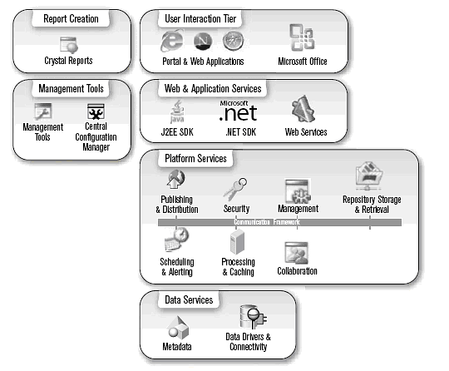
Crystal Reports : Functional Architecture
The diagram shows crystal products in action. It shows how the different pieces work together to deliver the report.
The diagram shows crystal administration, development, deployment and configuration tools.
Lesson 1
Notes:
What kind of content does a template include? Anything and everything, including text, styles, and formatting; page layout, such as margins and line spacing; and design elements such as special colors, borders, and accents, typical of a Word theme.
Think of a template as a very helpful starting point. If, for example, you have weekly work meetings and have to create the same meeting agenda over and over but with slightly different details every time, starting out with a lot of information already in place will vastly speed up your work.

Slide 10
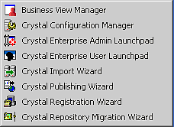


Crystal Enterprise Server
Located under
- Start > Programs > Crystal Enterprise 10
Software installation directory is
- C:\Program Files\Crystal Decisions
Crystal Admin Launchpad is located at the URL:
- http://ServerName/crystal/enterprise10/adminlaunch/en/default.htm
Crystal User Launchpad is located at the URL:
- http://ServerName/crystal/enterprise10/desktoplaunch/en/default.htm
Lesson 1
Notes:
Some of the most popular template categories on Office Online include Agendas, Calendars, Flyers, Letters, and Resumes.
You’ll see how to link to Office Online from Word later in the course.

Slide 11
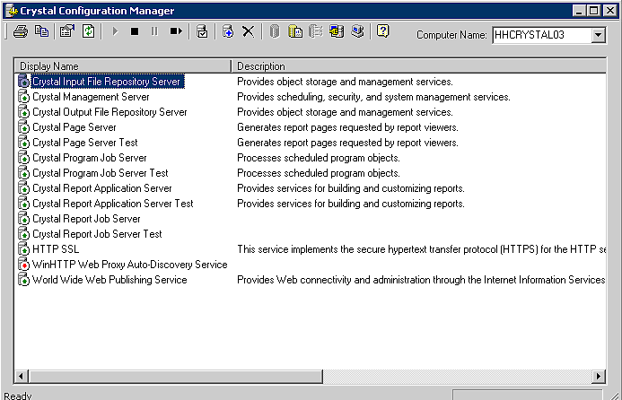
Crystal Configuration Manager
Lesson 1
Notes:
Note: Along with the numerous templates on this site that are developed by Microsoft, there are templates that have been created by customers.

Slide 12
Miscellanous Tools
Crystal Import Wizard
  Used to import reports from previous versions of Crystal Enterprise
Crystal publishing Wizard
  Publish a Crystal Report Definition File ( RPT ) to the server
Store the report on a network share on the server so that it gets backed up
Crystal License Manager
  Used to add / remove license keys
Lesson 1
Notes:
[Note to trainer: With Word 2007 installed on your computer, you can click the link in the slide to go to an online practice. In the practice, you can work through each of these tasks in Word, with instructions to guide you. Important: If you don’t have Word 2007, you won’t be able to access the practice instructions.]

Slide 13
Further reading…
Business Objects website
http://www.businessobjects.com
Crystal Reports Resources website
http://resources.crystalreports.com/
Free web seminars
http://www.crystalreports.com/events
Crystal Reports Developer website
http://diamond.businessobjects.com/developer/gettingstarted
Crystal Reports Website
http://www.crystalreports.com/
Lesson 1

