Slide 1
Windows Communication Foundation
- Evaluation Demo and FAQ

Slide 2
Agenda
Background : N-Tier Architecture
Background : SOA Architecture
Background : Web Service Software Factory ( WSSF)
Background : .NET Framework 3.0
Overview of WCF
FAQ: WCF Hosting
FAQ: WCF Communication
WCF Usage scenarios
WCF programming model
WCF Demo
Further Reading

Slide 3
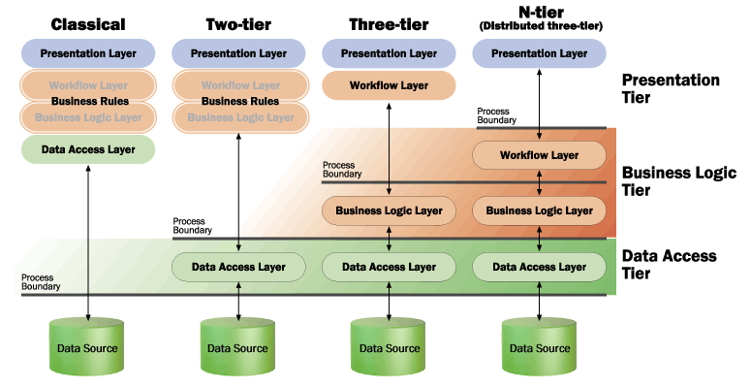
N-Tier Architecture

Slide 4
SOA Architecture
Presentation Tier
Web Services Tier
Web Framework
Web Service
Framework
Application Tier
Core Framework
XML Tasks
Command
Workflow
Common Tier
Business Tier
Service Interface
Rules Engine
Security
Logging
Data Tier
Domain Object
Data Access

Slide 5
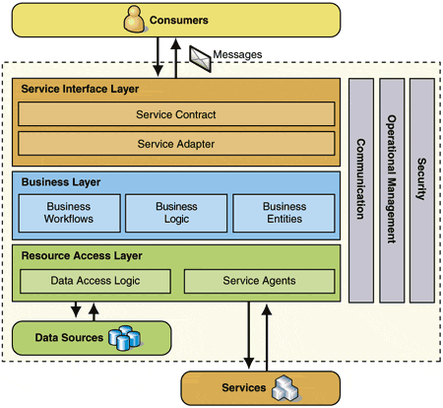
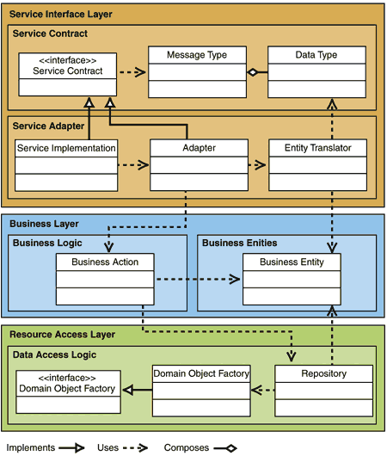
WSSF – Service Factory
Architectural View
Logical View

Slide 6










.NET Framework 3.0
Windows Presentation Foundation
Next generation user experience
Windows Communication Foundation
Service-oriented development
Windows Workflow Foundation
Business process modeling
“InfoCard”
Digital identity management

Slide 7
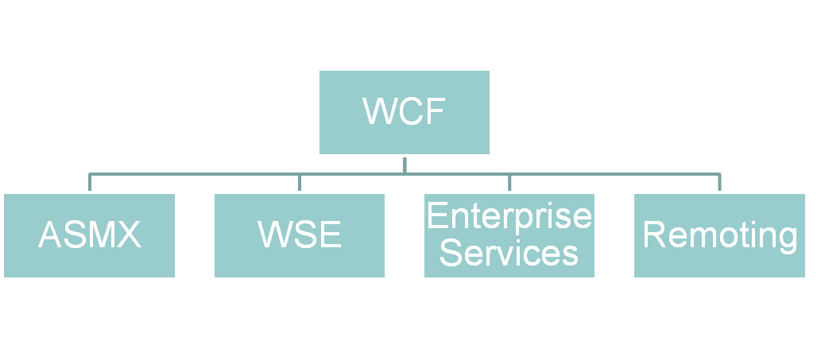
Overview – What is WCF?
Formerly named “Indigo”
ASMX, WSE, Enterprise Services & Remoting

Slide 8
FAQ : WCF Hosting
Where can it be hosted?
Windows Service
IIS
Dedicated application
Windows Activation Service

Slide 9
FAQ :WCF Communication
What communication methods does
WCF support?
Web Services
Remoting
MSMQ
Named Pipe
Peer to Peer

Slide 10
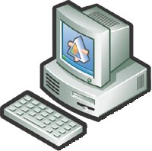


WCF Usage Scenarios
Typically used for long running processes.
Provides the communication Layer.
Suited for disparate environments and systems.
Reuse existing applications and legacy systems.
Good for asynchronous processing and transaction based systems.
WCF Layer
Caller
Web Services
Remoting
MSMQ
Peer to peer
Named Pipe
Service

Slide 11
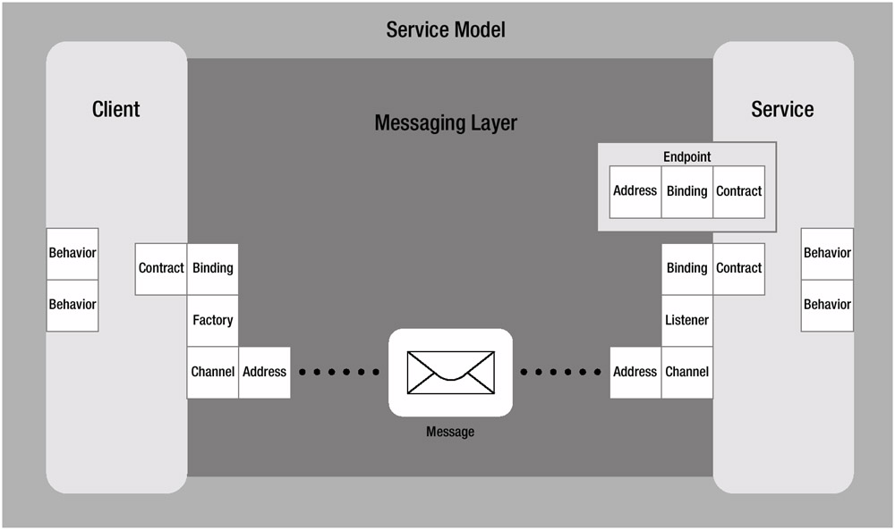
WCF Programming Model

Slide 12
WCF Demo
- Building WCF application
Service
  Define Contracts
  Implement Contracts
  Define Endpoints
  Host & Run Service
Client
  Generate Proxy from Metadata
  Implement & Run Client

Slide 13
Further Reading
 | Resources
Web Service Software Factory Web Services Enhancement Web Services Security | http://msdn.microsoft.com/en-us/library/aa480534.aspx http://msdn.microsoft.com/en-us/library/cc268283.aspx http://msdn.microsoft.com/en-us/library/aa302390.aspx

