Slide 1
Drone
Prepared By:
Ahmad Dhiya’uddin Bin Md Nasir
Jason Beh Wei Zhi

Slide 2
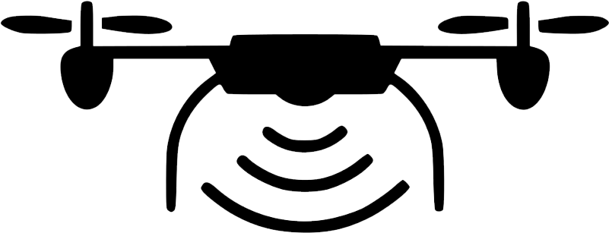
What is Drone?
A drone or unmanned aerial vehicle (UAV) is a flying robot with embedded technologies that may be commanded remotely or fly independently using software-driven flight plans.
Over the past few years, drone technology has developed and prospered which brings a significant increase in terms of drone adoptions for several usages.

Slide 3
Soil & Field Analysis
Planting
Applications of Drones in Agriculture
Drones can used to create accurate 3D maps of early soil analysis, which is helpful in seed planting planning patterns.
After planting, drone-assisted soil analysis can be used to plan irrigation and management of nitrogen levels.
Drones with planting systems have been designed and developed for tasks such as seed planting by shooting pods containing seeds and plant nutrients into the soil, giving the plant with all of the nutrition it requires to live.

Slide 4
Crop Spraying
Crop Monitoring
Irrigation
Drones can scan the ground and spray the appropriate amount of liquid, regulating distance from the ground and spraying in real time to ensure even coverage.
Application of drones with suitable sensors ease the crop monitoring process for farmers.
Drones equipped with hyper-spectral, multispectral, or thermal sensors can detect areas of a field that are dry or in need of improvement.
Drones can also calculate the vegetation index, which describes the relative density and health of the crop, and reveal the heat signature, which is the amount of energy or heat the crop releases while the crop is growing.

Slide 5
Health Assessment
Geofencing
Crop Insurance
Drone-carried equipment can distinguish which plants reflect various quantities of green light and near-infrared light by scanning a crop with both visible and near-infrared light.
This data can be used to create multispectral images that track plant changes and indicate their health.
Drones mounted with thermal sensors can detect human or animals during night time in order to protect the fields from external damage.
Drones can used precisely for determining and monitoring crops failure which bring convenience to farmer to claim insurance based on the degree of damage.

Slide 6
Mapping Forests and Biodiversity
Mapping Canopy Gaps
Applications of Drones in Forestry
A drone can be designed and developed for mapping forest.
Applications of drones for mapping purpose can save time, costs and labour power.
Wind and snow disturbances, in particular, have a direct impact on forest regeneration, biodiversity, and productivity.
Mapping the gaps in the forest canopy can provide a precise situation of these types of disruptions.

Slide 7
Precision Forestry and Sustainable Forest Planning Management
Important factors of forest planning and sustainable forest management include canopy cover, number of trees, volume estimation, vitality, and stand composition.
Quick and precise determination of these parameters can be done through the use of drones with appropriate sensors which lead to better decisions that improve optimal quality and productivity of stands.
A drone with radar SAR (L-band - Synthetic Aperture Radar) sensor is suitable for measuring biomass volume in young stands with lower BA (Basal Area) and lower AGB (Above Ground Biomass).

Slide 8
Measuring Forest Canopy Height and Attributes
Canopy height is an important forestry parameter that is usually measured through field measurements.
LiDAR (Light Detection and Ranging) technology is becoming more widely available, and it currently represents a new solution for canopy height measurements, especially given that it can be installed on drones.
Besides, drones equipped with an oblique optical sensor and new digital photogrammetry techniques can be another new methods for assessing canopy height.

Slide 9
Aerodyne (Agrimor SuperApp)
Trends of Precision Agriculture Technology in Malaysia
Problem Statement
Massive data processing is time-consuming.
Production costs to grow crops are increasing.
Solutions
Increased crop yields and profitability through the utilisation of new technologies such as drones and the IoT.
Reducing the amount of traditional agricultural inputs required (land, water, fertilizer, herbicides and insecticides).

Slide 10
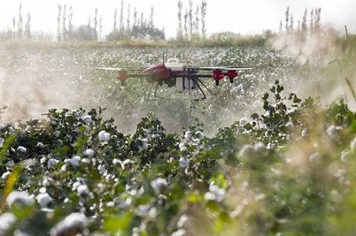
Goals Achieved
Crops yield increased by 67% with the help of drones and IoT.
Reduced the cost of food production by half by lowering the amount of traditional inputs needed to grow crops.

Slide 11
Braintree Technologies
Problem Statement
Inefficiency in plantation management.
Low yield and high costs in agriculture industry.
Solutions
Drones used for pesticide spraying over mature oil palm tree for better efficiency.
Provide more drone services such as AI powered tree counting and mapping.

Slide 12
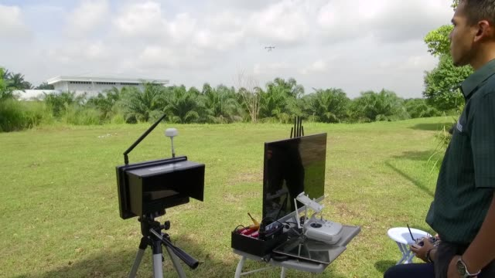
Goals Achieved
500 hectares of energy efficiency were achieved.
Drone pesticide spraying over mature oil palm trees is 100 percent effective.

Slide 13
BoomGrow (Machine Farm)
Problem Statement
Cost spent for farming is high.
Scarcity of land
Solutions
Controlled LEDs to ensure optimal growing conditions for plants.
Equipped with modular racking system that allow the farmers to grow a wide range of greens with the option of scaling up as needed.

Slide 14
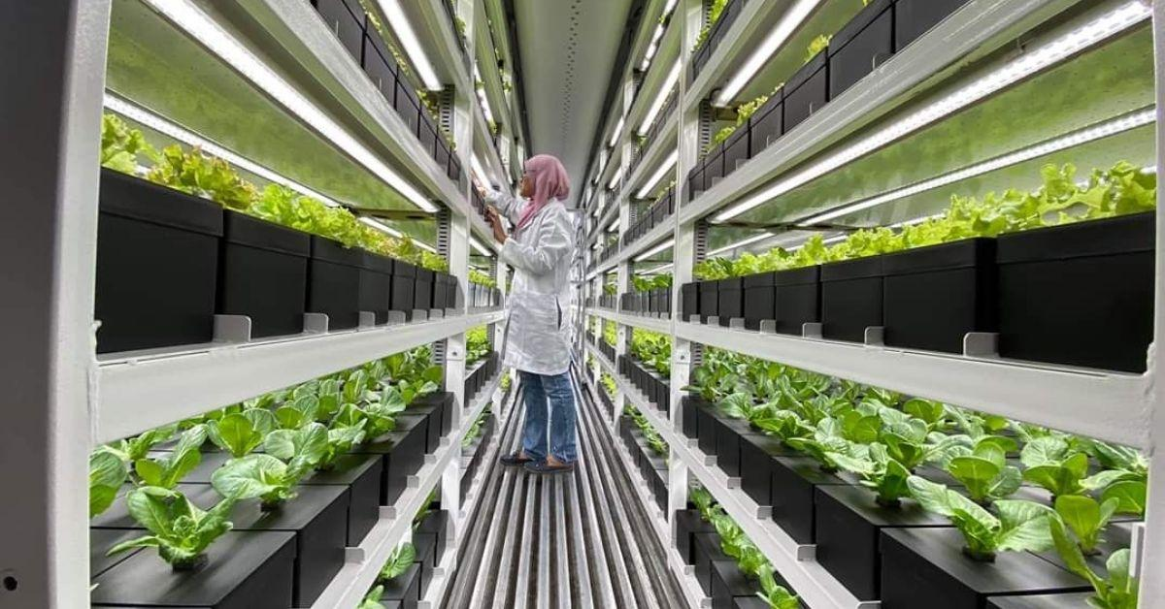
Goals Achieved
AI-driven platforms can shorten plant cycles and boost crop yield.
Lowered water, land and
fuel consumption by 95%
compared to traditional
outdoor farming.

Slide 15
Current Usage of Drones in RGE
UAV (drones) for tree and blank spot detection
Improved management decisions
Crop yields improved
Overall profitability increased
Plant health monitoring for palm oil and fiber tree
Reduce manual labour intervention
Lower labour costs
Implement appropriate actions without much delay

Slide 16
Empower Drones with Image Recognition
APRIL and ACE Digital collaborate to develop plant monitoring solutions through aerial imaginary and computer vision.
This is done by leveraging image analysis to reproduce expert observations on every plants across thousands of hectares using RGB aerial imaginary.

Slide 17
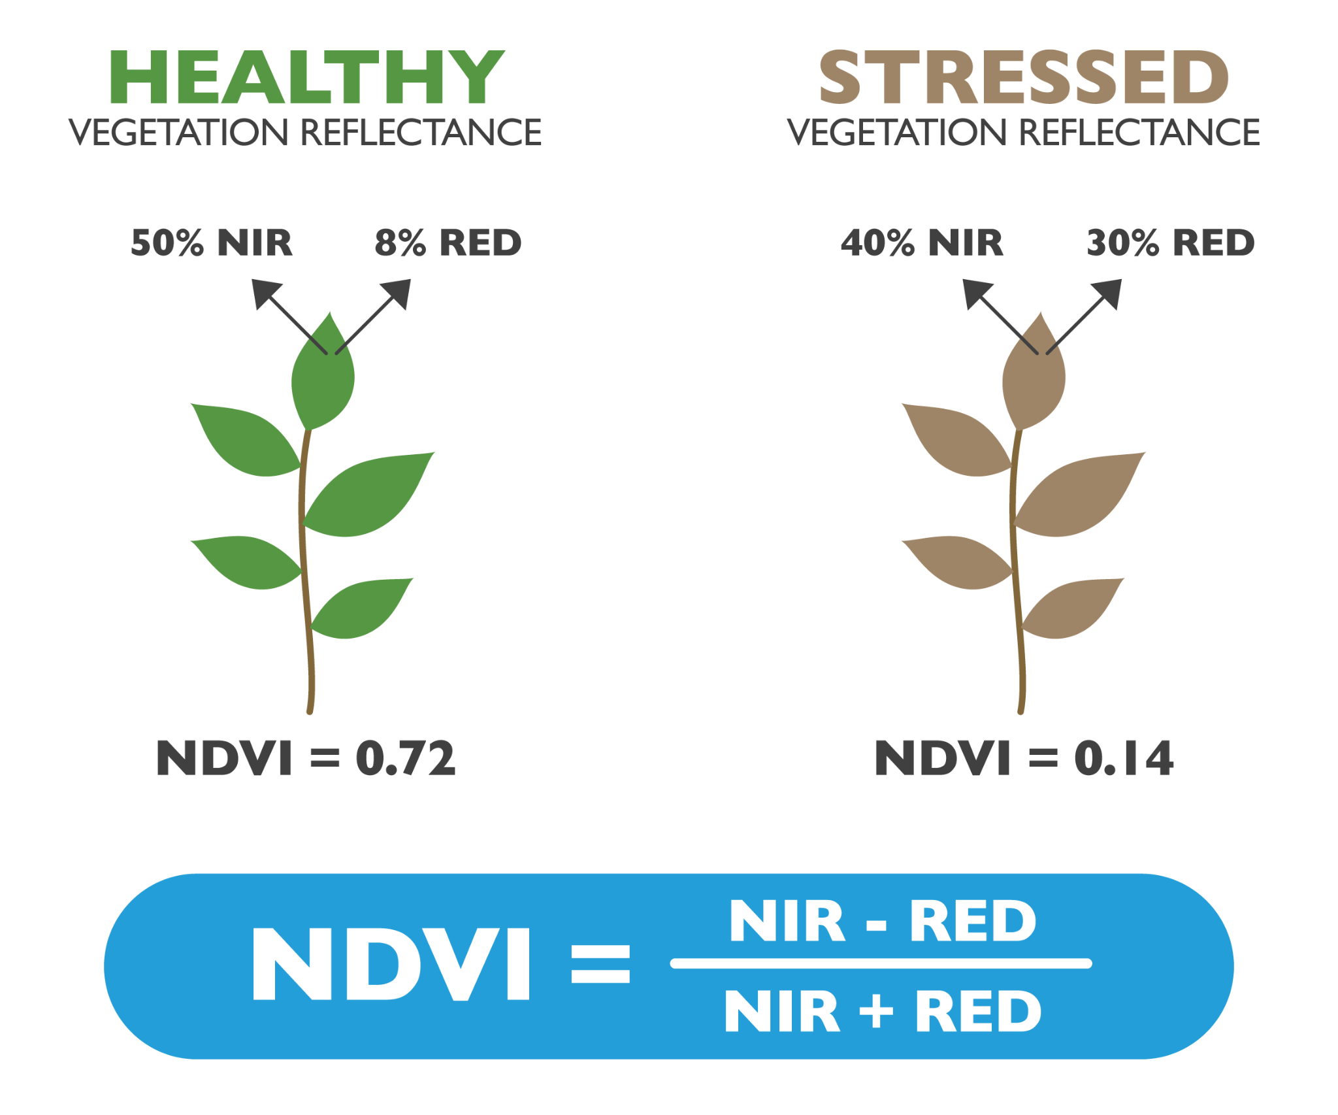
Normalized Difference Vegetation Index (NDVI) measures plant health based on how the plant reflects lights at near-infrared (NIR) and visible spectrum.
It differentiates bare soil from plantation or weed, aiding us from detecting stressed plants which allow us to implement appropriate actions.

Slide 18
Empower Drones with Sensors

Slide 19
Use cases

Slide 20
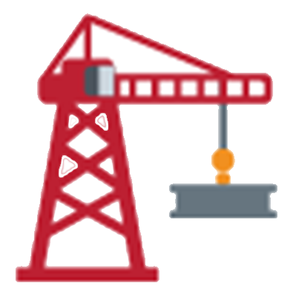

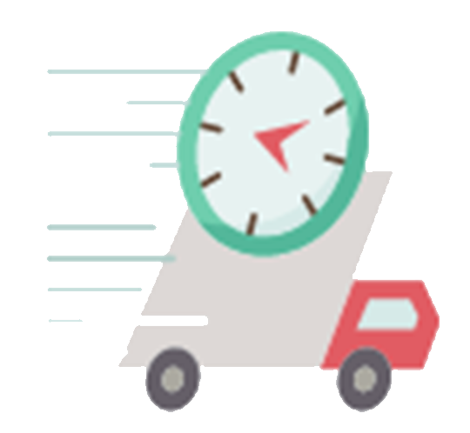
Other Applications of Drones
Construction site or building safety inspection
Equipped with thermal sensors for rescue operation
Shipping and delivery

Slide 21
Conclusions
Drones or unmanned aerial vehicle (UAV) plays an important role in revolutionizing the businesses such as agriculture and forestry.
Uses and applications of drones in appropriate fields are able to generate several benefits such as reduce costs, time and improved efficiency.

Slide 22
Sources Cited:
Amirudin A. S., Justin O., (2021). Emerging Tech & Innovation in Malaysia's Agriculture Landscape. Deloitte. https://www2.deloitte.com/my/en/pages/risk/articles/emerging-tech-innovation-in-malaysia-agriculture.html
Ahirwar, S., Swarnkar, R., Bhukya, S., & Namwade, G. (2019). Application of drone in agriculture. International Journal of Current Microbiology and Applied Sciences, 8(01), 2500-2505.
Rani, A. L. K. A., Chaudhary, A. M. R. E. S. H., Sinha, N., Mohanty, M., & Chaudhary, R. (2019). Drone: The green technology for future agriculture. Harit Dhara, 2(1), 3-6.
Banu, T. P., Borlea, G. F., & Banu, C. (2016). The use of drones in forestry. Journal of Environmental Science and Engineering B, 5(11), 557-562.

Slide 23
Weekly Picks Idea
Vertical Farming
Net-zero transitions
Quantum computing
Renewables (em)power smart cities
Postharvest crop loss reduction
Digital Agriculture
Precision Agriculture
Agricultural Robotics
Regenerative Agriculture
Notes:
Vertical farming is the practice of growing crops in vertically stacked layers.
Net-zero Transitions is being a state of balance between emissions and emissions reductions
Quantum computing https://drive.google.com/file/d/1FUKatnDbGqtFrT-CFL75gkX7G8q5zjWv/view
Objective of smart cities: economic growth, sustainability, and higher quality of life.
Postharvest handling is the stage of crop production immediately following harvest, including cooling, cleaning, sorting and packing.
Digital agriculture, sometimes known as smart farming or e-agriculture, is tools that digitally collect, store, analyze, and share electronic data and/or information in agriculture.

