Slide 1
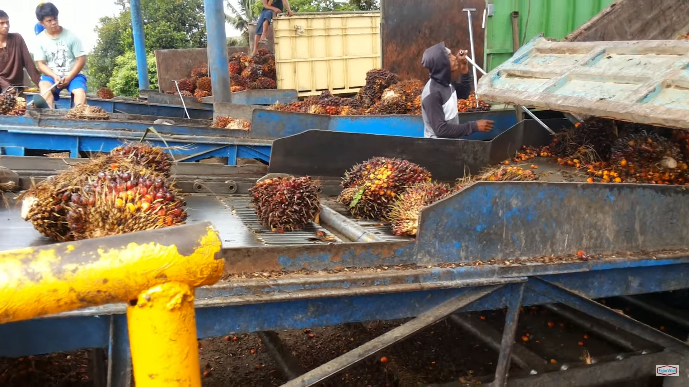
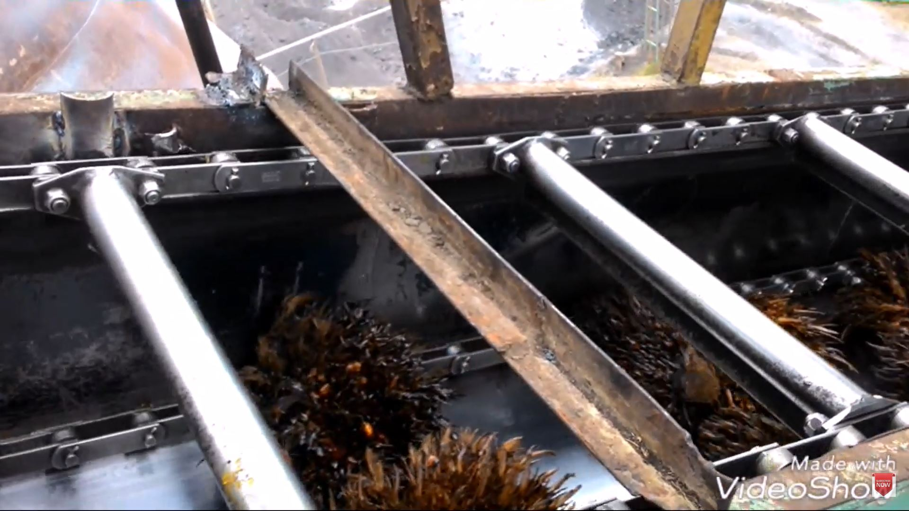
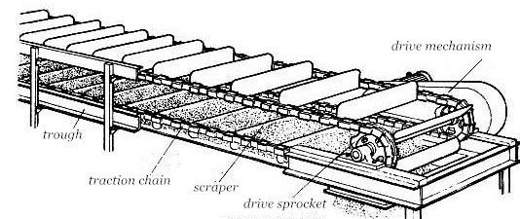
Scraper Chain Conveyor
(Using Top Side)
(Using Bottom Side)
(https://www.youtube.com/watch?v=kheSVEuh8Ww&ab_channel=Neko-Neko_Adventure)
(https://www.youtube.com/watch?v=gujQvUWipXk&ab_channel=DidenBae)

Slide 2
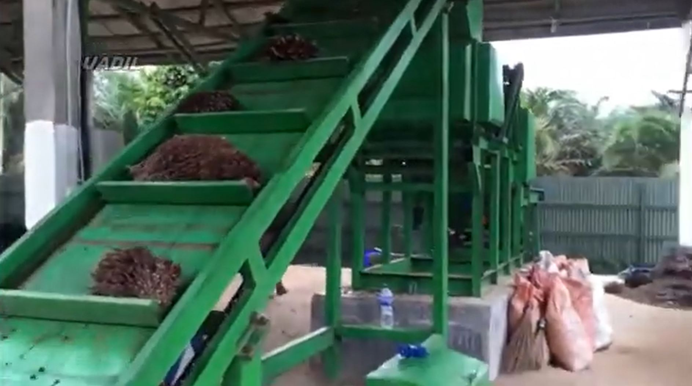
(Using Top Side)
(https://www.youtube.com/watch?v=fN-Z-yt1H2E&ab_channel=TheGery%27sTV)

